Slide 1
Operating Systems Multiprocessor Systems
Shyan-Ming Yuan
CS Department, NCTU
smyuan@gmail.com

Slide 2
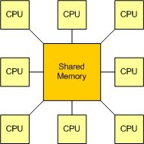
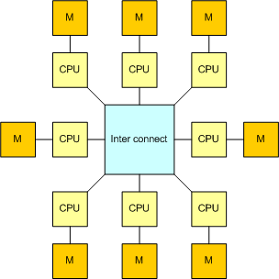
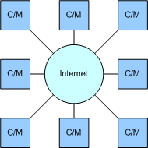
Systems with Multiple CPUs
A common main memory shared by multiple CPUs
Wide area networked distributed system
Interconnected multiple computers

Slide 3
Multiple CPUs with Shared Memory
A shared-memory multiprocessor is a computer that has two or more CPUs with a common shared RAM
All CPUs have full access to the shared RAM
It is also called a multiprocessor (MP)
There are two major groups of multiprocessors:
UMA (Uniform memory access)
All memory word can be accessed by any CPU with the same latency
NUMA (Non-uniform memory access)
Each CPU may have different access time to different memory word

Slide 4
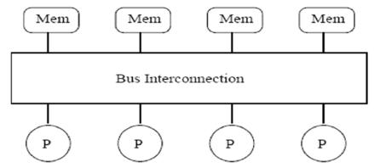
Bus Based UMA Multiprocessors
The simplest way is to connect all CPUs and memory modules to the single system bus
All CPUs and memory modules communicate through the same bus
To read a memory, a CPU first waits until the bus is idle, it then puts the address on the bus and waits until the memory puts the requested memory word on the bus.
The system performance is limited by the bus bandwidth.

Slide 5
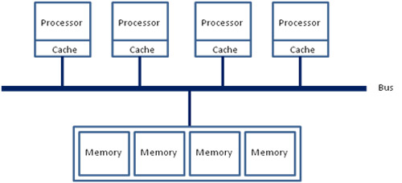
Bused UMA Multiprocessor + Cache
A cache can be added to each CPU to improve performance.
Thus, reads may be satisfied over the cache to reduce the bus traffic.
In general, caching is done on the block of 64 bytes.
When a word is referenced, the entire block (called cache line) is fetched into the cache of the requesting CPU.
A cache line is marked as read-only if it is present in multiple caches.
A cache line is marked as read-write if it is not present in any other caches.

Slide 6
The Cache Coherence Problem
When a CPU wants to write a word which is in more than one caches, the bus hardware must inform all caches of the write request.
If a cache has a clean copy, it can just discard the copy.
If a cache has a "dirty" (modified) copy, the cache must either write the modified copy back to the memory before the write request can proceed or transfer the modified copy to the writer directly.
This set of rules for maintaining the cache consistency is called cache coherence protocol.

Slide 7
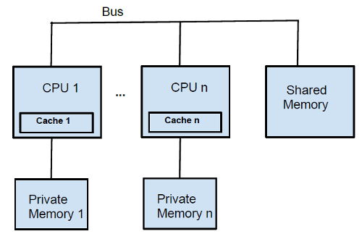
Bused UMA with Cache + Private RAM
To further improve the performance, a cache and a private memory can be added to each CPU.
A good compiler can put the program text, local variables, stack, and other read only data in the private memory.
The shared memory is then only used for global and writeable shared variables.

Slide 8
UMA MPs using Crossbar Switch
Even with the best caching, the number of CPUs of bus based UMA MPs are limited to under 100 (i.e. 32 or 64.)
To connect more CPUs, an nxk crossbar switch can be used for connecting n CPUs to k memory modules.
A crosspoint is an e-switch that can be opened or closed.
If the crosspoint (i,j) is closed, the i^{th} CPU is connected to the j^{th} memory modules.
The crossbar switch is a non-blocking network.
CPUs can access different memory modules at the same time.
However, If a CPU P_{i} tries to access a memory M_{j} that is currently accessed by an other CPU, the CPU P_{i} has to wait.
The size of a crossbar grows as O(n²).
This limits the size of MPs to around 1000.

Slide 9
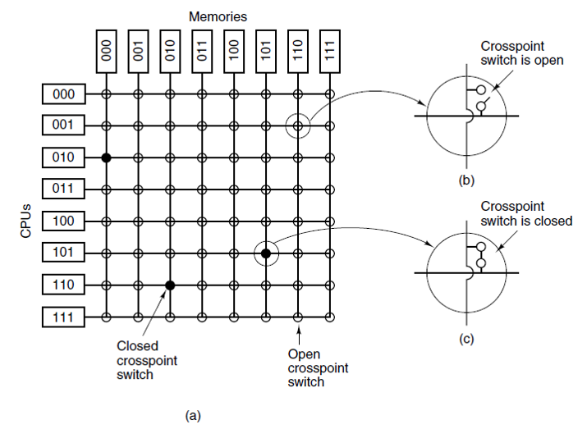
An 8x8 Crossbar Switch
Figure 8-3 of . Tanenbaum & Bos, Modern Operating Systems: 4th ed.
(a) An 8 × 8 crossbar switch. (b) An open crosspoint. (c) A closed crosspoint.

Slide 10
UMA MPs using Multistage Switch
A different MP architecture can be achieved by using the simple 2x2 switches.
The message arrives either on input A or B and is routed according to some header information to the output X or Y.
The message header is composed by 4 fields:
Module: Tells which memory to use
Address: Specifies an address within the module
Opcode: Operation (read or write)
Value (optional): for write operation only
The switch looks at the Module-field and decides if the message should be sent to output X (for 0) or Y (for 1.)
A
X
B
Module | Address | Opcode | Value
Y

Slide 11
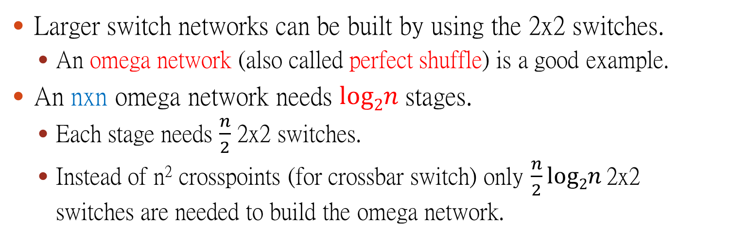
The Omega Network
Larger switch networks can be built by using the 2x2 switches.
An omega network (also called perfect shuffle) is a good example.
An nxn omega network needs $log2n$ stages.
Each stage needs $\frac{n}{2}$ 2x2 switches.
Instead of n² crosspoints (for crossbar switch) only $\frac{n}{2}log2n$2x2 switches are needed to build the omega network.

Slide 12
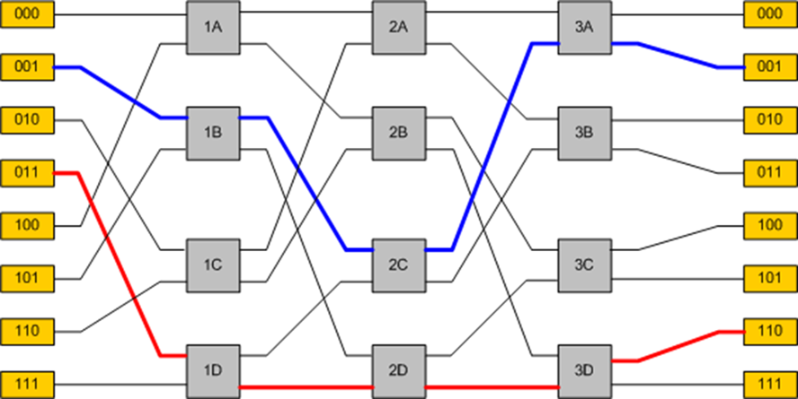
An 8x8 Omega Network
3 (log₂8) stages
CPUs
Memory modules
1
0
0
0
1
1
1
CPU P₀₀₁ requests memory M₀₀₁ through the blue line
CPU P₀₁₁ requests memory M₁₁₀ through the red line
CPU P₁₁₁ requests memory M₁₀₁ through the green line but conflicts with the red line in switch 1D

Slide 13
The routing of Omega network
The P₀₀₁ and P₀₁₁ can accesses two different memory modules M₀₀₁ and M₁₁₀ in the same time.
In the first stage, the switch 1B (P₀₀₁) looks at the 1st bit of the address of M₀₀₁ which is 0 and activates the upper output line of 1B.
In the second stage, the switch 2C (P₀₀₁) looks the 2nd bit which is also 0 and activates the upper output line of 2C.
In the last stage, the switch 3A (P₀₀₁) finds the bit 1 and then activates the lower output line of 3A.
The omega network is a blocking network.
If P₁₁₁ wants to access module M₁₀₁ in the same time, then the request of P₁₁₁ will conflict with the request of P₀₁₁ in the switch 1D.

Slide 14
Interleaved Addressing
To reduce conflict and blocking possibility, it is desirable to spread the memory reference uniformly across all modules.
It is very common to use the lower order bits as memory module number.
For example, in a byte addressable 4-byte word system, the last 2 lower order bits are always 00. Thus, the next 3 lower order bits can be used as the memory module number.
Therefore, consecutive words will be in different modules.
It is called interleaved addressing.
Interleaved memories may maximize parallelism because most memory references are to consecutive addresses.

Slide 15
NUMA Multiprocessors
The NUMA MPs have the following characteristics :
There is a single address space visible to all CPUs.
Access to remote memory is via LOAD and STORE instructions.
Access to remote memory is slower than access to local memory.
There are two types of NUMA architectures:
The NC-NUMA (no-cache NUMA)
The CC-NUMA (cache-coherent NUMA)
In general, the CC-NUMA is using a directory based architecture.
The idea is to maintain a directory database to record where each cache line is and what status it has.

Slide 16
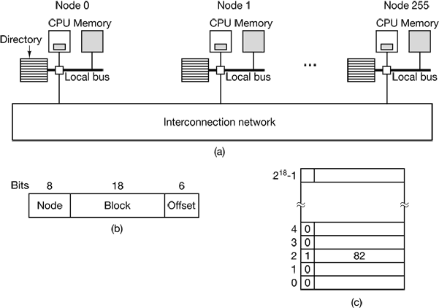
Directory Based CC-NUMA
Figure 8-6. of Tanenbaum & Bos, Modern Operating Systems: 4th ed.
A 256-node directory-based multiprocessor.
Division of a 32-bit memory address into fields.
The directory at node 36.

Slide 17
The Directory Cache Coherence Protocol
Considering a 256-node CC-NUMA system,
Each node has 1 CPU and 16 MB (2²⁴ bytes) local RAM.
Each node also holds a directory of 2¹⁸ entries where each entry has 9-bits.
The overhead is 9x2¹⁸/2²⁷=1.76%
The total memory is 2³² bytes.
It is divided into 2²⁶ cache lines of 64 bytes each.
The following example traces a LOAD instruction from CPU 20 that references a cached line.
The CPU 20 issuing an instruction to its MMU, which translates it to a physical address, say, 0x24000108.
The MMU splits this address into the three parts: 36 for node, 4 for cache line, and 8 for offset.

Slide 18
The DCCP -cont
Since the node 36 is not local, the MMU 20 sends a request message to the node 36 to check the status of its cache line 4.
On receiving the request, the MMU 36 routes it to the directory.
Since the cache line 4 is not cached, it is fetched from the local RAM and is sent back to node 20.
The entry 4 of directory 36 is then updated as cached at node 20.
Assume that the CPU 20 asks for cache line 2 of node 36 later.
Since the cache line 2 of node 36 was cached at node 82.
The entry 2 of directory 36 is first updated as cached at node 20.
A message is then sent to node 82 to ask it to pass the cached line 2 of node 36 to node 20 and invalidate its cache.
How about caching a line in multiple nodes?

Slide 19
Multicore Chips
Due to IC manufacture technology, more gates can be put in a chip.
It is very common to have multiple CPUs inside a chip.
In general, each core has its own private L1 cache.
However, L2 cache may be shared by cores in the same chip.

Slide 20
Chip Level Multiprocessors (CMPs)
Since CPUs in a multicore chip always share memory, a computer built by a multicore chip is simply a small MPs.
It is also called CMPs.
There are some differences between MPs and CMPs.
The shared L2 cache can affect performance.
A greedy core may hold a lot of shared cache to hurt performance of other cores.
All CPUs of CMPs are so closely connected, shared component failures may bring down multiple CPUs at once.
It is unlikely to happen in a normal MPs.

Slide 21
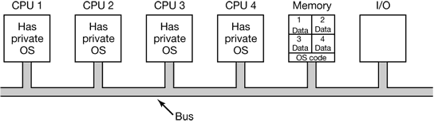
Multiprocessor Operating Systems
There are 3 basic approaches for MP operating systems
Each CPU Has Its Own Operating System
Master-Slave Multiprocessors (MS-MP)
Symmetric Multiprocessors (SMP)
Figure 8-7. of Tanenbaum & Bos, Modern Operating Systems: 4th ed.
Partitioning multiprocessor memory among four CPUs, but sharing a single copy of the operating system code.
The boxes marked Data are the operating system’s private data for each CPU.

Slide 22
Each CPU Has Its Own OS
There are the following interesting properties.
A system call can only be caught and handled by the same CPU of which the process is running.
Each OS has its own tables and own set of processes.
There is no sharing of processes.
Unbalanced workload can happened
A CPU is idle while another CPU is heavily loaded.
There is no sharing of pages.
A CPU has pages to spare while another CPU is paging continuously.
There is no sharing of I/O buffer cache for disk blocks.
It can happen that a disk block is present and dirty in multiple buffer caches at the same time. This may lead to inconsistent results.
Some coherence protocols are needed for buffer caches.

Slide 23
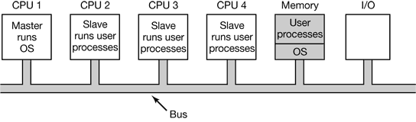
Master-Slave MP (MS-MP)
It is an asymmetric multiprocessing model
A master CPU is running the OS and manage all system data structures.
All system calls are handled by the master processor.
Other slave CPUs are running user processes only.
Figure 8-8. of Tanenbaum & Bos, Modern Operating Systems: 4th ed.

Slide 24
The MS-MP
Advantages:
Single OS copy makes it simple
No unbalanced workload
Disadvantages:
Failure of master CPU brings down the whole system
Master can become a performance bottleneck
It works only for small MPs
Slave CPU
Main Memory
I/O Device
Master CPU
Slave CPU

Slide 25
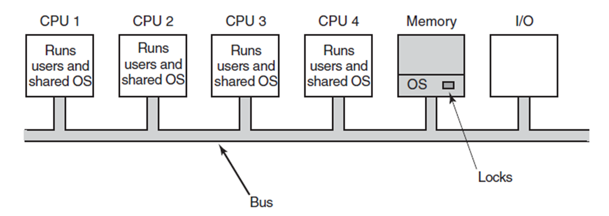
Symmetric Multiprocessors (SMP)
Only one OS copy is in the memory but all CPUs can execute the OS functions.
A system call is caught and handled by the CPU which made it.
Each OS data structure must be associated to a lock.
OS functions can be split into independent critical regions (CR).
Each CR is also associated to a lock.
Figure 8-9. of Tanenbaum & Bos, Modern Operating Systems: 4th ed.

Slide 26
The SMP
Most modern MPs use the SMP model.
There are following difficulties for the SMP model.
Special care must be taken for splitting OS functions into independent CRs such that each CR can be executed by different CPUs simultaneously.
Deadlocks must be handled with care for OS DSs that may be accessed by more than one CRs.
Accessing OS DSs must follow a predefined order to prevent deadlock.

Slide 27
Multi-Processor Synchronization
Since interrupt disabling can not preserve mutual exclusion access to shared DS in MP system, other HW mechanisms must be used to implement mutex locks.
Test-and-Set-Lock (TSL) instruction
Compare-and-Exchange instruction
Atomic Add/Subtract instructions

Slide 28
TSL on SMP
Hardware guarantees that the TSL executes atomically.
The instruction can not stop half way through.
It is only work in uniprocessor.
It does not work in SMP without some extra HW support.
Hardware locks the bus during the TSL instruction to prevent memory accesses by other CPUs.
Figure 8-10. of Tanenbaum & Bos, Modern Operating Systems: 4th ed.

Slide 29
TSL is a Spinlock
TSL is a busy-waiting synchronization primitive.
It is also called a spinlock.
Issues of spinlock on SMP:
Lock contention leads to spinning on the lock.
Spinning on a lock needs to lock the bus.
This action causes bus contention.
It slows all other CPUs down.
It is independent of whether other CPUs need a lock or not.

Slide 30
TSL + Cache on SMP
Caching does not help reduce bus contention.
TSL needs to lock the bus or require exclusive access to the lock
The cache line in the cache of the lock holder needs to be invalidated first.
Then the cache line can be loaded into the local cache of the TSL requester.
Each time the lock holder access a word in the cache line, the entire block must be moved back to the lock holder.
Therefore, the cache line containing the lock will be bounced between the lock holder and lock requesters.
This generates even more bus traffic than without caching

Slide 31
Read before TSL on SMP
One possible way to reduce bus contention is by requesting TSL after checking the status of the lock.
Spin reading the lock variable until it is unlocked.
Then acquire the lock by the TSL.
The cache line containing the lock is shared (read-only) in all caches until the lock is released or the lock holder updates a word of the cache line.
No bus traffic occurs until lock released or cache line updated.
No race conditions, since acquisition is still with TSL.
Repeat {
While (lock == 1);
tmp = TSL (lock);
} Until (tmp == 0)

Slide 32
TSL with backoff on SMP
Another way to reduce bus contention is by inserting backoff intervals between TSL requests.
A delay loop is inserted between polls.
Initially, the delay loop is one instruction.
If the lock is still busy, the loop is doubled to 2 instructions, then 4 instruction, and so on until a maximum.
Low maximum gives fast response when lock is released.
High maximum reduces the cache thrashing.
In general, the binary exponential backoff can be used with or without read before TSL.

Slide 33
(Mellor-Crummey & Scott) MCS locking
Each CPU enqueues its own private lock variable into a shared queue and spins on its private lock.
On lock release, the releaser unlocks the private lock waiting next in the shared queue.
Bus contention only occurs on actual unlock.
No starvation: the shared queue defines the order of lock acquisitions.

Slide 34
MCS Locking
John Mellor-Crummey and Michael Scott, Algorithms for Scalable Synchronisation on Shared-Memory Multiprocessors, ACM Transactions on Computer Systems, Vol. 9, No. 1, 21-65, 1991

Slide 35
Spinning versus Switching
Spinning on a lock made no sense for a uniprocessor system.
There was no other running process to release the lock.
Blocking and eventually switching to the lock holder is the only option.
On SMP systems, the decision to spin or block is not trivial.
If the lock is for the ready list, then the requesting CPU must spin.
If the lock is for a disk buffer, then the CPU can spin or block.
Spinlocks expect critical sections to be short.
If lock is held for less time than the overhead of blocking+switching, then it is more efficient to spin.
Blocking and switching require twice of the following overheads.
context switch, lock acquisition of the ready list, invocation of the CPU scheduler, the sudden increase of cache miss, and TLB rebuild.

Slide 36
Spinning vs Switching
There are three basic design options.
On lock failure, a CPU always spins.
It is assumed that all CRs are short.
On lock failure, a CPU always blocks.
It is assumed that most CRs are long.
On lock failure, a CPU first spins a predefined amount of time then blocks.
The best practice of the 3rd option is as follows.
Uses the history data to select a time quantum as the spin threshold.
On lock failure, If the spin threshold was reached in the last k contiguous times, then a CPU blocks immediately.
Otherwise, a CPU spins until the threshold then blocks.

Slide 37
Multiprocessor Scheduling
On a MP system, scheduling has two dimensions.
The scheduler has to decide which thread (or process) to run next and which CPU to run it on.
Given X threads (or processes) and Y CPUs,
How to allocate these X threads to the Y CPUs?
Another important factor affecting MP scheduling is
Whether these X threads are cooperative or independent?

Slide 38
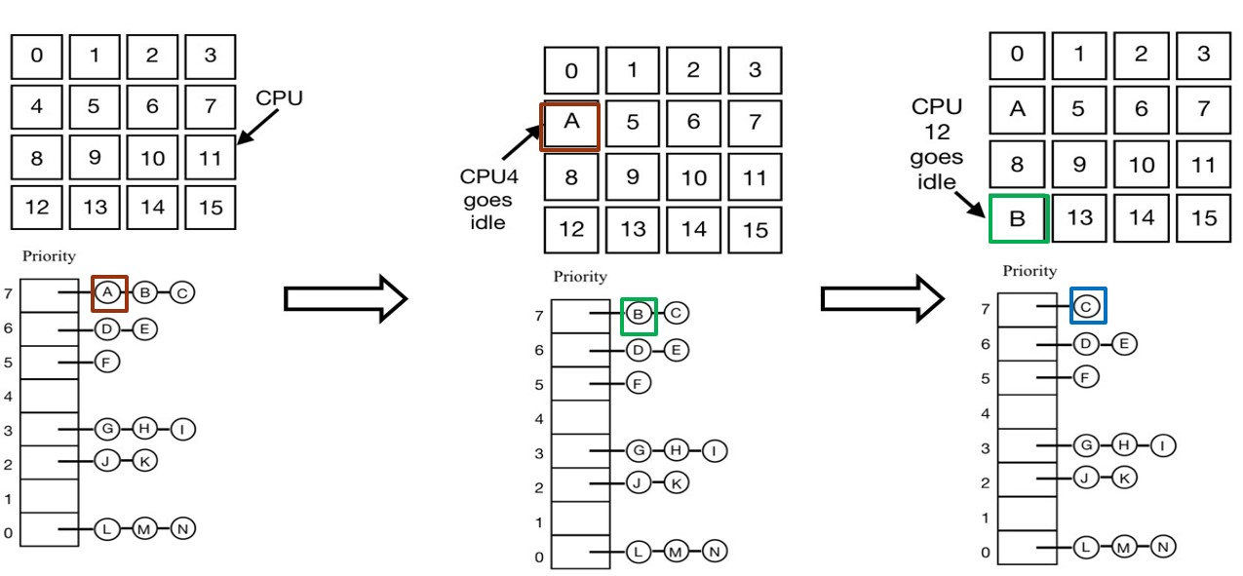
Time Sharing MP Scheduling
This is the simplest way to schedule independent threads on a MP.
It uses a single system wide DS for managing ready threads.
When a CPU goes idle, it takes the highest priority thread from the shared ready list.

Slide 39
Single Shared Ready List
Advantages:
Simple and Automatic load balancing
Disadvantages:
Lock contention on the ready list can be a major bottleneck.
Due to frequent scheduling or the large number of CPUs or both.
Not all CPUs are equal.
The last CPU a thread ran on may have more related entries in the cache.
If time quantum expires, a spinlock holder will be preempted.
Other CPUs may spin until the holder is rescheduled again.
Smart scheduling can be used to avoid this problem.
A spinlock holder sets a special flag to indicate that it holds a lock.
Scheduler will not preempt a thread with this flag on time expiration.
When a lock holder releases the lock, it reset the flag.

Slide 40
Affinity Scheduling
Since the last CPU a thread ran on have more related entries in the cache, it is desirable to run a thread on the CPU it ran on last time.
One possible approach is the Two-level scheduling:
Each CPU has its own ready queue.
Top-level scheduler assigns threads (or processes) to CPUs.
This defines their affinity and balances the workload.
The bottom-level scheduler is the frequently invoked scheduler (e.g. on blocking on I/O, a lock, or exhausting a time slice.)
It runs on each CPU and selects from its own ready queue.
This ensures affinity.
If nothing is available from the local ready queue, it runs a thread from another CPUs ready queue rather than go idle.

Slide 41
Two-level Scheduling
Advantages:
It distributes the workload evenly over available CPUs.
This makes load balanced and avoids idle queues.
The cache affinity is maximized.
Since a thread is usually running on the same CPU, it maximizes the cache capability.
Lock contention for ready list is minimized.
Since each CPU has its own ready list, lock contention may only happens when the private ready list of a CPU is empty.

Slide 42
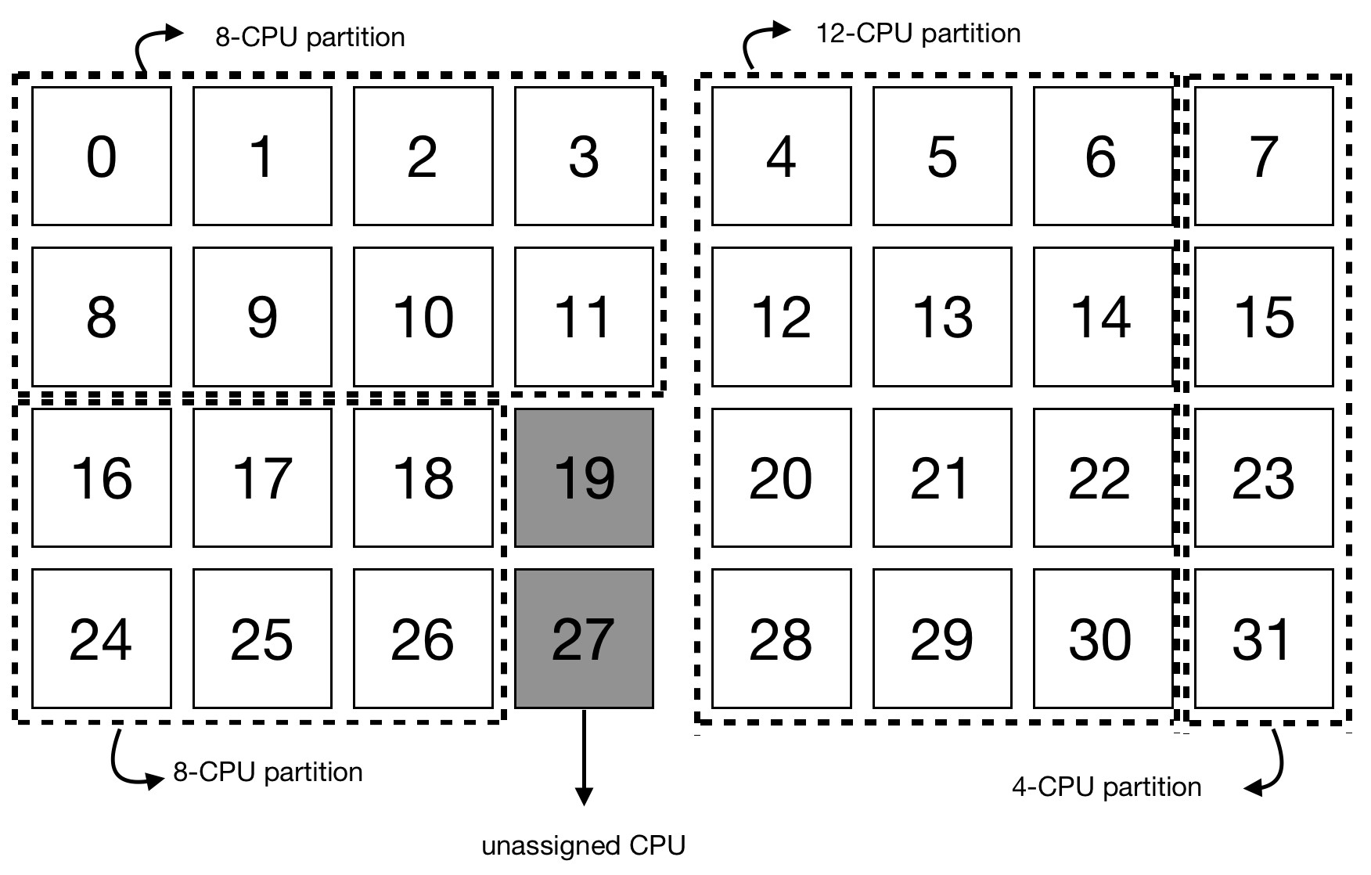
Space Sharing Scheduling
For cooperating threads (processes), it is desirable to schedule multiple threads of the same task at the same time.
Space sharing can be used to schedule a group of threads across multiple CPUs at the same time.

Slide 43
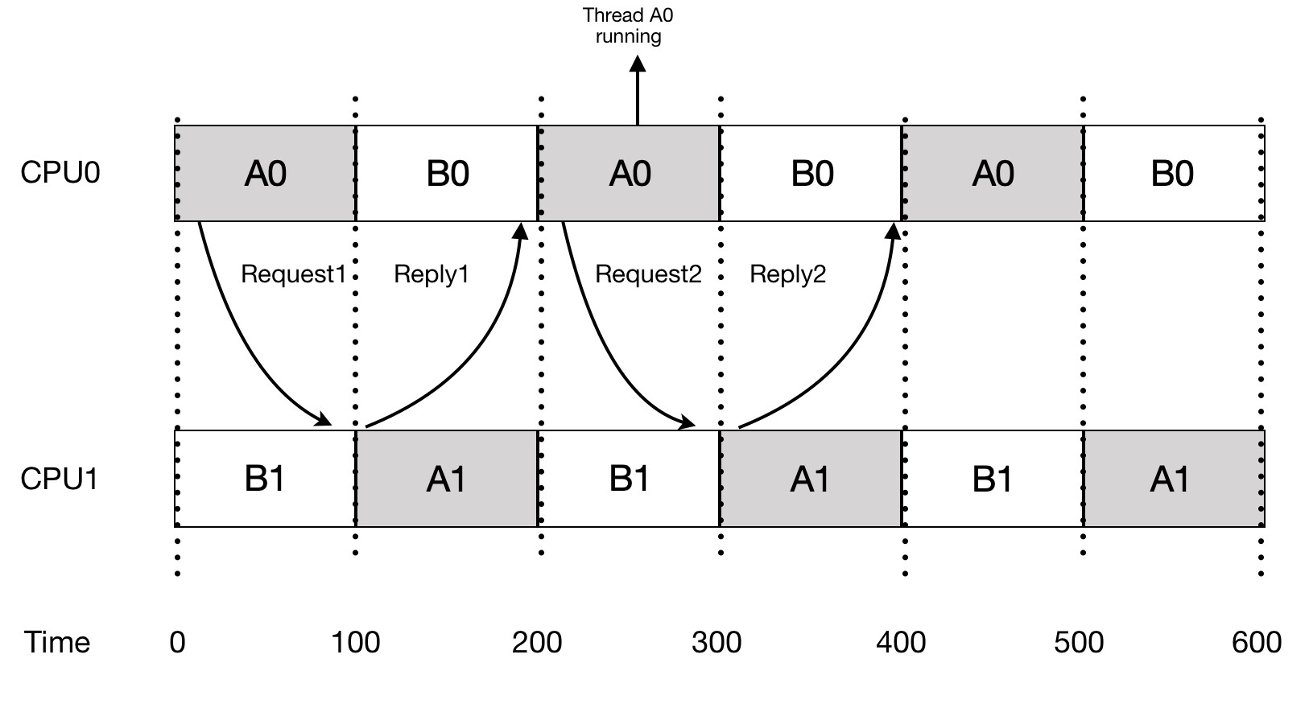
Out of Phase Comm.
Scheduling related threads independently may lead to out of phase communication.

Slide 44
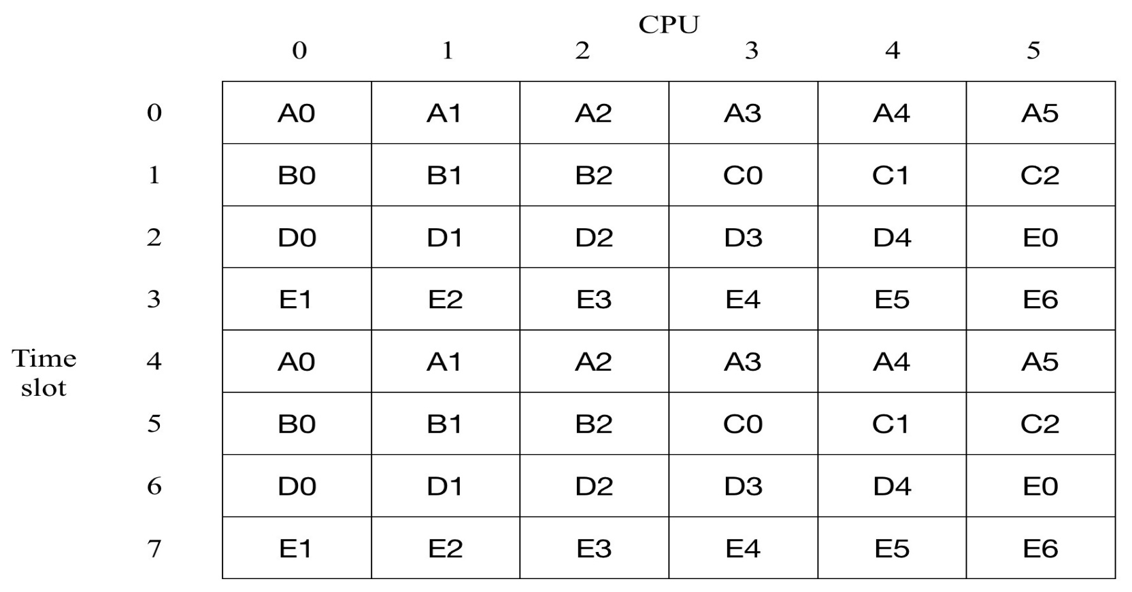
Gang Scheduling
Gang scheduling may eliminate out of phase problem.
Groups of related threads are scheduled as a unit, called a gang.
All members of a gang run at once on different timeshared CPUs.
All gang members start and end their time slices together.

