Slide 1
Operating Systems Distributed Systems
Shyan-Ming Yuan
CS Department, NCTU
smyuan@gmail.com
Office hours: Wed. 8~10 (EC442)

Slide 2
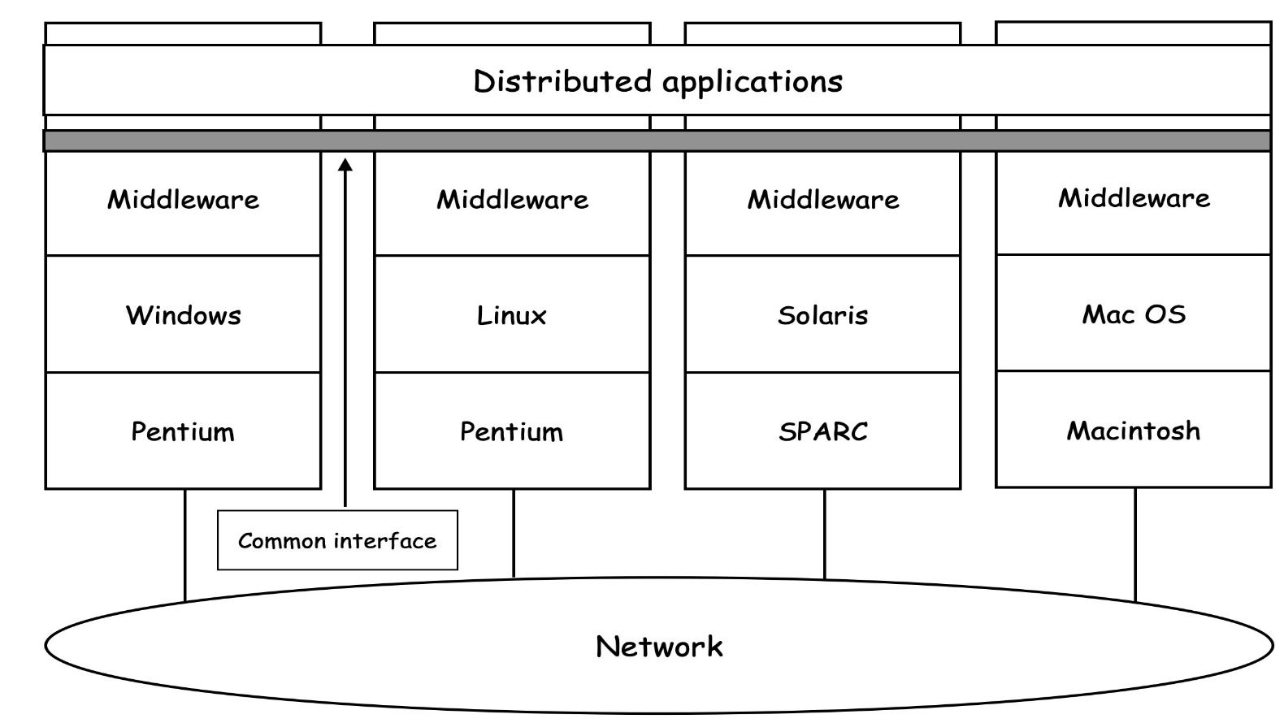
Distributed Systems (DS)
A distributed system is a collection of independent computers that appears to its users as a single coherent system.
In general, every computer uses a middleware on top its local OS to provide a common interface for distributed applications.

Slide 3
Comparisons Among MP, MC, and DS
Compared Items | Multiprocessor | Multicomputer | Distributed System
Node Configuration | CPU | CPU, RAM, NIB | Autonomous Computer
Node Peripherals | All Shared | Shared (Disk maybe) | Full set for each node
Node scattering | Same rack | Same room | Maybe whole world
Inter-Node comm. | Shared RAM | Dedicated IN | General network
Operating Systems | One, shared | Multiple, same | Multiple, maybe different
File Systems | One, shared | One, shared | Each node has its own
Administration | One organization | One organization | Many organizations

Slide 4
Why Distributed Systems?
Handling inherently distributed problems
Customers, suppliers, and companies are at different locations.
Performance Improvement (Speedup)
Resource Sharing
Special hardware and software
Services and applications

Slide 5
Design Issues of a DS
Transparency
Provide a single system image to users
Scalability:
Size scalability: number of users and/or processors
Geographical scalability: distance between nodes
Administrative scalability: number of administrative domains
Fault Tolerance

Slide 6
Types of Transparency in a DS (1)
Access Transparency enables local and remote information resources to be accessed using the identical operations.
The URL of a web resource (http://www.nctu.edu.tw)
Location Transparency enables resources to be accessed without knowledge of their actual locations.
Files of a Cloud Storage Service (google drive, drop box, …)
Concurrency Transparency enables several processes to operate concurrently using the same shared resources without interference with each other.
Money deposit (or withdraw) from an Automatic Teller Machine network (ATM)

Slide 7
Types of Transparency in a DS (2)
Replication Transparency enables multiple instances of resources to be used to increase reliability and performance without knowledge of the replicas by users or applications.
CDN or proxies of internet services (google, facebook, …)
Migration Transparency allows the movement of resources within a DS without affecting the operations of users or applications.
PaaS (Platform as a Service) in a cloud
google App Engine, Azure, …

Slide 8
Types of Transparency in a DS (3)
Failure Transparency enables the concealment of faults.
It allows users and applications to complete their tasks on the failure of some components.
Distributed File Systems: Hadoop, GlusterFS, …
Performance Transparency allows the DS and applications to be reconfigured on demand without changing the system structure or the application algorithms.
On demand of changing the number of VMs (virtual machines) in an IaaS (Infrastructure as a Service)

Slide 9
Size Scalability
Examples of size scalability limitations
Pros: easy to manage
Cons: single point of failure and performance bottleneck
Concept | Example
Centralized services | A single server for all users
Centralized data | A single on-line telephone book
Centralized algorithms | Doing routing based on complete information

Slide 10
Techniques for scalability
Distribution
Partition data and computations across multiple machines
Java applets move some computations to client sides
DNS (domain name system) is a hierarchical decentralized naming system
WWW is a globally distributed document sharing system
Replication
Make copies of resources available at different machines
Concealment of communication delay
Avoid waiting for response
Interoperability
Make use of open standards and open interfaces to integrate multiple administration domains and multiple local OSs

Slide 11
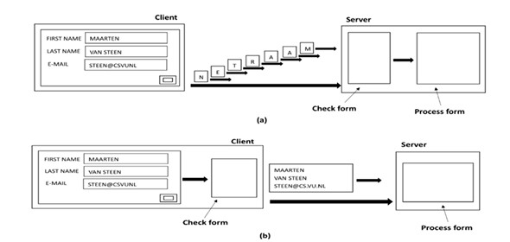
Java Applet Example
Form checking in client side can reduce communication traffic and server load

Slide 12
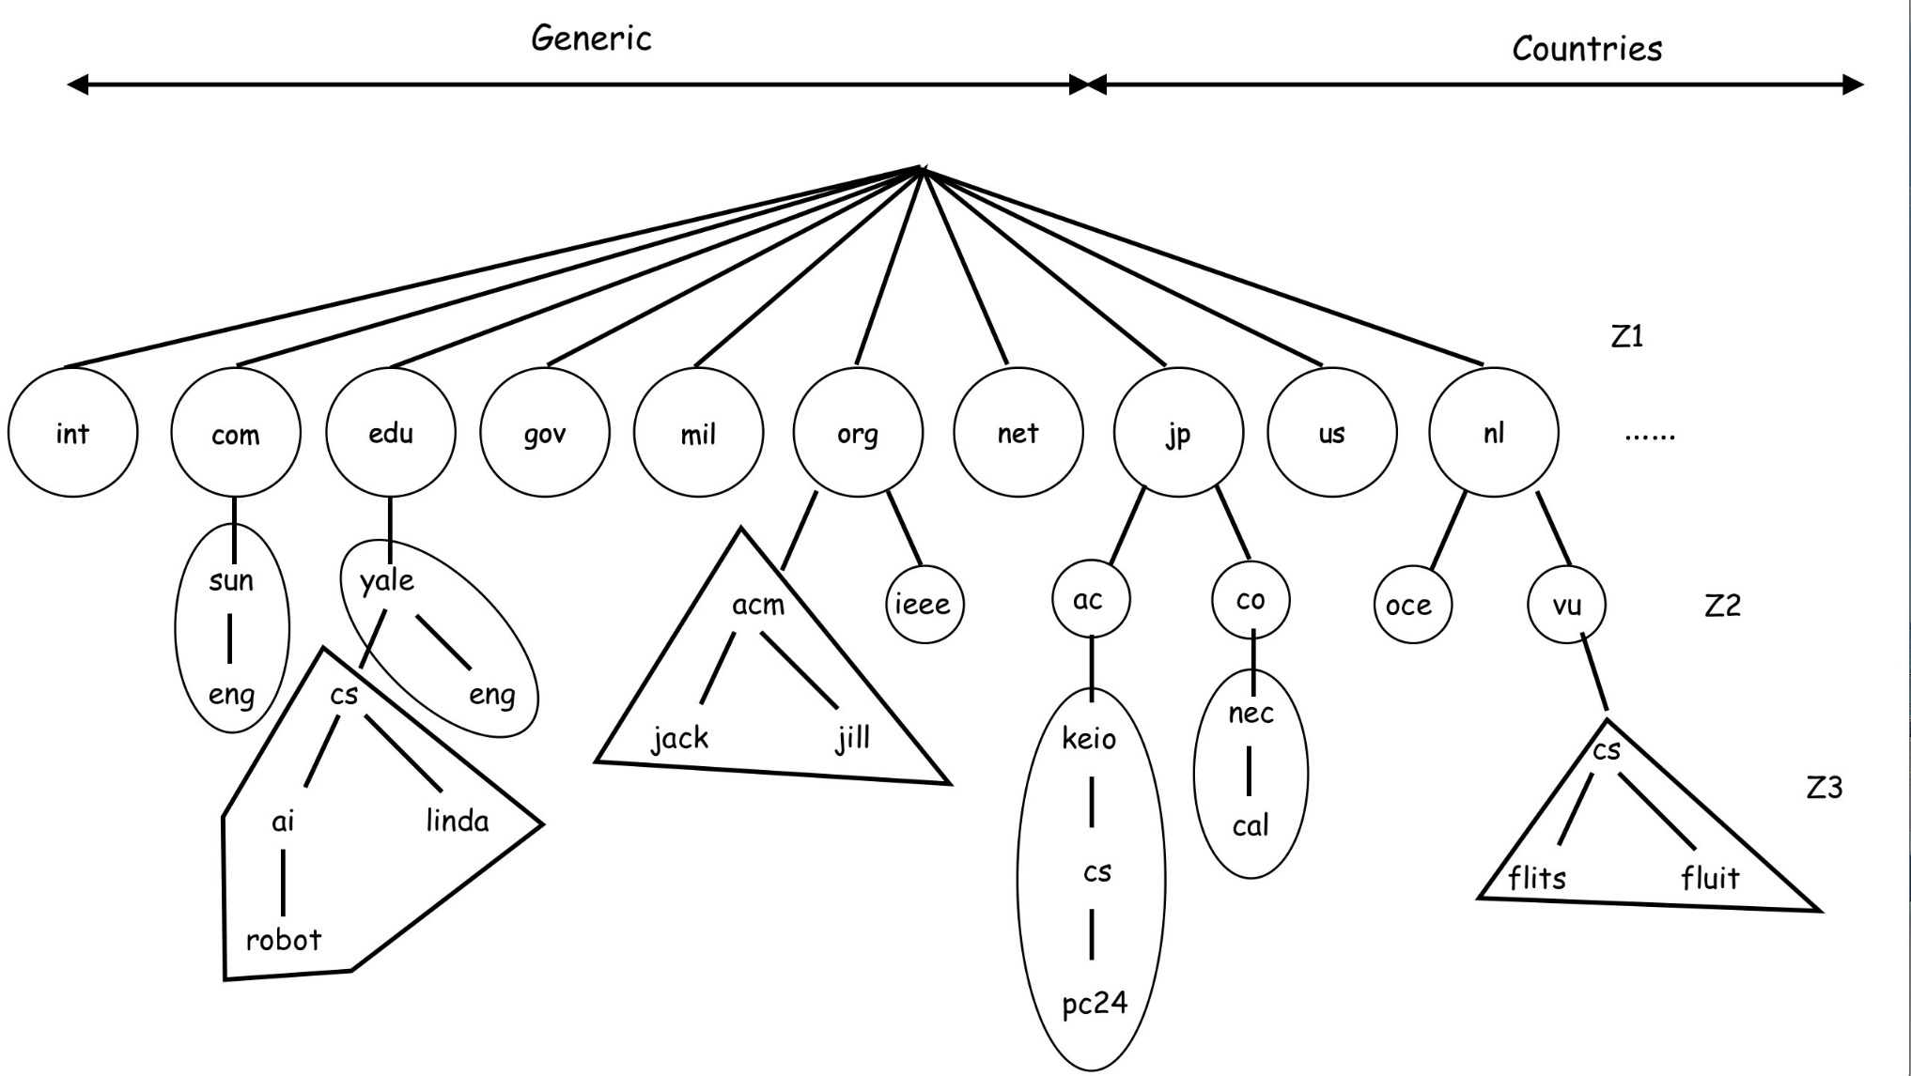
DNS Example
DNS name space are divided into zones

Slide 13
Replication and Caching
Make copies of data available at different machines
Web caches in browsers and proxy servers
CDN services can provide fast content delivering
Replicated database servers
Local replications for cloud storage services
Google drive, dropbox, onedrive, …
File caching in the client and/or the server

Slide 14
Concealment of Communication Delay
Avoid waiting for response
Uses asynchronous communication schemes
Non-blocking send and non-blocking receive
Uses separate handlers to process different incoming messages
Separate processes (or threads) for handling different events

Slide 15
Difficulties of Scaling
Applying scaling techniques are not trivial
Multiple copies (replication or cache) can lead to inconsistency.
Modifying one copy makes it different from others.
Consistency/coherency protocols are therefore needed.
In general, keeping copies consistent all the time requires global synchronization on each modification.
Global synchronization is extremely difficult for large scale systems.
Some applications may tolerate inconsistency.
Most popular internet services can tolerate some degree of inconsistency.
Search services, content sharing services, …

Slide 16
Fault Tolerant Approaches
Failure Masking:
Make a system continue to provide its specified function(s) in the presence of failures.
Example: voting protocols
Redundancy is the key technique for masking failures.
Well Defined Failure Behavior:
Make a system exhibit a well defined behavior in the presence of failures.
It may or it may not perform its specified function(s) but facilitates actions suitable for fault recovery.
Example: commit protocols
The result of a transaction is made visible only if it is successful and committed.
Otherwise, the transaction is aborted by undo.

Slide 17
Redundancy
Hide the occurrence of failures by using redundancy.
There are three types of redundancy:
Information Redundancy adds extra information to allow for error detection and recovery.
Error detection/correction codes: parity, checksum, hamming codes, …
Time Redundancy performs extra computations to cope with failures.
Checkpoint with retry, recovery blocks, …
Space Redundancy adds extra resources to cope with failures.
Replications in data, process, hardware, software, …
Groupwork, n-version software, …

Slide 18
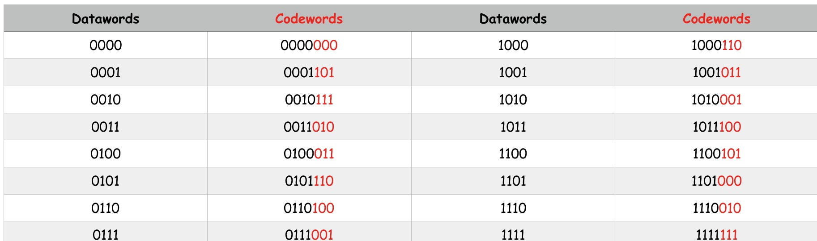
Information Redundancy: Hamming Codes
The hamming code (7, 4), n=7, k=4
Adds 3 extra bits to correct any single bit error for 4-bit data

Slide 19
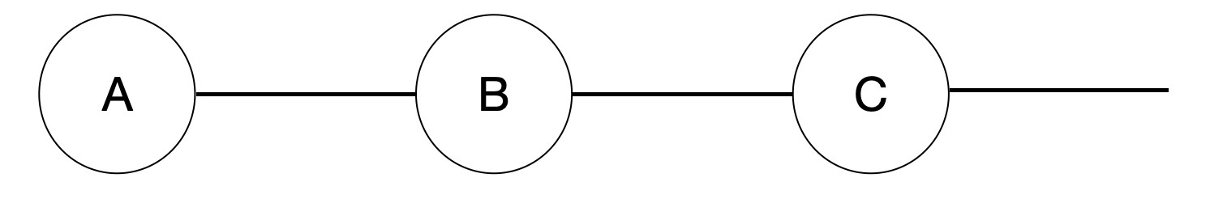
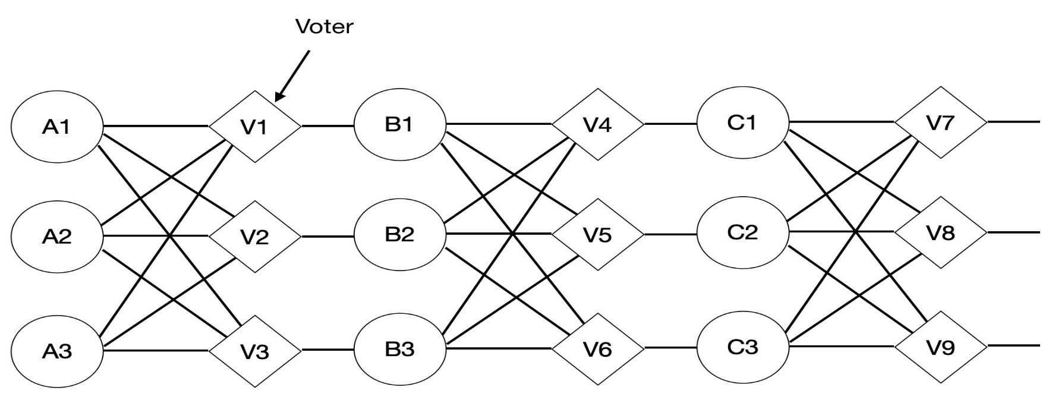
Space Redundancy: Triple Modular Redundancy (TMR)
A TMR replaces each component by three components with 3 voters to cope any single component failure.
(a)
(b)

Slide 20
Time Redundancy: Recovery Blocks (RB)
A RB consists of multiple alternates of the same function, a checkpoint module, and an acceptance test (AT) module.
One alternate is the primary and the others are secondary.
Upon involved, the RB first checkpoints the input and the current states, then executes the primary with the input.
After the completion of the primary, the output is then validated by the AT for correctness.
If the output is not acceptable, the RB restores its checkpoint and executes a secondary with the original input.
The output is then validated by the AT.
This procedure continues until either an output is accepted by the AT or all secondary are exhausted.

Slide 21
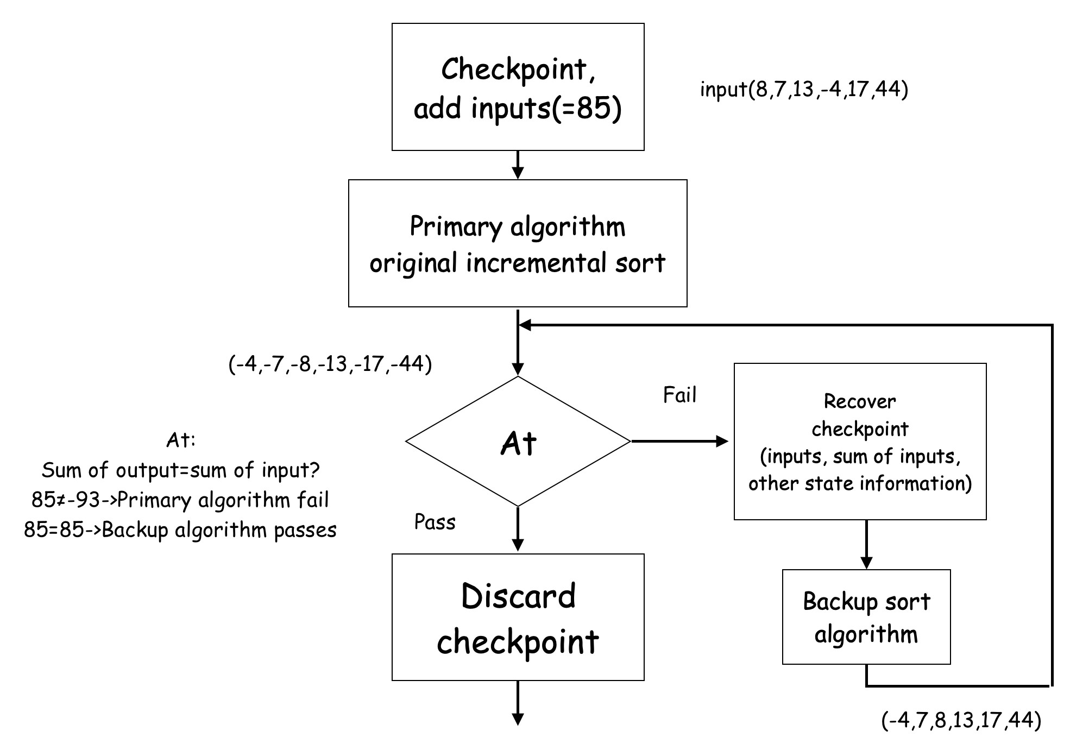
An Example of RB

Slide 22
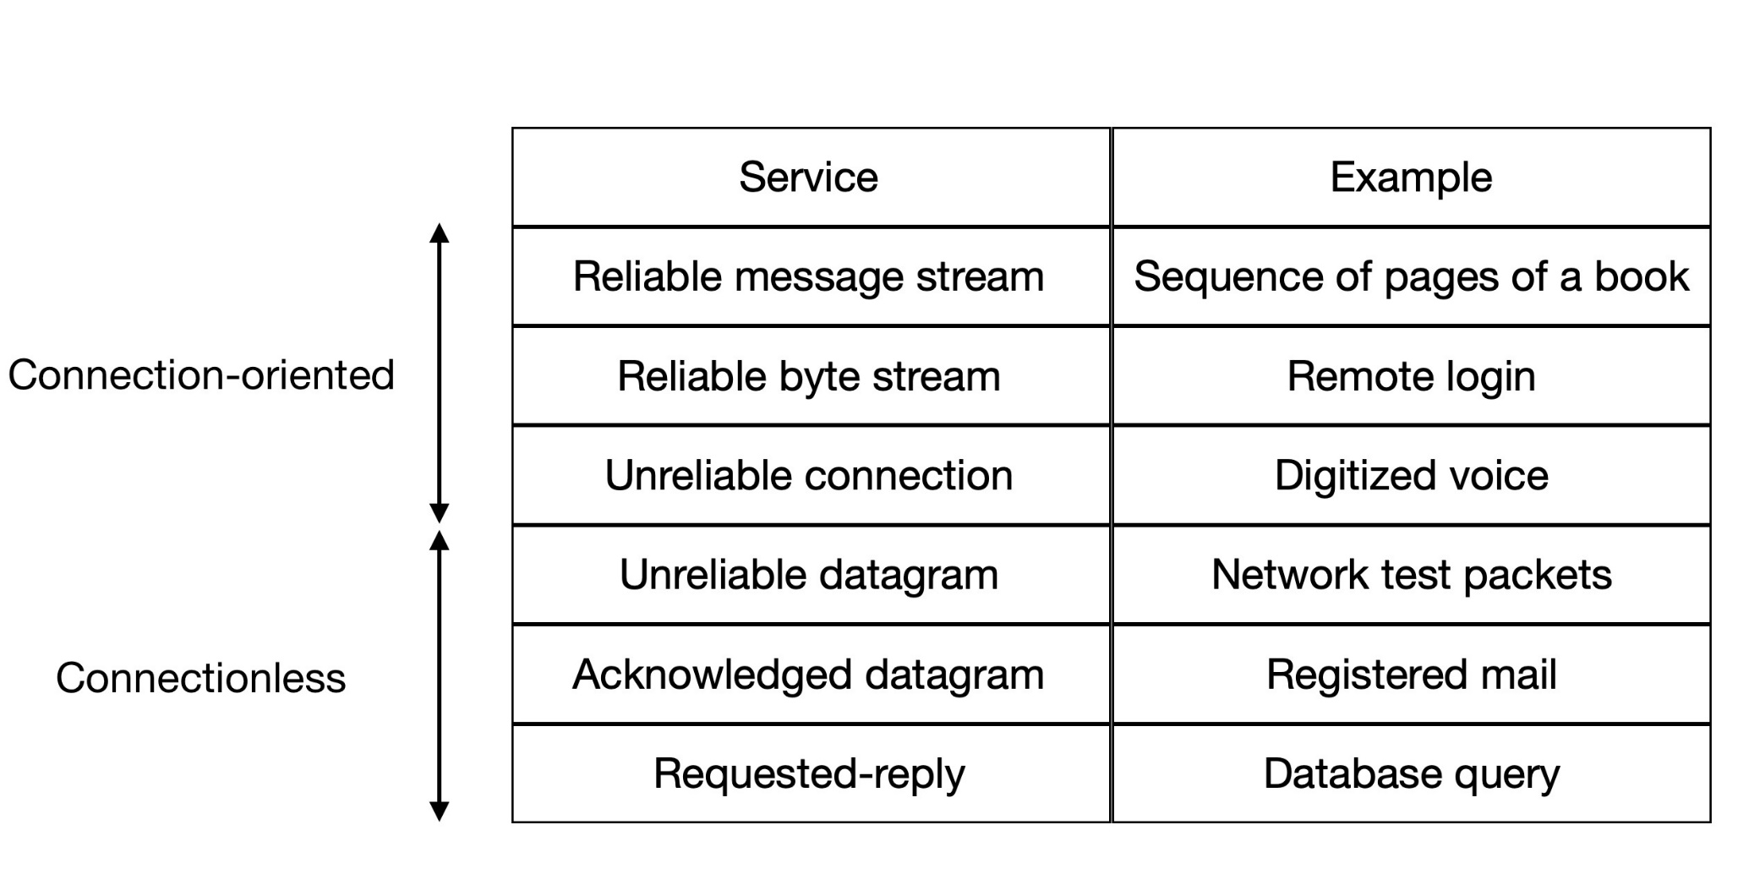
Network Services
There are six types of network services.

Slide 23
OS Types for Distributed Systems
DOS (Distributed Operating Systems)
NOS (Network Operating Systems)
Distributed system as a Middleware
System | Description | Main Goal
DOS | Tightly-coupled operating system for multi-processors and homogeneous multicomputers | Hide and manage hardware resources
NOS | Loosely-coupled operating system for heterogeneous multicomputers (LAN and WAN) | Offer local services to remote clients
Middleware | Additional layer on top of local OS to provide general-purpose services | Provide transparency

Slide 24
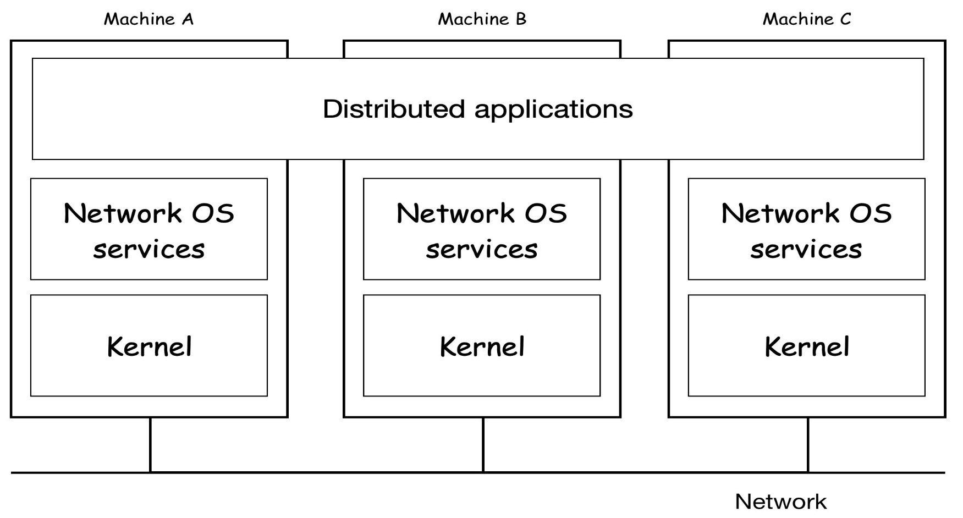
Network Operating Systems
Kernels can be different (Windows or Linux)
Typical services are: rlogin, rsh, ftp, …
Resource sharing is usually done by a fairly primitive way

Slide 25
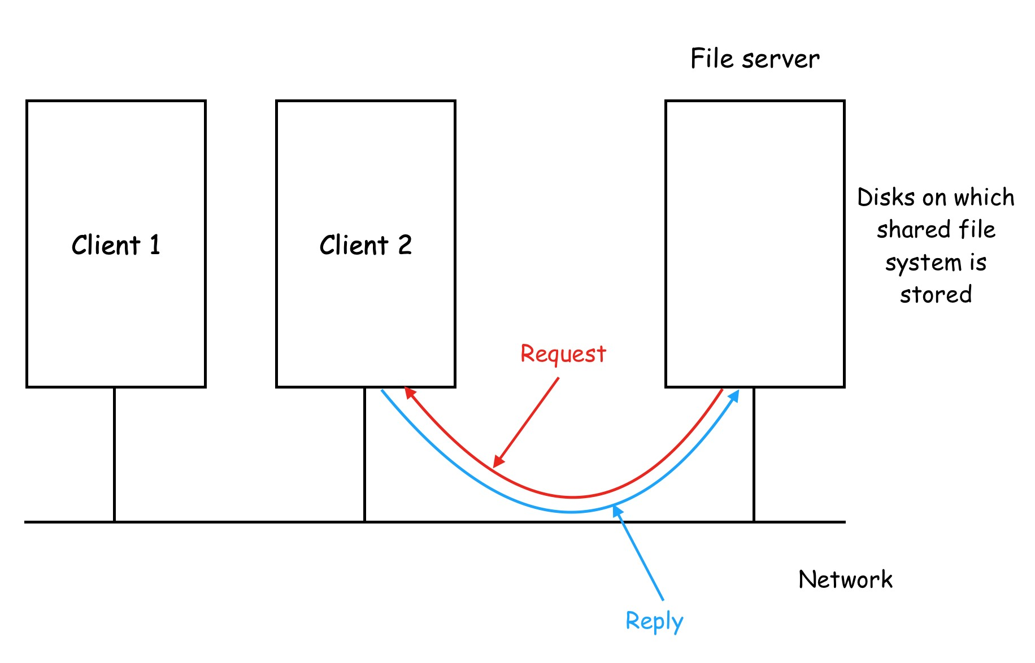
File Sharing in NOS (1)
One computer provides files for others (NFS)

Slide 26
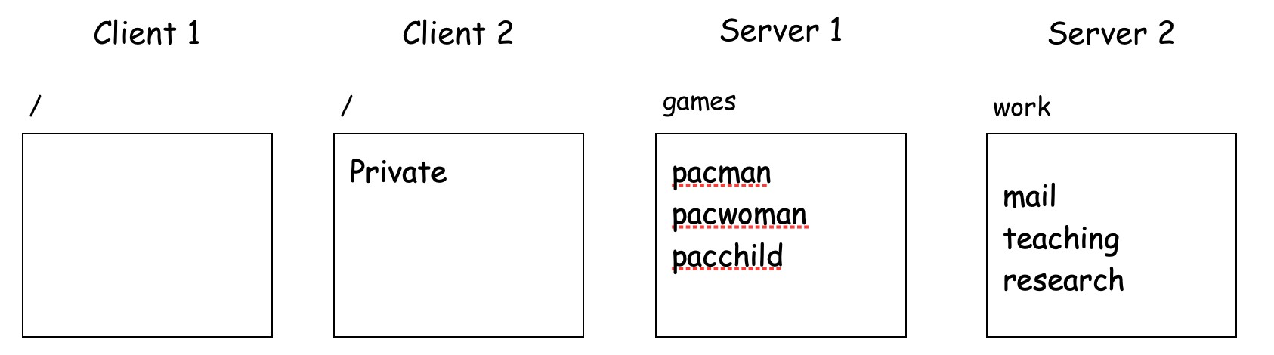
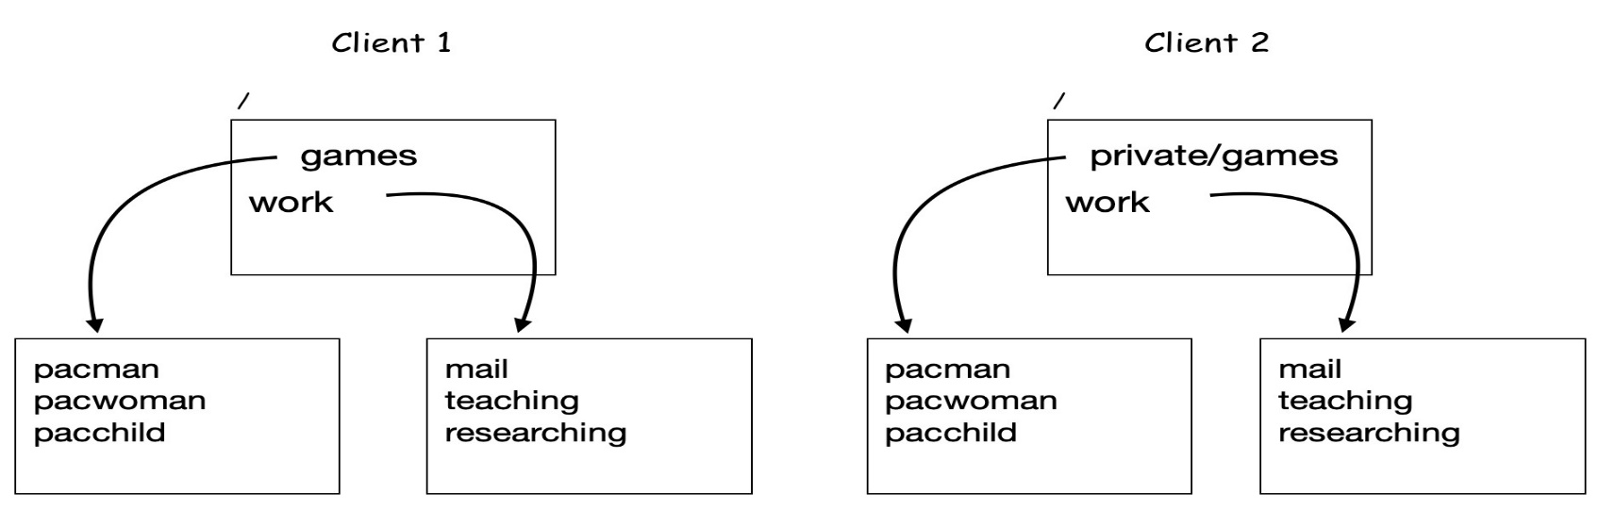
File Sharing in NOS (2)
Different clients may mount the servers in different places
NOS does not provide consistent view for users.
However, it is easier to scale by adding computers in NOS.
Before Mount
After Mount

Slide 27
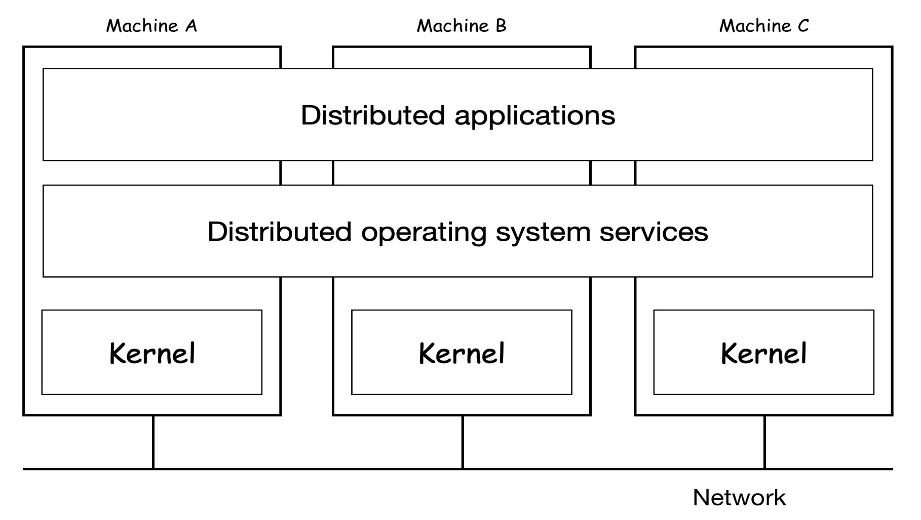
Distributed Operating Systems
Message passing is the default choice for communications.
Some provide distributed shared memory
The performance of DSM is usually unacceptable.

Slide 28
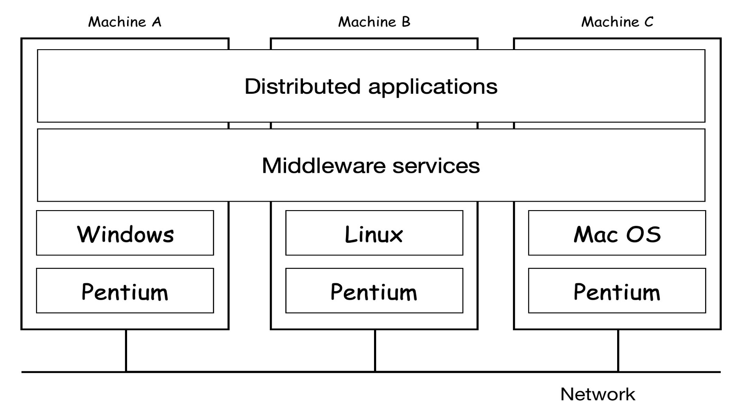
Distributed System as a Middleware
NOSs do not provide a single image to users
DOSs usually requires all nodes running the same kernel
Middleware can provide transparency and autonomous

Slide 29
Middleware Models
Document Based Middleware treat a DS as a giant collection of documents.
The World Wide Web (Web)
File System Based Middleware treat a DS as a big file system.
Plan 9 (http://9p.io/plan9/)
inferno (http://www.vitanuova.com/inferno/)
Distributed File Systems (less strict)
Object Based Middleware treat everything as an object.
CORBA (http://www.corba.org/), DCOM, Java+RMI
Coordination Based Middleware
Linda (http://lindaspaces.com/downloads/evaluation.html)
Publish/subscribe (event based middleware)

Slide 30
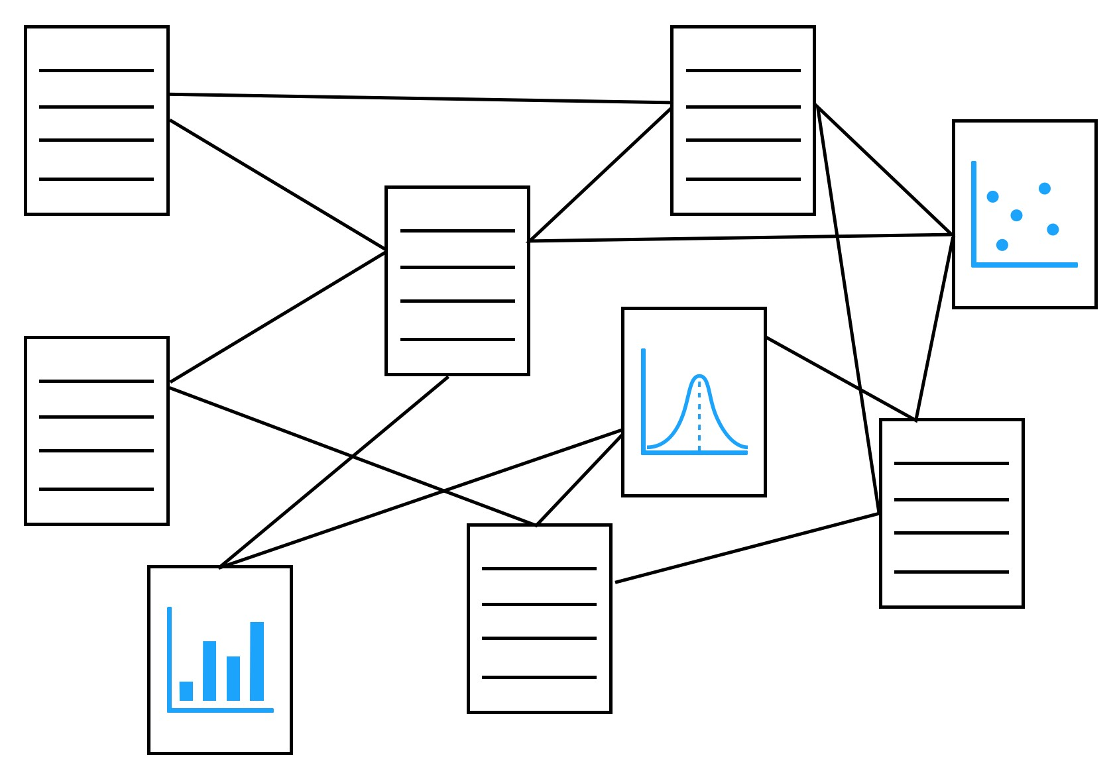
The World Wide Web
The World Wide Web is a network of hyperlinked documents and other resources that are hold on the Internet.

Slide 31
Gets a Document from the Web
To get the page of NYCU president https://www.nycu.edu.tw/president-office/chi-hung-lin/
A browser (UI to the web) first asks a DNS for IP address of www.nycu.edu.tw
The DNS replies with xxx.xxx.xxx.xxx
The browser then makes a TCP connection to port 80 on xxx.xxx.xxx.xxx
After connection is set up, it sends a request asking for the document “president-office/chi-hung-lin/”
The www.nycu.edu.tw server sends back the document
The browser displays all the text in the returned document
It also fetches and displays all images on the page
Finally, the TCP connection is released

Slide 32
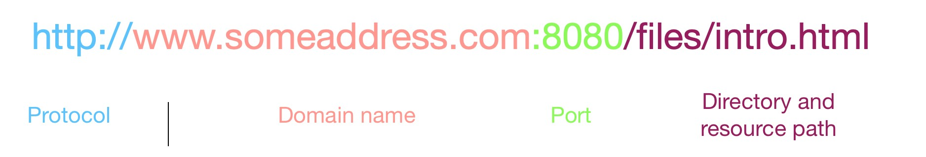
Uniform Resource Locator (URL)
Each document in the web has a unique address, called a URL.
Each URL consists of 4 components.
The protocol gives the method of communication to be used.
http is the most common one, but ftp and others are also used.
The domain name is the name of the computer (host) that holds the resource.
The port specifies the port number that the server is listening to for requests.
The port number is optional. If not given, the port 80 is used as the default.
The last part specifies the resource path in the host.
It is also optional. If omitted, the file “index.html” is used as the default.

Slide 33
Plan 9 & Inferno
Plan 9 was designed in mid 80s by many of the creators of UNIX in Bell Lab.
Rob Pike, Ken Thompson, Brian Kernighan, Dennis Ritchie
Inferno is a light and embedded version of Plan 9.
The goal of Plan 9 was to 『Build a UNIX out of little system』
Take the good things: 『Tree-structured file system』
Toss the rest : ttys, ioctl(), signals, …
Everything is a file !!
Pathnames for all resources (file, process, network, devices, …)
A standard resource access protocol 9P is used to access any resource (remote or local are the same)

Slide 34
Core Design Concept of Plan 9
All resources are represented as file hierarchies
System Resources: processes, devices, networking stack
System Services: DNS, Window System, Plumbing
Application Services: Editor Interfaces, Plumbing
Namespaces
are private and per-process by default
can be manipulated by users
can bind and union directories
Standard Communication Protocol
a standard protocol, 9P, is used to access both local and remote resources

Slide 35
Basic Facts of 9P Protocol
One protocol to access all resources
9P is the VFS of the Plan 9
Local operations are degraded to function calls
Remote operations are similar to proxy operations
Pure request/response RPC model is used
Reliable and in order delivery are supported by transport layer
It can be associated with authentication, encryption, and digesting modules
By default, requests are non-cached to avoid coherence problems and race conditions
9P was supported by the Linux Kernel since 2.6.14
/net/9p → global definitions and interface files

Slide 36
Basic Operations of 9P
Session Management
Version: protocol version and capability negotiation
Attach: user identification and session option negotiation
Auth: user authentication enablement
Walk: hierarchy traversal and transaction management
Clunk: forget about a fid
Error Management
Error: a pending request triggered an error
Flush: cancel a pending request
File I/O
Create: atomic create/open
Open, Read, Write, Close
Directory read packaged w/read operation (Reads stat information with file list)
Remove
Metadata Management
Stat: retrieve file metadata
Wstat: write file metadata

Slide 37
The Servers of Plan 9
A file server in Plan 9 is just something that serves resources in the form of files
Other notable servers are
Networking: /net
Email: /mail/fs
Graphics: /dev/draw
Window System: /dev/wsys
Process Control: /proc

Slide 38
Namespace
Any resource can be mounted in a customizable directory hierarchy, or namespace:
Several directories can be mounted at the same point to replace the need for a $PATH
bind /home/smyuan/bin /bin
bind /i386/bin /bin
Copying a local file foo to a remote floppy:
import lab.pc /a: /n/dos
cp foo /n/dos/
Piping the output of foo on host1 to the input of bar on host2
cpu -h host1 foo | cpu -h hos2 bar

Slide 39
Distributed File Systems (DFSs)
1984, Network File System (NFS), Sun Microsystems
http://nfs.sourceforge.net/
https://github.com/nfs-ganesha/nfs-ganesha/wiki
1985, Andrew File System (AFS), CMU
OpenAFS, http://www.openafs.org/
2003, Lustre, http://lustre.org/
2005, GlusterFS, http://www.gluster.org/
2006, Hadoop Distributed File System (HDFS), http://hadoop.apache.org/
2007, Ceph, http://ceph.com/

Slide 40
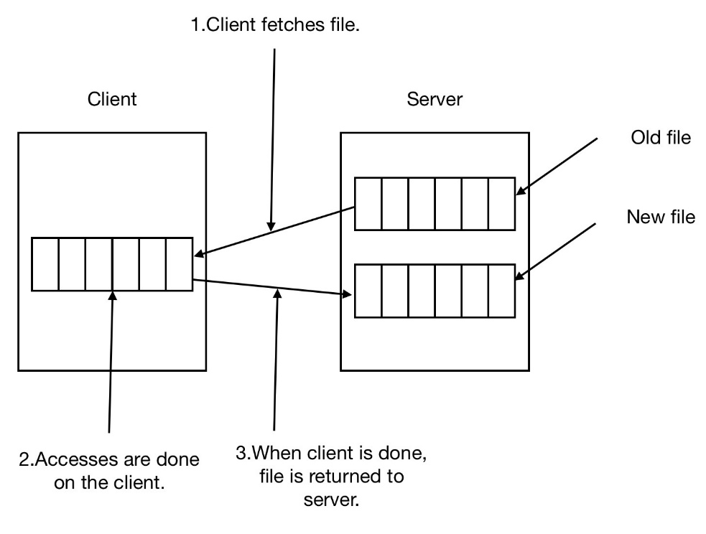
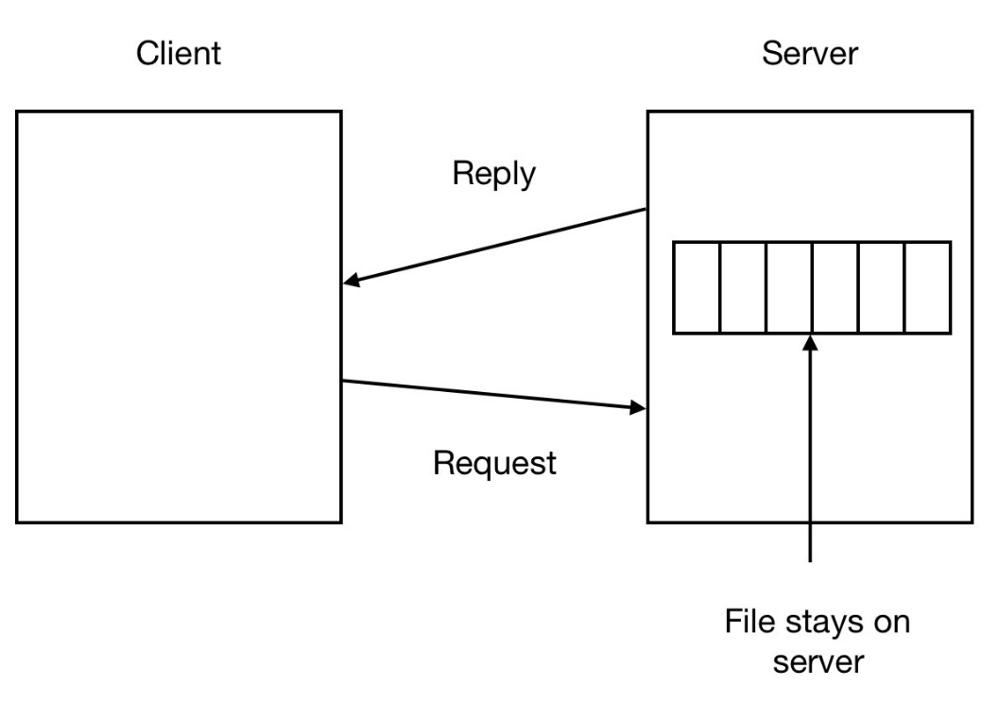
Data Transfer Models of DFSs
Upload download model is simple and efficient, but it requires space to hold the whole file.
Consistency problems need to be handled with care.
Remote access model is good for diskless clients.
The upload download model
The remote access model

Slide 41
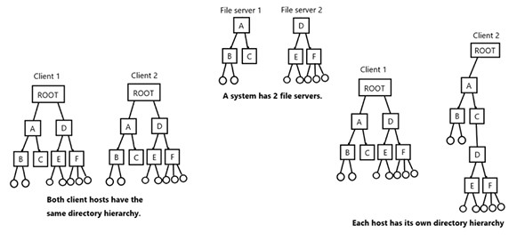
Directory Hierarchies of DFSs
Single directory image model makes a system easier to use.
Multiple directory image model is easy to implement, but the system is not transparent.

Slide 42
Naming in DFSs
There are 3 common approaches:
Machine + path naming: /hostname/path
This satisfies the location transparency, since a path of /server1/dir1/dir2/filename does not tell where the server1 is located.
The server1 can be moved to anywhere freely.
However, a file can not be moved among hosts freely.
A single name space for all hosts such that files can be moved freely without changing their names.
This is also called location independence.
Mount remote file systems onto the local file hierarchy.
Each client host may have different directory hierarchy.
A file may have different pathnames when accessed from different client host.
Also, files can not be moved without changing their names.

Slide 43
File Sharing Semantics (1)
Consistency Semantics is a contract between the data store and its clients that specifies the results that clients can expect to obtain when accessing the data store.
Sequential consistency (Lamport, 1979):
“The result of any execution is the same as if the operations of all the processes were executed in some sequential order and the operations of each individual process appear in this sequence in the order specified by its program”
Causal consistency (Hutto and Ahamad, 1990):
“Writes that are potentially causally related must be seen by all processes in the same order. Concurrent writes may be seen in a different order on different machines”

Slide 44
File Sharing Semantics (2)
FIFO consistency:
“Writes done by a single process are seen by all other processes in the order in which they were issued, but writes from different processes may be seen in a different order by different processes” (PRAM consistency, Lipton and Sandberg 1988)
Session consistency was proposed and used in AFS.
The AFS server keeps a list of which client has which file.
All updates are written back to the server on file close.
On close, if a file has been changed, the server notifies all clients with a copy.
The client can decide either reopen it to get the lasted version or continue with the old version.
Therefore, updates are visible only after file close.
On opening a file, a client gets the last closed version.

Slide 45
A Sequential Consistency Example
P₁: | W(x)a
P₂: |  | W(x)b
P₃: |  |  | R(x)b |  | R(x)a
P₄: |  |  |  | R(x)a | R(x)b
2
1
1
2
The above system does not satisfy the sequential consistency.
P₁: | W(x)a
P₂: |  | W(x)b
P₃: |  |  | R(x)b |  | R(x)a
P₄: |  |  |  | R(x)b | R(x)a
2
1
2
1
The above system satisfies the sequential consistency

Slide 46
A Causal Consistency Example
P₁: | W(x)a |  |  | W(x)c
P₂: |  | R(x)a
P₃: |  | R(x)a | W(x)b |  | R(x)c | R(x)b
P₄: |  | R(x)a |  |  | R(x)b | R(x)c
1
2
2
1
This system is not sequentially consistent.
However, it is causally consistent.
P₁: | W(x)a |  |  | W(x)c
P₂: |  | R(x)a
P₃: |  | R(x)a | W(x)b |  | R(x)c | R(x)b
P₄: |  | R(x)a |  |  | R(x)b | R(x)c

Slide 47
Another Causal Consistency Example
P₁: | W(x)a
P₂: |  | R(x)a | W(x)b
P₃: |  |  |  | R(x)b | R(x)a
P₄: |  |  |  | R(x)a | R(x)b
This system is neither sequentially consistent nor causally consistent.
P₁: | W(x)a
P₂: |  |  | W(x)b
P₃: |  |  |  | R(x)b | R(x)a
P₄: |  |  |  | R(x)a | R(x)b
This system is not sequentially consistent.
However, it is causally consistent.

Slide 48
A FIFO Consistency Example
P₁: | W(x)a
P₂: |  | R(x)a | W(x)b | W(x)c
P₃: |  |  |  |  | R(x)b | R(x)a | R(x)c
P₄: |  |  |  |  | R(x)a | R(x)b | R(x)c
This system is not causally consistent.
However, it is FIFO consistent.
P₁: | W(x)a
P₂: |  | R(x)a | W(x)b | W(x)c
P₃: |  |  |  |  | R(x)b | R(x)a | R(x)c
P₄: |  |  |  |  | R(x)a | R(x)b | R(x)c

Slide 49
References
Leslie Lamport, How to Make a Multiprocessor Computer that Correctly Executes Multiprocess Program, IEEE Trans. Comput. C-28,9 (Sept. 1979), 690-691.
Phillip W Hutto, Mustaque Ahamad, Slow memory: Weakening consistency to enhance concurrency in distributed shared memories, ICDCS-1990 Proceedings, 302-309.
Richard J. Lipton, Jonathan S. Sandberg, PRAM: A scalable shared memory, Princeton University, Department of Computer Science, 1988.

Slide 50
Object Based Middleware: CORBA
The CORBA (Common Object Request Broker Architecture) is a standard defined by the Object Management Group (OMG).
The standard was first released in 1991.
The basic CORBA standard consists of
Interface Design Language (IDL)
Object Request Broker (ORB)
Internet Inter-ORB Protocol (IIOP)
Official CORBA web site is http://www.corba.org/
Official OMG web site is http://www.omg.org/

Slide 51
Goals of the CORBA
Define a common infrastructure of plug-and-play distributed and object-oriented environment.
Enable the development of portable, object-oriented, interoperable distributed applications.
Facilitate the independent implementation of hardware, operating system, network, and programming language.
Allow client server interaction among interoperable ORBs.

Slide 52
Interface Definition Language (IDL)
IDL is language independent and can be mapped to any programming languages.
C, C++, Java, Cobol, Smalltalk, Ada, …
IDL is used to define object interfaces of CORBA objects.
It hides underlying object implementation from clients.
IDL definitions can be compiled into a client stub module and a server skeleton module.
The client stub is used in the client side as a proxy of the server object.
The server skeleton is used on the server side as an agent of the client.

Slide 53
The IDL syntax
module <identifier>
{
interface <identifier> [:inheritance]
{
<type declarations>;
<constant declarations>;
<exception declarations>;
<attribute declarations>;
[<op_type>] <identifier>(<parameters>)
[raises exception][context];
}
}
Defines a container (namespace)
Defines a CORBA object
Defines a method

Slide 54
The IDL Compiler
IDL Definitions
Define objects using IDL
Run IDL file through IDL compiler
Compiler uses language mappings to generate programming language specific stubs and skeletons
IDL Compiler
Stubs
Skeletons

Slide 55
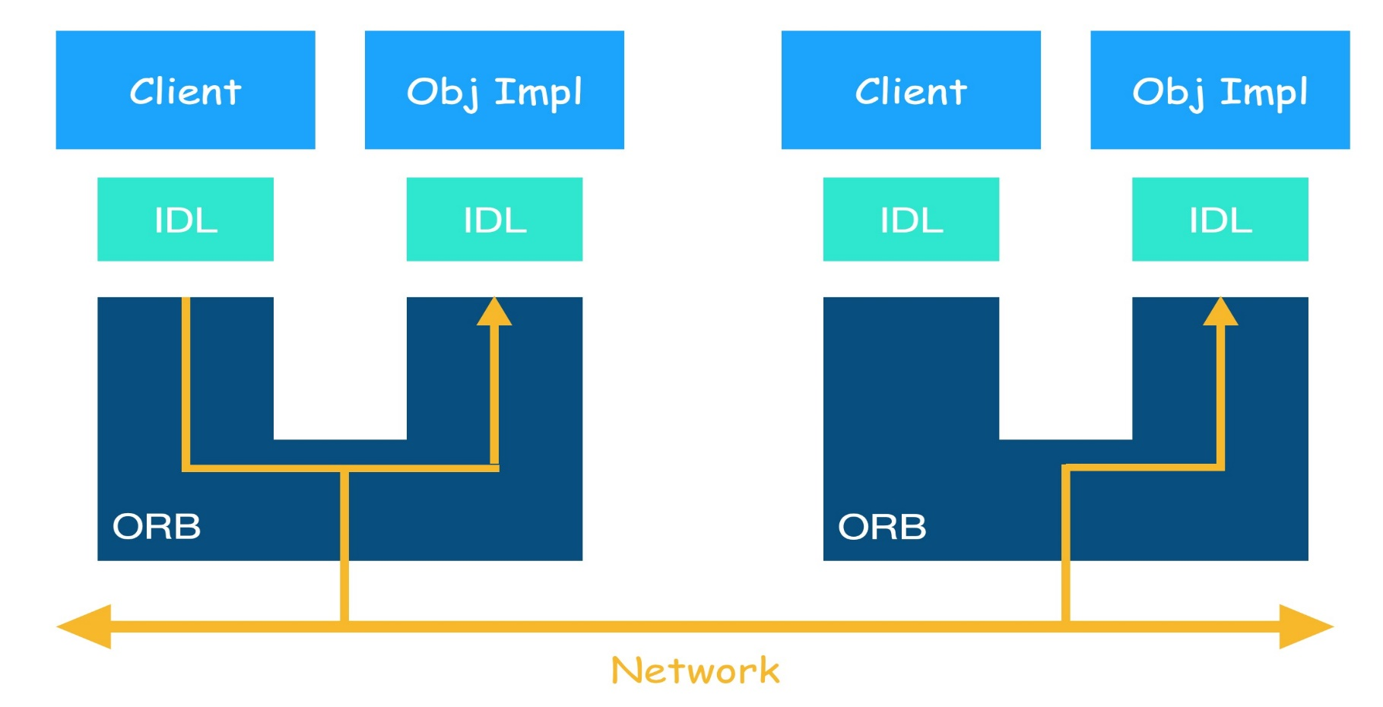
Client Server Interaction in CORBA
ORB is a middleware that implements the CORBA standard.
It is a conceptual software bus that hides location and implementation details about objects.

Slide 56
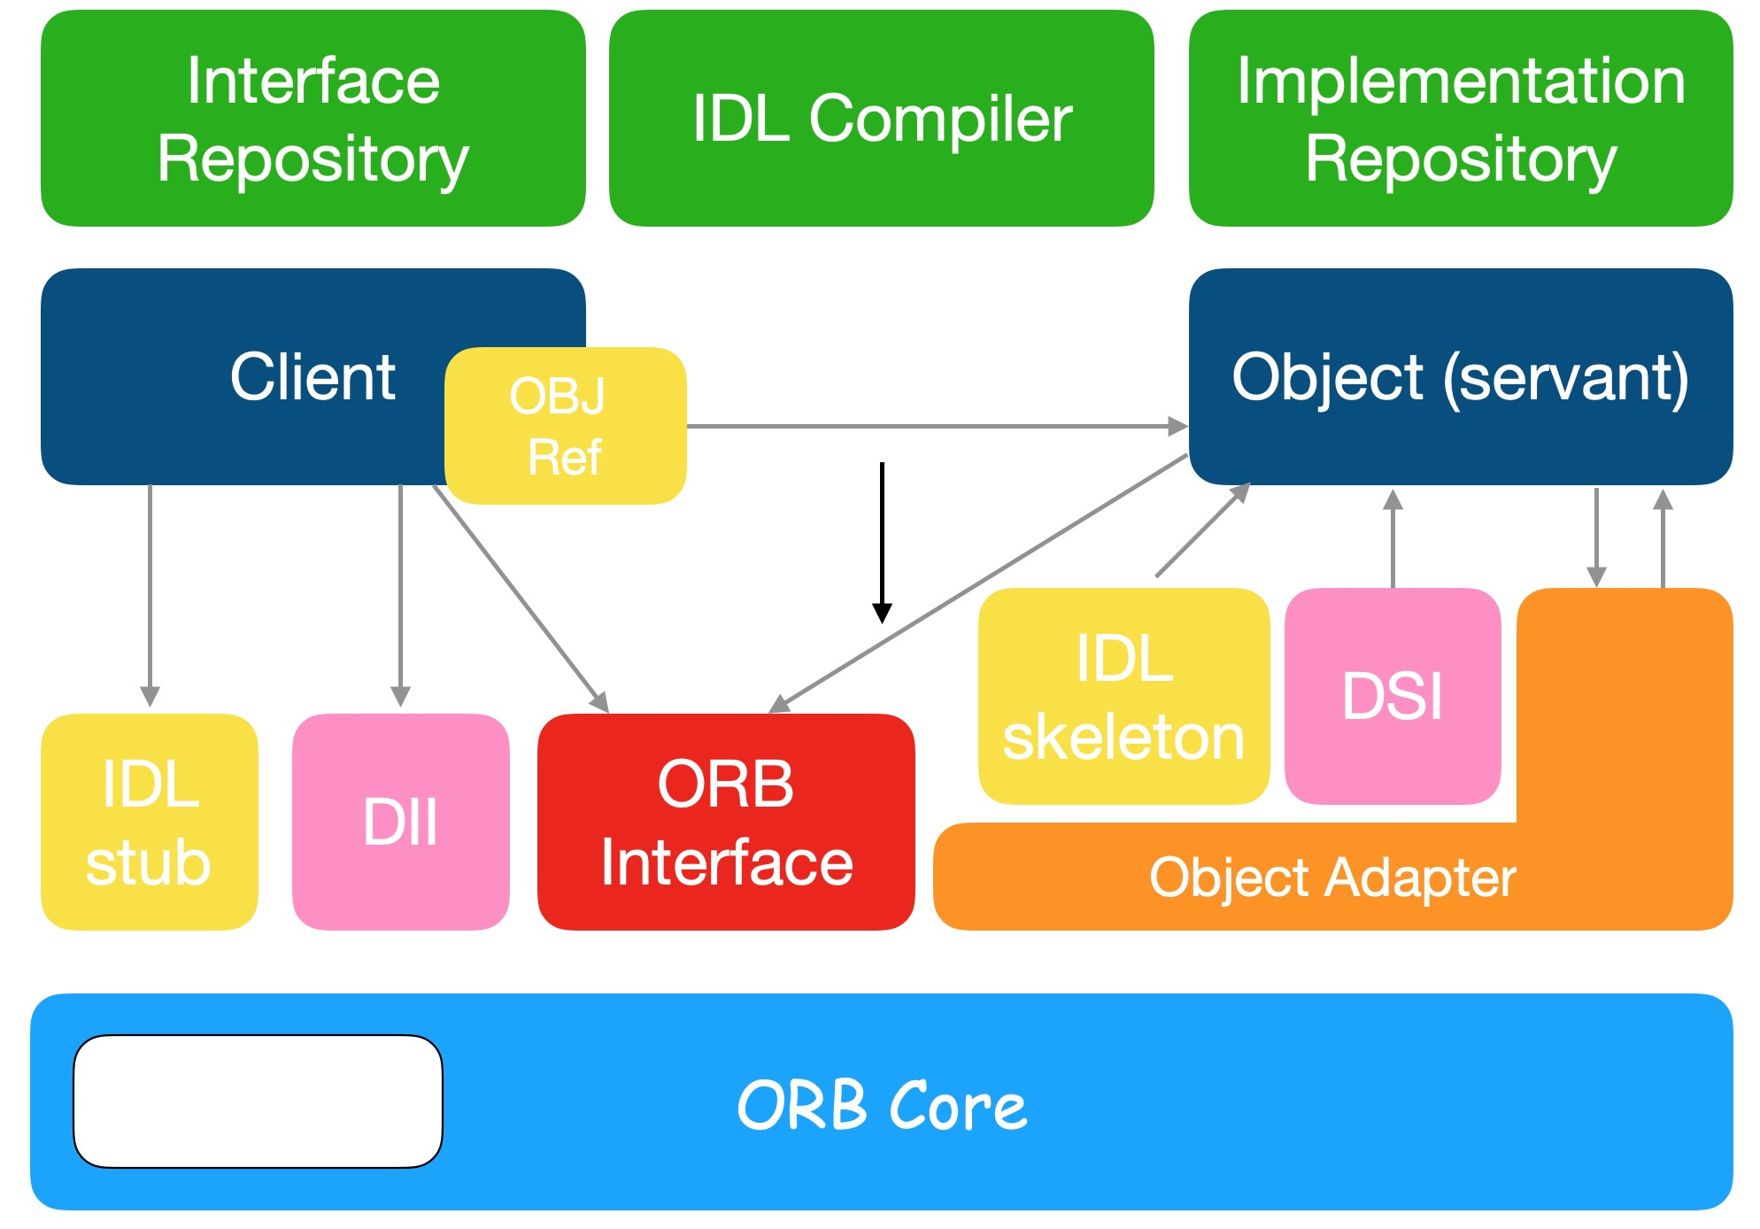
The ORB Architecture

Slide 57
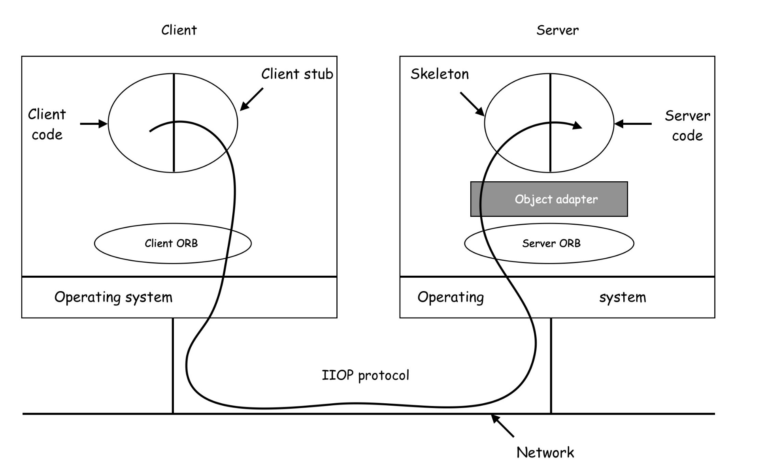
A CORBA Based Distributed System

Slide 58
The Linda System
Linda is a novel system of coordination and communication among processes operating upon data stored in and retrieved from a (virtually) shared memory.
It was proposed by David Gelernter and Nick Carriero at Yale University. (1985~)
The technology was later transferred to Scientific Computing Associates, Inc. (SCAI)
TCP-Linda was the product provided by SCAI
Official web site is http://lindaspaces.com/products/linda.html
Some other implementations are
LinuxTuples: https://sourceforge.net/projects/linuxtuples/
Simple C-Linda: https://www.comp.nus.edu.sg/~wongwf/linda.html

Slide 59
The Linda Concept
In Linda, processes communicate via a shared tuple space.
The tuple space (TS) is a shared global repository that holds tuples inserted by all processes.
All tuples can be read and retrieved by any process in Linda.
A tuple is a vector that consists of one or more fields.
Each field is a value of some type supported by the base language.
Linda is usually implemented by adding a library to an existing language, such as C, Java, …
The original Linda model has only four tuple operations:
In(), Out() moves a tuple to and from the tuple space.
Eval() spawns a new process to perform some task in tuple space.
Rd() reads a tuple from the tuple space without erasing it.

Slide 60
The Tuple Space Concept
P
P
Out()
Eval()
In()/Rd()
Tuples
P
Tuple Space

Slide 61
The Tuple Operations
A tuple is a series of typed fields.
Some examples are ("a string", 15.01, 17), (100), …
Operations:
out(t): insert a tuple t into the tuple space (non-blocking).
in(t): find and remove a matching tuple t from the tuple space.
It blocks until a matching tuple is found.
rd(t): like in(t) except that the tuple is not removed from the tuple space but duplicated.
It also blocks until a matching tuple is found.
eval(t): evaluate the tuple t in parallel and generate a new tuple in the tuple space.

Slide 62
The Tuple Matching
Let t(i) denote the i-th field in the tuple t.
A tuple t given in a in(t) or rd(t) operation matches a tuple tt in the tuple space if and only if:
t and tt have the same number of fields and
for each field one of the following conditions is true
t(i) is a value and t(i) = tt(i)
t(i) is of the form ?x and tt(i) is a valid value for the type of variable x
If more than one tuple in the tuple space matches, then one is selected non-deterministically.
As a result of tuple matching,
if t(i) is of the form ?x, then x is assigned to the value of tt(i).

Slide 63
A Tuple Matching Example
An n-element vector can be stored as n tuples in the TS.
("V", 1, FirstElt)
("V", 2, SecondElt)
…
("V", n, NthElt)
To read the j-th element and assign it to x,
rd ("V", j, ?x )
To change the i-th element,
in ("V", i, ?OldVal) // a tuple must be first deleted
out ("V", i, NewVal); // then be added a new value

Slide 64
A Message Passing Example
To send a message to process B, process A can generates a tuple and use out() to put it into the Tuple Space by
out("message to B", msg),
out("message from A", msg), or
out("A to B", msg)
To receive a message, process B can use in() to retrieve it from the Tuple Space by
in("message to B", ?msg),
in("message from A", ?msg), or
in("A to B", ?msg)
Process A
Out(“A to B”, msg)
Tuple Space
tuple
In(“A to B”, ?msg)
Process B

Slide 65
Semaphore Examples
For binary semaphore,
Initialization: out("sem")
wait() or P(): in("sem")
signal() or V(): out("sem")
For counting semaphore,
Initialization:
execute out("sem") N times
wait() and singal() are same as the binary case.

Slide 66
A Client Server Example
server()
{
int index = 1;
while (1){
// send request permission
out ("server index", index);
// get request with index#
in ("request", index, ?req);
… // generate response
out ("response", index, response);
index++;
}
}
client()
{
int index;
… // generates request
// get request permission from server
in (“server index”, ?index);
// send request with index#
out ("request", index, request);
// get response with index#
in ("response", index, ?response);
}

Slide 67
Coordination/Communication Models
The coordination models can be classified according to their temporal and spatial dependencies.
Direct messaging requires that all parties be up in the same time and be known by each others.
Indirect messaging requires that all parties know the same mailbox.
Video conferencing requires that all parties appear in the same time.
 |  | Temporal
 |  | Coupled | Uncoupled
Spatial | Coupled | Direct messaging | Indirect messaging
 | Uncoupled | Video conferencing | Linda-like

Slide 68
The Pub/Sub Model
Since the Linda uses a TS for coordination, it requires an efficient implementation of DSM.
In general, it is quite difficult to implement an efficient and reliable DSM on a DS.
The Linda model is therefore only good for MPs (or MCs).
However, if the Linda concept is only used for communication, it is possible to implement a useful and efficient message middleware based on the Linda.
The publish/subscribe model is inspired by the Linda.
It is a message-based communication paradigm.
All participants are both spatial and time decoupled.
They do not have to know each other.
They do not have to be up at the same time.

Slide 69
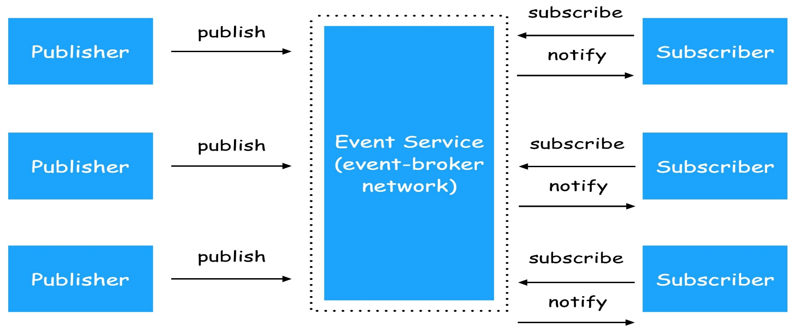
The Publish/Subscribe Middleware
It is also called event-based or notification middleware.
Publishers (advertise and) publish events (or messages).
Subscribers express interest in events with subscriptions.
Event Service notifies interested subscribers of published events.
Events can have arbitrary content (typed) or name/value pairs.

Slide 70
Properties of Pub/Sub Middleware
Asynchronous communication
Publishers and subscribers are loosely coupled
Many-to-many interaction between pubs. and subs.
Publishers do not need to know subscribers, and vice-versa
Dynamic join and leave of pubs and subs are allowed
Pub/sub can be classified into following models
Channel-Based: predefined channels or boards
RSS/Atom
Topic-Based: each event has a topic attribute
JMS, WS Notification
Content-Based: predicates and/or name-value pairs

Slide 71
Java Message Service (JMS)
The Java Message Service (JMS) API is a Java Message Oriented Middleware (MOM) API for sending messages between two or more participants.
The JMS API supports two models:
Point-to-point
Publish and subscribe
Some open source implementations:
OpenJMS: http://openjms.sourceforge.net/
ActiveMQ: http://activemq.apache.org/

Slide 72
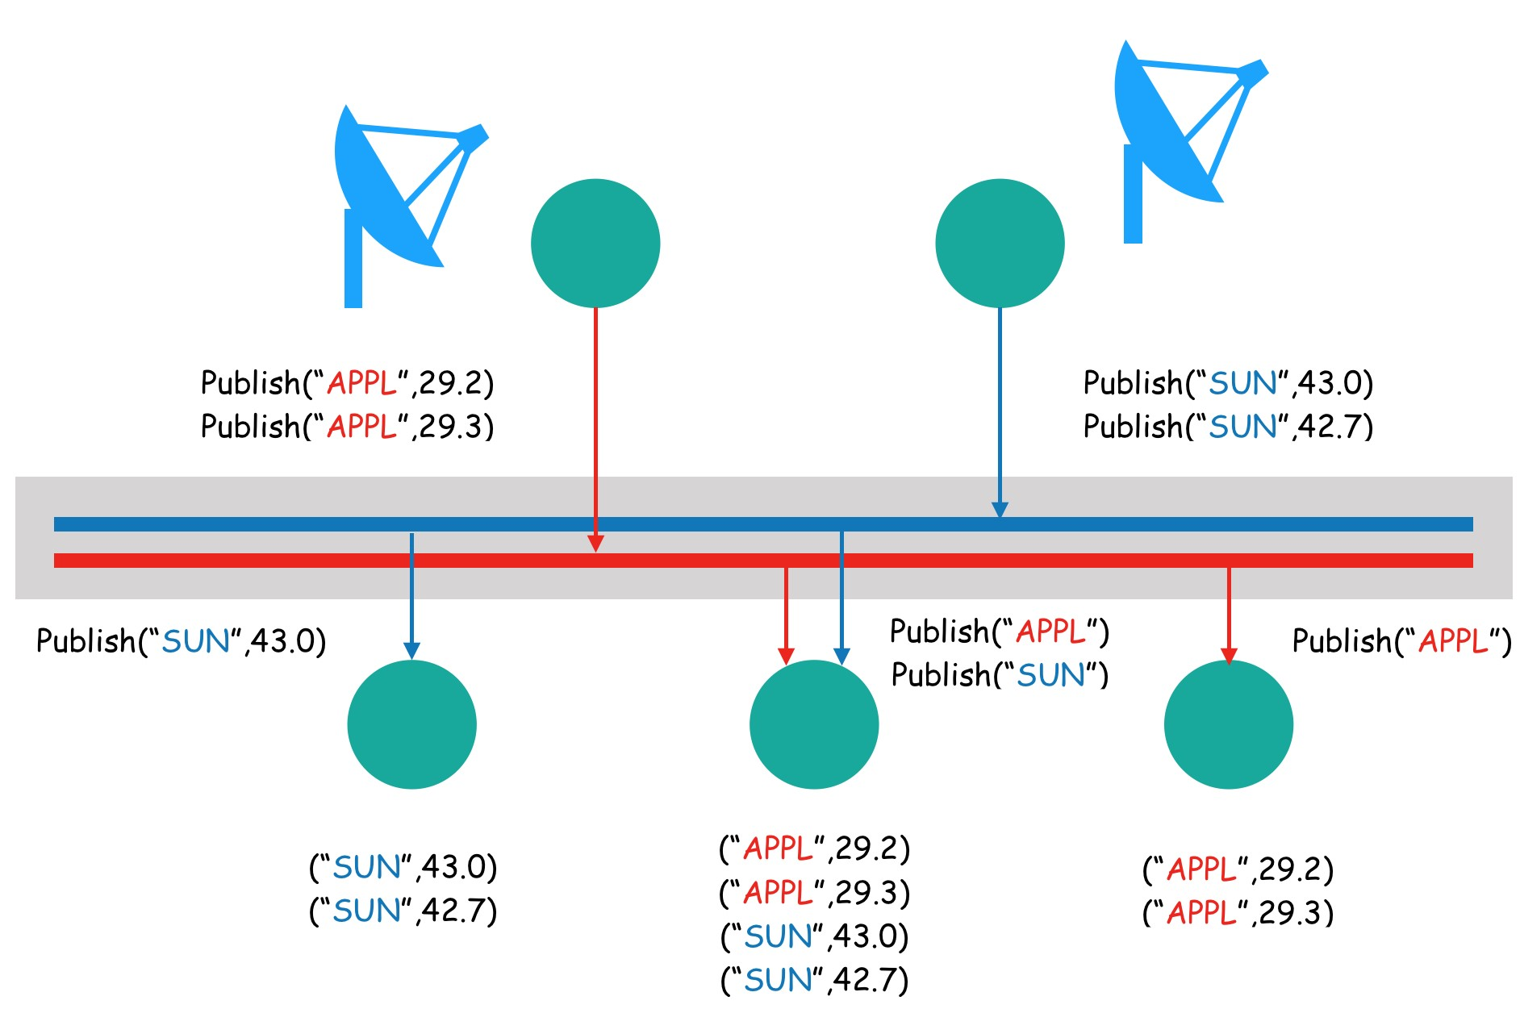
Topic-Based Pub/Sub Application
Subscribe(“SUN”)
Subscribe(“APPL”)
Subscribe(“APPL”)
Subscribe(“SUN”)

Slide 73
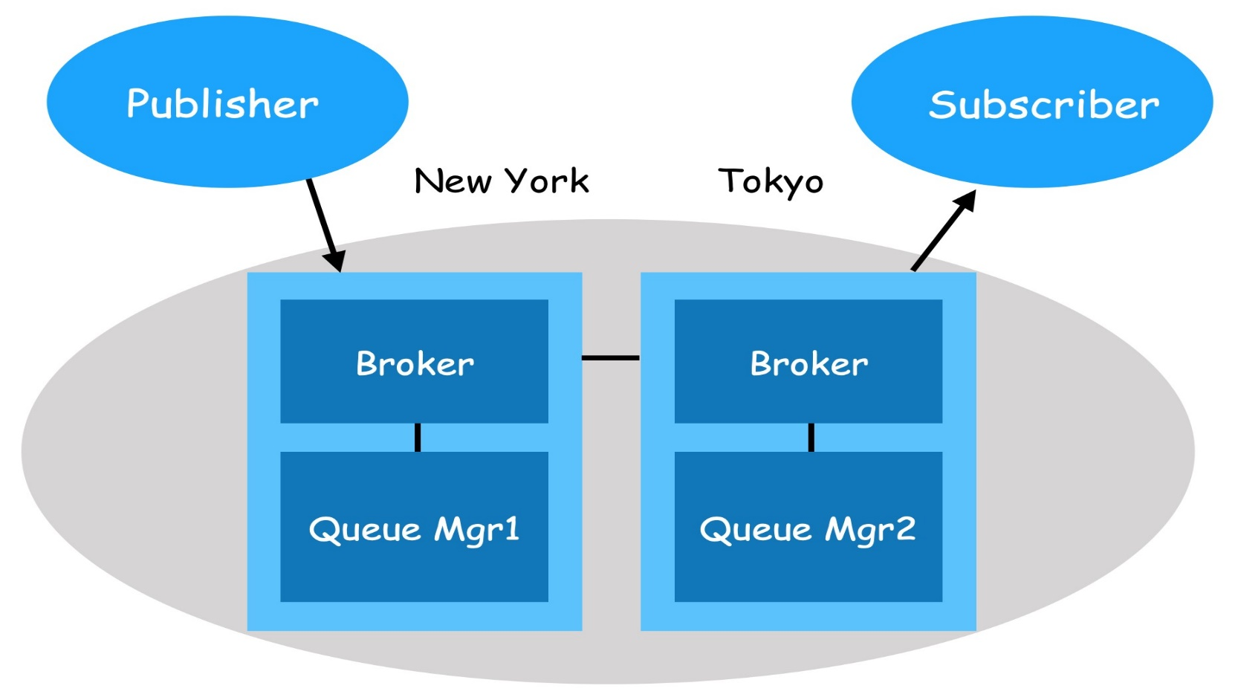
Topic-Based Pub/Sub Broker
Listen for publishers
Listen for subscribers
Maintain list of topics and subscribers
Maintain links with other brokers
Maintain links with queue manager

Slide 74
Content-Based Pub/Sub
Matching Semantic
Subscriptions are conjunctions of predicates
Publications are sets of name-value pairs
A subscription matches if all its predicates match
Approximate semantic (e.g., close to, cheap)
Semantic and similarity-based matching
Example | Tree-structured data | Graph-structured data | Un-structured data | Regular languages | Relational model
Subscription | XPath | RDF Query | Keywords | Regular expressions | SQL
Publication | XML | RSS feeds | Text, documents | Sentences over some alphabet | DBs, i.e., tables

Slide 75
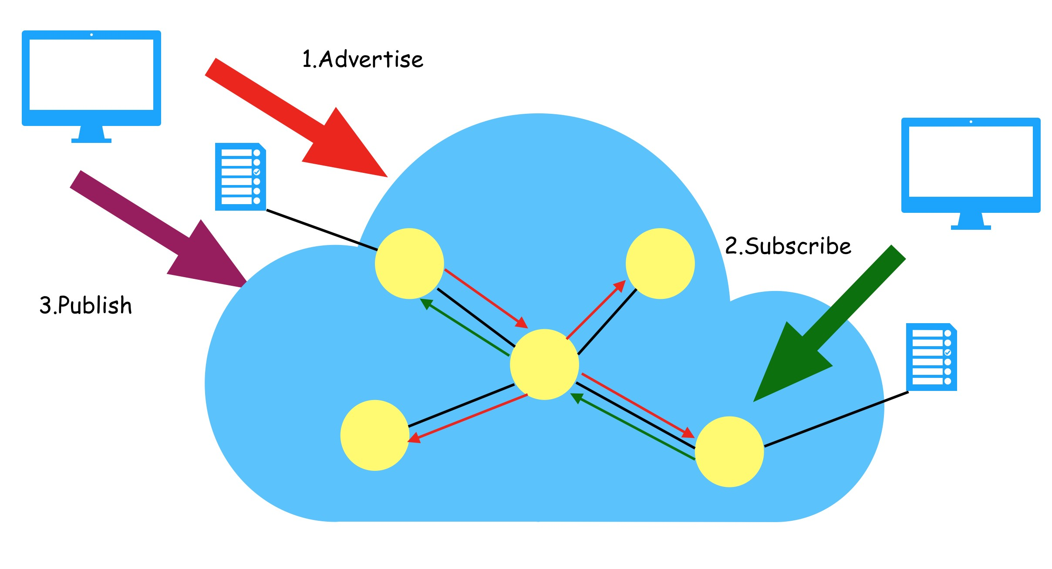
Content-Based Message Routing

Slide 76
Pub/Sub Operational Models
There are four operational models in Pub/Sub paradigm
Push publishers with Push consumers
The Middleware acts as a notifier
Pull publishers with Pull consumers
The Middleware acts as a clawer plus repository
Push publishers with Pull consumers
The Middleware acts as a queue
Pull publishers with Push consumers
The Middleware acts as an agent

Slide 77
The Canonical Push Model
Consumer
Supplier
Push()
Push()
Event Channel
(Notifier)
Consumer
Push()
Push()
Supplier
Push()
Consumer

Slide 78
The Canonical Pull Model
Consumer
Supplier
Pull()
Pull()
Event Channel
(Clawer,
Repository)
Consumer
Pull()
Pull()
Supplier
Pull()
Consumer

Slide 79
The Hybrid Push/Pull Model
Consumer
Supplier
Pull()
Push()
Event Channel
(Queue)
Consumer
Pull()
Push()
Supplier
Pull()
Consumer

Slide 80
The Hybrid Pull/Push Model
Consumer
Supplier
Push()
Pull()
Event Channel
(Agent)
Consumer
Push()
Pull()
Supplier
Push()
Consumer

