Slide 1
Python
Ivan Palijan

Slide 2
Alati
Python 3.5
https://www.python.org/downloads/release/python-363/
PyCharm
https://www.jetbrains.com/pycharm/download/
Knjiga
https://github.com/ehmatthes/pcc

Slide 3
Open source general-purpose jezik.
Object Oriented, Procedural, Functional
“Jednostavno” povezivanje sa C++ (via SWIG)

Slide 4
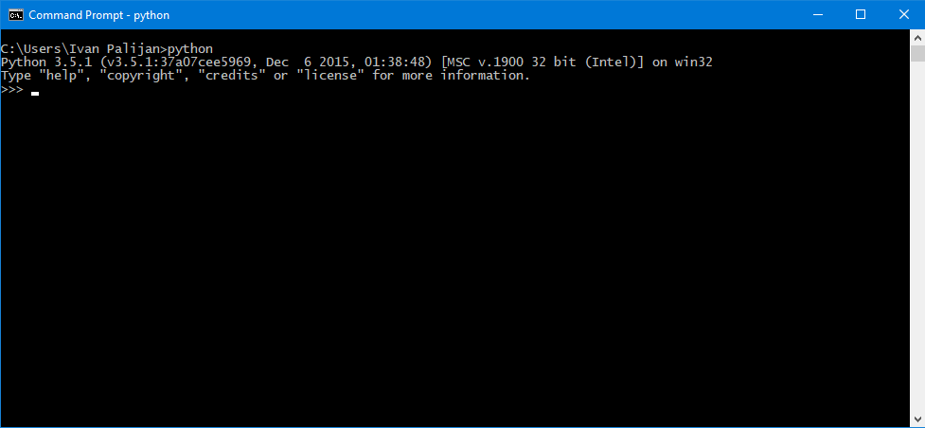
Python interpreter konzola

Slide 5
Hello world
print("Hello world!") | Ispis sa prelaskom u novi red
print("Hello world!", end="") | Ispis bez prelaska u novi red
print("There are <", 2**32, "> possibilities!", sep="---***---", end="**-//\n") | Ispis sa separatorom i zavrsetkom

Slide 6
For petlja
Python 3.X
Java
for i in range(4): print(i)
for(int i = 4; i < 4; i++) System.out.println(i);

Slide 7
Upis u tekstualni file
fh = open("data.txt","w") print("Neki tekst koji se upisuje u file", file=fh) fh.close()

Slide 8
Liste
bikes = ['trek', 'redline', 'giant'] | Napravi listu
first_bike = bikes[0] | Prvi clan u listi
last_bike = bikes[-1] | Poslednji clan u listi
for bike in bikes: print(bike) | Prolazak kroz listu

