Slide 1

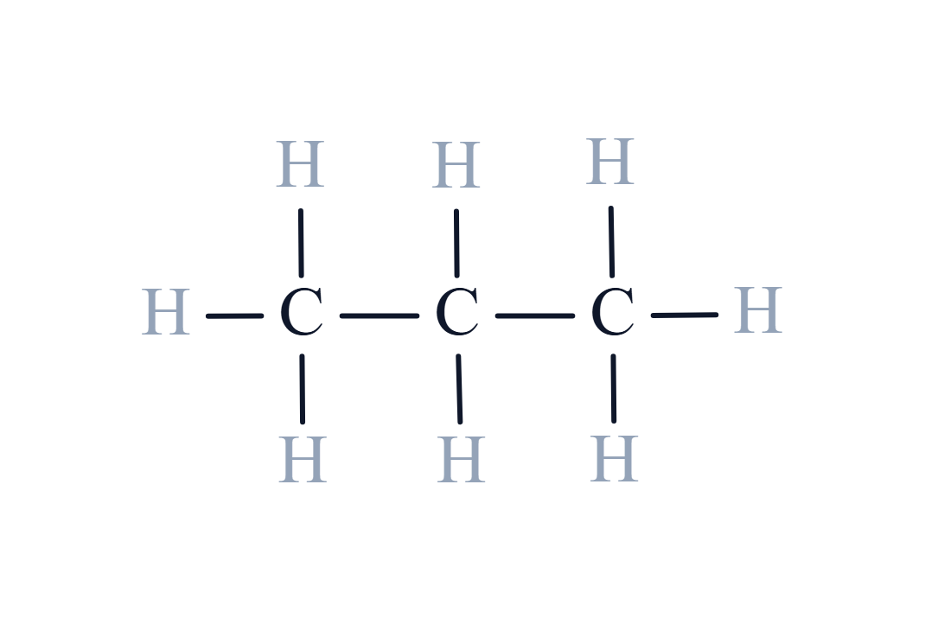
CARD 01 - PROPANE
MOLECULAR FORMULA
LEWIS STRUCTURE
C₃H₈
CONDENSED STRUCTURAL FORMULA
BOND LINE FORMULA
CH₃CH₂CH₃
ATOM COUNT VERIFIED
VALENCE CHECKED
BOND ORDER CHECKED
SAME CONNECTIVITY CONFIRMED

Slide 2

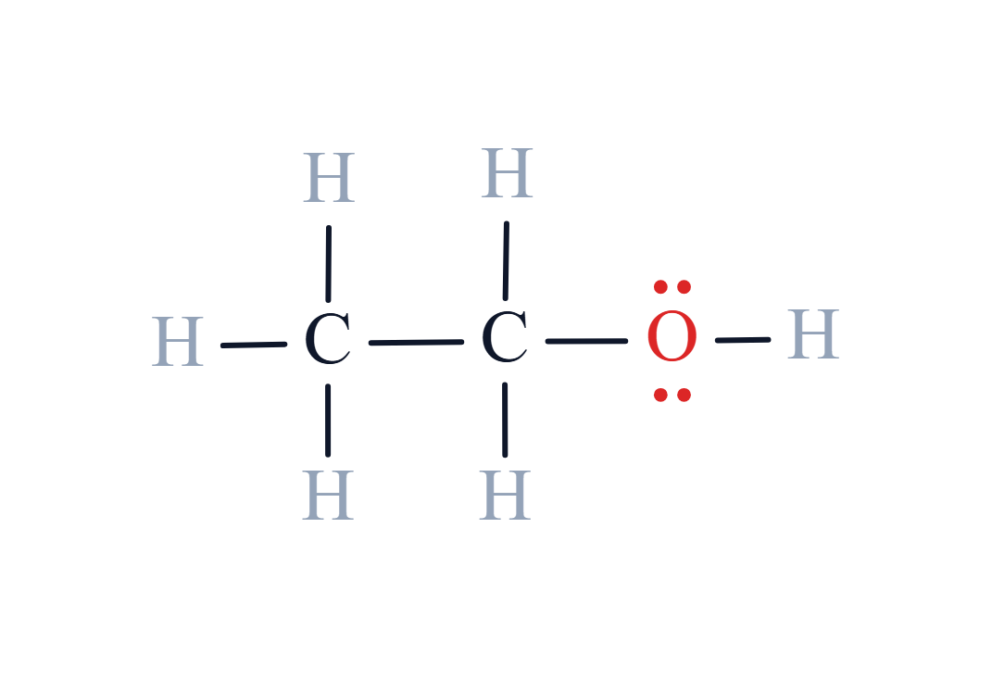
CARD 02 - ETHANOL
MOLECULAR FORMULA
LEWIS STRUCTURE
C₂H₆O
CONDENSED STRUCTURAL FORMULA
BOND LINE FORMULA
CH₃CH₂OH
ATOM COUNT VERIFIED
VALENCE CHECKED
BOND ORDER CHECKED
SAME CONNECTIVITY CONFIRMED

Slide 3
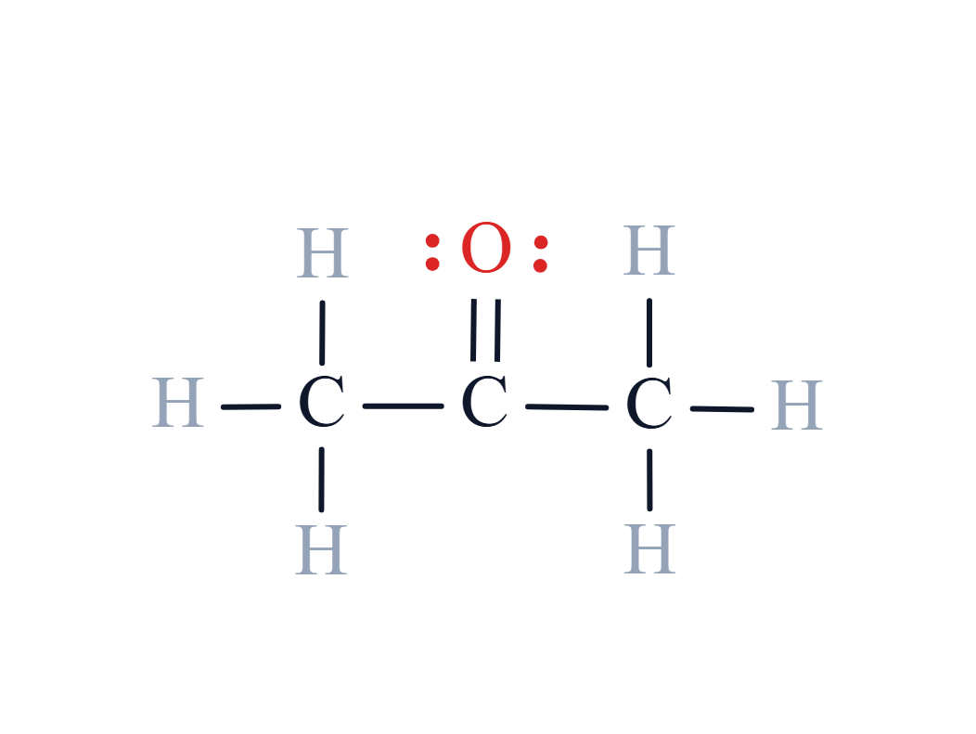
CARD 03 - ACETONE
MOLECULAR FORMULA
LEWIS STRUCTURE
C₃H₆O
Propan-2-one
CONDENSED STRUCTURAL FORMULA
BOND LINE FORMULA
CH₃COCH₃
ATOM COUNT VERIFIED
VALENCE CHECKED
BOND ORDER CHECKED
SAME CONNECTIVITY CONFIRMED

Slide 4
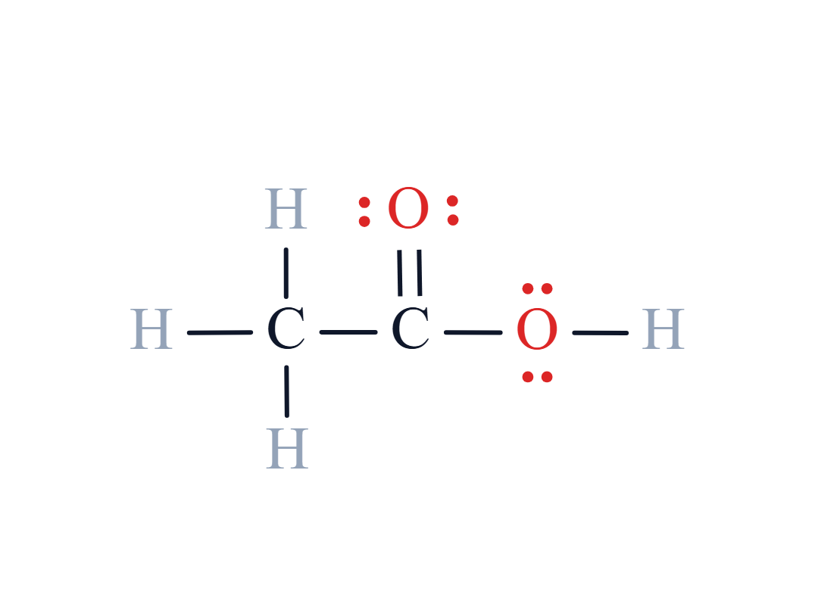
CARD 04 - ACETIC ACID
MOLECULAR FORMULA
LEWIS STRUCTURE
C₂H₄O₂
Ethanoic acid
CONDENSED STRUCTURAL FORMULA
BOND LINE FORMULA
CH₃COOH
ATOM COUNT VERIFIED
VALENCE CHECKED
BOND ORDER CHECKED
SAME CONNECTIVITY CONFIRMED

Slide 5
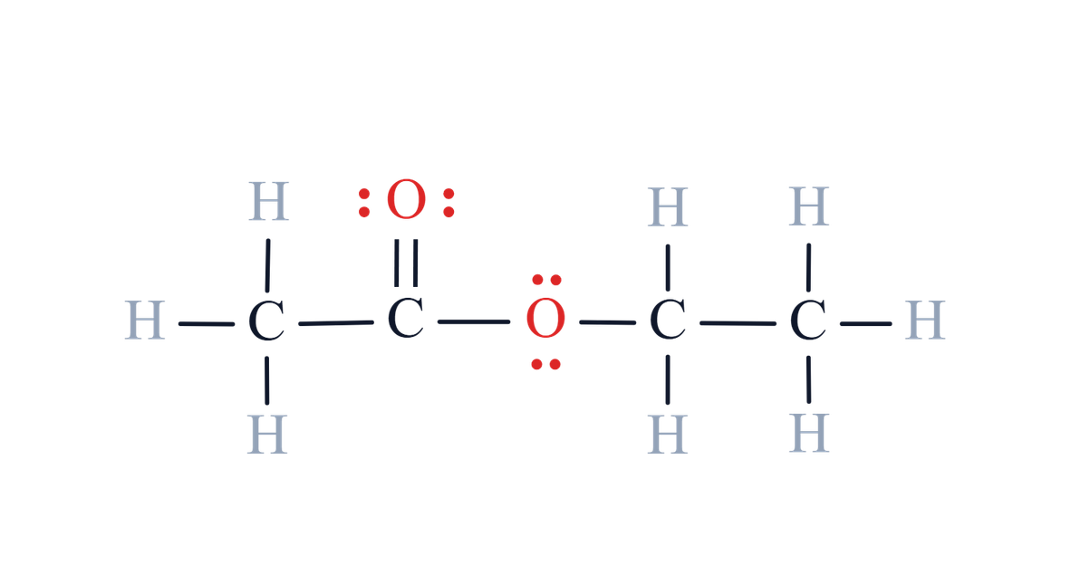
CARD 05 - ETHYL ACETATE
MOLECULAR FORMULA
LEWIS STRUCTURE
C₄H₈O₂
Ethyl ethanoate
CONDENSED STRUCTURAL FORMULA
BOND LINE FORMULA
CH₃COOCH₂CH₃
ATOM COUNT VERIFIED
VALENCE CHECKED
BOND ORDER CHECKED
SAME CONNECTIVITY CONFIRMED

Slide 6
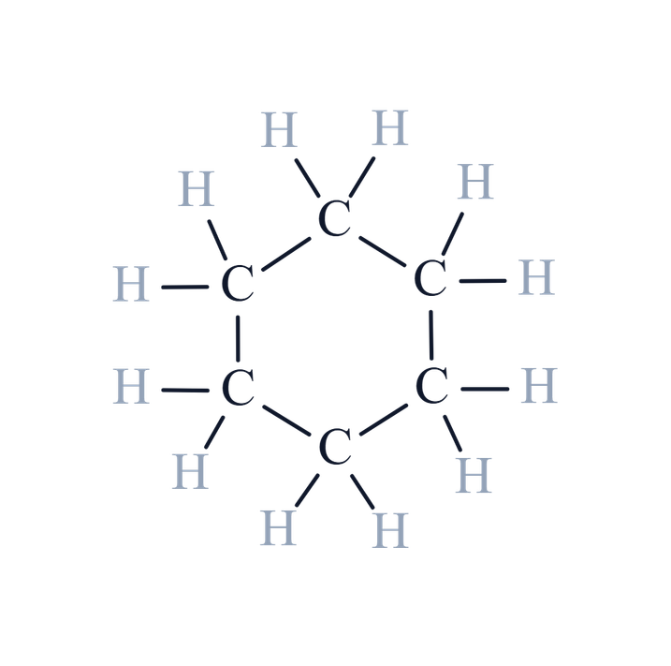
CARD 06 - CYCLOHEXANE
MOLECULAR FORMULA
LEWIS STRUCTURE
C₆H₁₂
CONDENSED STRUCTURAL FORMULA
BOND LINE FORMULA
(CH₂)₆
ATOM COUNT VERIFIED
VALENCE CHECKED
BOND ORDER CHECKED
SAME CONNECTIVITY CONFIRMED

Slide 7
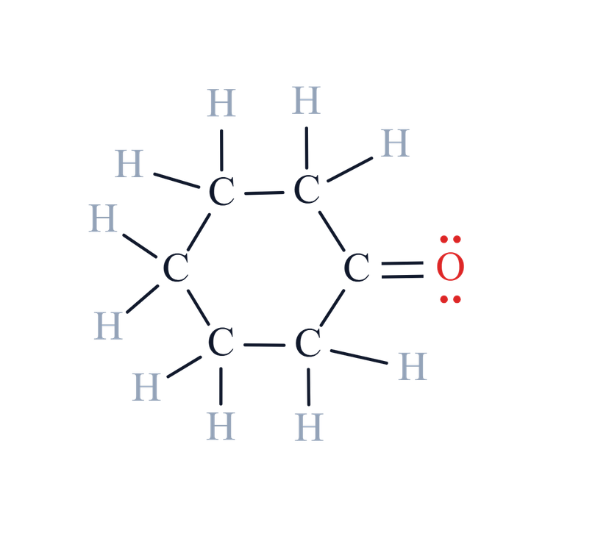
CARD 07 - CYCLOHEXANONE
MOLECULAR FORMULA
LEWIS STRUCTURE
C₆H₁₀O
CONDENSED STRUCTURAL FORMULA
BOND LINE FORMULA
(CH₂)₅CO
ATOM COUNT VERIFIED
VALENCE CHECKED
BOND ORDER CHECKED
SAME CONNECTIVITY CONFIRMED

Slide 8
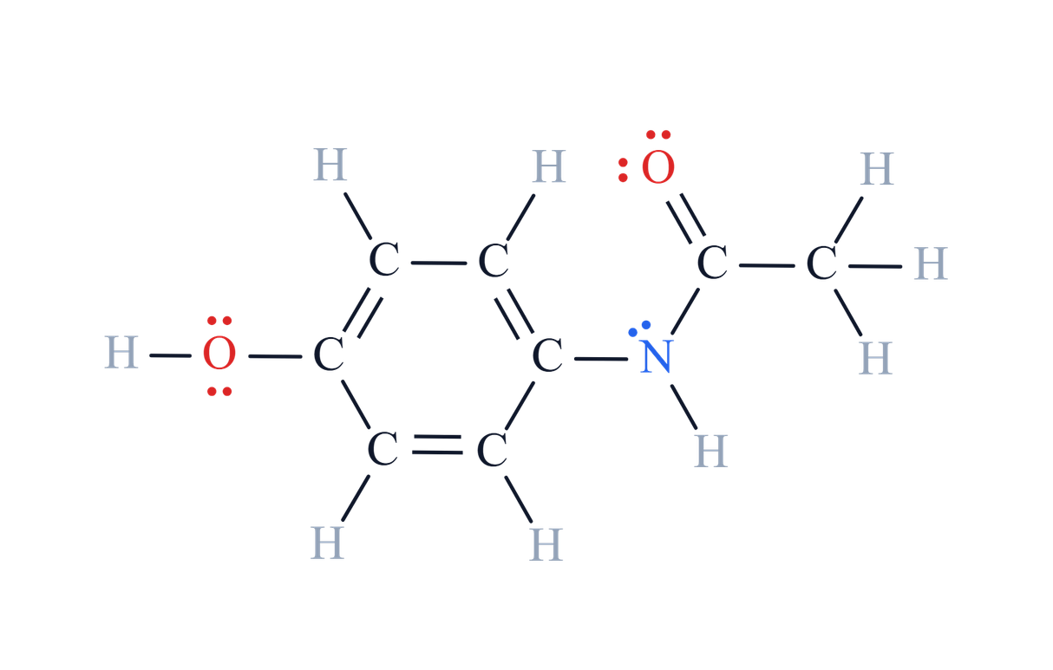
CARD 08 - ACETAMINOPHEN
MOLECULAR FORMULA
LEWIS STRUCTURE
C₈H₉NO₂
N-(4-hydroxyphenyl)acetamide
Paracetamol
CONDENSED STRUCTURAL FORMULA
BOND LINE FORMULA
HOC₆H₄NHCOCH₃
ATOM COUNT VERIFIED
VALENCE CHECKED
BOND ORDER CHECKED
SAME CONNECTIVITY CONFIRMED

Slide 9
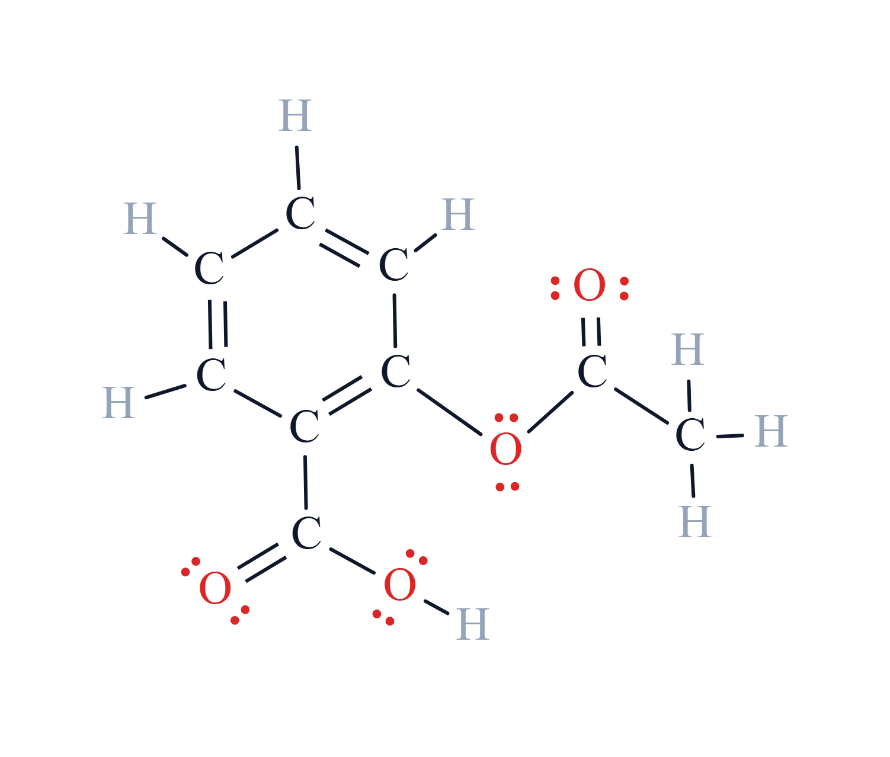
CARD 09 - ASPIRIN
MOLECULAR FORMULA
LEWIS STRUCTURE
C₉H₈O₄
2-Acetoxybenzoic acid
Acetylsalicylic acid
CONDENSED STRUCTURAL FORMULA
BOND LINE FORMULA
CH₃COOC₆H₄COOH
ATOM COUNT VERIFIED
VALENCE CHECKED
BOND ORDER CHECKED
SAME CONNECTIVITY CONFIRMED

Slide 10
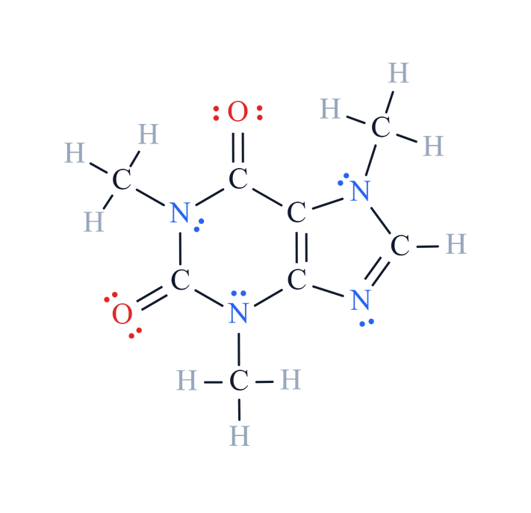
CARD 10 - CAFFEINE
MOLECULAR FORMULA
LEWIS STRUCTURE
C₈H₁₀N₄O₂
1,3,7-Trimethylpurine-2,6-dionee
CONDENSED STRUCTURAL FORMULA
BOND LINE FORMULA
C₅H(CH₃)₃N₄O₂
ATOM COUNT VERIFIED
VALENCE CHECKED
BOND ORDER CHECKED
SAME CONNECTIVITY CONFIRMED

