Slide 1

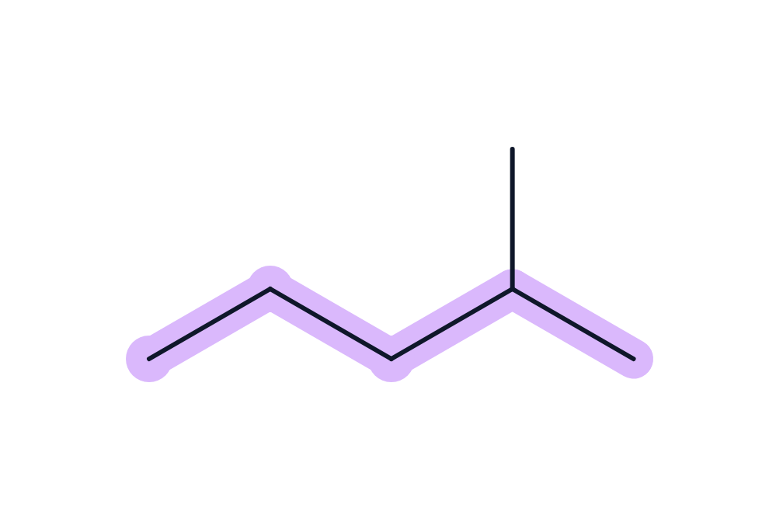
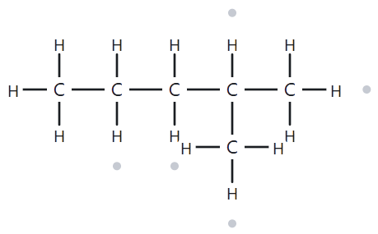


CARD A01
Level: Foundation | Molecular Formula: C₆H₁₄
NUMBERED PARENT
NAMING TRAIL
Parent: Longest chain = 5C → pentane
Numbering: left → right gives 4; right → left gives 2.
First point of difference: 2 < 4, so number from the right.
Substituents: Methyl on C2 → 2-methyl
4
5
1
2
3
MY NAME
THE ALKANE CHECK
2-methylpentane
Returned Name: 2-methylpentane
LONGEST CHAIN
LOWEST LOCANTS
ALPHABETICAL ORDER
PUNCTUATION
FORMULA COUNTED

Slide 2

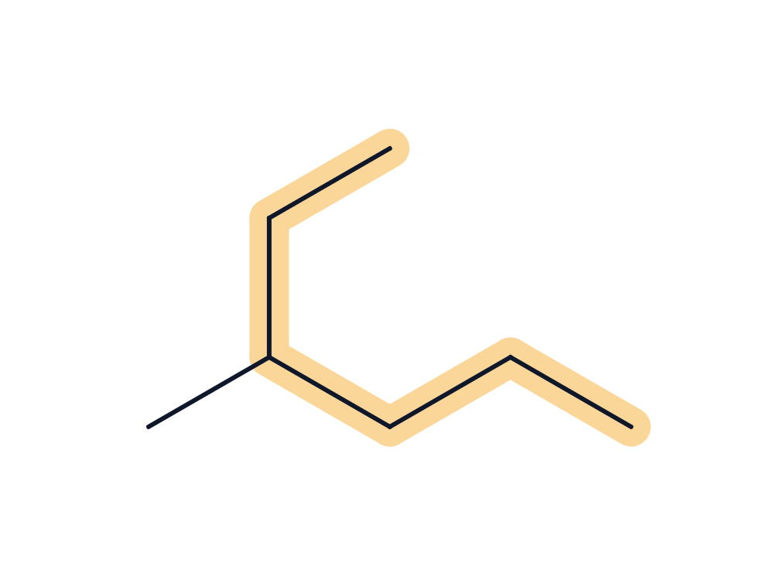
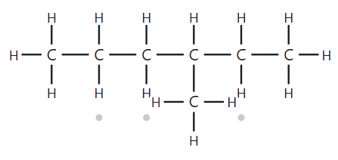
CARD A02
Level: Foundation | Molecular Formula: C₇H₁₆
NUMBERED PARENT
NAMING TRAIL
1
2
Parent: Longest chain = 6C → hexane
Numbering: left → right gives 4; right → left gives 3.
First point of difference: 3 < 4, so number from the right.
Substituents: Methyl on C3 → 3-methyl
4
6
3
5
MY NAME
THE ALKANE CHECK
3-methylhexane
Returned Name: 3-methylhexane
LONGEST CHAIN
LOWEST LOCANTS
ALPHABETICAL ORDER
PUNCTUATION
FORMULA COUNTED

Slide 3
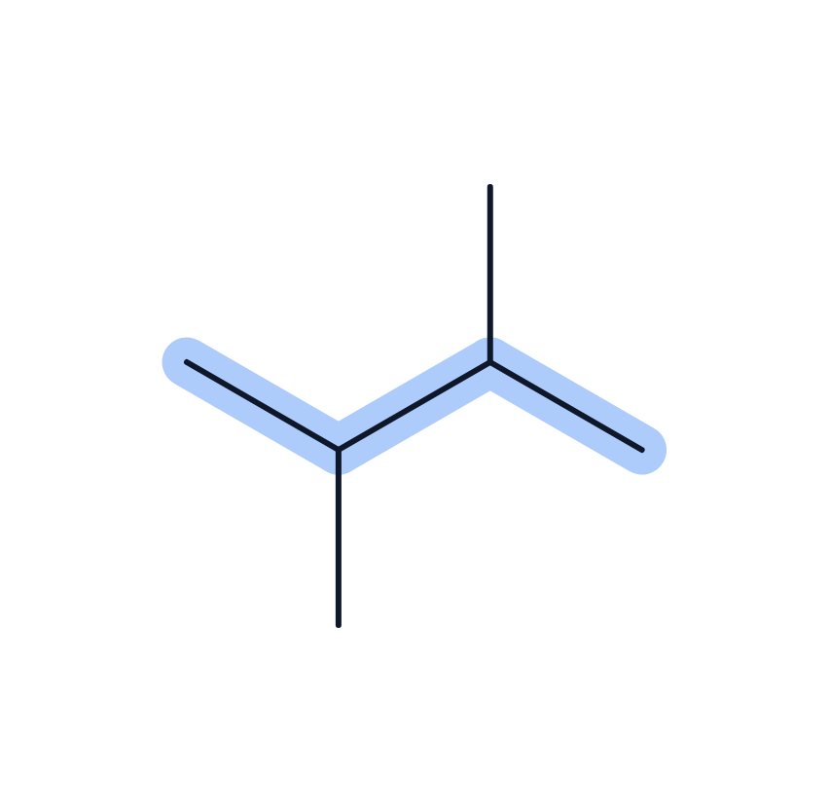
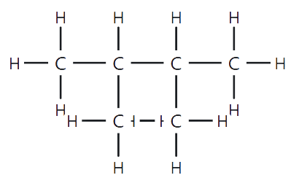
CARD A03
Level: Foundation | Molecular Formula: C₆H₁₄
NUMBERED PARENT
NAMING TRAIL
Parent: Longest chain = 6C → hexane
Numbering: left → right gives 2, 3; right → left gives 2,3.
Symmetrical, so either direction leads to the same name.
Substituents: Methyl groups on C2 and C3 → 2,3-dimethyl
2
4
1
3
MY NAME
THE ALKANE CHECK
2,3-dimethylbutane
Returned Name: 2,3-dimethylbutane
LONGEST CHAIN
LOWEST LOCANTS
ALPHABETICAL ORDER
PUNCTUATION
FORMULA COUNTED

Slide 4
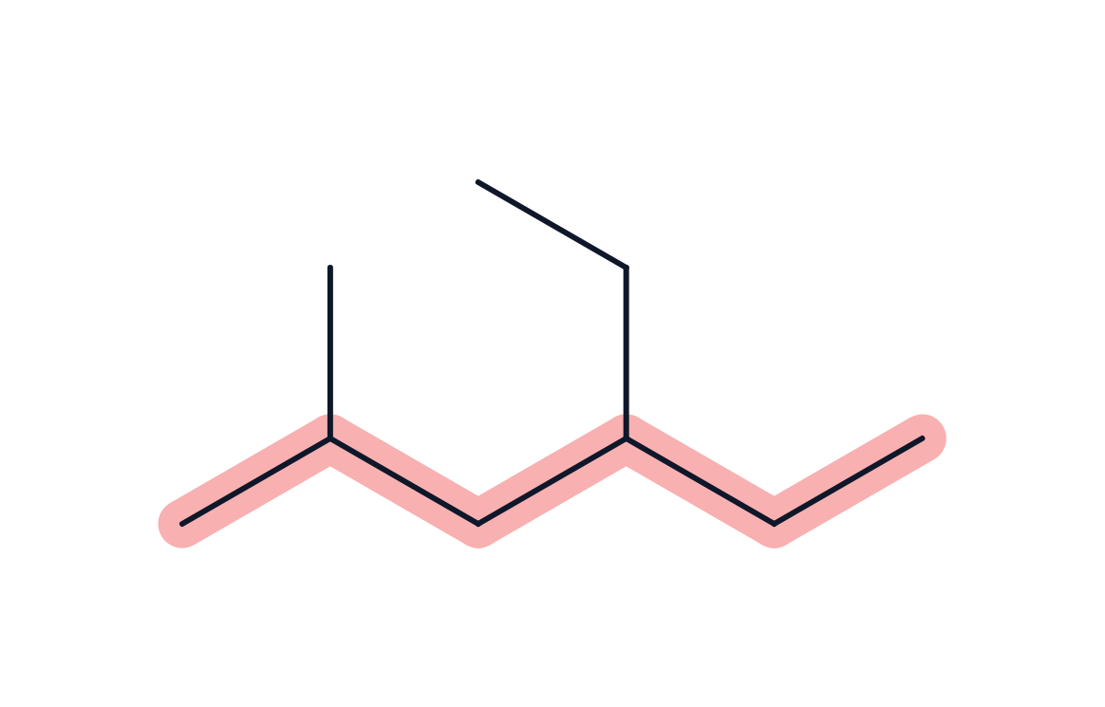
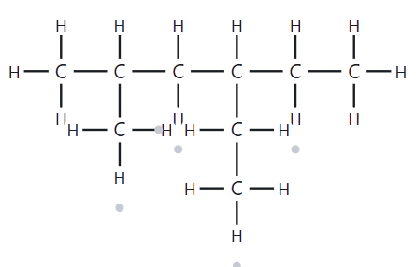
CARD A04
Level: Developing | Molecular Formula: C₉H₂₁
NUMBERED PARENT
NAMING TRAIL
Parent: Longest chain = 6C → hexane
Numbering: left → right gives 2,4; right → left gives 3,5
First point of difference: 2 < 3, so number from the left.
Substituents: Methyl on C2, Ethyl on C4 → 4-ethyl, 2-methyl
3
5
1
2
4
6
MY NAME
THE ALKANE CHECK
4-ethyl-2-methylhexane
Returned Name: 4-ethyl-2-methylhexane
LONGEST CHAIN
LOWEST LOCANTS
ALPHABETICAL ORDER
PUNCTUATION
FORMULA COUNTED

Slide 5
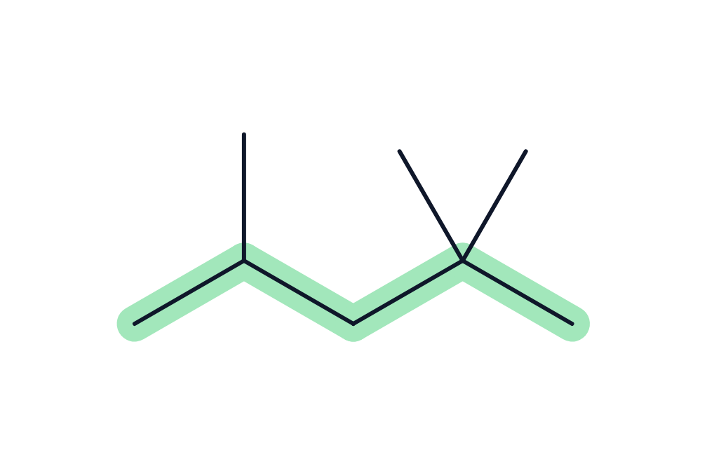
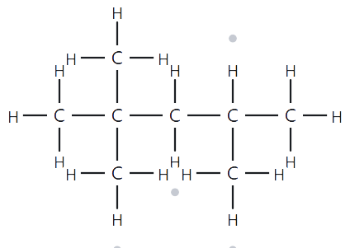
CARD A05
Level: Developing | Molecular Formula: C₈H₁₈
NUMBERED PARENT
NAMING TRAIL
Parent: Longest chain = 6C → hexane
Numbering: left → right gives 2,4,4; right → left gives 2,2,4. Second point of difference: 2 < 4, so number from the left.
Substituents: Methyl groups on C2 and C4 → 2,2,4-trimethyl
3
2
5
4
1
MY NAME
THE ALKANE CHECK
2,2,4-trimethylpentane
Returned Name: 2,2,4-trimethylpentane
LONGEST CHAIN
LOWEST LOCANTS
ALPHABETICAL ORDER
PUNCTUATION
FORMULA COUNTED

Slide 6
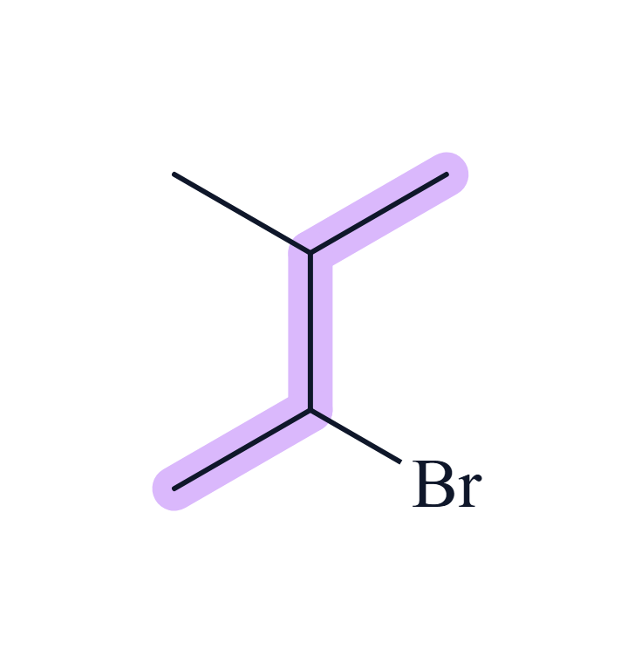
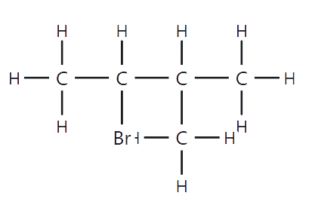
CARD A06
Level: Developing | Molecular Formula: C₅H₁₁
NUMBERED PARENT
NAMING TRAIL
4
Parent: Longest chain = 4C → butane
Numbering: bottom left → top right gives 2,3; top right → bottom left gives 2,3. Tie-breaker: alphabetical priority means bromo gets the lower number (C2) over methyl (C3).
Substituents: Bromo on C2, Methyl on C3 → 2-bromo-3-methyl
3
2
1
MY NAME
THE ALKANE CHECK
2-bromo-3-methylbutane
Returned Name: 2-bromo-3-methylbutane
LONGEST CHAIN
LOWEST LOCANTS
ALPHABETICAL ORDER
PUNCTUATION
FORMULA COUNTED

Slide 7
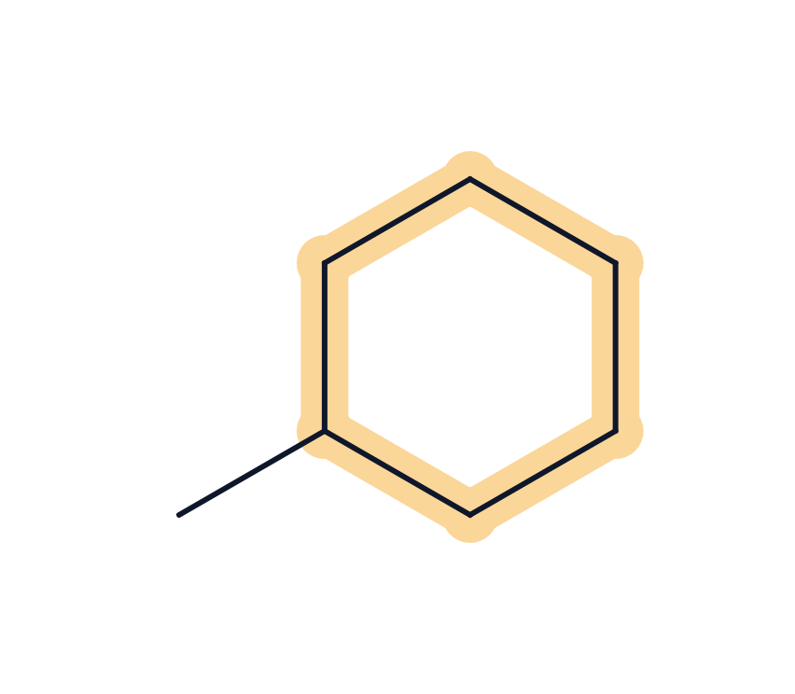
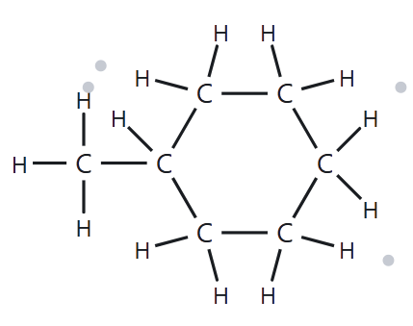
CARD A07
Level: Developing | Molecular Formula: C₇H₁₄
NUMBERED PARENT
NAMING TRAIL
2
3
4
Parent: 6C ring → cyclohexane
Numbering: With only one substituent on a ring, the attached carbon is automatically C1
Substituents: Methyl on C1 → 1-methyl
1
5
6
MY NAME
THE ALKANE CHECK
1-methylcyclohexane
Returned Name: 1-methylcyclohexane
LONGEST CHAIN
LOWEST LOCANTS
ALPHABETICAL ORDER
PUNCTUATION
FORMULA COUNTED

Slide 8
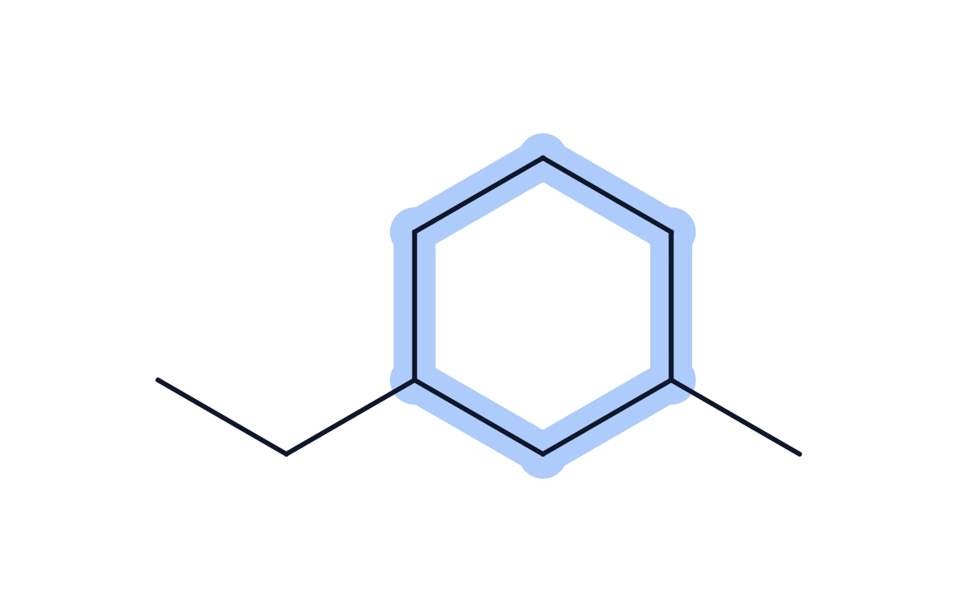
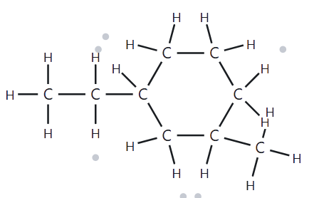
CARD A08
Level: Challenge | Molecular Formula: C₉H₁₈
NUMBERED PARENT
NAMING TRAIL
5
4
Parent: 6C ring → cyclohexane
Numbering: Always number around the ring in the direction that gives the substituents the lowest possible numbers. Start at the ethyl group (alphabetical priority over methyl) to make it C1. Number towards the methyl group to give it the lowest possible locant (C3)
Substituents: Ethyl on C1, Methyl on C3 → 1-ethyl-3-methyl
6
1
3
2
MY NAME
THE ALKANE CHECK
1-ethyl-3-methylcyclohexane
Returned Name: 1-ethyl-3-methylcyclohexane
LONGEST CHAIN
LOWEST LOCANTS
ALPHABETICAL ORDER
PUNCTUATION
FORMULA COUNTED

Slide 9
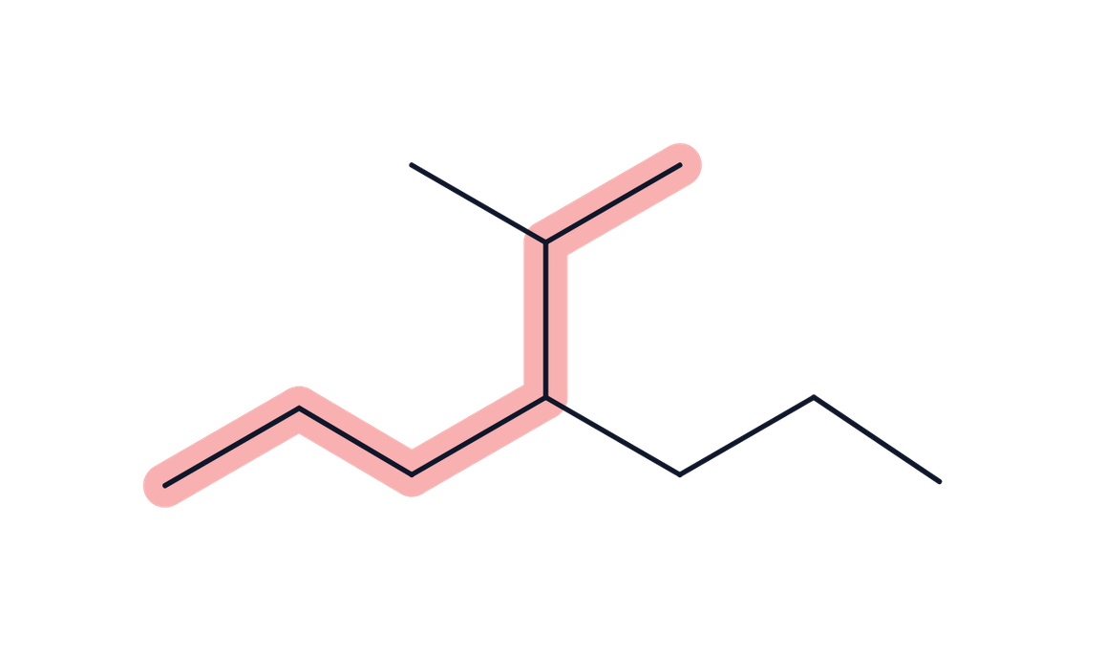
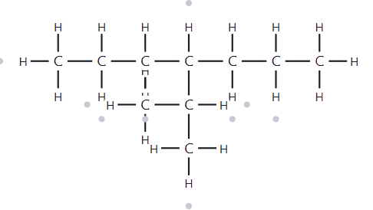
CARD A09
Level: Challenge | Molecular Formula: C₁₀H₂₂
NUMBERED PARENT
NAMING TRAIL
1
Parent: Longest chain = 6C → hexane
Numbering: Start from the top tip of the "Y" shape and trace down and to the right to give the branches the lowest possible numbers (2 and 3).
Substituents: Methyl on C2, Propyl on C3 → 2-methyl and 3-propyl
2
5
3
6
4
MY NAME
THE ALKANE CHECK
2-methyl-3-propylhexane
Returned Name: 2-methyl-3-propylhexane
LONGEST CHAIN
LOWEST LOCANTS
ALPHABETICAL ORDER
PUNCTUATION
FORMULA COUNTED

Slide 10

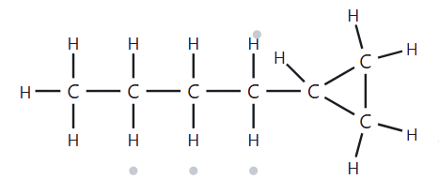
CARD A10
Level: Challenge | Molecular Formula: C₇H₁₄
NUMBERED PARENT
NAMING TRAIL
Parent: Longest chain = 5C → pentane
Numbering: left → right gives 5; right → left gives 1.
First point of difference: 1 < 5, so number from the right.
Substituents: Cyclopropyl ring on C1 → 1-cyclopropyl
4
2
5
3
1
MY NAME
THE ALKANE CHECK
1-cyclopropylpentane
Returned Name: butylcyclopropane
LONGEST CHAIN
LOWEST LOCANTS
ALPHABETICAL ORDER
PUNCTUATION
FORMULA COUNTED

Slide 11
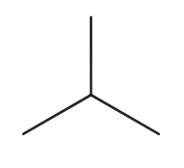
CARD B01
Level: Foundation | Given Name: 2-methylpropane
NAME DECODED
BOND LINE STRUCTURE
Parent: propane → 3C
Substituents: Methyl on C2
Expected Formula: 3 + 1 = 4C; alkane → C₄H₁₀
FORMULA CHECK
BACK CHECK
Counted from the drawing: C₄H₁₀
Alkane: CₙH₂ₙ₊₂ = C₄H₁₀ ✓
Returned by The Alkane: 2-methylpropane
Same as given name ✓
PARENT LENGTH MATCH
SUBSTITUENT POSITION MATCH
FORMULA AGREE
BACK CHECK RECORDED

Slide 12
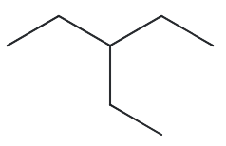
CARD B02
Level: Foundation | Given Name: 3-ethylpentane
NAME DECODED
BOND LINE STRUCTURE
Parent: pentane → 5C
Substituents: Ethyl on C3
Expected Formula: 5 + 2 = 7C; alkane → C₇H₁₆
FORMULA CHECK
BACK CHECK
Counted from the drawing: C₇H₁₆
Alkane: CₙH₂ₙ₊₂ = C₇H₁₆ ✓
Returned by The Alkane: 3-ethylpentane
Same as given name ✓
PARENT LENGTH MATCH
SUBSTITUENT POSITION MATCH
FORMULA AGREE
BACK CHECK RECORDED

Slide 13
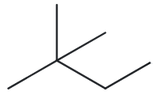
CARD B03
Level: Foundation | Given Name: 2,2-dimethylbutane
NAME DECODED
BOND LINE STRUCTURE
Parent: butane → 4C
Substituents: Two methyl groups on C2
Expected Formula: 4 + 2 = 6C; alkane → C₆H₁₄
FORMULA CHECK
BACK CHECK
Counted from the drawing: C₆H₁₄
Alkane: CₙH₂ₙ₊₂ = C₆H₁₄ ✓
Returned by The Alkane: 2,2-dimethylbutane
Same as given name ✓
PARENT LENGTH MATCH
SUBSTITUENT POSITION MATCH
FORMULA AGREE
BACK CHECK RECORDED

Slide 14
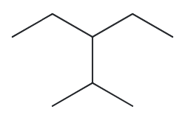
CARD B04
Level: Developing | Given Name: 3-ethyl-2-methylpentane
NAME DECODED
BOND LINE STRUCTURE
Parent: pentane → 5C
Substituents: Ethyl on C3, Methyl on C2
Expected Formula: 5 + 2 + 1 = 8C; alkane → C₈H₁₈
FORMULA CHECK
BACK CHECK
Counted from the drawing: C₈H₁₈
Alkane: CₙH₂ₙ₊₂ = C₈H₁₈ ✓
Returned by The Alkane: 3-ethyl-2-methylpentane
Same as given name ✓
PARENT LENGTH MATCH
SUBSTITUENT POSITION MATCH
FORMULA AGREE
BACK CHECK RECORDED

Slide 15
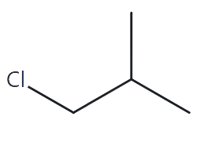
CARD B05
Level: Developing | Given Name: 1-chloro-2-methylpropane
NAME DECODED
BOND LINE STRUCTURE
Parent: propane → 3C
Substituents: Chloro on C1, Methyl on C2
Expected Formula: 3 + 1 = 4C; alkane → C₄H₁₀; Cl replaces one H → C₄H₉Cl
FORMULA CHECK
BACK CHECK
Counted from the drawing: C₄H₉Cl
Alkane: CₙH₂ₙ₊₂ = C₄H₁₀; minus one H for Cl = C₄H₉Cl ✓
Returned by The Alkane: 1-chloro-2-methylpropane
Same as given name ✓
PARENT LENGTH MATCH
SUBSTITUENT POSITION MATCH
FORMULA AGREE
BACK CHECK RECORDED

Slide 16
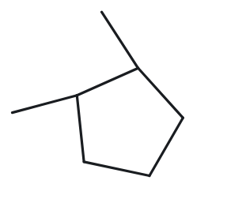
CARD B06
Level: Developing | Given Name: 1,2-dimethylcyclopentane
NAME DECODED
BOND LINE STRUCTURE
Parent: cyclopentane → 5C ring
Substituents: Methyl on C1, C2
Expected Formula: 5 + 2 = 7C; one ring → C₇H₁₄
FORMULA CHECK
BACK CHECK
Counted from the drawing: C₇H₁₄
One ring: CₙH₂ₙ = C₇H₁₄ ✓
Returned by The Alkane: 1,2-dimethylcyclopentane
Same as given name ✓
PARENT LENGTH MATCH
SUBSTITUENT POSITION MATCH
FORMULA AGREE
BACK CHECK RECORDED

Slide 17
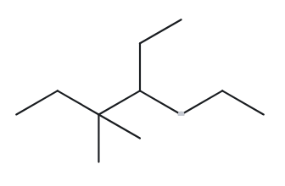
CARD B07
Level: Developing | Given Name: 4-ethyl-3,3-dimethylheptane
NAME DECODED
BOND LINE STRUCTURE
Parent: heptane → 7C
Substituents: Ethyl on C4, two methyl on C3
Expected Formula: 7 + 2 + 2 = 11C;
alkane → C₁₁H₂₄
FORMULA CHECK
BACK CHECK
Counted from the drawing: C₁₁H₂₄
Alkane: CₙH₂ₙ₊₂ = C₁₁H₂₄ ✓
Returned by The Alkane: 4-ethyl-3,3-dimethylheptane
Same as given name ✓
PARENT LENGTH MATCH
SUBSTITUENT POSITION MATCH
FORMULA AGREE
BACK CHECK RECORDED

Slide 18
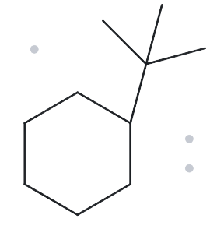
CARD B08
Level: Challenge | Given Name: tert-butylcyclohexane
NAME DECODED
BOND LINE STRUCTURE
Parent: cyclohexane → 6C ring
Substituents: tert butyl group on C1
Expected Formula: 6 + 4 = 10C; one ring → C₁₀H₂₀
FORMULA CHECK
BACK CHECK
Counted from the drawing: C₁₀H₂₀
One ring: CₙH₂ₙ = C₁₀H₂₀ ✓
Returned by The Alkane: (1,1-dimethylethyl)cyclohexane
Same as given name ✓
PARENT LENGTH MATCH
SUBSTITUENT POSITION MATCH
FORMULA AGREE
BACK CHECK RECORDED

Slide 19
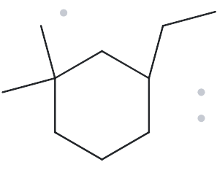
CARD B09
Level: Challenge | Given Name: 3-ethyl-1,1- dimethylcyclohexane
NAME DECODED
BOND LINE STRUCTURE
Parent: cyclohexane → 6C ring
Substituents: Ethyl on C3, two Methyl on C1
Expected Formula: 6 + 2 + 2 = 10C;
one ring → C₁₀H₂₀
FORMULA CHECK
BACK CHECK
Counted from the drawing: C₁₀H₂₀
One ring: CₙH₂ₙ = C₁₀H₂₀ ✓
Returned by The Alkane: 3-ethyl-1,1- dimethylcyclohexane
Same as given name ✓
PARENT LENGTH MATCH
SUBSTITUENT POSITION MATCH
FORMULA AGREE
BACK CHECK RECORDED

Slide 20
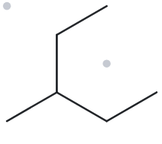
CARD B10
Level: Challenge | Given Name: 2-ethylbutane
NAME DECODED
BOND LINE STRUCTURE
Parent: butane → 4C
Substituents: Ethyl on C2
Expected Formula: 4 + 2 = 6C; alkane → C₆H₁₄
FORMULA CHECK
BACK CHECK
Counted from the drawing: C₆H₁₄
Alkane: CₙH₂ₙ₊₂ = C₆H₁₄ ✓
Returned by The Alkane: 3-methylpentane
Same as given name ✓
PARENT LENGTH MATCH
SUBSTITUENT POSITION MATCH
FORMULA AGREE
BACK CHECK RECORDED

