Slide 1
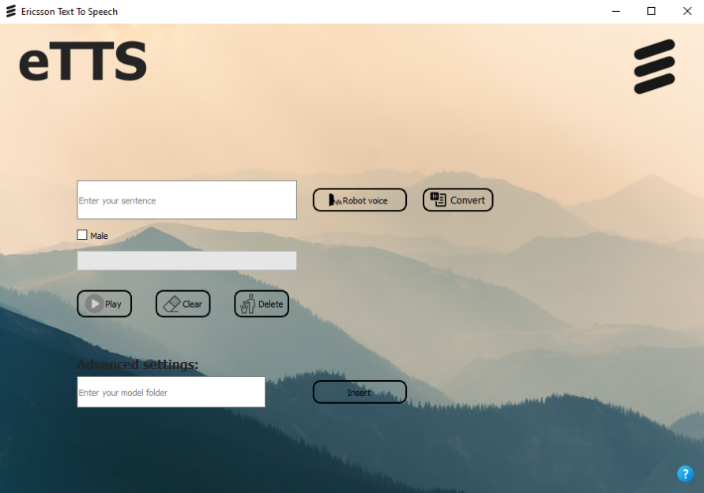
Ericsson Nikola Tesla Text – To – Speech
Our goal
Making the first steps towards Croatian TTS
Creating a prototype app with basic capabilities
Record small dataset for training the model
Motivation
For the Croatian-speaking area, there are several solutions for text-to-speech, all of which are owned by foreign companies. The need for such a tool has long been recognized, and the benefits of the TTS application are diverse and applicable in a wide variety of fields.
Project team
Matija Šantek
Vjeko Glibota
Andre Garašić
Ivana Galić
Mentor(s)
Snježana Draženović Đoja
Mateo Majstorović
Ericsson Nikola Tesla Summer Camp 2021

