Slide 1
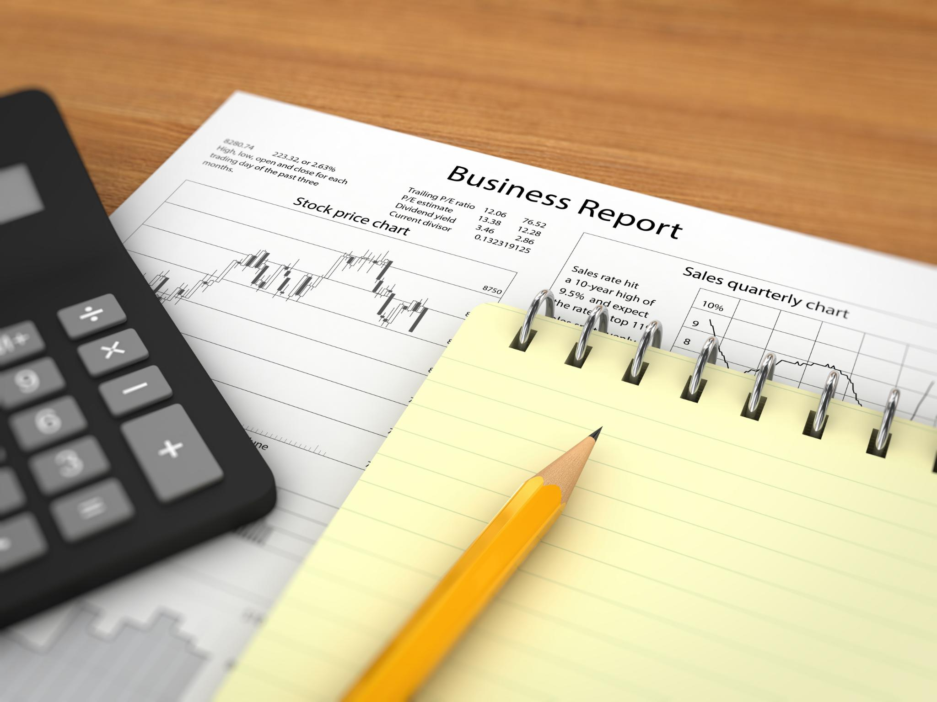
Career Development Workshop Series Part 1: Self-awareness in Career Development
Author & Presenter: Ivana Jones
Notes:
AI-generated content may be incorrect. Welcome to Part 1 of our Career Development Workshop Series! In this session, we will focus on how to build self-awareness, a crucial skill in career development.

Slide 2
Icebreaker Activity
Value | Description
$75 Friendship | Having strong connections, loyalty, and support from friends.
$75 Adventure | Having new experiences and fun activities.
$75 Creativity | Having opportunities for self-expression and artistic ideas.
$75 Family | Having supportive family relationships.
$75 Freedom | Having independence and the ability to make choices.
$75 Knowledge | Having a focus on education and understanding the world.
$75 Health | Having a priority on physical fitness and mental well-being.
$75 Success | Having a focus on achievement in school and personal goals.
$75 Balance | Having harmony between school, hobbies, and fun.
$75 Confidence | Having belief in oneself and embracing individuality.
$75 Change | Having novel experiences, sharing new ideas, and adapting to challenges.
$75 Justice | Having a commitment to fairness and equality.
$75 Perseverance | Having determination to overcome obstacles and keep going.
$75 Empathy | Having the ability to understand and share others’ feelings.
$75 Gratitude | Having appreciation for what you have and those around you.
Notes:
An icebreaker activity is a great way to get started and build a positive and collaborative atmosphere. In this exercise, we will auction off $75 among our personal values.

Slide 3
Icebreaker Activity
Value | Description
$25 Friendship | Having strong connections, loyalty, and support from friends.
$25 Adventure | Having new experiences and fun activities.
$25 Creativity | Having opportunities for self-expression and artistic ideas.
$25 Family | Having supportive family relationships.
$25 Freedom | Having independence and the ability to make choices.
$25 Knowledge | Having a focus on education and understanding the world.
$25 Health | Having a priority on physical fitness and mental well-being.
$25 Success | Having a focus on achievement in school and personal goals.
$25 Balance | Having harmony between school, hobbies, and fun.
$25 Confidence | Having belief in oneself and embracing individuality.
$25 Change | Having novel experiences, sharing new ideas, and adapting to challenges.
$25 Justice | Having a commitment to fairness and equality.
$25 Perseverance | Having determination to overcome obstacles and keep going.
$25 Empathy | Having the ability to understand and share others’ feelings.
$25 Gratitude | Having appreciation for what you have and those around you.
Notes:
An icebreaker activity is a great way to get started and build a positive and collaborative atmosphere. In this exercise, we will auction off $75 among our personal values.

Slide 4

Defining Self-Awareness
Self-Awareness
The ability to recognize and understand our own thoughts, feelings, and behaviors. Having a clear understanding of your own strengths, weaknesses, values, and motivations. Truly know why you do the things you do and what’s important to you.
Benefits of Self-Awareness in Career Development
Identifying Your Career Path
Preparing for Interviews
Crafting Your Elevator Pitch
Connecting with Coworkers and Peers
Self-Improvement
Staying True to Yourself
Notes:
Self-awareness is crucial in career development, as it helps us make informed decisions about our professional and personal lives. Understanding our strengths and values can lead to job satisfaction, higher productivity, and a sense of fulfillment.

Slide 5
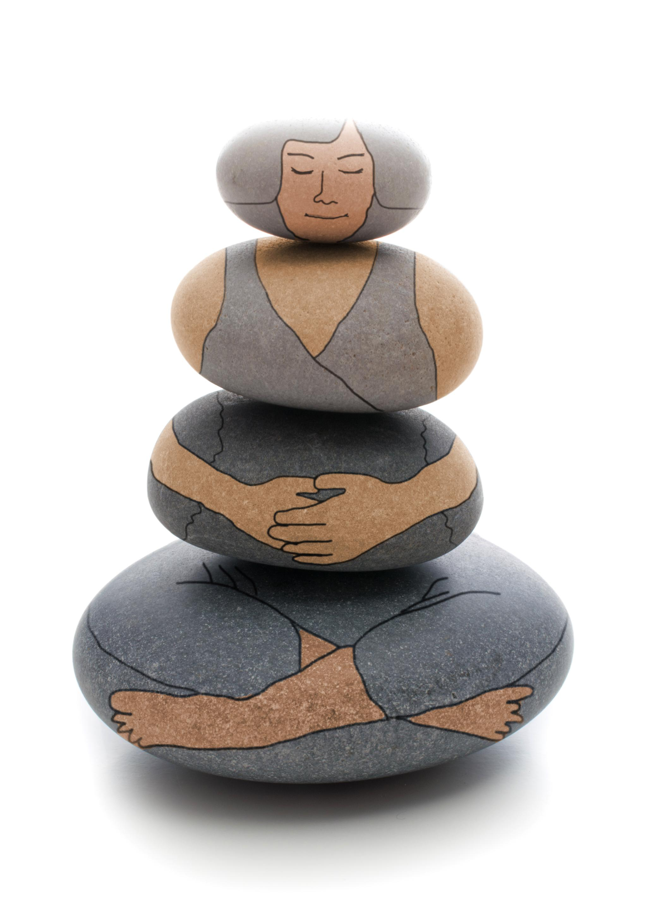
Self-Awareness in Personal and Professional Life
Better Decision-Making
Self-awareness can lead to better decision-making by helping individuals understand their own values, biases, and priorities, which can guide them toward making more informed and effective choices.
Improved Communication
Self-awareness can improve communication by helping individuals understand their own communication style and how it may be perceived by others. It can also help individuals be more empathetic and understanding when communicating with others.
Emotional Intelligence
Self-awareness can improve emotional intelligence by helping individuals understand their own emotions and how they impact their thoughts, behaviors, and relationships. It can also help individuals regulate their emotions and respond to others with empathy and compassion.
Personal Growth
Self-awareness can promote personal growth by helping individuals identify their strengths and weaknesses and develop strategies for self-improvement. It can also help individuals set goals and achieve them, leading to a sense of purpose and fulfillment.
Notes:
Self-awareness can bring several benefits in personal and professional life. It can lead to better decision-making, improved communication, and enhanced relationships. It can also improve emotional intelligence, increase resilience, and promote personal growth.

Slide 6
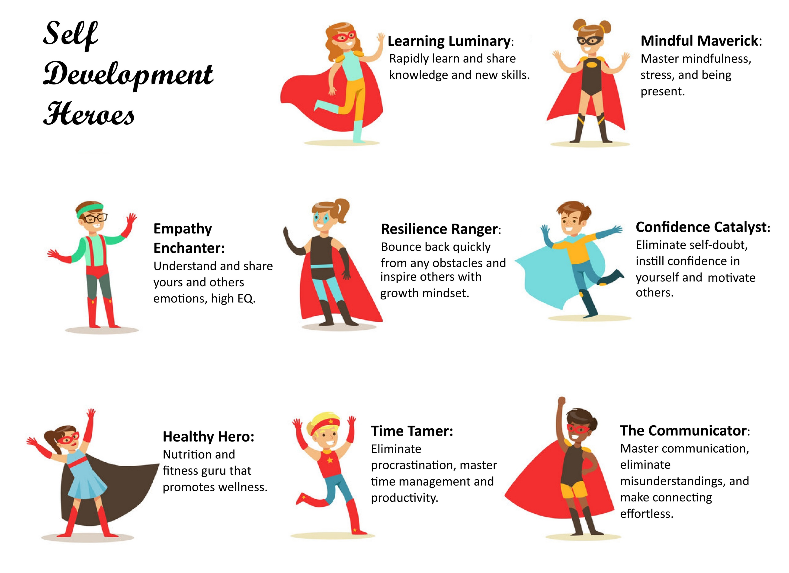
Self-Development & Personal Growth
Self-Development:
The ongoing process of improving yourself in various aspects, such as skills, knowledge, mindset, and behaviors. Self-awareness is a necessary first step to identify meaningful personal goals and take intentional actions to achieve them.
Benefits of Growth
Self-development focuses on intentional growth and enhancing your ability to achieve goals, overcome challenges, and improve your overall quality of life. The results include positive mindset, increased confidence, greater resilience, and deeper fulfillment.
Notes:
Self-awareness is crucial in career development, as it helps us make informed decisions about our professional and personal lives. Understanding our strengths and values can lead to job satisfaction, higher productivity, and a sense of fulfillment.

Slide 7
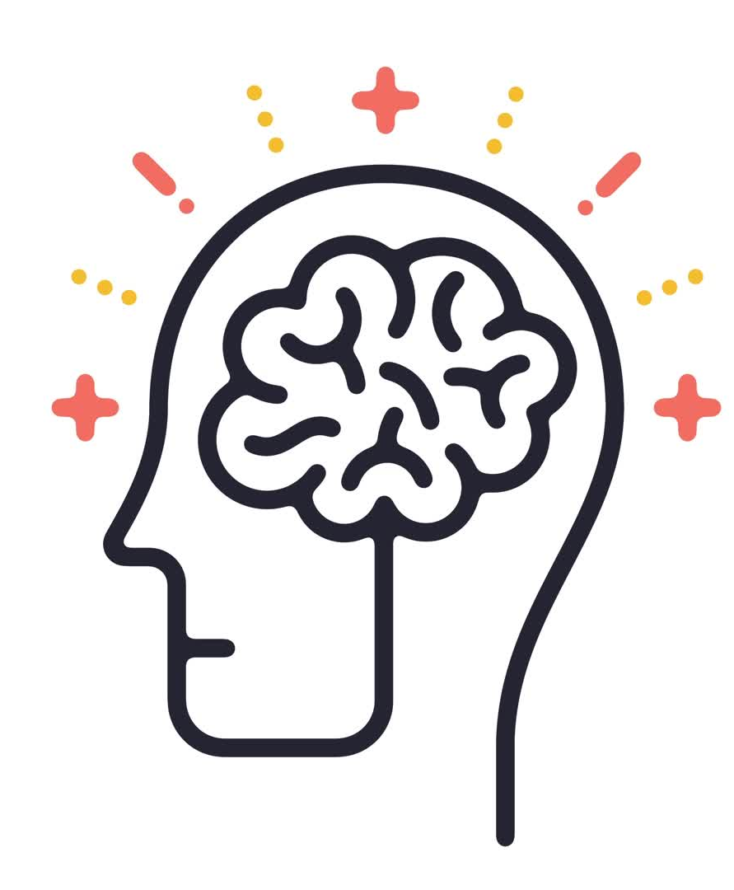
Identifying Limiting Beliefs
Definition of Limiting Beliefs
Limiting beliefs are negative beliefs that hold us back from our potential often formed in response to negative experiences, childhood experiences, or feedback from others. They may result in negative self-talk, self-doubt, self-sabotage, or low self-esteem. Self-awareness is a necessary first step to identify how you’re holding yourself back with limiting beliefs.
Examples
"I’m not good or smart enough; everyone else is better or smarter than me."
"I don’t deserve success or good things."
"No matter how hard I work, I will just fail again."
Challenging Limiting Beliefs
Overcoming limiting beliefs involves identifying and confronting negative self-talk, seeking constructive feedback from others, and taking action despite uncertainty. Self-awareness is essential for examining these beliefs, gaining clarity, and building confidence. Additionally, affirmations can help reframe limiting beliefs into a growth mindset by promoting positive self-talk and encouragement.
Notes:
Tools for uncovering subconscious beliefs include therapy, hypnosis, or guided meditations. These tools can help you access and challenge deeply ingrained beliefs.

Slide 8
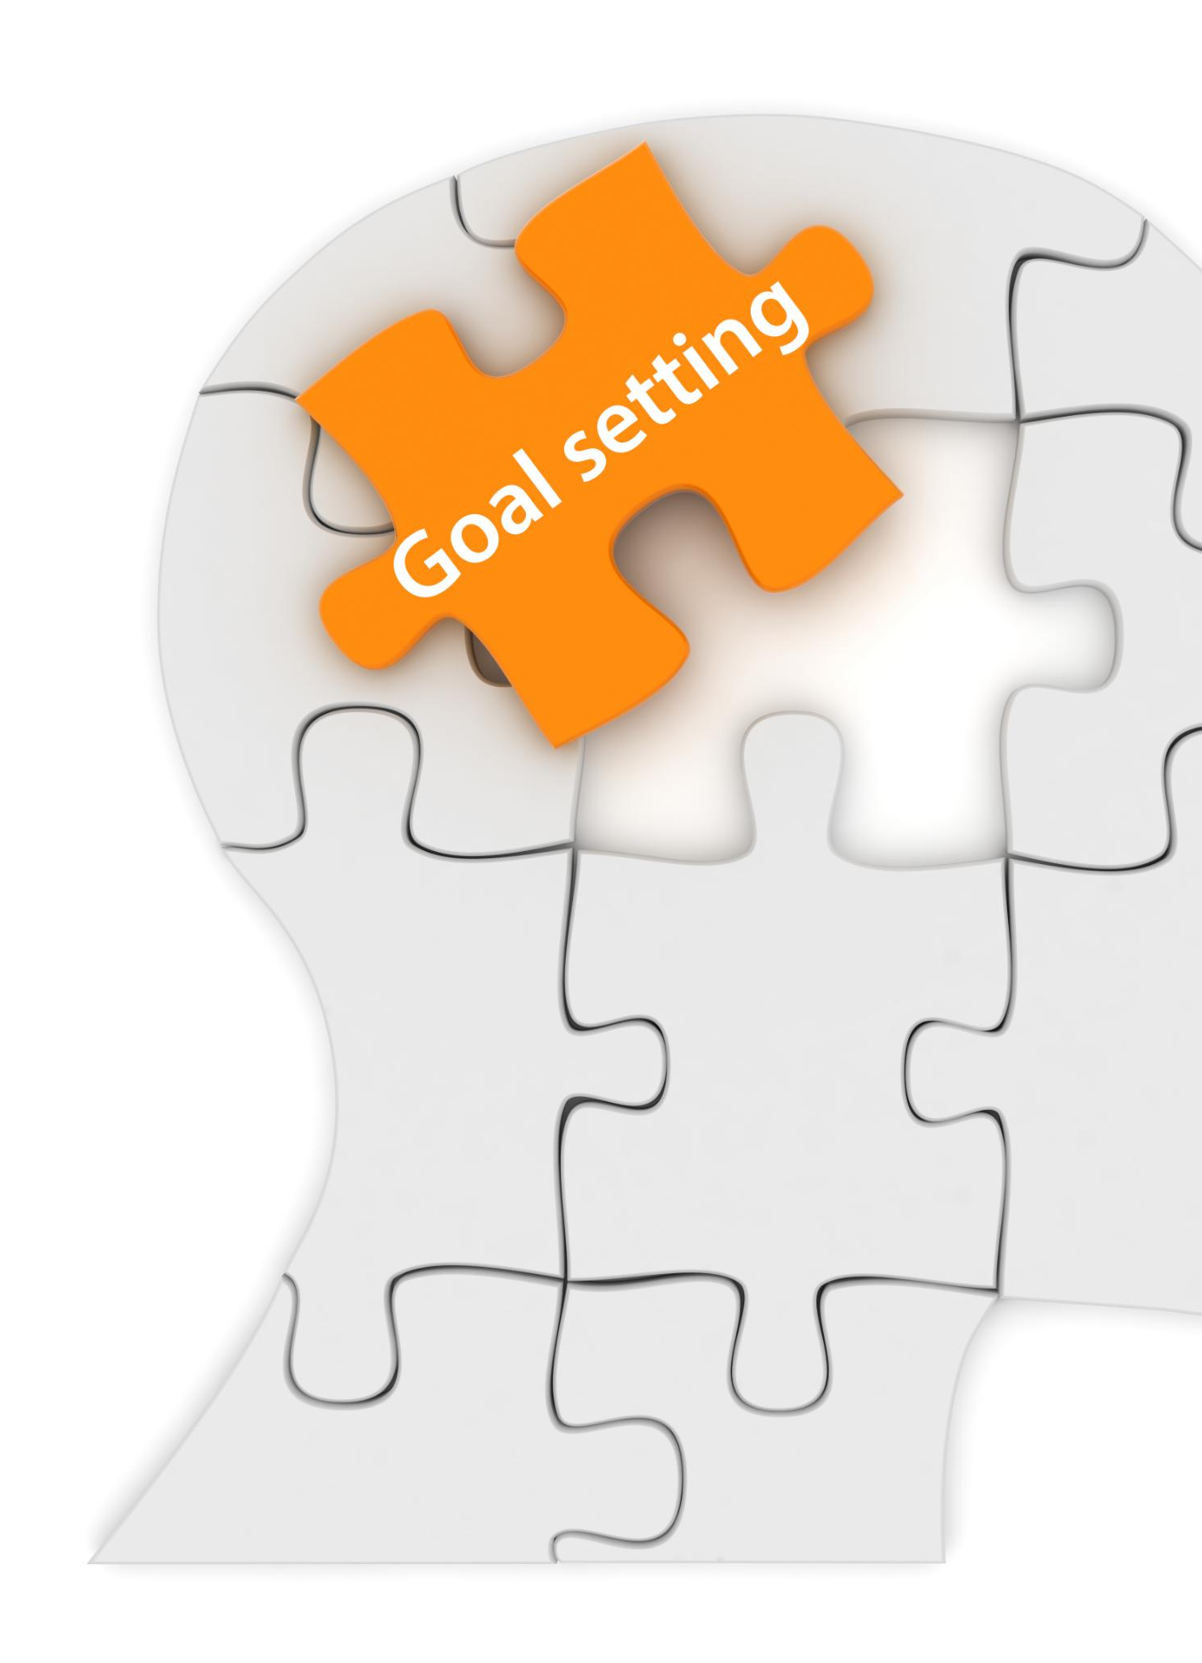
Self-Esteem
Impact of Self-Esteem on Behavior
Self-esteem refers to how we feel about ourselves overall. It is shaped by our upbringing, life experiences, caregivers, and cultural norms and beliefs. Self-esteem plays a significant role in how we interact with others and make decisions, influencing our confidence and actions in various situations.
Self-Esteem and Career Development
A person’s self-esteem can greatly impact their career choices, often due to self-limiting beliefs. It affects how confident we feel in unfamiliar environments and whether we can be resilient when faced with challenges or discomfort. A strong sense of self-esteem can empower us to pursue new opportunities, not get intimidated by new environments, and take on greater responsibilities.
Improving self-esteem
Identify and Leverage Your Strengths: Recognize the unique qualities and talents you bring to the table.
Invest in Learning: Continuously improve your skills and knowledge.
Embrace Challenges: Push yourself outside your comfort zone by taking on new projects or responsibilities.
Track Your Achievements: Keep a record of your accomplishments, no matter how small. Don’t downplay them or compare them to others. When faced with setbacks, refer to this list as a reminder of your capabilities and growth.
Notes:
Several factors impact self-esteem, including upbringing, experiences, and culture. Examining these factors can help us understand our self-esteem and how to improve it.

Slide 9

Boundaries
Definition of Boundaries
Boundaries are limits or guidelines we establish to define what is acceptable behavior for ourselves and others. They help us communicate our needs, desires, and expectations, while also respecting those of others.
How to Set Boundaries
Having self-awareness of your personal limits is crucial for setting effective boundaries. Healthy boundaries are communicated calmly, clearly, and respectfully. Compromise and negotiation are okay, but never abandon your boundary. Consequences from not setting boundaries include burnout and exhaustion, frustration and resentment, and neglecting self-care.
Identifying Boundary Pushers
Identifying boundary violations involves recognizing when our boundaries have been crossed. Including felling uncomfortable saying “No”, being disrespected or not listened to, or feeling taken advantage of.
If this happens repeatedly then you are dealing with a boundary pusher that prioritizes their needs over yours. They may test your limits, convince you to change your mind, argue against your reasons, react negatively to you prioritizing yourself, or pretend to listen and pretend to apologize and then disregard the boundary again later.
Handling Boundary Pushers
Dealing with boundary pushers is not easy. You have to remain assertive and consistently reinforce your boundaries. You have to set clear consequences for violating your boundaries, such as limiting their access to you. Seek support from loved ones or professionals if needed.
Notes:
Boundaries are limits that we set for ourselves and others to define what is acceptable behavior and what is not. They are crucial for maintaining healthy relationships, promoting self-care, and protecting our emotional and physical well-being.

Slide 10
Boundaries
Response Scripts to Practice:
“I’ve mentioned before that I feel drained when you do this. Can you please stop? If this continues, we won’t be interacting as frequently.”
“I’m sorry to hear you feel that way, but that doesn’t change where I stand. Arguing is not going to be productive because I’ve already made up my mind about what I need to do.”
“I’m not happy with how things are going. This isn’t meeting my needs or expectations, and it feels like you don’t care about that. If that doesn’t change, we won’t be able to continue as things are.”
“I’ve noticed that the workload feels uneven, and I’m taking on most of the heavy lifting. To avoid resentment and burnout, we need to distribute the labor and contributions more fairly so I can feel supported as well.”
“This is something that is not my responsibility, and I feel like you’re placing the burden on me. I need to focus on myself first so I can’t support you with this. We can revisit how I can offer support in a different way.”
Notes:
Boundaries are limits that we set for ourselves and others to define what is acceptable behavior and what is not. They are crucial for maintaining healthy relationships, promoting self-care, and protecting our emotional and physical well-being.

Slide 11

Self-Awareness in Choosing a Fulfilling Career
Analyze Job Responsibilities
Analyze job responsibilities to determine if they align with your career goals. Do you want to work in a team or individually? Do you want to travel or work remotely? These factors impact your job satisfaction.
Intrinsic Motivation
Self-awareness helps you identify what excites and energizes you—whether it’s solving problems, leading teams, or making a difference.Intrinsic motivations come from an individual's internal desires and values, and are more likely to lead to personal satisfaction and long-term success in a career.
Avoiding Career Burnout
A mismatch between your career and your values often leads to frustration, dissatisfaction, and burnout. By ensuring your career is in sync with your values, you’re less likely to experience these negative outcomes. Choosing a career that complements your passions and values supports overall life fulfillment.
Notes:
Having self-awareness allows you to identify your values and motivations, which in turn can help you choose a career in alignment with those values. When you are working in a job that aligns with your values, you are more likely to enjoy your work and feel fulfilled. Research has shown that job satisfaction is linked to greater happiness and overall life satisfaction. By taking the time to develop self-awareness, you can improve your chances of finding a fulfilling career.

Slide 12

Self-Reflection & Tools
Self-Reflection
Self-reflection is a practice to build self-awareness. It involves taking time to thoughtfully examine your own thoughts, feelings, behaviors, and experiences in order to gain deeper insights into who you are. Practicing regularly will uncover insights you may not have noticed.
Journaling
Keeping a reflective journal can help track your thoughts and experiences over time. It’s a powerful way to gain insights into your feelings and behaviors..
Assessments
Tools like Myers-Briggs or DISC can provide valuable insights into your personality traits and how they impact your work style and which careers work well with it.
Seeking Feedback
Constructive feedback from peers and mentors is crucial. It helps you identify blind spots and gain perspective on your strengths and areas for growth.
Notes:
Journaling is a powerful tool for self-reflection, as it helps you identify your feelings, thoughts, and experiences. By reflecting on your journal entries, you can gain insight into your values and motivations.

Slide 13
Tools for Self-Reflection
Benefits of Personality Assessments
Personality assessments can help individuals gain insight into their strengths, weaknesses, and interests. This can be helpful in identifying career paths that are in line with their personality traits and interests.
Free ones: https://www.16personalities.com/, https://www.truity.com/test/disc-personality-test, https://www.viacharacter.org/, https://www.truity.com/test/big-five-personality-test
Benefits of Career Tests
Career tests can help individuals identify their strengths and interests. This can help them make informed decisions about their future career paths and find the career that is most suitable for them.
Free ones: https://www.princetonreview.com/quiz/career-quiz, https://www.mynextmove.org/explore/ip, https://www.careerexplorer.com/, https://www.truity.com/test/career-personality-profiler-test
Notes:
Journaling is a powerful tool for self-reflection, as it helps you identify your feelings, thoughts, and experiences. By reflecting on your journal entries, you can gain insight into your values and motivations.

Slide 14

Activity: Self-Assessment Exercise
Core Values
Strengths & Weaknesses
Energizers
Key Experiences and Lessons Learned
Reflection
Next Part: Part 2 - Exploring Career Options
Notes:
In this step, we will guide you through identifying your personal values and how they relate to your career goals.

