Slide 1

Part 5: Your Paycheck and Financial Literacy
The Basics of Managing Your Money
Author & Presenter: Ivana Jones
Notes:
AI-generated content may be incorrect. In this presentation, we will discuss the basics of financial literacy, including understanding salary, salary negotiation, employee benefits and taxes, personal budgeting, retirement planning, credit and emergency savings, and financial goal setting.

Slide 2

Gross Vs. Net Salary
Gross Salary
Gross salary is your total pay you agreed to in your employment contract. A fixed amount earned per year.
Net Salary
Net salary is your take-home pay after deductions have been taken out of your gross salary. It is the amount you actually receive in your bank account.
Deductions
Deductions are the amounts taken out of your paycheck, including taxes, social security, retirement contributions, health insurance, and other benefits. Understanding your deductions can help you better manage your finances and budget.
Notes:
Gross salary is the amount you earn before any deductions, while net salary is the amount you take home after taxes and other deductions are taken out. It's important to understand both to help manage your finances and budget.

Slide 3

Salary Vs. Hourly Compensation
Salary
Advantages include financial stability, predictable income and benefits, while disadvantages include limited flexibility and fewer opportunities for overtime pay.
Hourly Compensation
Advantages include flexibility and higher opportunities for additional pay through overtime hours, while disadvantages include income instability and fewer benefits.
Pay Periods
Pay periods determine how often you receive your paycheck, whether it's weekly, bi-weekly or monthly. It is important to understand your pay period to effectively manage your finances and budget.
Notes:
Salary is a fixed amount you earn each year, while hourly compensation is based on the number of hours you work. It's important to understand the differences and how they can affect your finances.

Slide 4

Salary Vs. Hourly Compensation
Scenario 1: You are offered a weekly wage of $800 before taxes (gross salary). Your tax rate is 20%. Scenario 2: You are offered a monthly salary of $3,200 before taxes (gross salary). Your tax rate is also 20%.
Question: Which scenario provides more take-home pay?
Notes:
Salary is a fixed amount you earn each year, while hourly compensation is based on the number of hours you work. It's important to understand the differences and how they can affect your finances.

Slide 5
Salary Vs. Hourly Compensation
Scenario 1: You are working full-time at a job that pays $15 per hour. You work 40 hours per week. Your tax rate is 15%. Scenario 2: You are offered a salaried job paying $45,000 per year before taxes. The tax rate is 20%.
Question: Which scenario gives you a higher take-home pay per month?
Notes:
Salary is a fixed amount you earn each year, while hourly compensation is based on the number of hours you work. It's important to understand the differences and how they can affect your finances.

Slide 6
Salary Vs. Hourly Compensation
Scenario 1: You are working full-time at a job that pays $15 per hour. You work 40 hours per week. You decide to work 10 hours of overtime (paid at 1.5 times the normal rate). Your tax rate is 15%. Scenario 2: You are offered a salaried job paying $45,000 per year before taxes. The tax rate is 20%.
Question: Which scenario gives you a higher take-home pay for the first month?
Notes:
Salary is a fixed amount you earn each year, while hourly compensation is based on the number of hours you work. It's important to understand the differences and how they can affect your finances.

Slide 7

Salary Negotiation
Importance of Salary Research
Researching salaries in your industry helps you determine a fair salary range and gives you leverage in negotiations with your employer. It also helps you identify areas for career growth and development.
Knowing When to Negotiate
You don’t always have to accept the first offer. If you have extra experience or specialized skills, you’re in a stronger position to negotiate. If you’ve done your research and the offer is below the average salary for the role or your location, it’s a good idea to ask for more.
Be Prepared to Justify Your Request
When negotiating your salary, be prepared to explain why you deserve a higher salary. You need to come backed with the research you’ve done.
Consider Non-Salary Benefits
When negotiating your salary, consider other benefits that may be negotiable, such as vacation time, flexible hours, or work-from-home options. These benefits could be just as valuable as a higher salary.
Notes:
Negotiating your salary can be intimidating, but there are tips and strategies you can use to ensure a successful negotiation. We will discuss some negotiation tactics to help you get the salary you deserve.

Slide 8

Salary Withholdings
Employee benefits can include things like health insurance, retirement plans, and paid time off, among others. It's important to understand the different types of benefits and which ones are withheld from your paycheck.
Tax withholding is the amount of money your employer withholds from your paycheck to pay federal and state taxes. It's important to understand how much is being withheld to avoid any surprises come tax season. You do not want to owe the IRS – ever.
Notes:
Employee benefits can include things like health insurance, retirement plans, and paid time off. It's important to understand what benefits your employer offers and how to make the most of them.

Slide 9


Employee Benefits
Health Insurance
This is one of the most important benefits to consider. Ensure that the plan covers your medical needs, and compare the cost of premiums, deductibles, and out-of-pocket expenses.
Retirement Contributions (401k)
Many employers offer retirement savings plans like a 401k. Some even match a percentage of what you contribute. Take full advantage of this! It’s essentially free money.
Paid Time Off (PTO)
This can include vacation days, sick days, and holidays. Ensure you understand how much time off you’re entitled to, and whether there’s flexibility to take it when needed.
Notes:
Taxes are an inevitable part of earning income. We will discuss how taxes work and how they can affect your paycheck and overall finances.

Slide 10
Taxes
Taxation
Taxes are a way for the government to collect revenue from its citizens and businesses to fund public services and programs. Taxes can affect your paycheck by reducing your take-home pay. The amount of tax you pay depends on your income and tax bracket. It is important to understand how taxes work to plan your finances.
Types of Taxes
There are different types of taxes, including federal income tax, state income tax, social security tax, medicare tax, property tax, and other payroll taxes. The more you make the higher your tax rate.
Tax Filing
Each year, you’ll file a tax return (usually by April 15th). This is where you report your income, deductions, and credits to determine if you owe additional taxes or if you’re entitled to a refund.
Notes:
Taxes are an inevitable part of earning income. We will discuss how taxes work and how they can affect your paycheck and overall finances.

Slide 11
Example Breakdown of a Paycheck
Let’s say you earn $3,000 in gross pay for the month.
Here’s an example of how your paycheck might break down with typical deductions:
Type of Deduction | Amount
Federal Income Tax | $300
State Income Tax | $150
Social Security Tax (6.2%) | $186
Medicare Tax (1.45%) | $43.50
Net Pay (Take-home) | $2,320.50 (-22.6%)
Federal Income Tax: Levied by the U.S. government based on income level.
State Income Tax: Varies by state, not all states have it.
Local Income Tax: Imposed by some cities or counties.
Social Security Tax: Helps fund Social Security benefits (6.2%).
Medicare Tax: Funds Medicare healthcare (1.45% + 0.9% for high earners).
Other Payroll Taxes: Includes things like disability, unemployment insurance, and workers’ comp.
Type of Deduction | Amount
Health Insurance Premium | $150
401(k) Retirement Contribution | $120
Life Insurance Premium | $25
Net Pay (Take-home) | $2,025.50 (-32.5%)
Notes:
Tax withholding is the amount of money your employer withholds from your paycheck to pay federal and state taxes. It's important to understand how much is being withheld to avoid any surprises come tax season.

Slide 12
Importance of Budgeting
Living Within Your Means
Budgeting helps you live within your means by tracking your income and expenses. This enables you to make informed financial decisions and avoid debt.
Achieving Financial Goals
Budgeting helps you prioritize your spending and allocate resources towards achieving your financial goals. This can include saving for retirement, buying a house, or going on a vacation.
Needs vs Wants
Needs are essential expenses that are necessary to survive, such as housing, utilities, and food. These expenses should be prioritized over wants. Wants are not necessary for survival and should be limited and controlled.
Notes:
Budgeting helps you live within your means, avoid debt, and save for the future. It also helps you prioritize your spending and achieve your financial goals.

Slide 13

Long-term Goals
Long-term Goals
Setting aside money for long-term goals, such as buying a house or paying for college tuition, is a key savings strategy. It can help you achieve your financial goals and build wealth over time.
Emergency Fund
An emergency fund is to help cover unexpected expenses such as medical bills, car repairs, or job loss. Calculate your monthly expenses then aim to save monthly until you have at least three months' worth of expenses saved. This is key to avoiding credit card debt and financial stress.
Retirement Savings
Saving for retirement is another important savings strategy. It can help you build a nest egg for the future and ensure financial security in your golden years. Consider it investing in your future.
Notes:
Needs are essential expenses that you must pay for, such as rent, utilities, and food. Wants are non-essential expenses that you can live without, such as dining out and entertainment.

Slide 14

50/30/20 Rule
How much should I limit my wants?
The 50/30/20 rule is a simple budgeting method that can helps to manage finances. It suggests allocating 50% of take-home pay towards necessities, 30% towards discretionary spending or wants, and 20% towards savings and debt repayment.
This is also helpful to determine your budget for your needs such as how much rent you can afford and if you’re better off with a roommate.
Notes:
The 50/30/20 rule is a popular budgeting method that suggests 50% of your income goes to necessities, 30% to discretionary spending, and 20% to savings and debt repayment.

Slide 15

Retirement Goals
Desired Retirement Age
The desired retirement age is important to determine the amount of time you have to save and invest for retirement.
Desired Retirement Income
The desired retirement income is important to assess your financial situation and how much you will need to save and invest.
Calculators
Online retirement calculators can help estimate your retirement needs and savings goals. These calculators consider inflation, expected returns, and other financial variables to provide a nearly accurate picture of what you need to retire and maintain your lifesyle.
Maximizing Savings by Starting Early
Starting to save for retirement early can help you maximize your savings by taking advantage of compound interest. This can significantly increase the value of the investment over time and is a powerful tool for long-term wealth creation.
Notes:
Setting retirement goals is an important part of retirement planning. Retirement goals should include a desired retirement age, desired retirement income, and desired lifestyle during retirement. By setting clear goals, individuals can create a plan to achieve those goals.

Slide 16
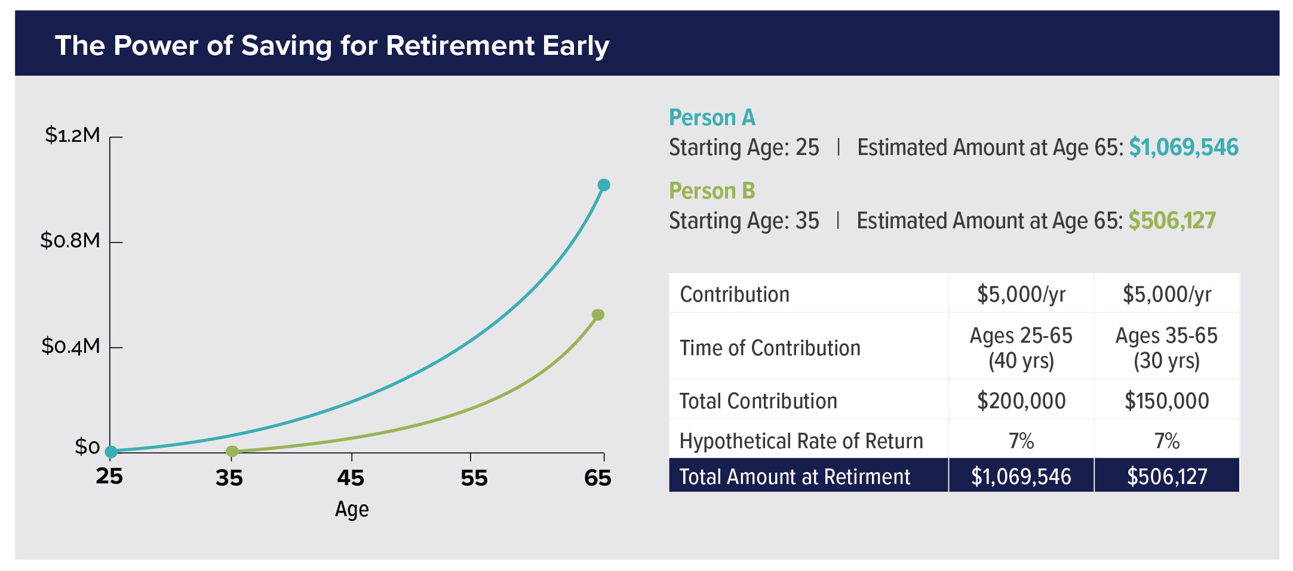
Notes:
Setting retirement goals is an important part of retirement planning. Retirement goals should include a desired retirement age, desired retirement income, and desired lifestyle during retirement. By setting clear goals, individuals can create a plan to achieve those goals.

Slide 17

Importance of Credit
What is Credit
Credit when you borrow money from a lender to make purchases. In return, you agree to pay back the money over a specified period, often with interest (a fee for borrowing the money). Your credit score represents your creditworthiness from 300 to 850 with 700 or higher being good.
Benefits of Good Credit
A good credit score can help you qualify for loans and credit cards with good interest rates (single digits). It can also help you get approved for rental applications, lower insurance premiums, and qualify for a house.
Building Good Credit
To build a good credit score, you need to CONSISTENTLY pay bills on time and keep your credit utilization low. This goes on your credit report that calculates your credit score.
You should also monitor your credit report regularly and start out with a small credit line to use responsibly.
Notes:
Good credit can help you qualify for loans and credit cards with favorable terms. We will discuss how to build good credit and maintain a good credit score.

Slide 18

Creating a Personal Financial Plan
Financial Goals
Identifying and prioritizing your financial goals is the first step in creating a personal financial plan that works for your specific situation.
Budgeting
Creating a budget is an important part of creating a personal financial plan. It helps you track your expenses and saves for your financial goals.
Investing
Investing wisely is a key component of a personal financial plan. It helps grow your wealth and achieve long-term financial goals.
Notes:
Creating a personal financial plan can help you achieve your financial goals and ensure financial security. We will discuss how to create a personal financial plan that works for your specific situation.

