Slide 1
Exploring the data in 2012th year
median and mode
Ticker Symbol Pivot table
unique values for research and development
useful excel functions
company for max total revenue
Data for 2012th
Research and Development analize

Slide 2
https://docs.google.com/spreadsheets/d/13fz4R95uX0WG1gZsNJfbfkbBw33wky7eSeVNV0T-vVU/edit?usp=sharing

Slide 3
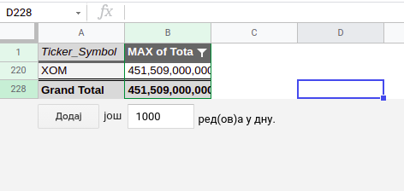
Which company posted the maximum total revenue in 2012?
To find out which company posted the maximum Total Revenue in 2012
I created a Pivot table-please follow the link:
maximum of total revenue
<visualization or summary statistics used for finding>

Slide 4
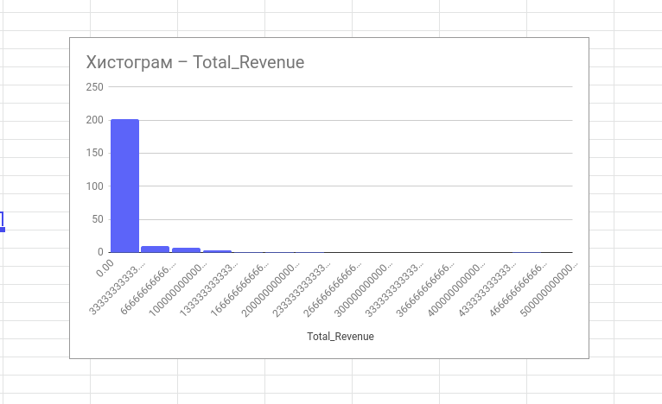
Let’s calculate the descriptive statistics for the Total Revenue column for all the companies across 2012th. Based on the descriptive statistics for Total Revenue there are some conclusions we can make.
This histogram is right skewed
Mean > Median

Slide 5
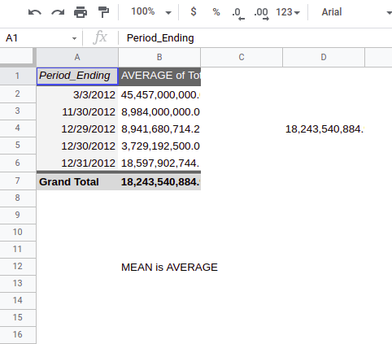

Slide 6
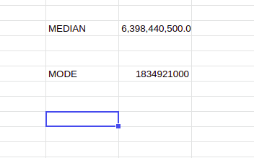
Median and Mode

Slide 7
SOME USEFUL FUNCTION IN EXCEL for financial modeling
Data validation
Tycker_Symbol-DropDownList
INDEX takes a range of cells and returns a cell from that range that is based on a cell
count number provided within the INDEX function.
Works like a GPS system
INDEX function can be used in combination with MATCH function.
I used it to find Ticker Symbol that matches specific value of Total Revenue

Slide 8
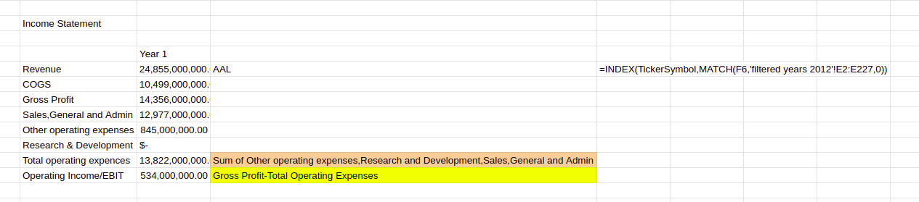
Combination of INDEX and MATCH function

Slide 9
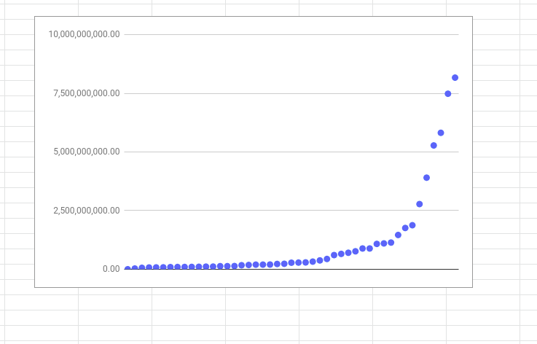
Since we analyze 2012th year lets see DESCRIPTIVE STATISTICS for Research_and_Development
First we make pivot table for filtered data
Than we can make scatter plot.
This scatter plot has positive correlation
The distribution is not a normal distribution. The majority of financial statements for all companies report $0 are spent on R&D expenses.
unique values

Slide 10
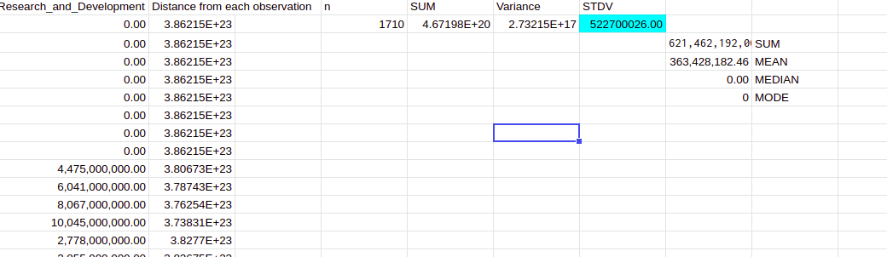
Standard deviation for Research and Development across all years

Slide 11
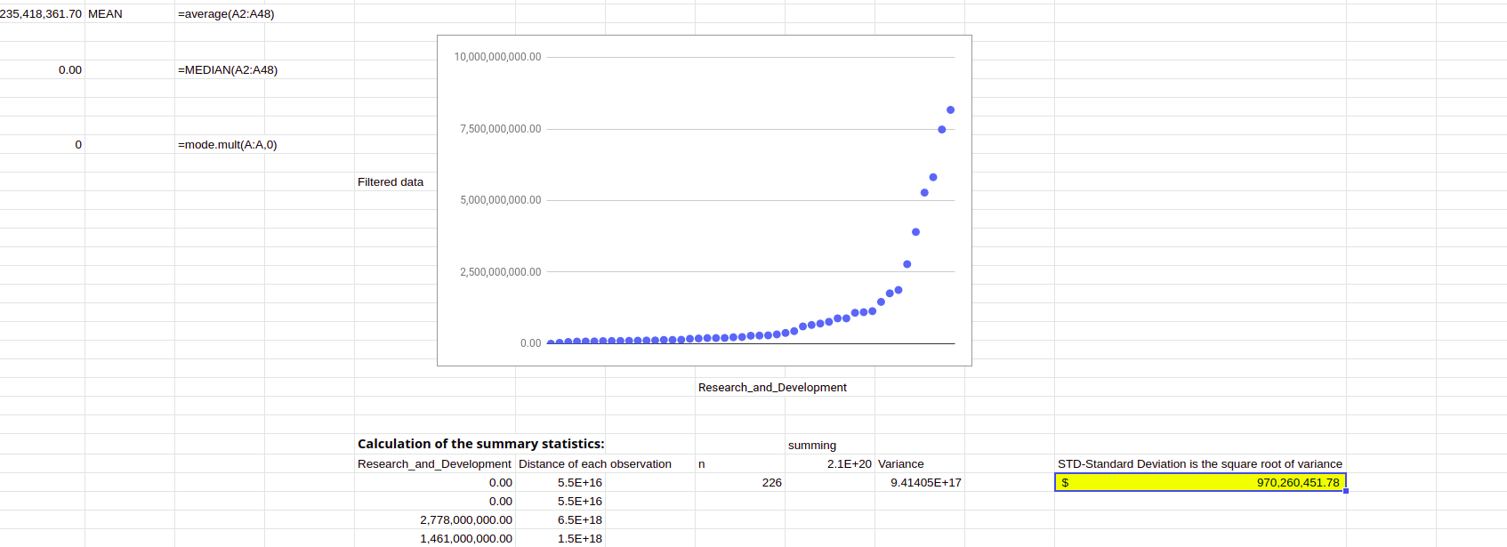
Standard deviation for Research and Development in 2012th

Slide 12
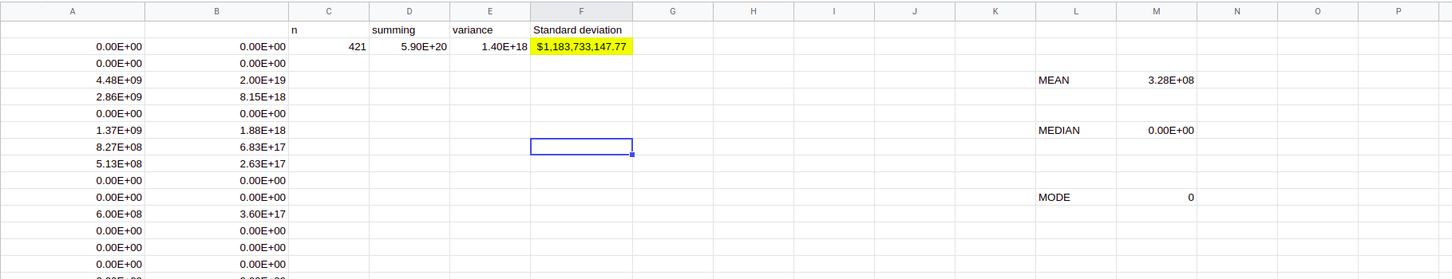
Standard deviation for Research and Development in 2013th

Slide 13
Range for the Total Revenue
Range for Total Revenue in 2013 is 468130387000,and in 2012 is 4122630844000.It looks like in 2012 was greater variability in the total revenues because their range is more spread out.

Slide 14
The standard deviation of Research and Development for companies in 2013 ( $ 1,183,733,147.77 ) was higher than the standard deviation of Research and Development for companies in 2012( $ 970,260,451.78 ).
There's a higher variability of Research and Development for companies in 2013 compared to Research and Development for companies in 2012

Slide 15
Links
https://docs.google.com/spreadsheets/d/13fz4R95uX0WG1gZsNJfbfkbBw33wky7eSeVNV0T-vVU/edit#gid=1783867646
https://docs.google.com/spreadsheets/d/13fz4R95uX0WG1gZsNJfbfkbBw33wky7eSeVNV0T-vVU/edit#gid=392379238

Slide 16
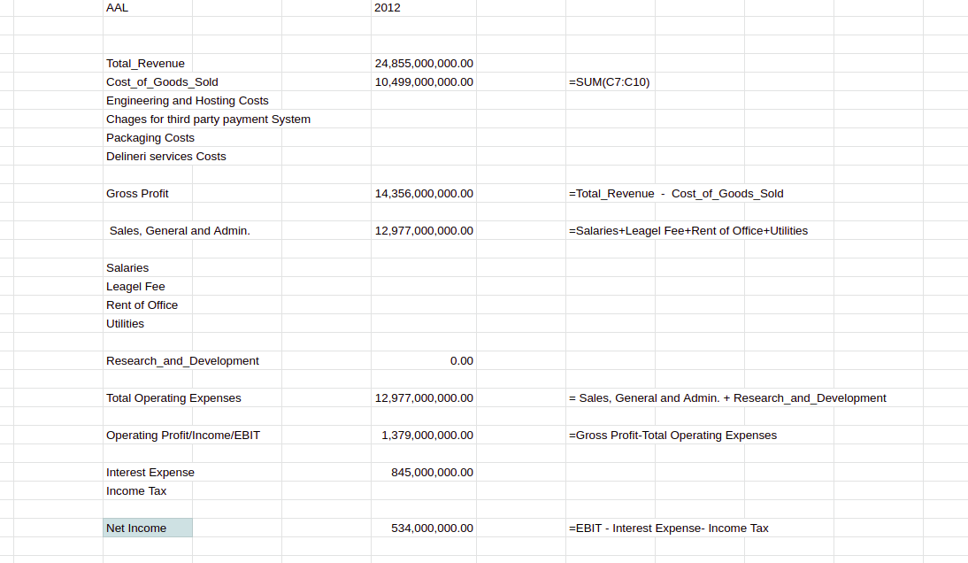
Dashboard for Profit and Loss Statement

Slide 17
Link
https://docs.google.com/spreadsheets/d/13fz4R95uX0WG1gZsNJfbfkbBw33wky7eSeVNV0T-vVU/edit#gid=731883705

Slide 18
Use Match with two criteria
https://docs.google.com/spreadsheets/d/13fz4R95uX0WG1gZsNJfbfkbBw33wky7eSeVNV0T-vVU/edit#gid=1270226985
https://docs.google.com/spreadsheets/d/13fz4R95uX0WG1gZsNJfbfkbBw33wky7eSeVNV0T-vVU/edit#gid=1966660222

Slide 19
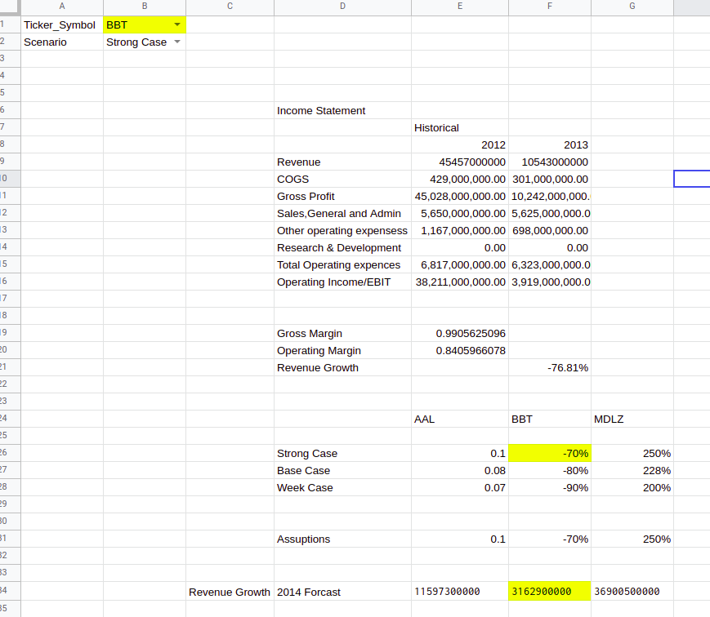
Assumption for the Revenue Growth in 2014 for company with Ticker Symbol BBT in Strong Case Scenario

Slide 20
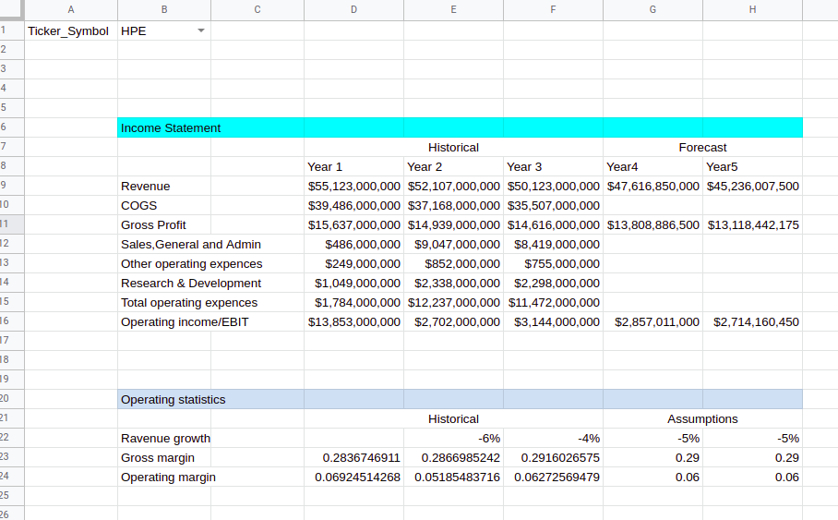
Forecasting model
Forecasting model with scenarios
the dataset for Financial Forecast

Slide 21
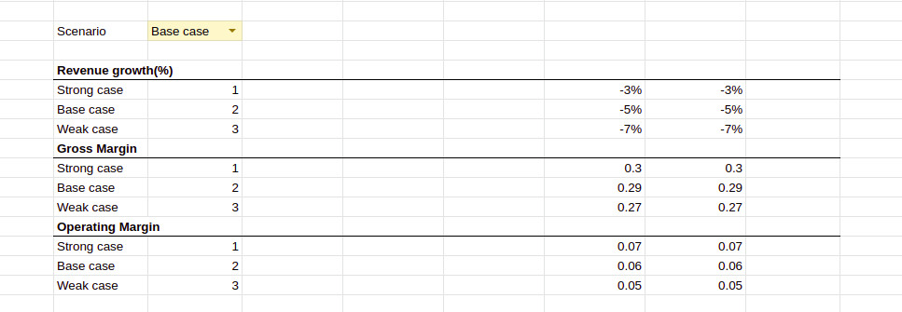

Slide 22
Some useful links
https://support.microsoft.com/en-us/topic/present-your-data-in-a-scatter-chart-or-a-line-chart-4570a80f-599a-4d6b-a155-104a9018b86e
https://www.youtube.com/watch?v=PrVErp8cFG4
https://www.youtube.com/watch?v=jQbE9BmET0Q
https://askubuntu.com/questions/660846/how-to-zip-and-unzip-a-directory-and-its-files-in-linux

