Slide 1

Mini Weather Station
Pressure-based rain and storm alert using the 8051 microcontroller and the MYOSA (ESP32) sensor kit
Anoof Muhammed K · Bhagath TP · Dania Abdulla · Gautham Laser · Ivana Anto
Embedded Systems mini project · B.Tech Electronics and Communication
School of Engineering, Cochin University of Science and Technology
Notes:
Introduce the team and the project: a mini weather station that measures temperature and pressure and warns of rain or storms from how fast the pressure is falling. Two controllers: the ESP32 on the MYOSA kit and an 8051.

Slide 2
Falling pressure warns of bad weather
Low-pressure systems bring clouds, rain and wind. As one approaches, the local barometer falls, often hours before the rain. Meteorologists use the 3-hour pressure tendency for short-range forecasts, and so do we.
1 hPa
Rain likely
fall in 3 hours
A single reading means little; the rate of change is what predicts the weather.
3 hPa
Storm warning
fall in 3 hours
Notes:
Explain why pressure trend is used. A fall of 1 hPa in 3 hours suggests rain; a fall of 3 hPa or more suggests a storm. These are simplified from standard pressure-tendency categories.

Slide 3






Objectives
Measure
Calculate
Read temperature and pressure from the BMP180 over I2C every 2 s
Altitude, max / min values and a 3-hour pressure history
Predict
Display
Classify stable, improving, rain likely or storm warning
Show readings and forecast on the 128 × 64 OLED
Communicate
Alert
Send the status to the 8051 over UART at 9600 baud
8051 drives a warning LED and buzzer and detects link failure
Notes:
Six objectives: measure, calculate, predict, display, communicate and alert.

Slide 4
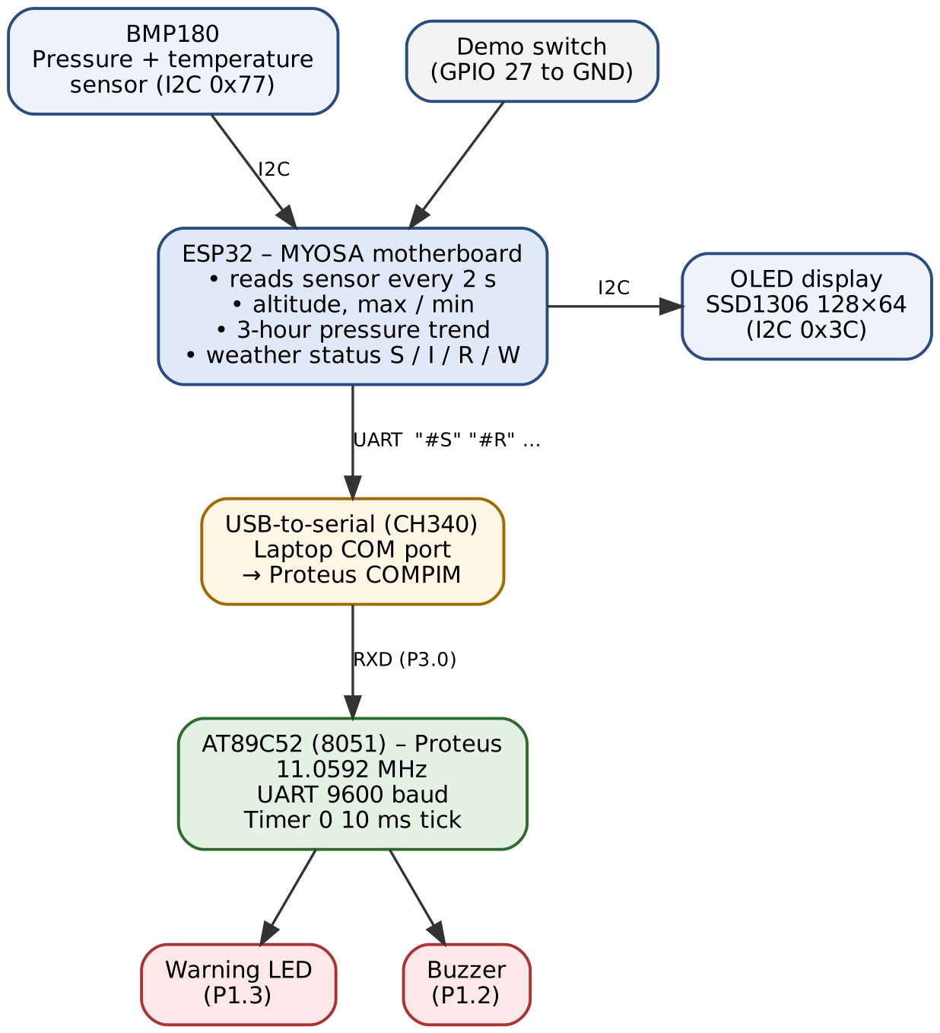
System architecture
Sensing unit (real hardware)
ESP32 on the MYOSA board reads the BMP180, does all calculations and drives the OLED.
Serial link
Status sent every 2 s as #S, #I, #R or #W at 9600 baud, via USB (CH340, COM7) into Proteus COMPIM.
Alarm unit (Proteus)
AT89C52 receives the status by serial interrupt and drives the LED (P1.3) and buzzer (P1.2).
Notes:
Walk through the block diagram top to bottom. The ESP32 does the heavy work (floating-point maths, I2C, graphics). The 8051 does the fast, interrupt-driven output control.

Slide 5


Hardware components
MYOSA motherboard
BMP180 sensor
OLED display
ESP32 dual-core, 3.3 V, Wi-Fi/BT, CH340 USB-serial
Pressure 300–1100 hPa + temperature, I2C 0x77
SSD1306, 128 × 64 pixels, I2C 0x3C
AT89C52 (8051)
LED + buzzer
Laptop + Proteus
8 KB flash, 256 B RAM, 3 timers, UART, 11.0592 MHz
Red LED with 330 Ω on P1.3, 5 V buzzer on P1.2
COMPIM links COM7 to the simulated 8051's RXD
Notes:
Top row is the real MYOSA hardware; bottom row is the 8051 alarm unit and the simulation link. The kit has no humidity sensor, so the BMP180 gives temperature.

Slide 6
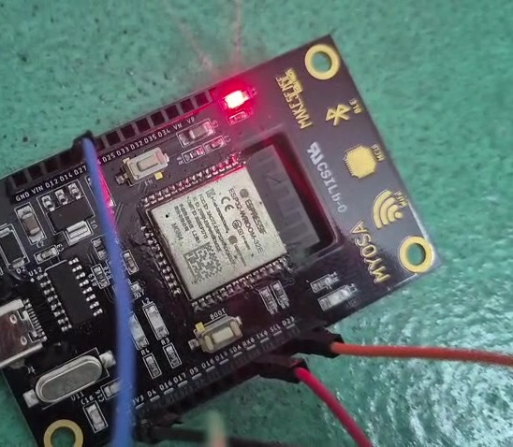
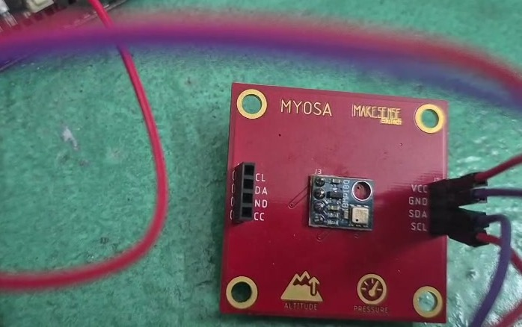
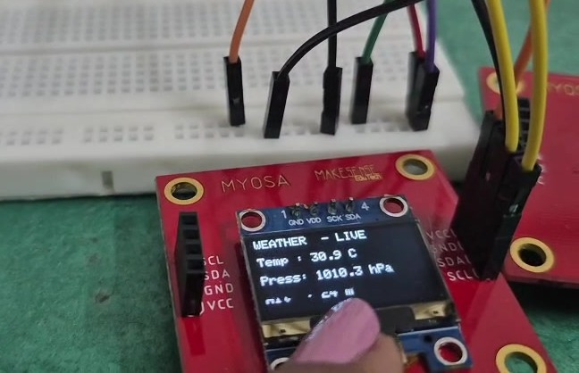
Our hardware
MYOSA motherboard
BMP180 sensor board
OLED display board
ESP32 with CH340 USB-serial
Pressure and temperature, I2C
Live readings: 30.9 °C, 1010.3 hPa
Notes:
These are the actual MYOSA boards we used. The sensor and display boards connect to the motherboard over the I2C bus.

Slide 7
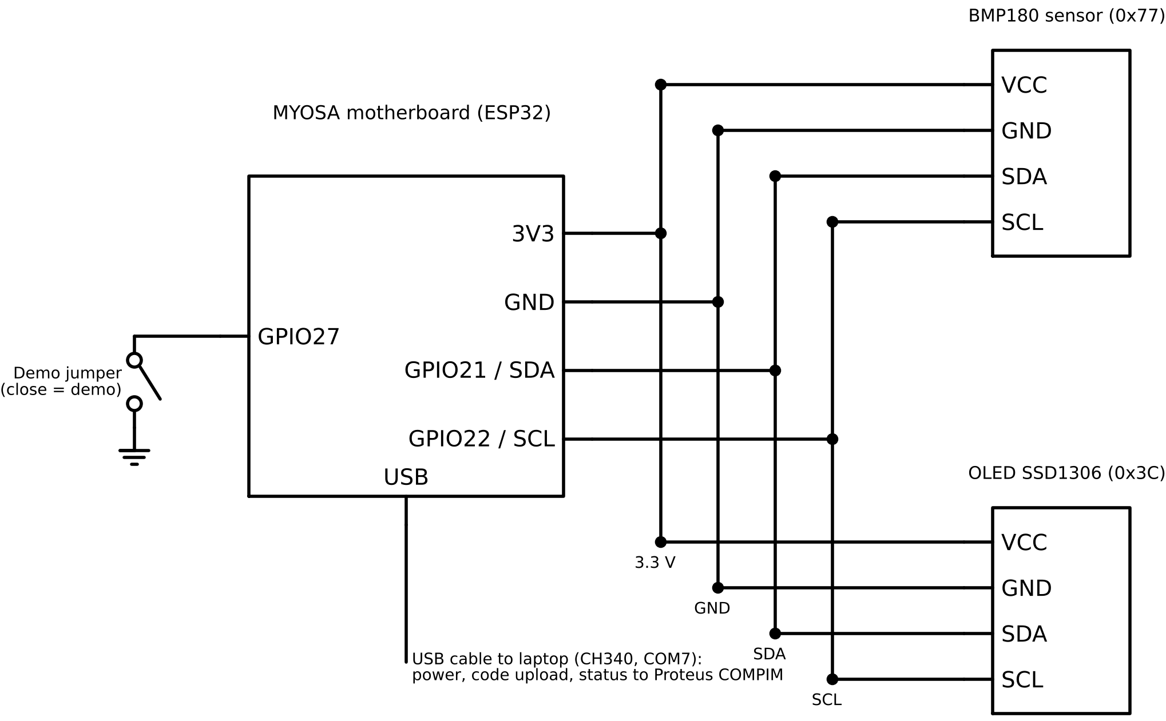

Sensing unit wiring
Shared I2C bus
BMP180 and OLED use the same four wires: 3.3 V, GND, SDA (GPIO 21), SCL (GPIO 22)
Unique addresses
BMP180 answers at 0x77, OLED at 0x3C
Demo jumper
GPIO 27 to GND starts the falling-pressure demo
One USB cable
Power, code upload and status messages to the laptop
Notes:
The MYOSA sensor boards plug straight into the motherboard's I2C connectors, so no breadboard or pull-up resistors are needed. Each device has its own address, so they can share the same two data wires.

Slide 8
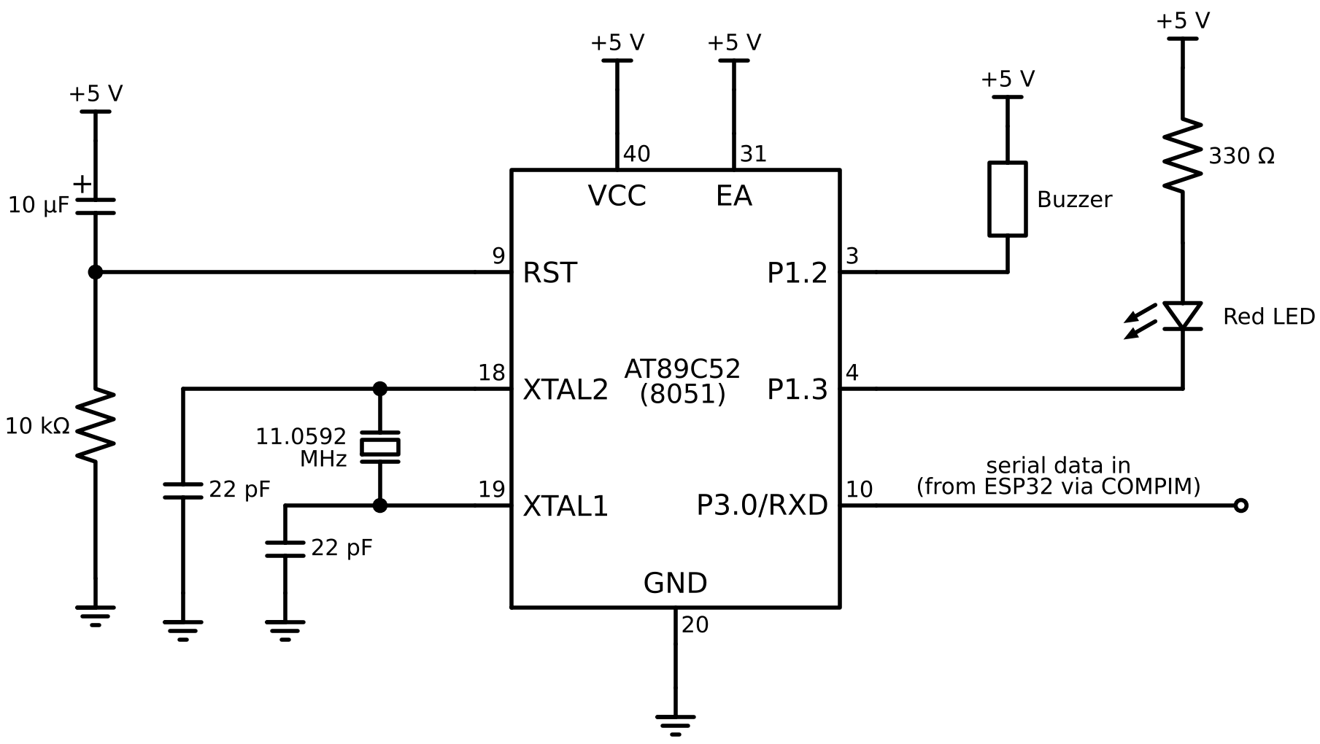
8051 alarm circuit
Pin | Use
P3.0 / RXD | Serial data in
P1.3 | LED (active-low)
P1.2 | Buzzer (active-low)
XTAL1/2 | 11.0592 MHz
RST | 10 µF + 10 kΩ
EA | +5 V (internal flash)
Writing 0 to a pin turns the LED or buzzer on, because port pins sink current better than they source it.
Notes:
Crystal and reset network are needed on real hardware; Proteus takes the clock from component properties. LED and buzzer are wired from +5 V to the pin, so they are active-low.

Slide 9
How it works
1
2
3
4
5
6
Read
Compute
Remember
Compare
Decide
Alert
T and P from BMP180 every 2 s
Altitude, max / min
1 sample per 10 min, 18 slots = 3 h
drop = P(3 h ago) − P(now)
S, I, R or W
OLED + "#X" to 8051
Demo mode: a jumper from GPIO 27 to GND makes the pressure fall 0.1 hPa every 2 s, giving RAIN LIKELY after about 20 s and STORM WARNING after about 60 s, instead of waiting hours.
Notes:
The ring buffer stores one value every 10 minutes in 18 slots, so the oldest value is always about 3 hours old. Demo mode lets us show the warnings in about a minute.

Slide 10
Weather status and alarm actions
Message | Status | Pressure change in 3 h | OLED shows | 8051 output
#S | Stable | between −1.0 and +1.0 hPa | STABLE | LED off
#I | Improving | rise ≥ 1.0 hPa | IMPROVING | LED off
#R | Rain likely | fall ≥ 1.0 hPa | RAIN LIKELY | LED steady on
#W | Storm warning | fall ≥ 3.0 hPa | STORM WARNING | LED blinks + buzzer 10 s
(none 5 s) | Link lost | – | – | LED blinks fast
Rule: the 8051 accepts a status letter only right after a "#", so the ESP32's debug text on the same line is ignored.
Notes:
Each message is three bytes: #, a letter and a newline. If no message arrives for 5 seconds the 8051 assumes the link is broken.

Slide 11
Programming the 8051
FDh
DC00h
50h
21h
TH1
Timer 0
SCON
TMOD
9600 baud
10 ms tick
UART mode 1, RX on
T1 mode 2, T0 mode 1
Why 11.0592 MHz?
Interrupt-driven design
TH1 = 256 − 11 059 200 / (384 × 9600) = 253 = FDh exactly.
With 12 MHz the baud rate would be about 10 417, an 8.5 % error, which is too large for reliable data.
Timer 0 ISR adds 1 to a tick counter every 10 ms
Serial ISR stores the letter that follows "#"
Main loop blinks and beeps using the tick count, with no delay loops
Code size about 0.6 KB of 8 KB, compiled with SDCC
Notes:
Machine cycle is 12 / 11.0592 MHz = 1.085 microseconds. 10 ms / 1.085 us = 9216 counts, so Timer 0 reload is 65536 − 9216 = DC00h.

Slide 12
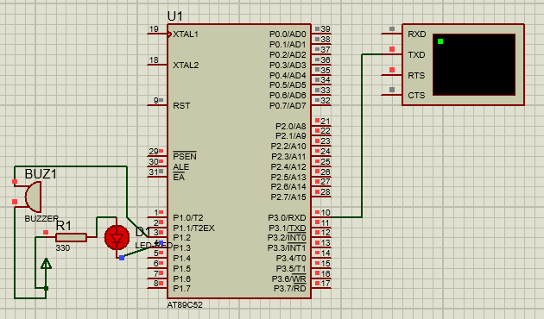
Simulation in Proteus
1
Build HEX in VS Code with SDCC (Ctrl+Shift+B)
2
Load HEX into AT89C52, clock 11.0592 MHz
3
Unit test: type #R, #W, #S in Virtual Terminal
4
Live: COMPIM on COM7 feeds real MYOSA data into RXD
Red and blue squares on the pins show live logic levels during simulation.
Notes:
Only one program can open COM7 at a time, so the PlatformIO serial monitor must be closed before running Proteus.

Slide 13
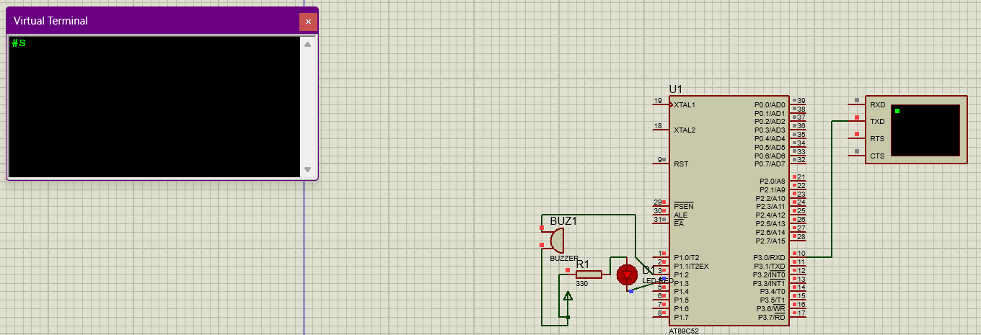
Testing the 8051 on its own
#R
#W
#S
no data 5 s
LED steady on
LED blinks + buzzer
LED off
LED blinks fast
Notes:
Before connecting the real board, we typed status messages into the Proteus Virtual Terminal to check every alarm state on its own.

Slide 14
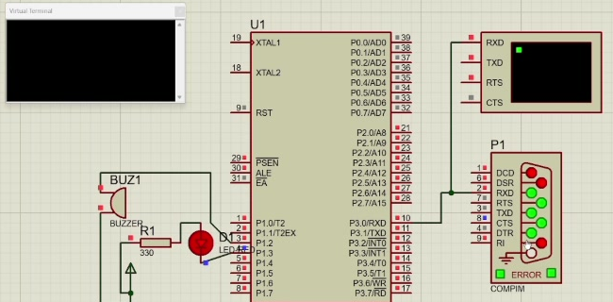
Live link: real board to Proteus
COMPIM on COM7
Brings the ESP32's USB serial data into the simulation
RXD lamp flashes
A new status message arrives every 2 s
LED follows status
P1.3 is driven by the latest #S / #R / #W
Proteus during the live run, with the COMPIM block (P1) connected to COM7
Notes:
The real MYOSA board and the simulated 8051 run together. The PlatformIO serial monitor must be closed so Proteus can open COM7.

Slide 15

Results
30.6 °C
I2C devices found: 0x3C 0x77
BMP180 OK OLED OK
#S
T=30.6 P=1010.8 A=20 drop=0.0 state=S
T=30.6 P=1010.7 A=21 drop=0.1 state=S
Temperature
1010.7 hPa
Pressure
Both I2C devices detected at the expected addresses
≈ 21 m
Demo mode: status changed S → R → W as the drop passed 1.0 and 3.0 hPa
Altitude estimate
8051 responded to #R, #W and #S, and showed link loss after 5 s
Notes:
Indoor readings at Kochi: 30.6 C, about 1010.7 hPa, altitude estimate about 21 m (it assumes 1013.25 hPa at sea level, so it is approximate).

Slide 16
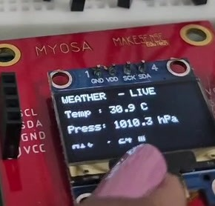
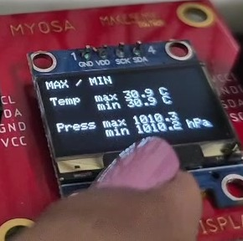
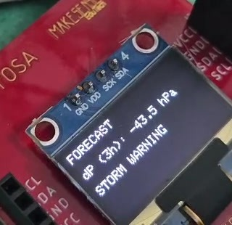
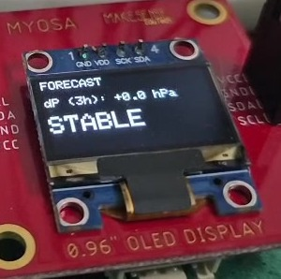
Demo on the OLED
1 Live readings
2 Max / Min
3 Storm warning
4 Stable again
Temperature, pressure, altitude
Highest and lowest values
Demo jumper on GPIO 27
Jumper removed, dP = 0.0
The OLED changes page every 4 s; during a warning it alternates between Live and Forecast.
Notes:
In demo mode the pressure keeps falling by 0.1 hPa every 2 s, so the 3-hour drop quickly passes 3 hPa and the OLED shows STORM WARNING. Removing the jumper brings the reading back to real data and the status returns to STABLE.

Slide 17

Problems we solved
No humidity sensor
HEX file not found
Used BMP180 temperature instead
Fixed with the full file path
8051 got no data
SDCC not found
Rewired TXD → RXD
Full path in tasks.json
Notes:
These were real issues during development. Also: Proteus defaults to a 12 MHz clock, which had to be changed to 11.0592 MHz, and only one program can use COM7 at a time.

Slide 18
Cost estimate
₹1,000
Item | ₹ (approx.)
ESP32 board (MYOSA equivalent) | 450
BMP180 module | 150
0.96" OLED display | 250
USB cable and wires | 150
AT89S52, crystal, R, C, LED, buzzer | 160
Breadboard | 90
USBasp programmer | 250
Software (VS Code, PlatformIO, SDCC) | 0
Sensing unit (MYOSA parts)
≈ ₹1,500
Complete hardware version
Notes:
The MYOSA kit was already available and the 8051 was simulated, so actual spending was negligible. Prices are approximate local market prices.

Slide 19




Merits and limitations
Early warning
Three-way alerts
Limitations
Predicts rain and storms hours ahead from the pressure trend
OLED text, warning LED and buzzer
Pressure only
Needs 3 h of history
8051 simulated
Very low cost
Instant demo
About ₹1,500 for a complete system
Full stable → rain → storm cycle in about a minute
Dual-controller design
Future-ready
ESP32 + 8051 working together, as in real products
Wi-Fi on board, 7 KB free on the 8051
Fail-safe link
Detects a lost connection within 5 s
Notes:
Be honest about limits: this is a simple pressure-trend indicator, not a full forecast.

Slide 20



Future scope
Real 8051 board
Humidity sensor
Wi-Fi dashboard
Wire to GPIO 25 and add a 16×2 LCD
SHT31 / AHT20 for humidity, dew point
Cloud upload and phone storm alerts
Data logging
Two-way link
Solar powered
SD card + RTC, long-term graphs
Acknowledgement and checksum
Outdoor unit with sleep modes
Notes:
The ESP32 already has Wi-Fi, and the 8051 code already supports a direct UART connection on GPIO 25.

Slide 21
Conclusion
1
Built a working weather station that warns of rain and storms from the 3-hour pressure trend
2
ESP32 handles sensing, maths and display; the 8051 handles interrupt-driven alarms
3
Learned I2C, UART between two MCU families, 8051 timers and interrupts, and Proteus co-simulation
Thank you · Questions?
Notes:
Summarise and invite questions.

