Slide 1

Box Office Performance
Data Presentation
Nelly Atsmon and Ivana Spasova

Slide 2
Background of the topic
Exploring box office performance data and understanding ‘success’ in the film industry
Examine the significance of the film industry;
Show the sheer amount of money that is involved
How do different factors impact revenue;
Genre
Budget
Release Date
Disparity between budget and gross revenue;
Value in profit
Are there budget thresholds where investing beyond which tends to yield diminishing results?

Slide 3
Introduction of Dataset
01
02
03
Highest Box Office
Highest Budgets
Highest Profits

Slide 4
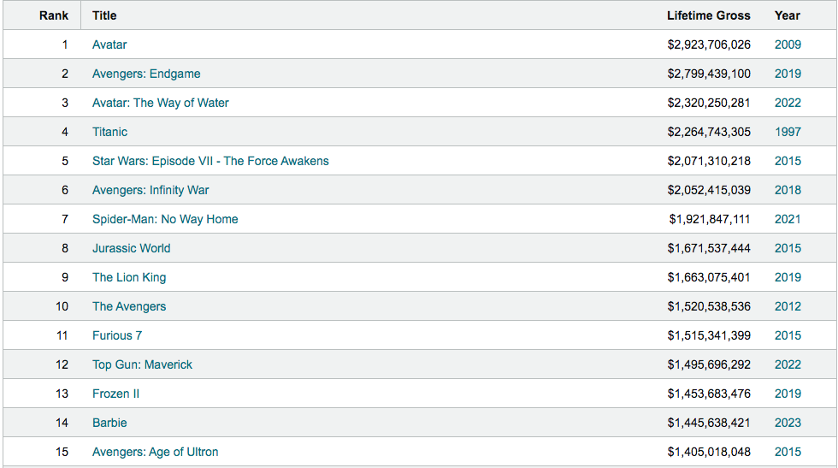

Slide 5
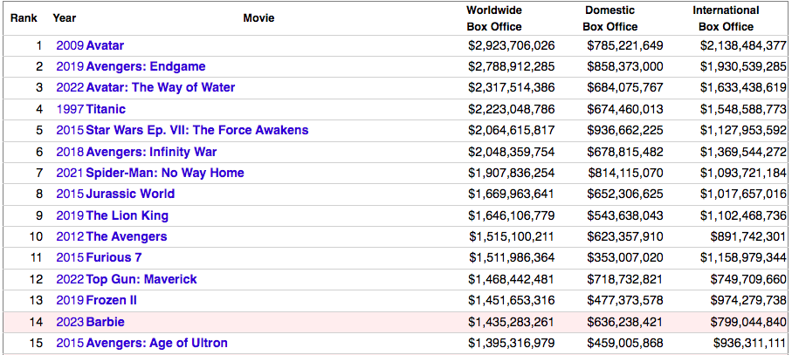
Movies with the most Golden Globe wins of all time as of 2024

Slide 6
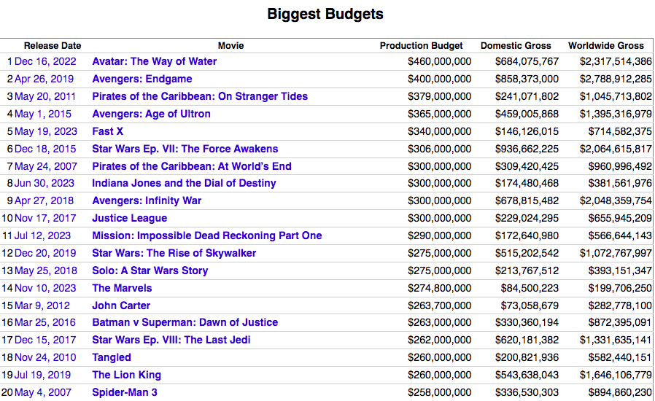

Slide 7
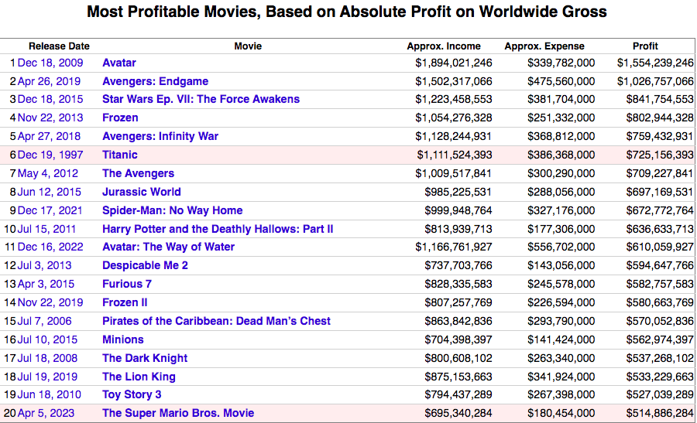

Slide 8
Critique of dataset
Limited Variables | Does not account for marketing expenditures, distribution strategies or audience demographics
Data Quality | Datasets may contain errors, inconsistencies or missing values due to human errors, we are avoiding that
Data Format | Inconsistent or unclear data formats complicate data processing and interpretation
Data accessibility | Datasets may not be available for us, based on location
Notes:
Limited Variables: while the dataset may provide information on box office revenue and production budgets, it may lack other relevant variables such as marketing expenditures, distribution strategies, or audience demographics, which could provide additional insights into box office performance. Moving on to the data quality, we have to properly handle our research so we can avoid errors, inconsistencies or missing values due to human errors. The data formats should also be consistent and clear so the data processing doesn’t get any more complicated. The last issue we’ll manage to get through and solve is accessibility of our data itself, we’ll use the data available to us on campus because of its accuracy.

Slide 9

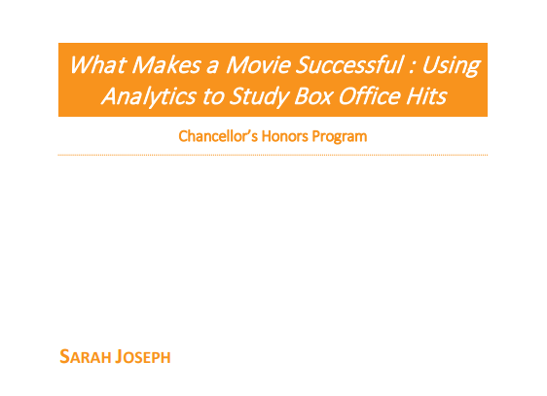
Relevant literature
"Data scientists must approach data accuracy with a critical eye, recognising that even seemingly reliable data sources can contain hidden inaccuracies that could undermine the integrity of their analyses."
- ‘Doing Data Science’
Carly O’Neil and
Rachel Schutt
“Using descriptive analytics can help a company decide on what month to release a movie, what a movie should be rated, whether or not to hire a famous director, or what genre movie to produce.”
- ‘What Makes a Movie Successful’
Sarah E. Joseph
Notes:
The relevant literature to our project are the book - Doing Data Science by Carly O’Neil and Rachel Schutt, which approaches of topic of how we can do the deep research for our project; And the independent research done by Sarah Joseph about what makes a movie successful in the box office and how the performance in the box office of a film can be predicted based on all of the criteria that a good film should cover.

Slide 10
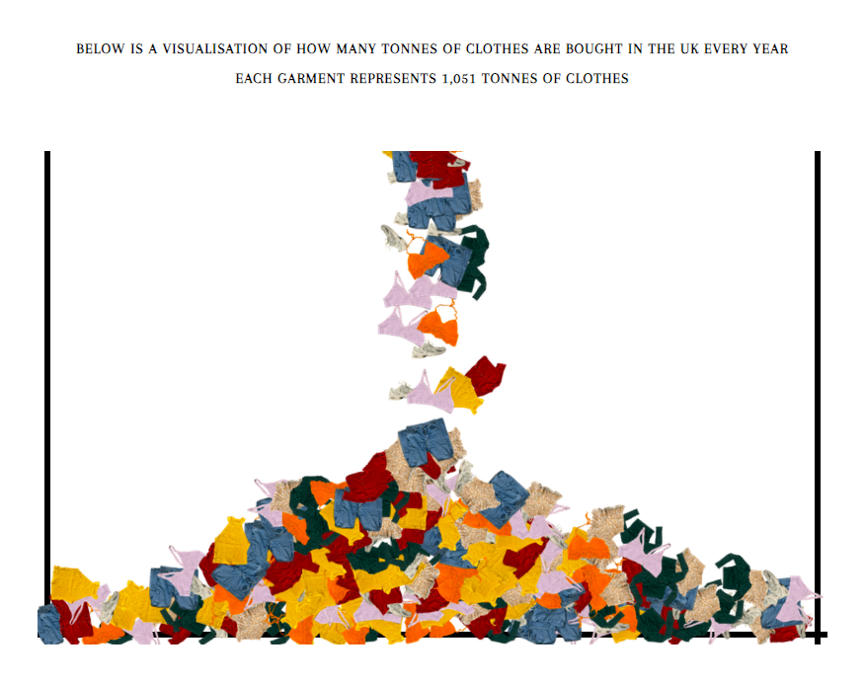
Type of visualisation
Bar charts
Most effective data visualisation for comparison
Comparing box office revenue, budgets, and profits across different films
Giving user’s a sense of the amount of money
A visualisation to represent the amount of dollars made for the highest grossing films - audience clarity
Student example

Slide 11

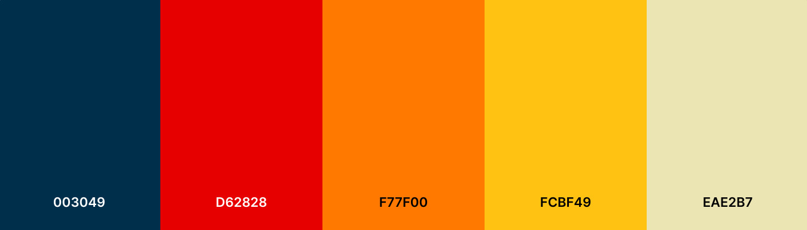

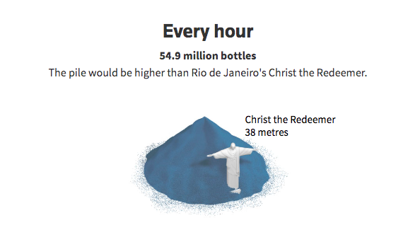

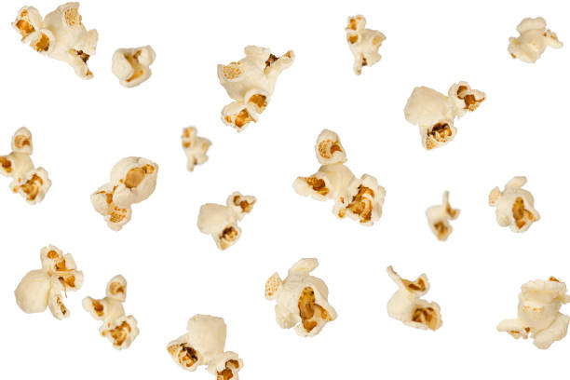
Aesthetic choices
Theme and visual consistency
Create the feeling of a cinema
E.g. Margins of website follow rules of theatre screens (wider ratio)
Colour palette and typography
Similar colours to presentation
Helvetica medium italic
Visual Elements
Visualisation that shows abundance of money in the film industry through something on theme (popcorn?)
Icons in bar charts instead of text

Slide 12
Technical choices
Navigation Menu
Accessibility/Compatibility
Footer
Each page on website will have clear hyperlinks to take you back to previous page, as well as a navigation menu at the top
Making sure it is accessible to different platforms and looks good on all browsers
A footer at the bottom of the website with the essence of our project so audience can read it whenever confused
Data visualisation
Visual hierarchy
Coding split up:
Data visualisation plays as soon as user opens the website to create an overwhelming feeling of abundance
Starting with the visual content at the start of website, then moving to the literary content after they click
Nelly will work on the HTML aspects of the project
Ivana will work on the p5.js aspects of the project

Slide 13
Foreseeable issues
Time management
Data accessibility
Data coverage
Data Quality
External factors
Seasonality and trends
Notes:
These are some foreseeable issues we will solve during the preparation of our project. Firstly, time management. We came up with the production timetable for the project so we are expected not to clash with our preparation of other university coursework and vacation. Secondly, data accessibility is important, I already mentioned how data will be the most accessible on campus but we won’t be on campus during the vacation so we have planned to do our research while we are still on the university’s campus. Also, we will take care of doing a deeper research into the coverage of the data accessible so we can avoid limited footage of datasets, such as missing revenue from streaming platforms or international markets. The last two aspects matter to the success of the film in the box office. External factors, such as natural disasters and pandemics (Covid 19) will change the revenue to the worse. Also, seasonality and trends are key, when the box office landscape is subject to seasonal fluctuations with the summer mostly experiencing higher ticket sales. (What makes a movie successful)

Slide 14
Production timetable
Week 1 | Presentation | Week 3-6 | Coding
Week 2 | Research | Week 8 | Wrap up
blue - work on the project
green - discuss our progress
red - break from project
Monday | Tuesday | Wednesday | Thursday | Friday | Saturday | Sunday
Notes:
Self-explanatory.

Slide 15
Thank you for your attention!
Any questions?

