Slide 1


WISER Quantum Project - Title
WISER Quantum Project
Project: Quantum Optimization with QAOA and Classical Benchmarks
Presenter: Ivan Barrientos
WISER Quantum Project

Slide 2

Problem Statement
WISER Quantum Project
Our project explores optimization problems relevant to finance.
We address the challenge of portfolio optimization using quantum algorithms.
Importance: Improves efficiency in high-dimensional investment decision-making.

Slide 3

Context & Importance
WISER Quantum Project
Classical methods have limitations in scalability and solution quality.
Quantum Approximate Optimization Algorithm (QAOA) offers potential speed-ups.
This project compares QAOA vs classical approaches for practical scenarios.

Slide 4

Goals
WISER Quantum Project
Evaluate quantum vs classical performance on a defined financial optimization problem.
Implement mean-variance and index tracking formulations.
Compare efficiency, accuracy, and potential scalability.

Slide 5

Approach
WISER Quantum Project
Formulated the problem mathematically using portfolio theory.
Implemented QAOA in Qiskit and compared with classical heuristics.
Tested with real and synthetic financial datasets.

Slide 6

Tools & Techniques
WISER Quantum Project
Quantum: Qiskit, QAOA, IBM Quantum simulators.
Classical: Heuristic search, Mean-Variance optimization.
Analysis: Python, Pandas, Matplotlib for results visualization.

Slide 7
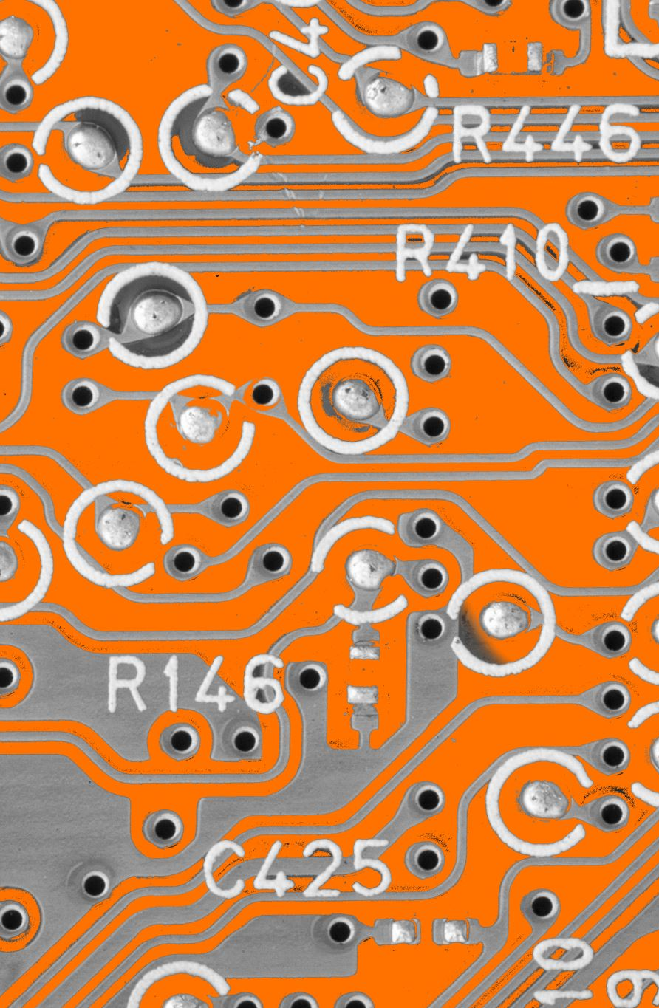
Solution Evolution
WISER Quantum Project
Started with classical baseline implementation.
Adapted QAOA circuits to problem constraints.
Iteratively tuned parameters and analyzed outputs.

Slide 8

Outcomes & Impact
WISER Quantum Project
Met project goals: successfully implemented and compared methods.
Success metrics: accuracy, execution time, scalability potential.
Contributes insight into when quantum methods might surpass classical baselines.

Slide 9

Future Scope
WISER Quantum Project
Integrate larger datasets and more complex constraints.
Test on real quantum hardware for performance assessment.
Explore hybrid quantum-classical algorithms.

Slide 10

Closing
WISER Quantum Project
WISER Quantum Project – Thank you.
Questions?

