Slide 1
Modeling Data With Networks + Network Embedding: Problems, Methodologies and Frontiers
Ivan Brugere (University of Illinois at Chicago)
Peng Cui (Tsinghua University)
Bryan Perozzi (Google)
Wenwu Zhu (Tsinghua University)
Tanya Berger-Wolf (University of Illinois at Chicago)
Jian Pei (Simon Fraser University)

Slide 2
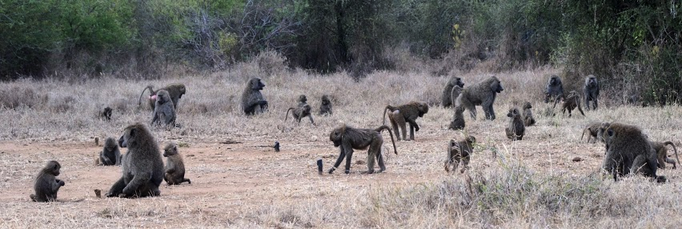
Motivation
Most data is not natively in the form of a graph
Graphs are a useful model of underlying data (sometimes)
Many choices for translating data to a graph and doing something with it
This talk: these choices matter, even with good ML (garbage-in garbage-out)

Slide 3
Questions as Graph Problems
Activity, location, gender, protein function, prediction/inference, product recommendation
Friendship recommendation, product recommendation
Entity role/function comparison
Complex data emergent property classification/comparison
Label prediction/inference
Link prediction
Node embedding
Whole network embedding

Slide 4
Outline
Introduction | Tanya Berger-Wolf, 1:00-1:15
Inferring Graphs From Data | Ivan Brugere, 1:15-2:30
BREAK | 2:30-3:00
Unsupervised Embedding | Peng Cui, Jian Pei, 3:00-4:40
Semi-Supervised Embedding | Bryan Perozzi, 4:40-5:20
Whole-Graph Embedding | Bryan Perozzi, 5:20-5:40
Conclusions | 5:40-6:00

