Slide 1
Service Desk Integration
Jira and Confluence API

Slide 2
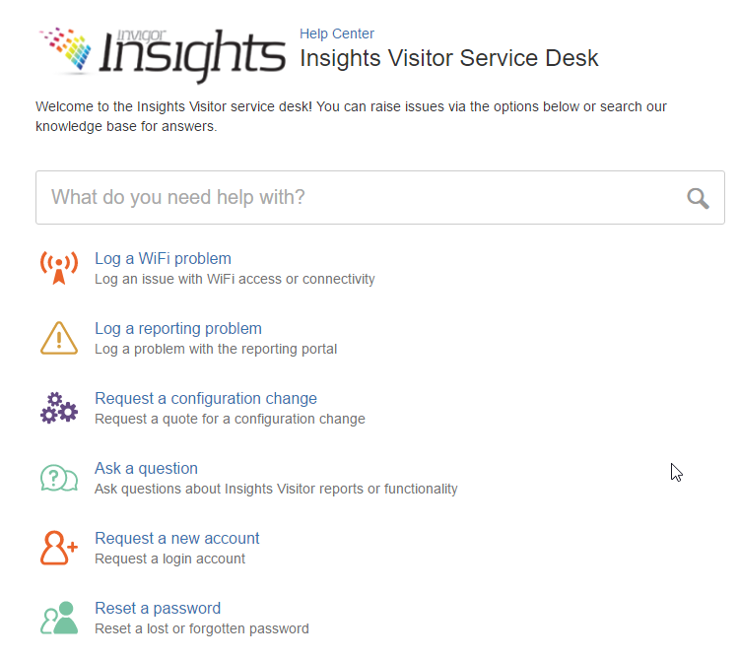
Background
Service Desk Customer Portal
https://globalgroup.atlassian.net/servicedesk/customer/portal/4
What it provides:
Browse and Advanced Search for FAQ
Submit Requests
Report Bugs

Slide 3
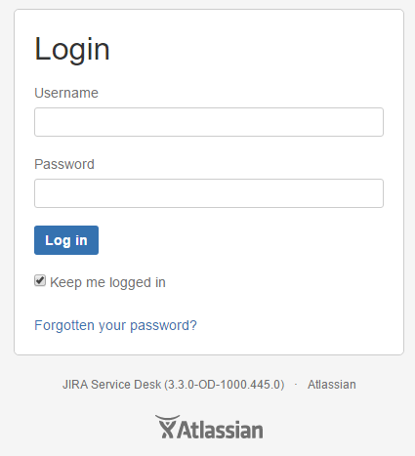
Issue
Atlassian account authentication required

Slide 4
Atlassian APIs
Jira API
Service Desk API – customer, organisations and requests management
https://docs.atlassian.com/jira-servicedesk/REST/cloud/
Agile API – board, sprint and issues management
https://docs.atlassian.com/jira-software/REST/cloud/
Confluence API
- space, article management and advanced search
https://docs.atlassian.com/confluence/REST/latest/

Slide 5
Suggestion
Create an Atlassian user for SpotLite
SpotLite consume Atlassian APIs by using this user
Functions:
Browse and Advanced Search for FAQ
Submit Requests
Report broken crawler
Report Bugs

