Slide 1
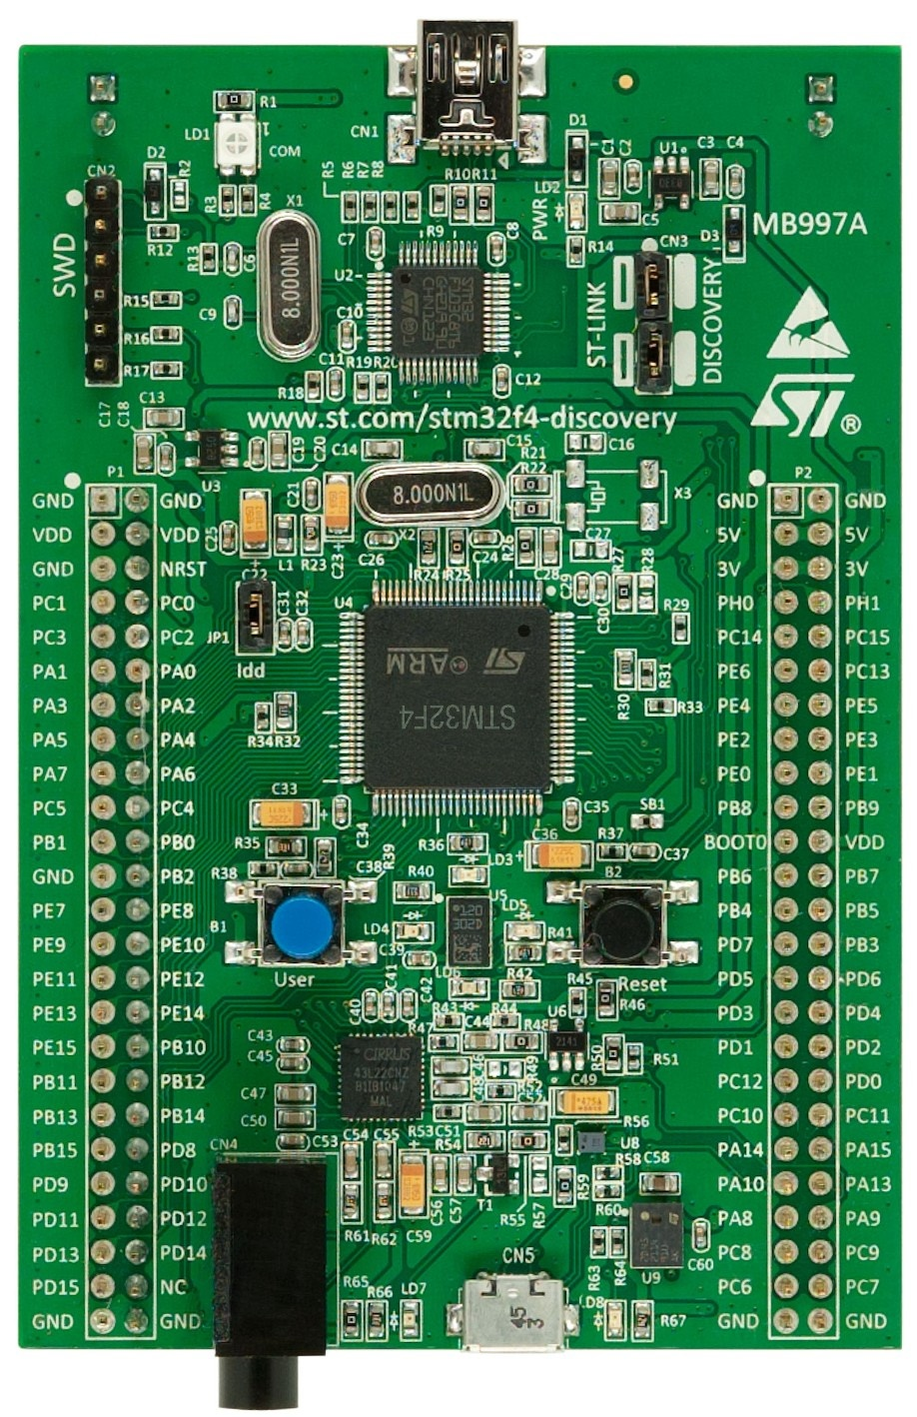
UART2_RX
UART2_TX
I2C1_SDA
ADC
I2C1_SCL
CS
SPI2_CLK
SPI2_MOSI
SPI2_MISO
BT Reset

