Slide 1
Azure API App Service in 10 minutes
Ivan Georgiev, TCS
Detailed instructions available at Dial Consumption DevOps Repo

Slide 2
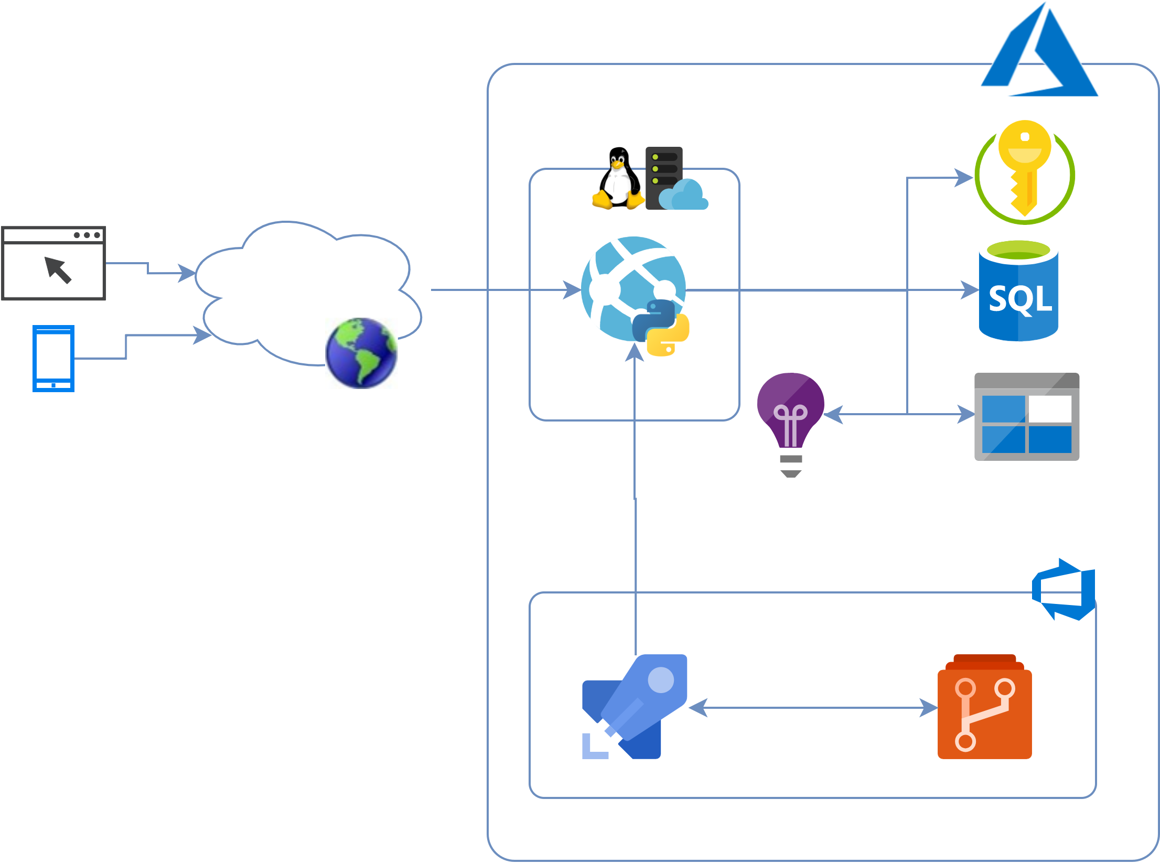
API App Service on Azure
Client – mobile, desktop, web app, etc.
Running on Linux App Service plan in Python
Connects to Azure SQL Database
Integrated with Azure Key Vault
App Insights and Storage Account for diagnostics
Azure DevOps

Slide 3
Goals and Requirements
Scalability – auto scale
Utilize PaaS
CBSP Certified products only
Monitoring, diagnostics and alerting
Development – develop and test locally, using arbitrary framework, e.g. FastApi, Flask or Django
DevOps
Automated resource administration
Automated application lifecycle – CI/CD by design

Slide 4
Steps
Step 1 – Create Azure Repo for the project
Step 2 – Create and test application locally
Checkout (empty) repository
Create virtual environment
Create application code
Test application locally
Step 3 – Create application resource management pipeline
Step 4 – Create release pipeline

Slide 5

Monitoring and alerting
Diagnostics
Deployment Slots
Managed Identity
Key Vault integration
Connect to SQL Database
The end … is just the beginning of everything you want

