Slide 1
Training of Agent to Play Black Jack
Aidan Uchimaru 500883656 Ivan Golovine 500813431
Ogan Batu Aktolun
500861276
Mohammed Qasim Khan
50085658

Slide 2
Introduction
Trained using a greedy epsilon, first-visit Monte Carlo algorithm
Win rate and the state value graph to determine the best variation of the algorithm for training the agent
There are 2 players, the dealer and the agent
No Betting
Success is purely dependent on the win rate and policy
No card splitting

Slide 3
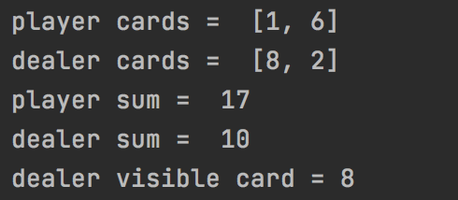
Environment
OpenAI Gym blackjack environment
Infinite Deck
Game initiates with 2 cards being randomly selected and dealt to both the player and the Dealer
The player can see their hand and 1 card from the dealer
Ex.

Slide 4
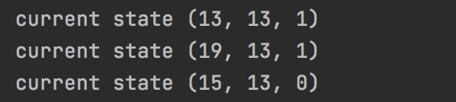
Actions
There are 2 actions that can be taken:
Ex.
(Player Total, Dealer Card, Hit/Stand)
Hit (1): additional card is dealt to the player
Stick (0): player keeps current hand as is
Once the player sticks, the dealer will repeatedly hit until their hand totals to 17 or more.
Rewards are given out based on the following scenarios:
Reward of -1 if the agent hits and busts or if the agent ends with a lower score than the dealer
Reward of 0 if the agent hits and doesn’t bust or if the agent and dealer end with the same score
Reward of 1 if the agent ends with a higher score than the dealer
Reward of 1.5 if the agent has a natural blackjack (face card/10 and an ace as initial two cards)

Slide 5
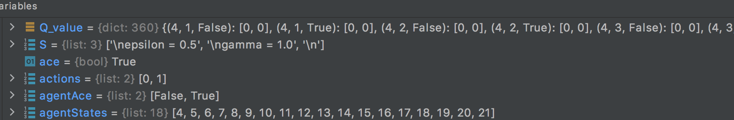
Setup
Dictionaries = Q value, Number of visits and Policy for state action pair
States were determined by the following values:
Agent hand total: Integer representing the total value of all cards in agent’s hand
Dealer card value: Integer representing the value of the dealer’s face-up card
Usable ace: Boolean representing whether or not the agent has a usable ace in hand. A usable ace means an ace that can be assigned a value of 11 without the hand busting
These 3 values make-up a tuple that is used as the key in the dictionaries to store and retrieve values for each action.

Slide 6
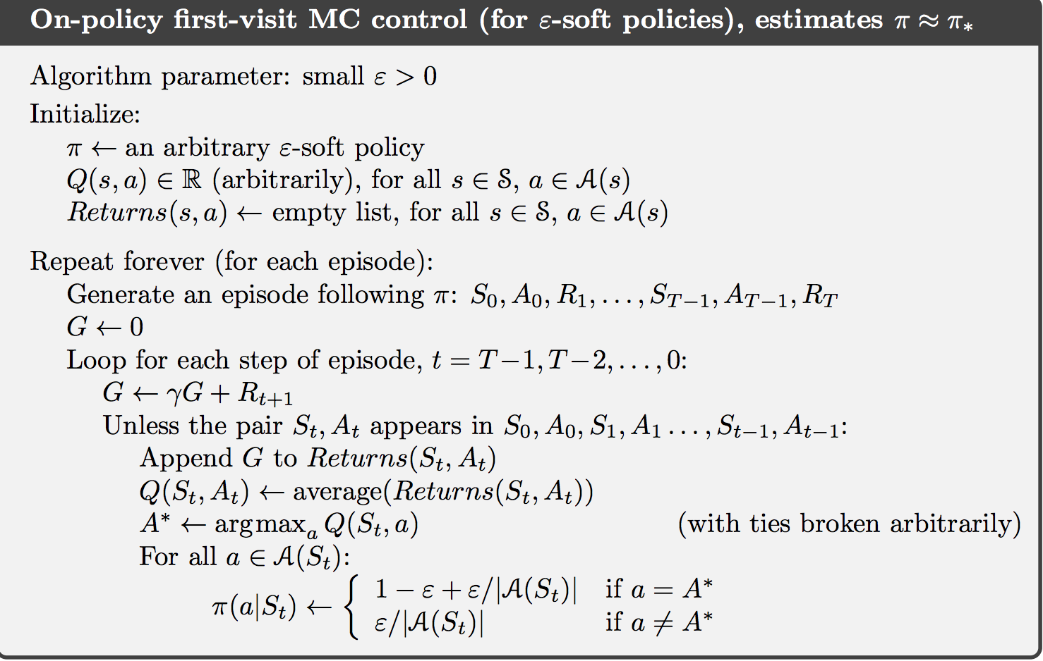
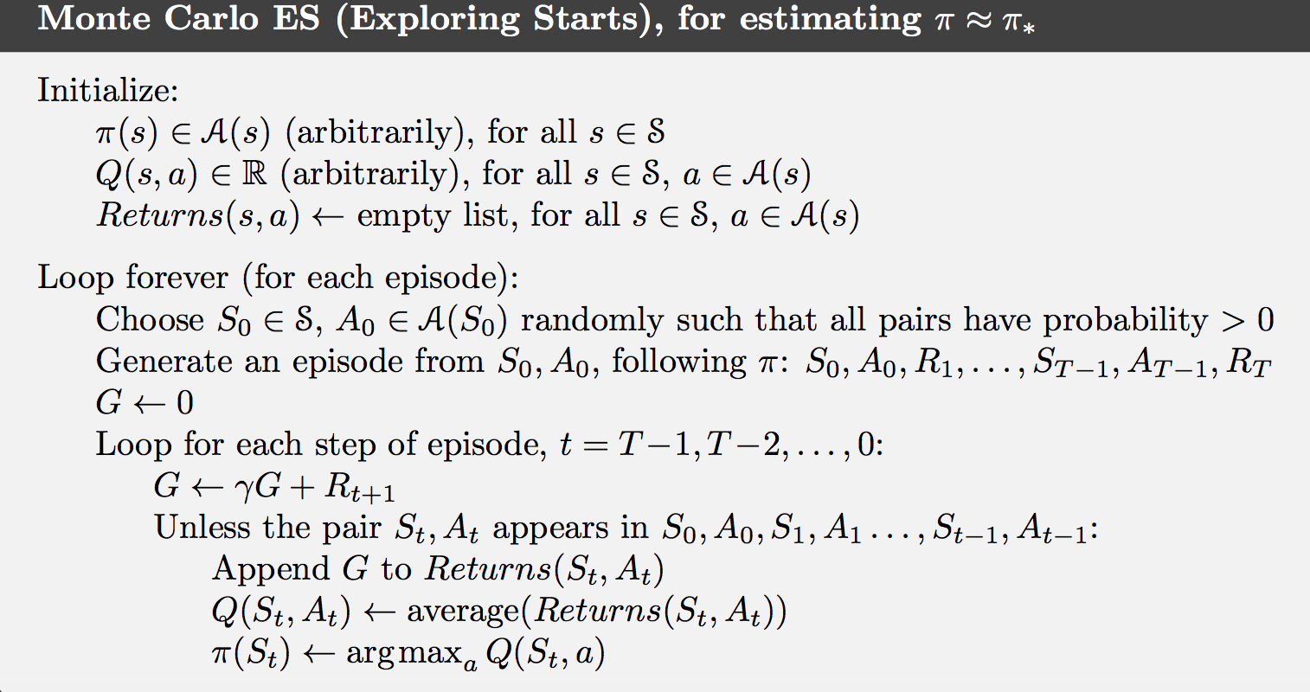
Methods and Model
Epsilon greedy policy improvement algorithm using Monte Carlo methods
First visit and every visit Monte Carlo policy evaluation
The functions used for the code in the monte carlo methods were based off those used in assignment 2.

Slide 7
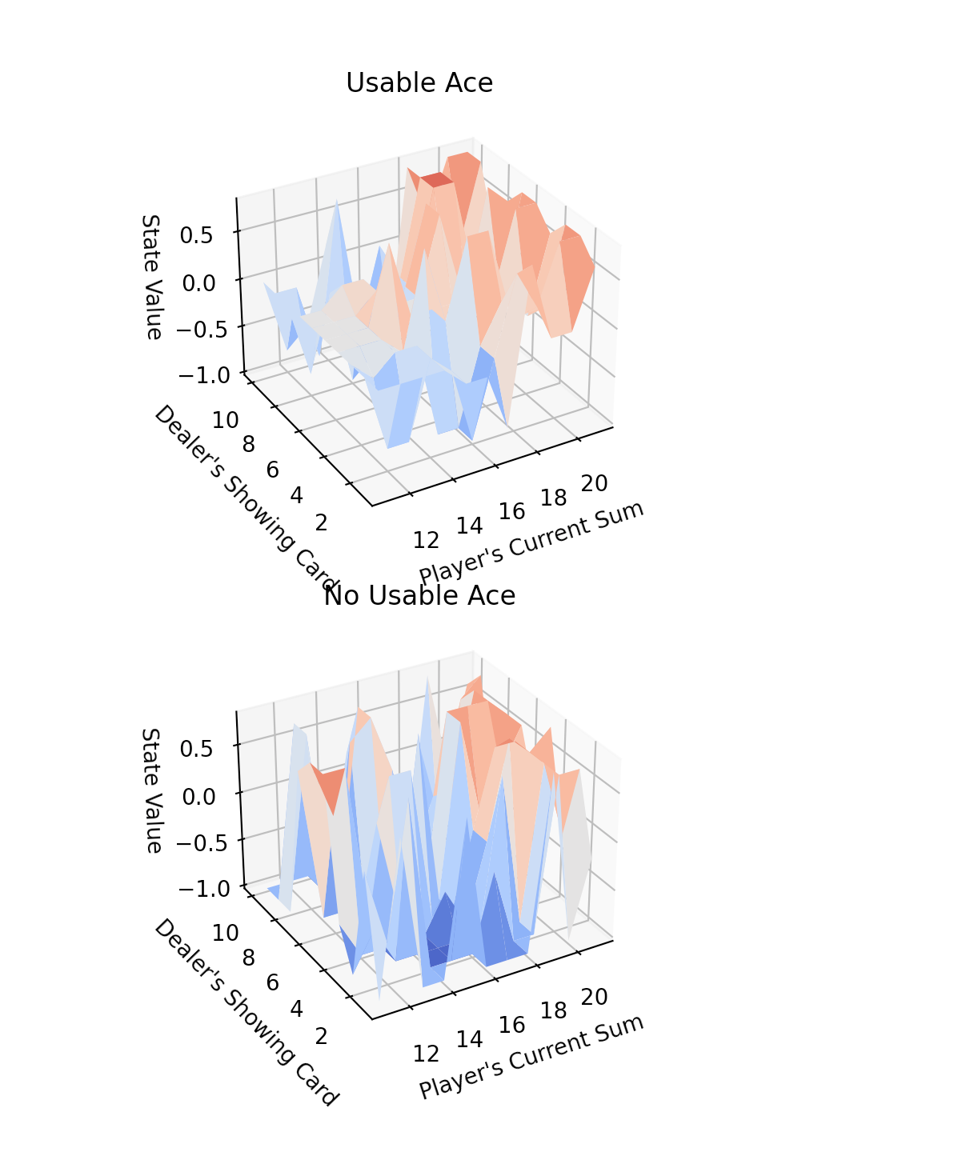
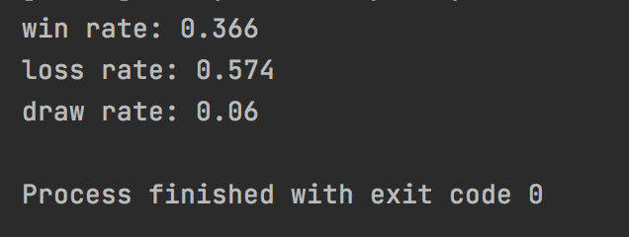
Control variables
State Value Ex.
Epsilon: We looked to determine an optimal balance between exploration and greedy decision making by the agent. We started with a decay rate of 1/iteration and fine tuned it from there. In some cases, we did not decay epsilon and kept it at a constant low value
Gamma: We tested with a couple of different gammas between the range of 0.3 and 1 to determine the effect of reduced delayed rewards on the agent’s learning
Number of games to train agent: We trained the agent for up to a million games and at different intervals, had the agent play 1000 games and looked at the win rate at these different intervals.
The success would be determined by the win rate and the how well the policy .
Win Rate Ex.

Slide 8
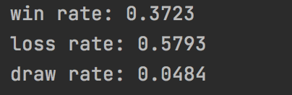
Results
Training = 1000, 5000 and 10000 games for most of the training.
Training = 50000 and 100000 games of training for some cases.
Agent plays 1000 games after training.
Objective 1: Beat an agent which always picks randomly
Objective 2: 42% win rate
Objective 3: Find out how gamma, epsilon, training episode number, and type of Monte Carlo effect the results.
Randomly Picking Hit or Stay 10k games

Slide 9
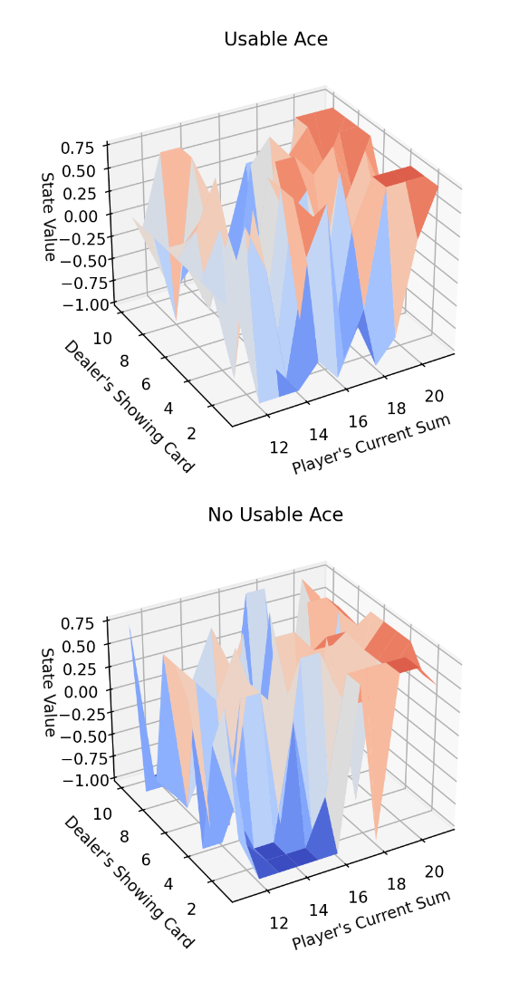
First Visit Monte Carlo Vs Every Visit Monte Carlo
First-visit Monte Carlo generated slightly better results but overall the difference was slight between every visit and First Visit
The win rate, regardless of the algorithm used, usually fell between 36% and 41%.
Gradual increase in win rate as the agent is trained more, but after 50000 the improvement is miniscule and takes a longtime to run.
Due to First-visit performing better it was used for the rest of the testing
 |  | 1000 games | 5000 games | 10000 games
First Visit MC | Win Rate | 0.374 | 0.385 | 0.409
 | Loss Rate | 0.537 | 0.544 | 0.524
 | Draw Rate | 0.089 | 0.071 | 0.067
Every Visit MC | Win Rate | 0.371 | 0.372 | 0.37
 | Loss Rate | 0.561 | 0.569 | 0.555
 | Draw Rate | 0.068 | 0.059 | 0.075
Fig 2: State Values for First-Visit Monte Carlo
Fig 1: Average agent stats when trained with first-visit and every-visit Monte Carlo Methods

Slide 10
Epsilon Effect on Training
3 variants
Epsilon = 1 / iterations
Epsilon = 1 - 1e⁻⁶ * iteration
Epsilon = 0.05

Slide 11
Epsilon Effect on Training
Epsilon = 1 / iterations: This was the base case the results are previously shown in First Visit Monte Carlo vs Every Visit Monte Carlo
 |  | 1000 games | 5000 games | 10000 games
First Visit MC | Win Rate | 0.374 | 0.385 | 0.409
 | Loss Rate | 0.537 | 0.544 | 0.524
 | Draw Rate | 0.089 | 0.071 | 0.067
Every Visit MC | Win Rate | 0.371 | 0.372 | 0.37
 | Loss Rate | 0.561 | 0.569 | 0.555
 | Draw Rate | 0.068 | 0.059 | 0.075
Fig 1: Average agent stats when trained with first-visit and every-visit Monte Carlo Methods
Fig 2: State Values for First-Visit Monte Carlo

Slide 12
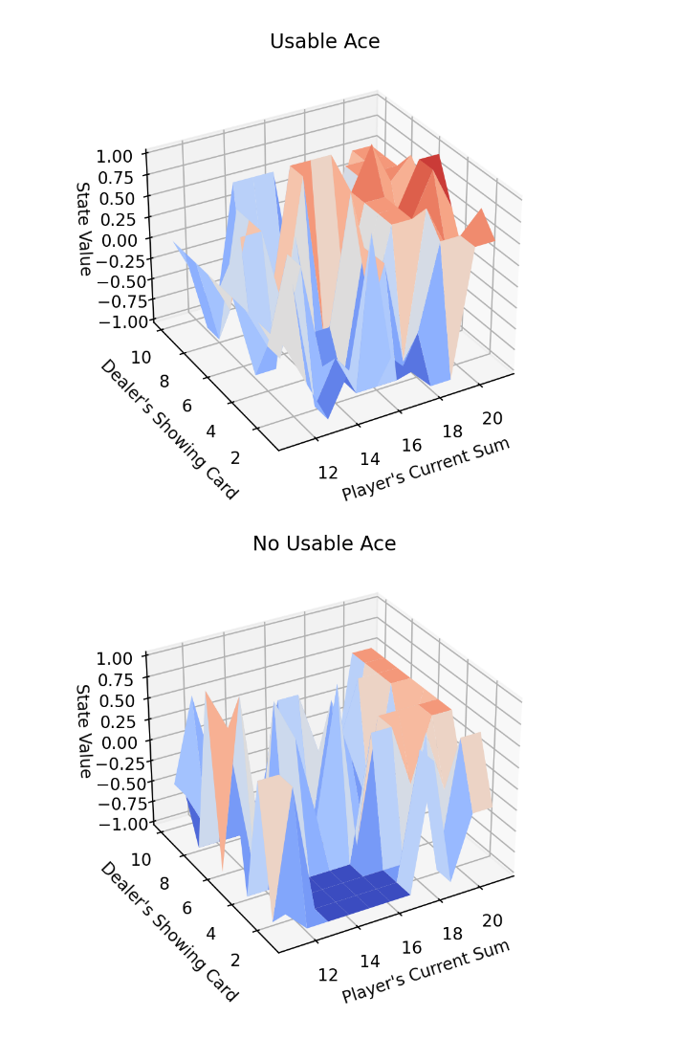
Epsilon Effect on Training
Epsilon = 1 - 1e⁻⁶ * iteration: We ran this one over the course of 100000 games, and all we got was the learning curve was less steep.
 | 1000 games | 5000 games | 10000 games | 50000 games | 100000 games
Win Rate | 0.27 | 0.27 | 0.279 | 0.331 | 0.389
Loss Rate | 0.668 | 0.668 | 0.673 | 0.603 | 0.532
Draw Rate | 0.04 | 0.04 | 0.048 | 0.066 | 0.079
Fig 3: Average agent stats trained with epsilon = 1 - 1e⁻⁶ * iteration
Fig 4: State values with slow decaying epsilon

Slide 13
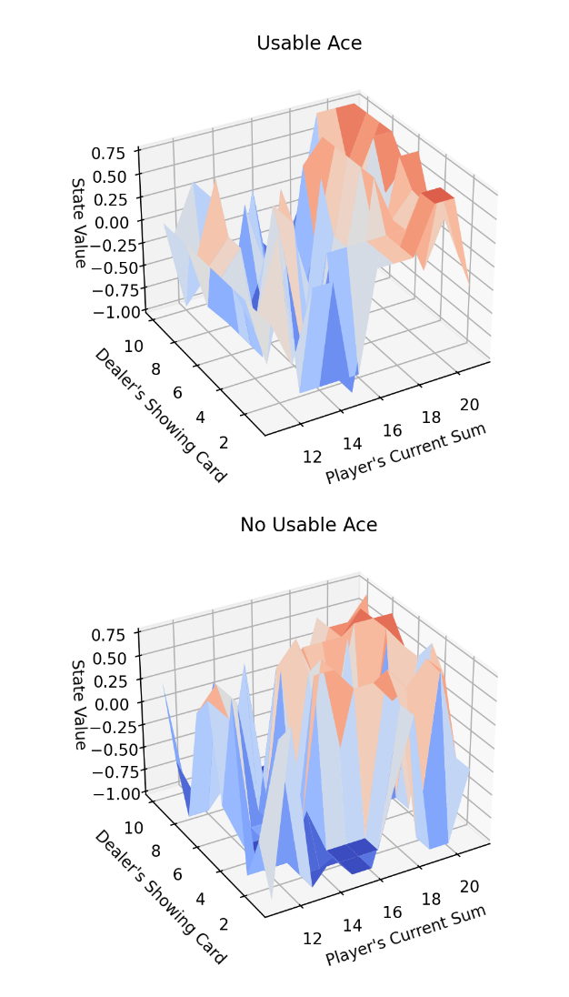
Epsilon Effect on Training
Epsilon = 0.05: Using a constant epsilon generated similar results when looking at win rate. There was steady learning before 10000 iterations and then the win rates level out after that.
 | 1000 games | 5000 games | 10000 games | 50000 games | 100000 games
Win Rate | 0.347 | 0.344 | 0.38 | 0.357 | 0.38
Loss Rate | 0.589 | 0.585 | 0.551 | 0.567 | 0.567
Draw Rate | 0.064 | 0.071 | 0.069 | 0.071 | 0.076
Fig 4: Average stats trained with constant 0.05 epsilon
Fig 5: State values with constant epsilon after 10000 iterations

Slide 14
Effect of Gamma on Training
Changing the gamma yielded similar results to the initial tests
Gamma value of 0.8 and 0.9 had no noticeable difference in the overall win rate
Through some tests the policy converged to the optimal policy to hit on lower player hand values sooner.
 | 1000 games | 5000 games | 10000 games
Win Rate | 0.366 | 0.404 | 0.406
Loss Rate | 0.573 | 0.572 | 0.527
Draw Rate | 0.061 | 0.059 | 0.067
 | 1000 games | 5000 games | 10000 games
Win Rate | 0.381 | 0.379 | 0.38
Loss Rate | 0.547 | 0.558 | 0.547
Draw Rate | 0.072 | 0.063 | 0.073
Fig 6: Average stats trained with 0.9 gamma
Fig 7: Average stats trained with 0.8 gamma

Slide 15
Future Testing
Test against multiple opponents
Implement card counting with a limited sized deck
Limiting the deck size
Running over 1 million iterations to flatten the state value graph
Implementing hand splitting and betting

Slide 16
Conclusion
The testing shows that the first implementation of the algorithm runs the best
To speed up training, reducing the gamma to slightly smaller than 1 can be used with and epsilon which decreases quickly or is already constant
Constant epsilon seems to be the best way to train the agent however the agent loses out on exploration doing this.

