Slide 1
Master’s thesis update
Péter Ivanics @ 11.07.2017.

Slide 2
Definitions
Data mining: the process of automatically discovering useful information in large repositories.
Data mining tasks:
Predictive: the goal is to predict a value of an unknown variable based on known input values.
Descriptive: identify patterns (based on statistical measures) that summarize underlying relationships in the data.
Dimensions/Features/Variables: the list of input fields of the data based on which the data mining task is performed.
Observations/Objects/Records: the objects that are described by the input attributes.

Slide 3

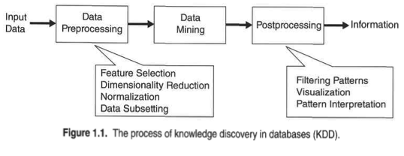

Slide 4
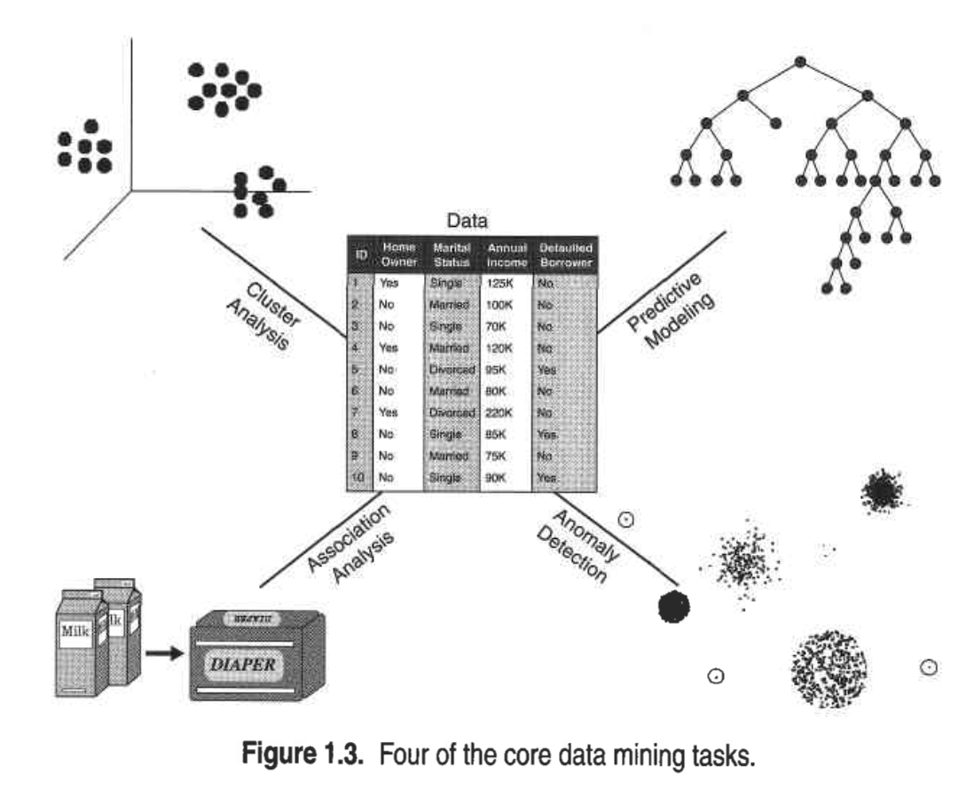
Identifying POIs based on location data
Document clustering
Classification
Optical Character Recognition
Shopping cart data analysis
Identifying web pages accessed together
Intrusion detection
Fraudulent usage detection

Slide 5
Related work
Analyzing Like Activities in Instagram
Structure - how does the like network of users look like?
Influence - what factors influence like activities (i.e. number of total followers, photos)?
Context - what kind of content is more likely to engage users?
=> two types of users (generalists & specialists) + self-promoters + high quality photos tend to get more likes
Faces Engage Us (Instagram)
Does content with human faces get more attention?
=> photos with faces are 38% more likely to receive likes and 32% more likely to receive comments
What We Instagram
What is the proportion of categories/themes posted in terms of picture (identified by computer vision)?
Clustering of users based on what do they spend likes on
Gender Roles and Behaviors on Pintrest
What are the usage pattern differences in terms of gender?
=> Females interact more + self-promoters + top categories by gender

Slide 6
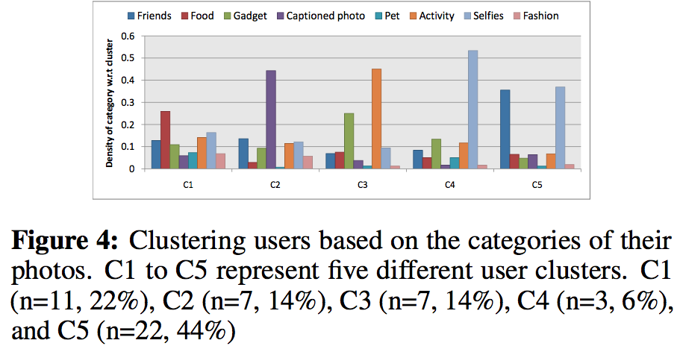

Slide 7
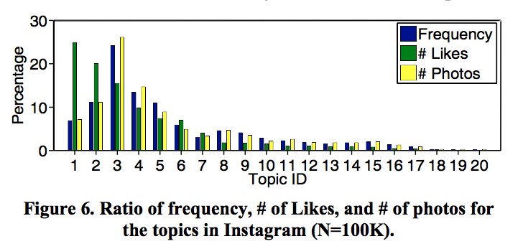

Slide 8
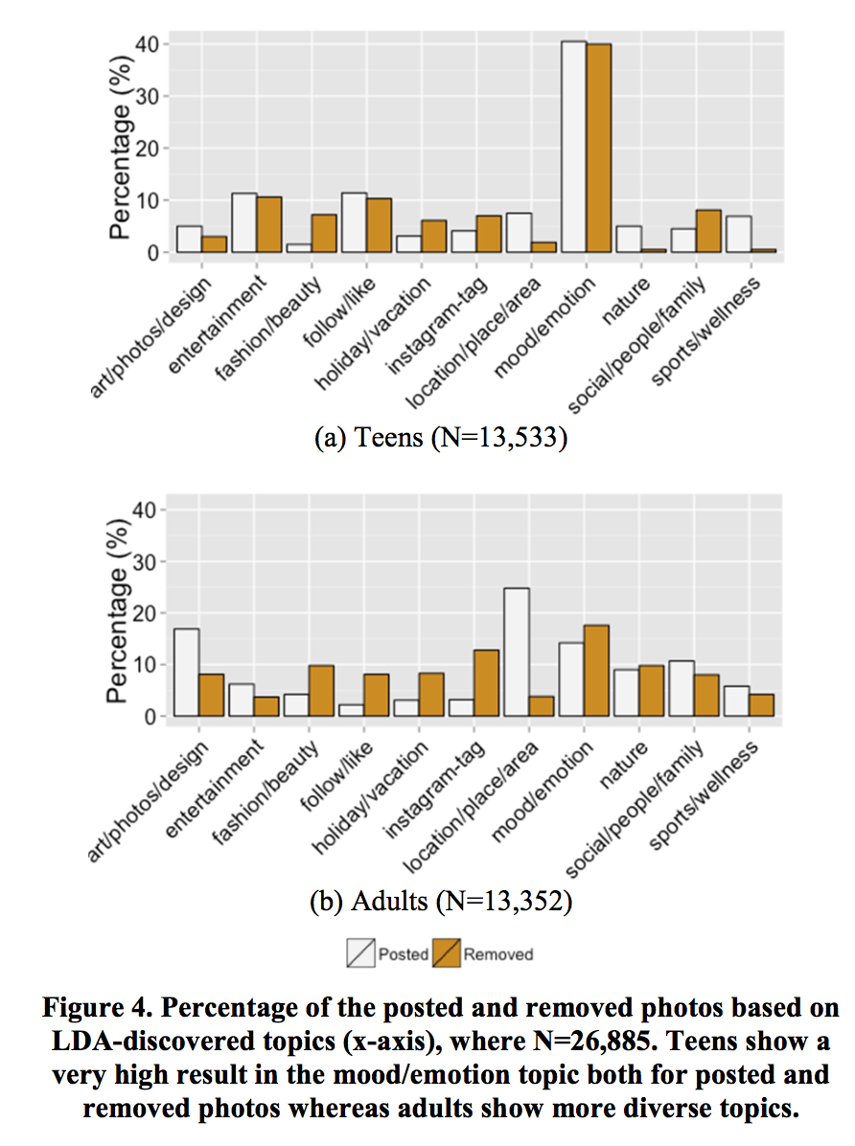

Slide 9
Research
How do users interact with the platform? What is the composition of the users, how they interact with the platform?
What kind of correlation lies behind the demographical distribution of the users and their expressed opinion, specifically focused on age, gender and location?
What kind of content is more/less popular? Why?
Can the system recommend new content for users based on prior activity?
Is it possible to predict results of upcoming contests?
Is it possible to detect outliers/anomalies/fraud usage based on the data?

Slide 10
Focus
Representative sample
Contests with small number of votes are excluded
Focus on contests in certain categories where we have expertise (e.g. beauty, sport)
Exclude users with incomplete profile?
Technology
Google Vision
Python (numpy/pandas, matplotlib)
R

Slide 11
Methods
T-test
LDA (Latent Dirichlet allocation)
Complementary Cumulative Distribution Function (CCDF)
Frequent Itemsets & Association Rule Learning

