Slide 1
Initialize unsorted list
[ 10 , -5 , 1 ]

Slide 2
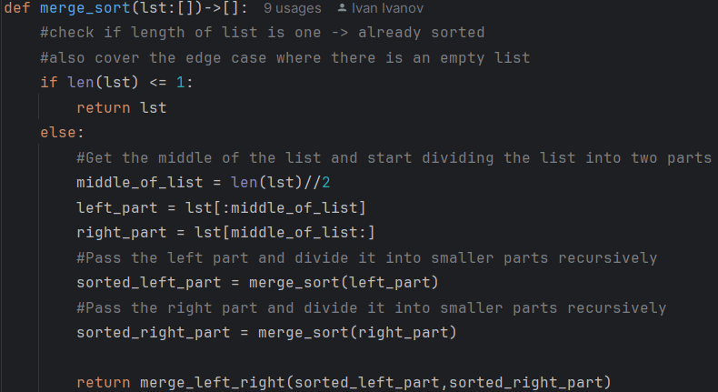
Enter merge_sort function
Initially the whole list [ 10 , -5 , 1 ] is passed as argument
Check the length ( 3 ) so go to the else block
Calculate the floor of the division by two to get the middle of the list ( 3 // 2 = 1 )
Split the list into left and right part left_part [ 10 ] , right_part [ -5 , 1 ]
Enter the recursion #1 for sorting the left and right parts. In this case the left part, having only one element is considered to be already sorted.

Slide 3
Entering the recursion for left_part # 1
The argument passed to the function is the list [10]
The if block will check the length and since it’s 1 will return the list [10] which is considered to be already sorted, as it has only one element.

Slide 4
Entering the recursion for right_part #1
The argument passed to the function is the list [-5 , 1] which contains two elements and the if block will check the length and go to the else block
Again the middle of the list will be calculated as 2 // 2 = 1
The left and right parts will be as follows : left_part = [-5] right_part = [1]
Enter the recursion #2 for sorting the left and right parts. In this case both the left and right parts, having only one element are considered to be already sorted.

Slide 5
Entering the recursion for left_part # 2
The argument passed to the function is the list [-5]
The if block will check the length and since it’s 1 will return the list [-5] which is considered to be already sorted, as it has only one element.

Slide 6
Entering the recursion for right_part # 2
The argument passed to the function is the list [1]
The if block will check the length and since it’s 1 will return the list [1] which is considered to be already sorted, as it has only one element.

Slide 7
Completing the recursive calls
After the completion of the recursive calls the variables sorted_left_part and sorted_right_part will be as follows : sorted_left_part = [-5] sorted_right_part = [1]
The function will go to the return merge_left_right(sorted_left_part,sorted_right_part) statement

Slide 8
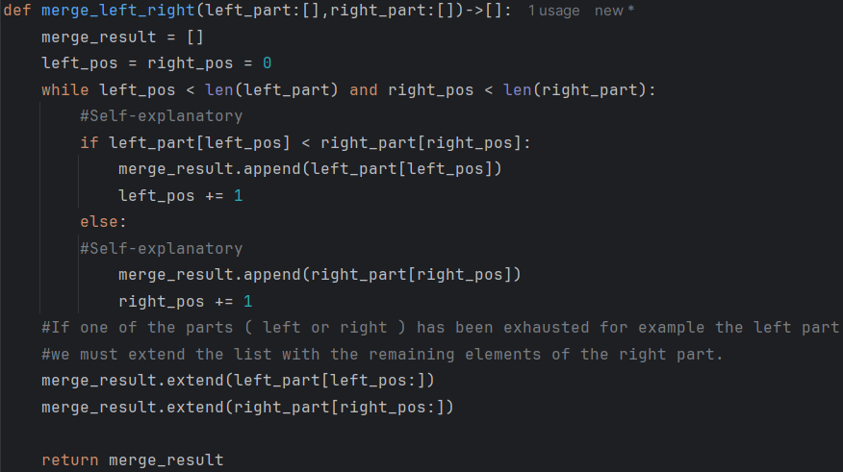
Entering the merge_left_right function #1
For clarity we will use a “shortened” implementation of the merge_left_right function, which will work only for comparison between floats and ints. The version which is able to work also with strings will be shown later.
The arguments passed to the function will be as follows : left_part = [-5] right_part = [1]
The left_pos and right_pos control which elements from left_part and right_part we compare during each iteration of the while loop. Initially left_pos and right_pos are set to 0 in order to start from the first elements of both lists.
The while loop will be executed until one of the lists has been traversed completely.

Slide 9
Entering the merge_left_right function #1
The if statement will compare the element at position 0 from left_part ( -5 ) and the element at position 0 from right_part ( 1 ). In this case the check will return True and the element -5 will be appended to merge_result list and left_pos will be incremented by 1.
The condition for exiting the while loop will be met, because left_pos has been set to 1 which will no longer meet the condition left_pos < len(left_part) # 1 < 1 will return False
The function will extend merge_result with the remainder of left_part and right_part lists : merge_result.extend(left_part[left_pos:]) will add 0 elements since left_pos is 1 and the length of left_part is 1. merge_result.extend(right_part[right_pos:]) will add 1 element ( 1 ) since right_pos is 0 and the length of right_part is 1.
merge_result will be equal to [ -5 , 1 ]

Slide 10
Entering the merge_left_right function #2
Another call to the function will be made. This time the arguments will be as follows : left_part = [10] right_part [-5 , 1]
The if statement will compare 10 from left part and -5 from right_part. This will return False and the code execution will enter the else block which will append -5 to the merge_result list. right_pos will be incremented by 1.
The if statement will compare 10 from left part and 1 from right_part. This will return False and the code execution will enter the else block which will append 1 to the merge_result list. right_pos will be incremented by 1.
The condition for breaking the while loop will be met since right_pos will be 2 and the length of right_part is also 2.

Slide 11
Entering the merge_left_right function #2
The function will extend merge_result with the contents of the remaining elements of left_part and right_part.
Since left_pos is still 0 it will add one element ( 10 ) to merge_result.
Since right_pos is already 2 the extend method will not add any elements to merge_result.
The function will return merge_result which is equal to [ -5 , 1 , 10 ]

Slide 12
Completion of merge_left_right function
After the completion of the merge_left_right function the code execution will return to the merge_sort function and will return the result of the merge_left_right function ( [-5 , 1 , 10] ) which is the expected result.
If we need reverse sorting we can “reverse” the already sorted list using some of the suitable methods available in Python, but this will increase the time and memory complexity of the algorithm, because additional looping through all elements will be executed.
Another possibility to sort in reverse is to modify the following line from the merge_left_right function if left_part[left_pos] < right_part[right_pos]: if left_part[left_pos] > right_part[right_pos]: which will not increase the complexity of the algorithm.

Slide 13
Working with strings
def merge_left_right(left_part:[],right_part:[])->[]: merge_result = [] left_pos = right_pos = 0 while left_pos < len(left_part) and right_pos < len(right_part): left_element = left_part[left_pos] right_element = right_part[right_pos] if isinstance(left_element,str) and isinstance(right_element,str): min_len = min(len(left_element),len(right_element)) cur_pos = 0 while cur_pos<min_len: left_element_code = ord(left_element[cur_pos]) right_element_code = ord(right_element[cur_pos]) #Self-explanatory if left_element_code < right_element_code: merge_result.append(left_element) left_pos +=1 | break elif left_element_code == right_element_code: if cur_pos<min_len-1: cur_pos +=1 else: if min_len == len(left_element): merge_result.append(left_element) left_pos +=1 break else: merge_result.append(right_element) right_pos +=1 break else: merge_result.append(right_element) right_pos +=1 break | elif isinstance(left_element,int|float) and isinstance(right_element,int|float): if left_part[left_pos] < right_part[right_pos]: merge_result.append(left_part[left_pos]) left_pos += 1 else: merge_result.append(right_part[right_pos]) right_pos += 1 else: raise TypeError("Types of list elements do not support sorting in such a way!") merge_result.extend(left_part[left_pos:]) merge_result.extend(right_part[right_pos:]) return merge_result

