Slide 1
How does revenue vary between the Information Technology and Financial sector?
In the following slides we are going to investigate the difference between the revenues in the Information Technology and financial sectors.
In the chart to the right, we can see that compared to the other sectors, both the IT and Financial sectors have similar total revenues at $3.7B and $3.4B respectively.

Slide 2
How does revenue vary between the Information Technology and Financial sector?
The sub industries within the financial sector that have the most companies are banks and property/casualty insurance companies.
In the information technology sector, almost 50% of the companies are internet & software services or semiconductor companies.

Slide 3
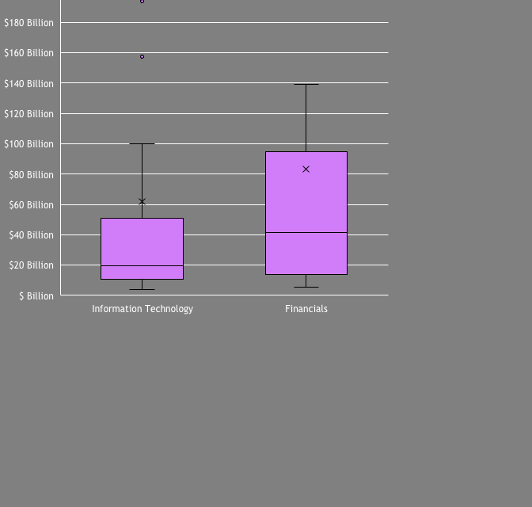
How does revenue vary between the Information Technology and Financial sector?
Here is a box & whisker plot of the information technology and financial sector company total revenues across all four years.
Both sectors have positively skewed revenues where the mean total revenues are higher than the median for both sectors. There are a few companies in the information technology sector which are much higher than most companies in the sector.
The mean for the IT sector is about $62 Billion which is slightly lower than the mean for the financial sector at about $83 Billion. The median total revenue is about $20 Billion which is less than half that of the financial sector which is at $42 Billion.
Where it gets interesting is the variability difference between the sectors. The IT sector has a range of $799 Billion with a standard deviation of $126 Billion, which is quite a bit larger than that of the financial sector with a range of $385 Billion and standard deviation of $106 Billion. This shows that there is a larger variability in the IT sector compared to the financial sector. In line with this, the company with the highest revenue in the IT sector has a revenue of $803 Billion which is much higher than the second highest with $376 Billion – this has pushed up the mean of revenues in the IT sector.

