Slide 1

Containers
C++ courses

Slide 2
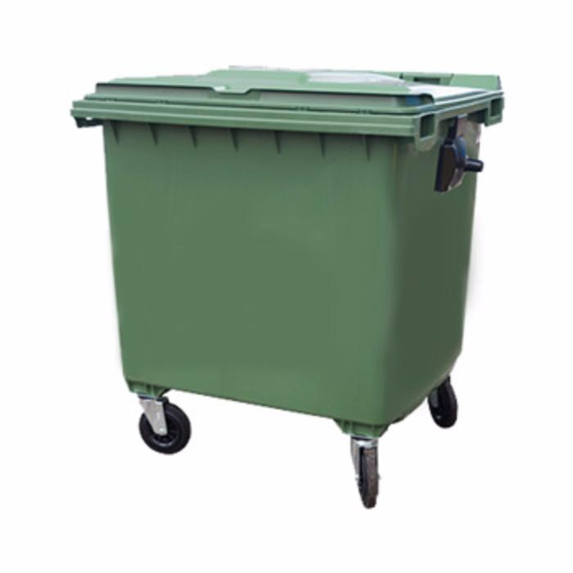
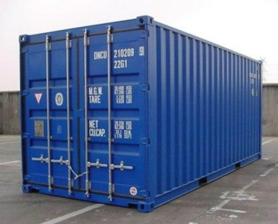
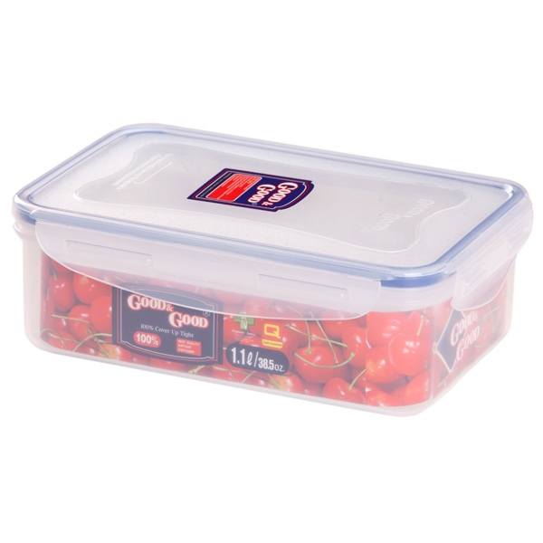
Containers

Slide 3
Containers
Data
Data
Data

Slide 4
Containers in STL
Sequence
Associative
Unordered associative
Auxiliary API
Container adaptors
Iterators

Slide 5
Sequence in STL
std::vector
std::array - since C++11
std::deque
std::forward_list - since C++11
std::list

Slide 6
Dynamic array – std::vector
std::vector<int> v(42); // Initial size is 42
v.push_back(1); // New size is 43
v.resize(142); // New size is 142
7
1
3
0
0

Slide 7
Dynamic array – std::vector
Capacity
7
1
3
0
0
Size

Slide 8
Dynamic array – std::vector (capacity extending)
7
1
3
2
2

Slide 9
Dynamic array – std::vector (capacity extending)
7
1
3
2
2

Slide 10
Dynamic array – std::vector (capacity extending)
7
1
3
2
2
7
1
3
2

Slide 11
Dynamic array – std::vector (capacity extending)
7
1
3
2
7
1
3
2
2

Slide 12
Dynamic array – std::vector (capacity extending)
7
1
3
2
2

Slide 13
Static array – std::array
Capacity
7
1
3
0
0
dc
dc
dc
Size

Slide 14
Static array – std::array
std::array<int, 42> arr; // Size is always 42
arr[0] = 1;
for (std::size_t i = 0; i < arr.size(); ++i)
arr[i] = 286;

Slide 15
std::deque
Double-ended queue
Provides API for insertion at the beginning and at the end
Provides the API for random access

Slide 16
std::list
7
2
5
10

Slide 17
std::forward_list
7
2
5
10

Slide 18
Sequences - complexity
vector deque list forward_list
push_back O(1)/O(N) O(1) O(1) O(1)/O(N)
push_front O(N) O(1) O(1) O(1)
Insert Mid O(N) O(N) O(1)/O(N) O(1)/O(N)
Erase Mid O(N) O(N) O(1)/O(N) O(1)/O(N)

Slide 19
Associative containers in STL
std::map
std::multimap
std::set
std::multiset

Slide 20
Associative containers
std::map<int, int> m;
m.insert(std::make_pair(1, 1)); // key is 1, value is 1
m.insert(std::make_pair(1, 10)); // Failed - key 1 is duplicated

Slide 21
Associative containers
std::map<int, int> m; // Unique keys, associated with values
std::multimap<int, int> mm; // Allows duplicated keys
std::set<int> s; // Unique elements
std::multiset<int> ms; // Duplicated elements

Slide 22
Associative containers
std::set<int> s;
s.insert(100);
s.insert(10);
s.insert(1);
1
10
100

Slide 23
Unordered Associative containers in STL
std::unordered_map
std::unordered_multimap
std::unordered_set
std::unordered_multiset

Slide 24
Associative containers
std::unordered_set<int> s;
s.insert(100);
s.insert(10);
s.insert(1);

Slide 25
Associative containers- average complexity
Ordered Unordered
Lookup O(log(N)) O(1)
Insertion O(log(N)) O(1)
Erase O(log(N)) O(1)

Slide 26
Container adaptors
template <typename T, typename Container = std::deque<T>>
class stack;

Slide 27
Container adaptors
std::stack;
std::queue;
std::priority_queue;

Slide 28
Container adaptors
template <typename T, typename Container = std::deque<T>>
class stack;
Contracts
Container should provide:
- back()
- push_back();
- pop_back();

