Slide 1
Compilation stages
C++ courses

Slide 2
Why compile?
Source C++ file — it is just code, it cannot be run as a program or used as a library.
Each source file must be compiled. Compilation result is typically executable or library(dynamic, static).

Slide 3
Compilation stages
Preprocessing
Compilation
Linkage

Slide 4
Preprocessor
Preprocessor behavior:
Removes comments.
Replaces #define macros with their values.
Selects the necessary pieces of code according to the conditions of #if, #ifdef and #ifndef.
Includes header files content.
Command example:
-E, run preprocessor for a given file without compilation.
–o, sets the name of the resulting file.
g++ -E 0001.cpp -o les1_compile.ii

Slide 5
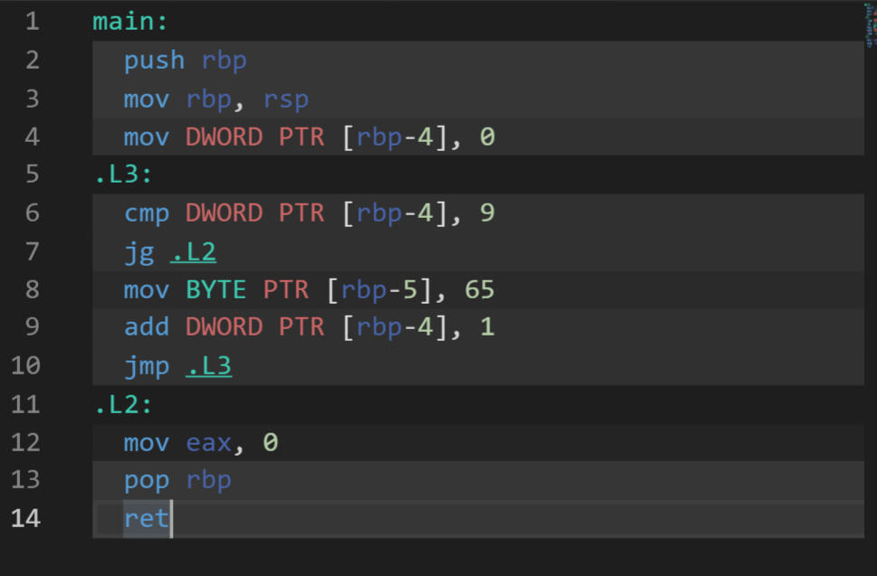
Compilation
At this step the compiler performs its main task - compiles, that is, converts the C++ code into lower level code (e.g. machine or assembler code).
This code is not yet linked with other files.

Slide 6
Linkage
The linker links all the object files and the static library into a single executable file or a library.
A symbol table is a data structure created by the compiler itself and stored in the object files themselves. The symbol table stores the names of variables and functions.

