Slide 1
Containers and introduction into initialization
C++ courses

Slide 2
Containers

Slide 3
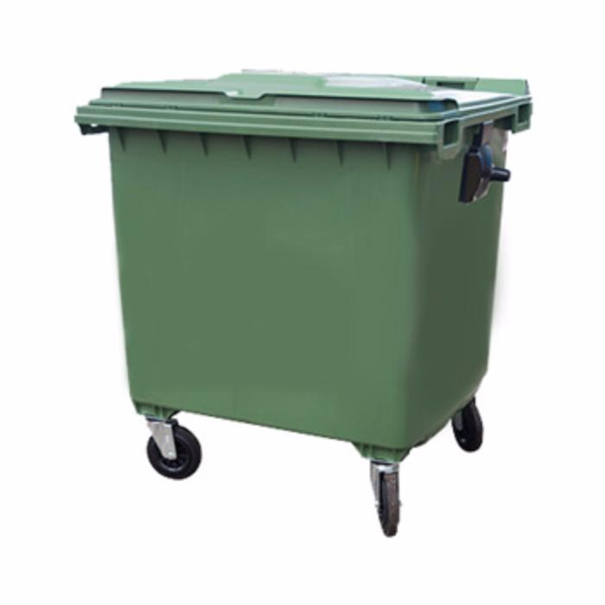
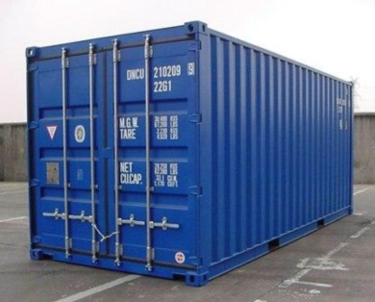
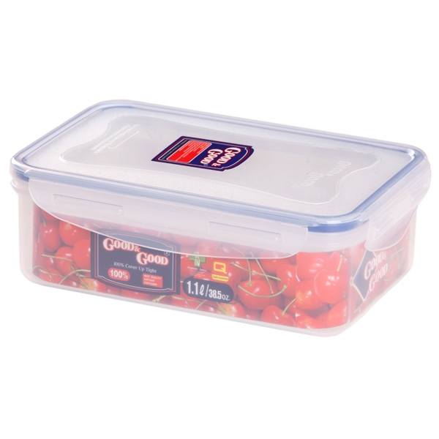
Containers

Slide 4
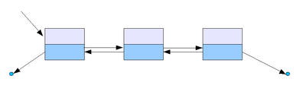
Containers

Slide 5
Containers in STL
Sequences
Associative
Unordered associative
Container adaptors
Auxiliary API
Iterators

Slide 6
Sequences in STL
std::vector
std::array - since C++11
std::deque
std::forward_list - since C++11
std::list

Slide 7
Dynamic array – std::vector
std::vector<int> v(42); // Initial size is 42
v.push_back(1); // New size is 43
v.resize(142); // New size is 142
7
1
3
0
0

Slide 8
Dynamic array – std::vector
Capacity
7
1
3
0
0
Size

Slide 9
Dynamic array – std::vector
7
1
3
2
2

Slide 10
Dynamic array – std::vector
7
1
3
2
2

Slide 11
Dynamic array – std::vector
7
1
3
2
2
7
1
3
2

Slide 12
Dynamic array – std::vector
7
1
3
2
7
1
3
2
2

Slide 13
Dynamic array – std::vector
7
1
3
2
2

Slide 14
Static array – std::array
7
1
3
2
2
std::array<int, 42> arr; // Size is always 42
arr[0] = 1;
for (std::size_t i = 0; i < arr.size(); ++i)
arr[i] = 286;

Slide 15
Std::deque
Doubly-ended queue
Provides API for growth in the beginning and in the end
Can be accessed by index

Slide 16
Std::list
7
2
5
10

Slide 17
Std::FORWARD_list
7
2
5
10

Slide 18
Sequences - complexity
vector deque list forward_list
push_back O(1)/O(N) O(1) O(1) O(1)/O(N)
push_front O(N) O(1) O(1) O(1)
Insert Mid O(N) O(N) O(1)/O(N) O(1)/O(N)
Erase Mid O(N) O(N) O(1)/O(N) O(1)/O(N)

Slide 19
Associative containers in STL
std::map
std::multimap
std::set
std::multiset

Slide 20
Associative containers
std::map<int, int> map;
map.insert(std::make_pair(1, 1)); // key is 1, value is 1
map.insert(std::make_pair(1, 10)); // Failed - key 1 is duplicated

Slide 21
Associative containers
std::map<int, int> map; // Unique keys, associated with values
std::multimap<int, int> mmap; // Allows duplicated keys
std::set<int> set; // Unique elements
std::multiset<int> mset; // Duplicated elements

Slide 22
Associative containers
std::set<int> s;
s.insert(100);
s.insert(10);
s.insert(1);
1
10
100

Slide 23
Unordered Associative containers in STL
std::unordered_map
std::unordered_multimap
std::unordered_set
std::unordered_multiset

Slide 24
Associative containers
std::unordered_set<int> s;
s.insert(100);
s.insert(10);
s.insert(1);

Slide 25
Associative containers- average complexity
Ordered Unordered
Lookup O(log(N)) O(1)
Insertion O(log(N)) O(1)
Erase O(log(N)) O(1)

Slide 26
Container adaptors
template <typename T, typename Container = std::deque<T>>
class stack;

Slide 27
Container adaptors
std::stack;
std::queue;
std::priority_queue;

Slide 28
Container adaptors
template <typename T, typename Container = std::deque<T>>
class stack;
Contracts
Container should provide:
- back()
- push_back();
- pop_back();

