Slide 1
GPU Fluid Simulation with Compute Shaders
Ivan Krukov
Advanced Computer Graphics
Spring 2020

Slide 2

Overview
Why Use Realistic Fluid Simulation?
Brief Overview of Compute Shaders
Navier Stokes Math/Implementation
Rendering Water
Custom Implementation Details/Shortcuts
Demo!

Slide 3

Why Use Navier Stokes?

Slide 4
Why Use Navier Stokes?
Very impressive looking results
Approximations can be done in real time
Interactions can be encoded with forces
Extendable outside of a graphics domain
Not limited to just water:
Realistic Smoke
Realistic Fire
Volumetric Clouds

Slide 5
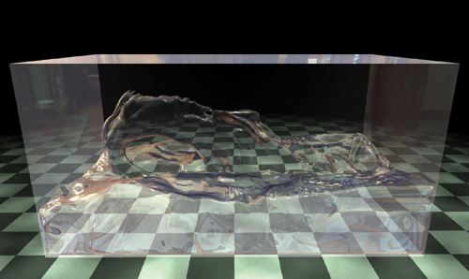
Why Use Navier Stokes?
From GPU Gems 3 chapter 30

Slide 6
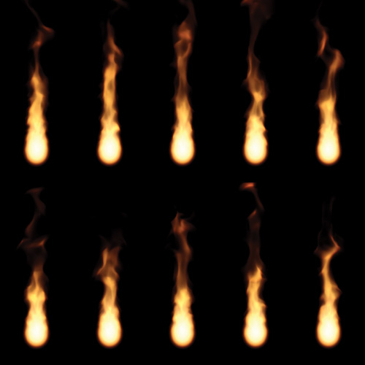
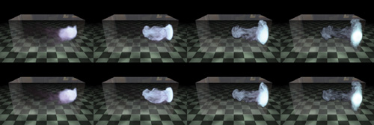
Why Use Navier Stokes?
https://paveldogreat.github.io/WebGL-Fluid-Simulation/
(images from GPU Gems
3 chapter 30)

Slide 7
Compute Shaders Overview

Slide 8
Compute Shaders
Completely separate from the rendering pipeline
Used for general-purpose computation/storing of values (a bit like OpenCL/CUDA)
Traditional approaches call for pixel shaders (I.e fragment shaders)
Some operations in our pipeline aren’t useful (per-fragment operations)
Less texture sampling per pixel
Opportunities for better parallelization

Slide 9
Compute Shaders: Work Groups
Execution split up into work groups
Each work group has a local size
Defined in shader (similar style to geometry shader)
Local invocations can share data through shared variables
glDispatchCompute(x, y, z)
Generally use work group to do a small workload

Slide 10
Compute Shaders: Storing Results
Don’t have “out” qualifier
Two ways to store results:
Image2D objects (texture units with imageStore)
SSBOs (access data like arrays)
Concurrency model in OpenGL means we have to be careful with reads/writes to the same object

Slide 11
Navier Stokes Implementation

Slide 12
Navier Stokes Equations
Incompressible, homogeneous fluid
Grid-based (cell represents “block” of fluid)
Four Components (applied in listed order):
Advection
Pressure
Diffusion
External Force

Slide 13
Navier Stokes: Advection
Fluid has some velocity
That velocity carries some quantity
Dye colors
Level Sets (“height” of the fluid)
Velocity itself
Solving: need to figure out divergence of velocity

Slide 14
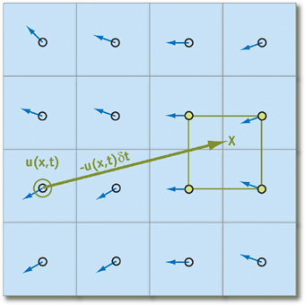
Navier Stokes: Advection
Velocity moving particles → simply move things around like a particle system in time!
Step back using velocity, bilerp to approximate quantity at that point
Appeal of rectangular textures
Notes:
Can start with standard Euler’s method of forward integration (or Rungee Kutta if you are fancy) to find the position of a particle in a future timestep, but unstable. Also more of a fragment shader issue, can’t write to different fragments
Opt more for an implicit method (where does our particle move at this time? Trace back velocity

Slide 15
Navier Stokes: Pressure
Force has a delayed propagation
Pressure build-up in the fluid causes acceleration (Newton’s Second Law)
Complex to compute: Gradient Operator

Slide 16
Navier Stokes: Viscous Diffusion
Fluids have varying consistencies/thicknesses (water versus maple syrup)
Resistance to flow → diffusion of momentum
Need to solve Laplacian Operator

Slide 17
Mathematical Approximations
Helmholtz-Hodge Decomposition Theorem
Field w = divergence free field (u) + gradient of a scalar field (p)
Pressure

Slide 18

Mathematical Approximations: Diffusion
Consider Diffusion term in explicit/discrete terms:
Just like advection, should use more stable form:
Laplacian Operator in this form can then be solved using jacobi iteration (slow, but easy to implement)

Slide 19

Jacobi Iteration
Technique to iteratively relax discrete form of the Laplacian operator
We can use the same formula to calculate the pressure gradient
More accurate with more iterations
Easy to implement, but S L O W

Slide 20
Jacobi Iteration Parameters
Diffusion: 20-50 iterations; x = b = velocity
α = (dx)^2/(ν * dt)
β = 4 + (dx)^2)/ν * dt)
Pressure: 40-80 iterations; x = pressure; b = div v
α = -(dx)^2
β = 4
(dx is the scale of our grid, usually 1, dt timestep)

Slide 21
Navier Stokes: External Force
Acceleration caused by external forces (gravity, pulling a hand through water, wind)
Simplest of them all: No calculus required!

Slide 22
Enforcing Boundary Conditions
Due to assertion of a stable fluid, need assertions on the boundaries of our textures to be well-posed:
No-Slip Condition: V → 0 as we approach a boundary
Sampling centers → need average of two cells next to boundary to equal zero
Pure Neumann Boundary Condition (dp/dn = 0)
Derivative approximation works out to the exact same code as velocity boundary conditions!
Notes:
(pressure with respect to normal of the boundary is zero, needed to have correct solution to Poisson pressure)

Slide 23
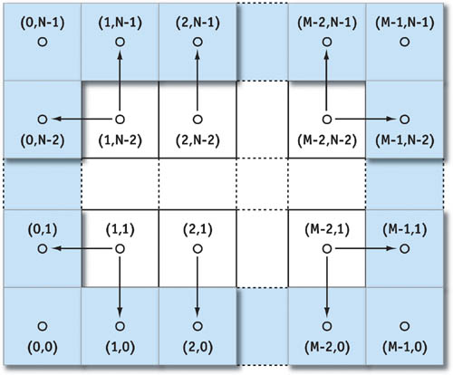
Enforcing Boundary Conditions

Slide 24
Rendering Water

Slide 25
3D Rendering of Water
After computing passes of each Navier Stokes Component, we have a 3D texture
But this only represents fluid velocity!
How do we represent a 3D volume and actually draw it?

Slide 26
The Level Set
Use a Level Set! (Advection to update per-frame)
Signed distance from cell center to surface
X < 0 → Cell contains water
X > 0 → Cell contains air
X = 0 → Exact point of fluid surface
Potential Optimization: Mask Computations
If the cell contains air, don’t care about pressure, external forces

Slide 27
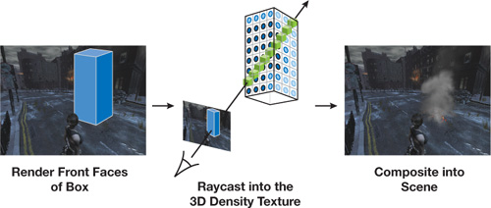
The Level Set: Rendering
Use 6 quads to represent space fluid takes
Perform Ray Marching until we find X = 0
shade it with a surface fragment shader
compute normal with the gradient

Slide 28
Fluid Lighting
Currently use PBR combined with reflection and base color (reflectance derived from roughness parameter)
Some research looks at different BRDF than Torrance-Sparrow (in particular with Gerstner waves)
Less uniform distribution of microfacets (Gaussian Distribution based) (Ward, Ross BRDF)
Ross good for varying LODs, self shadowing of waves, parameters from satellite data

Slide 29
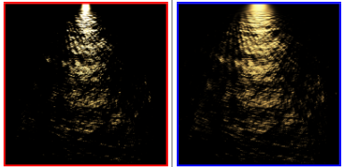
Ocean BRDF
https://hal.inria.fr/inria-00443630/file/article-1.pdf

Slide 30
Implementation Challenges
Traditional Fluid Simulation (3D) is complex:
Computation: 3d version of Navier Stokes (straightforward from 2D)
Rendering: Ray march through a 3d (or multiple 2d) level set texture(s)
Navier stokes depends on some sort of interaction (external force) and initial conditions
Had to figure out parameters that would look natural for something like a river

Slide 31
Custom Approach to Rendering
Use a single 2d textured level set as a cheap height/bump map
Make the river appear continuous by:
Initializing a level set with random values (advection smooths things out after a second)
Applying a constant field of force to the fluid
Setting values of the level set on the edge of the fluid

Slide 32
Demo

Slide 33
Further Readings
3D Fluid Rendering (including smoke)
https://developer.nvidia.com/gpugems/gpugems3/part-v-physics-simulation/chapter-30-real-time-simulation-and-rendering-3d-fluids
Navier Stokes on the GPU
https://developer.nvidia.com/gpugems/gpugems/part-vi-beyond-triangles/chapter-38-fast-fluid-dynamics-simulation-gpu
Ocean BRDF
https://hal.inria.fr/inria-00443630/file/article-1.pdf
The Book has good sample code for using compute shaders and PBR

