Slide 1
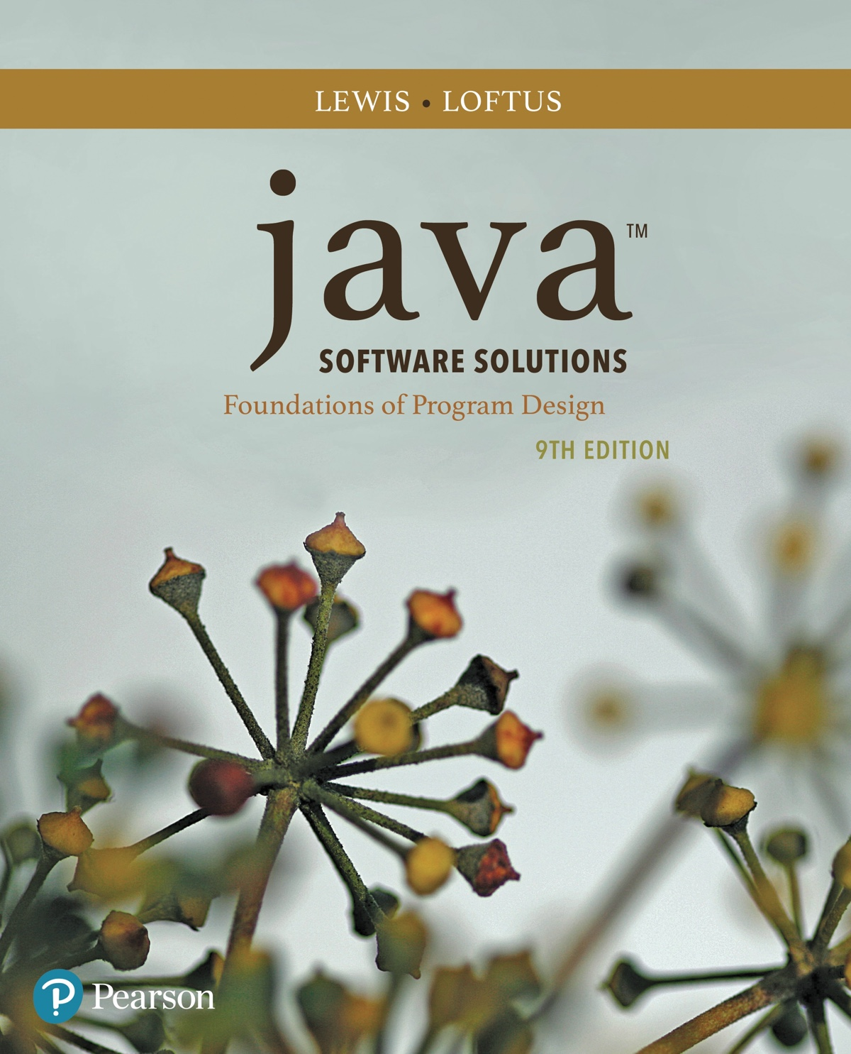
Chapter 3 Using Classes and Objects
Java Software Solutions
Foundations of Program Design
9th Edition
John Lewis
William Loftus

Slide 2
Using Classes and Objects
We can create more interesting programs using predefined classes and related objects
Chapter 3 focuses on:
object creation and object references
the String class and its methods
the Java API class library
the Random and Math classes
formatting output
enumerated types
wrapper classes
JavaFX graphics API
shape classes

Slide 3
Outline
Creating Objects
The String Class
The Random and Math Classes
Formatting Output
Enumerated Types
Wrapper Classes
Introduction to JavaFX
Shapes and Color

Slide 4
Creating Objects
A variable holds either a primitive value or a reference to an object
A class name can be used as a type to declare an object reference variable
String title;
No object is created with this declaration
An object reference variable holds the address of an object
The object itself must be created separately

Slide 5
Creating Objects
Generally, we use the new operator to create an object
Creating an object is called instantiation
An object is an instance of a particular class
title = new String("Java Software Solutions");
This calls the String constructor, which is
a special method that sets up the object

Slide 6
Invoking Methods
We've seen that once an object has been instantiated, we can use the dot operator to invoke its methods
numChars = title.length()
A method may return a value, which can be used in an assignment or expression
A method invocation can be thought of as asking an object to perform a service

Slide 7
References
Note that a primitive variable contains the value itself, but an object variable contains the address of the object
An object reference can be thought of as a pointer to the location of the object
Rather than dealing with arbitrary addresses, we often depict a reference graphically
num1
38
name1
"Steve Jobs"

Slide 8
Assignment Revisited
The act of assignment takes a copy of a value and stores it in a variable
For primitive types:
num1
38
Before:
num2
96
num2 = num1;
num1
38
After:
num2
38

Slide 9
Reference Assignment
For object references, assignment copies the address:
name1
"Steve Jobs"
Before:
name2
"Steve Wozniak"
name2 = name1;
name1
"Steve Jobs"
After:
name2

Slide 10
Aliases
Two or more references that refer to the same object are called aliases of each other
That creates an interesting situation: one object can be accessed using multiple reference variables
Aliases can be useful, but should be managed carefully
Changing an object through one reference changes it for all of its aliases, because there is really only one object

Slide 11
Garbage Collection
When an object no longer has any valid references to it, it can no longer be accessed by the program
The object is useless, and therefore is called garbage
Java performs automatic garbage collection periodically, returning an object's memory to the system for future use
In other languages, the programmer is responsible for performing garbage collection

Slide 12
Outline
Creating Objects
The String Class
The Random and Math Classes
Formatting Output
Enumerated Types
Wrapper Classes
Introduction to JavaFX
Shapes and Color

Slide 13
The String Class
Because strings are so common, we don't have to use the new operator to create a String object
title = "Java Software Solutions";
This is special syntax that works only for strings
Each string literal (enclosed in double quotes) represents a String object

Slide 14
String Methods
Once a String object has been created, neither its value nor its length can be changed
Therefore we say that an object of the String class is immutable
However, several methods of the String class return new String objects that are modified versions of the original

Slide 15
String Indexes
It is occasionally helpful to refer to a particular character within a string
This can be done by specifying the character's numeric index
The indexes begin at zero in each string
In the string "Hello", the character 'H' is at index 0 and the 'o' is at index 4
See StringMutation.java

Slide 16
//********************************************************************
// StringMutation.java Author: Lewis/Loftus
//
// Demonstrates the use of the String class and its methods.
//********************************************************************
public class StringMutation
{
//-----------------------------------------------------------------
// Prints a string and various mutations of it.
//-----------------------------------------------------------------
public static void main(String[] args)
{
String phrase = "Change is inevitable";
String mutation1, mutation2, mutation3, mutation4;
System.out.println("Original string: \"" + phrase + "\"");
System.out.println("Length of string: " + phrase.length());
mutation1 = phrase.concat(", except from vending machines.");
mutation2 = mutation1.toUpperCase();
mutation3 = mutation2.replace('E', 'X');
mutation4 = mutation3.substring(3, 30);
continued

Slide 17
continued
// Print each mutated string
System.out.println("Mutation #1: " + mutation1);
System.out.println("Mutation #2: " + mutation2);
System.out.println("Mutation #3: " + mutation3);
System.out.println("Mutation #4: " + mutation4);
System.out.println("Mutated length: " + mutation4.length());
}
}

Slide 18
Output
Original string: "Change is inevitable"
Length of string: 20
Mutation #1: Change is inevitable, except from vending machines.
Mutation #2: CHANGE IS INEVITABLE, EXCEPT FROM VENDING MACHINES.
Mutation #3: CHANGX IS INXVITABLX, XXCXPT FROM VXNDING MACHINXS.
Mutation #4: NGX IS INXVITABLX, XXCXPT F
Mutated length: 27
continued
// Print each mutated string
System.out.println("Mutation #1: " + mutation1);
System.out.println("Mutation #2: " + mutation2);
System.out.println("Mutation #3: " + mutation3);
System.out.println("Mutation #4: " + mutation4);
System.out.println("Mutated length: " + mutation4.length());
}
}

Slide 19
Quick Check
What output is produced by the following?
String str = "Space, the final frontier.";
System.out.println(str.length());
System.out.println(str.substring(7));
System.out.println(str.toUpperCase());
System.out.println(str.length());

Slide 20
Quick Check
What output is produced by the following?
String str = "Space, the final frontier.";
System.out.println(str.length());
System.out.println(str.substring(7));
System.out.println(str.toUpperCase());
System.out.println(str.length());
26
the final frontier.
SPACE, THE FINAL FRONTIER.
26

Slide 21
Outline
Creating Objects
The String Class
The Random and Math Classes
Formatting Output
Enumerated Types
Wrapper Classes
Introduction to JavaFX
Shapes and Color

Slide 22
Class Libraries
A class library is a collection of classes that we can use when developing programs
The Java standard class library is part of any Java development environment
Its classes are not part of the Java language per se, but we rely on them heavily
Various classes we've already used (System , Scanner, String) are part of the Java standard class library

Slide 23
The Java API
The Java class library is sometimes referred to as the Java API
API stands for Application Programming Interface
Clusters of related classes are sometimes referred to as specific APIs:
The JavaFX API
The Database API

Slide 24
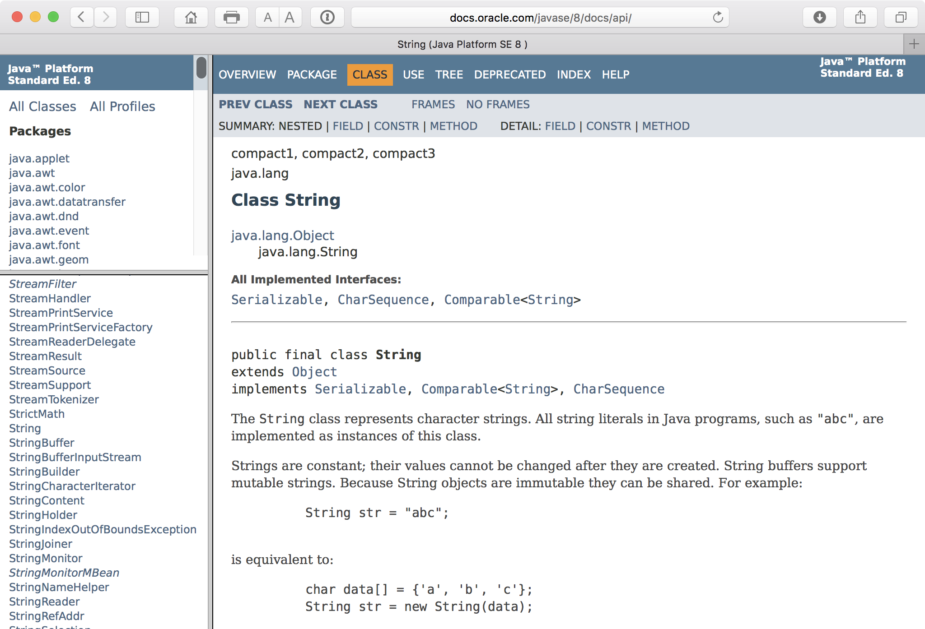
The Java API
Get comfortable using the online Java API documentation

Slide 25
Packages
For purposes of accessing them, classes in the Java API are organized into packages
These often overlap with specific APIs
Examples:
Package
java.lang
java.util
java.net
javafx.scene.shape
javafx.scene.control
Purpose
General support
Utilities
Network communication
Graphical shapes
GUI controls

Slide 26
The import Declaration
When you want to use a class from a package, you could use its fully qualified name
java.util.Scanner
Or you can import the class, and then use just the class name
import java.util.Scanner;
To import all classes in a particular package, you can use the * wildcard character
import java.util.*;

Slide 27
The import Declaration
All classes of the java.lang package are imported automatically into all programs
It's as if all programs contain the following line:
import java.lang.*;
That's why we didn't have to import the System or String classes explicitly in earlier programs
The Scanner class, on the other hand, is part of the java.util package, and therefore must be imported

Slide 28
The Random Class
The Random class is part of the java.util package
It provides methods that generate pseudorandom numbers
A Random object performs complicated calculations based on a seed value to produce a stream of seemingly random values
See RandomNumbers.java

Slide 29
//********************************************************************
// RandomNumbers.java Author: Lewis/Loftus
//
// Demonstrates the creation of pseudo-random numbers using the
// Random class.
//********************************************************************
import java.util.Random;
public class RandomNumbers
{
//-----------------------------------------------------------------
// Generates random numbers in various ranges.
//-----------------------------------------------------------------
public static void main(String[] args)
{
Random generator = new Random();
int num1;
float num2;
num1 = generator.nextInt();
System.out.println("A random integer: " + num1);
num1 = generator.nextInt(10);
System.out.println("From 0 to 9: " + num1);
continued

Slide 30
continued
num1 = generator.nextInt(10) + 1;
System.out.println("From 1 to 10: " + num1);
num1 = generator.nextInt(15) + 20;
System.out.println("From 20 to 34: " + num1);
num1 = generator.nextInt(20) - 10;
System.out.println("From -10 to 9: " + num1);
num2 = generator.nextFloat();
System.out.println("A random float (between 0-1): " + num2);
num2 = generator.nextFloat() * 6; // 0.0 to 5.999999
num1 = (int)num2 + 1;
System.out.println("From 1 to 6: " + num1);
}
}

Slide 31
Sample Run
A random integer: 672981683
From 0 to 9: 0
From 1 to 10: 3
From 20 to 34: 30
From -10 to 9: -4
A random float (between 0-1): 0.18538326
From 1 to 6: 3
continued
num1 = generator.nextInt(10) + 1;
System.out.println ("From 1 to 10: " + num1);
num1 = generator.nextInt(15) + 20;
System.out.println ("From 20 to 34: " + num1);
num1 = generator.nextInt(20) - 10;
System.out.println ("From -10 to 9: " + num1);
num2 = generator.nextFloat();
System.out.println("A random float (between 0-1): " + num2);
num2 = generator.nextFloat() * 6; // 0.0 to 5.999999
num1 = (int)num2 + 1;
System.out.println("From 1 to 6: " + num1);
}
}

Slide 32
Quick Check
Given a Random object named gen, what range of values are produced by the following expressions?
gen.nextInt(25)
gen.nextInt(6) + 1
gen.nextInt(100) + 10
gen.nextInt(50) + 100
gen.nextInt(10) – 5
gen.nextInt(22) + 12

Slide 33
Quick Check
Given a Random object named gen, what range of values are produced by the following expressions?
Range
0 to 24
1 to 6
10 to 109
100 to 149
-5 to 4
12 to 33
gen.nextInt(25)
gen.nextInt(6) + 1
gen.nextInt(100) + 10
gen.nextInt(50) + 100
gen.nextInt(10) – 5
gen.nextInt(22) + 12

Slide 34
Quick Check
Write an expression that produces a random integer in the following ranges:
Range
0 to 12
1 to 20
15 to 20
-10 to 0

Slide 35
Quick Check
Write an expression that produces a random integer in the following ranges:
Range
0 to 12
1 to 20
15 to 20
-10 to 0
gen.nextInt(13)
gen.nextInt(20) + 1
gen.nextInt(6) + 15
gen.nextInt(11) – 10

Slide 36
The Math Class
The Math class is part of the java.lang package
The Math class contains methods that perform various mathematical functions
These include:
absolute value
square root
exponentiation
trigonometric functions

Slide 37
The Math Class
The methods of the Math class are static methods (also called class methods)
Static methods are invoked through the class name – no object of the Math class is needed
value = Math.cos(90) + Math.sqrt(delta);
We discuss static methods further in Chapter 7
See Quadratic.java

Slide 38
//********************************************************************
// Quadratic.java Author: Lewis/Loftus
//
// Demonstrates the use of the Math class to perform a calculation
// based on user input.
//********************************************************************
import java.util.Scanner;
public class Quadratic
{
//-----------------------------------------------------------------
// Determines the roots of a quadratic equation.
//-----------------------------------------------------------------
public static void main(String[] args)
{
int a, b, c; // ax^2 + bx + c
double discriminant, root1, root2;
Scanner scan = new Scanner(System.in);
System.out.print("Enter the coefficient of x squared: ");
a = scan.nextInt();
continued

Slide 39
continued
System.out.print("Enter the coefficient of x: ");
b = scan.nextInt();
System.out.print("Enter the constant: ");
c = scan.nextInt();
// Use the quadratic formula to compute the roots.
// Assumes a positive discriminant.
discriminant = Math.pow(b, 2) - (4 * a * c);
root1 = ((-1 * b) + Math.sqrt(discriminant)) / (2 * a);
root2 = ((-1 * b) - Math.sqrt(discriminant)) / (2 * a);
System.out.println("Root #1: " + root1);
System.out.println("Root #2: " + root2);
}
}

Slide 40
Sample Run
Enter the coefficient of x squared: 3
Enter the coefficient of x: 8
Enter the constant: 4
Root #1: -0.6666666666666666
Root #2: -2.0
continued
System.out.print("Enter the coefficient of x: ");
b = scan.nextInt();
System.out.print("Enter the constant: ");
c = scan.nextInt();
// Use the quadratic formula to compute the roots.
// Assumes a positive discriminant.
discriminant = Math.pow(b, 2) - (4 * a * c);
root1 = ((-1 * b) + Math.sqrt(discriminant)) / (2 * a);
root2 = ((-1 * b) - Math.sqrt(discriminant)) / (2 * a);
System.out.println("Root #1: " + root1);
System.out.println("Root #2: " + root2);
}
}

Slide 41
Outline
Creating Objects
The String Class
The Random and Math Classes
Formatting Output
Enumerated Types
Wrapper Classes
Introduction to JavaFX
Shapes and Color

Slide 42
Formatting Output
It is often necessary to format output values in certain ways so that they can be presented properly
The Java standard class library contains classes that provide formatting capabilities
The NumberFormat class allows you to format values as currency or percentages
The DecimalFormat class allows you to format values based on a pattern
Both are part of the java.text package

Slide 43
Formatting Output
The NumberFormat class has static methods that return a formatter object
getCurrencyInstance()
getPercentInstance()
Each formatter object has a method called format that returns a string with the specified information in the appropriate format
See Purchase.java

Slide 44
//********************************************************************
// Purchase.java Author: Lewis/Loftus
//
// Demonstrates the use of the NumberFormat class to format output.
//********************************************************************
import java.util.Scanner;
import java.text.NumberFormat;
public class Purchase
{
//-----------------------------------------------------------------
// Calculates the final price of a purchased item using values
// entered by the user.
//-----------------------------------------------------------------
public static void main(String[] args)
{
final double TAX_RATE = 0.06; // 6% sales tax
int quantity;
double subtotal, tax, totalCost, unitPrice;
Scanner scan = new Scanner(System.in);
continued

Slide 45
continued
NumberFormat fmt1 = NumberFormat.getCurrencyInstance();
NumberFormat fmt2 = NumberFormat.getPercentInstance();
System.out.print("Enter the quantity: ");
quantity = scan.nextInt();
System.out.print("Enter the unit price: ");
unitPrice = scan.nextDouble();
subtotal = quantity * unitPrice;
tax = subtotal * TAX_RATE;
totalCost = subtotal + tax;
// Print output with appropriate formatting
System.out.println("Subtotal: " + fmt1.format(subtotal));
System.out.println("Tax: " + fmt1.format(tax) + " at "
+ fmt2.format(TAX_RATE));
System.out.println("Total: " + fmt1.format(totalCost));
}
}

Slide 46
Sample Run
Enter the quantity: 5
Enter the unit price: 3.87
Subtotal: $19.35
Tax: $1.16 at 6%
Total: $20.51
continued
NumberFormat fmt1 = NumberFormat.getCurrencyInstance();
NumberFormat fmt2 = NumberFormat.getPercentInstance();
System.out.print("Enter the quantity: ");
quantity = scan.nextInt();
System.out.print("Enter the unit price: ");
unitPrice = scan.nextDouble();
subtotal = quantity * unitPrice;
tax = subtotal * TAX_RATE;
totalCost = subtotal + tax;
// Print output with appropriate formatting
System.out.println("Subtotal: " + fmt1.format(subtotal));
System.out.println("Tax: " + fmt1.format(tax) + " at "
+ fmt2.format(TAX_RATE));
System.out.println("Total: " + fmt1.format(totalCost));
}
}

Slide 47
Formatting Output
The DecimalFormat class can be used to format a floating point value in various ways
For example, you can specify that the number should be truncated to three decimal places
The constructor of the DecimalFormat class takes a string that represents a pattern for the formatted number
See CircleStats.java

Slide 48
//********************************************************************
// CircleStats.java Author: Lewis/Loftus
//
// Demonstrates the formatting of decimal values using the
// DecimalFormat class.
//********************************************************************
import java.util.Scanner;
import java.text.DecimalFormat;
public class CircleStats
{
//-----------------------------------------------------------------
// Calculates the area and circumference of a circle given its
// radius.
//-----------------------------------------------------------------
public static void main(String[] args)
{
int radius;
double area, circumference;
Scanner scan = new Scanner(System.in);
continued

Slide 49
continued
System.out.print("Enter the circle's radius: ");
radius = scan.nextInt();
area = Math.PI * Math.pow(radius, 2);
circumference = 2 * Math.PI * radius;
// Round the output to three decimal places
DecimalFormat fmt = new DecimalFormat("0.###");
System.out.println("The circle's area: " + fmt.format(area));
System.out.println("The circle's circumference: "
+ fmt.format(circumference));
}
}

Slide 50
Sample Run
Enter the circle's radius: 5
The circle's area: 78.54
The circle's circumference: 31.416
continued
System.out.print("Enter the circle's radius: ");
radius = scan.nextInt();
area = Math.PI * Math.pow(radius, 2);
circumference = 2 * Math.PI * radius;
// Round the output to three decimal places
DecimalFormat fmt = new DecimalFormat("0.###");
System.out.println("The circle's area: " + fmt.format(area));
System.out.println("The circle's circumference: "
+ fmt.format(circumference));
}
}

Slide 51
Outline
Creating Objects
The String Class
The Random and Math Classes
Formatting Output
Enumerated Types
Wrapper Classes
Introduction to JavaFX
Shapes and Color

Slide 52
Enumerated Types
Java allows you to define an enumerated type, which can then be used to declare variables
An enumerated type declaration lists all possible values for a variable of that type
The values are identifiers of your own choosing
The following declaration creates an enumerated type called Season
enum Season {winter, spring, summer, fall};
Any number of values can be listed

Slide 53
Enumerated Types
Once a type is defined, a variable of that type can be declared:
Season time;
And it can be assigned a value:
time = Season.fall;
The values are referenced through the name of the type
Enumerated types are type-safe – you cannot assign any value other than those listed

Slide 54
Ordinal Values
Internally, each value of an enumerated type is stored as an integer, called its ordinal value
The first value in an enumerated type has an ordinal value of zero, the second one, and so on
However, you cannot assign a numeric value to an enumerated type, even if it corresponds to a valid ordinal value

Slide 55
Enumerated Types
The declaration of an enumerated type is a special type of class, and each variable of that type is an object
The ordinal method returns the ordinal value of the object
The name method returns the name of the identifier corresponding to the object's value
See IceCream.java

Slide 56
//********************************************************************
// IceCream.java Author: Lewis/Loftus
//
// Demonstrates the use of enumerated types.
//********************************************************************
public class IceCream
{
enum Flavor {vanilla, chocolate, strawberry, fudgeRipple, coffee,
rockyRoad, mintChocolateChip, cookieDough}
//-----------------------------------------------------------------
// Creates and uses variables of the Flavor type.
//-----------------------------------------------------------------
public static void main(String[] args)
{
Flavor cone1, cone2, cone3;
cone1 = Flavor.rockyRoad;
cone2 = Flavor.chocolate;
System.out.println("cone1 value: " + cone1);
System.out.println("cone1 ordinal: " + cone1.ordinal());
System.out.println("cone1 name: " + cone1.name());
continued

Slide 57
continued
System.out.println();
System.out.println("cone2 value: " + cone2);
System.out.println("cone2 ordinal: " + cone2.ordinal());
System.out.println("cone2 name: " + cone2.name());
cone3 = cone1;
System.out.println();
System.out.println("cone3 value: " + cone3);
System.out.println("cone3 ordinal: " + cone3.ordinal());
System.out.println("cone3 name: " + cone3.name());
}
}

Slide 58
Output
cone1 value: rockyRoad
cone1 ordinal: 5
cone1 name: rockyRoad
cone2 value: chocolate
cone2 ordinal: 1
cone2 name: chocolate
cone3 value: rockyRoad
cone3 ordinal: 5
cone3 name: rockyRoad
continued
System.out.println();
System.out.println("cone2 value: " + cone2);
System.out.println("cone2 ordinal: " + cone2.ordinal());
System.out.println("cone2 name: " + cone2.name());
cone3 = cone1;
System.out.println();
System.out.println("cone3 value: " + cone3);
System.out.println("cone3 ordinal: " + cone3.ordinal());
System.out.println("cone3 name: " + cone3.name());
}
}

Slide 59
Outline
Creating Objects
The String Class
The Random and Math Classes
Formatting Output
Enumerated Types
Wrapper Classes
Introduction to JavaFX
Shapes and Color

Slide 60
Wrapper Classes
The java.lang package contains wrapper classes that correspond to each primitive type:
Primitive Type | Wrapper Class
byte | Byte
short | Short
int | Integer
long | Long
float | Float
double | Double
char | Character
boolean | Boolean

Slide 61
Wrapper Classes
The following declaration creates an Integer object which represents the integer 40 as an object
Integer age = new Integer(40);
An object of a wrapper class can be used in any situation where a primitive value will not suffice
For example, some objects serve as containers of other objects
Primitive values could not be stored in such containers, but wrapper objects could be

Slide 62
Wrapper Classes
Wrapper classes also contain static methods that help manage the associated type
For example, the Integer class contains a method to convert an integer stored in a String to an int value:
num = Integer.parseInt(str);
They often contain useful constants as well
For example, the Integer class contains MIN_VALUE and MAX_VALUE which hold the smallest and largest int values

Slide 63
Autoboxing
Autoboxing is the automatic conversion of a primitive value to a corresponding wrapper object:
Integer obj;
int num = 42;
obj = num;
The assignment creates the appropriate Integer object
The reverse conversion (called unboxing) also occurs automatically as needed

Slide 64
Quick Check
Are the following assignments valid? Explain.
Double value = 15.75;
Character ch = new Character('T');
char myChar = ch;

Slide 65
Quick Check
Are the following assignments valid? Explain.
Double value = 15.75;
Character ch = new Character('T');
char myChar = ch;
Yes. The double literal is autoboxed into a Double object.
Yes, the char in the object is unboxed before the assignment.

Slide 66
Outline
Creating Objects
The String Class
The Random and Math Classes
Formatting Output
Enumerated Types
Wrapper Classes
Introduction to JavaFX
Shapes and Color

Slide 67
Intro to JavaFX
The programs we've explored thus far have been text-based
They are called command-line applications, which interact with the user using simple text prompts
We’ll now begin to explore programs that use graphics and graphical user interfaces (GUIs)
Support for these programs will come from the JavaFX API
JavaFX has replaced older approaches (AWT and Swing)

Slide 68
Intro to JavaFX
JavaFX programs extend the Application class, inheriting core graphical functionality
A JavaFX program has a start method
The main method is only needed to launch the JavaFX application
The start method accepts the primary stage (window) used by the program as a parameter
JavaFX embraces a theatre analogy
See HelloJavaFX.java

Slide 69
//************************************************************************
// HelloJavaFX.java Author: Lewis/Loftus
//
// Demonstrates a basic JavaFX application.
//************************************************************************
import javafx.application.Application;
import javafx.scene.Group;
import javafx.scene.Scene;
import javafx.scene.paint.Color;
import javafx.scene.text.Text;
import javafx.stage.Stage;
public class HelloJavaFX extends Application
{
//--------------------------------------------------------------------
// Creates and displays two Text objects in a JavaFX window.
//--------------------------------------------------------------------
public void start(Stage primaryStage)
{
Text hello = new Text(50, 50, "Hello, JavaFX!");
Text question = new Text(120, 80, "How's it going?");
Group root = new Group(hello, question);
Scene scene = new Scene(root, 300, 120, Color.LIGHTGREEN);
continued

Slide 70
continued
primaryStage.setTitle("A JavaFX Program");
primaryStage.setScene(scene);
primaryStage.show();
}
//--------------------------------------------------------------------
// Launches the JavaFX application. This method is not required
// in IDEs that launch JavaFX applications automatically.
//--------------------------------------------------------------------
public static void main(String[] args)
{
launch(args);
}
}

Slide 71
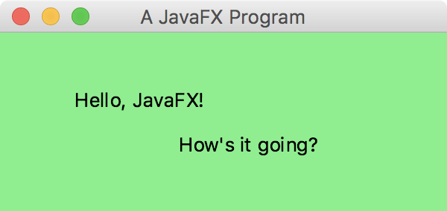
continued
primaryStage.setTitle("A JavaFX Program");
primaryStage.setScene(scene);
primaryStage.show();
}
//--------------------------------------------------------------------
// Launches the JavaFX application. This method is not required
// in IDEs that launch JavaFX applications automatically.
//--------------------------------------------------------------------
public static void main(String[] args)
{
launch(args);
}
}

Slide 72
Intro to JavaFX
In this example, two Text objects are added to a Group
The group serves as the root node of a Scene
The scene is displayed on the primary Stage (window)
The size and background color of the scene can be set when the Scene object is created
The position of each Text object is specified explicitly (in this case)

Slide 73
Intro to JavaFX
The origin of the Java coordinate system is in the upper left corner
All visible points have positive coordinates
(0, 0)
112
X
40
(112, 40)
Y

Slide 74
Outline
Creating Objects
The String Class
The Random and Math Classes
Formatting Output
Enumerated Types
Wrapper Classes
Introduction to JavaFX
Shapes and Color

Slide 75
Basic Shapes
JavaFX shapes are represented by classes in the javafx.scene.shape package
A line segment is defined by the Line class, whose constructor accepts the coordinates of the two endpoints:
Line(startX, startY, endX, endY)
For example:
Line myLine = new Line(10, 20, 300, 80);

Slide 76
Basic Shapes
A rectangle is specified by its upper left corner and its width and height:
Rectangle(x, y, width, height)
Rectangle r = new Rectangle(30, 50, 200, 70);
A circle is specified by its center point and radius:
Circle(centerX, centerY, radius)
Circle c = new Circle(100, 150, 40);

Slide 77
Basic Shapes
An ellipse is specified by its center point and its radius along the x and y axis:
Ellipse(centerX, centerY, radiusX, radiusY)
Ellipse e = new Ellipse(100, 50, 80, 30);
Shapes are drawn in the order in which they are added to the group
The stroke and fill of each shape can be set
See Einstein.java

Slide 78
//************************************************************************
// Einstein.java Author: Lewis/Loftus
//
// Demonstrates the use of various shape classes.
//************************************************************************
import javafx.application.Application;
import javafx.scene.Group;
import javafx.scene.Scene;
import javafx.scene.paint.Color;
import javafx.scene.shape.*;
import javafx.scene.text.Text;
import javafx.stage.Stage;
public class Einstein extends Application
{
//--------------------------------------------------------------------
// Creates and displays several shapes.
//--------------------------------------------------------------------
public void start(Stage primaryStage)
{
Line line = new Line(35, 60, 150, 170);
Circle circle = new Circle(100, 65, 20);
circle.setFill(Color.BLUE);
continued

Slide 79
continued
Rectangle rect = new Rectangle(60, 70, 250, 60);
rect.setStroke(Color.RED);
rect.setStrokeWidth(2);
rect.setFill(null);
Ellipse ellipse = new Ellipse(200, 100, 150, 50);
ellipse.setFill(Color.PALEGREEN);
Text quote = new Text(120, 100, "Out of clutter, find " +
"simplicity.\n-- Albert Einstein");
Group root = new Group(ellipse, rect, circle, line, quote);
Scene scene = new Scene(root, 400, 200);
primaryStage.setTitle("Einstein");
primaryStage.setScene(scene);
primaryStage.show();
}
// We will typically exclude the main method. Use it to launch
// the application if needed.
}

Slide 80
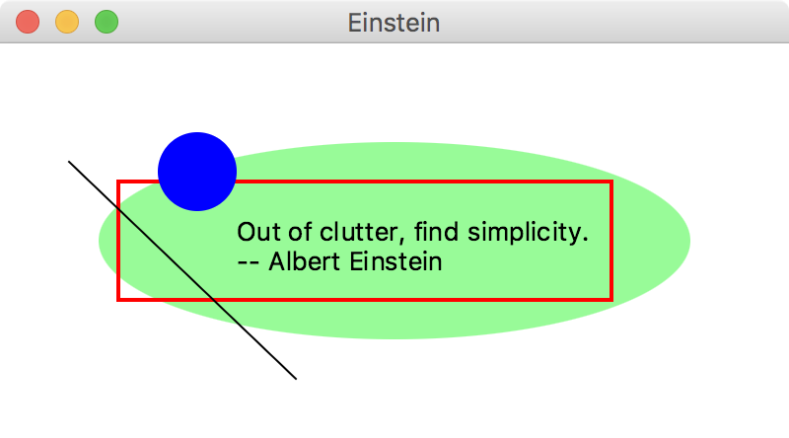
continued
Rectangle rect = new Rectangle(60, 70, 250, 60);
rect.setStroke(Color.RED);
rect.setStrokeWidth(2);
rect.setFill(null);
Ellipse ellipse = new Ellipse(200, 100, 150, 50);
ellipse.setFill(Color.PALEGREEN);
Text quote = new Text(120, 100, "Out of clutter, find " +
"simplicity.\n-- Albert Einstein");
Group root = new Group(ellipse, rect, circle, line, quote);
Scene scene = new Scene(root, 400, 200);
primaryStage.setTitle("Einstein");
primaryStage.setScene(scene);
primaryStage.show();
}
// We will typically exclude the main method. Use it to launch
// the application if needed.
}

Slide 81
Basic Shapes
Groups can be nested within groups
Translating a shape or group shifts its position along the x or y axis
A shape or group can be rotated using the setRotate method
See Snowman.java

Slide 82
//************************************************************************
// Snowman.java Author: Lewis/Loftus
//
// Demonstrates the translation of a set of shapes.
//************************************************************************
import javafx.application.Application;
import javafx.stage.Stage;
import javafx.scene.Group;
import javafx.scene.Scene;
import javafx.scene.paint.Color;
import javafx.scene.shape.*;
public class Snowman extends Application
{
//--------------------------------------------------------------------
// Presents a snowman scene.
//--------------------------------------------------------------------
public void start(Stage primaryStage)
{
Ellipse base = new Ellipse(80, 210, 80, 60);
base.setFill(Color.WHITE);
Ellipse middle = new Ellipse(80, 130, 50, 40);
middle.setFill(Color.WHITE);
continued

Slide 83
continued
Circle head = new Circle(80, 70, 30);
head.setFill(Color.WHITE);
Circle rightEye = new Circle(70, 60, 5);
Circle leftEye = new Circle(90, 60, 5);
Line mouth = new Line(70, 80, 90, 80);
Circle topButton = new Circle(80, 120, 6);
topButton.setFill(Color.RED);
Circle bottomButton = new Circle(80, 140, 6);
bottomButton.setFill(Color.RED);
Line leftArm = new Line(110, 130, 160, 130);
leftArm.setStrokeWidth(3);
Line rightArm = new Line(50, 130, 0, 100);
rightArm.setStrokeWidth(3);
Rectangle stovepipe = new Rectangle(60, 0, 40, 50);
Rectangle brim = new Rectangle(50, 45, 60, 5);
Group hat = new Group(stovepipe, brim);
hat.setTranslateX(10);
hat.setRotate(15);
continued

Slide 84
continued
Group snowman = new Group(base, middle, head, leftEye, rightEye,
mouth, topButton, bottomButton, leftArm, rightArm, hat);
snowman.setTranslateX(170);
snowman.setTranslateY(50);
Circle sun = new Circle(50, 50, 30);
sun.setFill(Color.GOLD);
Rectangle ground = new Rectangle(0, 250, 500, 100);
ground.setFill(Color.STEELBLUE);
Group root = new Group(ground, sun, snowman);
Scene scene = new Scene(root, 500, 350, Color.LIGHTBLUE);
primaryStage.setTitle("Snowman");
primaryStage.setScene(scene);
primaryStage.show();
}
}

Slide 85
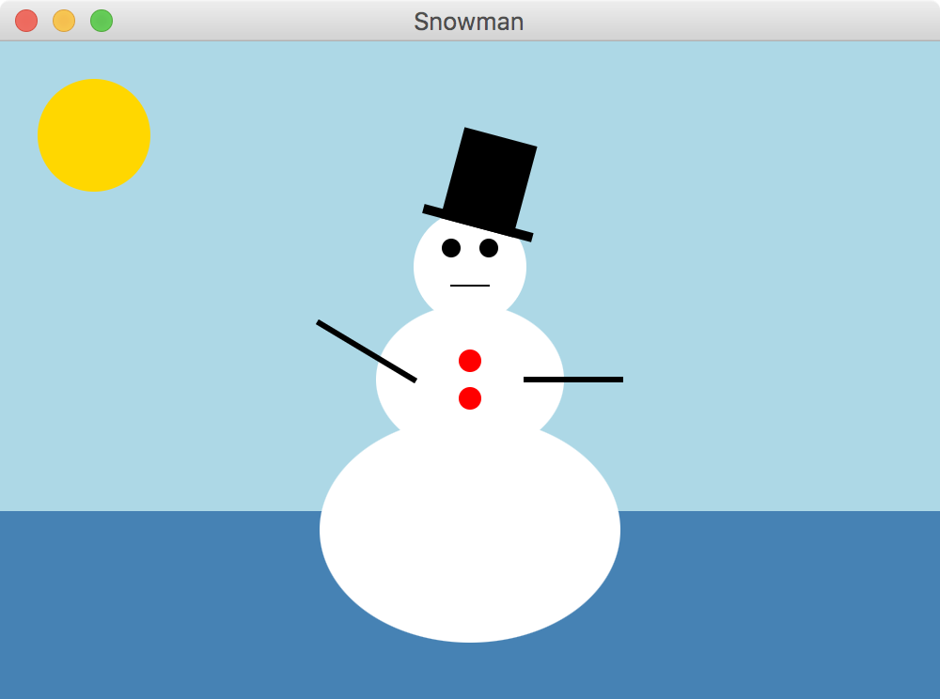
continued
Group snowman = new Group(base, middle, head, leftEye, rightEye,
mouth, topButton, bottomButton, leftArm, rightArm, hat);
snowman.setTranslateX(170);
snowman.setTranslateY(50);
Circle sun = new Circle(50, 50, 30);
sun.setFill(Color.GOLD);
Rectangle ground = new Rectangle(0, 250, 500, 100);
ground.setFill(Color.STEELBLUE);
Group root = new Group(ground, sun, snowman);
Scene scene = new Scene(root, 500, 350, Color.LIGHTBLUE);
primaryStage.setTitle("Snowman");
primaryStage.setScene(scene);
primaryStage.show();
}
}

Slide 86
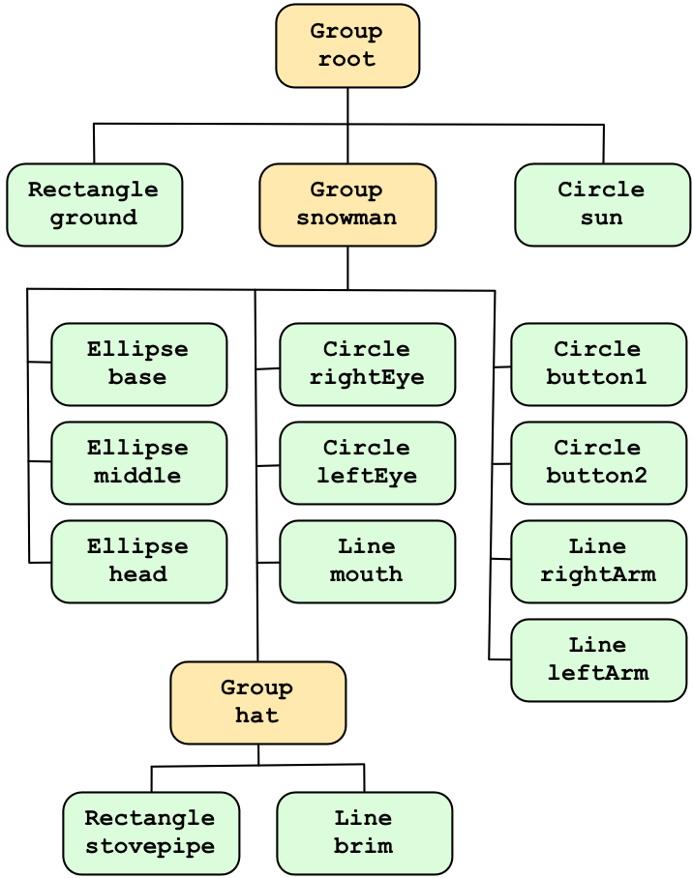

Slide 87
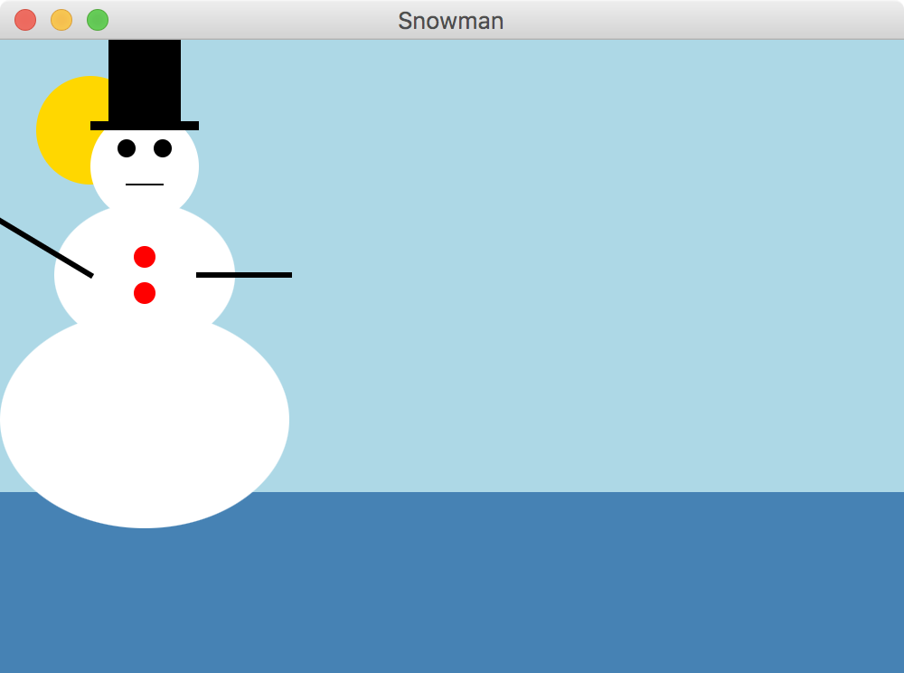
Basic Shapes
Without translating (shifting) the snowman’s position:

Slide 88
Representing Color
A color in Java is represented by a Color object
A color object holds three numbers called an RGB value, which stands for Red-Green-Blue
Each number represents the contribution of that color
This is how the human eye works
Each number in an RGB value is in the range 0 to 255

Slide 89
Representing Color
A color with an RGB value of 255, 255, 0 has a full contribution of red and green, but no blue, which is a shade of yellow
The static rgb method in the Color class returns a Color object with a specific RGB value:
Color purple = Color.rgb(183, 44, 150);
The color method uses percentages:
Color maroon = Color.color(0.6, 0.1, 0.0);

Slide 90
Representing Color
For convenience, several Color objects have been predefined, such as:
Color.BLACK 0, 0, 0
Color.WHITE 255, 255, 255
Color.CYAN 0, 255, 255
Color.PINK 255, 192, 203
Color.GRAY 128, 128, 128
See the online documentation of the Color class for a full list of predefined colors

Slide 91
Summary
Chapter 3 focused on:
object creation and object references
the String class and its methods
the Java standard class library
the Random and Math classes
formatting output
enumerated types
wrapper classes
JavaFX graphics API
shape classes

