Slide 1

Chapter 11 Exceptions
Java Software Solutions
Foundations of Program Design
9th Edition
John Lewis
William Loftus

Slide 2
Exceptions
Exception handling is an important aspect of object-oriented design
Chapter 11 focuses on:
the purpose of exceptions
exception messages
the try-catch statement
propagating exceptions
I/O exceptions and writing text files
GUI tool tips and disabled controls
more GUI controls

Slide 3
Outline
Exception Handling
The try-catch Statement
Exception Classes
I/O Exceptions
Tool Tips and Disabling Controls
Scroll Panes
Split Panes and List Views

Slide 4
Exceptions
An exception is an object that describes an unusual or erroneous situation
Exceptions are thrown by a program, and may be caught and handled by another part of the program
A program can be separated into a normal execution flow and an exception execution flow
An error is also represented as an object in Java, but usually represents a unrecoverable situation and should not be caught

Slide 5
Exception Handling
The Java API has a predefined set of exceptions that can occur during execution
A program can deal with an exception in one of three ways:
ignore it
handle it where it occurs
handle it at another place in the program
The manner in which an exception is processed is an important design consideration

Slide 6
Exception Handling
If an exception is ignored (not caught) by the program, the program will terminate and produce an appropriate message
The message includes a call stack trace that:
indicates the line on which the exception occurred
shows the method call trail that lead to the attempted execution of the offending line
See Zero.java

Slide 7
//********************************************************************
// Zero.java Author: Lewis/Loftus
//
// Demonstrates an uncaught exception.
//********************************************************************
public class Zero
{
//-----------------------------------------------------------------
// Deliberately divides by zero to produce an exception.
//-----------------------------------------------------------------
public static void main(String[] args)
{
int numerator = 10;
int denominator = 0;
System.out.println(numerator / denominator);
System.out.println("This text will not be printed.");
}
}

Slide 8
Output (when program terminates)
Exception in thread "main" java.lang.ArithmeticException: / by zero
at Zero.main(Zero.java:17)
//********************************************************************
// Zero.java Author: Lewis/Loftus
//
// Demonstrates an uncaught exception.
//********************************************************************
public class Zero
{
//-----------------------------------------------------------------
// Deliberately divides by zero to produce an exception.
//-----------------------------------------------------------------
public static void main(String[] args)
{
int numerator = 10;
int denominator = 0;
System.out.println(numerator / denominator);
System.out.println("This text will not be printed.");
}
}

Slide 9
Outline
Exception Handling
The try-catch Statement
Exception Classes
I/O Exceptions
Tool Tips and Disabling Controls
Scroll Panes
Split Panes and List Views

Slide 10
The try Statement
To handle an exception in a program, use a try-catch statement
A try block is followed by one or more catch clauses
Each catch clause has an associated exception type and is called an exception handler
When an exception occurs within the try block, processing immediately jumps to the first catch clause that matches the exception type
See ProductCodes.java

Slide 11
//********************************************************************
// ProductCodes.java Author: Lewis/Loftus
//
// Demonstrates the use of a try-catch block.
//********************************************************************
import java.util.Scanner;
public class ProductCodes
{
//-----------------------------------------------------------------
// Counts the number of product codes that are entered with a
// zone of R and and district greater than 2000.
//-----------------------------------------------------------------
public static void main(String[] args)
{
String code;
char zone;
int district, valid = 0, banned = 0;
Scanner scan = new Scanner(System.in);
System.out.print("Enter product code (XXX to quit): ");
code = scan.nextLine();
continue

Slide 12
continue
while (!code.equals("XXX"))
{
try
{
zone = code.charAt(9);
district = Integer.parseInt(code.substring(3, 7));
valid++;
if (zone == 'R' && district > 2000)
banned++;
}
catch (StringIndexOutOfBoundsException exception)
{
System.out.println("Improper code length: " + code);
}
catch (NumberFormatException exception)
{
System.out.println("District is not numeric: " + code);
}
System.out.print("Enter product code (XXX to quit): ");
code = scan.nextLine();
}
System.out.println("# of valid codes entered: " + valid);
System.out.println("# of banned codes entered: " + banned);
}
}

Slide 13
Sample Run
Enter product code (XXX to quit): TRV2475A5R-14
Enter product code (XXX to quit): TRD1704A7R-12
Enter product code (XXX to quit): TRL2k74A5R-11
District is not numeric: TRL2k74A5R-11
Enter product code (XXX to quit): TRQ2949A6M-04
Enter product code (XXX to quit): TRV2105A2
Improper code length: TRV2105A2
Enter product code (XXX to quit): TRQ2778A7R-19
Enter product code (XXX to quit): XXX
# of valid codes entered: 4
# of banned codes entered: 2
continue
while (!code.equals("XXX"))
{
try
{
zone = code.charAt(9);
district = Integer.parseInt(code.substring(3, 7));
valid++;
if (zone == 'R' && district > 2000)
banned++;
}
catch (StringIndexOutOfBoundsException exception)
{
System.out.println("Improper code length: " + code);
}
catch (NumberFormatException exception)
{
System.out.println("District is not numeric: " + code);
}
System.out.print("Enter product code (XXX to quit): ");
code = scan.nextLine();
}
System.out.println("# of valid codes entered: " + valid);
System.out.println("# of banned codes entered: " + banned);
}
}

Slide 14
The finally Clause
A try statement can have an optional finally clause, which is always executed
If no exception is generated, the statements in the finally clause are executed after the statements in the try block finish
If an exception is generated, the statements in the finally clause are executed after the statements in the appropriate catch clause finish

Slide 15
Exception Propagation
An exception can be handled at a higher level if it is not appropriate to handle it where it occurs
Exceptions propagate up through the method calling hierarchy until they are caught and handled or until they reach the level of the main method
See Propagation.java
See ExceptionScope.java

Slide 16
//********************************************************************
// Propagation.java Author: Lewis/Loftus
//
// Demonstrates exception propagation.
//********************************************************************
public class Propagation
{
//-----------------------------------------------------------------
// Invokes the level1 method to begin the exception demonstration.
//-----------------------------------------------------------------
static public void main(String[] args)
{
ExceptionScope demo = new ExceptionScope();
System.out.println("Program beginning.");
demo.level1();
System.out.println("Program ending.");
}
}

Slide 17
Output
Program beginning.
Level 1 beginning.
Level 2 beginning.
Level 3 beginning.
The exception message is: / by zero
The call stack trace:
java.lang.ArithmeticException: / by zero
at ExceptionScope.level3(ExceptionScope.java:54)
at ExceptionScope.level2(ExceptionScope.java:41)
at ExceptionScope.level1(ExceptionScope.java:18)
at Propagation.main(Propagation.java:17)
Level 1 ending.
Program ending.
//********************************************************************
// Propagation.java Author: Lewis/Loftus
//
// Demonstrates exception propagation.
//********************************************************************
public class Propagation
{
//-----------------------------------------------------------------
// Invokes the level1 method to begin the exception demonstration.
//-----------------------------------------------------------------
static public void main(String[] args)
{
ExceptionScope demo = new ExceptionScope();
System.out.println("Program beginning.");
demo.level1();
System.out.println("Program ending.");
}
}

Slide 18
//********************************************************************
// ExceptionScope.java Author: Lewis/Loftus
//
// Demonstrates exception propagation.
//********************************************************************
public class ExceptionScope
{
//-----------------------------------------------------------------
// Catches and handles the exception that is thrown in level3.
//-----------------------------------------------------------------
public void level1()
{
System.out.println("Level 1 beginning.");
try
{
level2();
}
catch (ArithmeticException problem)
{
System.out.println();
System.out.println("The exception message is: " +
problem.getMessage());
System.out.println();
continue

Slide 19
continue
System.out.println("The call stack trace:");
problem.printStackTrace();
System.out.println();
}
System.out.println("Level 1 ending.");
}
//-----------------------------------------------------------------
// Serves as an intermediate level. The exception propagates
// through this method back to level1.
//-----------------------------------------------------------------
public void level2()
{
System.out.println("Level 2 beginning.");
level3();
System.out.println("Level 2 ending.");
}
continue

Slide 20
continue
//-----------------------------------------------------------------
// Performs a calculation to produce an exception. It is not
// caught and handled at this level.
//-----------------------------------------------------------------
public void level3()
{
int numerator = 10, denominator = 0;
System.out.println("Level 3 beginning.");
int result = numerator / denominator;
System.out.println("Level 3 ending.");
}
}

Slide 21
Outline
Exception Handling
The try-catch Statement
Exception Classes
I/O Exceptions
Tool Tips and Disabling Controls
Scroll Panes
Split Panes and List Views

Slide 22
The Exception Class Hierarchy
Exception classes in the Java API are related by inheritance, forming an exception class hierarchy
All error and exception classes are descendents of the Throwable class
A programmer can define an exception by extending the Exception class or one of its descendants
The parent class used depends on how the new exception will be used

Slide 23
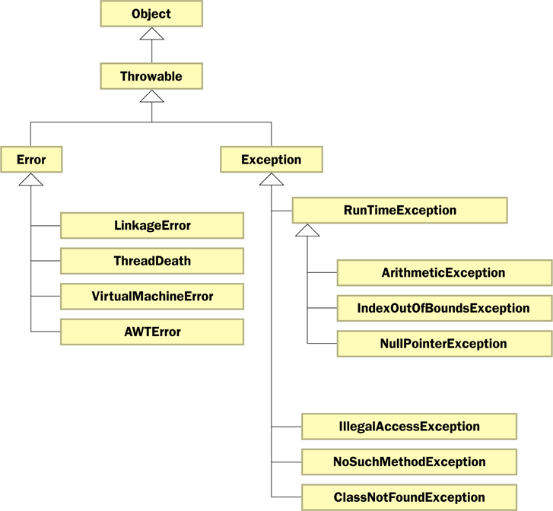
The Exception Class Hierarchy

Slide 24
Checked Exceptions
An exception is either checked or unchecked
A checked exception must either be caught or must be listed in the throws clause of any method that may throw or propagate it
A throws clause is appended to the method header
The compiler will issue an error if a checked exception is not caught or listed in a throws clause

Slide 25
Unchecked Exceptions
An unchecked exception does not require explicit handling, though it could be processed that way
The only unchecked exceptions in Java are objects of type RuntimeException or any of its descendants
Errors are similar to RuntimeException and its descendants in that:
Errors should not be caught
Errors do not require a throws clause

Slide 26
Quick Check
Which of these exceptions are checked and which are unchecked?
NullPointerException
IndexOutOfBoundsException
ClassNotFoundException
NoSuchMethodException
ArithmeticException

Slide 27
Quick Check
Which of these exceptions are checked and which are unchecked?
NullPointerException
IndexOutOfBoundsException
ClassNotFoundException
NoSuchMethodException
ArithmeticException
Unchecked
Unchecked
Checked
Checked
Unchecked

Slide 28
The throw Statement
Exceptions are thrown using the throw statement
Usually a throw statement is executed inside an if statement that evaluates a condition to see if the exception should be thrown
See CreatingExceptions.java
See OutOfRangeException.java

Slide 29
//********************************************************************
// CreatingExceptions.java Author: Lewis/Loftus
//
// Demonstrates the ability to define an exception via inheritance.
//********************************************************************
import java.util.Scanner;
public class CreatingExceptions
{
//-----------------------------------------------------------------
// Creates an exception object and possibly throws it.
//-----------------------------------------------------------------
public static void main(String[] args) throws OutOfRangeException
{
final int MIN = 25, MAX = 40;
Scanner scan = new Scanner(System.in);
OutOfRangeException problem =
new OutOfRangeException("Input value is out of range.");
continue

Slide 30
continue
System.out.print("Enter an integer value between " + MIN +
" and " + MAX + ", inclusive: ");
int value = scan.nextInt();
// Determine if the exception should be thrown
if (value < MIN || value > MAX)
throw problem;
System.out.println("End of main method."); // may never reach
}
}

Slide 31
Sample Run
Enter an integer value between 25 and 40, inclusive: 69
Exception in thread "main" OutOfRangeException:
Input value is out of range.
at CreatingExceptions.main(CreatingExceptions.java:20)
continue
System.out.print("Enter an integer value between " + MIN +
" and " + MAX + ", inclusive: ");
int value = scan.nextInt();
// Determine if the exception should be thrown
if (value < MIN || value > MAX)
throw problem;
System.out.println("End of main method."); // may never reach
}
}

Slide 32
//********************************************************************
// OutOfRangeException.java Author: Lewis/Loftus
//
// Represents an exceptional condition in which a value is out of
// some particular range.
//********************************************************************
public class OutOfRangeException extends Exception
{
//-----------------------------------------------------------------
// Sets up the exception object with a particular message.
//-----------------------------------------------------------------
OutOfRangeException(String message)
{
super(message);
}
}

Slide 33
Quick Check
What is the matter with this code?
System.out.println("Before throw");
throw new OutOfRangeException("Too High");
System.out.println("After throw");

Slide 34
Quick Check
What is the matter with this code?
System.out.println("Before throw");
throw new OutOfRangeException("Too High");
System.out.println("After throw");
The throw is not conditional and therefore always occurs. The second println statement can never be reached.

Slide 35
Outline
Exception Handling
The try-catch Statement
Exception Classes
I/O Exceptions
Tool Tips and Disabling Controls
Scroll Panes
Split Panes and List Views

Slide 36
I/O Exceptions
Let's examine issues related to exceptions and I/O
A stream is a sequence of bytes that flow from a source to a destination
In a program, we read information from an input stream and write information to an output stream
A program can manage multiple streams simultaneously

Slide 37
Standard I/O
There are three standard I/O streams:
standard output – defined by System.out
standard input – defined by System.in
standard error – defined by System.err
We use System.out when we execute println statements
System.out and System.err typically represent the console window
System.in typically represents keyboard input, which we've used many times with Scanner

Slide 38
The IOException Class
Operations performed by some I/O classes may throw an IOException
A file might not exist
Even if the file exists, a program may not be able to find it
The file might not contain the kind of data we expect
An IOException is a checked exception

Slide 39
Writing Text Files
In Chapter 5 we explored the use of the Scanner class to read input from a text file
Let's now explore writing data to a text file
The PrintWriter class represents a text output file
Output streams should be closed explicitly
See TestData.java

Slide 40
//********************************************************************
// TestData.java Author: Lewis/Loftus
//
// Demonstrates I/O exceptions and the use of a character file
// output stream.
//********************************************************************
import java.util.Random;
import java.io.*;
public class TestData
{
//-----------------------------------------------------------------
// Creates a file of test data that consists of ten lines each
// containing ten integer values in the range 10 to 99.
//-----------------------------------------------------------------
public static void main(String[] args) throws IOException
{
final int MAX = 10;
int value;
String fileName = "test.txt";
PrintWriter outFile = new PrintWriter(fileName);
continue

Slide 41
continue
Random rand = new Random();
for (int line = 1; line <= MAX; line++)
{
for (int num = 1; num <= MAX; num++)
{
value = rand.nextInt(90) + 10;
outFile.print(value + " ");
}
outFile.println();
}
outFile.close();
System.out.println("Output file has been created: " + fileName);
}
}

Slide 42
Output
Output file has been created: test.txt
continue
Random rand = new Random();
for (int line = 1; line <= MAX; line++)
{
for (int num = 1; num <= MAX; num++)
{
value = rand.nextInt(90) + 10;
outFile.print(value + " ");
}
outFile.println();
}
outFile.close();
System.out.println("Output file has been created: " + fileName);
}
}
Sample test.txt File
77 46 24 67 45 37 32 40 39 10
90 91 71 64 82 80 68 18 83 89
25 80 45 75 74 40 15 90 79 59
44 43 95 85 93 61 15 20 52 86
60 85 18 73 56 41 35 67 21 42
93 25 89 47 13 27 51 94 76 13
33 25 48 42 27 24 88 18 32 17
71 10 90 88 60 19 89 54 21 92
45 26 47 68 55 98 34 38 98 38
48 59 90 12 86 36 11 65 41 62

Slide 43
Outline
Exception Handling
The try-catch Statement
Exception Classes
I/O Exceptions
Tool Tips and Disabling Controls
Scroll Panes
Split Panes and List Views

Slide 44
Tool Tips
A tool tip provides a short pop-up description when the mouse cursor rests momentarily on a component
A tool tip is assigned using the setToolTip method of a JavaFX control
ToolTip tip = new ToolTip("Update cost");
myButton.setToolTip(tip);

Slide 45
Disabled Controls
Controls can be disabled if they should not be used
A disabled control is "grayed out" and will not respond to user interaction
To disable a control, call the setDisable method:
myButton.setDisable(true);
See LightBulb.java

Slide 46
import javafx.application.Application;
import javafx.event.ActionEvent;
import javafx.geometry.Pos;
import javafx.geometry.Rectangle2D;
import javafx.scene.Scene;
import javafx.scene.control.Button;
import javafx.scene.control.Tooltip;
import javafx.scene.image.Image;
import javafx.scene.image.ImageView;
import javafx.scene.layout.HBox;
import javafx.scene.layout.VBox;
import javafx.stage.Stage;
//************************************************************************
// LightBulb.java Author: Lewis/Loftus
//
// Demonstrates the use of tool tips and disabled controls.
//************************************************************************
public class LightBulb extends Application
{
private Button onButton, offButton;
private ImageView bulbView;
continue

Slide 47
continue
//--------------------------------------------------------------------
// Displays an image of a light bulb that can be turned on and off
// using enabled buttons with tool tips set.
//--------------------------------------------------------------------
public void start(Stage primaryStage)
{
Image img = new Image("lightBulbs.png");
bulbView = new ImageView(img);
bulbView.setViewport(new Rectangle2D(0, 0, 125, 200)); // off
onButton = new Button("On");
onButton.setPrefWidth(70);
onButton.setTooltip(new Tooltip("Turn me on!"));
onButton.setOnAction(this::processButtonPress);
offButton = new Button("Off");
offButton.setPrefWidth(70);
offButton.setTooltip(new Tooltip("Turn me off!"));
offButton.setDisable(true);
offButton.setOnAction(this::processButtonPress);
continue

Slide 48
continue
HBox buttons = new HBox(onButton, offButton);
buttons.setAlignment(Pos.CENTER);
buttons.setSpacing(30);
VBox root = new VBox(bulbView, buttons);
root.setAlignment(Pos.CENTER);
root.setStyle("-fx-background-color: black");
root.setSpacing(20);
Scene scene = new Scene(root, 250, 300);
primaryStage.setTitle("Light Bulb");
primaryStage.setScene(scene);
primaryStage.show();
}
continue

Slide 49
continue
//--------------------------------------------------------------------
// Determines which button was pressed and sets the image viewport
// appropriately to show either the on or off bulb. Also swaps the
// disable state of both buttons.
//--------------------------------------------------------------------
public void processButtonPress(ActionEvent event)
{
if (event.getSource() == onButton)
{
bulbView.setViewport(new Rectangle2D(143, 0, 125, 200)); // on
onButton.setDisable(true);
offButton.setDisable(false);
}
else
{
bulbView.setViewport(new Rectangle2D(0, 0, 125, 200)); // off
offButton.setDisable(true);
onButton.setDisable(false);
}
}
}

Slide 50
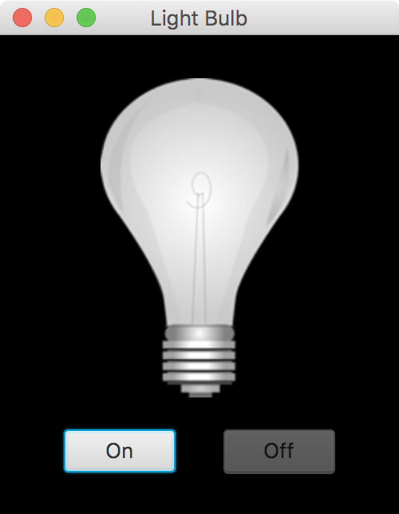
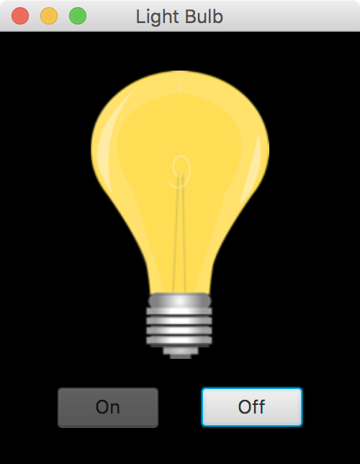
continue
//--------------------------------------------------------------------
// Determines which button was pressed and sets the image viewport
// appropriately to show either the on or off bulb. Also swaps the
// disable state of both buttons.
//--------------------------------------------------------------------
public void processButtonPress(ActionEvent event)
{
if (event.getSource() == onButton)
{
bulbView.setViewport(new Rectangle2D(143, 0, 125, 200)); // on
onButton.setDisable(true);
offButton.setDisable(false);
}
else
{
bulbView.setViewport(new Rectangle2D(0, 0, 125, 200)); // off
offButton.setDisable(true);
onButton.setDisable(false);
}
}
}

Slide 51
Outline
Exception Handling
The try-catch Statement
Exception Classes
I/O Exceptions
Tool Tips and Disabling Controls
Scroll Panes
Split Panes and List Views

Slide 52
Scroll Panes
A JavaFX scroll pane provides a limited but scrollable view of a large underlying node, such as an image
A scroll pane provides horizontal and vertical scroll bars, as needed
No event listener is needed for a scroll pane
See MapViewer.java

Slide 53
import javafx.application.Application;
import javafx.scene.Scene;
import javafx.scene.control.ScrollPane;
import javafx.scene.control.ScrollPane.ScrollBarPolicy;
import javafx.scene.image.Image;
import javafx.scene.image.ImageView;
import javafx.stage.Stage;
//************************************************************************
// MapViewer.java Author: Lewis/Loftus
//
// Demonstrates the use of a scroll pane.
//************************************************************************
public class MapViewer extends Application
{
//--------------------------------------------------------------------
// Presents a scroll pane that allows the user to determine which
// section of the underlying image (a map of the USA) is visible.
//--------------------------------------------------------------------
public void start(Stage primaryStage)
{
continue

Slide 54
continue
Image img = new Image("map.jpg");
ImageView imgView = new ImageView(img);
ScrollPane root = new ScrollPane(imgView);
root.setHbarPolicy(ScrollBarPolicy.ALWAYS);
Scene scene = new Scene(root, 600, 400);
primaryStage.setTitle("Map Viewer");
primaryStage.setScene(scene);
primaryStage.show();
}
}

Slide 55
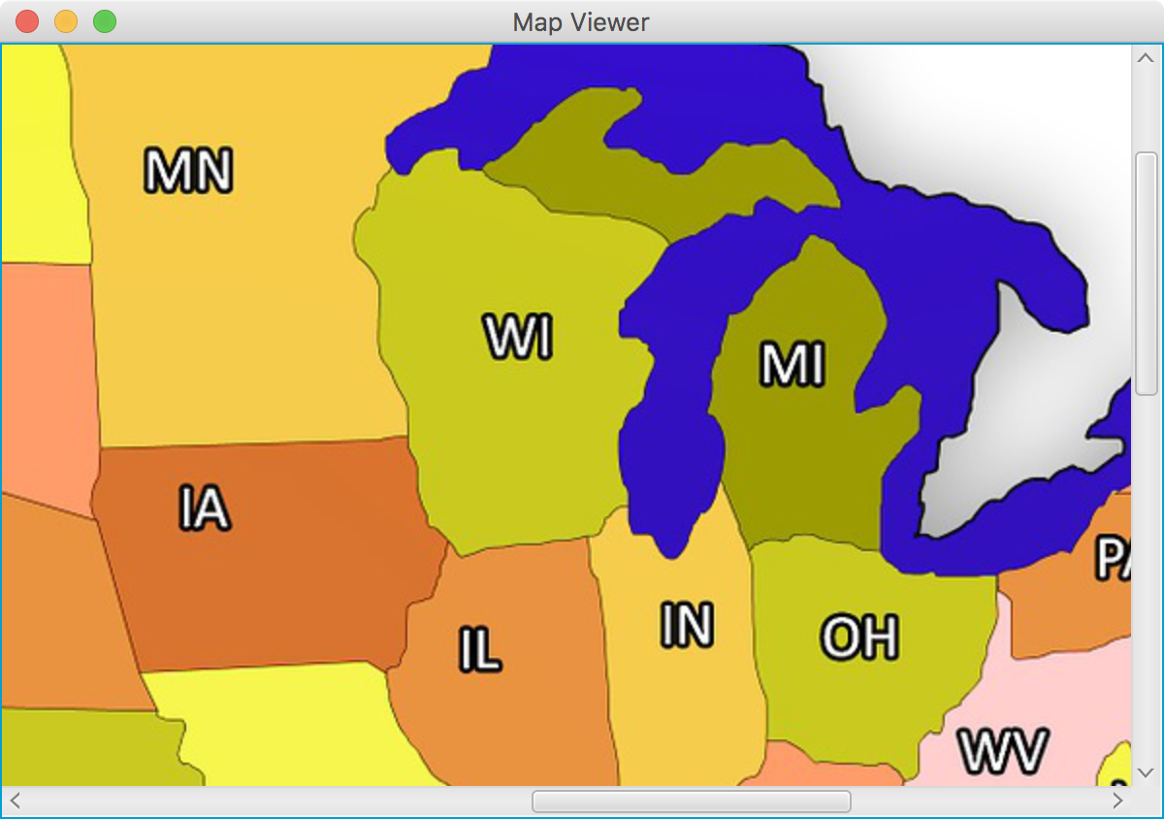
continue
Image img = new Image("map.jpg");
ImageView imgView = new ImageView(img);
ScrollPane root = new ScrollPane(imgView);
root.setHbarPolicy(ScrollBarPolicy.ALWAYS);
Scene scene = new Scene(root, 600, 400);
primaryStage.setTitle("Map Viewer");
primaryStage.setScene(scene);
primaryStage.show();
}
}

Slide 56
Outline
Exception Handling
The try-catch Statement
Exception Classes
I/O Exceptions
Tool Tips and Disabling Controls
Scroll Panes
Split Panes and List Views

Slide 57
Split Panes
A JavaFX split pane displays two or more nodes separated by a moveable divider bar
As the user slides the divider bar, it gives more space to one side and reduces space on the other
The nodes can be displayed side by side or one on top of the other
If more than two nodes are added to a split pane, each node is separated from the next by another divider bar

Slide 58
List Views
A JavaFX list view presents a list of selectable options
The options are always visible (not a drop-down), and the view is resizable and scrollable
A list view contains Observable items
The following example displays a list of words (food items) on one side of a split pane and an image of the selected food item on the other
See FoodImages.java

Slide 59
import javafx.application.Application;
import javafx.beans.value.ObservableValue;
import javafx.collections.FXCollections;
import javafx.collections.ObservableList;
import javafx.scene.Scene;
import javafx.scene.control.ListView;
import javafx.scene.control.SplitPane;
import javafx.scene.image.Image;
import javafx.scene.image.ImageView;
import javafx.scene.layout.StackPane;
import javafx.stage.Stage;
//************************************************************************
// FoodImages.java Author: Lewis/Loftus
//
// Demonstrates a split pane and a list view.
//************************************************************************
public class FoodImages extends Application
{
private Image[] foodImages;
private ImageView imgView;
private ListView<String> listView;
continue

Slide 60
continue
//--------------------------------------------------------------------
// Displays a split pane with a list of food items on the left
// and an image of the selected food item on the right.
//--------------------------------------------------------------------
public void start(Stage primaryStage)
{
String[] food = {"apples", "asparagus", "bacon", "bread",
"carrots", "cheesecake", "eggs", "hamburger", "muffins",
"onions", "oranges", "pancakes", "peanuts", "pizza",
"potatoes", "pretzels", "spaghetti", "sushi", "watermelon"};
foodImages = new Image[food.length];
for (int i = 0; i < food.length; i++)
foodImages[i] = new Image(food[i] + ".jpg");
imgView = new ImageView(foodImages[0]);
StackPane imgPane = new StackPane(imgView);
imgPane.setMinWidth(300);
imgView.setPreserveRatio(true);
imgView.fitWidthProperty().bind(imgPane.widthProperty());
ObservableList<String> list = FXCollections.observableArrayList();
list.addAll(food);
continue

Slide 61
continue
listView = new ListView<String>(list);
listView.setMinWidth(100);
listView.getSelectionModel().select(0);
listView.getSelectionModel().selectedItemProperty().addListener(
this::processListSelection);
SplitPane root = new SplitPane();
root.setDividerPositions(0.25);
root.getItems().addAll(listView, imgPane);
Scene scene = new Scene(root, 600, 350);
primaryStage.setTitle("Food Images");
primaryStage.setScene(scene);
primaryStage.show();
}
continue

Slide 62
continue
//--------------------------------------------------------------------
// Processes a list view selection by getting the index of the
// selected item and displaying the corresponding image.
//--------------------------------------------------------------------
public void processListSelection(ObservableValue<? extends String> val,
String oldValue, String newValue)
{
int index = listView.getSelectionModel().getSelectedIndex();
imgView.setImage(foodImages[index]);
}
}

Slide 63
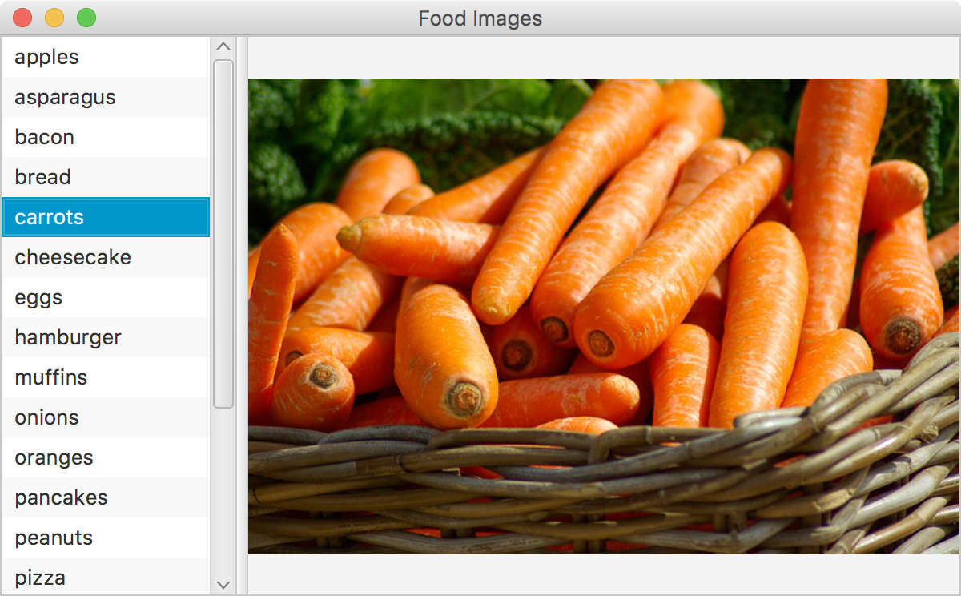
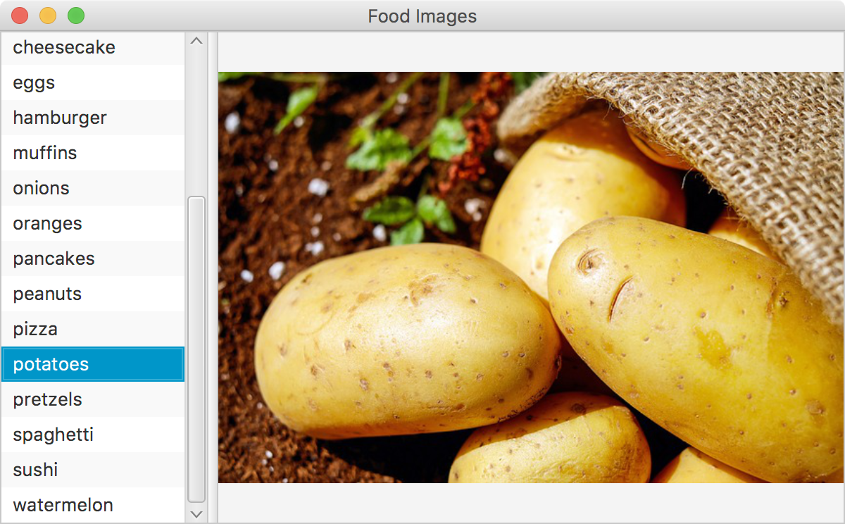
continue
//--------------------------------------------------------------------
// Processes a list view selection by getting the index of the
// selected item and displaying the corresponding image.
//--------------------------------------------------------------------
public void processListSelection(ObservableValue<? extends String> val,
String oldValue, String newValue)
{
int index = listView.getSelectionModel().getSelectedIndex();
imgView.setImage(foodImages[index]);
}
}

Slide 64
Summary
Chapter 11 has focused on:
the purpose of exceptions
exception messages
the try-catch statement
propagating exceptions
I/O exceptions and writing text files
GUI tool tips and disabled controls
more GUI controls

