Slide 1

Chapter 12 Recursion
Java Software Solutions
Foundations of Program Design
9th Edition
John Lewis
William Loftus

Slide 2
Recursion
Recursion is a fundamental programming technique that can provide an elegant solution certain kinds of problems
Chapter 12 focuses on:
thinking in a recursive manner
programming in a recursive manner
the correct use of recursion
recursion examples
recursion in graphics
fractals

Slide 3
Outline
Recursive Thinking
Recursive Programming
Traversing a Maze
The Towers of Hanoi
Tiled Images
Fractals

Slide 4
Recursive Thinking
A recursive definition is one which uses the word or concept being defined in the definition itself
When defining an English word, a recursive definition is often not helpful
But in other situations, a recursive definition can be an appropriate way to express a concept
Before applying recursion to programming, it is best to practice thinking recursively

Slide 5
Recursive Definitions
Consider the following list of numbers:
24, 88, 40, 37
Such a list can be defined as follows:
A List is a: number
or a: number comma List
That is, a List is defined to be a single number, or a number followed by a comma followed by a List
The concept of a List is used to define itself

Slide 6
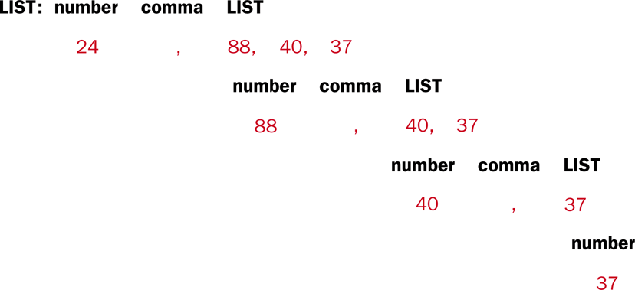
Recursive Definitions
The recursive part of the LIST definition is used several times, terminating with the non-recursive part:

Slide 7
Infinite Recursion
All recursive definitions have to have a non-recursive part called the base case
If they didn't, there would be no way to terminate the recursive path
Such a definition would cause infinite recursion
This problem is similar to an infinite loop, but the non-terminating "loop" is part of the definition itself

Slide 8
Recursive Factorial
N!, for any positive integer N, is defined to be the product of all integers between 1 and N inclusive
This definition can be expressed recursively as:
1! = 1
N! = N * (N-1)!
A factorial is defined in terms of another factorial
Eventually, the base case of 1! is reached

Slide 9
Recursive Factorial
5!
5 * 4!
4 * 3!
3 * 2!
2 * 1!
1
120
24
6
2

Slide 10
Quick Check
Write a recursive definition of 5 * n, where n > 0.

Slide 11
Quick Check
Write a recursive definition of 5 * n, where n > 0.
5 * 1 = 5
5 * n = 5 + (5 * (n-1))

Slide 12
Outline
Recursive Thinking
Recursive Programming
Traversing a Maze
The Towers of Hanoi
Tiled Images
Fractals

Slide 13
Recursive Programming
A recursive method is a method that invokes itself
A recursive method must be structured to handle both the base case and the recursive case
Each call to the method sets up a new execution environment, with new parameters and local variables
As with any method call, when the method completes, control returns to the method that invoked it (which may be an earlier invocation of itself)

Slide 14
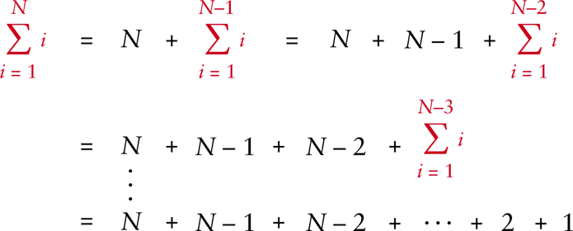
Sum of 1 to N
Consider the problem of computing the sum of all the numbers between 1 and any positive integer N
This problem can be recursively defined as:

Slide 15
Sum of 1 to N
The summation could be implemented recursively as follows:
// This method returns the sum of 1 to num
public int sum(int num)
{
int result;
if (num == 1)
result = 1;
else
result = num + sum(n-1);
return result;
}

Slide 16
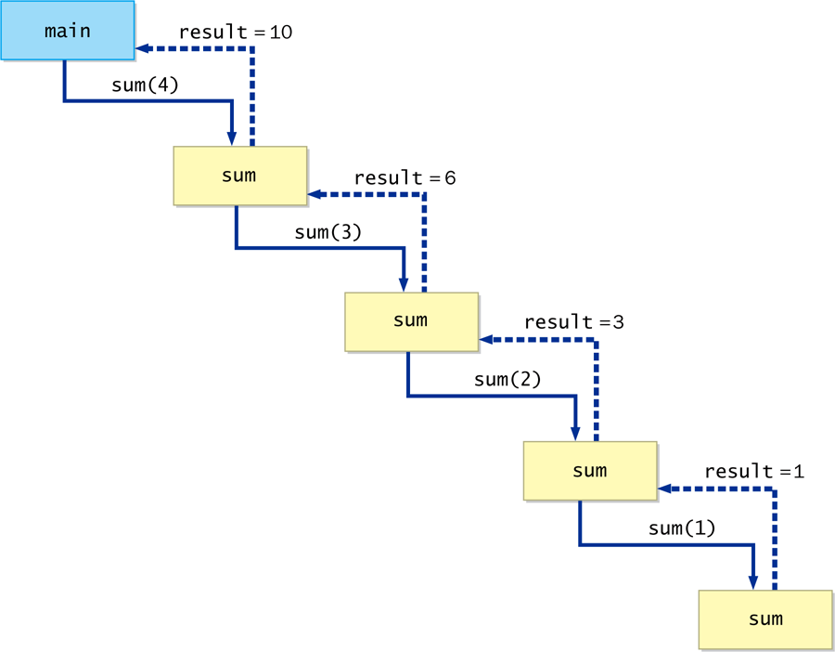
Sum of 1 to N

Slide 17
Recursive Programming
Note that just because we can use recursion to solve a problem, doesn't mean we should
We usually would not use recursion to solve the summation problem, because the iterative version is easier to understand
However, for some problems, recursion provides an elegant solution, often cleaner than an iterative version
You must carefully decide whether recursion is the correct technique for any problem

Slide 18
Indirect Recursion
A method invoking itself is considered to be direct recursion
A method could invoke another method, which invokes another, etc., until eventually the original method is invoked again
For example, method m1 could invoke m2, which invokes m3, which in turn invokes m1 again
This is called indirect recursion, and requires all the same care as direct recursion
It is often more difficult to trace and debug

Slide 19
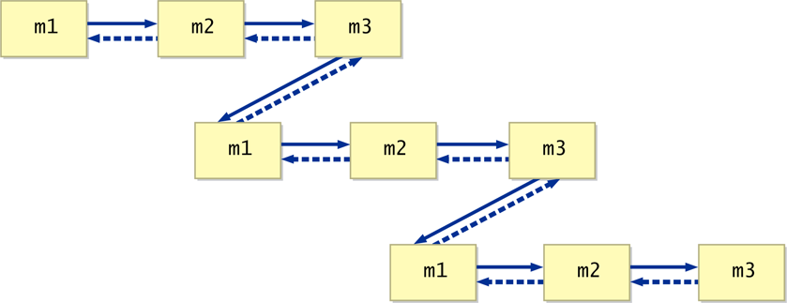
Indirect Recursion

Slide 20
Outline
Recursive Thinking
Recursive Programming
Traversing a Maze
The Towers of Hanoi
Tiled Images
Fractals

Slide 21
Maze Traversal
We can use recursion to find a path through a maze
From each location, we can search in each direction
The recursive calls keep track of the path through the maze
The base case is an invalid move or reaching the final destination
See MazeSearch.java
See Maze.java

Slide 22
//********************************************************************
// MazeSearch.java Author: Lewis/Loftus
//
// Demonstrates recursion.
//********************************************************************
public class MazeSearch
{
//-----------------------------------------------------------------
// Creates a new maze, prints its original form, attempts to
// solve it, and prints out its final form.
//-----------------------------------------------------------------
public static void main(String[] args)
{
Maze labyrinth = new Maze();
System.out.println(labyrinth);
if (labyrinth.traverse(0, 0))
System.out.println("The maze was successfully traversed!");
else
System.out.println("There is no possible path.");
System.out.println(labyrinth);
}
}

Slide 23
Output
1110110001111
1011101111001
0000101010100
1110111010111
1010000111001
1011111101111
1000000000000
1111111111111
The maze was successfully traversed!
7770110001111
3077707771001
0000707070300
7770777070333
7070000773003
7077777703333
7000000000000
7777777777777
//********************************************************************
// MazeSearch.java Author: Lewis/Loftus
//
// Demonstrates recursion.
//********************************************************************
public class MazeSearch
{
//-----------------------------------------------------------------
// Creates a new maze, prints its original form, attempts to
// solve it, and prints out its final form.
//-----------------------------------------------------------------
public static void main(String[] args)
{
Maze labyrinth = new Maze();
System.out.println(labyrinth);
if (labyrinth.traverse(0, 0))
System.out.println("The maze was successfully traversed!");
else
System.out.println("There is no possible path.");
System.out.println(labyrinth);
}
}

Slide 24
//********************************************************************
// Maze.java Author: Lewis/Loftus
//
// Represents a maze of characters. The goal is to get from the
// top left corner to the bottom right, following a path of 1s.
//********************************************************************
public class Maze
{
private final int TRIED = 3;
private final int PATH = 7;
private int[][] grid = { {1,1,1,0,1,1,0,0,0,1,1,1,1},
{1,0,1,1,1,0,1,1,1,1,0,0,1},
{0,0,0,0,1,0,1,0,1,0,1,0,0},
{1,1,1,0,1,1,1,0,1,0,1,1,1},
{1,0,1,0,0,0,0,1,1,1,0,0,1},
{1,0,1,1,1,1,1,1,0,1,1,1,1},
{1,0,0,0,0,0,0,0,0,0,0,0,0},
{1,1,1,1,1,1,1,1,1,1,1,1,1} };
continued

Slide 25
continued
//-----------------------------------------------------------------
// Attempts to recursively traverse the maze. Inserts special
// characters indicating locations that have been tried and that
// eventually become part of the solution.
//-----------------------------------------------------------------
public boolean traverse(int row, int column)
{
boolean done = false;
if (valid(row, column))
{
grid[row][column] = TRIED; // this cell has been tried
if (row == grid.length - 1 && column == grid[0].length - 1)
done = true; // the maze is solved
else
{
done = traverse(row + 1, column); // down
if (!done)
done = traverse(row, column + 1); // right
if (!done)
done = traverse(row - 1, column); // up
if (!done)
done = traverse(row, column - 1); // left
}
continued

Slide 26
continued
if (done) // this location is part of the final path
grid[row][column] = PATH;
}
return done;
}
//-----------------------------------------------------------------
// Determines if a specific location is valid.
//-----------------------------------------------------------------
private boolean valid(int row, int column)
{
boolean result = false;
// check if cell is in the bounds of the matrix
if (row >= 0 && row < grid.length &&
column >= 0 && column < grid[row].length)
// check if cell is not blocked and not previously tried
if (grid[row][column] == 1)
result = true;
return result;
}
continued

Slide 27
continued
//-----------------------------------------------------------------
// Returns the maze as a string.
//-----------------------------------------------------------------
public String toString()
{
String result = "\n";
for (int row = 0; row < grid.length; row++)
{
for (int column=0; column < grid[row].length; column++)
result += grid[row][column] + "";
result += "\n";
}
return result;
}
}

Slide 28
Outline
Recursive Thinking
Recursive Programming
Traversing a Maze
The Towers of Hanoi
Tiled Images
Fractals

Slide 29
Towers of Hanoi
The Towers of Hanoi is a puzzle made up of three vertical pegs and several disks that slide onto the pegs
The disks are of varying size, initially placed on one peg with the largest disk on the bottom with increasingly smaller ones on top
The goal is to move all of the disks from one peg to another under the following rules:
Move only one disk at a time
A larger disk cannot be put on top of a smaller one

Slide 30
Towers of Hanoi
Original Configuration
Move 1
Move 2
Move 3

Slide 31
Towers of Hanoi
Move 4
Move 5
Move 6
Move 7 (done)

Slide 32
Towers of Hanoi
An iterative solution to the Towers of Hanoi is quite complex
A recursive solution is much shorter and more elegant
See SolveTowers.java
See TowersOfHanoi.java

Slide 33
//********************************************************************
// SolveTowers.java Author: Lewis/Loftus
//
// Demonstrates recursion.
//********************************************************************
public class SolveTowers
{
//-----------------------------------------------------------------
// Creates a TowersOfHanoi puzzle and solves it.
//-----------------------------------------------------------------
public static void main(String[] args)
{
TowersOfHanoi towers = new TowersOfHanoi(4);
towers.solve();
}
}

Slide 34
Output
Move one disk from 1 to 2
Move one disk from 1 to 3
Move one disk from 2 to 3
Move one disk from 1 to 2
Move one disk from 3 to 1
Move one disk from 3 to 2
Move one disk from 1 to 2
Move one disk from 1 to 3
Move one disk from 2 to 3
Move one disk from 2 to 1
Move one disk from 3 to 1
Move one disk from 2 to 3
Move one disk from 1 to 2
Move one disk from 1 to 3
Move one disk from 2 to 3
//********************************************************************
// SolveTowers.java Author: Lewis/Loftus
//
// Demonstrates recursion.
//********************************************************************
public class SolveTowers
{
//-----------------------------------------------------------------
// Creates a TowersOfHanoi puzzle and solves it.
//-----------------------------------------------------------------
public static void main(String[] args)
{
TowersOfHanoi towers = new TowersOfHanoi(4);
towers.solve();
}
}

Slide 35
//********************************************************************
// TowersOfHanoi.java Author: Lewis/Loftus
//
// Represents the classic Towers of Hanoi puzzle.
//********************************************************************
public class TowersOfHanoi
{
private int totalDisks;
//-----------------------------------------------------------------
// Sets up the puzzle with the specified number of disks.
//-----------------------------------------------------------------
public TowersOfHanoi(int disks)
{
totalDisks = disks;
}
//-----------------------------------------------------------------
// Performs the initial call to moveTower to solve the puzzle.
// Moves the disks from tower 1 to tower 3 using tower 2.
//-----------------------------------------------------------------
public void solve()
{
moveTower(totalDisks, 1, 3, 2);
}
continued

Slide 36
continued
//-----------------------------------------------------------------
// Moves the specified number of disks from one tower to another
// by moving a subtower of n-1 disks out of the way, moving one
// disk, then moving the subtower back. Base case of 1 disk.
//-----------------------------------------------------------------
private void moveTower(int numDisks, int start, int end, int temp)
{
if (numDisks == 1)
moveOneDisk(start, end);
else
{
moveTower(numDisks-1, start, temp, end);
moveOneDisk(start, end);
moveTower(numDisks-1, temp, end, start);
}
}
//-----------------------------------------------------------------
// Prints instructions to move one disk from the specified start
// tower to the specified end tower.
//-----------------------------------------------------------------
private void moveOneDisk(int start, int end)
{
System.out.println("Move one disk from " + start + " to " +
end);
}
}

Slide 37
Outline
Recursive Thinking
Recursive Programming
Traversing a Maze
The Towers of Hanoi
Tiled Images
Fractals

Slide 38
Tiled Images
Consider the task of repeatedly displaying a set of images in a mosaic
Three quadrants contain individual images
Upper-left quadrant repeats pattern
The base case is reached when the area for the images shrinks to a certain size
See TiledImages.java

Slide 39
import javafx.application.Application;
import javafx.scene.Group;
import javafx.scene.Scene;
import javafx.scene.effect.ColorAdjust;
import javafx.scene.effect.SepiaTone;
import javafx.scene.image.Image;
import javafx.scene.image.ImageView;
import javafx.scene.paint.Color;
import javafx.stage.Stage;
//************************************************************************
// TiledImages.java Author: Lewis/Loftus
//
// Demonstrates the use of recursion.
//************************************************************************
public class TiledImages extends Application
{
private final static int MIN = 20;
private Image image;
private ColorAdjust monochrome;
private SepiaTone sepia;
private Group root;
continue

Slide 40
continue
//--------------------------------------------------------------------
// Sets up the display of a series of tiled images.
//--------------------------------------------------------------------
public void start(Stage primaryStage)
{
image = new Image("girl.jpg");
monochrome = new ColorAdjust(0, -1, 0, 0);
sepia = new SepiaTone();
root = new Group();
addPictures(300);
Scene scene = new Scene(root, 600, 600, Color.WHITE);
primaryStage.setTitle("Tiled Images");
primaryStage.setScene(scene);
primaryStage.show();
}
continue

Slide 41
continue
//--------------------------------------------------------------------
// Uses the parameter to specify the size and position of an image.
// Displays the image in full color, monochrome, and sepia tone,
// then repeats the display recursively in the upper left quadrant.
//--------------------------------------------------------------------
private void addPictures(double size)
{
ImageView colorView = new ImageView(image);
colorView.setFitWidth(size);
colorView.setFitHeight(size);
colorView.setX(size);
colorView.setY(size);
ImageView monochromeView = new ImageView(image);
monochromeView.setEffect(monochrome);
monochromeView.setFitWidth(size);
monochromeView.setFitHeight(size);
monochromeView.setX(0);
monochromeView.setY(size);
ImageView sepiaView = new ImageView(image);
sepiaView.setEffect(sepia);
sepiaView.setFitWidth(size);
sepiaView.setFitHeight(size);
sepiaView.setX(size);
sepiaView.setY(0);
continue

Slide 42
continue
root.getChildren().addAll(sepiaView, colorView, monochromeView);
if (size > MIN)
addPictures(size / 2);
}
}

Slide 43

continue
root.getChildren().addAll(sepiaView, colorView, monochromeView);
if (size > MIN)
addPictures(size / 2);
}
}

Slide 44
Outline
Recursive Thinking
Recursive Programming
Traversing a Maze
The Towers of Hanoi
Tiled Images
Fractals

Slide 45
Fractals
A fractal is a geometric shape made up of the same pattern repeated in different sizes and orientations
The Koch Snowflake is a particular fractal that begins with an equilateral triangle
To get a higher order of the fractal, the sides of the triangle are replaced with angled line segments
See KochSnowflake.java
See KochPane.java

Slide 46
import javafx.application.Application;
import javafx.event.ActionEvent;
import javafx.geometry.Pos;
import javafx.scene.Scene;
import javafx.scene.control.Button;
import javafx.scene.image.Image;
import javafx.scene.image.ImageView;
import javafx.scene.layout.HBox;
import javafx.scene.layout.VBox;
import javafx.scene.text.Text;
import javafx.stage.Stage;
//************************************************************************
// KochSnowflake.java Author: Lewis/Loftus
//
// Demonstrates the use of recursion to draw a fractal.
//************************************************************************
public class KochSnowflake extends Application
{
private final static int MIN_ORDER = 1;
private final static int MAX_ORDER = 6;
private int order;
private Button up, down;
private Text orderText;
private KochPane fractalPane;
continue

Slide 47
continue
//--------------------------------------------------------------------
// Displays two buttons that control the order of the fractal
// shown in the pane below the buttons.
//--------------------------------------------------------------------
public void start(Stage primaryStage)
{
Image upImage = new Image("up.png");
up = new Button();
up.setGraphic(new ImageView(upImage));
up.setOnAction(this::processUpButtonPress);
Image downImage = new Image("down.png");
down = new Button();
down.setGraphic(new ImageView(downImage));
down.setOnAction(this::processDownButtonPress);
down.setDisable(true);
order = 1;
orderText = new Text("Order: 1");
HBox toolbar = new HBox();
toolbar.setStyle("-fx-background-color: darksalmon");
toolbar.setAlignment(Pos.CENTER);
toolbar.setPrefHeight(50);
toolbar.setSpacing(40);
toolbar.getChildren().addAll(up, orderText, down);
continue

Slide 48
continue
fractalPane = new KochPane();
VBox root = new VBox();
root.setStyle("-fx-background-color: white");
root.getChildren().addAll(toolbar, fractalPane);
Scene scene = new Scene(root, 400, 450);
primaryStage.setTitle("Koch Snowflake");
primaryStage.setScene(scene);
primaryStage.show();
}
//--------------------------------------------------------------------
// Increments the fractal order when the up button is pressed.
// Disables the up button if the maximum order is reached.
//--------------------------------------------------------------------
public void processUpButtonPress(ActionEvent event)
{
order++;
orderText.setText("Order: " + order);
fractalPane.makeFractal(order);
down.setDisable(false);
if (order == MAX_ORDER)
up.setDisable(true);
}
continue

Slide 49
continue
//--------------------------------------------------------------------
// Decrements the fractal order when the down button is pressed.
// Disables the down button if the minimum order is reached.
//--------------------------------------------------------------------
public void processDownButtonPress(ActionEvent event)
{
order--;
orderText.setText("Order: " + order);
fractalPane.makeFractal(order);
up.setDisable(false);
if (order == MIN_ORDER)
down.setDisable(true);
}
}

Slide 50
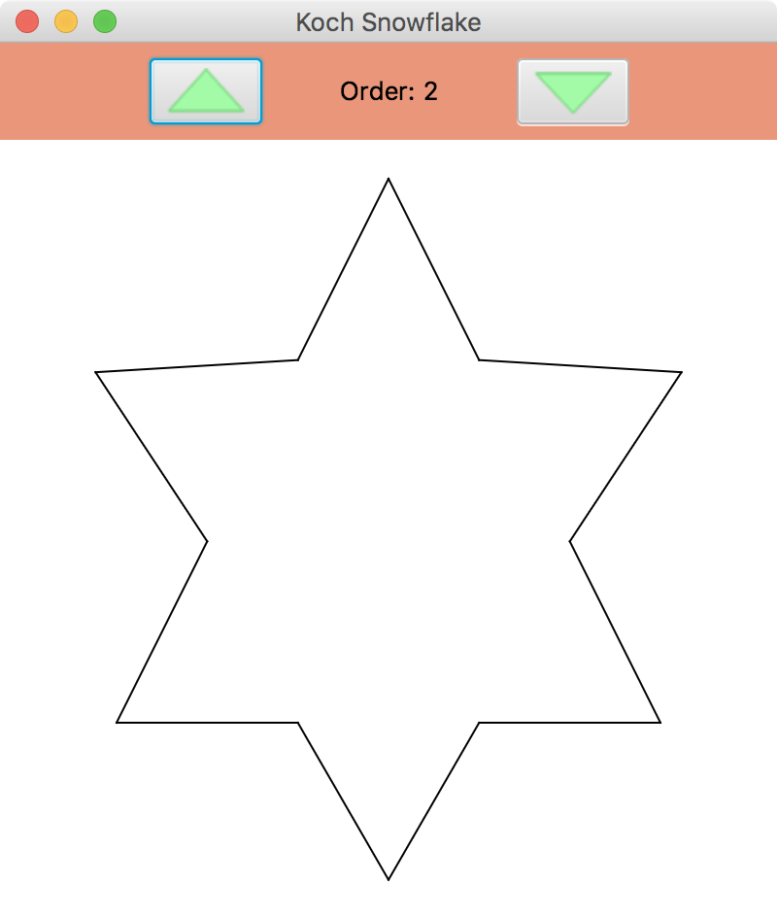
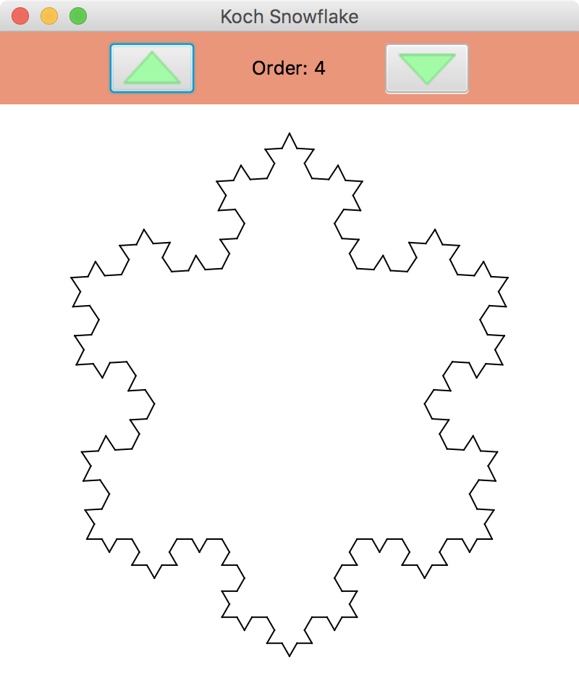
continue
//--------------------------------------------------------------------
// Decrements the fractal order when the down button is pressed.
// Disables the down button if the minimum order is reached.
//--------------------------------------------------------------------
public void processDownButtonPress(ActionEvent event)
{
order--;
orderText.setText("Order: " + order);
fractalPane.makeFractal(order);
up.setDisable(false);
if (order == MIN_ORDER)
down.setDisable(true);
}
}

Slide 51
Koch Snowflake
< x₅, y₅>
< x₅, y₅>
< x₄, y₄>
Becomes
< x₃, y₃>
< x₂, y₂>
< x₁, y₁>
< x₁, y₁>

Slide 52
import javafx.scene.layout.Pane;
import javafx.scene.shape.Line;
//************************************************************************
// KochPane.java Author: Lewis/Loftus
//
// Represents the pane in which the Koch Snowflake fractal is presented.
//************************************************************************
public class KochPane extends Pane
{
public final static double SQ = Math.sqrt(3) / 6;
//--------------------------------------------------------------------
// Makes an initial fractal of order 1 (a triangle) when the pane
// is first created.
//--------------------------------------------------------------------
public KochPane()
{
makeFractal(1);
}
continue

Slide 53
continue
//--------------------------------------------------------------------
// Draws the fractal by clearing the pane and then adding three
// lines of the specified order between three predetermined points.
//--------------------------------------------------------------------
public void makeFractal(int order)
{
getChildren().clear();
addLine(order, 200, 20, 60, 300);
addLine(order, 60, 300, 340, 300);
addLine(order, 340, 300, 200, 20);
}
//--------------------------------------------------------------------
// Recursively adds a line of the specified order to the fractal.
// The base case is a straight line between the given points.
// Otherwise, three intermediate points are computed and four line
// segments are added as a fractal of decremented order.
//--------------------------------------------------------------------
public void addLine(int order, double x1, double y1, double x5,
double y5)
{
double deltaX, deltaY, x2, y2, x3, y3, x4, y4;
continue

Slide 54
continue
if (order == 1)
{
getChildren().add(new Line(x1, y1, x5, y5));
}
else
{
deltaX = x5 - x1; // distance between the end points
deltaY = y5 - y1;
x2 = x1 + deltaX / 3; // one third
y2 = y1 + deltaY / 3;
x3 = (x1 + x5) / 2 + SQ * (y1 - y5); // projection
y3 = (y1 + y5) / 2 + SQ * (x5 - x1);
x4 = x1 + deltaX * 2 / 3; // two thirds
y4 = y1 + deltaY * 2 / 3;
addLine(order - 1, x1, y1, x2, y2);
addLine(order - 1, x2, y2, x3, y3);
addLine(order - 1, x3, y3, x4, y4);
addLine(order - 1, x4, y4, x5, y5);
}
}
}

Slide 55
Summary
Chapter 12 has focused on:
thinking in a recursive manner
programming in a recursive manner
the correct use of recursion
recursion examples
recursion in graphics
fractals

