Slide 1

Chapter 13 Collections
Java Software Solutions
Foundations of Program Design
9th Edition
John Lewis
William Loftus

Slide 2
Collections
A collection is an object that helps us organize and manage other objects
Chapter 13 focuses on:
the concept of a collection
separating the interface from the implementation
dynamic data structures
linked lists
queues and stacks
trees and graphs
generics

Slide 3
Outline
Collections and Data Structures
Dynamic Representations
Queues and Stacks
Trees and Graphs
The Java Collections API

Slide 4
Collections
A collection is an object that serves as a repository for other objects
A collection provides services for adding, removing, and otherwise managing the elements it contains
Sometimes the elements in a collection are ordered, sometimes they are not
All collection classes in Java are generic
You create a collection that holds a specific type, such as ArrayList<String>

Slide 5
Collections
Often collections can be implemented in a variety of ways
A collection is implemented with a particular underlying data structure
For example, an ArrayList is implemented using an array and a LinkedList is implemented using a dynamic list (discussed later)
But both represent a list collection, and behave in similar ways

Slide 6
Abstraction
Collections, like all objects, are abstractions
They hide underlying details
They separate the interface of the object from its underlying implementation
This helps manage complexity and makes it possible to change the implementation without changing the interface

Slide 7
Abstract Data Types
An abstract data type (ADT) is an organized collection of information and a set of operations used to manage that information
The set of operations defines the interface to the ADT
In one sense, as long as the ADT fulfills the promises of the interface, it doesn't matter how the ADT is implemented
Essentially, the terms collection and abstract data type are interchangeable

Slide 8
Outline
Collections and Data Structures
Dynamic Representations
Queues and Stacks
Trees and Graphs
The Java Collections API

Slide 9
Dynamic Structures
A static data structure has a fixed size
This meaning is different from the meaning of the static modifier
Arrays are static; once you define the number of elements it can hold, the size doesn’t change
A dynamic data structure grows and shrinks at execution time as required by its contents
A dynamic data structure is implemented using object references as links

Slide 10
Object References
Recall that an object reference is a variable that stores the address of an object
A reference also can be called a pointer
References often are depicted graphically:
student
John Smith
40725
3.58

Slide 11
References as Links
Object references can be used to create links between objects
Suppose a class contains a reference to another object of the same class:
class Node
{
int info;
Node next;
}

Slide 12
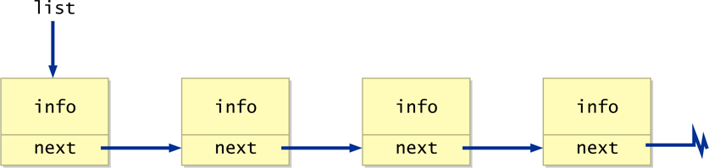
References as Links
References can be used to create a variety of linked structures, such as a linked list:

Slide 13
Intermediate Nodes
The objects being stored should not be concerned with the details of the data structure in which they may be stored
For example, the Student class should not have to store a link to the next Student object in the list
Instead, use a separate node class with two parts:
a reference to an independent object
a link to the next node in the list
The internal representation becomes a linked list of nodes

Slide 14
Magazine Collection
Let’s explore an example of a collection of Magazine objects, managed by the MagazineList class, which has an private inner class called MagazineNode
See MagazineRack.java
See MagazineList.java
See Magazine.java

Slide 15
//*******************************************************************
// MagazineRack.java Author: Lewis/Loftus
//
// Driver to exercise the MagazineList collection.
//*******************************************************************
public class MagazineRack
{
//----------------------------------------------------------------
// Creates a MagazineList object, adds several magazines to the
// list, then prints it.
//----------------------------------------------------------------
public static void main(String[] args)
{
MagazineList rack = new MagazineList();
rack.add(new Magazine("Time"));
rack.add(new Magazine("Woodworking Today"));
rack.add(new Magazine("Communications of the ACM"));
rack.add(new Magazine("House and Garden"));
rack.add(new Magazine("GQ"));
System.out.println(rack);
}
}

Slide 16
Output
Time
Woodworking Today
Communications of the ACM
House and Garden
GQ
//*******************************************************************
// MagazineRack.java Author: Lewis/Loftus
//
// Driver to exercise the MagazineList collection.
//*******************************************************************
public class MagazineRack
{
//----------------------------------------------------------------
// Creates a MagazineList object, adds several magazines to the
// list, then prints it.
//----------------------------------------------------------------
public static void main(String[] args)
{
MagazineList rack = new MagazineList();
rack.add(new Magazine("Time"));
rack.add(new Magazine("Woodworking Today"));
rack.add(new Magazine("Communications of the ACM"));
rack.add(new Magazine("House and Garden"));
rack.add(new Magazine("GQ"));
System.out.println(rack);
}
}

Slide 17
//*******************************************************************
// MagazineList.java Author: Lewis/Loftus
//
// Represents a collection of magazines.
//*******************************************************************
public class MagazineList
{
private MagazineNode list;
//----------------------------------------------------------------
// Sets up an initially empty list of magazines.
//----------------------------------------------------------------
public MagazineList()
{
list = null;
}
continue

Slide 18
continue
//----------------------------------------------------------------
// Creates a new MagazineNode object and adds it to the end of
// the linked list.
//----------------------------------------------------------------
public void add(Magazine mag)
{
MagazineNode node = new MagazineNode(mag);
MagazineNode current;
if (list == null)
list = node;
else
{
current = list;
while (current.next != null)
current = current.next;
current.next = node;
}
}
continue

Slide 19
continue
//----------------------------------------------------------------
// Returns this list of magazines as a string.
//----------------------------------------------------------------
public String toString()
{
String result = "";
MagazineNode current = list;
while (current != null)
{
result += current.magazine + "\n";
current = current.next;
}
return result;
}
continue

Slide 20
continue
//*****************************************************************
// An inner class that represents a node in the magazine list.
// The public variables are accessed by the MagazineList class.
//*****************************************************************
private class MagazineNode
{
public Magazine magazine;
public MagazineNode next;
//--------------------------------------------------------------
// Sets up the node
//--------------------------------------------------------------
public MagazineNode(Magazine mag)
{
magazine = mag;
next = null;
}
}
}

Slide 21
//********************************************************************
// Magazine.java Author: Lewis/Loftus
//
// Represents a single magazine.
//********************************************************************
public class Magazine
{
private String title;
//-----------------------------------------------------------------
// Sets up the new magazine with its title.
//-----------------------------------------------------------------
public Magazine(String newTitle)
{
title = newTitle;
}
//-----------------------------------------------------------------
// Returns this magazine as a string.
//-----------------------------------------------------------------
public String toString()
{
return title;
}
}

Slide 22
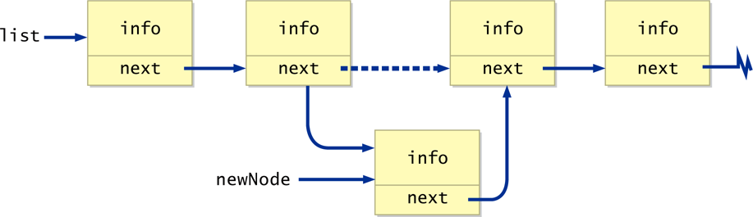
Inserting a Node
A node can be inserted into a linked list with a few reference changes:

Slide 23
Quick Check
Write code that inserts newNode after the node pointed to by current.

Slide 24
Quick Check
Write code that inserts newNode after the node pointed to by current.
newNode.next = current.next;
current.next = newNode;

Slide 25
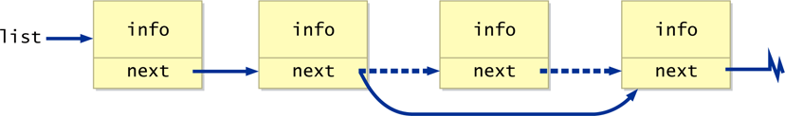
Deleting a Node
Likewise, a node can be removed from a linked list by changing the next pointer of the preceding node:

Slide 26
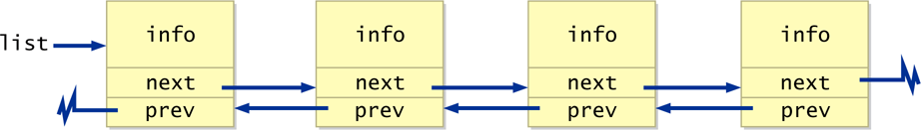
Other Dynamic Representations
It may be convenient to implement a list as a doubly linked list, with next and previous references:

Slide 27
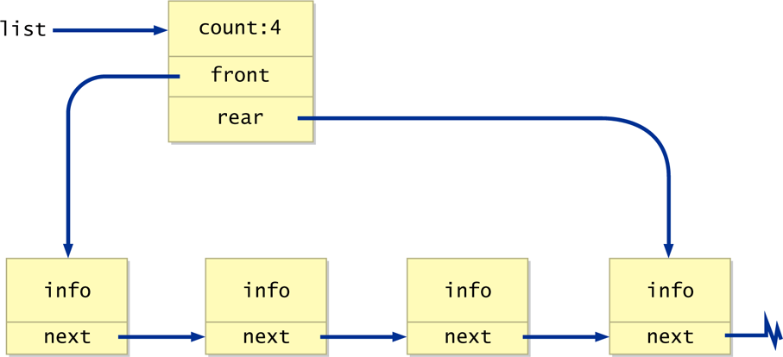
Other Dynamic Representations
Another approach is to use a separate header node, with a count and references to both the front and rear of the list:

Slide 28
Outline
Collections and Data Structures
Dynamic Representations
Queues and Stacks
Trees and Graphs
The Java Collections API

Slide 29
Classic Collections
Now we'll examine some common collections that are helpful in many situations
Classic linear collections include queues and stacks
Classic nonlinear collections include trees and graphs

Slide 30
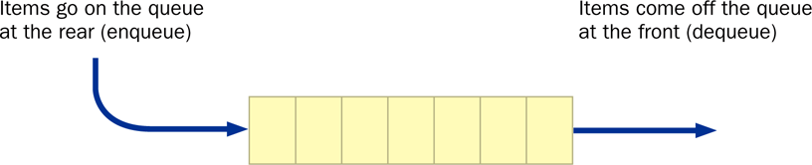
Queues
A queue is a list that adds items only to the rear of the list and removes them only from the front
It is a FIFO data structure: First-In, First-Out
Analogy: a line of people at a bank teller’s window

Slide 31
Queues
Classic operations for a queue
enqueue - add an item to the rear of the queue
dequeue (or serve) - remove an item from the front of the queue
empty - returns true if the queue is empty
Queues often are helpful in simulations or any situation in which items get “backed up” while awaiting processing

Slide 32
Queues
A queue can be represented by a singly-linked list; it is most efficient if the references point from the front toward the rear of the queue
A queue can be represented by an array, using the remainder operator (%) to “wrap around” when the end of the array is reached and space is available at the front of the array

Slide 33
Stacks
A stack is also linear, like a list or a queue
Items are added and removed from only one end of a stack
It is therefore LIFO: Last-In, First-Out
Analogies: a stack of plates or a stack of books

Slide 34
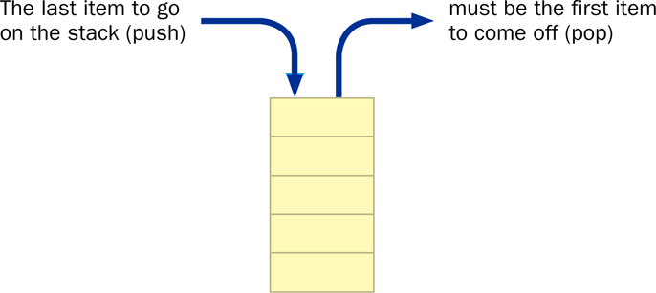
Stacks
Stacks often are drawn vertically:

Slide 35
Stacks
Clasic stack operations:
push - add an item to the top of the stack
pop - remove an item from the top of the stack
peek (or top) - retrieves the top item without removing it
empty - returns true if the stack is empty
A stack can be represented by a singly-linked list, with the first node in the list being to top element on the stack
A stack can also be represented by an array, with the bottom of the stack at index 0

Slide 36
Stacks
The java.util package contains a Stack class
Suppose a message has been encoded by reversing the letters of each word
The message can be decoded by stacking the individual characters of each word to reverse them
See Decode.java

Slide 37
//********************************************************************
// Decode.java Author: Lewis/Loftus
//
// Demonstrates the use of the Stack class.
//********************************************************************
import java.util.*;
public class Decode
{
//-----------------------------------------------------------------
// Decodes a message by reversing each word in a string.
//-----------------------------------------------------------------
public static void main(String[] args)
{
Scanner scan = new Scanner(System.in);
Stack<Character> word = new Stack<Character>();
String message;
int index = 0;
System.out.println("Enter the coded message:");
message = scan.nextLine();
System.out.println("The decoded message is:");
continue

Slide 38
continue
while (index < message.length())
{
// Push word onto stack
while (index < message.length() && message.charAt(index) != ' ')
{
word.push(message.charAt(index));
index++;
}
// Print word in reverse
while (!word.empty())
System.out.print(word.pop());
System.out.print(" ");
index++;
}
System.out.println();
}
}

Slide 39
Sample Run
Enter the coded message:
artxE eseehc esaelp
The decoded message is:
Extra cheese please
continue
while (index < message.length())
{
// Push word onto stack
while (index < message.length() && message.charAt(index) != ' ')
{
word.push(message.charAt(index));
index++;
}
// Print word in reverse
while (!word.empty())
System.out.print(word.pop());
System.out.print(" ");
index++;
}
System.out.println();
}
}

Slide 40
Outline
Collections and Data Structures
Dynamic Representations
Queues and Stacks
Trees and Graphs
The Java Collections API

Slide 41
Trees
A tree is a non-linear data structure that consists of a root node and potentially many levels of additional nodes that form a hierarchy
Nodes that have no children are called leaf nodes
Nodes except for the root and leaf nodes are called internal nodes
In a general tree, each node can have many child nodes

Slide 42
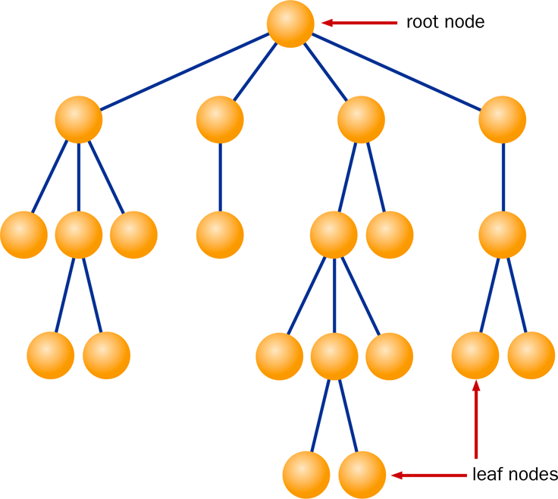
A General Tree

Slide 43
Binary Trees
In a binary tree, each node can have no more than two child nodes
Trees are typically are represented using references as dynamic links
For binary trees, this requires storing only two links per node to the left and right child

Slide 44
Graphs
A graph is another non-linear structure
Unlike a tree, a graph does not have a root
Any node in a graph can be connected to any other node by an edge
Analogy: the highway system connecting cities on a map

Slide 45
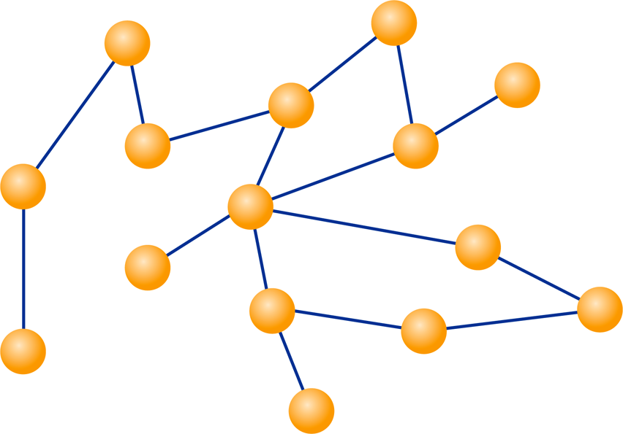
Graphs

Slide 46
Digraphs
In a directed graph or digraph, each edge has a specific direction.
Edges with direction sometimes are called arcs
Analogy: airline flights between airports

Slide 47
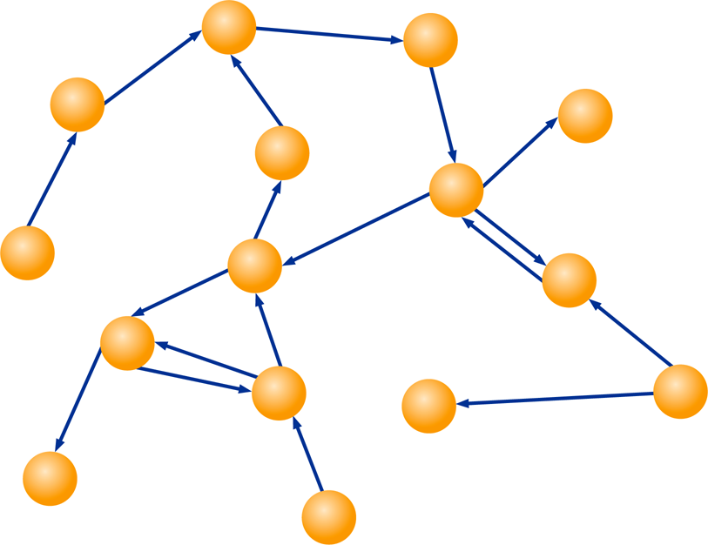
Digraphs

Slide 48
Representing Graphs
Both graphs and digraphs can be represented using dynamic links or using arrays.
As always, the representation should facilitate the intended operations and make them convenient to implement

Slide 49
Outline
Collections and Data Structures
Dynamic Representations
Queues and Stacks
Trees and Graphs
The Java Collections API

Slide 50
Collection Classes
The Java standard library contains several classes that represent collections, often referred to as the Java Collections API
Their underlying implementation is implied in the class names such as ArrayList and LinkedList
Several interfaces are used to define operations on the collections, such as List, Set, SortedSet, Map, and SortedMap

Slide 51
Generics
As mentioned in Chapter 5, Java supports generic types, which are useful when defining collections
A class can be defined to operate on a generic data type which is specified when the class is instantiated:
LinkedList<Book> myList =
new LinkedList<Book>();
By specifying the type stored in a collection, only objects of that type can be added to it
Furthermore, when an object is removed, its type is already established

Slide 52
Summary
Chapter 13 has focused on:
the concept of a collection
separating the interface from the implementation
dynamic data structures
linked lists
queues and stacks
trees and graphs
generics

