Slide 1
Boolean Algebra
Chapter 12
Copyright © McGraw-Hill Education. All rights reserved. No reproduction or distribution without the prior written consent of McGraw-Hill Education.

Slide 2
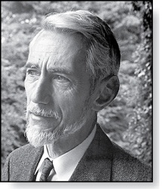
Chapter Summary
Claude Shannon (1916 - 2001)
Boolean Functions
Representing Boolean Functions
Logic Gates

Slide 3
Boolean Functions
Section 12.1

Slide 4
Section Summary
Introduction to Boolean Algebra
Boolean Expressions and Boolean Functions
Identities of Boolean Algebra
Duality
The Abstract Definition of a Boolean Algebra

Slide 5
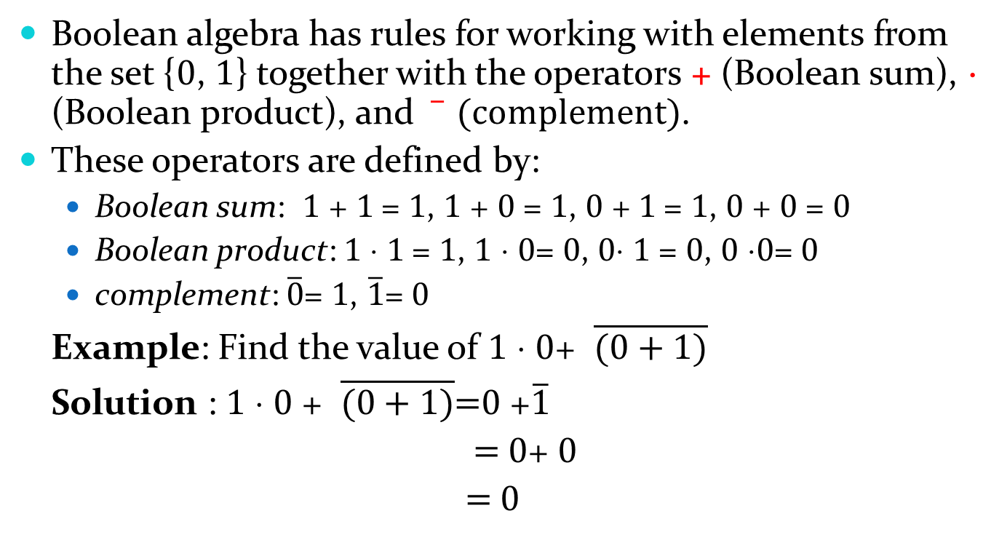
Introduction to Boolean Algebra
Boolean algebra has rules for working with elements from the set {0, 1} together with the operators + (Boolean sum), ⋅ (Boolean product), and $\overline{ } (complement)$.
These operators are defined by:
Boolean sum: 1 + 1 = 1, 1 + 0 = 1, 0 + 1 = 1, 0 + 0 = 0
Boolean product: 1 ⋅ 1 = 1, 1 ⋅ 0= 0, 0⋅ 1 = 0, 0 ⋅0= 0
complement: $\overline{0}$= 1, $\overline{1}$= 0
Example: Find the value of 1 ⋅ 0+ $\overline{(0+1)}$
Solution : 1 ⋅ 0 + $\overline{(0+1)}$=0 +$\overline{1}$
= 0+ 0
= 0

Slide 6
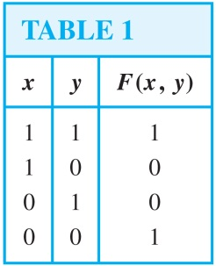
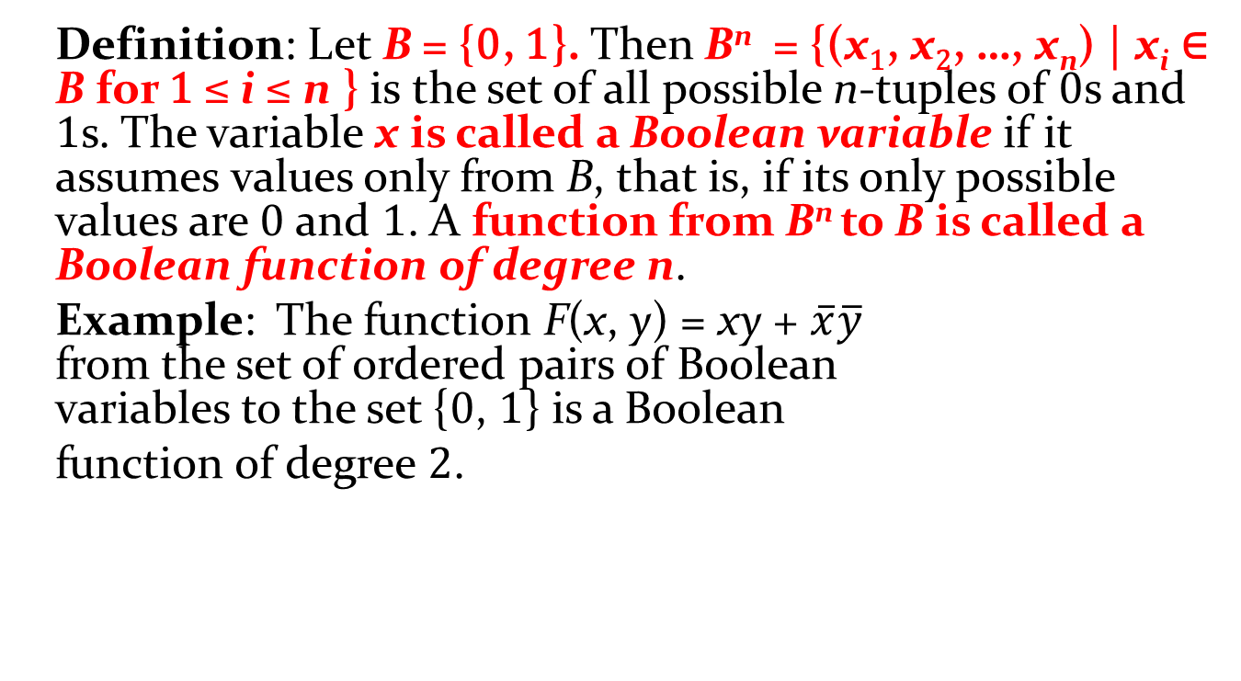
Boolean Expressions and Boolean Functions
Definition: Let B = {0, 1}. Then B^{n} = {(x₁, x₂, …, x_{n}) | x_{i} ∈ B for 1 ≤ i ≤ n } is the set of all possible n-tuples of 0s and 1s. The variable x is called a Boolean variable if it assumes values only from B, that is, if its only possible values are 0 and 1. A function from B^{n} to B is called a Boolean function of degree n.
Example: The function F(x, y) = xy + $\overline{x}\overline{y}$ from the set of ordered pairs of Boolean variables to the set {0, 1} is a Boolean
function of degree 2.

Slide 7
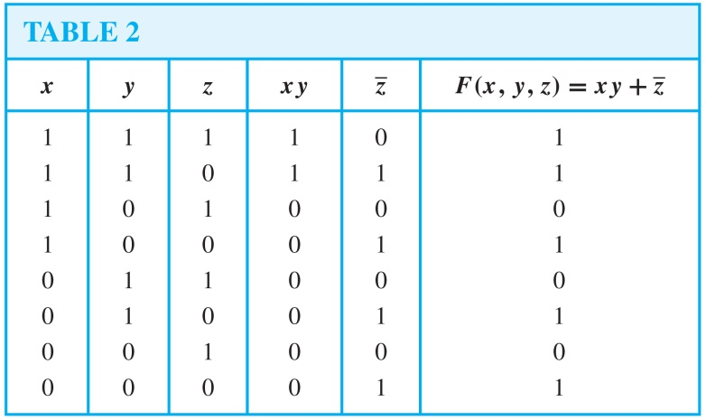

Boolean Expressions and Boolean Functions (continued)
Example: Find the values of the Boolean function represented by F(x, y, z) = xy + $\overline{z}$.
Solution: We use a table with a row for each combination of values of x, y, and z to compute the values of F(x,y,z).

Slide 8
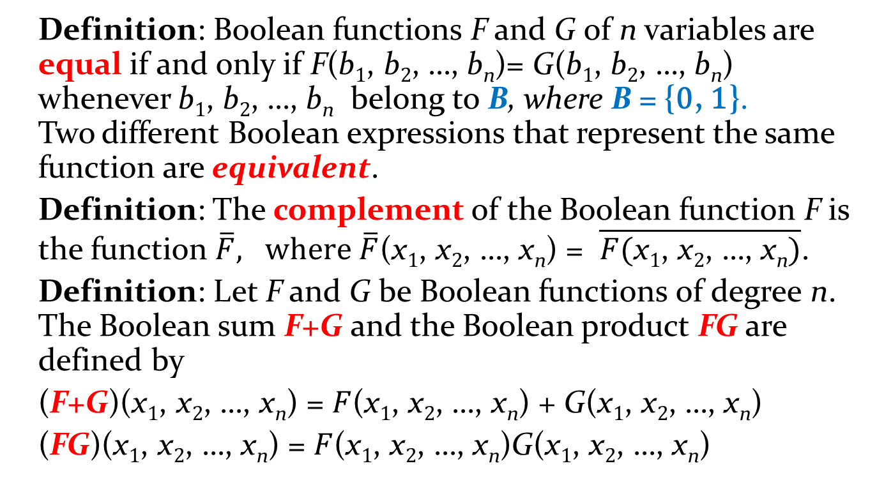
Boolean Expressions and Boolean Functions (continued)
Definition: Boolean functions F and G of n variables are equal if and only if F(b₁, b₂, …, b_{n})= G(b₁, b₂, …, b_{n}) whenever b₁, b₂, …, b_{n} belong to B, where B = {0, 1}. Two different Boolean expressions that represent the same function are equivalent.
Definition: The complement of the Boolean function F is the function $\overline{F}, where \overline{F}$(x₁, x₂, …, x_{n}) = $\overline{F(\text{x}\text{1}\text{, }\text{x}\text{2}\text{, …, }\text{x}\text{n})}$.
Definition: Let F and G be Boolean functions of degree n. The Boolean sum F+G and the Boolean product FG are defined by
(F+G)(x₁, x₂, …, x_{n}) = $F$(x₁, x₂, …, x_{n}) + G(x₁, x₂, …, x_{n})
(FG)(x₁, x₂, …, x_{n}) = $F$(x₁, x₂, …, x_{n})G(x₁, x₂, …, x_{n})

Slide 9
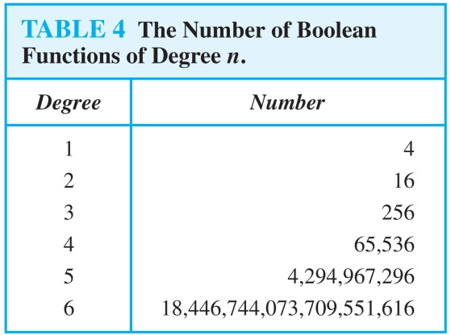
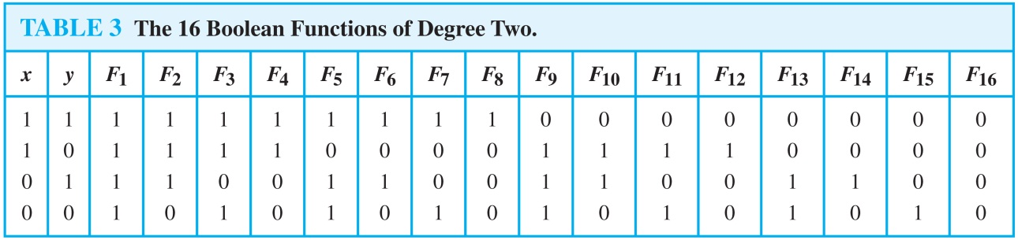
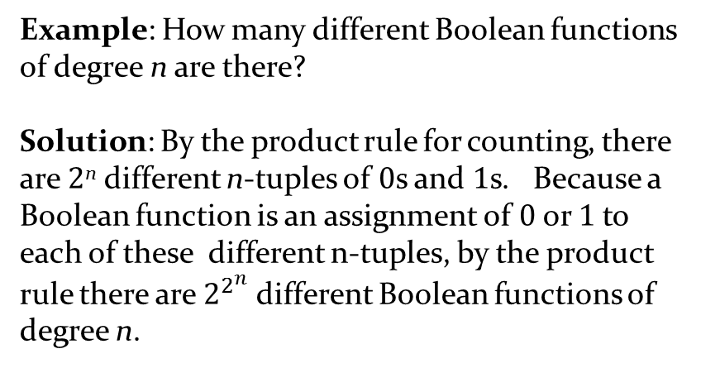
Boolean Functions
Example: How many different Boolean functions of degree n are there?
Solution: By the product rule for counting, there are 2^{n} different n-tuples of 0s and 1s. Because a Boolean function is an assignment of 0 or 1 to each of these different n-tuples, by the product rule there are $2^{2^{n}}$ different Boolean functions of degree n.
The example tells us that there are 16 different Boolean functions of degree two. We display these in Table 3.

Slide 10
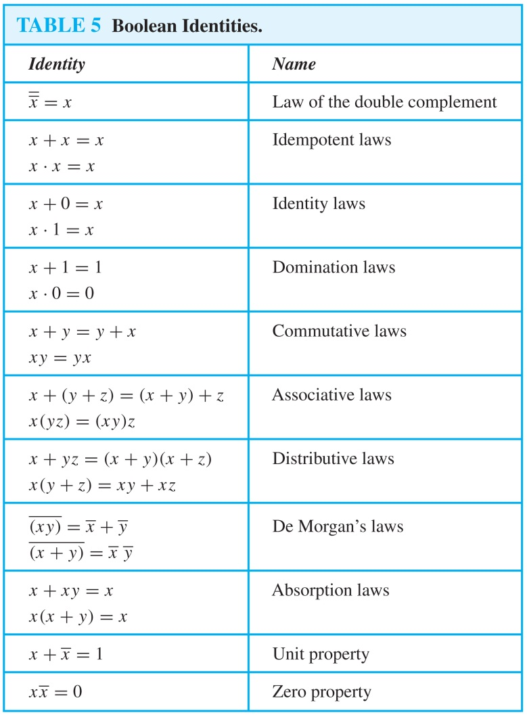
Identities of Boolean Algebra
Each identity can be proved using a table.
All identities in Table 5, except for the first and the last two come in pairs. Each element of the pair is the dual of the other (obtained by switching Boolean sums and Boolean products and 0’s and 1’s ).
The Boolean identities correspond to the identities of propositional logic (Section 1.3) and the set identities (Section 2.2).

Slide 11
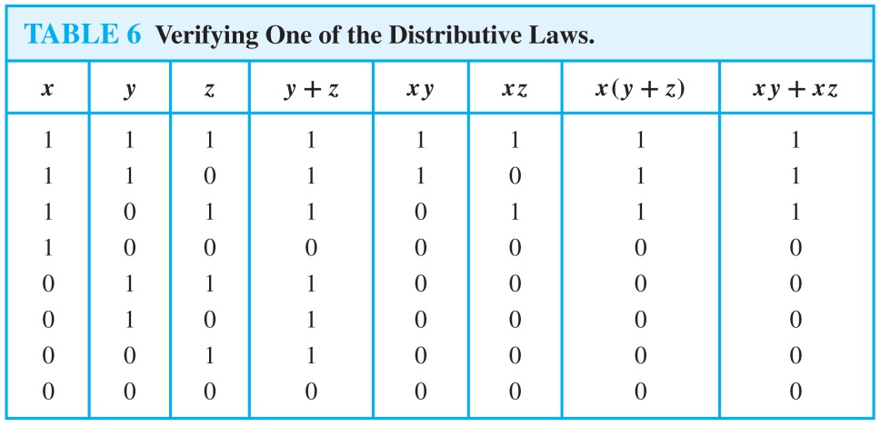
Identities of Boolean Algebra
Example: Show that the distributive law x(y + z) = xy + xz is valid.
Solution: We show that both sides of this identity always take the same value by constructing this table.

Slide 12
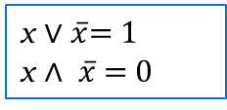
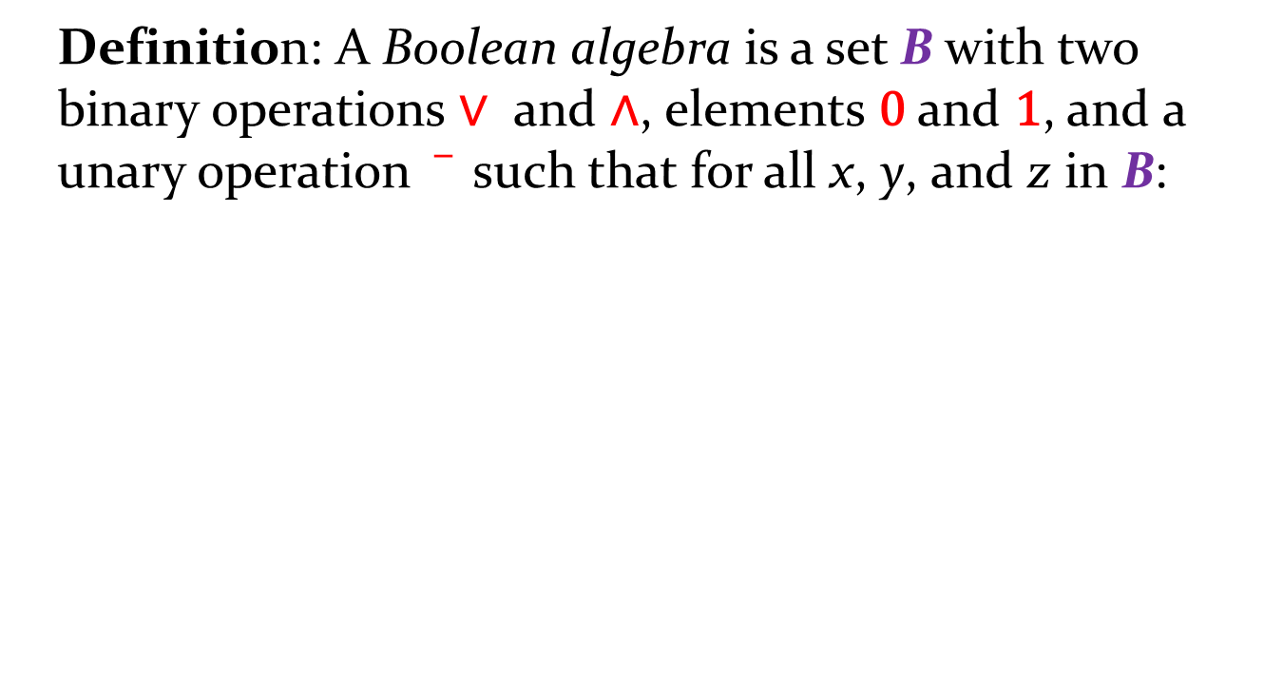

Formal Definition of a Boolean Algebra
Definition: A Boolean algebra is a set B with two binary operations ∨ and ∧, elements 0 and 1, and a unary operation such that for all x, y, and z in B:
x ∨ 0 = x
x ∧ 1 = x
identity laws
The set of propositional variables with the operators ∧ and ∨, elements T and F, and the negation operator ¬ is a Boolean algebra.
x ∨ $\overline{x}$= 1
x ∧ $\overline{x}$ = 0
complement laws
(x ∨ y ) ∨ z = x ∨ (y ∨ z)
(x ∧ y ) ∧ z = x ∧ (y ∧ z)
associative laws
The set of subsets of a universal set with the operators ∪ and ∩, the empty set (∅), universal set (U), and the set complementation operator ( ) is a Boolean algebra.
x ∨ y = y ∨ x
x ∧ y = y ∧ x
commutative laws
x ∨ (y ∧ z) = (x ∨ y) ∧ (x ∨ z)
x ∧ (y ∨ z ) = (x ∧ y) ∨ (x ∧ z)
distributive laws

Slide 13
Representing Boolean Functions
Section 12.2

Slide 14
Section Summary
Sum-of-Products Expansions
Functional Completeness

Slide 15
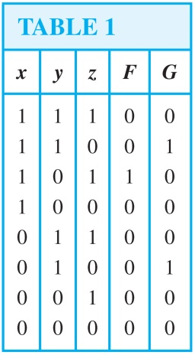
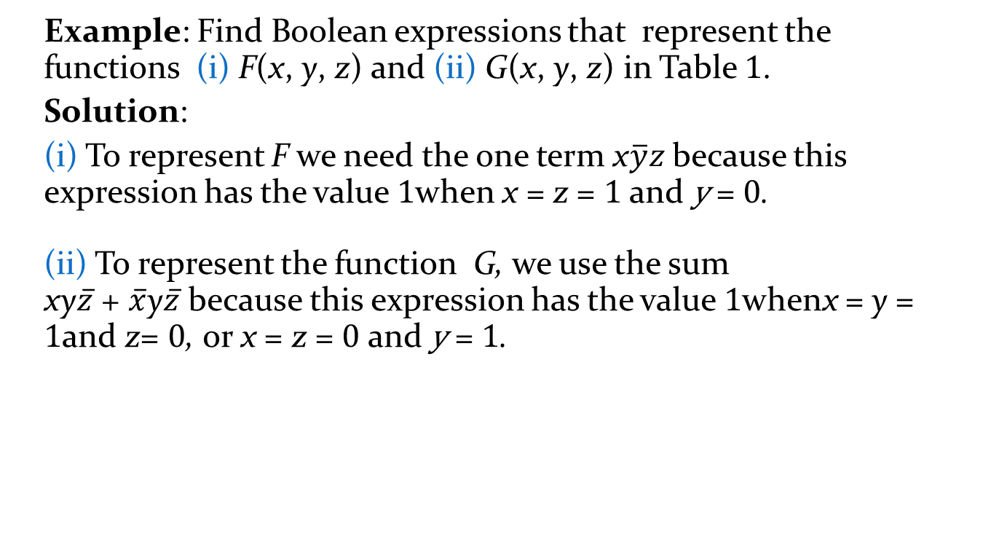
Sum-of-Products Expansion
Example: Find Boolean expressions that represent the functions (i) F(x, y, z) and (ii) G(x, y, z) in Table 1.
Solution:
(i) To represent F we need the one term x$\overline{y}z$because this expression has the value 1when x = z = 1 and y = 0.
(ii) To represent the function G, we use the sum xy$\overline{z}$ + $\overline{x}$y$\overline{z}$ because this expression has the value 1whenx = y = 1and z= 0, or x = z = 0 and y = 1.
The general principle is that each combination of values of the variables for which the function has the value 1 requires a term in the Boolean sum that is the Boolean product of the variables or their complements.

Slide 16
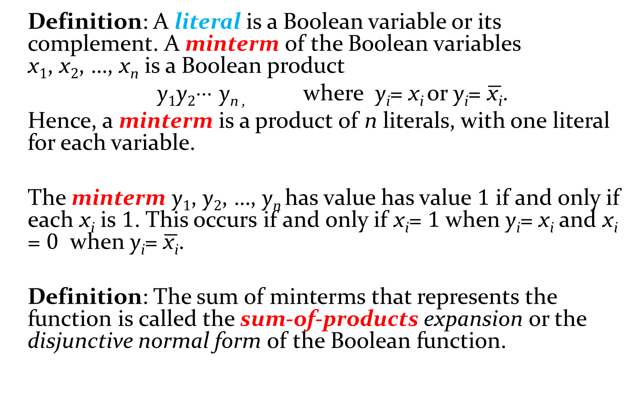
Sum-of-Products Expansion (cont)
Definition: A literal is a Boolean variable or its complement. A minterm of the Boolean variables x₁, x₂, …, x_{n} is a Boolean product
y₁y₂⋅⋅⋅ y_{n ,} where y_{i}= x_{i} or y_{i}= $\overline{\text{x}\text{i}}$.
Hence, a minterm is a product of n literals, with one literal for each variable.
The minterm y₁, y₂, …, y_{n} has value has value 1 if and only if each x_{i} is 1. This occurs if and only if x_{i}= 1 when y_{i}= x_{i} and x_{i} = 0 when y_{i}= $\overline{\text{x}\text{i}}$.
Definition: The sum of minterms that represents the function is called the sum-of-products expansion or the disjunctive normal form of the Boolean function.

Slide 17
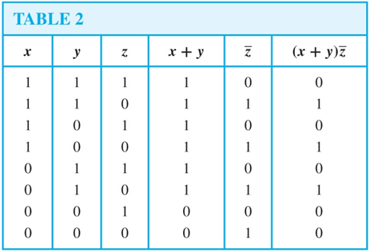
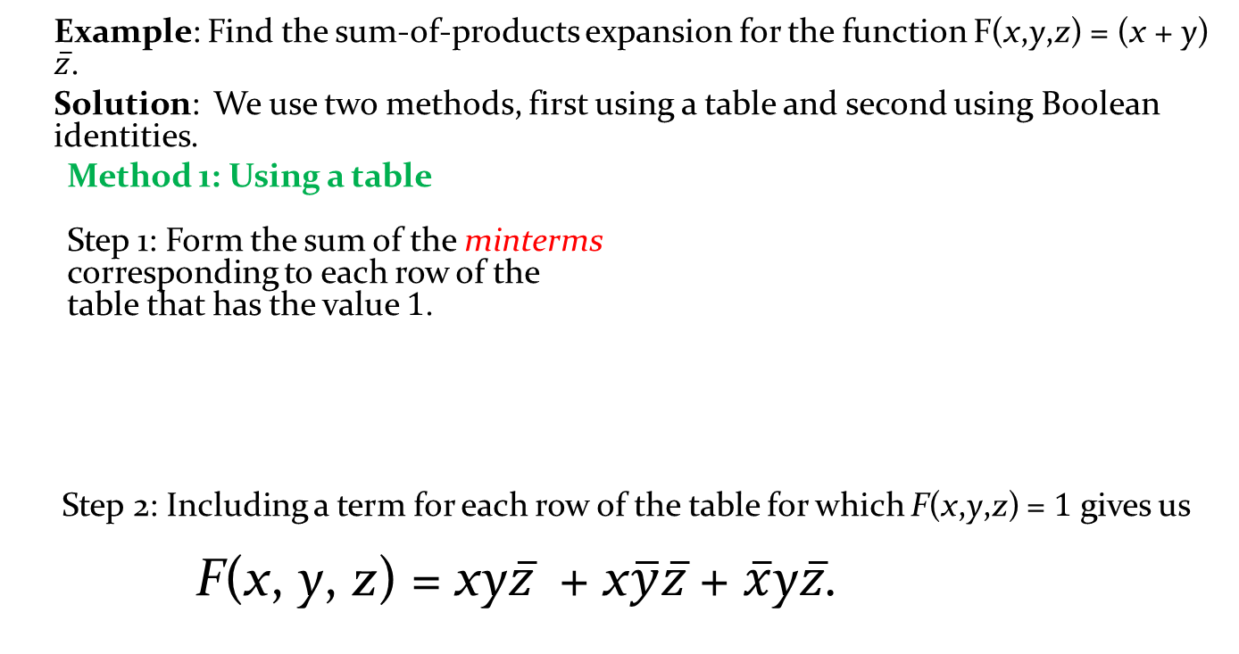
Sum-of-Products Expansion (cont)
Example: Find the sum-of-products expansion for the function F(x,y,z) = (x + y) $\overline{z}$.
Solution: We use two methods, first using a table and second using Boolean identities.
Method 1: Using a table Step 1: Form the sum of the minterms corresponding to each row of the table that has the value 1.
Step 2: Including a term for each row of the table for which F(x,y,z) = 1 gives us F(x, y, z) = xy$\overline{z}$ + x$\overline{y}\overline{z}$ + $\overline{x}$y$\overline{z}$.

Slide 18
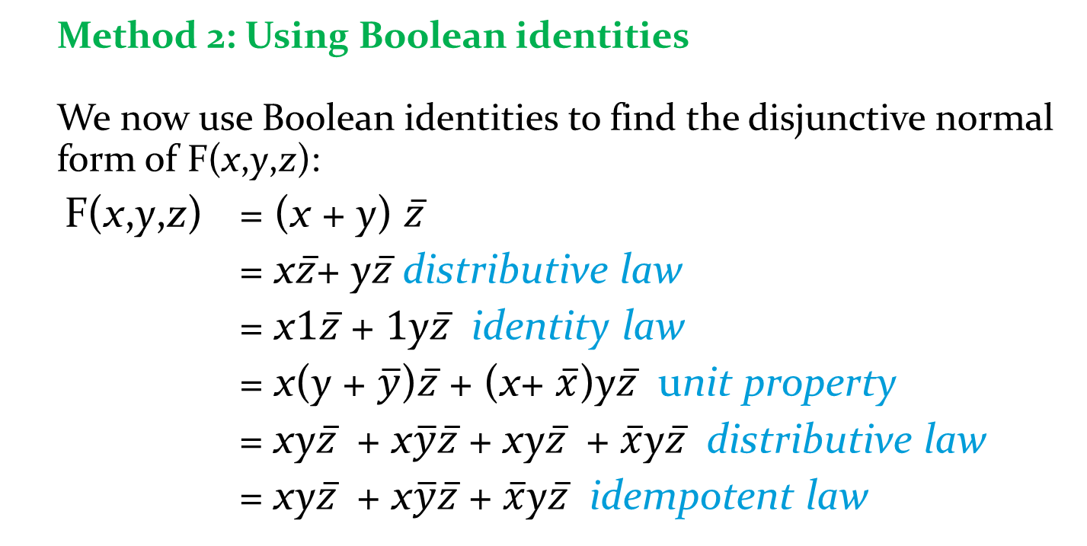
Sum-of-Products Expansion (cont)
Method 2: Using Boolean identities We now use Boolean identities to find the disjunctive normal form of F(x,y,z):
F(x,y,z) = (x + y) $\overline{z}$
= x$\overline{z}$+ y$\overline{z}$ distributive law
= x1$\overline{z}$ + 1y$\overline{z}$ identity law
= x(y + $\overline{y}$)$\overline{z}$ + (x+ $\overline{x}$)y$\overline{z}$ unit property
= xy$\overline{z}$ + x$\overline{y}\overline{z}$ + xy$\overline{z}$ + $\overline{x}$y$\overline{z}$ distributive law
= xy$\overline{z}$ + x$\overline{y}\overline{z}$ + $\overline{x}$y$\overline{z}$ idempotent law

Slide 19
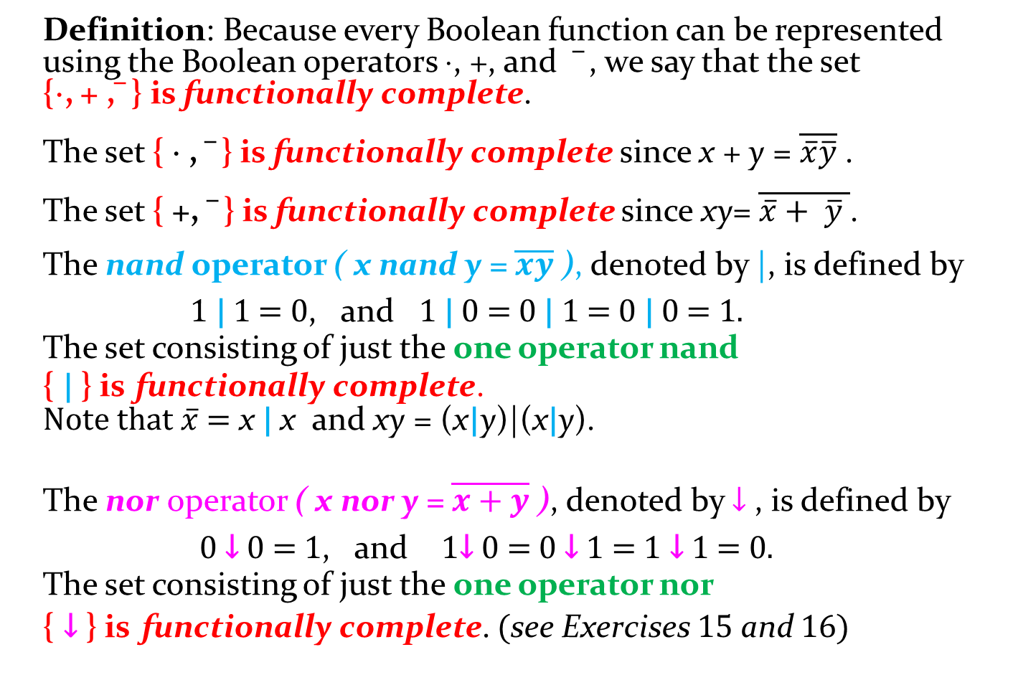
Functional Completeness
Definition: Because every Boolean function can be represented using the Boolean operators ⋅, +, and , we say that the set {⋅, + , } is functionally complete.
The set { ⋅ , } is functionally complete since x + y = $\overline{\overline{x}\overline{y}}$ .
The set { +, } is functionally complete since xy= $\overline{\overline{x}+ \overline{y} }$.
The nand operator ( x nand y = $\overline{xy}$ ), denoted by |, is defined by 1 | 1 = 0, and 1 | 0 = 0 | 1 = 0 | 0 = 1. The set consisting of just the one operator nand { | } is functionally complete. Note that $\overline{x}$ = x | x and xy = (x|y)|(x|y).
The nor operator ( x nor y = $\overline{x+y}$ ), denoted by ↓ , is defined by 0 ↓ 0 = 1, and 1↓ 0 = 0 ↓ 1 = 1 ↓ 1 = 0. The set consisting of just the one operator nor { ↓ } is functionally complete. (see Exercises 15 and 16)

Slide 20
Logic Gates
Section 12.3

Slide 21
Section Summary
Logic Gates
Combinations of Gates
Examples of Circuits

Slide 22
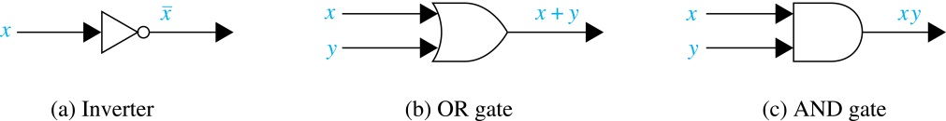
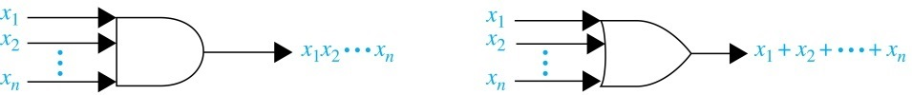
Logic Gates
We construct circuits using gates, which take as input the values of two or more Boolean variables and produce one or more bits as output, and inverters, which take the value of a Boolean variable as input and produce the complement of this value as output.

Slide 23
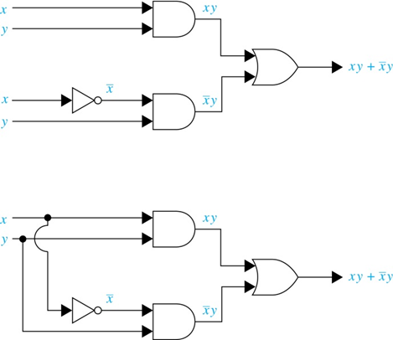
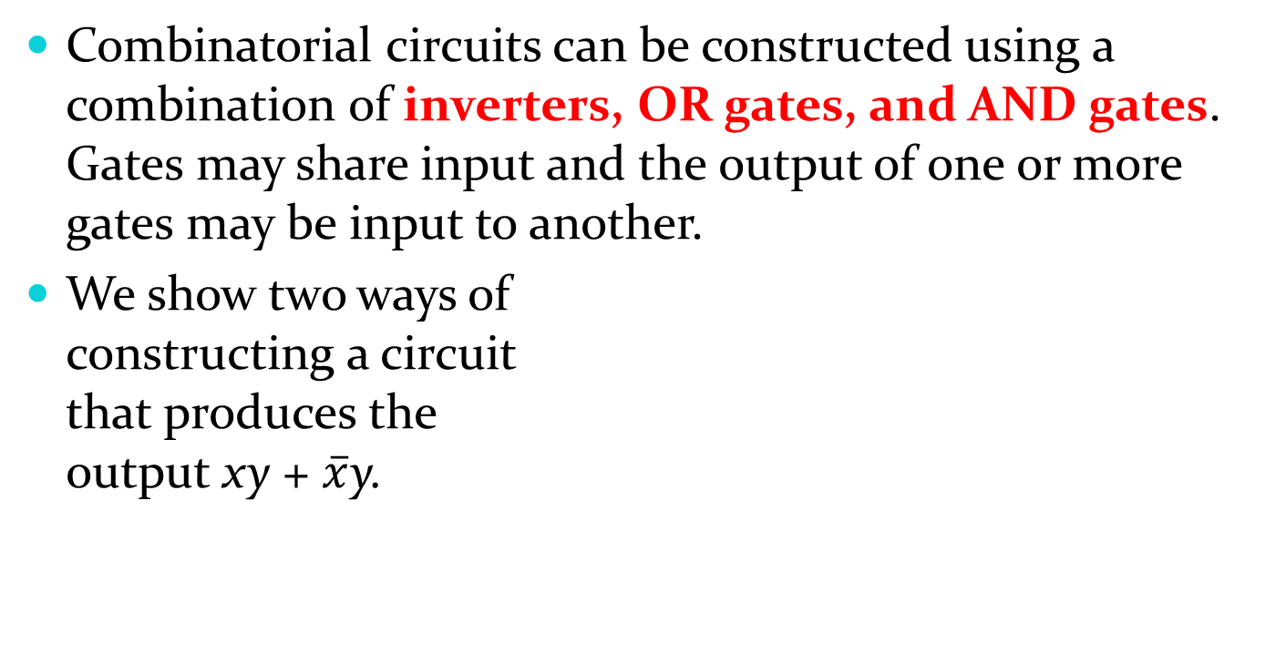
Combinations of Gates
Combinatorial circuits can be constructed using a combination of inverters, OR gates, and AND gates. Gates may share input and the output of one or more gates may be input to another.
We show two ways of constructing a circuit that produces the output xy + $\overline{x}$y.

Slide 24
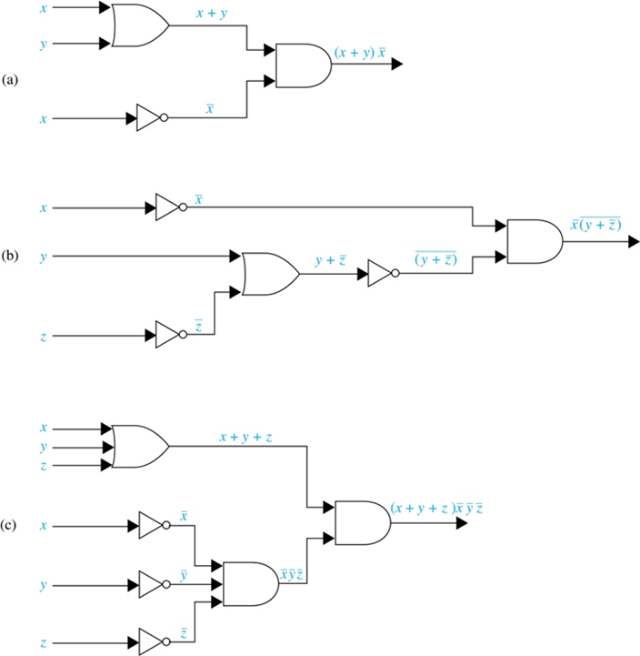
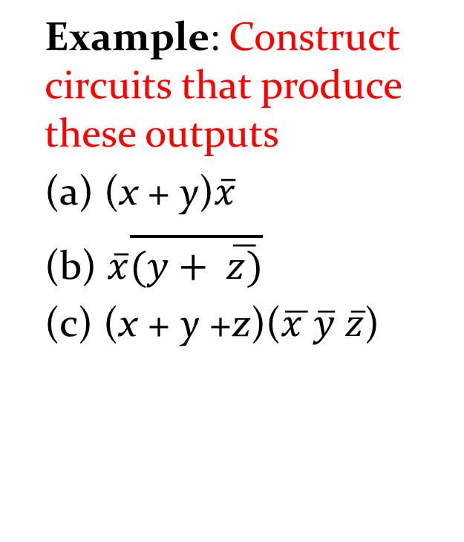
Combinations of Gates
Example: Construct circuits that produce these outputs
(a) (x + y)$\overline{x}$
(b) $\overline{x}\overline{(y+ \overline{z)}}$
(c) (x + y +z)($\overline{x }\overline{y} \overline{z}$)

Slide 25
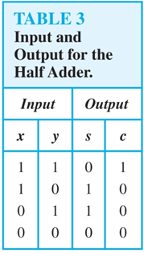
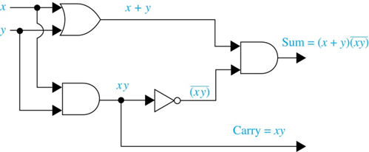
Adders
Logic circuits can be used to add two positive integers from their binary expansions.
The first step is to build a half adder that adds two bits, but which does not accept a carry from a previous addition.
Since the circuit has more than one output,
it is a multiple output circuit.

Slide 26
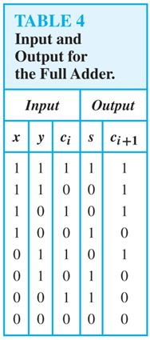
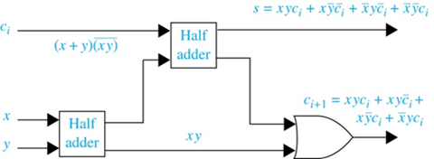
Adders (continued)
A full adder is used to compute the sum bit and the carry bit when two bits and a carry are added.

Slide 27
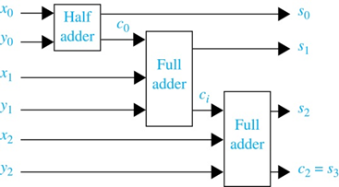
Adders (continued)
A half adder and multiple full adders can be used to produce the sum of n bit integers.
Example: Here is a circuit to compute the sum of two three-bit integers.

