Slide 1
Advanced Counting Techniques
Chapter 8
With Question/Answer Animations
Copyright © McGraw-Hill Education. All rights reserved. No reproduction or distribution without the prior written consent of McGraw-Hill Education.

Slide 2
Chapter Summary
Applications of Recurrence Relations
Linear Homogeneous Recurrence Relations
Divide-and-Conquer Algorithms and Recurrence Relations

Slide 3
Applications of Recurrence Relations
Section 8.1

Slide 4
Section Summary
Applications of Recurrence Relations
Fibonacci Numbers
The Tower of Hanoi
Counting Problems

Slide 5
Recurrence Relations (recalling definitions from Chapter 2)
Definition: A recurrence relation for the sequence {a_{n}} is an equation that expresses a_{n} in terms of one or more of the previous terms of the sequence, namely, a₀, a₁, …, a_{n-1}, for all integers n with n ≥ n₀, where n₀ is a nonnegative integer.
A sequence is called a solution of a recurrence relation if its terms satisfy the recurrence relation.
The initial conditions for a sequence specify the terms that precede the first term where the recurrence relation takes effect.

Slide 6
Rabbits and the Fiobonacci Numbers
Example: A young pair of rabbits (one of each gender) is placed on an island. A pair of rabbits does not breed until they are 2 months old. After they are 2 months old, each pair of rabbits produces another pair each month. Find a recurrence relation for the number of pairs of rabbits on the island after n months, assuming that rabbits never die.
This is the original problem considered by Leonardo Pisano (Fibonacci) in the thirteenth century.

Slide 7
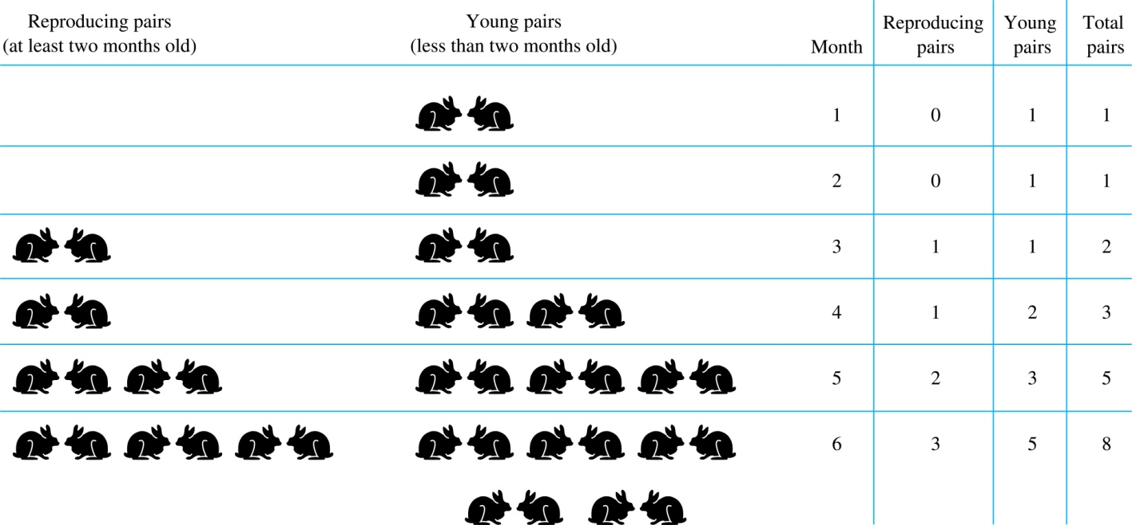
Rabbits and the Fiobonacci Numbers (cont.)
Modeling the Population Growth of Rabbits on an Island

Slide 8
Rabbits and the Fibonacci Numbers (cont.)
Solution: Let f_{n} be the the number of pairs of rabbits after n months.
There are is f₁ = 1 pairs of rabbits on the island at the end of the first month.
We also have f₂ = 1 because the pair does not breed during the first month.
To find the number of pairs on the island after n months, add the number on the island after the previous month, f_{n-1}, and the number of newborn pairs, which equals f_{n-2}, because each newborn pair comes from a pair at least two months old.
Consequently the sequence {f_{n} } satisfies the recurrence relation f_{n} = f_{n-1} + f_{n-2} for n ≥ 3 with the initial conditions f₁ = 1 and f₂ = 1.
The number of pairs of rabbits on the island after n months is given by the nth Fibonacci number.

Slide 9
The Tower of Hanoi
In the late nineteenth century, the French mathematician Édouard Lucas invented a puzzle consisting of three pegs on a board with disks of different sizes. Initially all of the disks are on the first peg in order of size, with the largest on the bottom.
Rules: You are allowed to move the disks one at a time from one peg to another as long as a larger disk is never placed on a smaller.
Goal: Using allowable moves, end up with all the disks on the second peg in order of size with largest on the bottom.

Slide 10
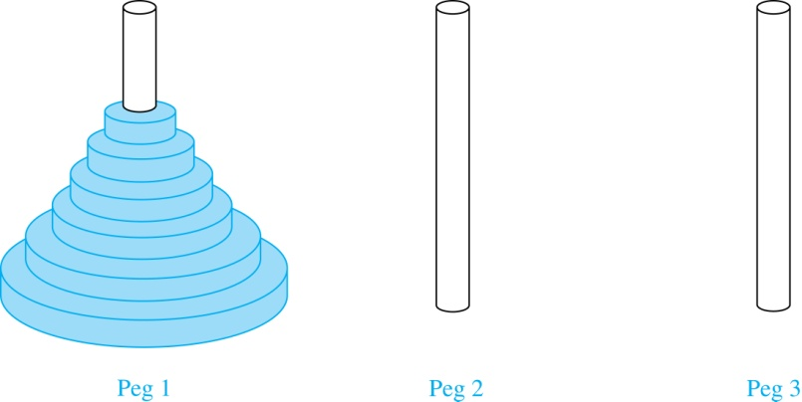
The Tower of Hanoi (continued)
The Initial Position in the Tower of Hanoi Puzzle

Slide 11
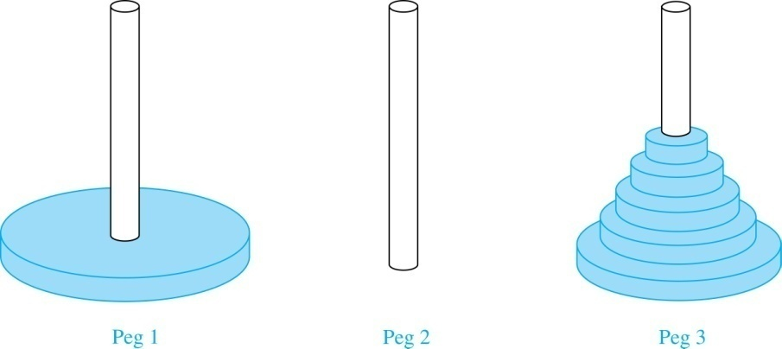
The Tower of Hanoi (continued)
Solution: Let {H_{n}} denote the number of moves needed to solve the Tower of Hanoi Puzzle with n disks. Set up a recurrence relation for the sequence {H_{n}}. Begin with n disks on peg 1. We can transfer the top n −1 disks, following the rules of the puzzle, to peg 3 using H_{n−1} moves.
First, we use 1 move to transfer the largest disk to the second peg. Then we transfer the n −1 disks from peg 3 to peg 2 using H_{n−1} additional moves. This can not be done in fewer steps. Hence,
H_{n} = 2H_{n−1} + 1.
The initial condition is H₁= 1 since a single disk can be transferred from peg 1 to peg 2 in one move.

Slide 12
The Tower of Hanoi (continued)
We can use an iterative approach to solve this recurrence relation by repeatedly expressing H_{n} in terms of the previous terms of the sequence.
H_{n} = 2H_{n−1} + 1
= 2(2H_{n−2} + 1) + 1 = 2² H_{n−2} +2 + 1
= 2²(2H_{n−3} + 1) + 2 + 1 = 2³ H_{n−3} +2² + 2 + 1
⋮
= 2^{n-1}H₁ + 2^{n−2} + 2^{n−3} + …. + 2 + 1
= 2^{n−1} + 2^{n−2} + 2^{n−3} + …. + 2 + 1 because H₁= 1
= 2^{n} − 1 using the formula for the sum of the terms of a geometric series
There was a myth created with the puzzle. Monks in a tower in Hanoi are transferring 64 gold disks from one peg to another following the rules of the puzzle. They move one disk each day. When the puzzle is finished, the world will end.
Using this formula for the 64 gold disks of the myth,
2⁶⁴ −1 = 18,446, 744,073, 709,551,615
days are needed to solve the puzzle, which is more than 500 billion years.

Slide 13
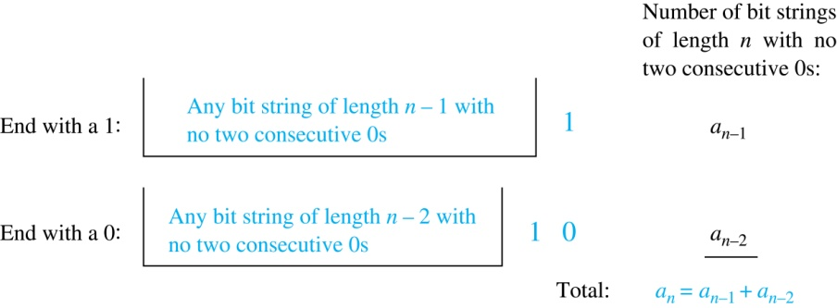
Counting Bit Strings
Example 3: Find a recurrence relation and give initial conditions for the number of bit strings of length n without two consecutive 0s. How many such bit strings are there of length five?
Solution: Let a_{n} denote the number of bit strings of length n without two consecutive 0s. To obtain a recurrence relation for {a_{n} } note that the number of bit strings of length n that do not have two consecutive 0s is the number of bit strings ending with a 0 plus the number of such bit strings ending with a 1.
Now assume that n ≥ 3.
The bit strings of length n ending with 1 without two consecutive 0s are the bit strings of length n −1 with no two consecutive 0s with a 1 at the end. Hence, there are a_{n−1} such bit strings.
The bit strings of length n ending with 0 without two consecutive 0s are the bit strings of length n −2 with no two consecutive 0s with 10 at the end. Hence, there are a_{n−2} such bit strings.
We conclude that a_{n} = a_{n−1} + a_{n−2} for n ≥ 3.

Slide 14
Bit Strings (continued)
The initial conditions are:
a₁ = 2, since both the bit strings 0 and 1 do not have consecutive 0s.
a₂ = 3, since the bit strings 01, 10, and 11 do not have consecutive 0s, while 00 does.
To obtain a₅ , we use the recurrence relation three times to find that:
a₃ = a₂ + a₁ = 3 + 2 = 5
a₄ = a₃ + a₂ = 5+ 3 = 8
a₅ = a₄ + a₃ = 8+ 5 = 13
Note that {a_{n} } satisfies the same recurrence relation as the Fibonacci sequence. Since a₁ = f₃ and a₂ = f₄ , we conclude that a_{n} = f_{n+2} .

Slide 15
Linear Homogeneous Recurrence Relations
Section 8.2

Slide 16
Section Summary
Linear Homogeneous Recurrence Relations

Slide 17
Linear Homogeneous Recurrence Relations
Definition: A linear homogeneous recurrence relation of degree k with constant coefficients is a recurrence relation of the form a_{n} = c₁a_{n−1} + c₂a_{n−2} + ….. + c_{k} a_{n−k ,} where c₁, c₂, ….,c_{k} are real numbers, and c_{k} ≠ 0
it is linear because the right-hand side is a sum of the previous terms of the sequence each multiplied by a function of n.
it is homogeneous because no terms occur that are not multiples of the a_{j}s. Each coefficient is a constant.
the degree is k because a_{n} is expressed in terms of the previous k terms of the sequence.
By strong induction, a sequence satisfying such a recurrence relation is uniquely determined by the recurrence relation and the k initial conditions a₀ = C₁, a₀ = C₁ ,… , a_{k−1} = C_{k−1}.

Slide 18
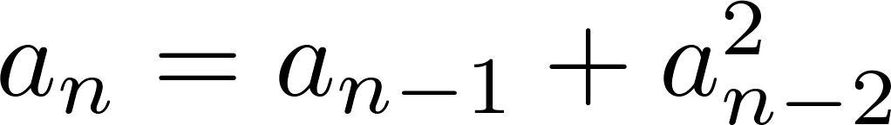
Examples of Linear Homogeneous Recurrence Relations
P_{n} = (1.11)P_{n-1} linear homogeneous recurrence relation of degree one
f_{n} = f_{n-1} + f_{n-2} linear homogeneous recurrence relation of degree two
not linear
B_{n} = nB_{n−1} coefficients are not constants

Slide 19
Divide-and-Conquer Algorithms and Recurrence Relations
Section 8.3

Slide 20
Section Summary
Divide-and-Conquer Algorithms and Recurrence Relations
Examples
Binary Search
Merge Sort
Fast Multiplication of Integers
Theorem 1
Master Theorem

Slide 21
Divide-and-Conquer Algorithmic Paradigm
Definition: A divide-and-conquer algorithm works by first dividing a problem into one or more instances of the same problem of smaller size and then conquering the problem using the solutions of the smaller problems to find a solution of the original problem.
Examples:
Binary search, covered in Chapters 3 and 5: It works by comparing the element to be located to the middle element. The original list is then split into two lists and the search continues recursively in the appropriate sublist.
Merge sort, covered in Chapter 5: A list is split into two approximately equal sized sublists, each recursively sorted by merge sort. Sorting is done by successively merging pairs of lists.

Slide 22
Divide-and-Conquer Recurrence Relations
Suppose that a recursive algorithm divides a problem of size n into a subproblems.
Assume each subproblem is of size n/b.
Suppose g(n) extra operations are needed in the conquer step.
Then f(n) represents the number of operations to solve a problem of size n satisfies the following recurrence relation:
f(n) = a f(n/b) + g(n)
This is called a divide-and-conquer recurrence relation.

Slide 23
Example: Binary Search
Binary search reduces the search for an element in a sequence of size n to the search in a sequence of size n/2. Two comparisons are needed to implement this reduction;
one to decide whether to search the upper or lower half of the sequence and
the other to determine if the sequence has elements.
Hence, if f(n) is the number of comparisons required to search for an element in a sequence of size n, then
when n is even.
f(n) = f(n/2) + 2

Slide 24
Example: Merge Sort
The merge sort algorithm splits a list of n (assuming n is even) items to be sorted into two lists with n/2 items. It uses fewer than n comparisons to merge the two sorted lists.
Hence, the number of comparisons required to sort a sequence of size n, is no more than than M(n) where
M(n) = 2 M(n/2) + n.

Slide 25
Example: Fast Multiplication of Integers
An algorithm for the fast multiplication of two 2n-bit integers (assuming n is even) first splits each of the 2n-bit integers into two blocks, each of n bits.
Suppose that a and b are integers with binary expansions of length 2n. Let
a = (a_{2n−1}a_{2n−2} … a₁a₀)₂ and b = (b_{2n−1}b_{2n−2} … b₁b₀)₂ .
Let a = 2^{n}A₁ + A₀, b = 2^{n}B₁ + B₀ , where
A₁ = (a_{2n−1} … a_{n+1}a_{n})₂ , A₀ = (a_{n−1} … a₁a₀)₂ ,
B₁ = (b_{2n−1} … b_{n+1}b_{n})₂ , B₀ = (b_{n−1} … b₁b₀)₂.
The algorithm is based on the fact that ab can be rewritten as:
ab = (2^{2n} + 2^{n})A₁B₁ +2^{n} (A₁−A₀)(B₀ − B₁) +(2^{n} + 1)A₀B₀.
This identity shows that the multiplication of two 2n-bit integers can be carried out using three multiplications of n-bit integers, together with additions, subtractions, and shifts.
Hence, if f(n) is the total number of operations needed to multiply two n-bit integers, then
f(2n) = 3 f(n) + C n
where Cn represents the total number of bit operations; the additions, subtractions and shifts that are a constant multiple of n-bit operations.

Slide 26
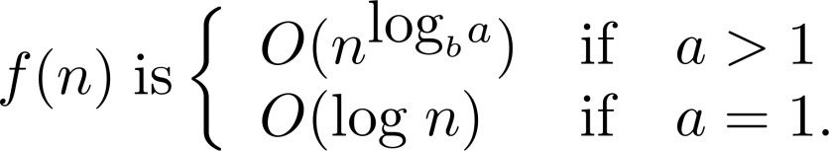
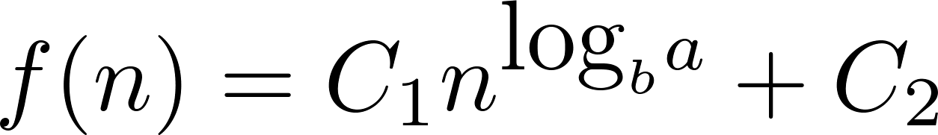
Estimating the Size of Divide-and-Conquer Functions
Theorem 1: Let f be an increasing function that satisfies the recurrence relation
f(n) = a f(n/b) + c
whenever n is divisible by b, where a≥ 1, b is an integer greater than 1, and c is a positive real number. Then
Furthermore, when n = b^{k} and a ≠1, where k is a positive integer,
where C₁ = f(1) + c/(a−1) and C₁ = −c/(a−1).

Slide 27
Complexity of Binary Search
Binary Search Example: Give a big-O estimate for the number of comparisons used by a binary search.
Solution: Since the number of comparisons used by binary search is f(n) = f(n/2) + 2 where n is even, by Theorem 1, it follows that f(n) is O(log n).

Slide 28
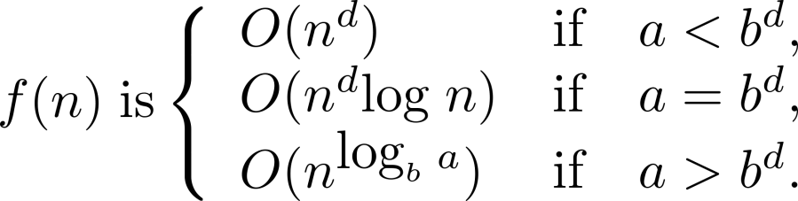
Estimating the Size of Divide-and-conquer Functions (continued)
Theorem 2. Master Theorem: Let f be an increasing function that satisfies the recurrence relation
f(n) = af(n/b) + cn^{d}
whenever n = b^{k}, where k is a positive integer greater than 1, and c and d are real numbers with c positive and d nonnegative. Then

Slide 29
Complexity of Merge Sort
Merge Sort Example: Give a big-O estimate for the number of comparisons used by merge sort.
Solution: Since the number of comparisons used by merge sort to sort a list of n elements is less than M(n) where M(n) = 2M(n/2) + n, by the Master Theorem M(n) is O(n log n).

Slide 30
Complexity of Fast Integer Multiplication Algorithm
Integer Multiplication Example: Give a big-O estimate for the number of bit operations used needed to multiply two n-bit integers using the fast multiplication algorithm.
Solution: We have shown that f(n) = 3f(n/2) + Cn, when n is even, where f(n) is the number of bit operations needed to multiply two n-bit integers. Hence by the Master Theorem with a = 3, b = 2, c = C, and d = 0 (so that we have the case where a > b^{d}), it follows that f(n) is O(n^{log 3}).
Note that log 3 ≈ 1.6. Therefore the fast multiplication algorithm is a substantial improvement over the conventional algorithm that uses O(n²) bit operations.

