Slide 1
Basic Structures: Sets, Functions, Sequences, Sums, and Matrices
Chapter 2
With Question/Answer Animations
Copyright © McGraw-Hill Education. All rights reserved. No reproduction or distribution without the prior written consent of McGraw-Hill Education.

Slide 2
Chapter Summary
Sets
The Language of Sets
Set Operations
Set Identities
Functions
Types of Functions
Operations on Functions
Computability
Sequences and Summations
Types of Sequences
Summation Formulae
Matrices

Slide 3
Sets
Section 2.1

Slide 4
Section Summary
Definition of sets
Describing Sets
Roster Method
Set-Builder Notation
Some Important Sets in Mathematics
Empty Set and Universal Set
Subsets and Set Equality
Cardinality of Sets
Tuples
Cartesian Product

Slide 5
Introduction
Sets are one of the basic building blocks for the types of objects considered in discrete mathematics.
Important for counting.
Programming languages have set operations.
Set theory is an important branch of mathematics.
Many different systems of axioms have been used to develop set theory.
Here we are not concerned with a formal set of axioms for set theory. Instead, we will use what is called naïve set theory.

Slide 6
Sets
A set is an unordered collection of objects.
the students in this class
the chairs in this room
The objects in a set are called the elements, or members of the set. A set is said to contain its elements.
The notation a ∈ A denotes that a is an element of the set A.
If a is not a member of A, write a ∉ A

Slide 7
Describing a Set: Roster Method
S = {a,b,c,d}
Order not important
S = {a,b,c,d} = {b,c,a,d}
Each distinct object is either a member or not; listing more than once does not change the set.
S = {a,b,c,d} = {a,b,c,b,c,d}
Elipses (…) may be used to describe a set without listing all of the members when the pattern is clear.
S = {a,b,c,d, … ,z }

Slide 8
Roster Method
Set of all vowels in the English alphabet:
V = {a,e,i,o,u}
Set of all odd positive integers less than 10:
O = {1,3,5,7,9}
Set of all positive integers less than 100:
S = {1,2,3, … ,99}
Set of all integers less than 0:
S = {… , -3,-2,-1}

Slide 9
Some Important Sets
N = natural numbers = {0,1,2,3, …}
Z = integers = {… ,-3,-2,-1,0,1,2,3, …}
Z⁺ = positive integers = {1,2,3, …}
R = set of real numbers
R⁺ = set of positive real numbers
C = set of complex numbers.
Q = set of rational numbers

Slide 10
Set-Builder Notation
Specify the property or properties that all members must satisfy:
S = {x | x is a positive integer less than 100}
O = {x | x is an odd positive integer less than 10}
O = {x ∈ Z⁺ | x is odd and x < 10}
A predicate may be used:
S = {x | P(x)}
Example: S = {x | Prime(x)}
Positive rational numbers:
Q⁺ = {x ∈ R | x = p/q, for some positive integers p,q}

Slide 11
Interval Notation
[a,b] = {x | a ≤ x ≤ b}
[a,b) = {x | a ≤ x < b}
(a,b] = {x | a < x ≤ b}
(a,b) = {x | a < x < b}
closed interval [a,b]
open interval (a,b)

Slide 12
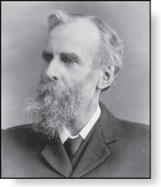
Universal Set and Empty Set
The universal set U is the set containing everything currently under consideration.
Sometimes implicit
Sometimes explicitly stated.
Contents depend on the context.
The empty set is the set with no
elements. Symbolized ∅, but
{} also used.
Venn Diagram
U
V
a e i
o u
John Venn (1834-1923)
Cambridge, UK

Slide 13
Some things to remember
Sets can be elements of sets.
{{1,2,3}, a, {b,c}}
{N,Z,Q,R}
The empty set is different from a set containing the empty set.
∅ ≠ { ∅ }

Slide 14
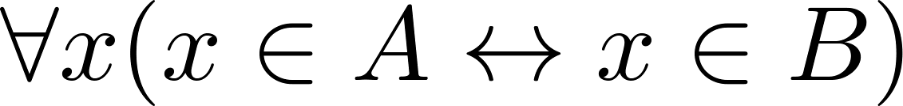
Set Equality
Definition: Two sets are equal if and only if they have the same elements.
Therefore if A and B are sets, then A and B are equal if and only if .
We write A = B if A and B are equal sets.
{1,3,5} = {3, 5, 1}
{1,5,5,5,3,3,1} = {1,3,5}

Slide 15
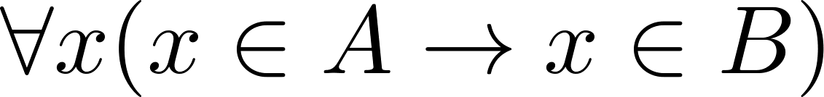
Subsets
Definition: The set A is a subset of B, if and only if every element of A is also an element of B.
The notation A ⊆ B is used to indicate that A is a subset of the set B.
A ⊆ B holds if and only if is true.
Because a ∈ ∅ is always false, ∅ ⊆ S ,for every set S.
Because a ∈ S → a ∈ S, S ⊆ S, for every set S.

Slide 16
Showing a Set is or is not a Subset of Another Set
Showing that A is a Subset of B: To show that A ⊆ B, show that if x belongs to A, then x also belongs to B.
Showing that A is not a Subset of B: To show that A is not a subset of B, A ⊈ B, find an element x ∈ A with x ∉ B. (Such an x is a counterexample to the claim that x ∈ A implies x ∈ B.)
Examples:
The set of all computer science majors at your school is a subset of all students at your school.
The set of integers with squares less than 100 is not a subset of the set of nonnegative integers.

Slide 17
Another look at Equality of Sets
Recall that two sets A and B are equal, denoted by A = B, iff
Using logical equivalences we have that A = B iff
This is equivalent to
A ⊆ B and B ⊆ A

Slide 18
Proper Subsets
Definition: If A ⊆ B, but A ≠B, then we say A is a proper subset of B, denoted by A ⊂ B. If A ⊂ B, then
is true.
Venn Diagram
U
B
A

Slide 19
Set Cardinality
Definition: If there are exactly n distinct elements in S where n is a nonnegative integer, we say that S is finite. Otherwise it is infinite.
Definition: The cardinality of a finite set A, denoted by |A|, is the number of (distinct) elements of A.
Examples:
|ø| = 0
Let S be the letters of the English alphabet. Then |S| = 26
|{1,2,3}| = 3
|{ø}| = 1
The set of integers is infinite.

Slide 20
Power Sets
Definition: The set of all subsets of a set A, denoted P(A), is called the power set of A.
Example: If A = {a, b} then
P(A) = {ø, {a}, {b}, {a,b}}
If a set has n elements, then the cardinality of the power set is 2ⁿ. (In Chapters 5 and 6, we will discuss different ways to show this.)

Slide 21
Tuples
The ordered n-tuple (a₁, a₂ , … , a_{n}) is the ordered collection that has a₁ as its first element and a₂ as its second element and so on until a_{n} as its last element.
Two n-tuples are equal if and only if their corresponding elements are equal.
2-tuples are called ordered pairs.
The ordered pairs (a, b) and (c, d) are equal if and only if a = c and b = d.

Slide 22
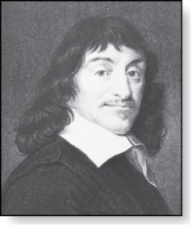
Cartesian Product
René Descartes (1596-1650)
Definition: The Cartesian Product of two sets A and B, denoted by A × B is the set of ordered pairs (a,b) where a ∈ A and b ∈ B .
Example:
A = {a,b} B = {1,2,3}
A × B = {(a,1), (a,2), (a,3), (b,1), (b,2), (b,3)}
Definition: A subset R of the Cartesian product A × B is called a relation from the set A to the set B. (Relations will be covered in depth in Chapter 9. )

Slide 23
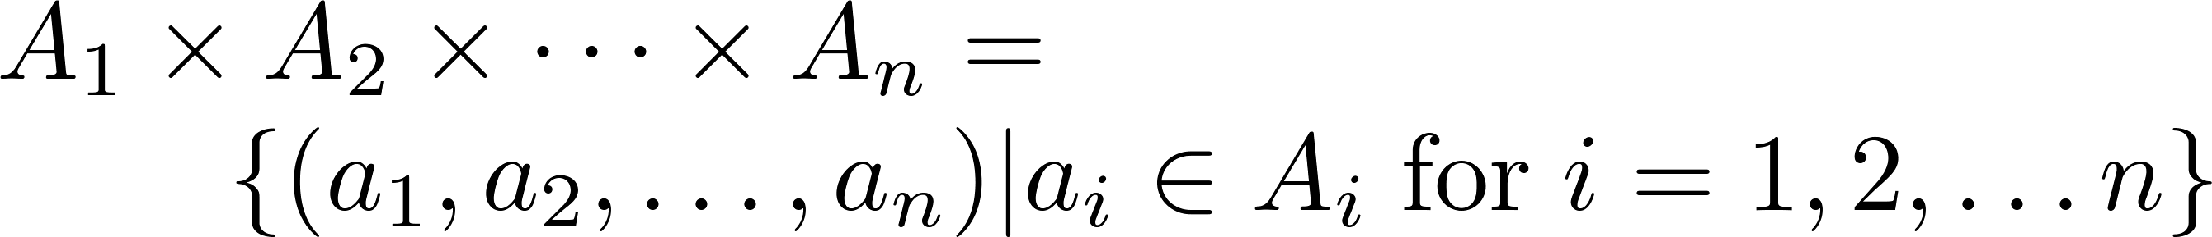
Cartesian Product
Definition: The cartesian products of the sets A₁,A₂, … ,A_{n}, denoted by A₁ × A₂ × … × A_{n} , is the set of ordered n-tuples (a₁,a₂, … ,a_{n}) where a_{i} belongs to A_{i} for i = 1, … n.
Example: What is A × B × C where A = {0,1}, B = {1,2} and C = {0,1,2}
Solution: A × B × C = {(0,1,0), (0,1,1), (0,1,2),(0,2,0), (0,2,1), (0,2,2),(1,1,0), (1,1,1), (1,1,2), (1,2,0), (1,2,1), (1,2,2)}

Slide 24
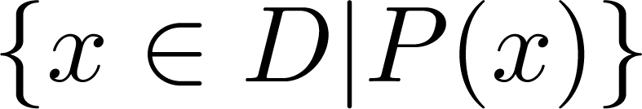
Truth Sets of Quantifiers
Given a predicate P and a domain D, we define the truth set of P to be the set of elements in D for which P(x) is true. The truth set of P(x) is denoted by
Example: The truth set of P(x) where the domain is the integers and P(x) is “|x| = 1” is the set {-1,1}

Slide 25
Set Operations
Section 2.2

Slide 26
Section Summary
Set Operations
Union
Intersection
Complementation
Difference
More on Set Cardinality
Set Identities
Proving Identities
Membership Tables

Slide 27
Boolean Algebra
Propositional calculus and set theory are both instances of an algebraic system called a Boolean Algebra. This is discussed in Chapter 12.
The operators in set theory are analogous to the corresponding operator in propositional calculus.
As always there must be a universal set U. All sets are assumed to be subsets of U.

Slide 28
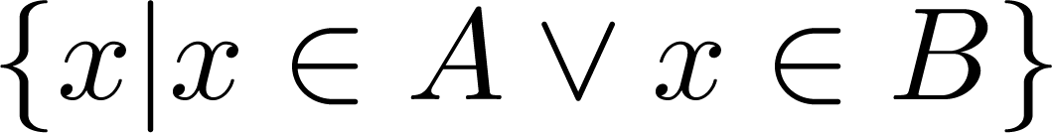
Union
Definition: Let A and B be sets. The union of the sets A and B, denoted by A ∪ B, is the set:
Example: What is {1,2,3} ∪ {3, 4, 5}?
Solution: {1,2,3,4,5}
Venn Diagram for A ∪ B
U
A
B

Slide 29
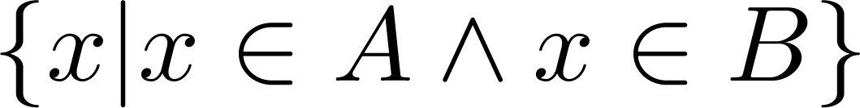
Intersection
Definition: The intersection of sets A and B, denoted by A ∩ B, is
Note if the intersection is empty, then A and B are said to be disjoint.
Example: What is? {1,2,3} ∩ {3,4,5} ?
Solution: {3}
Example:What is?
{1,2,3} ∩ {4,5,6} ?
Solution: ∅
Venn Diagram for A ∩B
U
A
B

Slide 30
Complement
Definition: If A is a set, then the complement of the A (with respect to U), denoted by Ā is the set U - A
Ā = {x ∈ U | x ∉ A}
(The complement of A is sometimes denoted by A^{c} .)
Example: If U is the positive integers less than 100, what is the complement of {x | x > 70}
Solution: {x | x ≤ 70}
Venn Diagram for Complement
U
Ā
A

Slide 31
Difference
Definition: Let A and B be sets. The difference of A and B, denoted by A – B, is the set containing the elements of A that are not in B. The difference of A and B is also called the complement of B with respect to A.
A – B = {x | x ∈ A ∧ x ∉ B} = A ∩‾B
U
Venn Diagram for A − B
A
B

Slide 32
The Cardinality of the Union of Two Sets
Inclusion-Exclusion
|A ∪ B| = |A| + | B| − |A ∩ B|
Example: Let A be the math majors in your class and B be the CS majors. To count the number of students who are either math majors or CS majors, add the number of math majors and the number of CS majors, and subtract the number of joint CS/math majors.
We will return to this principle in Chapter 6 and Chapter 8 where we will derive a formula for the cardinality of the union of n sets, where n is a positive integer.
U
A
B
Venn Diagram for A, B, A ∩ B, A ∪ B

Slide 33
Review Questions
Example: U = {0,1,2,3,4,5,6,7,8,9,10} A = {1,2,3,4,5}, B ={4,5,6,7,8}
A ∪ B
Solution: {1,2,3,4,5,6,7,8}
A ∩ B
Solution: {4,5}
Ā
Solution: {0,6,7,8,9,10}
Solution: {0,1,2,3,9,10}
A – B
Solution: {1,2,3}
B – A
Solution: {6,7,8}

Slide 34



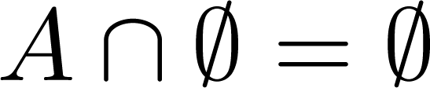


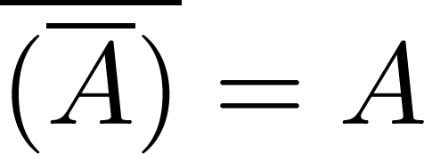
Set Identities
Identity laws
Domination laws
Idempotent laws
Complementation law
Continued on next slide →

Slide 35


Set Identities
Commutative laws
Associative laws
Distributive laws
Continued on next slide →

Slide 36


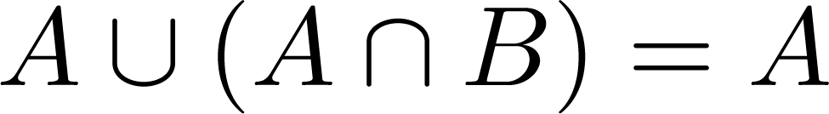
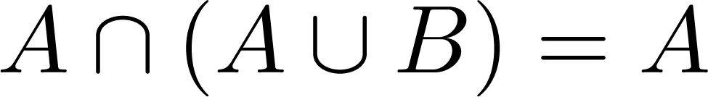

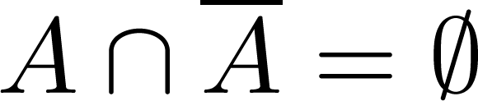
Set Identities
De Morgan’s laws
Absorption laws
Complement laws

Slide 37
Proving Set Identities
One way to prove set identities:
Membership Tables: Verify that elements in the same combination of sets always either belong or do not belong to the same side of the identity. Use 1 to indicate it is in the set and a 0 to indicate that it is not.

Slide 38





Membership Table
Example:
Construct a membership table to show that the distributive law holds.
Solution:
A | B | C
1 | 1 | 1 | 1 | 1 | 1 | 1 | 1
1 | 1 | 0 | 0 | 1 | 1 | 1 | 1
1 | 0 | 1 | 0 | 1 | 1 | 1 | 1
1 | 0 | 0 | 0 | 1 | 1 | 1 | 1
0 | 1 | 1 | 1 | 1 | 1 | 1 | 1
0 | 1 | 0 | 0 | 0 | 1 | 0 | 0
0 | 0 | 1 | 0 | 0 | 0 | 1 | 0
0 | 0 | 0 | 0 | 0 | 0 | 0 | 0

Slide 39
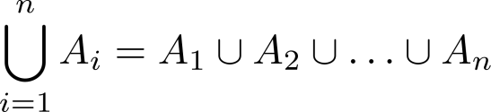
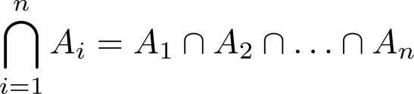
Generalized Unions and Intersections
Let A₁, A₂ , … , A_{n} be an indexed collection of sets.
We define:

Slide 40
Functions
Section 2.3

Slide 41
Section Summary
Definition of a Function.
Domain, Codomain
Image, Preimage
Injection, Surjection, Bijection
Inverse Function
Function Composition
Graphing Functions
Floor, Ceiling, Factorial

Slide 42
Functions
Definition: Let A and B be nonempty sets. A function f from A to B, denoted f: A → B is an assignment of each element of A to exactly one element of B. We write f(a) = b if b is the unique element of B assigned by the function f to the element a of A.
Functions are sometimes
called mappings or
transformations.
Students
Grades
A
Carlota Rodriguez
B
Sandeep Patel
C
Jalen Williams
D
F
Kathy Scott

Slide 43
Functions
A function f: A → B can also be defined as a subset of A×B (a relation). This subset is restricted to be a relation where no two elements of the relation have the same first element.
Specifically, a function f from A to B contains one, and only one ordered pair (a, b) for every element a∈ A.
and

Slide 44
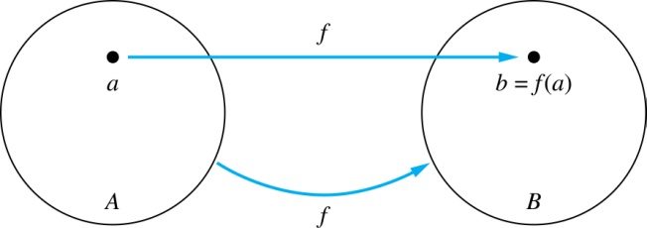
Functions
Given a function f: A → B:
We say f maps A to B or
f is a mapping from A to B.
A is called the domain of f.
B is called the codomain of f.
If f(a) = b,
then b is called the image of a under f.
a is called the preimage of b.
The range of f is the set of all images of points in A under f. We denote it by f(A).
Two functions are equal when they have the same domain, the same codomain and map each element of the domain to the same element of the codomain.

Slide 45
Representing Functions
Functions may be specified in different ways:
An explicit statement of the assignment.
Students and grades example.
A formula.
f(x) = x + 1
A computer program.
A Java program that when given an integer n, produces the nth Fibonacci Number (covered in the next section and also inChapter 5).

Slide 46
Questions
z
A
B
f(a) = ?
The image of d is ?
z
a
x
The domain of f is ?
A
b
y
The codomain of f is ?
B
c
d
z
The preimage of y is ?
b
f(A) = ?
{y,z}
The preimage(s) of z is (are) ?
{a,c,d}

Slide 47
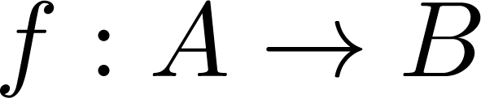
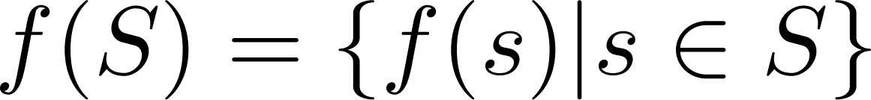
Question on Functions and Sets
If and S is a subset of A, then
A
B
f ({a,b,c,}) is ?
{y,z}
a
x
f ({c,d}) is ?
b
{z}
y
c
d
z

Slide 48
Injections
Definition: A function f is said to be one-to-one , or injective, if and only if f(a) = f(b) implies that a = b for all a and b in the domain of f. A function is said to be an injection if it is one-to-one.
A
B
a
x
v
b
y
c
z
d
w

Slide 49

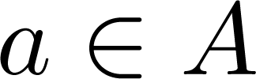
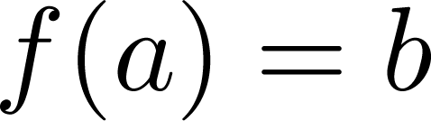
Surjections
Definition: A function f from A to B is called onto or surjective, if and only if for every element there is an element with . A function f is called a surjection if it is onto.
A
B
a
x
b
y
c
z
d

Slide 50
Bijections
Definition: A function f is a one-to-one correspondence, or a bijection, if it is both one-to-one and onto (surjective and injective).
A
B
a
x
b
y
c
d
z
w

Slide 51
Showing that f is one-to-one or onto
Example 1: Let f be the function from {a,b,c,d} to {1,2,3} defined by f(a) = 3, f(b) = 2, f(c) = 1, and f(d) = 3. Is f an onto function?
Solution: Yes, f is onto since all three elements of the codomain are images of elements in the domain. If the codomain were changed to {1,2,3,4}, f would not be onto.
Example 2: Is the function f(x) = x² from the set of integers to the set of integers onto?
Solution: No, f is not onto because there is no integer x with x² = −1, for example.

Slide 52
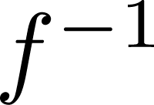
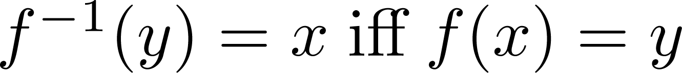
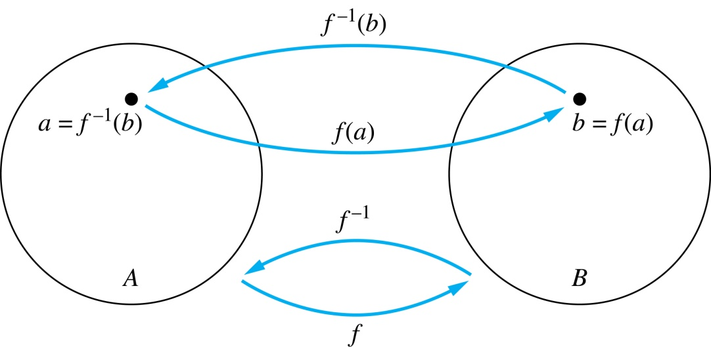
Inverse Functions
Definition: Let f be a bijection from A to B. Then the inverse of f, denoted , is the function from B to A defined as
No inverse exists unless f is a bijection. Why?

Slide 53
Inverse Functions
A
B
A
B
f
a
V
V
a
b
b
W
W
c
c
d
X
X
d
Y
Y

Slide 54
Questions
Example 1: Let f be the function from {a,b,c} to {1,2,3} such that f(a) = 2, f(b) = 3, and f(c) = 1. Is f invertible and if so what is its inverse?
Solution: The function f is invertible because it is a one-to-one correspondence.
The inverse function f⁻¹ reverses the correspondence given by f,
so f⁻¹ (1) = c, f⁻¹ (2) = a, and f⁻¹ (3) = b.

Slide 55
Questions
Example 2: Let f: Z → Z be such that f(x) = x + 1. Is f invertible, and if so, what is its inverse?
Solution: The function f is invertible because it is a one-to-one correspondence.
The inverse function f⁻¹ reverses the correspondence so f⁻¹ (y) = y – 1.

Slide 56
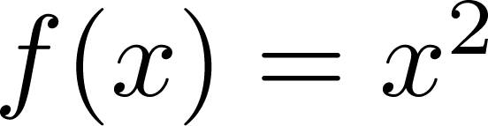
Questions
Example 3: Let f: R → R be such that . Is f invertible, and if so, what is its inverse?
Solution: The function f is not invertible because it is not one-to-one .

Slide 57
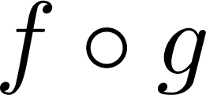
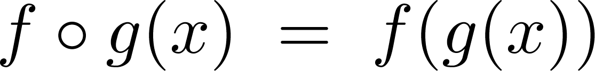
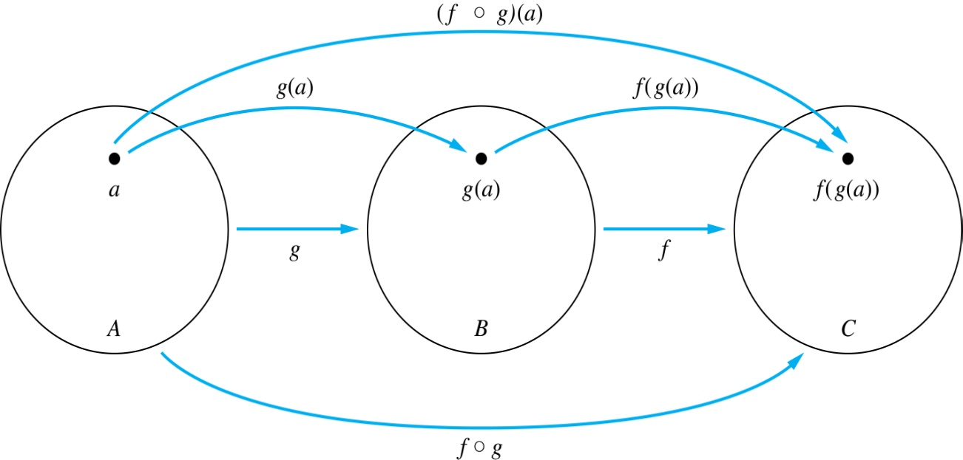
Composition
Definition: Let f: B → C, g: A → B. The composition of f with g, denoted is the function from A to C defined by

Slide 58
Composition
A
g
B
f
C
A
C
V
a
a
h
h
b
i
b
W
i
c
c
X
j
d
d
j
Y

Slide 59
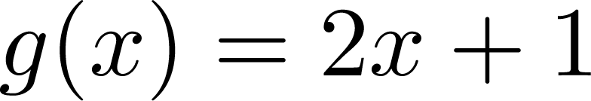
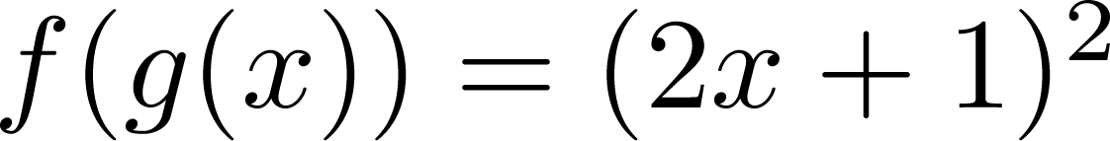
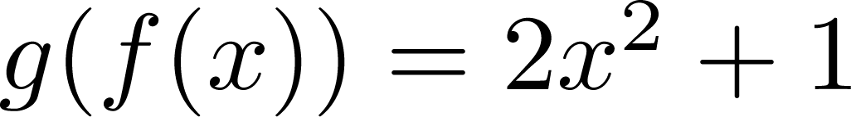
Composition
Example 1: If and , then
and

Slide 60
Composition Questions
Example 2: Let g be the function from the set {a,b,c} to itself such that g(a) = b, g(b) = c, and g(c) = a. Let f be the function from the set {a,b,c} to the set {1,2,3} such that f(a) = 3, f(b) = 2, and f(c) = 1.
What is the composition of f and g, and what is the composition of g and f.
Solution: The composition f∘g is defined by
f∘g (a)= f(g(a)) = f(b) = 2.
f∘g (b)= f(g(b)) = f(c) = 1.
f∘g (c)= f(g(c)) = f(a) = 3.
Note that g∘f is not defined, because the range of f is not a subset of the domain of g.

Slide 61
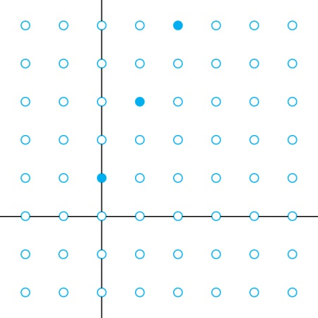
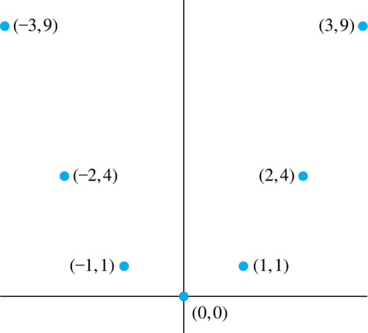
Graphs of Functions
Let f be a function from the set A to the set B. The graph of the function f is the set of ordered pairs {(a,b) | a ∈A and f(a) = b}.
Graph of f(n) = 2n + 1
from Z to Z
Graph of f(x) = x²
from Z to Z

Slide 62
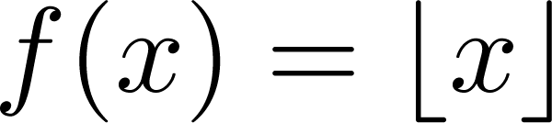
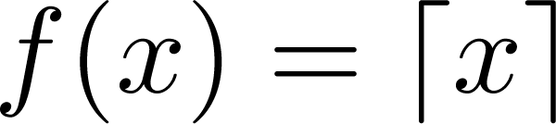
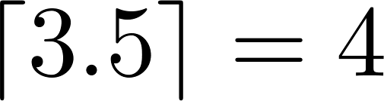
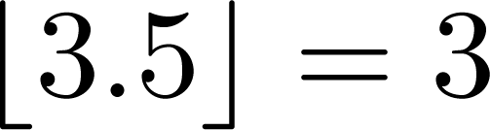
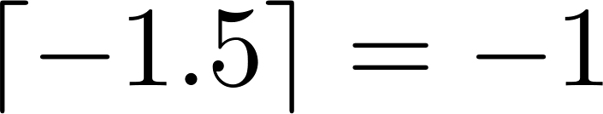
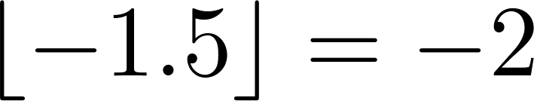
Some Important Functions
The floor function, denoted
is the largest integer less than or equal to x.
The ceiling function, denoted
is the smallest integer greater than or equal to x
Example:

Slide 63
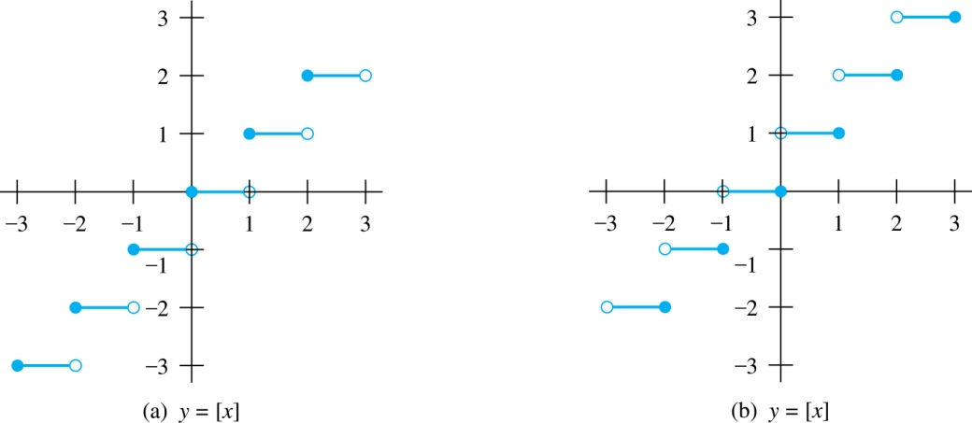
Floor and Ceiling Functions
Graph of (a) Floor and (b) Ceiling Functions

Slide 64
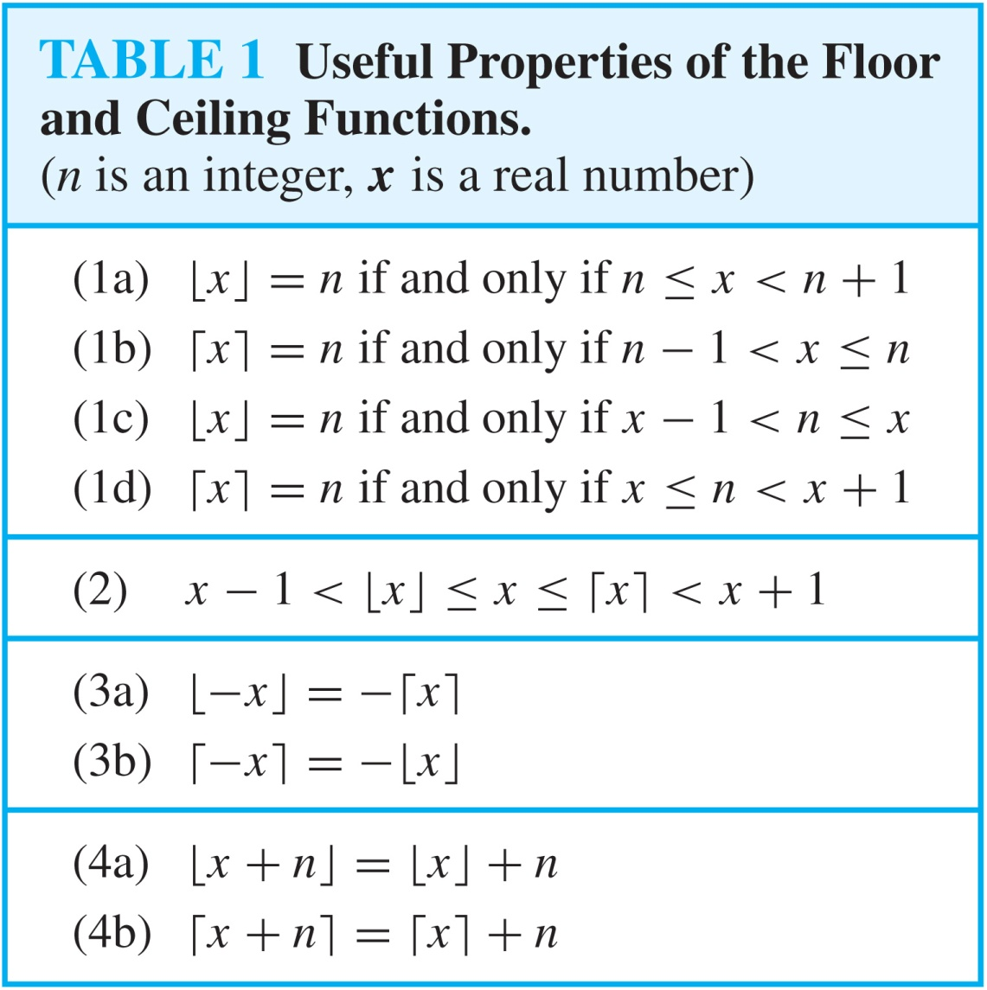
Floor and Ceiling Functions

Slide 65
Factorial Function
Definition: f: N → Z⁺ , denoted by f(n) = n! is the product of the first n positive integers when n is a nonnegative integer.
f(n) = 1 ∙ 2 ∙∙∙ (n – 1) ∙ n, f(0) = 0! = 1
Examples:
^{f(1) = 1! = 1}
^{f(2) = 2! = 1 ∙ 2 = 2}
^{f(6) = 6! = 1 ∙ 2 ∙ 3∙ 4∙ 5} ^{∙ 6 = 720}
f(20) = 2,432,902,008,176,640,000.

