Slide 1
Sequences and Summations
Section 2.4

Slide 2
Section Summary
Sequences.
Examples: Geometric Progression, Arithmetic Progression
Recurrence Relations
Example: Fibonacci Sequence
Summations

Slide 3
Introduction
Sequences are ordered lists of elements.
1, 2, 3, 5, 8
1, 3, 9, 27, 81, …
Sequences arise throughout mathematics, computer science, and in many other disciplines, ranging from botany to music.
We will introduce the terminology to represent sequences and sums of the terms in the sequences.

Slide 4
Sequences
Definition: A sequence is a function from a subset of the integers (usually either the set {0, 1, 2, 3, 4, … } or {1, 2, 3, 4, … } ) to a set S.
The notation a_{n} is used to denote the image of the integer n. We can think of a_{n} as the equivalent of f(n) where f is a function from {0,1,2, … } to S. We call a_{n} a term of the sequence.

Slide 5
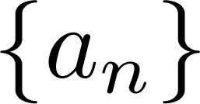
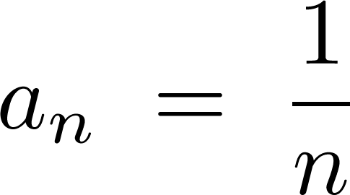
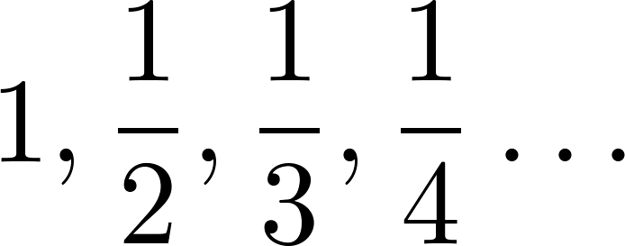
Sequences
Example: Consider the sequence where

Slide 6
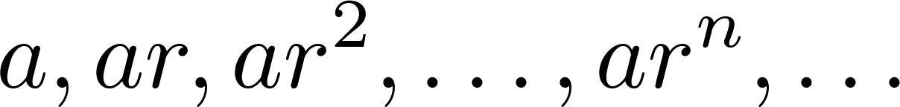
Geometric Progression
Definition: A geometric progression is a sequence of the form:
where the initial term a and the common ratio r are real numbers.
Examples:
Let a = 1 and r = −1. Then:
Let a = 2 and r = 5. Then:
Let a = 6 and r = 1/3. Then:

Slide 7
Arithmetic Progression
Definition: A arithmetic progression is a sequence of the form:
where the initial term a and the common difference d are real numbers.
Examples:
Let a = −1 and d = 4:
Let a = 7 and d = −3:
Let a = 1 and d = 2:

Slide 8
Strings
Definition: A string is a finite sequence of characters from a finite set (an alphabet).
Sequences of characters or bits are important in computer science.
The empty string is represented by λ.
The string abcde has length 5.

Slide 9
Recurrence Relations
Definition: A recurrence relation for the sequence {a_{n}} is an equation that expresses a_{n} in terms of one or more of the previous terms of the sequence, namely, a₀, a₁, … , a_{n-1}, for all integers n with n ≥ n₀, where n₀ is a nonnegative integer.
A sequence is called a solution of a recurrence relation if its terms satisfy the recurrence relation.
The initial conditions for a sequence specify the terms that precede the first term where the recurrence relation takes effect.

Slide 10
Questions about Recurrence Relations
Example 1: Let {a_{n}} be a sequence that satisfies the recurrence relation a_{n} = a_{n-1} + 3 for n = 1,2,3,4, … and suppose that a₀ = 2. What are a₁ , a₂ and a₃?
[Here a₀ = 2 is the initial condition.]
Solution: We see from the recurrence relation that
a₁ = a₀ + 3 = 2 + 3 = 5
a₂ = 5 + 3 = 8
a₃ = 8 + 3 = 11

Slide 11
Questions about Recurrence Relations
Example 2: Let {a_{n}} be a sequence that satisfies the recurrence relation a_{n} = a_{n-1} – a_{n-2} for n = 2,3,4,…. and suppose that a₀ = 3 and a₁ = 5. What are a₂ and a₃?
[Here the initial conditions are a₀ = 3 and a₁ = 5. ]
Solution: We see from the recurrence relation that
a₂ = a₁ - a₀ = 5 – 3 = 2
a₃ = a₂ – a₁ = 2 – 5 = –3

Slide 12
Fibonacci Sequence
Definition: Define the Fibonacci sequence, f₀ ,f₁ ,f₂, … , by:
Initial Conditions: f₀ = 0, f₁ = 1
Recurrence Relation: f_{n} = f_{n-1} + f_{n-2}
Example: Find f₂ ,f₃ ,f₄ , f₅ and f₆ .
Answer:
f₂ = f₁ + f₀ = 1 + 0 = 1,
f₃ = f₂ + f₁ = 1 + 1 = 2,
f₄ = f₃ + f₂ = 2 + 1 = 3,
f₅ = f₄ + f₃ = 3 + 2 = 5,
f₆ = f₅ + f₄ = 5 + 3 = 8.

Slide 13
Solving Recurrence Relations
Finding a formula for the nth term of the sequence generated by a recurrence relation is called solving the recurrence relation.
Such a formula is called a closed formula.
Various methods for solving recurrence relations will be covered in Chapter 8 where recurrence relations will be studied in greater depth.
Here we illustrate by example the method of iteration in which we need to guess the formula. The guess can be proved correct by the method of induction (Chapter 5).

Slide 14
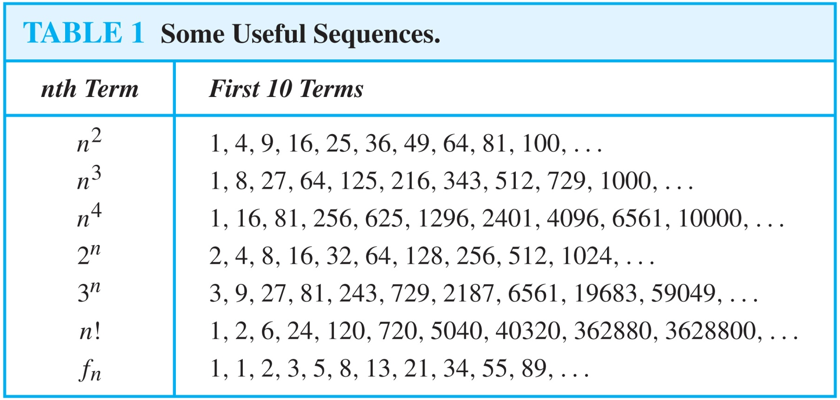
Useful Sequences

Slide 15
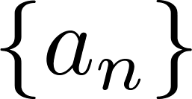
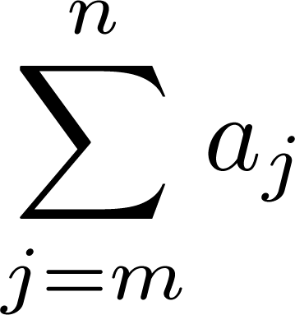
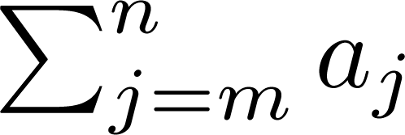
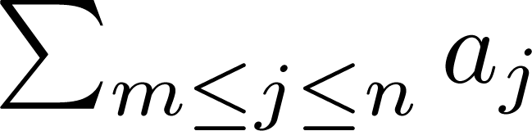
Summations
Sum of the terms
from the sequence
The notation:
represents
The variable j is called the index of summation. It runs through all the integers starting with its lower limit m and ending with its upper limit n.

Slide 16
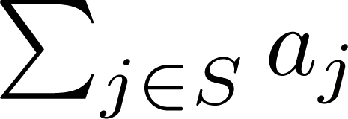
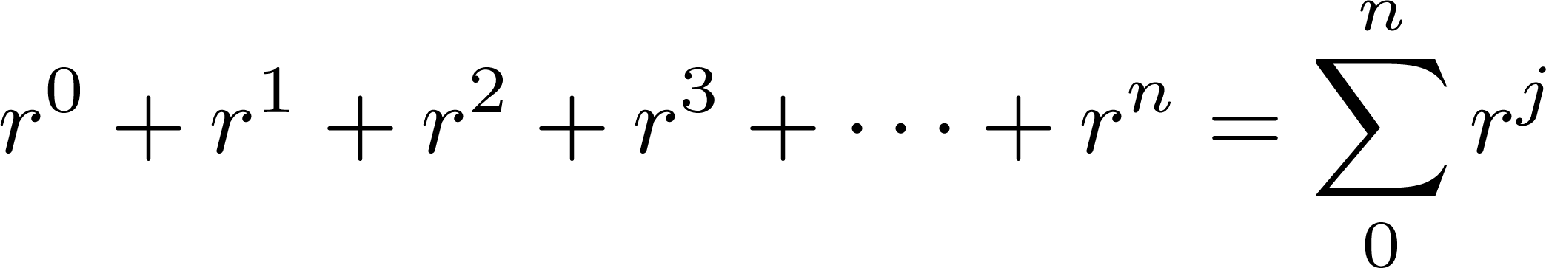
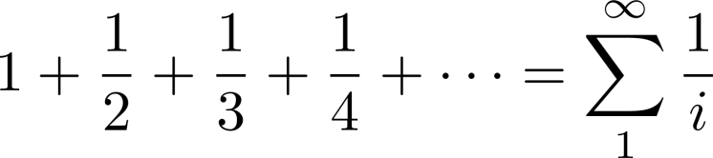
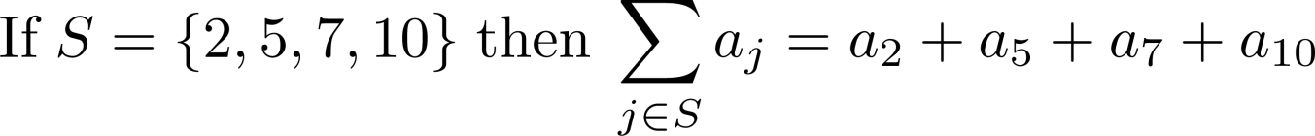
Summations
More generally for a set S:
Examples:

Slide 17
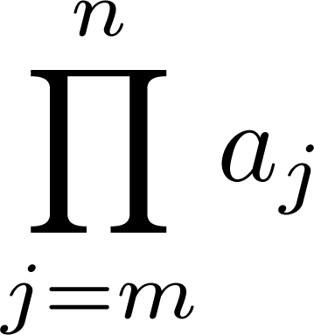
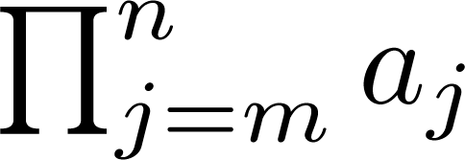
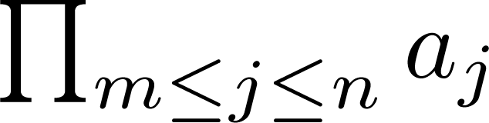
Product Notation (optional)
Product of the terms
from the sequence
The notation:
represents

Slide 18
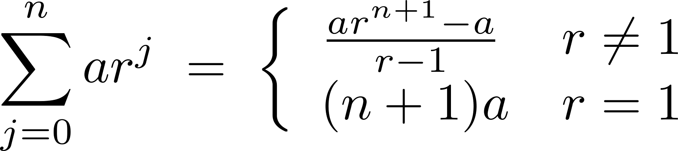
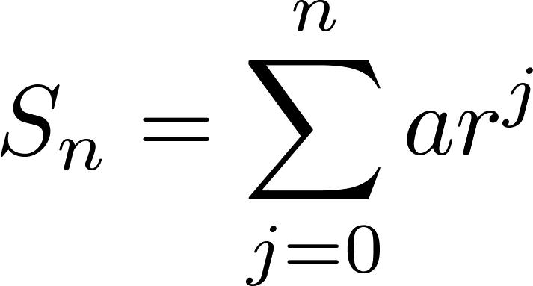
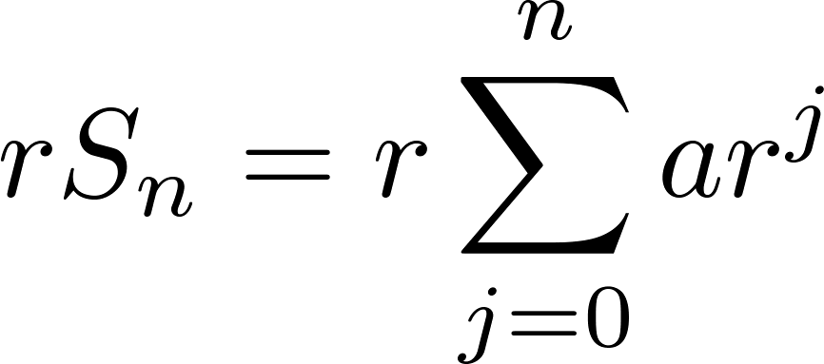
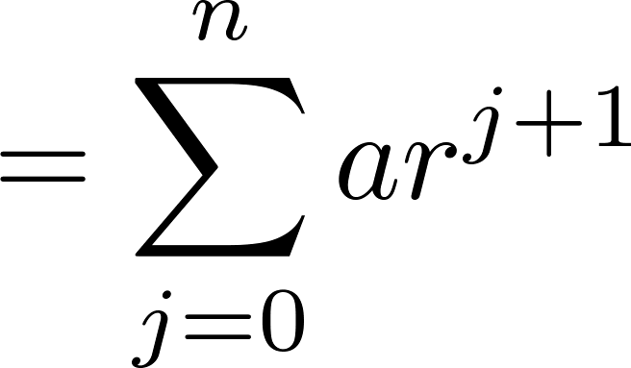
Geometric Series
Sums of terms of geometric progressions
To compute S_{n} , first multiply both sides of the equality by r and then manipulate the resulting sum as follows:
Proof:
Let
Continued on next slide →

Slide 19
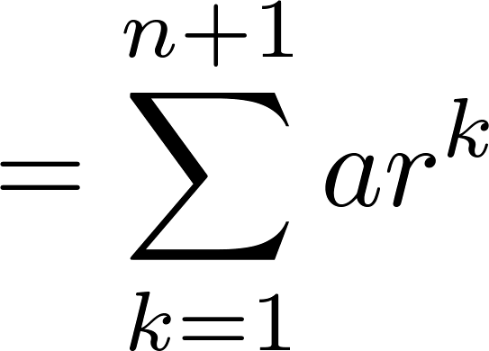
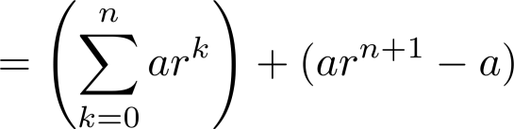
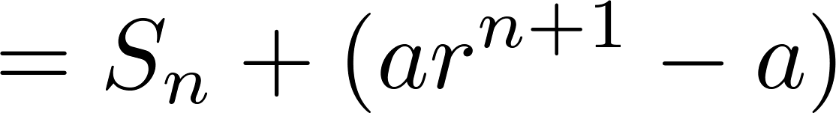
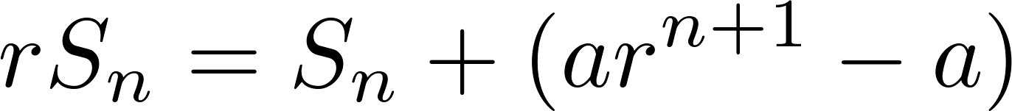
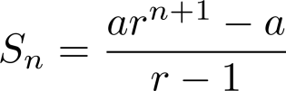
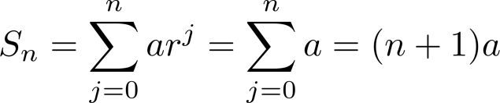
Geometric Series
From previous slide.
Shifting the index of summation with k = j + 1.
Removing k = n + 1 term and
adding k = 0 term.
Substituting S for summation formula
∴
if r ≠1
if r = 1

Slide 20
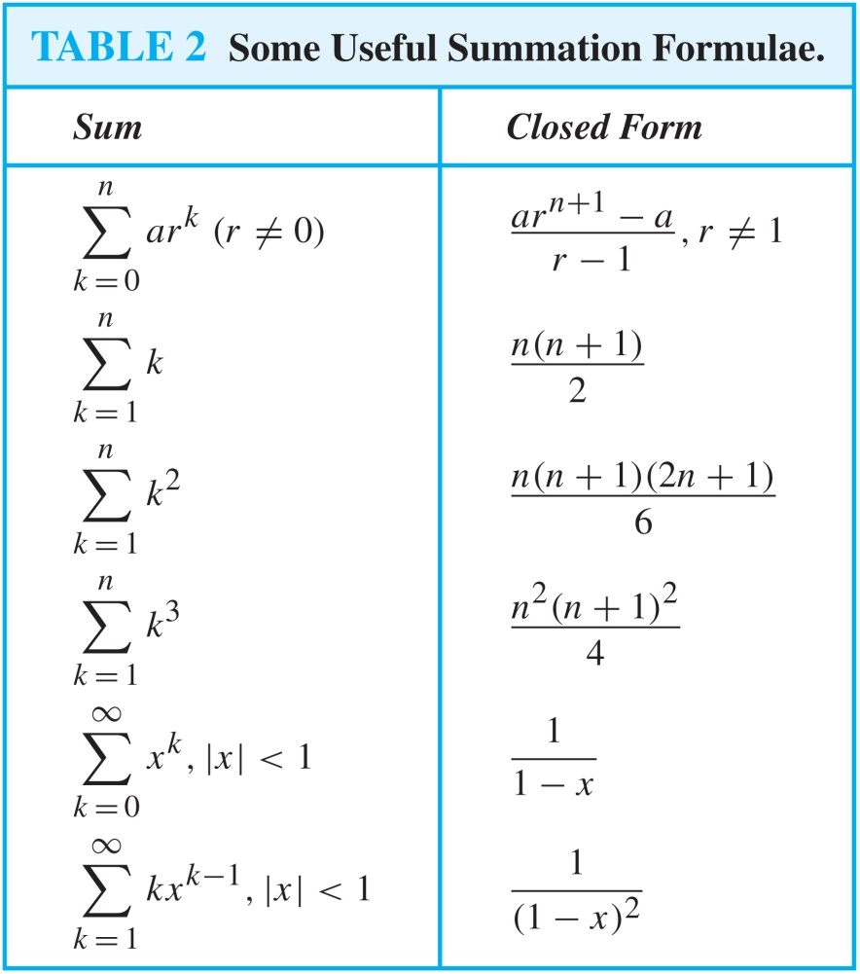
Some Useful Summation Formulae
Geometric Series: We just proved this.
Later we will prove some of these by induction.
Proof in text
(requires calculus)

Slide 21
Matrices
Section 2.6

Slide 22
Section Summary
Definition of a Matrix
Matrix Arithmetic
Transposes and Powers of Arithmetic
Zero-One matrices

Slide 23
Matrices
Matrices are useful discrete structures that can be used in many ways. For example, they are used to:
describe certain types of functions known as linear transformations.
Express which vertices of a graph are connected by edges (see Chapter 10).
In later chapters, we will see matrices used to build models of:
Transportation systems.
Communication networks.
Algorithms based on matrix models will be presented in later chapters.
Here we cover the aspect of matrix arithmetic that will be needed later.

Slide 24

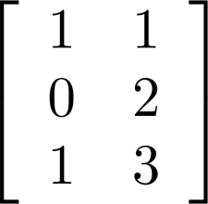
Matrix
Definition: A matrix is a rectangular array of numbers. A matrix with m rows and n columns is called an m n matrix.
The plural of matrix is matrices.
A matrix with the same number of rows as columns is called square.
Two matrices are equal if they have the same number of rows and the same number of columns and the corresponding entries in every position are equal.
3 2 matrix

Slide 25
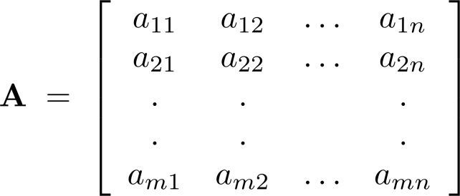
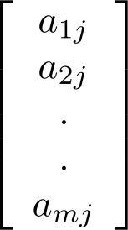
Notation
Let m and n be positive integers and let
The ith row of A is the 1 n matrix [a_{i1}, a_{i2},…,a_{in}]. The jth column of A is the m 1 matrix:
The (i,j)th element or entry of A is the
element a_{ij}. We can use A = [a_{ij} ] to denote the matrix with its (i,j)th element equal to a_{ij}.

Slide 26
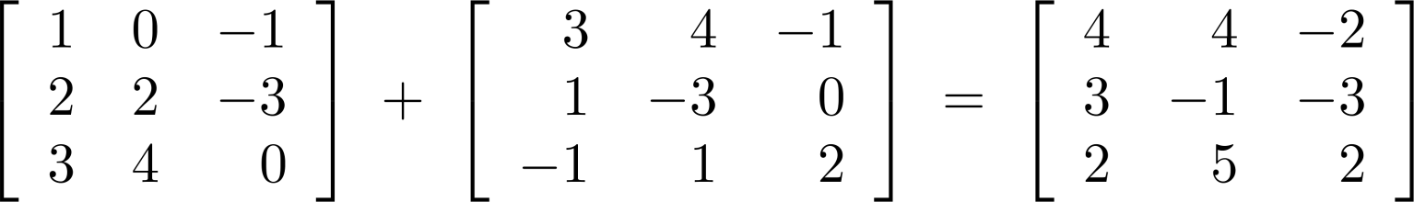
Matrix Arithmetic: Addition
Defintion: Let A = [a_{ij}] and B = [b_{ij}] be m n matrices. The sum of A and B, denoted by A + B, is the m n matrix that has a_{ij} + b_{ij} as its (i,j)th element. In other words, A + B = [a_{ij} + b_{ij}].
Example:
Note that matrices of different sizes can not be added.

Slide 27
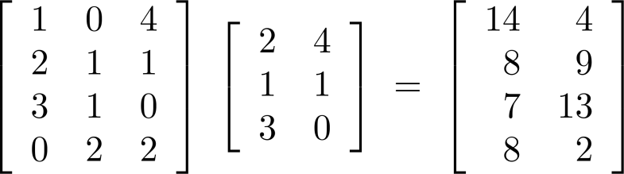
Matrix Multiplication
Definition: Let A be an m k matrix and B be a k n matrix. The product of A and B, denoted by AB, is the m n matrix that has its (i,j)th element equal to the sum of the products of the corresponding elements from the ith row of A and the jth column of B. In other words, if AB = [c_{ij}] then c_{ij} = a_{i1}b_{1j} + a_{i2}b_{2j} + … + a_{ik}b_{kj}.
Example:
The product of two matrices is undefined when the number of columns in the first matrix is not the same as the number of rows in the second.

Slide 28
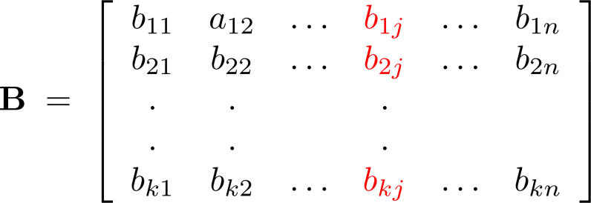
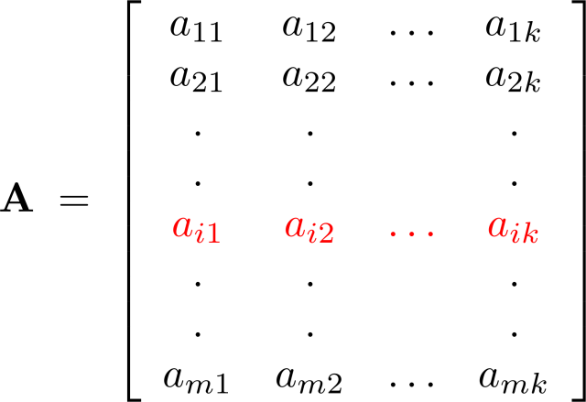
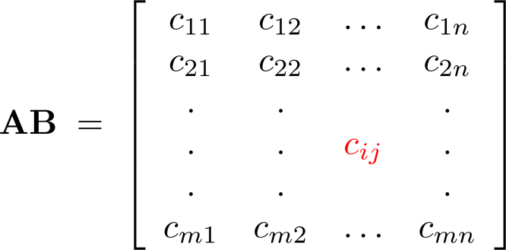
Illustration of Matrix Multiplication
The Product of A = [a_{ij}] and B = [b_{ij}]

Slide 29
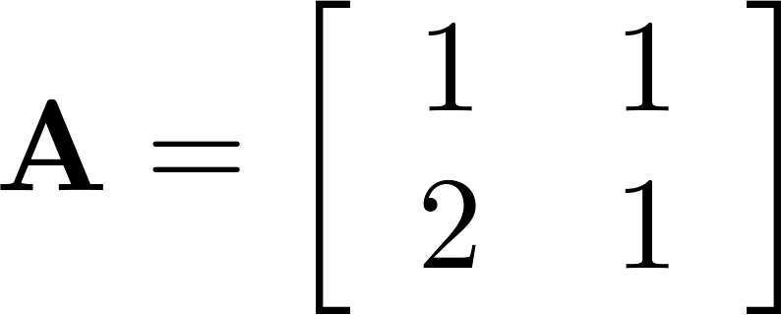
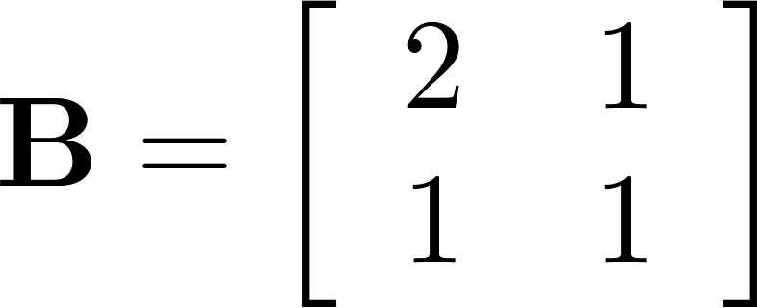
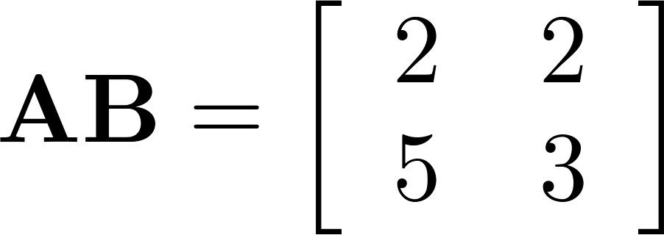
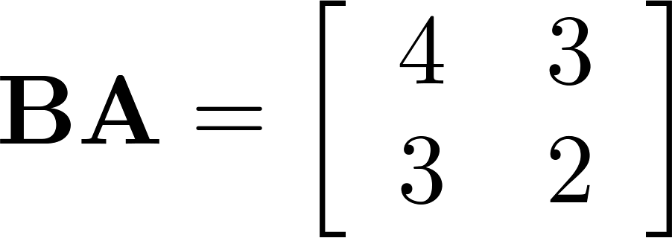
Matrix Multiplication is not Commutative
Example: Let
Does AB = BA?
Solution:
AB ≠ BA
3

Slide 30
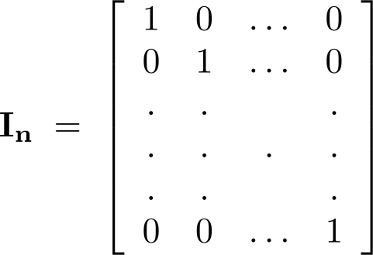
Identity Matrix and Powers of Matrices
Definition: The identity matrix of order n is the n n matrix I_{n} = [δ_{ij}], where δ_{ij} = 1 if i = j and δ_{ij} = 0 if i≠j.
AI_{n} = I_{m}A = A
when A is an m n matrix
Powers of square matrices can be defined. When A is an n × n matrix, we have:
A⁰ = I_{n} A^{r} = AAA∙∙∙A
r times

Slide 31
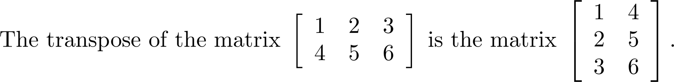
Transposes of Matrices
Definition: Let A = [a_{ij}] be an m n matrix. The transpose of A, denoted by A^{t} ,is the n m matrix obtained by interchanging the rows and columns of A.
If A^{t} = [b_{ij}], then b_{ij} = a_{ji} for i =1,2,…,n and j = 1,2, ...,m.

Slide 32
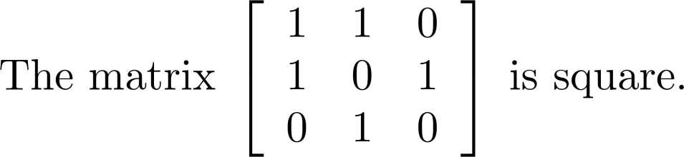
Transposes of Matrices
Definition: A square matrix A is called symmetric if A = A^{t}. Thus A = [a_{ij}] is symmetric if a_{ij} = a_{ji} for i and j with 1≤ i≤ n and 1≤ j≤ n.
Square matrices do not change when their rows and columns are interchanged.

Slide 33
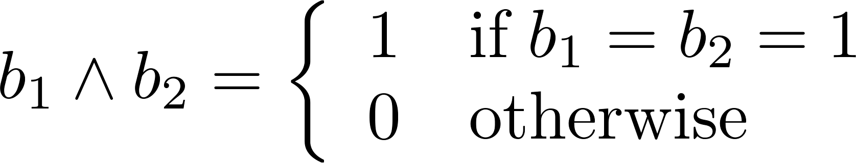
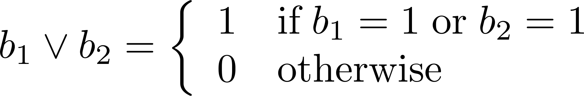
Zero-One Matrices
Definition: A matrix all of whose entries are either 0 or 1 is called a zero-one matrix. (These will be used in Chapters 9 and 10.)
Algorithms operating on discrete structures represented by zero-one matrices are based on Boolean arithmetic defined by the following Boolean operations:

Slide 34
Zero-One Matrices
Definition: Let A = [a_{ij}] and B = [b_{ij}] be an m × n zero-one matrices.
The join of A and B is the zero-one matrix with (i,j)th entry a_{ij} ∨ b_{ij}. The join of A and B is denoted by A ∨ B.
The meet of of A and B is the zero-one matrix with (i,j)th entry a_{ij} ∧ b_{ij}. The meet of A and B is denoted by A ∧ B.

Slide 35
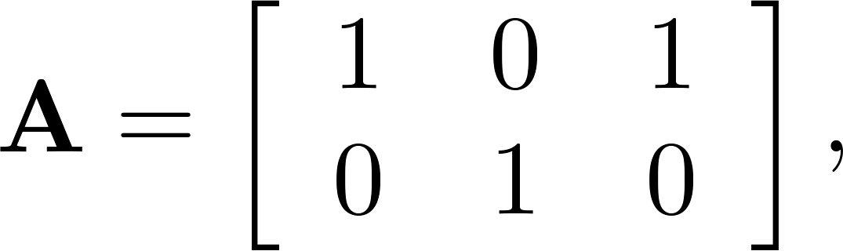
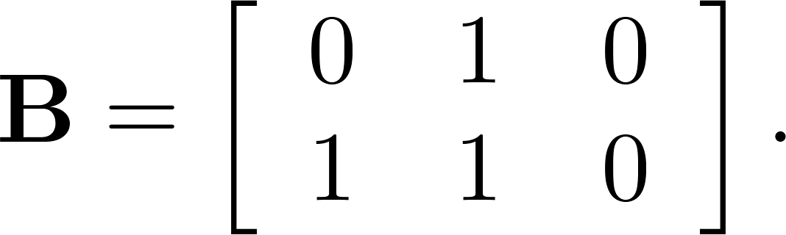
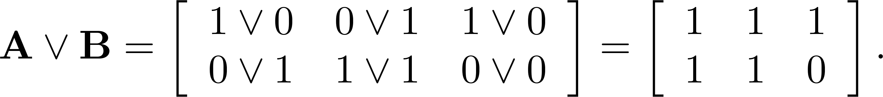
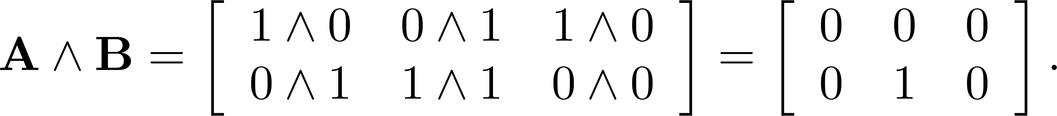
Joins and Meets of Zero-One Matrices
Example: Find the join and meet of the zero-one matrices
Solution: The join of A and B is
The meet of A and B is

Slide 36
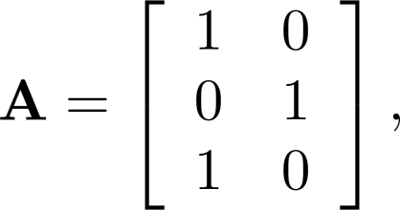
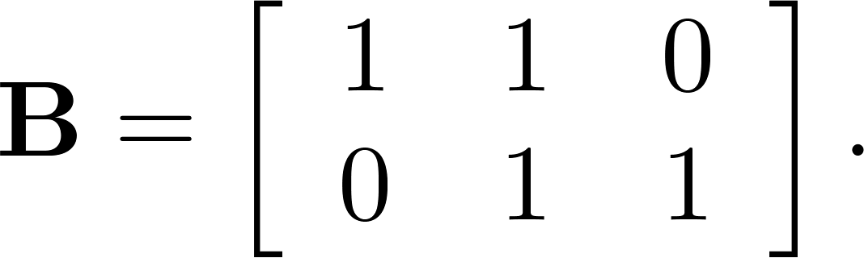
Boolean Product of Zero-One Matrices
Definition: Let A = [a_{ij}] be an m k zero-one matrix and B = [b_{ij}] be a k n zero-one matrix. The Boolean product of A and B, denoted by A ⊙ B, is the m n zero-one matrix with(i,j)th entry
c_{ij} = (a_{i1} ∧ b_{1j})∨ (a_{i2} ∧ b_{2j}) ∨ … ∨ (a_{ik} ∧ b_{kj}).
Example: Find the Boolean product of A and B, where
Continued on next slide →

Slide 37



Boolean Product of Zero-One Matrices
Solution: The Boolean product A ⊙ B is given by

Slide 38

Boolean Powers of Zero-One Matrices
Definition: Let A be a square zero-one matrix and let r be a positive integer. The rth Boolean power of A is the Boolean product of r factors of A, denoted by A^{[r]} . Hence,
We define A^{[0]} to be I_{n}.
(The Boolean product is well defined because the Boolean product of matrices is associative.)

Slide 39





Boolean Powers of Zero-One Matrices
Example: Let
Find A^{n} for all positive integers n.
Solution:

