Slide 1
Number Theory and Cryptography
Chapter 4
With Question/Answer Animations
Copyright © McGraw-Hill Education. All rights reserved. No reproduction or distribution without the prior written consent of McGraw-Hill Education.

Slide 2
Chapter Motivation
Number theory is the part of mathematics devoted to the study of the integers and their properties.
Key ideas in number theory include divisibility and the primality of integers.
Representations of integers, including binary and hexadecimal representations, are part of number theory.
Number theory has long been studied because of the beauty of its ideas, its accessibility, and its wealth of open questions.
We’ll use many ideas developed in Chapter 1 about proof methods and proof strategy in our exploration of number theory.
Mathematicians have long considered number theory to be pure mathematics, but it has important applications to computer science and cryptography studied in Sections 4.5 and 4.6.

Slide 3
Chapter Summary
Divisibility and Modular Arithmetic
Integer Representations and Algorithms
Primes and Greatest Common Divisors
Solving Congruences
Applications of Congruences
Cryptography

Slide 4
Divisibility and Modular Arithmetic
Section 4.1

Slide 5
Section Summary
Division
Division Algorithm
Modular Arithmetic

Slide 6
Division
Definition: If a and b are integers with a ≠ 0, then a divides b if there exists an integer c such that b = ac.
When a divides b we say that a is a factor or divisor of b and that b is a multiple of a.
The notation a | b denotes that a divides b.
If a | b, then b/a is an integer.
If a does not divide b, we write a ∤ b.
Example: Determine whether 3 | 7 & whether 3 | 12. Answer: No & Yes.

Slide 7
Properties of Divisibility
Theorem 1: Let a, b, and c be integers, where a ≠0.
If a | b and a | c, then a | (b + c);
If a | b, then a | bc for all integers c;
If a | b and b | c, then a | c.
Proof:
(i) Suppose a | b and a | c, then it follows that there are integers s and t with b = as and c = at. Hence,
b + c = as + at = a(s + t). Hence, a | (b + c)
(Exercises 3 and 4 ask for proofs of parts (ii) and (iii).) Corollary: If a, b, and c be integers, where a ≠0, such that a | b and a | c, then a | mb + nc whenever m and n are integers.
Can you show how it follows easily from from (ii) and (i) of Theorem 1?

Slide 8
Division Algorithm
When an integer is divided by a positive integer, there is a quotient and a remainder. This is traditionally called the “Division Algorithm,” but is really a theorem.
Division Algorithm: If a is an integer and d a positive integer, then there are unique integers q and r, with 0 ≤ r < d, such that a = dq + r (proved in Section 5.2).
d is called the divisor.
a is called the dividend.
q is called the quotient.
r is called the remainder.
Examples:
What are the quotient and remainder when 101 is divided by 11?
Solution: The quotient when 101 is divided by 11 is 9 = 101 div 11, and the remainder is 2 = 101 mod 11.
What are the quotient and remainder when −11 is divided by 3?
Solution: The quotient when −11 is divided by 3 is −4 = −11 div 3, and the remainder is 1 = −11 mod 3.
Definitions of Functions div and mod
q = a div d
r = a mod d

Slide 9
Congruence Relation
Definition: If a and b are integers and m is a positive integer, then a is congruent to b modulo m if m divides a – b.
The notation a ≡ b (mod m) says that a is congruent to b modulo m.
We say that a ≡ b (mod m) is a congruence and that m is its modulus.
Two integers are congruent mod m if and only if they have the same remainder when divided by m.
If a is not congruent to b modulo m, we write
a ≢ b (mod m)
Example: Determine whether 17 is congruent to 5 modulo 6 and whether 24 and 14 are congruent modulo 6.
Solution:
17 ≡ 5 (mod 6) because 6 divides 17 − 5 = 12.
24 ≢ 14 (mod 6) since 24 − 14 = 10 is not divisible by 6.

Slide 10
More on Congruences
Theorem 4: Let m be a positive integer. The integers a and b are congruent modulo m if and only if there is an integer k such that a = b + km.
Proof:
If a ≡ b (mod m), then (by the definition of congruence) m | a – b. Hence, there is an integer k such that a – b = km and equivalently a = b + km.
Conversely, if there is an integer k such that a = b + km, then km = a – b. Hence, m | a – b and a ≡ b (mod m).

Slide 11
The Relationship between (mod m) and mod m Notations
The use of “mod” in a ≡ b (mod m) and a mod m = b are different.
a ≡ b (mod m) is a relation on the set of integers.
In a mod m = b, the notation mod denotes a function.
The relationship between these notations is made clear in this theorem.
Theorem 3: Let a and b be integers, and let m be a positive integer. Then a ≡ b (mod m) if and only if a mod m = b mod m. (Proof in the exercises)

Slide 12
Congruences of Sums and Products
Theorem 5: Let m be a positive integer. If a ≡ b (mod m) and c ≡ d (mod m), then
a + c ≡ b + d (mod m) and ac ≡ bd (mod m)
Proof:
Because a ≡ b (mod m) and c ≡ d (mod m), by Theorem 4 there are integers s and t with b = a + sm and d = c + tm.
Therefore,
b + d = (a + sm) + (c + tm) = (a + c) + m(s + t) and
b d = (a + sm) (c + tm) = ac + m(at + cs + stm).
Hence, a + c ≡ b + d (mod m) and ac ≡ bd (mod m).
Example: Because 7 ≡ 2 (mod 5) and 11 ≡ 1 (mod 5) , it follows from Theorem 5 that
18 = 7 + 11 ≡ 2 + 1 = 3 (mod 5)
77 = 7 ∙ 11 ≡ 2 ∙ 1 = 2 (mod 5)

Slide 13
Algebraic Manipulation of Congruences
Multiplying both sides of a valid congruence by an integer preserves validity.
If a ≡ b (mod m) holds then c∙a ≡ c∙b (mod m), where c is any integer, holds by Theorem 5 with d = c.
Adding an integer to both sides of a valid congruence preserves validity.
If a ≡ b (mod m) holds then c + a ≡ c + b (mod m), where c is any integer, holds by Theorem 5 with d = c.
Dividing a congruence by an integer does not always produce a valid congruence.
Example: The congruence 14≡ 8 (mod 6) holds. But dividing both sides by 2 does not produce a valid congruence since 14/2 = 7 and 8/2 = 4, but 7≢4 (mod 6).
See Section 4.3 for conditions when division is ok.

Slide 14
Computing the mod m Function of Products and Sums
We use the following corollary to Theorem 5 to compute the remainder of the product or sum of two integers when divided by m from the remainders when each is divided by m.
Corollary: Let m be a positive integer and let a and b be integers. Then
(a + b) (mod m) = ((a mod m) + (b mod m)) mod m
and
ab mod m = ((a mod m) (b mod m)) mod m.
(proof in text)

Slide 15
Arithmetic Modulo m
Definitions: Let Z_{m} be the set of nonnegative integers less than m: {0,1, …., m−1}
The operation +_{m} is defined as a +_{m} b = (a + b) mod m. This is addition modulo m.
The operation ∙_{m} is defined as a ∙_{m} b = (a ∙ b) mod m. This is multiplication modulo m.
Using these operations is said to be doing arithmetic modulo m.
Example: Find 7 +₁₁ 9 and 7 ∙₁₁ 9.
Solution: Using the definitions above:
7 +₁₁ 9 = (7 + 9) mod 11 = 16 mod 11 = 5
7 ∙₁₁ 9 = (7 ∙ 9) mod 11 = 63 mod 11 = 8

Slide 16
Integer Representations and Algorithms
Section 4.2

Slide 17
Section Summary
Integer Representations
Base b Expansions
Binary Expansions
Octal Expansions
Hexadecimal Expansions
Base Conversion Algorithm
Algorithms for Integer Operations

Slide 18
Representations of Integers
In the modern world, we use decimal, or base 10, notation to represent integers. For example when we write 965, we mean 9∙10² + 6∙10¹ + 5∙10⁰ .
We can represent numbers using any base b, where b is a positive integer greater than 1.
The bases b = 2 (binary), b = 8 (octal) , and b= 16 (hexadecimal) are important for computing and communications
The ancient Mayans used base 20 and the ancient Babylonians used base 60.

Slide 19
Base b Representations
We can use positive integer b greater than 1 as a base, because of this theorem:
Theorem 1: Let b be a positive integer greater than 1. Then if n is a positive integer, it can be expressed uniquely in the form:
n = a_{k}b^{k} + a_{k-1}b^{k-1} + …. + a₁b + a₀
where k is a nonnegative integer, a₀,a₁,…. a_{k} are nonnegative integers less than b, and a_{k}≠ 0. The a_{j}, j = 0,…,k are called the base-b digits of the representation.
(We will prove this using mathematical induction in Section 5.1.)
The representation of n given in Theorem 1 is called the base b expansion of n and is denoted by (a_{k}a_{k-1}….a₁a₀)_{b}.
We usually omit the subscript 10 for base 10 expansions.

Slide 20
Binary Expansions
Most computers represent integers and do arithmetic with binary (base 2) expansions of integers. In these expansions, the only digits used are 0 and 1.
Example: What is the decimal expansion of the integer that has (1 0101 1111)₂ as its binary expansion?
Solution:
(1 0101 1111)₂ = 1∙2⁸ + 0∙2⁷ + 1∙2⁶ + 0∙2⁵ + 1∙2⁴ + 1∙2³ + 1∙2² + 1∙2¹ + 1∙2⁰ =351.
Example: What is the decimal expansion of the integer that has (11011)₂ as its binary expansion?
Solution: (11011)₂ = 1 ∙2⁴ + 1∙2³ + 0∙2² + 1∙2¹ + 1∙2⁰ =27.

Slide 21
Octal Expansions
The octal expansion (base 8) uses the digits {0,1,2,3,4,5,6,7}.
Example: What is the decimal expansion of the number with octal expansion (7016)₈ ?
Solution: 7∙8³ + 0∙8² + 1∙8¹ + 6∙8⁰ =3598
Example: What is the decimal expansion of the number with octal expansion (111)₈ ?
Solution: 1∙8² + 1∙8¹ + 1∙8⁰ = 64 + 8 + 1 = 73

Slide 22
Hexadecimal Expansions
The hexadecimal expansion needs 16 digits, but our decimal system provides only 10. So letters are used for the additional symbols. The hexadecimal system uses the digits {0,1,2,3,4,5,6,7,8,9,A,B,C,D,E,F}. The letters A through F represent the decimal numbers 10 through 15.
Example: What is the decimal expansion of the number with hexadecimal expansion (2AE0B)₁₆ ?
Solution:
2∙16⁴ + 10∙16³ + 14∙16² + 0∙16¹ + 11∙16⁰ =175627
Example: What is the decimal expansion of the number with hexadecimal expansion (E5)₁₆ ?
Solution: 14∙16¹ + 5∙16⁰ = 224 + 5 = 229

Slide 23
Base Conversion
To construct the base b expansion of an integer n:
Divide n by b to obtain a quotient and remainder.
n = bq₀ + a₀ 0 ≤ a₀ ≤ b
The remainder, a₀ , is the rightmost digit in the base b expansion of n. Next, divide q₀ by b.
q₀ = bq₁ + a₁ 0 ≤ a₁ ≤ b
The remainder, a₁, is the second digit from the right in the base b expansion of n.
Continue by successively dividing the quotients by b, obtaining the additional base b digits as the remainder. The process terminates when the quotient is 0.
continued →

Slide 24
Algorithm: Constructing Base b Expansions
procedure base b expansion(n, b: positive integers with b > 1)
q := n
k := 0
while (q ≠ 0)
a_{k} := q mod b
q := q div b
k := k + 1
return(a_{k-1} ,…, a₁,a₀){(a_{k-1} … a₁a₀)_{b} is base b expansion of n}
q represents the quotient obtained by successive divisions by b, starting with q = n.
The digits in the base b expansion are the remainders of the division given by q mod b.
The algorithm terminates when q = 0 is reached.

Slide 25
Base Conversion
Example: Find the octal expansion of (12345)₁₀
Solution: Successively dividing by 8 gives:
12345 = 8 ∙ 1543 + 1
1543 = 8 ∙ 192 + 7
192 = 8 ∙ 24 + 0
24 = 8 ∙ 3 + 0
3 = 8 ∙ 0 + 3
The remainders are the digits from right to left yielding (30071)₈.

Slide 26
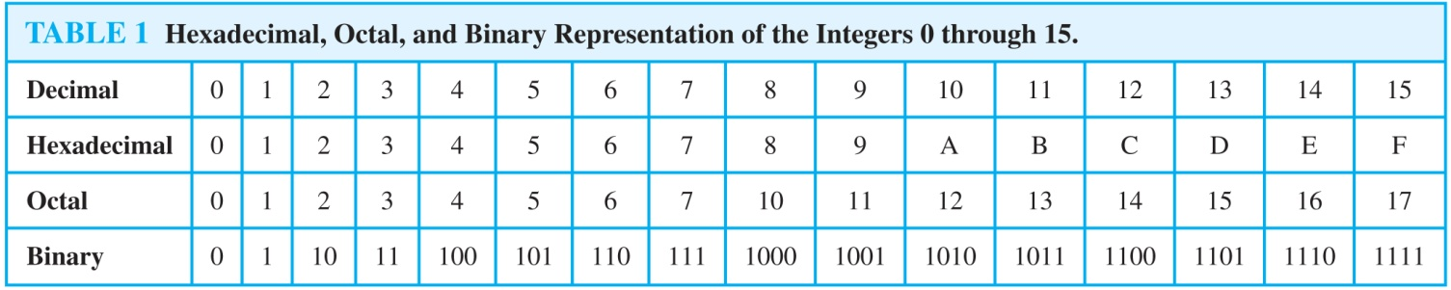
Comparison of Hexadecimal, Octal, and Binary Representations
Initial 0s are not shown
Each octal digit corresponds to a block of 3 binary digits.
Each hexadecimal digit corresponds to a block of 4 binary digits.
So, conversion between binary, octal, and hexadecimal is easy.

Slide 27
Conversion Between Binary, Octal, and Hexadecimal Expansions
Example: Find the octal and hexadecimal expansions of (11 1110 1011 1100)₂.
Solution:
To convert to octal, we group the digits into blocks of three (011 111 010 111 100)₂, adding initial 0s as needed. The blocks from left to right correspond to the digits 3,7,2,7, and 4. Hence, the solution is (37274)₈.
To convert to hexadecimal, we group the digits into blocks of four (0011 1110 1011 1100)₂, adding initial 0s as needed. The blocks from left to right correspond to the digits 3,E,B, and C. Hence, the solution is (3EBC)₁₆.

Slide 28
Binary Addition of Integers
Algorithms for performing operations with integers using their binary expansions are important as computer chips work with binary numbers. Each digit is called a bit.
The number of additions of bits used by the algorithm to add two n-bit integers is O(n).
procedure add(a, b: positive integers)
{the binary expansions of a and b are (a_{n-1},a_{n-2},…,a₀)₂ and (b_{n-1},b_{n-2},…,b₀)₂, respectively}
c := 0
for j := 0 to n − 1
d := ⌊(a_{j} + b_{j} + c)/2⌋
s_{j} := a_{j} + b_{j} + c − 2d
c := d
s_{n} := c
return(s₀,s₁,…, s_{n}){the binary expansion of the sum is (s_{n},s_{n-1},…,s₀)₂}

Slide 29
Binary Multiplication of Integers
Algorithm for computing the product of two n bit integers.
The number of additions of bits used by the algorithm to multiply two n-bit integers is O(n²).
procedure multiply(a, b: positive integers)
{the binary expansions of a and b are (a_{n-1},a_{n-2},…,a₀)₂ and (b_{n-1},b_{n-2},…,b₀)₂, respectively}
for j := 0 to n − 1
if b_{j} = 1 then c_{j} = a shifted j places
else c_{j} := 0
{c_{o},c₁,…, c_{n-1} are the partial products}
p := 0
for j := 0 to n − 1
p := p + c_{j}
return p {p is the value of ab}

Slide 30
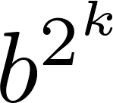
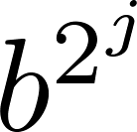
Binary Modular Exponentiation
In cryptography, it is important to be able to find b^{n} mod m efficiently, where b, n, and m are large integers.
Use the binary expansion of n, n = (a_{k-1},…,a₁,a_{o})₂ , to compute b^{n} .
Note that:
Therefore, to compute b^{n}, we need only compute the values of b, b², (b²)² = b⁴, (b⁴)² = b⁸ , …, and the multiply the terms in this list, where a_{j} = 1.
Example: Compute 3¹¹ using this method.
Solution: Note that 11 = (1011)₂ so that 3¹¹ = 3⁸ 3² 3¹ =
((3²)² )² 3² 3¹ = (9² )² ∙ 9 ∙3 = (81)² ∙ 9 ∙3 =6561 ∙ 9 ∙3 =117,147.
continued →

Slide 31
Primes and Greatest Common Divisors
Section 4.3

Slide 32
Section Summary
Prime Numbers and their Properties
Conjectures and Open Problems About Primes
Greatest Common Divisors and Least Common Multiples
The Euclidian Algorithm

Slide 33
Primes
Definition: A positive integer p greater than 1 is called prime if the only positive factors of p are 1 and p. A positive integer that is greater than 1 and is not prime is called composite.
Example: The integer 7 is prime because its only positive factors are 1 and 7, but 9 is composite because it is divisible by 3.

Slide 34
The Fundamental Theorem of Arithmetic
Theorem: Every positive integer greater than 1 can be written uniquely as a prime or as the product of two or more primes where the prime factors are written in order of nondecreasing size.
Examples:
100 = 2 ∙ 2 ∙ 5 ∙ 5 = 2² ∙ 5²
641 = 641
999 = 3 ∙ 3 ∙ 3 ∙ 37 = 3³ ∙ 37
1024 = 2 ∙ 2 ∙ 2 ∙ 2 ∙ 2 ∙ 2 ∙ 2 ∙ 2 ∙ 2 ∙ 2 = 2¹⁰

Slide 35
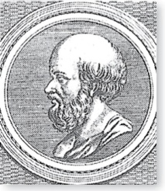
The Sieve of Erastosthenes
Erastothenes
(276-194 B.C.)
The Sieve of Erastosthenes can be used to find all primes not exceeding a specified positive integer. For example, begin with the list of integers between 1 and 100.
Delete all the integers, other than 2, divisible by 2.
Delete all the integers, other than 3, divisible by 3.
Next, delete all the integers, other than 5, divisible by 5.
Next, delete all the integers, other than 7, divisible by 7.
Since all the remaining integers are not divisible by any of the previous integers, other than 1, the primes are:
{2,3,5,7,11, 13, 1719,23,29,31,37,41,43,47,53,
59,61,67,71,73,79,83,89, 97}
continued →

Slide 36
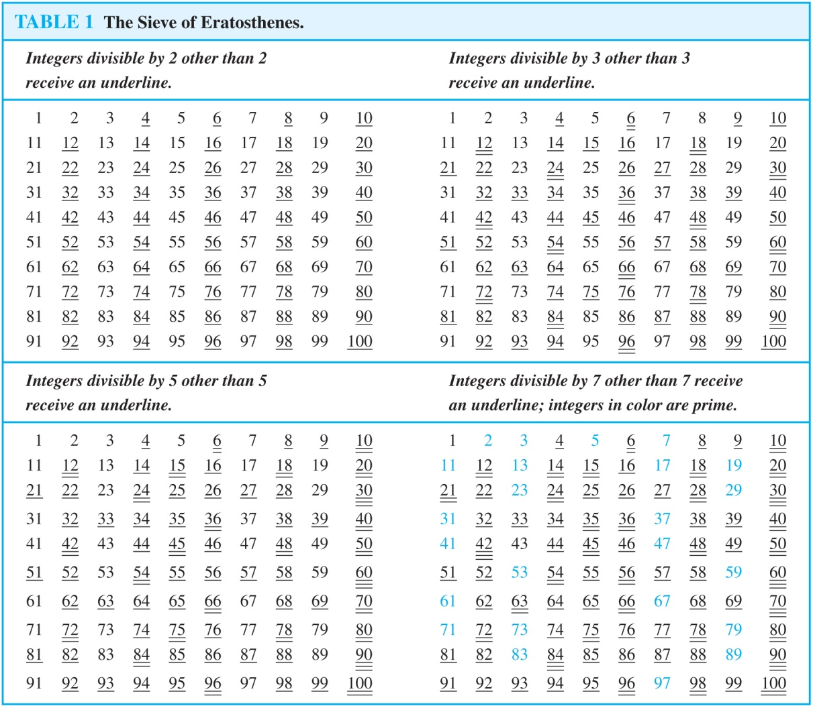
The Sieve of Erastosthenes
If an integer n is a composite integer, then it has a prime divisor less than or equal to √n.
To see this, note that if n = ab, then a ≤ √n or b ≤√n.
Trial division, a very inefficient method of determining if a number n is prime, is to try every integer i ≤√n and see if n is divisible by i.

Slide 37
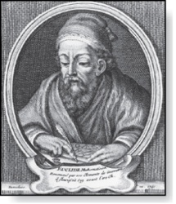
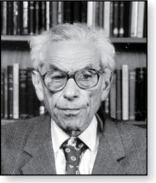
Infinitude of Primes
Euclid
(325 B.C.E. – 265 B.C.E.)
Theorem: There are infinitely many primes. (Euclid)
Proof: Assume finitely many primes: p₁, p₂, ….., p_{n}
Let q = p₁p₂∙∙∙ p_{n} + 1
Either q is prime or by the fundamental theorem of arithmetic it is a product of primes.
But none of the primes p_{j} divides q since if p_{j} | q, then p_{j} divides q − p₁p₂∙∙∙ p_{n} = 1 .
Hence, there is a prime not on the list p₁, p₂, ….., p_{n}. It is either q, or if q is composite, it is a prime factor of q. This contradicts the assumption that p₁, p₂, ….., p_{n} are all the primes.
Consequently, there are infinitely many primes.
This proof was given by Euclid The Elements. The proof is considered to be one of the most beautiful in all mathematics. It is the first proof in The Book, inspired by the famous mathematician Paul Erdős’ imagined collection of perfect proofs maintained by God.
Paul Erdős
(1913-1996)

Slide 38
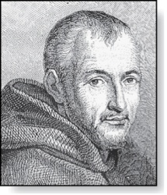
Mersene Primes
Marin Mersenne
(1588-1648)
Definition: Prime numbers of the form 2^{p} − 1 , where p is prime, are called Mersene primes.
2² − 1 = 3, 2³ − 1 = 7, 2⁵ − 1 = 31 , and 2⁷ − 1 = 127 are Mersene primes.
2¹¹ − 1 = 2047 is not a Mersene prime since 2047 = 23∙89.
There is an efficient test for determining if 2^{p} − 1 is prime.
The largest known prime numbers are Mersene primes.
As of mid 2011, 47 Mersene primes were known, the largest is 2^{43,112,609} − 1, which has nearly 13 million decimal digits.
The Great Internet Mersene Prime Search (GIMPS) is a distributed computing project to search for new Mersene Primes.
http://www.mersenne.org/

Slide 39
Generating Primes
The problem of generating large primes is of both theoretical and practical interest.
We will see (in Section 4.6) that finding large primes with hundreds of digits is important in cryptography.
So far, no useful closed formula that always produces primes has been found. There is no simple function f(n) such that f(n) is prime for all positive integers n.

Slide 40
Greatest Common Divisor
Definition: Let a and b be integers, not both zero. The largest integer d such that d | a and also d | b is called the greatest common divisor of a and b. The greatest common divisor of a and b is denoted by gcd(a,b).
One can find greatest common divisors of small numbers by inspection.
Example:What is the greatest common divisor of 24 and 36?
Solution: gcd(24, 36) = 12
Example:What is the greatest common divisor of 17 and 22?
Solution: gcd(17,22) = 1

Slide 41
Greatest Common Divisor
Definition: The integers a and b are relatively prime if their greatest common divisor is 1.
Example: 17 and 22
Definition: The integers a₁, a₂, …, a_{n} are pairwise relatively prime if gcd(a_{i}, a_{j})= 1 whenever 1 ≤ i<j ≤n.
Example: Determine whether the integers 10, 17 and 21 are pairwise relatively prime.
Solution: Because gcd(10,17) = 1, gcd(10,21) = 1, and gcd(17,21) = 1, 10, 17, and 21 are pairwise relatively prime.
Example: Determine whether the integers 10, 19, and 24 are pairwise relatively prime.
Solution: Because gcd(10,24) = 2, 10, 19, and 24 are not pairwise relatively prime.

Slide 42
Greatest Common Divisor
Definition: The integers a and b are relatively prime if their greatest common divisor is 1.
Example: 17 and 22
Definition: The integers a₁, a₂, …, a_{n} are pairwise relatively prime if gcd(a_{i}, a_{j})= 1 whenever 1 ≤ i<j ≤n.
Example: Determine whether the integers 10, 17 and 21 are pairwise relatively prime.
Solution: Because gcd(10,17) = 1, gcd(10,21) = 1, and gcd(17,21) = 1, 10, 17, and 21 are pairwise relatively prime.
Example: Determine whether the integers 10, 19, and 24 are pairwise relatively prime.
Solution: Because gcd(10,24) = 2, 10, 19, and 24 are not pairwise relatively prime.

Slide 43
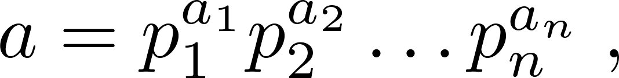
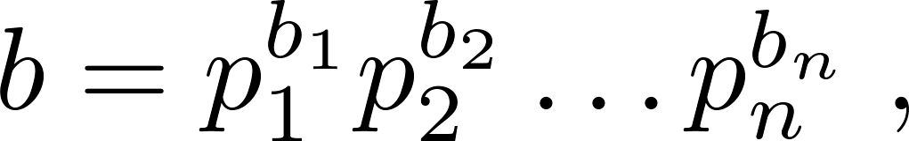
Finding the Greatest Common Divisor Using Prime Factorizations
Suppose the prime factorizations of a and b are:
where each exponent is a nonnegative integer, and where all primes occurring in either prime factorization are included in both. Then:
This formula is valid since the integer on the right (of the equals sign) divides both a and b. No larger integer can divide both a and b.
Example: 120 = 2³ ∙3 ∙5 500 = 2² ∙5³
gcd(120,500) = 2^{min(3,2)} ∙3^{min(1,0)} ∙5^{min(1,3)} = 2² ∙3⁰ ∙5¹ = 20
Finding the gcd of two positive integers using their prime factorizations is not efficient because there is no efficient algorithm for finding the prime factorization of a positive integer.

Slide 44
Least Common Multiple
Definition: The least common multiple of the positive integers a and b is the smallest positive integer that is divisible by both a and b. It is denoted by lcm(a,b).
The least common multiple can also be computed from the prime factorizations.
This number is divided by both a and b and no smaller number is divided by a and b.
Example: lcm(2³3⁵7², 2⁴3³) = 2^{max(3,4)} 3^{max(5,3)} 7^{max(2,0)} = 2⁴ 3⁵ 7²
The greatest common divisor and the least common multiple of two integers are related by:
Theorem 5: Let a and b be positive integers. Then
ab = gcd(a,b) ∙lcm(a,b)
(proof is Exercise 31)

Slide 45
Euclidean Algorithm
Euclid
(325 B.C.E. – 265 B.C.E.)
The Euclidian algorithm is an efficient method for computing the greatest common divisor of two integers. It is based on the idea that gcd(a,b) is equal to gcd(a,c) when a > b and c is the remainder when a is divided by b.
Example: Find gcd(91, 287):
287 = 91 ∙ 3 + 14
91 = 14 ∙ 6 + 7
14 = 7 ∙ 2 + 0
gcd(287, 91) = gcd(91, 14) = gcd(14, 7) = 7
Divide 287 by 91
Divide 91 by 14
Divide 14 by 7
Stopping condition
continued →

Slide 46
Euclidean Algorithm
The Euclidean algorithm expressed in pseudocode is:
procedure gcd(a, b: positive integers)
x := a
y := b
while y ≠ 0
r := x mod y
x := y
y := r
return x {gcd(a,b) is x}

Slide 47


Uniqueness of Prime Factorization
We will prove that a prime factorization of a positive integer where the primes are in nondecreasing order is unique. (This part of the fundamental theorem of arithmetic. The other part, which asserts that every positive integer has a prime factorization into primes, will be proved in Section 5.2.)
Proof: (by contradiction) Suppose that the positive integer n can be written as a product of primes in two distinct ways:
n = p₁p₂ ∙∙∙ p_{s} and n = q₁q₂ ∙∙∙ p_{t}.
Remove all common primes from the factorizations to get
By Lemma 3, it follows that divides , for some k, contradicting the assumption that and are distinct primes.
Hence, there can be at most one factorization of n into primes in nondecreasing order.

Slide 48
Cryptography
Section 4.6

Slide 49
Section Summary
Classical Cryptography

Slide 50
Caesar Cipher
Julius Caesar created secret messages by shifting each letter three letters forward in the alphabet (sending the last three letters to the first three letters.) For example, the letter B is replaced by E and the letter X is replaced by A. This process of making a message secret is an example of encryption.
Here is how the encryption process works:
Replace each letter by an integer from Z₂₆, that is an integer from 0 to 25 representing one less than its position in the alphabet.
The encryption function is f(p) = (p + 3) mod 26. It replaces each integer p in the set {0,1,2,…,25} by f(p) in the set {0,1,2,…,25} .
Replace each integer p by the letter with the position p + 1 in the alphabet.
Example: Encrypt the message “MEET YOU IN THE PARK” using the Caesar cipher.
Solution: 12 4 4 19 24 14 20 8 13 19 7 4 15 0 17 10.
Now replace each of these numbers p by f(p) = (p + 3) mod 26.
15 7 7 22 1 17 23 11 16 22 10 7 18 3 20 13.
Translating the numbers back to letters produces the encrypted message
“PHHW BRX LQ WKH SDUN.”

Slide 51
Caesar Cipher
To recover the original message, use f⁻¹(p) = (p−3) mod 26. So, each letter in the coded message is shifted back three letters in the alphabet, with the first three letters sent to the last three letters. This process of recovering the original message from the encrypted message is called decryption.
The Caesar cipher is one of a family of ciphers called shift ciphers. Letters can be shifted by an integer k, with 3 being just one possibility. The encryption function is
f(p) = (p + k) mod 26
and the decryption function is
f⁻¹(p) = (p−k) mod 26
The integer k is called a key.

Slide 52
Shift Cipher
Example 1: Encrypt the message “STOP GLOBAL WARMING” using the shift cipher with k = 11.
Solution: Replace each letter with the corresponding element of Z₂₆.
18 19 14 15 6 11 14 1 0 11 22 0 17 12 8 13 6.
Apply the shift f(p) = (p + 11) mod 26, yielding
3 4 25 0 17 22 25 12 11 22 7 11 2 23 19 24 17.
Translating the numbers back to letters produces the ciphertext
“DEZA RWZMLW HLCXTYR.”

Slide 53
Shift Cipher
Example 2: Decrypt the message “LEWLYPLUJL PZ H NYLHA ALHJOLY” that was encrypted using the shift cipher with k = 7.
Solution: Replace each letter with the corresponding element of Z₂₆.
11 4 22 11 24 15 11 20 9 11 15 25 7 13 24 11 7 0 0 11 7 9 14 11 24.
Shift each of the numbers by −k = −7 modulo 26, yielding
4 23 15 4 17 8 4 13 2 4 8 18 0 6 17 4 0 19 19 4 0 2 7 4 17.
Translating the numbers back to letters produces the decrypted message
“EXPERIENCE IS A GREAT TEACHER.”

Slide 54
Affine Ciphers
Shift ciphers are a special case of affine ciphers which use functions of the form
f(p) = (ap + b) mod 26,
where a and b are integers, chosen so that f is a bijection.
The function is a bijection if and only if gcd(a,26) = 1.
Example: What letter replaces the letter K when the function f(p) = (7p + 3) mod 26 is used for encryption.
Solution: Since 10 represents K, f(10) = (7∙10 + 3) mod 26 =21, which is then replaced by V.
To decrypt a message encrypted by a shift cipher, the congruence c ≡ ap + b (mod 26) needs to be solved for p.
Subtract b from both sides to obtain c− b ≡ ap (mod 26).
Multiply both sides by the inverse of a modulo 26, which exists since gcd(a,26) = 1.
ā(c− b) ≡ āap (mod 26), which simplifies to ā(c− b) ≡ p (mod 26).
p ≡ ā(c− b) (mod 26) is used to determine p in Z₂₆.

Slide 55
Cryptanalysis of Affine Ciphers
The process of recovering plaintext from ciphertext without knowledge both of the encryption method and the key is known as cryptanalysis or breaking codes.
An important tool for cryptanalyzing ciphertext produced with a affine ciphers is the relative frequencies of letters. The nine most common letters in the English texts are E 13%, T 9%, A 8%, O 8%, I 7%, N 7%, S 7%, H 6%, and R 6%.
To analyze ciphertext:
Find the frequency of the letters in the ciphertext.
Hypothesize that the most frequent letter is produced by encrypting E.
If the value of the shift from E to the most frequent letter is k, shift the ciphertext by −k and see if it makes sense.
If not, try T as a hypothesis and continue.
Example: We intercepted the message “ZNK KGXRE HOXJ MKZY ZNK CUXS” that we know was produced by a shift cipher. Let’s try to cryptanalyze.
Solution: The most common letter in the ciphertext is K. So perhaps the letters were shifted by 6 since this would then map E to K. Shifting the entire message by −6 gives us “THE EARLY BIRD GETS THE WORM.”

