Slide 1
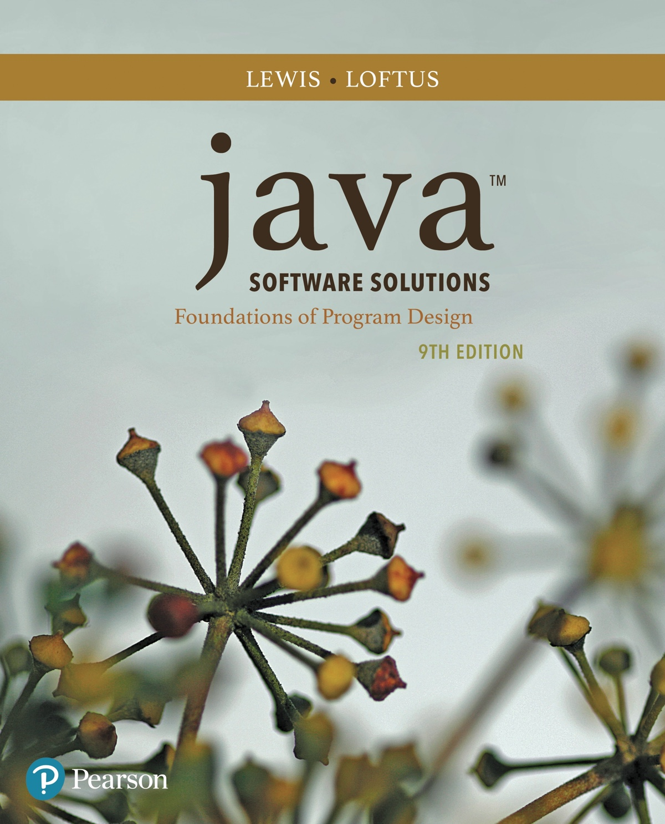
Chapter 1 Introduction
Java Software Solutions
Foundations of Program Design
9th Edition
John Lewis
William Loftus

Slide 2
Focus of the Course
Object-Oriented Software Development
problem solving
program design, implementation, and testing
object-oriented concepts
classes
objects
encapsulation
inheritance
polymorphism
graphical user interfaces
the Java programming language

Slide 3
Introduction
We start with the fundamentals of computer processing
Chapter 1 focuses on:
components of a computer
how computers store and manipulate information
computer networks
the Internet and the World Wide Web
programming and programming languages
an introduction to Java
an overview of object-oriented concepts

Slide 4
Outline
Computer Processing
Hardware Components
Networks
The Java Programming Language
Program Development
Object-Oriented Programming

Slide 5
Hardware and Software
Hardware
the physical, tangible parts of a computer
keyboard, monitor, disks, wires, chips, etc.
Software
programs and data
a program is a series of instructions
A computer requires both hardware and software
Each is essentially useless without the other

Slide 6
CPU and Main Memory
Central
Processing
Unit
Chip that executes program commands
Primary storage area for programs and data that are in active use
Synonymous with RAM
Main
Memory

Slide 7


Input / Output Devices
Monitor screen
Keyboard
Mouse
Touch screen
Central
Processing
Unit
I/O devices facilitate
user interaction
Main
Memory

Slide 8


Secondary Memory Devices
Information is moved
between main and
secondary memory
as needed
Central
Processing
Unit
Hard Disk
Main
Memory
Secondary memory
devices provide
long-term storage
USB Flash Drive

Slide 9
Software Categories
Operating System
controls all machine activities
provides the user interface to the computer
manages resources such as the CPU and memory
Windows, Mac OS, Unix, Linux,
Application program
generic term for any other kind of software
word processors, missile control systems, games
Most operating systems and application programs have a graphical user interface (GUI)

Slide 10
Analog vs. Digital
There are two basic ways to store and manage data:
Analog
continuous, in direct proportion to the data represented
music on a record album - a needle rides on ridges in the grooves that are directly proportional to the voltages sent to the speaker
Digital
the information is broken down into pieces, and each piece is represented separately
sampling – record discrete values of the analog representation
music on a compact disc - the disc stores numbers representing specific voltage levels sampled at specific times

Slide 11
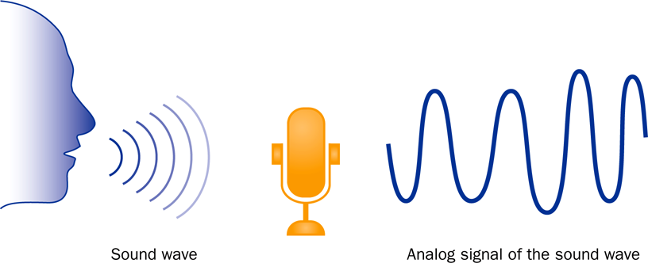
Analog Information

Slide 12
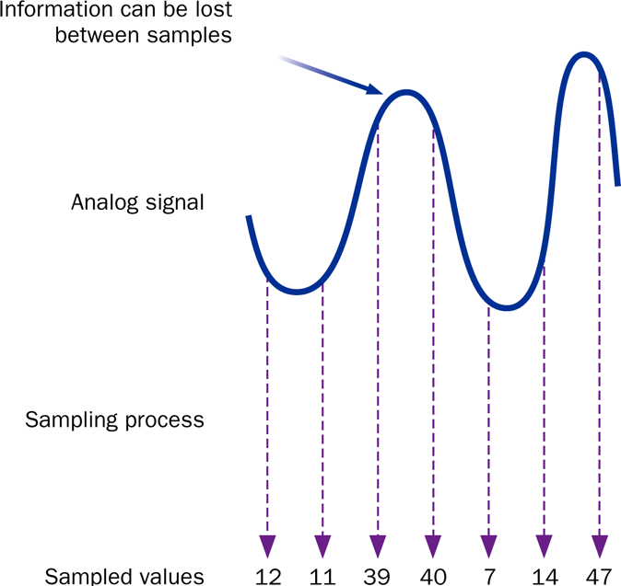
Sampling

Slide 13
Digital Information
Computers store all information digitally:
numbers
text
graphics and images
audio
video
program instructions
In some way, all information is digitized - broken down into pieces and represented as numbers

Slide 14
Representing Text Digitally
For example, every character is stored as a number, including spaces, digits, and punctuation
Corresponding upper and lower case letters are separate characters
H i , H e a t h e r .
72 105 44 32 72 101 97 116 104 101 114 46

Slide 15
Binary Numbers
Once information has been digitized, it is represented and stored in memory using the binary number system
A single binary digit (0 or 1) is called a bit
Devices that store and move information are cheaper and more reliable if they have to represent only two states
A single bit can represent two possible states, like a light bulb that is either on (1) or off (0)
Permutations of bits are used to store values

Slide 16
Bit Permutations
1 bit
2 bits
3 bits
4 bits
0
1
00
01
10
11
000
001
010
011
100
101
110
111
0000
0001
0010
0011
0100
0101
0110
0111
1000
1001
1010
1011
1100
1101
1110
1111
Each additional bit doubles the number of possible permutations

Slide 17
Bit Permutations
Each permutation can represent a particular item
There are 2^{N} permutations of N bits
Therefore, N bits are needed to represent 2^{N} unique items
1 bit ?
2 bits ?
3 bits ?
4 bits ?
5 bits ?
2¹ = 2 items
How many
items can be
represented by
2² = 4 items
2³ = 8 items
2⁴ = 16 items
2⁵ = 32 items

Slide 18
Quick Check
How many bits would you need to represent each of the 50 United States using a unique permutation of bits?

Slide 19
Quick Check
How many bits would you need to represent each of the 50 United States using a unique permutation of bits?
000000 Alabama
000001 Alaska
000010 Arizona
000011 Arkansas
000100 California
000101 Colorado
etc.
Five bits wouldn't be enough, because 2⁵ is 32.
Six bits would give us 64 permutations, and some wouldn't be used.

Slide 20
Outline
Computer Processing
Hardware Components
Networks
The Java Programming Language
Program Development
Object-Oriented Programming

Slide 21
A Computer Specification
Consider the following specification for a personal computer:
Intel Dual-Core i7 processor
4 GB RAM
750 GB Hard Disk
15” High Definition Display with 1366 x 768 resolution
802.11 wireless card

Slide 22
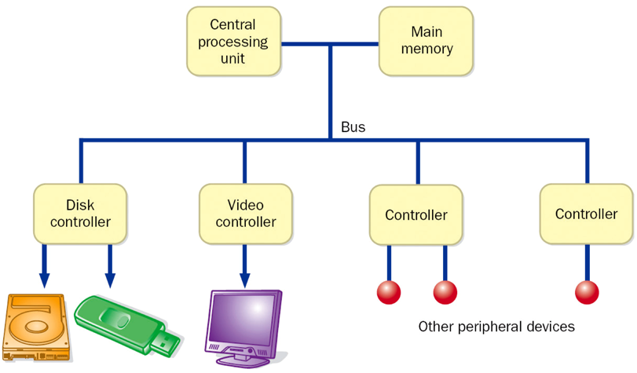
Computer Architecture

Slide 23
Memory
9278
9279
9280
9281
9282
9283
9284
9285
9286
Main memory is divided into many memory locations (or cells)
Each memory cell has a numeric address, which uniquely identifies it

Slide 24
Storing Information
9278
9279
9280
9281
9282
9283
9284
9285
9286
Each memory cell stores a set number of bits (usually 8 bits, or one byte)
10011010
Large values are
stored in consecutive
memory locations

Slide 25
Storage Capacity
Every memory device has a storage capacity, indicating the number of bytes it can hold
Capacities are expressed in various units:
Unit | Symbol | Number of Bytes
kilobyte | KB | 2¹⁰ = 1024
megabyte | MB | 2²⁰ (over one million)
gigabyte | GB | 2³⁰ (over one billion)
terabyte | TB | 2⁴⁰ (over one trillion)
petabyte | PB | 2⁵⁰ (a whole bunch)

Slide 26
Memory
Main memory is volatile - stored information is lost if the electric power is removed
Secondary memory devices are nonvolatile
Main memory and disks are direct access devices - information can be reached directly
The terms direct access and random access often are used interchangeably
A magnetic tape is a sequential access device since its data is arranged in a linear order - you must get by the intervening data in order to access other information

Slide 27
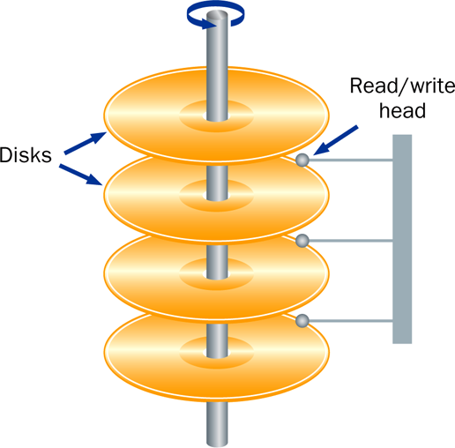
Hard Disk Drive

Slide 28
RAM vs. ROM
RAM - Random Access Memory (direct access)
ROM - Read-Only Memory
The terms RAM and main memory are basically interchangeable
ROM could be a set of memory chips, or a separate device, such as a CD ROM
Both RAM and ROM are random (direct) access devices!
RAM probably should be called Read-Write Memory

Slide 29
Compact Discs
A CD-ROM is portable read-only memory
A microscopic pit on a CD represents a binary 1 and a smooth area represents a binary 0
A low-intensity laser reflects strongly from a smooth area and weakly from a pit
A CD-Recordable (CD-R) drive can be used to write information to a CD once
The speed of a CD drive indicates how fast (max) it can read and write information to a CD

Slide 30
DVDs
A DVD is the same physical size as a CD, but can store much more information
The format of a DVD stores more bits per square inch
A CD can store 650 MB, while a standard DVD can store 4.7 GB
A double sided DVD can store 9.4 GB
Other advanced techniques can bring the capacity up to 17.0 GB
Like CDs, there are DVD-R discs

Slide 31
The Central Processing Unit
A CPU is on a chip called a microprocessor
It continuously follows the fetch-decode-execute cycle:
Retrieve an instruction from main memory
fetch
execute
decode
Carry out the
instruction
Determine what the
instruction is

Slide 32
The Central Processing Unit
Arithmetic / Logic Unit
Performs calculations and makes decisions
Coordinates processing steps
Control Unit
Small storage areas
Registers

Slide 33
The Central Processing Unit
The speed of a CPU is controlled by the system clock
The system clock generates an electronic pulse at regular intervals
The pulses coordinate the activities of the CPU
The speed is usually measured in gigahertz (GHz)

Slide 34
Monitor
The size of a monitor (15.6") is measured diagonally, like a television screen
A monitor has a certain maximum resolution , indicating the number of picture elements, called pixels, that it can display (such as 1366 by 768)
High resolution (more pixels) produces sharper pictures

Slide 35
Outline
Computer Processing
Hardware Components
Networks
The Java Programming Language
Program Development
Object-Oriented Programming

Slide 36
Networks
A network is two or more computers that are connected so that data and resources can be shared
Most computers are connected to some kind of network
Each computer has its own network address, which uniquely identifies it among the others
A file server is a network computer dedicated to storing programs and data that are shared among network users

Slide 37
Network Connections
Each computer in a network could be directly connected to every other computer in the network
These are called point-to-point connections
Adding a computer requires
a new communication line
for each computer already
in the network
This technique is not practical for
more than a few close machines

Slide 38
Network Connections
Most networks share a single communication line
Adding a new computer to the network is relatively easy
Network traffic must take
turns using the line, which
introduces delays
Often information is broken
down in parts, called packets,
which are sent to the receiving
machine and then reassembled

Slide 39
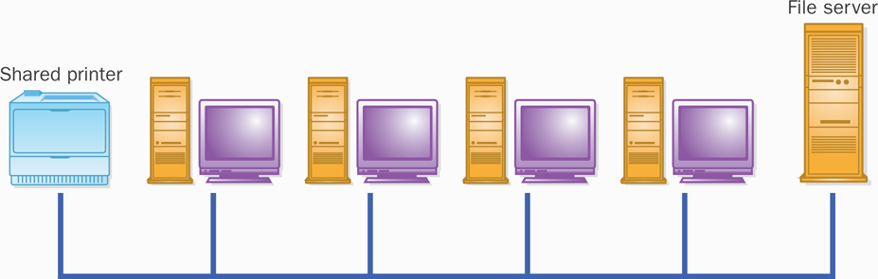
A Computer Network

Slide 40
Local-Area Networks
A Local-Area Network
(LAN) covers a small
distance and a small
number of computers
LAN
A LAN often connects the machines
in a single room or building

Slide 41
Wide-Area Networks
A Wide-Area Network (WAN)
connects two or more LANs,
often over long distances
LAN
LAN

Slide 42
The Internet
The Internet is a WAN which spans the planet
The word Internet comes from the term internetworking
It started as a United States government project, sponsored by the Advanced Research Projects Agency (ARPA)
originally it was called the ARPANET
The Internet grew quickly throughout the 1980s and 90s

Slide 43
TCP/IP
A protocol is a set of rules that determine how things communicate with each other
The software that manages Internet communication follows a suite of protocols called TCP/IP
The Internet Protocol (IP) determines the format of the information as it is transferred
The Transmission Control Protocol (TCP) dictates how messages are reassembled and handles lost information

Slide 44
IP and Internet Addresses
Each computer on the Internet has a unique IP address, such as:
204.192.116.2
Most computers also have a unique Internet name, which also is referred to as an Internet address:
hector.vt.edu
The first part indicates a particular computer (hector)
The rest is the domain name, indicating the organization (vt.edu)

Slide 45
Domain Names
The last part of a domain name, called a top-level domain (TLD), supposedly indicates the type of organization:
edu educational institution
com commercial entity
org non-profit organization
net network-based organization
Sometimes the suffix
indicates the country:
uk United Kingdom
au Australia
ca Canada
se Sweden
Additional TLDs have
been added, including:
biz, info, tv, name

Slide 46
Domain Names
A domain name can have several parts
Unique domain names mean that multiple sites can have individual computers with the same local name
When used, an Internet address is translated to an IP address by software called the Domain Name System (DNS)
There is no one-to-one correspondence between the sections of an IP address and the sections of an Internet address

Slide 47
The World Wide Web
The World Wide Web allows many different types of information to be accessed using a common interface
A browser is a program which accesses network resources and presents them
Popular browsers: Internet Explorer, Safari, Firefox
Resources presented include:
text, graphics, video, sound, audio, executable programs
A Web document usually contains links to other Web documents, creating a hypermedia environment
The term Web comes from the fact that information is not organized in a linear fashion

Slide 48
The World Wide Web
Web documents are often defined using the HyperText Markup Language (HTML)
Information on the Web is found using a Uniform Resource Locator (URL):
http://www.google.com
http://www.whitehouse.gov/issues/education
A URL specifies a protocol (http), a domain, and possibly specific documents
You can also use a browser with other protocols, such as ftp

Slide 49
Outline
Computer Processing
Hardware Components
Networks
The Java Programming Language
Program Development
Object-Oriented Programming

Slide 50
Java
The Java programming language was created by Sun Microsystems, Inc.
It was introduced in 1995 and it's popularity has grown quickly since
A programming language specifies the words and symbols that we can use to write a program
A programming language employs a set of rules that dictate how the words and symbols can be put together to form valid program statements

Slide 51
Java Program Structure
In the Java programming language:
A program is made up of one or more classes
A class contains one or more methods
A method contains program statements
These terms will be explored in detail throughout the course
A Java application always contains a method called main
See Lincoln.java

Slide 52
//********************************************************************
// Lincoln.java Author: Lewis/Loftus
//
// Demonstrates the basic structure of a Java application.
//********************************************************************
public class Lincoln
{
//-----------------------------------------------------------------
// Prints a presidential quote.
//-----------------------------------------------------------------
public static void main(String[] args)
{
System.out.println("A quote by Abraham Lincoln:");
System.out.println("Whatever you are, be a good one.");
}
}

Slide 53
Output
A quote by Abraham Lincoln:
Whatever you are, be a good one.
//********************************************************************
// Lincoln.java Author: Lewis/Loftus
//
// Demonstrates the basic structure of a Java application.
//********************************************************************
public class Lincoln
{
//-----------------------------------------------------------------
// Prints a presidential quote.
//-----------------------------------------------------------------
public static void main(String[] args)
{
System.out.println("A quote by Abraham Lincoln:");
System.out.println("Whatever you are, be a good one.");
}
}

Slide 54
Java Program Structure
// comments about the class
public class MyProgram
{
}
class header
class body
Comments can be placed almost anywhere

Slide 55
Java Program Structure
// comments about the class
public class MyProgram
{
}
// comments about the method
public static void main (String[] args)
{
}
method header
method body

Slide 56
Comments
Comments should be included to explain the purpose of the program and describe processing steps
They do not affect how a program works
Java comments can take three forms:
// this comment runs to the end of the line
/* this comment runs to the terminating
symbol, even across line breaks */
/** this is a javadoc comment */

Slide 57
Identifiers
Identifiers are the "words" in a program
A Java identifier can be made up of letters, digits, the underscore character ( _ ), and the dollar sign
Identifiers cannot begin with a digit
Java is case sensitive: Total, total, and TOTAL are different identifiers
By convention, programmers use different case styles for different types of identifiers, such as
title case for class names - Lincoln
upper case for constants - MAXIMUM

Slide 58
Identifiers
Sometimes the programmer chooses the identifer(such as Lincoln)
Sometimes we are using another programmer's code, so we use the identifiers that he or she chose (such as println)
Often we use special identifiers called reserved words that already have a predefined meaning in the language
A reserved word cannot be used in any other way

Slide 59
Reserved Words
The Java reserved words:
abstract
assert
boolean
break
byte
case
catch
char
class
const
continue
default
do
double
else
enum
extends
false
final
finally
float
for
goto
if
implements
import
instanceof
int
interface
long
native
new
null
package
private
protected
public
return
short
static
strictfp
super
switch
synchronized
this
throw
throws
transient
true
try
void
volatile
while

Slide 60
Quick Check
Which of the following are valid Java identifiers?
grade
quizGrade
NetworkConnection
frame2
3rdTestScore
MAXIMUM
MIN_CAPACITY
student#
Shelves1&2

Slide 61
Quick Check
Which of the following are valid Java identifiers?
grade
quizGrade
NetworkConnection
frame2
3rdTestScore
MAXIMUM
MIN_CAPACITY
student#
Shelves1&2
Valid
Valid
Valid
Valid
Invalid – cannot begin with a digit
Valid
Valid
Invalid – cannot contain the '#' character
Invalid – cannot contain the '&' character

Slide 62
White Space
Spaces, blank lines, and tabs are called white space
White space is used to separate words and symbols in a program
Extra white space is ignored
A valid Java program can be formatted many ways
Programs should be formatted to enhance readability, using consistent indentation
See Lincoln2.java and Lincoln3.java

Slide 63
Outline
Computer Processing
Hardware Components
Networks
The Java Programming Language
Program Development
Object-Oriented Programming

Slide 64
Program Development
The mechanics of developing a program include several activities:
writing the program in a specific programming language (such as Java)
translating the program into a form that the computer can execute
investigating and fixing various types of errors that can occur
Software tools can be used to help with all parts of this process

Slide 65
Language Levels
There are four programming language levels:
machine language
assembly language
high-level language
fourth-generation language
Each type of CPU has its own specific machine language
The other levels were created to make it easier for a human being to read and write programs

Slide 66
Programming Languages
Each type of CPU executes only a particular machine language
A program must be translated into machine language before it can be executed
A compiler is a software tool which translates source code into a specific target language
Sometimes, that target language is the machine language for a particular CPU type
The Java approach is somewhat different

Slide 67
Java Translation
The Java compiler translates Java source code into a special representation called bytecode
Java bytecode is not the machine language for any traditional CPU
Bytecode is executed by the Java Virtual Machine (JVM)
Therefore Java bytecode is not tied to any particular machine
Java is considered to be architecture-neutral

Slide 68
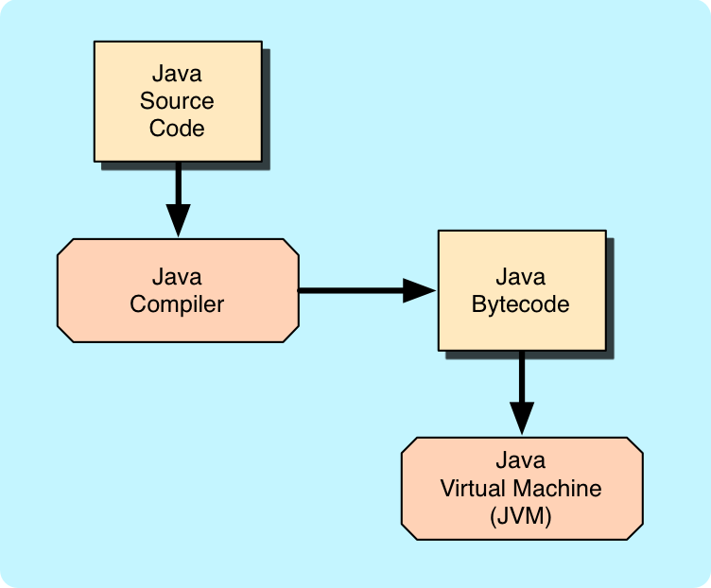
Java Translation

Slide 69
Development Environments
There are many programs that support the development of Java software, including:
Java Development Kit (JDK)
Eclipse
NetBeans
BlueJ
jGRASP
Though the details of these environments differ, the basic compilation and execution process is essentially the same

Slide 70
Syntax and Semantics
The syntax rules of a language define how we can put together symbols, reserved words, and identifiers to make a valid program
The semantics of a program statement define what that statement means (its purpose or role in a program)
A program that is syntactically correct is not necessarily logically (semantically) correct
A program will always do what we tell it to do, not what we meant to tell it to do

Slide 71
Errors
A program can have three types of errors
The compiler will find syntax errors and other basic problems (compile-time errors)
If compile-time errors exist, an executable version of the program is not created
A problem can occur during program execution, such as trying to divide by zero, which causes a program to terminate abnormally (run-time errors)
A program may run, but produce incorrect results, perhaps using an incorrect formula (logical errors)

Slide 72
Basic Program Development
Edit and
save program
errors?
Compile program
errors?
Execute program and
evaluate results

Slide 73
Outline
Computer Processing
Hardware Components
Networks
The Java Programming Language
Program Development
Object-Oriented Programming

Slide 74
Problem Solving
The purpose of writing a program is to solve a problem
Solving a problem consists of multiple activities:
Understand the problem
Design a solution
Consider alternatives and refine the solution
Implement the solution
Test the solution
These activities are not purely linear – they overlap and interact

Slide 75
Problem Solving
The key to designing a solution is breaking it down into manageable pieces
When writing software, we design separate pieces that are responsible for certain parts of the solution
An object-oriented approach lends itself to this kind of solution decomposition
We will dissect our solutions into pieces called objects and classes

Slide 76
Object-Oriented Programming
Java is an object-oriented programming language
As the term implies, an object is a fundamental entity in a Java program
Objects can be used effectively to represent real-world entities
For instance, an object might represent a particular employee in a company
Each employee object handles the processing and data management related to that employee

Slide 77
Objects
An object has:
state - descriptive characteristics
behaviors - what it can do (or what can be done to it)
The state of a bank account includes its account number and its current balance
The behaviors associated with a bank account include the ability to make deposits and withdrawals
Note that the behavior of an object might change its state

Slide 78
Classes
An object is defined by a class
A class is the blueprint of an object
The class uses methods to define the behaviors of the object
The class that contains the main method of a Java program represents the entire program
A class represents a concept, and an object represents the embodiment of that concept
Multiple objects can be created from the same class

Slide 79
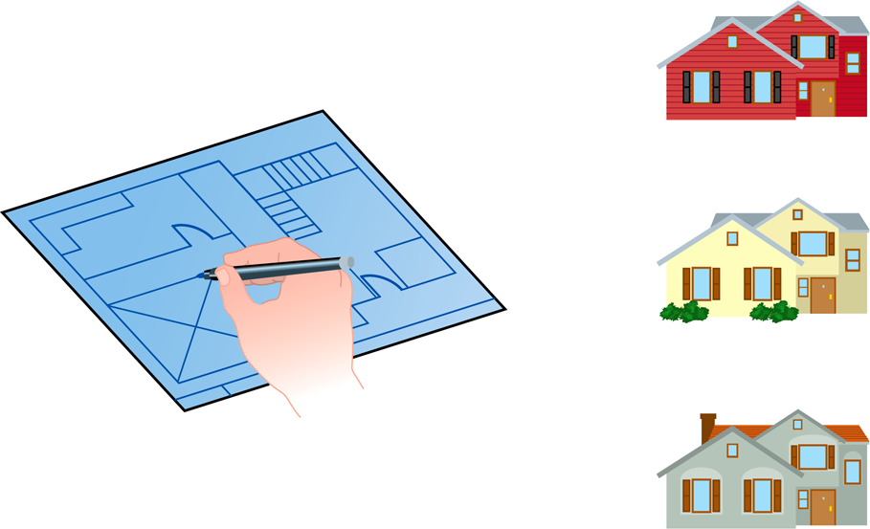
Class = Blueprint
One blueprint to create several similar, but different, houses:

Slide 80
Objects and Classes
An object
(the realization)
A class
(the concept)
John’s Bank Account
Balance: $5,257
Bank Account
Bill’s Bank Account
Balance: $1,245,069
Multiple objects
from the same class
Mary’s Bank Account
Balance: $16,833

Slide 81
Inheritance
One class can be used to derive another via inheritance
Classes can be organized into hierarchies
Account
Charge Account
Bank Account
Savings Account
Checking Account

Slide 82
Summary
Chapter 1 focused on:
components of a computer
how those components interact
how computers store and manipulate information
computer networks
the Internet and the World Wide Web
programming and programming languages
an introduction to Java
an overview of object-oriented concepts

