Slide 1

Chapter 4 Writing Classes
Java Software Solutions
Foundations of Program Design
9th Edition
John Lewis
William Loftus

Slide 2
Writing Classes
We've been using predefined classes from the Java API. Now we will learn to write our own classes.
Chapter 4 focuses on:
class definitions
instance data
encapsulation and Java modifiers
method declaration and parameter passing
constructors
arcs and images
events and event handlers
buttons and text fields

Slide 3
Outline
Anatomy of a Class
Encapsulation
Anatomy of a Method
Arcs
Images
Graphical User Interfaces
Text Fields

Slide 4
Writing Classes
The programs we’ve written in previous examples have used classes defined in the Java API
Now we will begin to design programs that rely on classes that we write ourselves
The class that contains the main method is just the starting point of a program
True object-oriented programming is based on defining classes that represent objects with well-defined characteristics and functionality

Slide 5
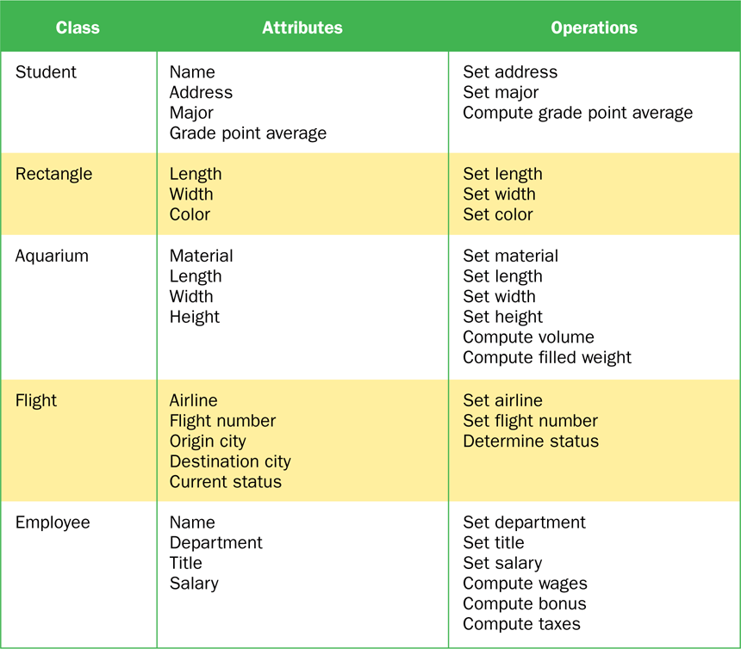
Examples of Classes

Slide 6
Classes and Objects
Recall from our overview of objects in Chapter 1 that an object has state and behavior
Consider a six-sided die (singular of dice)
Its state can be defined as which face is showing
Its primary behavior is that it can be rolled
We represent a die by designing a class called Die that models this state and behavior
The class serves as the blueprint for a die object
We can then instantiate as many die objects as we need for any particular program

Slide 7
Classes
A class can contain data declarations and method declarations
int size, weight;
char category;
Data declarations
Method declarations

Slide 8
Classes
The values of the data define the state of an object created from the class
The functionality of the methods define the behaviors of the object
For our Die class, we might declare an integer called faceValue that represents the current value showing on the face
One of the methods would “roll” the die by setting faceValue to a random number between one and six

Slide 9
Classes
We’ll want to design the Die class so that it is a versatile and reusable resource
Any given program will probably not use all operations of a given class
See RollingDice.java
See Die.java

Slide 10
//********************************************************************
// RollingDice.java Author: Lewis/Loftus
//
// Demonstrates the creation and use of a user-defined class.
//********************************************************************
public class RollingDice
{
//-----------------------------------------------------------------
// Creates two Die objects and rolls them several times.
//-----------------------------------------------------------------
public static void main(String[] args)
{
Die die1, die2;
int sum;
die1 = new Die();
die2 = new Die();
die1.roll();
die2.roll();
System.out.println("Die One: " + die1 + ", Die Two: " + die2);
continue

Slide 11
continue
die1.roll();
die2.setFaceValue(4);
System.out.println("Die One: " + die1 + ", Die Two: " + die2);
sum = die1.getFaceValue() + die2.getFaceValue();
System.out.println("Sum: " + sum);
sum = die1.roll() + die2.roll();
System.out.println("Die One: " + die1 + ", Die Two: " + die2);
System.out.println("New sum: " + sum);
}
}

Slide 12
Sample Run
Die One: 5, Die Two: 2
Die One: 1, Die Two: 4
Sum: 5
Die One: 4, Die Two: 2
New sum: 6
continue
die1.roll();
die2.setFaceValue(4);
System.out.println("Die One: " + die1 + ", Die Two: " + die2);
sum = die1.getFaceValue() + die2.getFaceValue();
System.out.println("Sum: " + sum);
sum = die1.roll() + die2.roll();
System.out.println("Die One: " + die1 + ", Die Two: " + die2);
System.out.println("New sum: " + sum);
}
}

Slide 13
//********************************************************************
// Die.java Author: Lewis/Loftus
//
// Represents one die (singular of dice) with faces showing values
// between 1 and 6.
//********************************************************************
public class Die
{
private final int MAX = 6; // maximum face value
private int faceValue; // current value showing on the die
//-----------------------------------------------------------------
// Constructor: Sets the initial face value.
//-----------------------------------------------------------------
public Die()
{
faceValue = 1;
}
continue

Slide 14
continue
//-----------------------------------------------------------------
// Rolls the die and returns the result.
//-----------------------------------------------------------------
public int roll()
{
faceValue = (int)(Math.random() * MAX) + 1;
return faceValue;
}
//-----------------------------------------------------------------
// Face value mutator.
//-----------------------------------------------------------------
public void setFaceValue(int value)
{
faceValue = value;
}
//-----------------------------------------------------------------
// Face value accessor.
//-----------------------------------------------------------------
public int getFaceValue()
{
return faceValue;
}
continue

Slide 15
continue
//-----------------------------------------------------------------
// Returns a string representation of this die.
//-----------------------------------------------------------------
public String toString()
{
String result = Integer.toString(faceValue);
return result;
}
}

Slide 16
The Die Class
The Die class contains two data values
a constant MAX that represents the maximum face value
an integer faceValue that represents the current face value
The roll method uses the random method of the Math class to determine a new face value
There are also methods to explicitly set and retrieve the current face value at any time

Slide 17
The toString Method
It's good practice to define a toString method for a class
The toString method returns a character string that represents the object in some way
It is called automatically when an object is concatenated to a string or when it is passed to the println method
It's also convenient for debugging problems

Slide 18
Constructors
As mentioned previously, a constructor is used to set up an object when it is initially created
A constructor has the same name as the class
The Die constructor is used to set the initial face value of each new die object to one
We examine constructors in more detail later in this chapter

Slide 19
Data Scope
The scope of data is the area in a program in which that data can be referenced (used)
Data declared at the class level can be referenced by all methods in that class
Data declared within a method can be used only in that method
Data declared within a method is called local data
In the Die class, the variable result is declared inside the toString method -- it is local to that method and cannot be referenced anywhere else

Slide 20
Instance Data
A variable declared at the class level (such as faceValue) is called instance data
Each instance (object) has its own instance variable
A class declares the type of the data, but it does not reserve memory space for it
Each time a Die object is created, a new faceValue variable is created as well
The objects of a class share the method definitions, but each object has its own data space
That's the only way two objects can have different states

Slide 21
Instance Data
We can depict the two Die objects from the RollingDice program as follows:
die1
faceValue
5
die2
faceValue
2
Each object maintains its own faceValue variable, and thus its own state

Slide 22
UML Diagrams
UML stands for the Unified Modeling Language
UML diagrams show relationships among classes and objects
A UML class diagram consists of one or more classes, each with sections for the class name, attributes (data), and operations (methods)
Lines between classes represent associations
A dotted arrow shows that one class uses the other (calls its methods)

Slide 23
UML Class Diagrams
A UML class diagram for the RollingDice program:
RollingDice
Die
faceValue : int
main (args : String[]) : void
roll() : int
setFaceValue (int value) : void
getFaceValue() : int
toString() : String

Slide 24
Quick Check
What is the relationship between a class and an object?

Slide 25
Quick Check
What is the relationship between a class and an object?
A class is the definition/pattern/blueprint of an object. It defines the data that will be managed by an object but doesn't reserve memory space for it. Multiple objects can be created from a class, and each object has its own copy of the instance data.

Slide 26
Quick Check
Where is instance data declared?
What is the scope of instance data?
What is local data?

Slide 27
Quick Check
Where is instance data declared?
What is the scope of instance data?
What is local data?
At the class level.
It can be referenced in any method of the class.
Local data is declared within a method, and is only accessible in that method.

Slide 28
Outline
Anatomy of a Class
Encapsulation
Anatomy of a Method
Arcs
Images
Graphical User Interfaces
Text Fields

Slide 29
Encapsulation
There are two views of an object:
internal - the details of the variables and methods of the class that defines it
external - the services that an object provides and how the object interacts with the rest of the system
From the external view, an object is an encapsulated entity, providing a set of specific services
These services define the interface to the object

Slide 30
Encapsulation
One object (called the client) may use another object for the services it provides
The client of an object may request its services (call its methods), but it should not have to be aware of how those services are accomplished
Any changes to the object's state (its variables) should be made by that object's methods
We should make it difficult, if not impossible, for a client to access an object’s variables directly
That is, an object should be self-governing

Slide 31
Encapsulation
An encapsulated object can be thought of as a black box -- its inner workings are hidden from the client
The client invokes the interface methods and they manage the instance data
Client
Methods
Data

Slide 32
Visibility Modifiers
In Java, we accomplish encapsulation through the appropriate use of visibility modifiers
A modifier is a Java reserved word that specifies particular characteristics of a method or data
We've used the final modifier to define constants
Java has three visibility modifiers: public, protected, and private
The protected modifier involves inheritance, which we will discuss later

Slide 33
Visibility Modifiers
Members of a class that are declared with public visibility can be referenced anywhere
Members of a class that are declared with private visibility can be referenced only within that class
Members declared without a visibility modifier have default visibility and can be referenced by any class in the same package
An overview of all Java modifiers is presented in Appendix E

Slide 34
Visibility Modifiers
Public variables violate encapsulation because they allow the client to modify the values directly
Therefore instance variables should not be declared with public visibility
It is acceptable to give a constant public visibility, which allows it to be used outside of the class
Public constants do not violate encapsulation because, although the client can access it, its value cannot be changed

Slide 35
Visibility Modifiers
Methods that provide the object's services are declared with public visibility so that they can be invoked by clients
Public methods are also called service methods
A method created simply to assist a service method is called a support method
Since a support method is not intended to be called by a client, it should not be declared with public visibility

Slide 36
Visibility Modifiers
public
private
Violate
encapsulation
Enforce
encapsulation
Variables
Support other
methods in the
class
Provide services
to clients
Methods

Slide 37
Accessors and Mutators
Because instance data is private, a class usually provides services to access and modify data values
An accessor method returns the current value of a variable
A mutator method changes the value of a variable
The names of accessor and mutator methods take the form getX and setX, respectively, where X is the name of the value
They are sometimes called “getters” and “setters”

Slide 38
Mutator Restrictions
The use of mutators gives the class designer the ability to restrict a client’s options to modify an object’s state
A mutator is often designed so that the values of variables can be set only within particular limits
For example, the setFaceValue mutator of the Die class should restrict the value to the valid range (1 to MAX)
We’ll see in Chapter 5 how such restrictions can be implemented

Slide 39
Quick Check
Why was the faceValue variable declared as private in the Die class?
Why is it ok to declare MAX as public in the Die class?

Slide 40
Quick Check
Why was the faceValue variable declared as private in the Die class?
Why is it ok to declare MAX as public in the Die class?
By making it private, each Die object controls its own data and allows it to be modified only by the well-defined operations it provides.
MAX is a constant. Its value cannot be changed. Therefore, there is no violation of encapsulation.

Slide 41
Outline
Anatomy of a Class
Encapsulation
Anatomy of a Method
Arcs
Images
Graphical User Interfaces
Text Fields

Slide 42
Method Declarations
Let’s now examine methods in more detail
A method declaration specifies the code that will be executed when the method is invoked (called)
When a method is invoked, the flow of control jumps to the method and executes its code
When complete, the flow returns to the place where the method was called and continues
The invocation may or may not return a value, depending on how the method is defined

Slide 43
Method Control Flow
If the called method is in the same class, only the method name is needed
compute
myMethod
myMethod();

Slide 44
Method Control Flow
The called method is often part of another class or object
main
doIt
helpMe
obj.doIt();
helpMe();

Slide 45
Method Header
A method declaration begins with a method header
char calc(int num1, int num2, String message)
method
name
parameter list
return
type
The parameter list specifies the type
and name of each parameter
The name of a parameter in the method
declaration is called a formal parameter

Slide 46
Method Body
The method header is followed by the method body
char calc(int num1, int num2, String message)
{
int sum = num1 + num2;
char result = message.charAt(sum);
return result;
}
sum and result
are local data
They are created each time the method is called, and are destroyed when it finishes executing
The return expression
must be consistent with
the return type

Slide 47
The return Statement
The return type of a method indicates the type of value that the method sends back to the calling location
A method that does not return a value has a void return type
A return statement specifies the value that will be returned
return expression;
Its expression must conform to the return type

Slide 48
Parameters
When a method is called, the actual parameters in the invocation are copied into the formal parameters in the method header
ch = obj.calc(25, count, "Hello");
char calc(int num1, int num2, String message)
{
int sum = num1 + num2;
char result = message.charAt(sum);
return result;
}

Slide 49
Local Data
As we’ve seen, local variables can be declared inside a method
The formal parameters of a method create automatic local variables when the method is invoked
When the method finishes, all local variables are destroyed (including the formal parameters)
Keep in mind that instance variables, declared at the class level, exists as long as the object exists

Slide 50
Bank Account Example
Let’s look at another example that demonstrates the implementation details of classes and methods
We’ll represent a bank account by a class named Account
It’s state can include the account number, the current balance, and the name of the owner
An account’s behaviors (or services) include deposits and withdrawals, and adding interest

Slide 51
Driver Programs
A driver program drives the use of other, more interesting parts of a program
Driver programs are often used to test other parts of the software
The Transactions class contains a main method that drives the use of the Account class, exercising its services
See Transactions.java
See Account.java

Slide 52
//********************************************************************
// Transactions.java Author: Lewis/Loftus
//
// Demonstrates the creation and use of multiple Account objects.
//********************************************************************
public class Transactions
{
//-----------------------------------------------------------------
// Creates some bank accounts and requests various services.
//-----------------------------------------------------------------
public static void main(String[] args)
{
Account acct1 = new Account("Ted Murphy", 72354, 102.56);
Account acct2 = new Account("Jane Smith", 69713, 40.00);
Account acct3 = new Account("Edward Demsey", 93757, 759.32);
acct1.deposit(25.85);
double smithBalance = acct2.deposit(500.00);
System.out.println("Smith balance after deposit: " +
smithBalance);
continue

Slide 53
continue
System.out.println("Smith balance after withdrawal: " +
acct2.withdraw (430.75, 1.50));
acct1.addInterest();
acct2.addInterest();
acct3.addInterest();
System.out.println();
System.out.println(acct1);
System.out.println(acct2);
System.out.println(acct3);
}
}

Slide 54
Output
Smith balance after deposit: 540.0
Smith balance after withdrawal: 107.55
72354 Ted Murphy $132.90
69713 Jane Smith $111.52
93757 Edward Demsey $785.90
continue
System.out.println("Smith balance after withdrawal: " +
acct2.withdraw (430.75, 1.50));
acct1.addInterest();
acct2.addInterest();
acct3.addInterest();
System.out.println();
System.out.println(acct1);
System.out.println(acct2);
System.out.println(acct3);
}
}

Slide 55
//********************************************************************
// Account.java Author: Lewis/Loftus
//
// Represents a bank account with basic services such as deposit
// and withdraw.
//********************************************************************
import java.text.NumberFormat;
public class Account
{
private final double RATE = 0.035; // interest rate of 3.5%
private long acctNumber;
private double balance;
private String name;
//-----------------------------------------------------------------
// Sets up the account by defining its owner, account number,
// and initial balance.
//-----------------------------------------------------------------
public Account(String owner, long account, double initial)
{
name = owner;
acctNumber = account;
balance = initial;
}
continue

Slide 56
continue
//-----------------------------------------------------------------
// Deposits the specified amount into the account. Returns the
// new balance.
//-----------------------------------------------------------------
public double deposit(double amount)
{
balance = balance + amount;
return balance;
}
//-----------------------------------------------------------------
// Withdraws the specified amount from the account and applies
// the fee. Returns the new balance.
//-----------------------------------------------------------------
public double withdraw(double amount, double fee)
{
balance = balance - amount - fee;
return balance;
}
continue

Slide 57
continue
//-----------------------------------------------------------------
// Adds interest to the account and returns the new balance.
//-----------------------------------------------------------------
public double addInterest()
{
balance += (balance * RATE);
return balance;
}
//-----------------------------------------------------------------
// Returns the current balance of the account.
//-----------------------------------------------------------------
public double getBalance()
{
return balance;
}
//-----------------------------------------------------------------
// Returns a one-line description of the account as a string.
//-----------------------------------------------------------------
public String toString()
{
NumberFormat fmt = NumberFormat.getCurrencyInstance();
return (acctNumber + "\t" + name + "\t" + fmt.format(balance));
}
}

Slide 58
Bank Account Example
acct1
acctNumber
72354
balance
102.56
name
"Ted Murphy"
acct2
acctNumber
69713
balance
40.00
name
"Jane Smith"

Slide 59
Bank Account Example
There are some improvements that can be made to the Account class
Formal getters and setters could have been defined for all data
The design of some methods could also be more robust, such as verifying that the amount parameter to the withdraw method is positive

Slide 60
Constructors Revisited
Note that a constructor has no return type specified in the method header, not even void
A common error is to put a return type on a constructor, which makes it a “regular” method that happens to have the same name as the class
The programmer does not have to define a constructor for a class
Each class has a default constructor that accepts no parameters

Slide 61
Quick Check
How do we express which Account object's balance is updated when a deposit is made?

Slide 62
Quick Check
How do we express which Account object's balance is updated when a deposit is made?
Each account is referenced by an object reference variable:
Account myAcct = new Account(…);
and when a method is called, you call it through a particular object:
myAcct.deposit(50);

Slide 63
Outline
Anatomy of a Class
Encapsulation
Anatomy of a Method
Arcs
Images
Graphical User Interfaces
Text Fields

Slide 64
Arcs
In Chapter 3 we explored basic shapes: lines, rectangles, circles, and ellipses
In JavaFX, an arc is defined as a portion of an ellipse
Like an ellipse, the first four parameters to the Arc constructor specify the center point (x and y) as well as the radii along the horizontal and vertical
Two additional parameters specify the portion of the ellipse that define the arc

Slide 65
Arcs
The Arc constructor:
Arc(centerX, centerY, radiusX, radiusY, startAngle, arcLength)
The start angle is where the arc begins relative to the horizontal
The arc length is the angle that defines how big the arc is
Both angles are specified in degrees

Slide 66
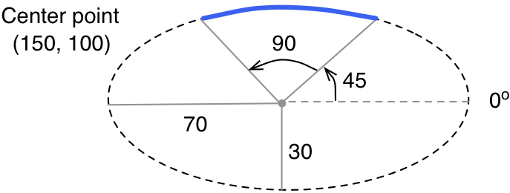
Arcs
An arc whose underlying ellipse is centered at (150, 100), a horizontal radius of 70 and a vertical radius of 30, a start angle of 45 and a arc length of 90:
Arc myArc = new Arc(150, 100, 70, 30, 45, 90);

Slide 67
Arcs
An arc also has an arc type:
See ArcDisplay.java
ArcType.OPEN | The curve along the ellipse edge
ArcType.CHORD | End points are connected by a straight line
ArcType.ROUND | End points are connected to the center point of the ellipse, forming a rounded “pie” piece

Slide 68
import javafx.application.Application;
import javafx.scene.Scene;
import javafx.scene.Group;
import javafx.scene.paint.Color;
import javafx.scene.shape.Arc;
import javafx.scene.shape.ArcType;
import javafx.scene.shape.Ellipse;
import javafx.stage.Stage;
//************************************************************************
// ArcDisplay.java Author: Lewis/Loftus
//
// Demonstrates the use of the JavaFX Arc class.
//************************************************************************
public class ArcDisplay extends Application
{
//--------------------------------------------------------------------
// Draws three arcs based on the same underlying ellipse.
//--------------------------------------------------------------------
public void start(Stage primaryStage)
{
Ellipse backgroundEllipse = new Ellipse(250, 150, 170, 100);
backgroundEllipse.setFill(null);
backgroundEllipse.setStroke(Color.GRAY);
backgroundEllipse.getStrokeDashArray().addAll(5.0, 5.0);
continue

Slide 69
continue
Arc arc1 = new Arc(250, 150, 170, 100, 90, 90);
arc1.setType(ArcType.OPEN);
arc1.setStroke(Color.RED);
arc1.setFill(null);
Arc arc2 = new Arc(250, 150, 170, 100, 20, 50);
arc2.setType(ArcType.ROUND);
arc2.setStroke(Color.GREEN);
arc2.setFill(Color.GREEN);
Arc arc3 = new Arc(250, 150, 170, 100, 230, 130);
arc3.setType(ArcType.CHORD);
arc3.setStroke(Color.BLUE);
arc3.setFill(null);
Group root = new Group(backgroundEllipse, arc1, arc2, arc3);
Scene scene = new Scene(root, 500, 300, Color.LIGHTYELLOW);
primaryStage.setTitle("Arc Display");
primaryStage.setScene(scene);
primaryStage.show();
}
}

Slide 70
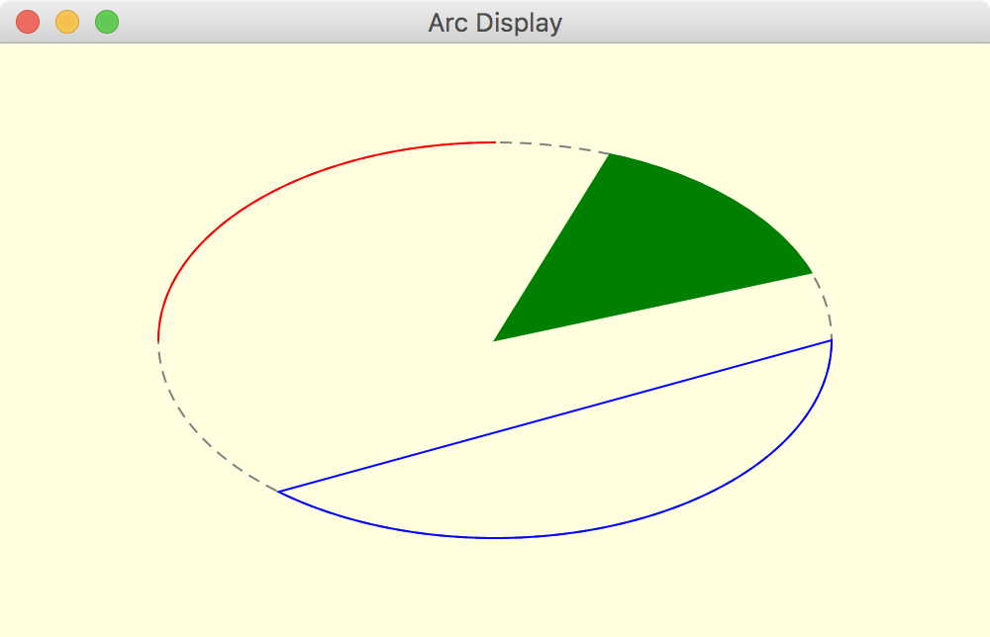
continue
Arc arc1 = new Arc(250, 150, 170, 100, 90, 90);
arc1.setType(ArcType.OPEN);
arc1.setStroke(Color.RED);
arc1.setFill(null);
Arc arc2 = new Arc(250, 150, 170, 100, 20, 50);
arc2.setType(ArcType.ROUND);
arc2.setStroke(Color.GREEN);
arc2.setFill(Color.GREEN);
Arc arc3 = new Arc(250, 150, 170, 100, 230, 130);
arc3.setType(ArcType.CHORD);
arc3.setStroke(Color.BLUE);
arc3.setFill(null);
Group root = new Group(backgroundEllipse, arc1, arc2, arc3);
Scene scene = new Scene(root, 500, 300, Color.LIGHTYELLOW);
primaryStage.setTitle("Arc Display");
primaryStage.setScene(scene);
primaryStage.show();
}
}

Slide 71
Outline
Anatomy of a Class
Encapsulation
Anatomy of a Method
Arcs
Images
Graphical User Interfaces
Text Fields

Slide 72
Images
The JavaFX Image class is used to load an image from a file or URL
Supported formats: jpeg, gif, and png
To display an image, use an ImageView object
An Image object cannot be added to a container directly
See ImageDisplay.java

Slide 73
import javafx.application.Application;
import javafx.geometry.Rectangle2D;
import javafx.scene.Scene;
import javafx.scene.image.Image;
import javafx.scene.image.ImageView;
import javafx.scene.layout.StackPane;
import javafx.stage.Stage;
//************************************************************************
// ImageDisplay.java Author: Lewis/Loftus
//
// Demonstrates a the use of Image and ImageView objects.
//************************************************************************
public class ImageDisplay extends Application
{
//--------------------------------------------------------------------
// Displays an image centered in a window.
//--------------------------------------------------------------------
public void start(Stage primaryStage)
{
Image img = new Image("gull.jpg");
ImageView imgView = new ImageView(img);
StackPane pane = new StackPane(imgView);
pane.setStyle("-fx-background-color: cornsilk");
continue

Slide 74
continue
Scene scene = new Scene(pane, 500, 350);
primaryStage.setTitle("Image Display");
primaryStage.setScene(scene);
primaryStage.show();
}
}

Slide 75
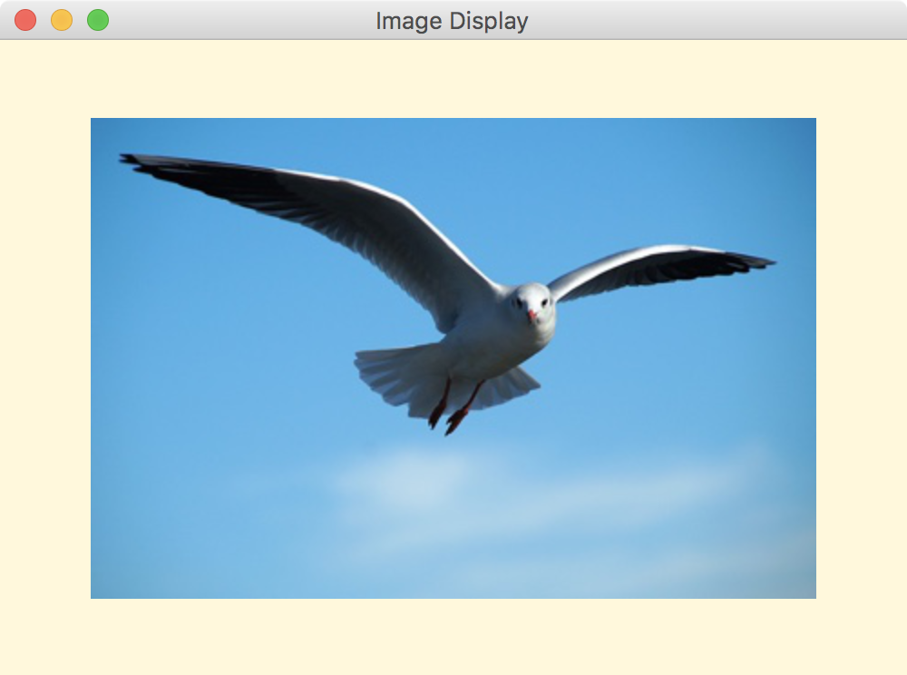
continue
Scene scene = new Scene(pane, 500, 350);
primaryStage.setTitle("Image Display");
primaryStage.setScene(scene);
primaryStage.show();
}
}

Slide 76
Layout Panes
This example uses a StackPane instead of a Group as the root node of the scene
A stack pane is a JavaFX layout pane (one of several), which governs how its contents are presented
A stack pane stacks its nodes on top of each other
Since the image view is the only node in the pane, the stack pane simply serves to keep the image centered in the window

Slide 77
Layout Panes
The background color of a layout pane is set using a call to the setStyle method
The setStyle method accepts a string that can specify various style properties
The notation used for JavaFX style properties are similar to cascading style sheets (CSS), used to specify the look of HTML elements on a Web page
JavaFX style property names begin with the prefix “-fx-”

Slide 78
Images
The parameter to the Image constructor can include a pathname:
Image logo = new Image("myPix/smallLogo.png");
It can also be a URL:
Image logo = new Image("http://example.com/images/bio.jpg");

Slide 79
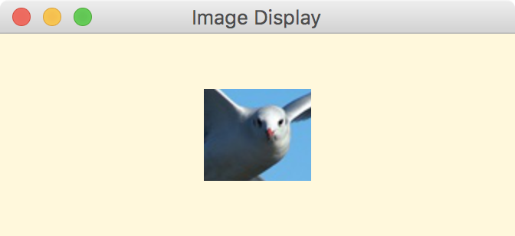
Viewports
A viewport is a rectangular area that restricts the pixels displayed in an ImageView
It is defined by a Rectangle2D object:
imgView.setViewport(new Rectangle2D(200, 80, 70, 60));

Slide 80
Outline
Anatomy of a Class
Encapsulation
Anatomy of a Method
Arcs
Images
Graphical User Interfaces
Text Fields

Slide 81
Graphical User Interfaces
A Graphical User Interface (GUI) in Java is created with at least three kinds of objects:
controls, events, and event handlers
A control is a screen element that displays information or allows the user to interact with the program:
labels, buttons, text fields, sliders, etc.

Slide 82
Graphical User Interfaces
An event is an object that represents some activity to which we may want to respond
For example, we may want our program to perform some action when the following occurs:
a graphical button is pressed
a slider is dragged
the mouse is moved
the mouse is dragged
the mouse button is clicked
a keyboard key is pressed

Slide 83
Graphical User Interfaces
The Java API contains several classes that represent typical events
Controls, such as a button, generate (or fire) an event when it occurs
We set up an event handler object to respond to an event when it occurs
We design event handlers to take whatever actions are appropriate when an event occurs

Slide 84
Graphical User Interfaces
Event
Control
Event
Handler
A control object
generates an event
A corresponding event handler
is designed to respond
to the event
When the event occurs, the control calls
the appropriate method of the listener,
passing an object that describes the event

Slide 85
Graphical User Interfaces
A JavaFX button is defined by the Button class
It generates an action event
The PushCounter example displays a button that increments a counter each time it is pushed
See PushCounter.java

Slide 86
import javafx.application.Application;
import javafx.event.ActionEvent;
import javafx.geometry.Pos;
import javafx.scene.Scene;
import javafx.scene.control.Button;
import javafx.scene.text.Text;
import javafx.scene.layout.FlowPane;
import javafx.stage.Stage;
//************************************************************************
// PushCounter.java Author: Lewis/Loftus
//
// Demonstrates JavaFX buttons and event handlers.
//************************************************************************
public class PushCounter extends Application
{
private int count;
private Text countText;
continue

Slide 87
continue
//--------------------------------------------------------------------
// Presents a GUI containing a button and text that displays
// how many times the button is pushed.
//--------------------------------------------------------------------
public void start(Stage primaryStage)
{
count = 0;
countText = new Text("Pushes: 0");
Button push = new Button("Push Me!");
push.setOnAction(this::processButtonPress);
FlowPane pane = new FlowPane(push, countText);
pane.setAlignment(Pos.CENTER);
pane.setHgap(20);
pane.setStyle("-fx-background-color: cyan");
Scene scene = new Scene(pane, 300, 100);
primaryStage.setTitle("Push Counter");
primaryStage.setScene(scene);
primaryStage.show();
}
continue

Slide 88
continue
//--------------------------------------------------------------------
// Updates the counter and text when the button is pushed.
//--------------------------------------------------------------------
public void processButtonPress(ActionEvent event)
{
count++;
countText.setText("Pushes: " + count);
}
}

Slide 89
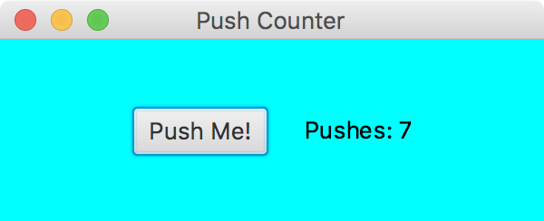
continue
//--------------------------------------------------------------------
// Updates the counter and text when the button is pushed.
//--------------------------------------------------------------------
public void processButtonPress(ActionEvent event)
{
count++;
countText.setText("Pushes: " + count);
}
}

Slide 90
Graphical User Interfaces
A call to the setOnAction method sets up the relationship between the button that generates the event and the event handler that responds to it
This example uses a method reference (using the :: operator) to specify the event handler method
The this reference indicates that the event handler method is in the same class
So the PushCounter class also represents the event handler for this program

Slide 91
Graphical User Interfaces
The event handler method can be called whatever you want, but must accept an ActionEvent object as a parmeter
In this example, the event handler method increments the counter and updates the text object
The counter and Text object are declared at the class level so that both methods can use them

Slide 92
Graphical User Interfaces
In this example, a FlowPane is used as the root node of the scene
A flow pane is another layout pane, which displays its contents horizontally in rows or vertically in columns
A gap of 20 pixels is established between elements on a row using the setHGap method

Slide 93
Alternate Event Handlers
Instead of using a method reference, the event handler could be specified using a separate class that implements the EventHandler interface:
public class ButtonHandler implements EventHandler<ActionEvent>
{
public void handle(ActionEvent event)
{
count++;
countText.setText("Pushes: " + count);
}
}

Slide 94
Alternate Event Handlers
The event handler class could be defined as public in a separate file or as a private inner class in the same file
Either way, the call to the setOnAction method would specify a new event handler object:
push.setOnAction(new ButtonHandler());

Slide 95
Alternate Event Handlers
Another approach would be to define the event handler using a lambda expression in the call to setOnAction:
push.setOnAction((event) -> {
count++;
countText.setText("Pushes: " + count);
});
A lambda expression is defined by a set of parameters, the -> operator and an expression

Slide 96
Alternate Event Handlers
A lambda expression can be used whenever an object of a functional interface is required
A functional interface contains a single method
The EventHandler interface is a functional interface
The method reference approach is equivalent to a lambda expression

Slide 97
Outline
Anatomy of a Class
Encapsulation
Anatomy of a Method
Arcs
Images
Graphical User Interfaces
Text Fields

Slide 98
Text Fields
Let's look at a GUI example that uses another type of control
A text field allows the user to enter one line of input
If the cursor is in the text field, the text field object generates an action event when the enter key is pressed
See FahrenheitConverter.java
See FahrenheitPane.java

Slide 99
import javafx.application.Application;
import javafx.scene.Scene;
import javafx.stage.Stage;
//************************************************************************
// FahrenheitConverter.java Author: Lewis/Loftus
//
// Demonstrates the use of a TextField and a GridPane.
//************************************************************************
public class FahrenheitConverter extends Application
{
//--------------------------------------------------------------------
// Launches the temperature converter application.
//--------------------------------------------------------------------
public void start(Stage primaryStage)
{
Scene scene = new Scene(new FahrenheitPane(), 300, 150);
primaryStage.setTitle("Fahrenheit Converter");
primaryStage.setScene(scene);
primaryStage.show();
}
}

Slide 100
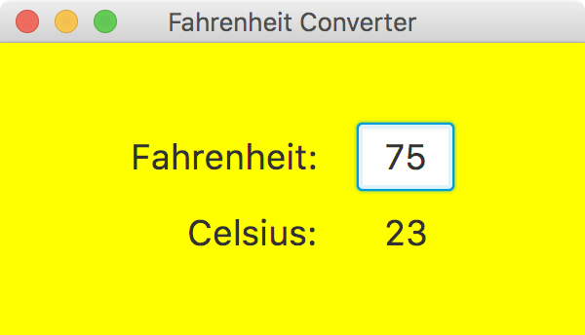
import javafx.application.Application;
import javafx.scene.Scene;
import javafx.stage.Stage;
//************************************************************************
// FahrenheitConverter.java Author: Lewis/Loftus
//
// Demonstrates the use of a TextField and a GridPane.
//************************************************************************
public class FahrenheitConverter extends Application
{
//--------------------------------------------------------------------
// Launches the temperature converter application.
//--------------------------------------------------------------------
public void start(Stage primaryStage)
{
Scene scene = new Scene(new FahrenheitPane(), 300, 150);
primaryStage.setTitle("Fahrenheit Converter");
primaryStage.setScene(scene);
primaryStage.show();
}
}

Slide 101
Text Fields
The details of the user interface are set up in a separate class that extends GridPane
GridPane is a JavaFX layout pane that displays nodes in a rectangular grid
The GUI elements are set up in the constructor of FahrenheitPane
The event handler method is also defined in FahrenheitPane

Slide 102
import javafx.event.ActionEvent;
import javafx.geometry.HPos;
import javafx.geometry.Pos;
import javafx.scene.control.Label;
import javafx.scene.control.TextField;
import javafx.scene.layout.GridPane;
import javafx.scene.text.Font;
//************************************************************************
// FahrenheitPane.java Author: Lewis/Loftus
//
// Demonstrates the use of a TextField and a GridPane.
//************************************************************************
public class FahrenheitPane extends GridPane
{
private Label result;
private TextField fahrenheit;
continue

Slide 103
continue
//--------------------------------------------------------------------
// Sets up a GUI containing a labeled text field for converting
// temperatures in Fahrenheit to Celsius.
//--------------------------------------------------------------------
public FahrenheitPane()
{
Font font = new Font(18);
Label inputLabel = new Label("Fahrenheit:");
inputLabel.setFont(font);
GridPane.setHalignment(inputLabel, HPos.RIGHT);
Label outputLabel = new Label("Celsius:");
outputLabel.setFont(font);
GridPane.setHalignment(outputLabel, HPos.RIGHT);
result = new Label("---");
result.setFont(font);
GridPane.setHalignment(result, HPos.CENTER);
continue

Slide 104
continue
fahrenheit = new TextField();
fahrenheit.setFont(font);
fahrenheit.setPrefWidth(50);
fahrenheit.setAlignment(Pos.CENTER);
fahrenheit.setOnAction(this::processReturn);
setAlignment(Pos.CENTER);
setHgap(20);
setVgap(10);
setStyle("-fx-background-color: yellow");
add(inputLabel, 0, 0);
add(fahrenheit, 1, 0);
add(outputLabel, 0, 1);
add(result, 1, 1);
}
continue

Slide 105
continue
//--------------------------------------------------------------------
// Computes and displays the converted temperature when the user
// presses the return key while in the text field.
//--------------------------------------------------------------------
public void processReturn(ActionEvent event)
{
int fahrenheitTemp = Integer.parseInt(fahrenheit.getText());
int celsiusTemp = (fahrenheitTemp - 32) * 5 / 9;
result.setText(celsiusTemp + "");
}
}

Slide 106
Text Fields
Through inheritance, a FahrenheitPane is a GridPane and inherits the add method
The parameters to add specify the grid cell to which to add the node
Row and column numbering in a grid pane start at 0
When the user presses return, the event handler method is called, which converts the value and updates the text result

Slide 107
Summary
Chapter 4 focused on:
class definitions
instance data
encapsulation and Java modifiers
method declaration and parameter passing
constructors
arcs and images
events and event handlers
buttons and text fields

