Slide 1

Chapter 5 Conditionals and Loops
Java Software Solutions
Foundations of Program Design
9th Edition
John Lewis
William Loftus

Slide 2
Conditionals and Loops
Now we will examine programming statements that allow us to:
make decisions
repeat processing steps in a loop
Chapter 5 focuses on:
boolean expressions
the if and if-else statements
comparing data
while loops
iterators
the ArrayList class
more GUI controls

Slide 3
Outline
Boolean Expressions
The if Statement
Comparing Data
The while Statement
Iterators
The ArrayList Class
Determining Event Sources
Managing Fonts
Check Boxes and Radio Buttons

Slide 4
Flow of Control
Unless specified otherwise, the order of statement execution through a method is linear: one after another
Some programming statements allow us to make decisions and perform repetitions
These decisions are based on boolean expressions (also called conditions) that evaluate to true or false
The order of statement execution is called the flow of control

Slide 5
Conditional Statements
A conditional statement lets us choose which statement will be executed next
They are sometimes called selection statements
Conditional statements give us the power to make basic decisions
The Java conditional statements are the:
if and if-else statement
switch statement
We'll explore the switch statement in Chapter 6

Slide 6
Boolean Expressions
A condition often uses one of Java's equality operators or relational operators, which all return boolean results:
== equal to
!= not equal to
< less than
> greater than
<= less than or equal to
>= greater than or equal to
Note the difference between the equality operator (==) and the assignment operator (=)

Slide 7
Boolean Expressions
An if statement with its boolean condition:
if (sum > MAX)
delta = sum – MAX;
First, the condition is evaluated: the value of sum is either greater than the value of MAX, or it is not
If the condition is true, the assignment statement is executed; if it isn't, it is skipped
See Age.java

Slide 8
//********************************************************************
// Age.java Author: Lewis/Loftus
//
// Demonstrates the use of an if statement.
//********************************************************************
import java.util.Scanner;
public class Age
{
//-----------------------------------------------------------------
// Reads the user's age and prints comments accordingly.
//-----------------------------------------------------------------
public static void main(String[] args)
{
final int MINOR = 21;
Scanner scan = new Scanner(System.in);
System.out.print("Enter your age: ");
int age = scan.nextInt();
continue

Slide 9
continue
System.out.println("You entered: " + age);
if (age < MINOR)
System.out.println("Youth is a wonderful thing. Enjoy.");
System.out.println("Age is a state of mind.");
}
}

Slide 10
Sample Run
Enter your age: 47
You entered: 47
Age is a state of mind.
continue
System.out.println("You entered: " + age);
if (age < MINOR)
System.out.println("Youth is a wonderful thing. Enjoy.");
System.out.println("Age is a state of mind.");
}
}
Another Sample Run
Enter your age: 12
You entered: 12
Youth is a wonderful thing. Enjoy.
Age is a state of mind.

Slide 11
Logical Operators
Boolean expressions can also use the following logical operators:
! Logical NOT
&& Logical AND
|| Logical OR
They all take boolean operands and produce boolean results
Logical NOT is a unary operator (it operates on one operand)
Logical AND and logical OR are binary operators (each operates on two operands)

Slide 12
Logical NOT
The logical NOT operation is also called logical negation or logical complement
If some boolean condition a is true, then !a is false; if a is false, then !a is true
Logical expressions can be shown using a truth table:
a | !a
true | false
false | true

Slide 13
Logical AND and Logical OR
The logical AND expression
a && b
is true if both a and b are true, and false otherwise
The logical OR expression
a || b
is true if a or b or both are true, and false otherwise

Slide 14
Logical AND and Logical OR
A truth table shows all possible true-false combinations of the terms
Since && and || each have two operands, there are four possible combinations of a and b
a | b | a && b | a || b
true | true | true | true
true | false | false | true
false | true | false | true
false | false | false | false

Slide 15
Logical Operators
Expressions that use logical operators can form complex conditions
if (total < MAX+5 && !found)
System.out.println("Processing…");
All logical operators have lower precedence than the relational operators
The ! operator has higher precedence than && and ||

Slide 16
Boolean Expressions
Specific expressions can be evaluated using truth tables
total < MAX | found | !found | total < MAX && !found
false | false | true | false
false | true | false | false
true | false | true | true
true | true | false | false

Slide 17
Short-Circuited Operators
The processing of && and || is “short-circuited”
If the left operand is sufficient to determine the result, the right operand is not evaluated
if (count != 0 && total/count > MAX)
System.out.println("Testing.");
This type of processing should be used carefully

Slide 18
Outline
Boolean Expressions
The if Statement
Comparing Data
The while Statement
Iterators
The ArrayList Class
Determining Event Sources
Managing Fonts
Check Boxes and Radio Buttons

Slide 19
The if Statement
Let's now look at the if statement in more detail
The if statement has the following syntax:
The condition must be a
boolean expression. It must
evaluate to either true or false.
if is a Java
reserved word
if ( condition )
statement;
If the condition is true, the statement is executed.
If it is false, the statement is skipped.

Slide 20
Logic of an if statement
condition
evaluated
true
false
statement

Slide 21
Indentation
The statement controlled by the if statement is indented to indicate that relationship
The use of a consistent indentation style makes a program easier to read and understand
The compiler ignores indentation, which can lead to errors if the indentation is not correct
"Always code as if the person who ends up maintaining your code will be a violent psychopath who knows where you live."
-- Martin Golding

Slide 22
Quick Check
What do the following statements do?
if (total != stock + warehouse)
inventoryError = true;
if (found || !done)
System.out.println("Ok");

Slide 23
Quick Check
What do the following statements do?
if (total != stock + warehouse)
inventoryError = true;
Sets the boolean variable to true if the value of total
is not equal to the sum of stock and warehouse
if (found || !done)
System.out.println("Ok");
Prints "Ok" if found is true or done is false

Slide 24
The if-else Statement
An else clause can be added to an if statement to make an if-else statement
if ( condition )
statement1;
else
statement2;
If the condition is true, statement1 is executed; if the condition is false, statement2 is executed
One or the other will be executed, but not both
See Wages.java

Slide 25
//********************************************************************
// Wages.java Author: Lewis/Loftus
//
// Demonstrates the use of an if-else statement.
//********************************************************************
import java.text.NumberFormat;
import java.util.Scanner;
public class Wages
{
//-----------------------------------------------------------------
// Reads the number of hours worked and calculates wages.
//-----------------------------------------------------------------
public static void main(String[] args)
{
final double RATE = 8.25; // regular pay rate
final int STANDARD = 40; // standard hours in a work week
Scanner scan = new Scanner(System.in);
double pay = 0.0;
continue

Slide 26
continue
System.out.print("Enter the number of hours worked: ");
int hours = scan.nextInt();
System.out.println();
// Pay overtime at "time and a half"
if (hours > STANDARD)
pay = STANDARD * RATE + (hours-STANDARD) * (RATE * 1.5);
else
pay = hours * RATE;
NumberFormat fmt = NumberFormat.getCurrencyInstance();
System.out.println("Gross earnings: " + fmt.format(pay));
}
}

Slide 27
Sample Run
Enter the number of hours worked: 46
Gross earnings: $404.25
continue
System.out.print("Enter the number of hours worked: ");
int hours = scan.nextInt();
System.out.println();
// Pay overtime at "time and a half"
if (hours > STANDARD)
pay = STANDARD * RATE + (hours-STANDARD) * (RATE * 1.5);
else
pay = hours * RATE;
NumberFormat fmt = NumberFormat.getCurrencyInstance();
System.out.println("Gross earnings: " + fmt.format(pay));
}
}

Slide 28
Logic of an if-else statement
condition
evaluated
true
false
statement1
statement2

Slide 29
The Coin Class
Let's look at an example that uses a class that represents a coin that can be flipped
Instance data is used to indicate which face (heads or tails) is currently showing
See CoinFlip.java
See Coin.java

Slide 30
//********************************************************************
// CoinFlip.java Author: Lewis/Loftus
//
// Demonstrates the use of an if-else statement.
//********************************************************************
public class CoinFlip
{
//-----------------------------------------------------------------
// Creates a Coin object, flips it, and prints the results.
//-----------------------------------------------------------------
public static void main(String[] args)
{
Coin myCoin = new Coin();
myCoin.flip();
System.out.println(myCoin);
if (myCoin.isHeads())
System.out.println("You win.");
else
System.out.println("Better luck next time.");
}
}

Slide 31
Sample Run
Tails
Better luck next time.
//********************************************************************
// CoinFlip.java Author: Lewis/Loftus
//
// Demonstrates the use of an if-else statement.
//********************************************************************
public class CoinFlip
{
//-----------------------------------------------------------------
// Creates a Coin object, flips it, and prints the results.
//-----------------------------------------------------------------
public static void main(String[] args)
{
Coin myCoin = new Coin();
myCoin.flip();
System.out.println(myCoin);
if (myCoin.isHeads())
System.out.println("You win.");
else
System.out.println("Better luck next time.");
}
}

Slide 32
//********************************************************************
// Coin.java Author: Lewis/Loftus
//
// Represents a coin with two sides that can be flipped.
//********************************************************************
public class Coin
{
private final int HEADS = 0;
private final int TAILS = 1;
private int face;
//-----------------------------------------------------------------
// Sets up the coin by flipping it initially.
//-----------------------------------------------------------------
public Coin()
{
flip();
}
continue

Slide 33
continue
//-----------------------------------------------------------------
// Flips the coin by randomly choosing a face value.
//-----------------------------------------------------------------
public void flip()
{
face = (int) (Math.random() * 2);
}
//-----------------------------------------------------------------
// Returns true if the current face of the coin is heads.
//-----------------------------------------------------------------
public boolean isHeads()
{
return (face == HEADS);
}
continue

Slide 34
continue
//-----------------------------------------------------------------
// Returns the current face of the coin as a string.
//-----------------------------------------------------------------
public String toString()
{
String faceName;
if (face == HEADS)
faceName = "Heads";
else
faceName = "Tails";
return faceName;
}
}

Slide 35
Indentation Revisited
Remember that indentation is for the human reader, and is ignored by the compiler
if (depth >= UPPER_LIMIT)
delta = 100;
else
System.out.println("Reseting Delta");
delta = 0;
Despite what the indentation implies, delta will be set to 0 no matter what

Slide 36
Block Statements
Several statements can be grouped together into a block statement delimited by braces
A block statement can be used wherever a statement is called for in the Java syntax rules
if (total > MAX)
{
System.out.println("Error!!");
errorCount++;
}

Slide 37
Block Statements
The if clause, or the else clause, or both, could govern block statements
See Guessing.java
if (total > MAX)
{
System.out.println("Error!!");
errorCount++;
}
else
{
System.out.println("Total: " + total);
current = total*2;
}

Slide 38
//********************************************************************
// Guessing.java Author: Lewis/Loftus
//
// Demonstrates the use of a block statement in an if-else.
//********************************************************************
import java.util.*;
public class Guessing
{
//-----------------------------------------------------------------
// Plays a simple guessing game with the user.
//-----------------------------------------------------------------
public static void main(String[] args)
{
final int MAX = 10;
int answer, guess;
Scanner scan = new Scanner(System.in);
Random generator = new Random();
answer = generator.nextInt(MAX) + 1;
continue

Slide 39
continue
System.out.print("I'm thinking of a number between 1 and "
+ MAX + ". Guess what it is: ");
guess = scan.nextInt();
if (guess == answer)
System.out.println("You got it! Good guessing!");
else
{
System.out.println("That is not correct, sorry.");
System.out.println("The number was " + answer);
}
}
}

Slide 40
Sample Run
I'm thinking of a number between 1 and 10. Guess what it is: 6
That is not correct, sorry.
The number was 9
continue
System.out.print("I'm thinking of a number between 1 and "
+ MAX + ". Guess what it is: ");
guess = scan.nextInt();
if (guess == answer)
System.out.println("You got it! Good guessing!");
else
{
System.out.println("That is not correct, sorry.");
System.out.println("The number was " + answer);
}
}
}

Slide 41
Nested if Statements
The statement executed as a result of an if or else clause could be another if statement
These are called nested if statements
An else clause is matched to the last unmatched if (no matter what the indentation implies)
Braces can be used to specify the if statement to which an else clause belongs
See MinOfThree.java

Slide 42
//********************************************************************
// MinOfThree.java Author: Lewis/Loftus
//
// Demonstrates the use of nested if statements.
//********************************************************************
import java.util.Scanner;
public class MinOfThree
{
//-----------------------------------------------------------------
// Reads three integers from the user and determines the smallest
// value.
//-----------------------------------------------------------------
public static void main(String[] args)
{
int num1, num2, num3, min = 0;
Scanner scan = new Scanner(System.in);
System.out.println("Enter three integers: ");
num1 = scan.nextInt();
num2 = scan.nextInt();
num3 = scan.nextInt();
continue

Slide 43
continue
if (num1 < num2)
if (num1 < num3)
min = num1;
else
min = num3;
else
if (num2 < num3)
min = num2;
else
min = num3;
System.out.println("Minimum value: " + min);
}
}

Slide 44
Sample Run
Enter three integers:
84 69 90
Minimum value: 69
continue
if (num1 < num2)
if (num1 < num3)
min = num1;
else
min = num3;
else
if (num2 < num3)
min = num2;
else
min = num3;
System.out.println("Minimum value: " + min);
}
}

Slide 45
Outline
Boolean Expressions
The if Statement
Comparing Data
The while Statement
Iterators
The ArrayList Class
Determining Event Sources
Managing Fonts
Check Boxes and Radio Buttons

Slide 46
Comparing Data
When comparing data using boolean expressions, it's important to understand the nuances of certain data types
Let's examine some key situations:
Comparing floating point values for equality
Comparing characters
Comparing strings (alphabetical order)
Comparing object vs. comparing object references

Slide 47
Comparing Float Values
You should rarely use the equality operator (==) when comparing two floating point values (float or double)
Two floating point values are equal only if their underlying binary representations match exactly
Computations often result in slight differences that may be irrelevant
In many situations, you might consider two floating point numbers to be "close enough" even if they aren't exactly equal

Slide 48
Comparing Float Values
To determine the equality of two floats, use the following technique:
if (Math.abs(f1 - f2) < TOLERANCE)
System.out.println("Essentially equal");
If the difference between the two floating point values is less than the tolerance, they are considered to be equal
The tolerance could be set to any appropriate level, such as 0.000001

Slide 49
Comparing Characters
As we've discussed, Java character data is based on the Unicode character set
Unicode establishes a particular numeric value for each character, and therefore an ordering
We can use relational operators on character data based on this ordering
For example, the character '+' is less than the character 'J' because it comes before it in the Unicode character set
Appendix C provides an overview of Unicode

Slide 50
Comparing Characters
In Unicode, the digit characters (0-9) are contiguous and in order
Likewise, the uppercase letters (A-Z) and lowercase letters (a-z) are contiguous and in order
Characters | Unicode Values
0 – 9 | 48 through 57
A – Z | 65 through 90
a – z | 97 through 122

Slide 51
Comparing Strings
Remember that in Java a character string is an object
The equals method can be called with strings to determine if two strings contain exactly the same characters in the same order
The equals method returns a boolean result
if (name1.equals(name2))
System.out.println("Same name");

Slide 52
Comparing Strings
We cannot use the relational operators to compare strings
The String class contains the compareTo method for determining if one string comes before another
A call to name1.compareTo(name2)
returns zero if name1 and name2 are equal (contain the same characters)
returns a negative value if name1 is less than name2
returns a positive value if name1 is greater than name2

Slide 53
Comparing Strings
Because comparing characters and strings is based on a character set, it is called a lexicographic ordering
int result = name1.comareTo(name2);
if (result < 0)
System.out.println(name1 + "comes first");
else
if (result == 0)
System.out.println("Same name");
else
System.out.println(name2 + "comes first");

Slide 54
Lexicographic Ordering
Lexicographic ordering is not strictly alphabetical when uppercase and lowercase characters are mixed
For example, the string "Great" comes before the string "fantastic" because all of the uppercase letters come before all of the lowercase letters in Unicode
Also, short strings come before longer strings with the same prefix (lexicographically)
Therefore "book" comes before "bookcase"

Slide 55
Comparing Objects
The == operator can be applied to objects – it returns true if the two references are aliases of each other
The equals method is defined for all objects, but unless we redefine it when we write a class, it has the same semantics as the == operator
It has been redefined in the String class to compare the characters in the two strings
When you write a class, you can redefine the equals method to return true under whatever conditions are appropriate

Slide 56
Outline
Boolean Expressions
The if Statement
Comparing Data
The while Statement
Iterators
The ArrayList Class
Determining Event Sources
Managing Fonts
Check Boxes and Radio Buttons

Slide 57
Repetition Statements
Repetition statements allow us to execute a statement multiple times
Often they are referred to as loops
Like conditional statements, they are controlled by boolean expressions
Java has three kinds of repetition statements: while, do, and for loops
The do and for loops are discussed in Chapter 6

Slide 58
The while Statement
A while statement has the following syntax:
while ( condition )
statement;
If the condition is true, the statement is executed
Then the condition is evaluated again, and if it is still true, the statement is executed again
The statement is executed repeatedly until the condition becomes false

Slide 59
Logic of a while Loop
condition
evaluated
false
true
statement

Slide 60
The while Statement
An example of a while statement:
If the condition of a while loop is false initially, the statement is never executed
Therefore, the body of a while loop will execute zero or more times
int count = 1;
while (count <= 5)
{
System.out.println(count);
count++;
}

Slide 61
Sentinel Values
Let's look at some examples of loop processing
A loop can be used to maintain a running sum
A sentinel value is a special input value that represents the end of input
See Average.java

Slide 62
//********************************************************************
// Average.java Author: Lewis/Loftus
//
// Demonstrates the use of a while loop, a sentinel value, and a
// running sum.
//********************************************************************
import java.text.DecimalFormat;
import java.util.Scanner;
public class Average
{
//-----------------------------------------------------------------
// Computes the average of a set of values entered by the user.
// The running sum is printed as the numbers are entered.
//-----------------------------------------------------------------
public static void main(String[] args)
{
int sum = 0, value, count = 0;
double average;
Scanner scan = new Scanner(System.in);
System.out.print("Enter an integer (0 to quit): ");
value = scan.nextInt();
continue

Slide 63
continue
while (value != 0) // sentinel value of 0 to terminate loop
{
count++;
sum += value;
System.out.println("The sum so far is " + sum);
System.out.print("Enter an integer (0 to quit): ");
value = scan.nextInt();
}
continue

Slide 64
continue
System.out.println();
if (count == 0)
System.out.println("No values were entered.");
else
{
average = (double)sum / count;
DecimalFormat fmt = new DecimalFormat("0.###");
System.out.println("The average is " + fmt.format(average));
}
}
}

Slide 65
Sample Run
Enter an integer (0 to quit): 25
The sum so far is 25
Enter an integer (0 to quit): 164
The sum so far is 189
Enter an integer (0 to quit): -14
The sum so far is 175
Enter an integer (0 to quit): 84
The sum so far is 259
Enter an integer (0 to quit): 12
The sum so far is 271
Enter an integer (0 to quit): -35
The sum so far is 236
Enter an integer (0 to quit): 0
The average is 39.333
continue
System.out.println();
if (count == 0)
System.out.println("No values were entered.");
else
{
average = (double)sum / count;
DecimalFormat fmt = new DecimalFormat ("0.###");
System.out.println("The average is " + fmt.format(average));
}
}
}

Slide 66
Input Validation
A loop can also be used for input validation, making a program more robust
It's generally a good idea to verify that input is valid (in whatever sense) when possible
See WinPercentage.java

Slide 67
//********************************************************************
// WinPercentage.java Author: Lewis/Loftus
//
// Demonstrates the use of a while loop for input validation.
//********************************************************************
import java.text.NumberFormat;
import java.util.Scanner;
public class WinPercentage
{
//-----------------------------------------------------------------
// Computes the percentage of games won by a team.
//-----------------------------------------------------------------
public static void main(String[] args)
{
final int NUM_GAMES = 12;
int won;
double ratio;
Scanner scan = new Scanner(System.in);
System.out.print("Enter the number of games won (0 to "
+ NUM_GAMES + "): ");
won = scan.nextInt();
continue

Slide 68
continue
while (won < 0 || won > NUM_GAMES)
{
System.out.print("Invalid input. Please reenter: ");
won = scan.nextInt();
}
ratio = (double)won / NUM_GAMES;
NumberFormat fmt = NumberFormat.getPercentInstance();
System.out.println();
System.out.println("Winning percentage: " + fmt.format(ratio));
}
}

Slide 69
Sample Run
Enter the number of games won (0 to 12): -5
Invalid input. Please reenter: 13
Invalid input. Please reenter: 7
Winning percentage: 58%
continue
while (won < 0 || won > NUM_GAMES)
{
System.out.print("Invalid input. Please reenter: ");
won = scan.nextInt();
}
ratio = (double)won / NUM_GAMES;
NumberFormat fmt = NumberFormat.getPercentInstance();
System.out.println();
System.out.println("Winning percentage: " + fmt.format(ratio));
}
}

Slide 70
Infinite Loops
The body of a while loop eventually must make the condition false
If not, it is called an infinite loop, which will execute until the user interrupts the program
This is a common logical error
You should always double check the logic of a program to ensure that your loops will terminate normally

Slide 71
Infinite Loops
An example of an infinite loop:
This loop will continue executing until interrupted (Control-C) or until an underflow error occurs
int count = 1;
while (count <= 25)
{
System.out.println(count);
count = count - 1;
}

Slide 72
Nested Loops
Similar to nested if statements, loops can be nested as well
That is, the body of a loop can contain another loop
For each iteration of the outer loop, the inner loop iterates completely
See PalindromeTester.java

Slide 73
//********************************************************************
// PalindromeTester.java Author: Lewis/Loftus
//
// Demonstrates the use of nested while loops.
//********************************************************************
import java.util.Scanner;
public class PalindromeTester
{
//-----------------------------------------------------------------
// Tests strings to see if they are palindromes.
//-----------------------------------------------------------------
public static void main(String[] args)
{
String str, another = "y";
int left, right;
Scanner scan = new Scanner(System.in);
while (another.equalsIgnoreCase("y")) // allows y or Y
{
System.out.println("Enter a potential palindrome:");
str = scan.nextLine();
left = 0;
right = str.length() - 1;
continue

Slide 74
continue
while (str.charAt(left) == str.charAt(right) && left < right)
{
left++;
right--;
}
System.out.println();
if (left < right)
System.out.println("That string is NOT a palindrome.");
else
System.out.println("That string IS a palindrome.");
System.out.println();
System.out.print("Test another palindrome (y/n)? ");
another = scan.nextLine();
}
}
}

Slide 75
Sample Run
Enter a potential palindrome:
radar
That string IS a palindrome.
Test another palindrome (y/n)? y
Enter a potential palindrome:
able was I ere I saw elba
That string IS a palindrome.
Test another palindrome (y/n)? y
Enter a potential palindrome:
abracadabra
That string is NOT a palindrome.
Test another palindrome (y/n)? n
continue
while (str.charAt(left) == str.charAt(right) && left < right)
{
left++;
right--;
}
System.out.println();
if (left < right)
System.out.println("That string is NOT a palindrome.");
else
System.out.println("That string IS a palindrome.");
System.out.println();
System.out.print("Test another palindrome (y/n)? ");
another = scan.nextLine();
}
}
}

Slide 76
Quick Check
How many times will the string "Here" be printed?
count1 = 1;
while (count1 <= 10)
{
count2 = 1;
while (count2 < 20)
{
System.out.println("Here");
count2++;
}
count1++;
}

Slide 77
Quick Check
How many times will the string "Here" be printed?
count1 = 1;
while (count1 <= 10)
{
count2 = 1;
while (count2 < 20)
{
System.out.println("Here");
count2++;
}
count1++;
}
10 * 19 = 190

Slide 78
Outline
Boolean Expressions
The if Statement
Comparing Data
The while Statement
Iterators
The ArrayList Class
Determining Event Sources
Managing Fonts
Check Boxes and Radio Buttons

Slide 79
Iterators
An iterator is an object that allows you to process a collection of items one at a time
It lets you step through each item in turn and process it as needed
An iterator has a hasNext method that returns true if there is at least one more item to process
The next method returns the next item
Iterator objects are defined using the Iterator interface, which is discussed further in Chapter 7

Slide 80
Iterators
Several classes in the Java standard class library are iterators
The Scanner class is an iterator
the hasNext method returns true if there is more data to be scanned
the next method returns the next scanned token as a string
The Scanner class also has variations on the hasNext method for specific data types (such as hasNextInt)

Slide 81
Iterators
The fact that a Scanner is an iterator is particularly helpful when reading input from a file
Suppose we wanted to read and process a list of URLs stored in a file
One scanner can be set up to read each line of the input until the end of the file is encountered
Another scanner can be set up for each URL to process each part of the path
See URLDissector.java

Slide 82
//********************************************************************
// URLDissector.java Author: Lewis/Loftus
//
// Demonstrates the use of Scanner to read file input and parse it
// using alternative delimiters.
//********************************************************************
import java.util.Scanner;
import java.io.*;
public class URLDissector
{
//-----------------------------------------------------------------
// Reads urls from a file and prints their path components.
//-----------------------------------------------------------------
public static void main(String[] args) throws IOException
{
String url;
Scanner fileScan, urlScan;
fileScan = new Scanner(new File("urls.inp"));
continue

Slide 83
continue
// Read and process each line of the file
while (fileScan.hasNext())
{
url = fileScan.nextLine();
System.out.println("URL: " + url);
urlScan = new Scanner(url);
urlScan.useDelimiter("/");
// Print each part of the url
while (urlScan.hasNext())
System.out.println(" " + urlScan.next());
System.out.println();
}
}
}

Slide 84
Sample Run
URL: www.google.com
www.google.com
URL: www.linux.org/info/gnu.html
www.linux.org
info
gnu.html
URL: thelyric.com/calendar/
thelyric.com
calendar
URL: www.cs.vt.edu/undergraduate/about
www.cs.vt.edu
undergraduate
about
URL: youtube.com/watch?v=EHCRimwRGLs
youtube.com
watch?v=EHCRimwRGLs
continue
// Read and process each line of the file
while (fileScan.hasNext())
{
url = fileScan.nextLine();
System.out.println("URL: " + url);
urlScan = new Scanner(url);
urlScan.useDelimiter("/");
// Print each part of the url
while (urlScan.hasNext())
System.out.println(" " + urlScan.next());
System.out.println();
}
}
}

Slide 85
Outline
Boolean Expressions
The if Statement
Comparing Data
The while Statement
Iterators
The ArrayList Class
Determining Event Sources
Managing Fonts
Check Boxes and Radio Buttons

Slide 86
The ArrayList Class
An ArrayList object stores a list of objects, and is often processed using a loop
The ArrayList class is part of the java.util package
You can reference each object in the list using a numeric index
An ArrayList object grows and shrinks as needed, adjusting its capacity as necessary

Slide 87
The ArrayList Class
Index values of an ArrayList begin at 0 (not 1):
0 "Bashful"
1 "Sleepy"
2 "Happy"
3 "Dopey"
4 "Doc"
Elements can be inserted and removed
The indexes of the elements adjust accordingly

Slide 88
ArrayList Methods
Some ArrayList methods:
boolean add(E obj)
void add(int index, E obj)
Object remove(int index)
Object get(int index)
boolean isEmpty()
int size()

Slide 89
The ArrayList Class
The type of object stored in the list is established when the ArrayList object is created:
ArrayList<String> names = new ArrayList<String>();
ArrayList<Book> list = new ArrayList<Book>();
This makes use of Java generics, which provide additional type checking at compile time
An ArrayList object cannot store primitive types, but that's what wrapper classes are for
See Beatles.java

Slide 90
//********************************************************************
// Beatles.java Author: Lewis/Loftus
//
// Demonstrates the use of a ArrayList object.
//********************************************************************
import java.util.ArrayList;
public class Beatles
{
//-----------------------------------------------------------------
// Stores and modifies a list of band members.
//-----------------------------------------------------------------
public static void main(String[] args)
{
ArrayList<String> band = new ArrayList<String>();
band.add("Paul");
band.add("Pete");
band.add("John");
band.add("George");
continue

Slide 91
continue
System.out.println(band);
int location = band.indexOf("Pete");
band.remove(location);
System.out.println(band);
System.out.println("At index 1: " + band.get(1));
band.add(2, "Ringo");
System.out.println("Size of the band: " + band.size());
int index = 0;
while (index < band.size())
{
System.out.println(band.get(index));
index++;
}
}
}

Slide 92
Output
[Paul, Pete, John, George]
[Paul, John, George]
At index 1: John
Size of the band: 4
Paul
John
Ringo
George
continue
System.out.println(band);
int location = band.indexOf("Pete");
band.remove(location);
System.out.println(band);
System.out.println("At index 1: " + band.get(1));
band.add(2, "Ringo");
System.out.println("Size of the band: " + band.size());
int index = 0;
while (index < band.size())
{
System.out.println(band.get(index));
index++;
}
}
}

Slide 93
Outline
Boolean Expressions
The if Statement
Comparing Data
The while Statement
Iterators
The ArrayList Class
Determining Event Sources
Managing Fonts
Check Boxes and Radio Buttons

Slide 94
Determining Event Sources
Recall that you must establish a relationship between controls and the event handlers that respond to events
When appropriate, one event handler object can be used to listen to multiple controls
The source of the event can be determined by using the getSource method of the event passed to the event handler
See RedOrBlue.java

Slide 95
import javafx.application.Application;
import javafx.event.ActionEvent;
import javafx.geometry.Pos;
import javafx.scene.Scene;
import javafx.scene.control.Button;
import javafx.scene.layout.FlowPane;
import javafx.stage.Stage;
//************************************************************************
// RedOrBlue.java Author: Lewis/Loftus
//
// Demonstrates the use of one handler for multiple buttons.
//************************************************************************
public class RedOrBlue extends Application
{
private Button redButton, blueButton;
private FlowPane pane;
continue

Slide 96
continue
//--------------------------------------------------------------------
// Presents a GUI with two buttons that control the color of the
// pane background.
//--------------------------------------------------------------------
public void start(Stage primaryStage)
{
redButton = new Button("Red!");
redButton.setOnAction(this::processColorButton);
blueButton = new Button("Blue!");
blueButton.setOnAction(this::processColorButton);
pane = new FlowPane(redButton, blueButton);
pane.setAlignment(Pos.CENTER);
pane.setHgap(20);
pane.setStyle("-fx-background-color: white");
Scene scene = new Scene(pane, 300, 100);
primaryStage.setTitle("Red or Blue?");
primaryStage.setScene(scene);
primaryStage.show();
}
continue

Slide 97
continue
//--------------------------------------------------------------------
// Determines which button was pressed and sets the pane color
// accordingly.
//--------------------------------------------------------------------
public void processColorButton(ActionEvent event)
{
if (event.getSource() == redButton)
pane.setStyle("-fx-background-color: crimson");
else
pane.setStyle("-fx-background-color: deepskyblue");
}
}

Slide 98
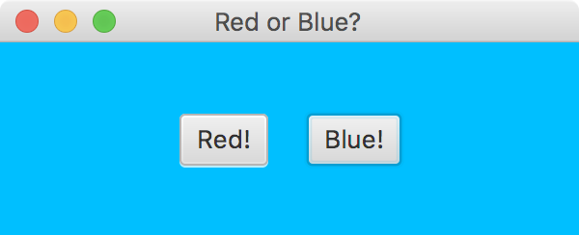
continue
//--------------------------------------------------------------------
// Determines which button was pressed and sets the pane color
// accordingly.
//--------------------------------------------------------------------
public void processColorButton(ActionEvent event)
{
if (event.getSource() == redButton)
pane.setStyle("-fx-background-color: crimson");
else
pane.setStyle("-fx-background-color: deepskyblue");
}
}

Slide 99
Outline
Boolean Expressions
The if Statement
Comparing Data
The while Statement
Iterators
The ArrayList Class
Determining Event Sources
Managing Fonts
Check Boxes and Radio Buttons

Slide 100
Managing Fonts
The Font class represents a character font, which specify what characters look like when displayed
A font can be applied to a Text object or any control that displays text (such as a Button or Label)
A font is specifies:
font family (Arial, Courier, Helvetica)
font size (in units called points)
font weight (boldness)
font posture (italic or normal)

Slide 101
Managing Fonts
A Font object is created using either the Font constructor or by calling the static font method
The Font constructor can only take a font size, or a font family and size
To set the font weight or font posture, use the font method, which can specify various combinations of font characteristics
See FontDemo.java

Slide 102
import javafx.application.Application;
import javafx.scene.Scene;
import javafx.scene.Group;
import javafx.scene.paint.Color;
import javafx.scene.text.Font;
import javafx.scene.text.FontPosture;
import javafx.scene.text.FontWeight;
import javafx.scene.text.Text;
import javafx.stage.Stage;
//************************************************************************
// FontDemo.java Author: Lewis/Loftus
//
// Demonstrates the creation and use of fonts.
//************************************************************************
public class FontDemo extends Application
{
//--------------------------------------------------------------------
// Displays three Text objects using various font styles.
//--------------------------------------------------------------------
public void start(Stage primaryStage)
{
Font font1 = new Font("Courier", 36);
Font font2 = Font.font("Times", FontWeight.BOLD,
FontPosture.ITALIC, 28);
Font font3 = Font.font("Arial", FontPosture.ITALIC, 14);
continue

Slide 103
continue
Text text1 = new Text(30, 55, "Dream Big");
text1.setFont(font1);
text1.setUnderline(true);
Text text2 = new Text(150, 110, "Know thyself!");
text2.setFont(font2);
text2.setFill(Color.GREEN);
Text text3 = new Text(50, 150, "In theory, there is no difference " +
"between theory\nand practice, but in practice there is.");
text3.setFont(font3);
Group root = new Group(text1, text2, text3);
Scene scene = new Scene(root, 400, 200, Color.LIGHTCYAN);
primaryStage.setTitle("Font Demo");
primaryStage.setScene(scene);
primaryStage.show();
}
}

Slide 104
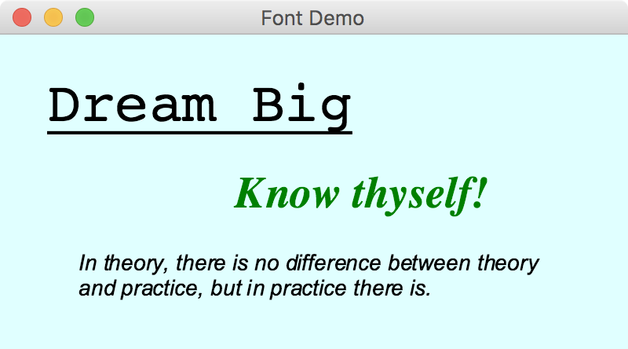
continue
Text text1 = new Text(30, 55, "Dream Big");
text1.setFont(font1);
text1.setUnderline(true);
Text text2 = new Text(150, 110, "Know thyself!");
text2.setFont(font2);
text2.setFill(Color.GREEN);
Text text3 = new Text(50, 150, "In theory, there is no difference " +
"between theory\nand practice, but in practice there is.");
text3.setFont(font3);
Group root = new Group(text1, text2, text3);
Scene scene = new Scene(root, 400, 200, Color.LIGHTCYAN);
primaryStage.setTitle("Font Demo");
primaryStage.setScene(scene);
primaryStage.show();
}
}

Slide 105
Managing Fonts
Note that setting the text color is not a function of the font applied
It's set through the Text object directly
The same is true for underlined text (or a "strike through" effect)

Slide 106
Outline
Boolean Expressions
The if Statement
Comparing Data
The while Statement
Iterators
The ArrayList Class
Determining Event Sources
Managing Fonts
Check Boxes and Radio Buttons

Slide 107
Check Boxes
A check box is a button that can be toggled on or off
It is represented by the JavaFX CheckBox class
Checking or unchecking a check box produces an action event
See StyleOptions.java
See StyleOptionsPane.java

Slide 108
import javafx.application.Application;
import javafx.geometry.Pos;
import javafx.scene.Scene;
import javafx.stage.Stage;
//************************************************************************
// StyleOptions.java Author: Lewis/Loftus
//
// Demonstrates the use of check boxes.
//************************************************************************
public class StyleOptions extends Application
{
//--------------------------------------------------------------------
// Creates and presents the program window.
//--------------------------------------------------------------------
public void start(Stage primaryStage)
{
StyleOptionsPane pane = new StyleOptionsPane();
pane.setAlignment(Pos.CENTER);
pane.setStyle("-fx-background-color: skyblue");
Scene scene = new Scene(pane, 400, 150);
primaryStage.setTitle("Style Options");
primaryStage.setScene(scene);
primaryStage.show();
}
}

Slide 109
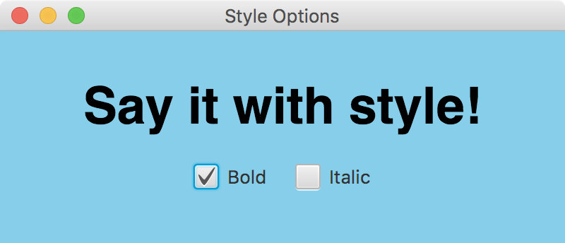
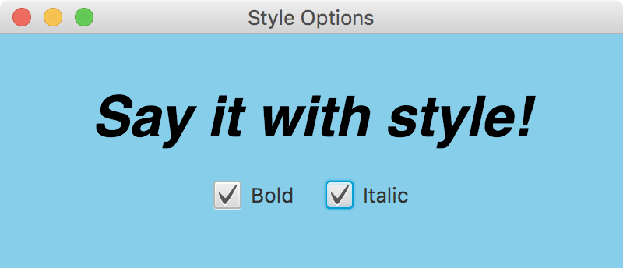
import javafx.application.Application;
import javafx.geometry.Pos;
import javafx.scene.Scene;
import javafx.stage.Stage;
//************************************************************************
// StyleOptions.java Author: Lewis/Loftus
//
// Demonstrates the use of check boxes.
//************************************************************************
public class StyleOptions extends Application
{
//--------------------------------------------------------------------
// Creates and presents the program window.
//--------------------------------------------------------------------
public void start(Stage primaryStage)
{
StyleOptionsPane pane = new StyleOptionsPane();
pane.setAlignment(Pos.CENTER);
pane.setStyle("-fx-background-color: skyblue");
Scene scene = new Scene(pane, 400, 150);
primaryStage.setTitle("Style Options");
primaryStage.setScene(scene);
primaryStage.show();
}
}

Slide 110
Check Boxes
The StyleOptionsPane class uses two layout panes: HBox and VBox
The HBox pane arranges its nodes into a single row horizontally
The VBox pane arranges its nodes into a single column vertically
StyleOptionsPane extends VBox, and is used to put the text above the check boxes
The HBox puts the check boxes side by side

Slide 111
import javafx.event.ActionEvent;
import javafx.geometry.Pos;
import javafx.scene.control.CheckBox;
import javafx.scene.layout.HBox;
import javafx.scene.layout.VBox;
import javafx.scene.text.Text;
import javafx.scene.text.Font;
import javafx.scene.text.FontPosture;
import javafx.scene.text.FontWeight;
//************************************************************************
// StyleOptionsPane.java Author: Lewis/Loftus
//
// Demonstrates the use of check boxes.
//************************************************************************
public class StyleOptionsPane extends VBox
{
private Text phrase;
private CheckBox boldCheckBox, italicCheckBox;
continue

Slide 112
continue
//--------------------------------------------------------------------
// Sets up this pane with a Text object and check boxes that
// determine the style of the text font.
//--------------------------------------------------------------------
public StyleOptionsPane()
{
phrase = new Text("Say it with style!");
phrase.setFont(new Font("Helvetica", 36));
boldCheckBox = new CheckBox("Bold");
boldCheckBox.setOnAction(this::processCheckBoxAction);
italicCheckBox = new CheckBox("Italic");
italicCheckBox.setOnAction(this::processCheckBoxAction);
HBox options = new HBox(boldCheckBox, italicCheckBox);
options.setAlignment(Pos.CENTER);
options.setSpacing(20); // between the check boxes
setSpacing(20); // between the text and the check boxes
getChildren().addAll(phrase, options);
}
continue

Slide 113
continue
//--------------------------------------------------------------------
// Updates the font style of the displayed text.
//--------------------------------------------------------------------
public void processCheckBoxAction(ActionEvent event)
{
FontWeight weight = FontWeight.NORMAL;
FontPosture posture = FontPosture.REGULAR;
if (boldCheckBox.isSelected())
weight = FontWeight.BOLD;
if (italicCheckBox.isSelected())
posture = FontPosture.ITALIC;
phrase.setFont(Font.font("Helvetica", weight, posture, 36));
}
}

Slide 114
Check Boxes
The event handler method is called when either check box is toggled
Instead of tracking which box was changed, the method just checks the current status of both boxes and sets the font accordingly

Slide 115
Radio Buttons
Let's look at a similar example that uses radio buttons
A group of radio buttons represents a set of mutually exclusive options – only one button can be selected at any given time
When a radio button from a group is selected, the button that is currently "on" in the group is automatically toggled off
See QuoteOptions.java
See QuoteOptionsPane.java

Slide 116
import javafx.application.Application;
import javafx.geometry.Pos;
import javafx.scene.Scene;
import javafx.stage.Stage;
//************************************************************************
// QuoteOptions.java Author: Lewis/Loftus
//
// Demonstrates the use of radio buttons.
//************************************************************************
public class QuoteOptions extends Application
{
//--------------------------------------------------------------------
// Creates and presents the program window.
//--------------------------------------------------------------------
public void start(Stage primaryStage)
{
QuoteOptionsPane pane = new QuoteOptionsPane();
pane.setAlignment(Pos.CENTER);
pane.setStyle("-fx-background-color: lightgreen");
Scene scene = new Scene(pane, 500, 150);
primaryStage.setTitle("Quote Options");
primaryStage.setScene(scene);
primaryStage.show();
}
}

Slide 117
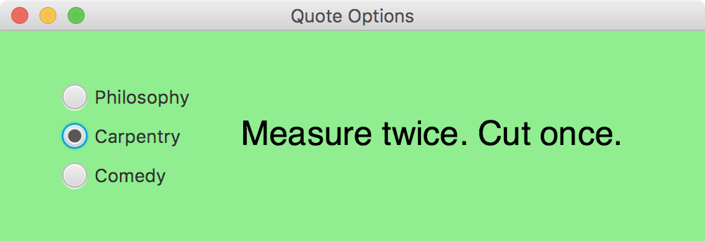
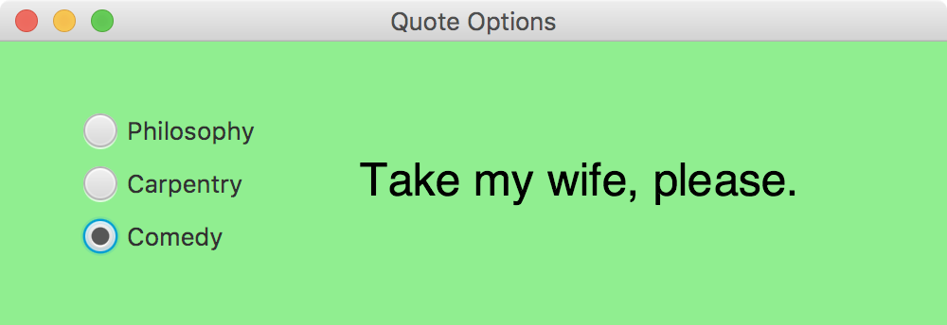
import javafx.application.Application;
import javafx.geometry.Pos;
import javafx.scene.Scene;
import javafx.stage.Stage;
//************************************************************************
// QuoteOptions.java Author: Lewis/Loftus
//
// Demonstrates the use of radio buttons.
//************************************************************************
public class QuoteOptions extends Application
{
//--------------------------------------------------------------------
// Creates and presents the program window.
//--------------------------------------------------------------------
public void start(Stage primaryStage)
{
QuoteOptionsPane pane = new QuoteOptionsPane();
pane.setAlignment(Pos.CENTER);
pane.setStyle("-fx-background-color: lightgreen");
Scene scene = new Scene(pane, 500, 150);
primaryStage.setTitle("Quote Options");
primaryStage.setScene(scene);
primaryStage.show();
}
}

Slide 118
Radio Buttons
To establish a set of mutually exclusive options, the radio buttons that work together as a group are added to a ToggleGroup object
The setToggleGroup method is used to specify which toggle group a button belongs to
The isSelected method of a radio button returns true if that button is currently "on"

Slide 119
import javafx.event.ActionEvent;
import javafx.geometry.Pos;
import javafx.scene.control.RadioButton;
import javafx.scene.control.ToggleGroup;
import javafx.scene.layout.HBox;
import javafx.scene.layout.StackPane;
import javafx.scene.layout.VBox;
import javafx.scene.text.Text;
import javafx.scene.text.Font;
//************************************************************************
// QuoteOptionsPane.java Author: Lewis/Loftus
//
// Demonstrates the use of radio buttons.
//************************************************************************
public class QuoteOptionsPane extends HBox
{
private Text quote;
private String philosophyQuote, carpentryQuote, comedyQuote;
private RadioButton philosophyButton, carpentryButton, comedyButton;
continue

Slide 120
continue
//--------------------------------------------------------------------
// Sets up this pane with a Text object and radio buttons that
// determine which phrase is displayed.
//--------------------------------------------------------------------
public QuoteOptionsPane()
{
philosophyQuote = "I think, therefore I am.";
carpentryQuote = "Measure twice. Cut once.";
comedyQuote = "Take my wife, please.";
quote = new Text(philosophyQuote);
quote.setFont(new Font("Helvetica", 24));
StackPane quotePane = new StackPane(quote);
quotePane.setPrefSize(300, 100);
ToggleGroup group = new ToggleGroup();
philosophyButton = new RadioButton("Philosophy");
philosophyButton.setSelected(true);
philosophyButton.setToggleGroup(group);
philosophyButton.setOnAction(this::processRadioButtonAction);
continue

Slide 121
continue
carpentryButton = new RadioButton("Carpentry");
carpentryButton.setToggleGroup(group);
carpentryButton.setOnAction(this::processRadioButtonAction);
comedyButton = new RadioButton("Comedy");
comedyButton.setToggleGroup(group);
comedyButton.setOnAction(this::processRadioButtonAction);
VBox options = new VBox(philosophyButton, carpentryButton,
comedyButton);
options.setAlignment(Pos.CENTER_LEFT);
options.setSpacing(10);
setSpacing(20);
getChildren().addAll(options, quotePane);
}
continue

Slide 122
continue
//--------------------------------------------------------------------
// Updates the content of the displayed text.
//--------------------------------------------------------------------
public void processRadioButtonAction(ActionEvent event)
{
if (philosophyButton.isSelected())
quote.setText(philosophyQuote);
else if (carpentryButton.isSelected())
quote.setText(carpentryQuote);
else
quote.setText(comedyQuote);
}
}

Slide 123
Summary
Chapter 5 focused on:
boolean expressions
the if and if-else statements
comparing data
while loops
iterators
the ArrayList class
more GUI controls

