Slide 1

Chapter 6 More Conditionals and Loops
Java Software Solutions
Foundations of Program Design
9th Edition
John Lewis
William Loftus

Slide 2
More Conditionals and Loops
Now we can fill in some additional details regarding Java conditional and repetition statements
Chapter 6 focuses on:
the switch statement
the conditional operator
the do loop
the for loop
using conditionals and loops with graphics
graphic transformations

Slide 3
Outline
The switch Statement
The Conditional Operator
The do Statement
The for Statement
Using Loops and Conditionals with Graphics
Graphic Transformations

Slide 4
The switch Statement
The switch statement provides another way to decide which statement to execute next
The switch statement evaluates an expression, then attempts to match the result to one of several possible cases
Each case contains a value and a list of statements
The flow of control transfers to statement associated with the first case value that matches

Slide 5
The switch Statement
The general syntax of a switch statement is:
switch
and
case
are
reserved
words
switch ( expression )
{
case value1 :
statement-list1
case value2 :
statement-list2
case value3 :
statement-list3
case ...
}
If expression
matches value2,
control jumps
to here

Slide 6
The switch Statement
Often a break statement is used as the last statement in each case's statement list
A break statement causes control to transfer to the end of the switch statement
If a break statement is not used, the flow of control will continue into the next case
Sometimes this may be appropriate, but often we want to execute only the statements associated with one case

Slide 7
The switch Statement
An example of a switch statement:
switch (option)
{
case 'A':
aCount++;
break;
case 'B':
bCount++;
break;
case 'C':
cCount++;
break;
}

Slide 8
The switch Statement
A switch statement can have an optional default case
The default case has no associated value and simply uses the reserved word default
If the default case is present, control will transfer to it if no other case value matches
If there is no default case, and no other value matches, control falls through to the statement after the switch

Slide 9
The switch Statement
The type of a switch expression can be integers, characters, enumerated types, or String objects
You cannot use a switch with floating point values
The implicit boolean condition in a switch statement is equality
You cannot perform relational checks with a switch statement
See GradeReport.java

Slide 10
//********************************************************************
// GradeReport.java Author: Lewis/Loftus
//
// Demonstrates the use of a switch statement.
//********************************************************************
import java.util.Scanner;
public class GradeReport
{
//-----------------------------------------------------------------
// Reads a grade from the user and prints comments accordingly.
//-----------------------------------------------------------------
public static void main(String[] args)
{
int grade, category;
Scanner scan = new Scanner(System.in);
System.out.print("Enter a numeric grade (0 to 100): ");
grade = scan.nextInt();
category = grade / 10;
System.out.print("That grade is ");
continue

Slide 11
continue
switch (category)
{
case 10:
System.out.println("a perfect score. Well done.");
break;
case 9:
System.out.println("well above average. Excellent.");
break;
case 8:
System.out.println("above average. Nice job.");
break;
case 7:
System.out.println("average.");
break;
case 6:
System.out.println("below average. You should see the");
System.out.println("instructor to clarify the material "
+ "presented in class.");
break;
default:
System.out.println("not passing.");
}
}
}

Slide 12
Sample Run
Enter a numeric grade (0 to 100): 91
That grade is well above average. Excellent.
continue
switch (category)
{
case 10:
System.out.println("a perfect score. Well done.");
break;
case 9:
System.out.println("well above average. Excellent.");
break;
case 8:
System.out.println("above average. Nice job.");
break;
case 7:
System.out.println("average.");
break;
case 6:
System.out.println("below average. You should see the");
System.out.println("instructor to clarify the material "
+ "presented in class.");
break;
default:
System.out.println("not passing.");
}
}
}

Slide 13
Outline
The switch Statement
The Conditional Operator
The do Statement
The for Statement
Using Loops and Conditionals with Graphics
Graphic Transformations

Slide 14
The Conditional Operator
The conditional operator evaluates to one of two expressions based on a boolean condition
Its syntax is:
condition ? expression1 : expression2
If the condition is true, expression1 is evaluated; if it is false, expression2 is evaluated
The value of the entire conditional operator is the value of the selected expression

Slide 15
The Conditional Operator
The conditional operator is similar to an if-else statement, except that it is an expression that returns a value
For example:
larger = ((num1 > num2) ? num1 : num2);
If num1 is greater than num2, then num1 is assigned to larger; otherwise, num2 is assigned to larger
The conditional operator is ternary because it requires three operands

Slide 16
The Conditional Operator
Another example:
If count equals 1, then "Dime" is printed
If count is anything other than 1, then "Dimes" is printed
System.out.println("Your change is " + count +
((count == 1) ? "Dime" : "Dimes"));

Slide 17
Quick Check
Express the following logic in a succinct manner using the conditional operator.
if (val <= 10)
System.out.println("It is not greater than 10.");
else
System.out.println("It is greater than 10.");

Slide 18
Quick Check
Express the following logic in a succinct manner using the conditional operator.
if (val <= 10)
System.out.println("It is not greater than 10.");
else
System.out.println("It is greater than 10.");
System.out.println("It is" +
((val <= 10) ? " not" : "") +
" greater than 10.");

Slide 19
Outline
The switch Statement
The Conditional Operator
The do Statement
The for Statement
Using Loops and Conditionals with Graphics
Graphic Transformations

Slide 20
The do Statement
A do statement has the following syntax:
do
{
statement-list;
}
while (condition);
The statement-list is executed once initially, and then the condition is evaluated
The statement is executed repeatedly until the condition becomes false

Slide 21
Logic of a do Loop
statement
true
condition
evaluated
false

Slide 22
The do Statement
An example of a do loop:
The body of a do loop executes at least once
See ReverseNumber.java
int count = 0;
do
{
count++;
System.out.println(count);
} while (count < 5);

Slide 23
//********************************************************************
// ReverseNumber.java Author: Lewis/Loftus
//
// Demonstrates the use of a do loop.
//********************************************************************
import java.util.Scanner;
public class ReverseNumber
{
//-----------------------------------------------------------------
// Reverses the digits of an integer mathematically.
//-----------------------------------------------------------------
public static void main(String[] args)
{
int number, lastDigit, reverse = 0;
Scanner scan = new Scanner(System.in);
continue

Slide 24
continue
System.out.print("Enter a positive integer: ");
number = scan.nextInt();
do
{
lastDigit = number % 10;
reverse = (reverse * 10) + lastDigit;
number = number / 10;
}
while (number > 0);
System.out.println("That number reversed is " + reverse);
}
}

Slide 25
Sample Run
Enter a positive integer: 2896
That number reversed is 6982
continue
System.out.print ("Enter a positive integer: ");
number = scan.nextInt();
do
{
lastDigit = number % 10;
reverse = (reverse * 10) + lastDigit;
number = number / 10;
}
while (number > 0);
System.out.println("That number reversed is " + reverse);
}
}

Slide 26
Comparing while and do
The while Loop
The do Loop
statement
condition
evaluated
true
false
condition
evaluated
true
statement
false

Slide 27
Outline
The switch Statement
The Conditional Operator
The do Statement
The for Statement
Using Loops and Conditionals with Graphics
Graphic Transformations

Slide 28
The for Statement
A for statement has the following syntax:
The initialization
is executed once
before the loop begins
The statement is
executed until the
condition becomes false
for ( initialization ; condition ; increment )
statement;
The increment portion is executed at the end of each iteration

Slide 29
Logic of a for loop
initialization
condition
evaluated
true
false
statement
increment

Slide 30
The for Statement
A for loop is functionally equivalent to the following while loop structure:
initialization;
while ( condition )
{
statement;
increment;
}

Slide 31
The for Statement
An example of a for loop:
for (int count=1; count <= 5; count++)
System.out.println(count);
The initialization section can be used to declare a variable
Like a while loop, the condition of a for loop is tested prior to executing the loop body
Therefore, the body of a for loop will execute zero or more times

Slide 32
The for Statement
The increment section can perform any calculation:
for (int num=100; num > 0; num -= 5)
System.out.println(num);
A for loop is well suited for executing statements a specific number of times that can be calculated or determined in advance
See Multiples.java
See Stars.java

Slide 33
//********************************************************************
// Multiples.java Author: Lewis/Loftus
//
// Demonstrates the use of a for loop.
//********************************************************************
import java.util.Scanner;
public class Multiples
{
//-----------------------------------------------------------------
// Prints multiples of a user-specified number up to a user-
// specified limit.
//-----------------------------------------------------------------
public static void main(String[] args)
{
final int PER_LINE = 5;
int value, limit, mult, count = 0;
Scanner scan = new Scanner(System.in);
System.out.print("Enter a positive value: ");
value = scan.nextInt();
continue

Slide 34
continue
System.out.print("Enter an upper limit: ");
limit = scan.nextInt();
System.out.println();
System.out.println("The multiples of " + value + " between " +
value + " and " + limit + " (inclusive) are:");
for (mult = value; mult <= limit; mult += value)
{
System.out.print(mult + "\t");
// Print a specific number of values per line of output
count++;
if (count % PER_LINE == 0)
System.out.println();
}
}
}

Slide 35
Sample Run
Enter a positive value: 7
Enter an upper limit: 400
The multiples of 7 between 7 and 400 (inclusive) are:
7 14 21 28 35
42 49 56 63 70
77 84 91 98 105
112 119 126 133 140
147 154 161 168 175
182 189 196 203 210
217 224 231 238 245
252 259 266 273 280
287 294 301 308 315
322 329 336 343 350
357 364 371 378 385
392 399
continue
System.out.print("Enter an upper limit: ");
limit = scan.nextInt();
System.out.println();
System.out.println("The multiples of " + value + " between " +
value + " and " + limit + " (inclusive) are:");
for (mult = value; mult <= limit; mult += value)
{
System.out.print(mult + "\t");
// Print a specific number of values per line of output
count++;
if (count % PER_LINE == 0)
System.out.println();
}
}
}

Slide 36
//********************************************************************
// Stars.java Author: Lewis/Loftus
//
// Demonstrates the use of nested for loops.
//********************************************************************
public class Stars
{
//-----------------------------------------------------------------
// Prints a triangle shape using asterisk (star) characters.
//-----------------------------------------------------------------
public static void main(String[] args)
{
final int MAX_ROWS = 10;
for (int row = 1; row <= MAX_ROWS; row++)
{
for (int star = 1; star <= row; star++)
System.out.print("*");
System.out.println();
}
}
}

Slide 37
Output
*
**
***
****
*****
******
*******
********
*********
**********
//********************************************************************
// Stars.java Author: Lewis/Loftus
//
// Demonstrates the use of nested for loops.
//********************************************************************
public class Stars
{
//-----------------------------------------------------------------
// Prints a triangle shape using asterisk (star) characters.
//-----------------------------------------------------------------
public static void main(String[] args)
{
final int MAX_ROWS = 10;
for (int row = 1; row <= MAX_ROWS; row++)
{
for (int star = 1; star <= row; star++)
System.out.print("*");
System.out.println();
}
}
}

Slide 38
Quick Check
Write a code fragment that rolls a die 100 times and counts the number of times a 3 comes up.

Slide 39
Quick Check
Write a code fragment that rolls a die 100 times and counts the number of times a 3 comes up.
Die die = new Die();
int count = 0;
for (int num=1; num <= 100; num++)
if (die.roll() == 3)
count++;
Sytem.out.println(count);

Slide 40
The for Statement
Each expression in the header of a for loop is optional
If the initialization is left out, no initialization is performed
If the condition is left out, it is always considered to be true, and therefore creates an infinite loop
If the increment is left out, no increment operation is performed

Slide 41
For-each Loops
A variant of the for loop simplifies the repetitive processing of items in an iterator
For example, suppose bookList is an ArrayList<Book> object
The following loop will print each book:
for (Book myBook : bookList)
System.out.println(myBook);
This version of a for loop is often called a for-each loop

Slide 42
For-each Loops
A for-each loop can be used on any object that implements the Iterable interface
It eliminates the need to retrieve an iterator and call the hasNext and next methods explicitly
It also will be helpful when processing arrays, which are discussed in Chapter 8

Slide 43
Quick Check
Write a for-each loop that prints all of the Student objects in an ArrayList<Student> object called roster.

Slide 44
Quick Check
Write a for-each loop that prints all of the Student objects in an ArrayList<Student> object called roster.
for (Student student : roster)
System.out.println(student);

Slide 45
Outline
The switch Statement
The Conditional Operator
The do Statement
The for Statement
Using Loops and Conditionals with Graphics
Graphic Transformations

Slide 46
More Graphics
Conditionals and loops enhance our ability to generate interesting graphics
See Bullseye.java
See Boxes.java

Slide 47
import javafx.application.Application;
import javafx.scene.Group;
import javafx.scene.Scene;
import javafx.scene.paint.Color;
import javafx.scene.shape.Circle;
import javafx.stage.Stage;
//************************************************************************
// Bullseye.java Author: Lewis/Loftus
//
// Demonstrates the use of loops and conditionals to draw.
//************************************************************************
public class Bullseye extends Application
{
//--------------------------------------------------------------------
// Displays a target using concentric black and white circles
// and a red center.
//--------------------------------------------------------------------
public void start(Stage primaryStage)
{
Group root = new Group();
Color ringColor = Color.BLACK;
Circle ring = null;
int radius = 150;
continue

Slide 48
continue
for (int count = 1; count <= 8; count++)
{
ring = new Circle(160, 160, radius);
ring.setFill(ringColor);
root.getChildren().add(ring);
if (ringColor.equals(Color.BLACK))
ringColor = Color.WHITE;
else
ringColor = Color.BLACK;
radius = radius - 20;
}
ring.setFill(Color.RED);
Scene scene = new Scene(root, 320, 320, Color.CYAN);
primaryStage.setTitle("Bullseye");
primaryStage.setScene(scene);
primaryStage.show();
}
}

Slide 49
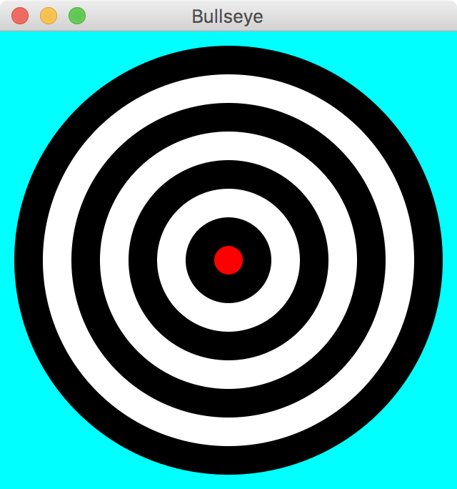
continue
for (int count = 1; count <= 8; count++)
{
ring = new Circle(160, 160, radius);
ring.setFill(ringColor);
root.getChildren().add(ring);
if (ringColor.equals(Color.BLACK))
ringColor = Color.WHITE;
else
ringColor = Color.BLACK;
radius = radius - 20;
}
ring.setFill(Color.RED);
Scene scene = new Scene(root, 320, 320, Color.CYAN);
primaryStage.setTitle("Bullseye");
primaryStage.setScene(scene);
primaryStage.show();
}
}

Slide 50
import java.util.Random;
import javafx.application.Application;
import javafx.scene.Group;
import javafx.scene.Scene;
import javafx.scene.paint.Color;
import javafx.scene.shape.Rectangle;
import javafx.stage.Stage;
//************************************************************************
// Boxes.java Author: Lewis/Loftus
//
// Demonstrates the use of loops and conditionals to draw.
//************************************************************************
public class Boxes extends Application
{
//--------------------------------------------------------------------
// Displays multiple rectangles with random width and height in
// random locations. Narrow and short boxes are highlighted with
// a fill color.
//--------------------------------------------------------------------
public void start(Stage primaryStage)
{
Group root = new Group();
Random gen = new Random();
continue

Slide 51
continue
for (int count = 1; count <= 50; count++)
{
int x = gen.nextInt(350) + 1;
int y = gen.nextInt(350) + 1;
int width = gen.nextInt(50) + 1;
int height = gen.nextInt(50) + 1;
Color fill = null;
if (width < 10)
fill = Color.YELLOW;
else if (height < 10)
fill = Color.GREEN;
Rectangle box = new Rectangle(x, y, width, height);
box.setStroke(Color.WHITE);
box.setFill(fill);
root.getChildren().add(box);
}
continue

Slide 52
continue
Scene scene = new Scene(root, 400, 400, Color.BLACK);
primaryStage.setTitle("Boxes");
primaryStage.setScene(scene);
primaryStage.show();
}
}

Slide 53
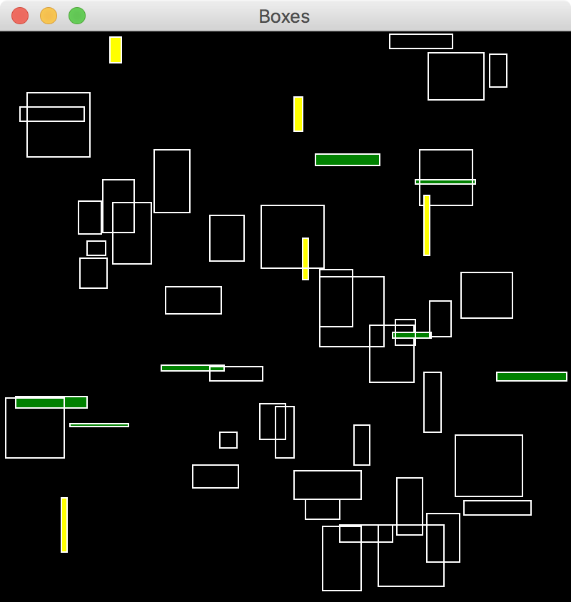
continue
Scene scene = new Scene(root, 400, 400, Color.BLACK);
primaryStage.setTitle("Boxes");
primaryStage.setScene(scene);
primaryStage.show();
}
}

Slide 54
Outline
The switch Statement
The Conditional Operator
The do Statement
The for Statement
Using Loops and Conditionals with Graphics
Graphic Transformations

Slide 55
Graphic Transformations
A JavaFX transformation changes the way a node is presented visually
translation – shifts the position along the x or y axis
scaling – causes the node to appear larger or smaller
rotation – rotates the node around its center point
shearing – rotates one axis so that the x and y axes are no longer perpendicular

Slide 56

Translation
The following creates two rectangles in the same position, then shifts the second one:
Rectangle rec1 = new Rectangle(100, 100, 200, 50);
rec1.setFill(Color.STEELBLUE);
Rectangle rec2 = new Rectangle(100, 100, 200, 50);
rec2.setFill(Color.ORANGE); rec2.setTranslateX(70); rec2.setTranslateY(10);

Slide 57

Scaling
The following displays two ImageView objects, the second scaled to 70%:
Image img = new Image("water lily.jpg");
ImageView imgView1 = new ImageView(img);
ImageView imgView2 = new ImageView(img);
imgView2.setX(300);
imgView2.setScaleX(0.7);
imgView2.setScaleY(0.7);

Slide 58
Rotation
The parameter to setRotate determines how many degrees the node is rotated
If the parameter positive, the node is rotated clockwise
If the parameter is negative, the node is rotated counterclockwise

Slide 59

Rotation
Rectangle rec = new Rectangle(50, 100, 200, 50);
rec.setFill(Color.STEELBLUE); rec.setRotate(40);
Text text = new Text(270, 125, "Tilted Text!");
text.setFont(new Font("Courier", 24));
text.setRotate(-15);

Slide 60
Rotation
To rotate a node around a point other than its center point, create a Rotate object and add it to the node's list of transformations
The following rotates a node 45 degrees around the point (70, 150):
node.getTransforms().add(new Rotate(45, 70, 150));

Slide 61

Shearing
Shearing is accomplished by creating a Shear object and adding it to this list of transformations
The following applies a shear of 40% on the x axis and 20% on the y axis to an ImageView object:
Image img = new Image("duck.jpg"); ImageView imgView = new ImageView(img);
imgView.getTransforms().add(new Shear(0.4, 0.2));

Slide 62
Transformations on Groups
Transformations can be applied to any JavaFX nodes
shapes, images, controls
groups and panes
When applied to a group or pane, the transformation is applied to each node it contains
See RobotFace.java
See Robots.java

Slide 63
import javafx.scene.Group;
import javafx.scene.paint.Color;
import javafx.scene.shape.Rectangle;
//************************************************************************
// RobotFace.java Author: Lewis/Loftus
//
// Presents the face of a robot.
//************************************************************************
public class RobotFace extends Group
{
//--------------------------------------------------------------------
// Sets up the elements that make up the robots face, positioned
// in the upper left corner of the coordinate system.
//--------------------------------------------------------------------
public RobotFace()
{
Rectangle head = new Rectangle(5, 0, 100, 70);
head.setFill(Color.SILVER);
head.setArcHeight(10);
head.setArcWidth(10);
Rectangle ears = new Rectangle(0, 20, 110, 30);
ears.setFill(Color.DARKBLUE);
ears.setArcHeight(10);
ears.setArcWidth(10);
continue

Slide 64
continue
Rectangle eye1 = new Rectangle(25, 15, 20, 10);
eye1.setFill(Color.GOLD);
Rectangle eye2 = new Rectangle(65, 15, 20, 10);
eye2.setFill(Color.GOLD);
Rectangle nose = new Rectangle(52, 25, 6, 15);
nose.setFill(Color.BLACK);
Rectangle mouth = new Rectangle(35, 45, 40, 10);
mouth.setFill(Color.RED);
getChildren().addAll(ears, head, eye1, eye2, nose, mouth);
}
}

Slide 65
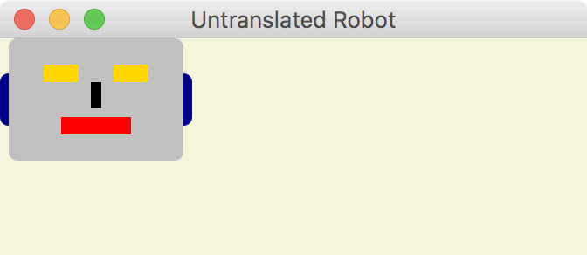
Transformations on Groups
If presented as defined, the robot face would be displayed in the upper left corner:

Slide 66
import javafx.application.Application;
import javafx.scene.Group;
import javafx.scene.Scene;
import javafx.scene.paint.Color;
import javafx.stage.Stage;
//************************************************************************
// Robots.java Author: Lewis/Loftus
//
// Demonstrates graphical transformations.
//************************************************************************
public class Robots extends Application
{
//--------------------------------------------------------------------
// Displays three robot faces, applying various transformations.
//--------------------------------------------------------------------
public void start(Stage primaryStage)
{
RobotFace robot1 = new RobotFace();
robot1.setTranslateX(70);
robot1.setTranslateY(40);
RobotFace robot2 = new RobotFace();
robot2.setTranslateX(300);
robot2.setTranslateY(40);
robot2.setRotate(20);
continue

Slide 67
continue
RobotFace robot3 = new RobotFace();
robot3.setTranslateX(200);
robot3.setTranslateY(200);
robot3.setScaleX(2.5);
robot3.setScaleY(2.5);
Group root = new Group(robot1, robot2, robot3);
Scene scene = new Scene(root, 500, 380, Color.WHITE);
primaryStage.setTitle("Robots");
primaryStage.setScene(scene);
primaryStage.show();
}
}

Slide 68
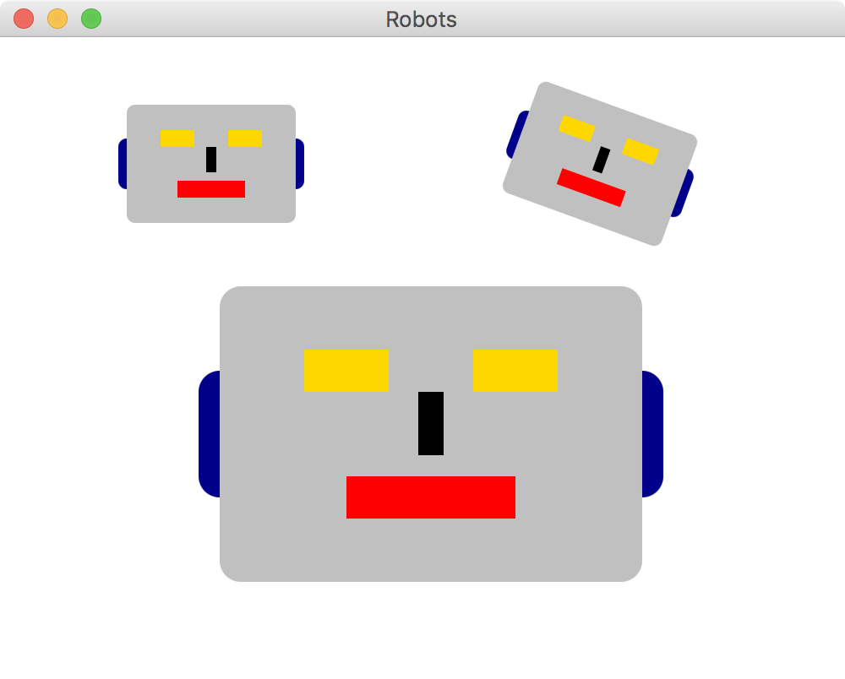
continue
RobotFace robot3 = new RobotFace();
robot3.setTranslateX(200);
robot3.setTranslateY(200);
robot3.setScaleX(2.5);
robot3.setScaleY(2.5);
Group root = new Group(robot1, robot2, robot3);
Scene scene = new Scene(root, 500, 380, Color.WHITE);
primaryStage.setTitle("Robots");
primaryStage.setScene(scene);
primaryStage.show();
}
}

Slide 69
Summary
Chapter 6 focused on:
the switch statement
the conditional operator
the do loop
the for loop
using conditionals and loops with graphics
graphic transformations

