Slide 1
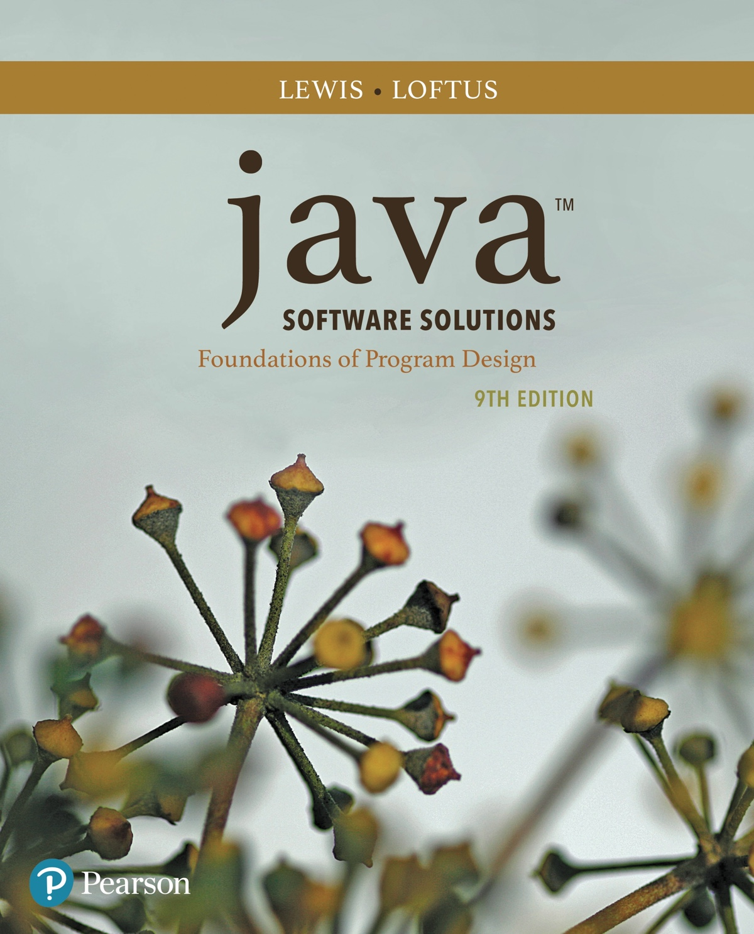
Chapter 8 Arrays
Java Software Solutions
Foundations of Program Design
9th Edition
John Lewis
William Loftus

Slide 2
Arrays
Arrays are objects that help us organize large amounts of information
Chapter 8 focuses on:
array declaration and use
bounds checking and capacity
arrays that store object references
variable length parameter lists
multidimensional arrays
polygons and polylines
choice boxes

Slide 3
Outline
Declaring and Using Arrays
Arrays of Objects
Variable Length Parameter Lists
Two-Dimensional Arrays
Polygons and Polylines
Array of Color Objects
Choice Boxes

Slide 4
Arrays
The ArrayList class, introduced in Chapter 5, is used to organize a list of objects
It is a class in the Java API
An array is a programming language construct used to organize a list of objects
It has special syntax to access elements
As its name implies, the ArrayList class uses an array internally to manage the list of objects

Slide 5
Arrays
An array is an ordered list of values:
The entire array
has a single name
Each value has a numeric index
0 1 2 3 4 5 6 7 8 9
scores
79 87 94 82 67 98 87 81 74 91
An array of size N is indexed from zero to N-1
This array holds 10 values that are indexed from 0 to 9

Slide 6
Arrays
A particular value in an array is referenced using the array name followed by the index in brackets
For example, the expression
scores[2]
refers to the value 94 (the 3rd value in the array)
That expression represents a place to store a single integer and can be used wherever an integer variable can be used

Slide 7
Arrays
For example, an array element can be assigned a value, printed, or used in a calculation:
scores[2] = 89;
scores[first] = scores[first] + 2;
mean = (scores[0] + scores[1])/2;
System.out.println("Top = " + scores[5]);
pick = scores[rand.nextInt(11)];

Slide 8
Arrays
The values held in an array are called array elements
An array stores multiple values of the same type – the element type
The element type can be a primitive type or an object reference
Therefore, we can create an array of integers, an array of characters, an array of String objects, an array of Coin objects, etc.

Slide 9
Arrays
In Java, the array itself is an object that must be instantiated
Another way to depict the scores array:
scores
79
87
94
82
The name of the array
is an object reference
variable
67
98
87
81
74
91

Slide 10
Declaring Arrays
The scores array could be declared as follows:
int[] scores = new int[10];
The type of the variable scores is int[] (an array of integers)
Note that the array type does not specify its size, but each object of that type has a specific size
The reference variable scores is set to a new array object that can hold 10 integers

Slide 11
Declaring Arrays
Some other examples of array declarations:
int[] weights = new int[2000];
double[] prices = new double[500];
boolean[] flags;
flags = new boolean[20];
char[] codes = new char[1750];

Slide 12
Using Arrays
The for-each version of the for loop can be used when processing array elements:
for (int score : scores)
System.out.println(score);
This is only appropriate when processing all array elements starting at index 0
It can't be used to set the array values
See BasicArray.java

Slide 13
//********************************************************************
// BasicArray.java Author: Lewis/Loftus
//
// Demonstrates basic array declaration and use.
//********************************************************************
public class BasicArray
{
//-----------------------------------------------------------------
// Creates an array, fills it with various integer values,
// modifies one value, then prints them out.
//-----------------------------------------------------------------
public static void main(String[] args)
{
final int LIMIT = 15, MULTIPLE = 10;
int[] list = new int[LIMIT];
// Initialize the array values
for (int index = 0; index < LIMIT; index++)
list[index] = index * MULTIPLE;
list[5] = 999; // change one array value
// Print the array values
for (int value : list)
System.out.print(value + " ");
}
}

Slide 14
Output
0 10 20 30 40 999 60 70 80 90 100 110 120 130 140
//********************************************************************
// BasicArray.java Author: Lewis/Loftus
//
// Demonstrates basic array declaration and use.
//********************************************************************
public class BasicArray
{
//-----------------------------------------------------------------
// Creates an array, fills it with various integer values,
// modifies one value, then prints them out.
//-----------------------------------------------------------------
public static void main(String[] args)
{
final int LIMIT = 15, MULTIPLE = 10;
int[] list = new int[LIMIT];
// Initialize the array values
for (int index = 0; index < LIMIT; index++)
list[index] = index * MULTIPLE;
list[5] = 999; // change one array value
// Print the array values
for (int value : list)
System.out.print(value + " ");
}
}

Slide 15
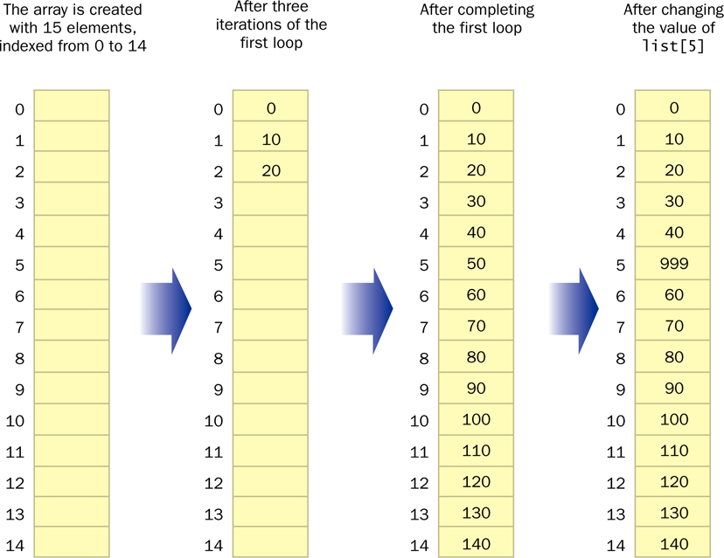
Basic Array Example

Slide 16
Quick Check
Write an array declaration to represent the ages of 100 children.
Write code that prints each value in an array of integers named values.

Slide 17
Quick Check
Write an array declaration to represent the ages of 100 children.
Write code that prints each value in an array of integers named values.
int[] ages = new int[100];
for (int value : values)
System.out.println(value);

Slide 18
Bounds Checking
Once an array is created, it has a fixed size
An index used in an array reference must specify a valid element
That is, the index value must be in range 0 to N-1
The Java interpreter throws an ArrayIndexOutOfBoundsException if an array index is out of bounds
This is called automatic bounds checking

Slide 19
Bounds Checking
For example, if the array codes can hold 100 values, it can be indexed from 0 to 99
If the value of count is 100, then the following reference will cause an exception to be thrown:
System.out.println(codes[count]);
It’s common to introduce off-by-one errors when using arrays:
problem
for (int index = 0; index <= 100; index++)
codes[index] = index*50 + epsilon;

Slide 20
Bounds Checking
Each array object has a public constant called length that stores the size of the array
It is referenced using the array name:
scores.length
Note that length holds the number of elements, not the largest index
See ReverseOrder.java
See LetterCount.java

Slide 21
//********************************************************************
// ReverseOrder.java Author: Lewis/Loftus
//
// Demonstrates array index processing.
//********************************************************************
import java.util.Scanner;
public class ReverseOrder
{
//-----------------------------------------------------------------
// Reads a list of numbers from the user, storing them in an
// array, then prints them in the opposite order.
//-----------------------------------------------------------------
public static void main(String[] args)
{
Scanner scan = new Scanner(System.in);
double[] numbers = new double[10];
System.out.println("The size of the array: " + numbers.length);
continue

Slide 22
continue
for (int index = 0; index < numbers.length; index++)
{
System.out.print("Enter number " + (index+1) + ": ");
numbers[index] = scan.nextDouble();
}
System.out.println("The numbers in reverse order:");
for (int index = numbers.length-1; index >= 0; index--)
System.out.print(numbers[index] + " ");
}
}

Slide 23
Sample Run
The size of the array: 10
Enter number 1: 18.36
Enter number 2: 48.9
Enter number 3: 53.5
Enter number 4: 29.06
Enter number 5: 72.404
Enter number 6: 34.8
Enter number 7: 63.41
Enter number 8: 45.55
Enter number 9: 69.0
Enter number 10: 99.18
The numbers in reverse order:
99.18 69.0 45.55 63.41 34.8 72.404 29.06 53.5 48.9 18.36
continue
for (int index = 0; index < numbers.length; index++)
{
System.out.print("Enter number " + (index+1) + ": ");
numbers[index] = scan.nextDouble();
}
System.out.println("The numbers in reverse order:");
for (int index = numbers.length-1; index >= 0; index--)
System.out.print(numbers[index] + " ");
}
}

Slide 24
//********************************************************************
// LetterCount.java Author: Lewis/Loftus
//
// Demonstrates the relationship between arrays and strings.
//********************************************************************
import java.util.Scanner;
public class LetterCount
{
//-----------------------------------------------------------------
// Reads a sentence from the user and counts the number of
// uppercase and lowercase letters contained in it.
//-----------------------------------------------------------------
public static void main(String[] args)
{
final int NUMCHARS = 26;
Scanner scan = new Scanner(System.in);
int[] upper = new int[NUMCHARS];
int[] lower = new int[NUMCHARS];
char current; // the current character being processed
int other = 0; // counter for non-alphabetics
continue

Slide 25
continue
System.out.println("Enter a sentence:");
String line = scan.nextLine();
// Count the number of each letter occurence
for (int ch = 0; ch < line.length(); ch++)
{
current = line.charAt(ch);
if (current >= 'A' && current <= 'Z')
upper[current-'A']++;
else
if (current >= 'a' && current <= 'z')
lower[current-'a']++;
else
other++;
}
continue

Slide 26
continue
// Print the results
System.out.println();
for (int letter = 0; letter < upper.length; letter++)
{
System.out.print( (char) (letter + 'A') );
System.out.print(": " + upper[letter]);
System.out.print("\t\t" + (char) (letter + 'a') );
System.out.println(": " + lower[letter]);
}
System.out.println();
System.out.println("Non-alphabetic characters: " + other);
}
}

Slide 27
Sample Run
Enter a sentence:
In Casablanca, Humphrey Bogart never says "Play it again, Sam."
A: 0 a: 10
B: 1 b: 1
C: 1 c: 1
D: 0 d: 0
E: 0 e: 3
F: 0 f: 0
G: 0 g: 2
H: 1 h: 1
I: 1 i: 2
J: 0 j: 0
K: 0 k: 0
L: 0 l: 2
M: 0 m: 2
N: 0 n: 4
O: 0 o: 1
P: 1 p: 1
Q: 0 q: 0
continue
continue
// Print the results
System.out.println();
for (int letter = 0; letter < upper.length; letter++)
{
System.out.print( (char) (letter + 'A') );
System.out.print(": " + upper[letter]);
System.out.print("\t\t" + (char) (letter + 'a') );
System.out.println(": " + lower[letter]);
}
System.out.println();
System.out.println("Non-alphabetic characters: " + other);
}
}
Sample Run (continued)
R: 0 r: 3
S: 1 s: 3
T: 0 t: 2
U: 0 u: 1
V: 0 v: 1
W: 0 w: 0
X: 0 x: 0
Y: 0 y: 3
Z: 0 z: 0
Non-alphabetic characters: 14

Slide 28
Alternate Array Syntax
The brackets of the array type can be associated with the element type or with the name of the array
Therefore the following two declarations are equivalent:
double[] prices;
double prices[];
The first format generally is more readable and should be used

Slide 29
Initializer Lists
An initializer list can be used to instantiate and fill an array in one step
The values are delimited by braces and separated by commas
Examples:
int[] units = {147, 323, 89, 933, 540,
269, 97, 114, 298, 476};
char[] grades = {'A', 'B', 'C', 'D', ’F'};

Slide 30
Initializer Lists
Note that when an initializer list is used:
the new operator is not used
no size value is specified
The size of the array is determined by the number of items in the list
An initializer list can be used only in the array declaration
See Primes.java

Slide 31
//********************************************************************
// Primes.java Author: Lewis/Loftus
//
// Demonstrates the use of an initializer list for an array.
//********************************************************************
public class Primes
{
//-----------------------------------------------------------------
// Stores some prime numbers in an array and prints them.
//-----------------------------------------------------------------
public static void main(String[] args)
{
int[] primeNums = {2, 3, 5, 7, 11, 13, 17, 19};
System.out.println("Array length: " + primeNums.length);
System.out.println("The first few prime numbers are:");
for (int prime : primeNums)
System.out.print(prime + " ");
}
}

Slide 32
Output
Array length: 8
The first few prime numbers are:
2 3 5 7 11 13 17 19
//********************************************************************
// Primes.java Author: Lewis/Loftus
//
// Demonstrates the use of an initializer list for an array.
//********************************************************************
public class Primes
{
//-----------------------------------------------------------------
// Stores some prime numbers in an array and prints them.
//-----------------------------------------------------------------
public static void main(String[] args)
{
int[] primeNums = {2, 3, 5, 7, 11, 13, 17, 19};
System.out.println("Array length: " + primeNums.length);
System.out.println("The first few prime numbers are:");
for (int prime : primeNums)
System.out.print(prime + " ");
}
}

Slide 33
Arrays as Parameters
An entire array can be passed as a parameter to a method
Like any other object, the reference to the array is passed, making the formal and actual parameters aliases of each other
Therefore, changing an array element within the method changes the original
An individual array element can be passed to a method as well, in which case the type of the formal parameter is the same as the element type

Slide 34
Outline
Declaring and Using Arrays
Arrays of Objects
Variable Length Parameter Lists
Two-Dimensional Arrays
Polygons and Polylines
Array of Color Objects
Choice Boxes

Slide 35
Arrays of Objects
The elements of an array can be object references
The following declaration reserves space to store 5 references to String objects
String[] words = new String[5];
It does NOT create the String objects themselves
Initially an array of objects holds null references
Each object stored in an array must be instantiated separately

Slide 36
Arrays of Objects
The words array when initially declared:
At this point, the following line of code would throw a NullPointerException:
System.out.println(words[0]);
words
-
-
-
-
-

Slide 37
Arrays of Objects
After some String objects are created and stored in the array:
words
"friendship"
"loyalty"
"honor"
-
-

Slide 38
Arrays of Objects
Keep in mind that String objects can be created using literals
The following declaration creates an array object called verbs and fills it with four String objects created using string literals
String[] verbs = {"play", "work", "eat",
"sleep", "run"};

Slide 39
Arrays of Objects
The following example creates an array of Grade objects, each with a string representation and a numeric lower bound
The letter grades include plus and minus designations, so must be stored as strings instead of char
See GradeRange.java
See Grade.java

Slide 40
//********************************************************************
// GradeRange.java Author: Lewis/Loftus
//
// Demonstrates the use of an array of objects.
//********************************************************************
public class GradeRange
{
//-----------------------------------------------------------------
// Creates an array of Grade objects and prints them.
//-----------------------------------------------------------------
public static void main(String[] args)
{
Grade[] grades =
{
new Grade("A", 95), new Grade("A-", 90),
new Grade("B+", 87), new Grade("B", 85), new Grade("B-", 80),
new Grade("C+", 77), new Grade("C", 75), new Grade("C-", 70),
new Grade("D+", 67), new Grade("D", 65), new Grade("D-", 60),
new Grade("F", 0)
};
for (Grade letterGrade : grades)
System.out.println(letterGrade);
}
}

Slide 41
Output
A 95
A- 90
B+ 87
B 85
B- 80
C+ 77
C 75
C- 70
D+ 67
D 65
D- 60
F 0
//********************************************************************
// GradeRange.java Author: Lewis/Loftus
//
// Demonstrates the use of an array of objects.
//********************************************************************
public class GradeRange
{
//-----------------------------------------------------------------
// Creates an array of Grade objects and prints them.
//-----------------------------------------------------------------
public static void main(String[] args)
{
Grade[] grades =
{
new Grade("A", 95), new Grade("A-", 90),
new Grade("B+", 87), new Grade("B", 85), new Grade("B-", 80),
new Grade("C+", 77), new Grade("C", 75), new Grade("C-", 70),
new Grade("D+", 67), new Grade("D", 65), new Grade("D-", 60),
new Grade("F", 0)
};
for (Grade letterGrade : grades)
System.out.println(letterGrade);
}
}

Slide 42
//********************************************************************
// Grade.java Author: Lewis/Loftus
//
// Represents a school grade.
//********************************************************************
public class Grade
{
private String name;
private int lowerBound;
//-----------------------------------------------------------------
// Constructor: Sets up this Grade object with the specified
// grade name and numeric lower bound.
//-----------------------------------------------------------------
public Grade(String grade, int cutoff)
{
name = grade;
lowerBound = cutoff;
}
//-----------------------------------------------------------------
// Returns a string representation of this grade.
//-----------------------------------------------------------------
public String toString()
{
return name + "\t" + lowerBound;
}
continue

Slide 43
continue
//-----------------------------------------------------------------
// Name mutator.
//-----------------------------------------------------------------
public void setName(String grade)
{
name = grade;
}
//-----------------------------------------------------------------
// Lower bound mutator.
//-----------------------------------------------------------------
public void setLowerBound(int cutoff)
{
lowerBound = cutoff;
}
continue

Slide 44
continue
//-----------------------------------------------------------------
// Name accessor.
//-----------------------------------------------------------------
public String getName()
{
return name;
}
//-----------------------------------------------------------------
// Lower bound accessor.
//-----------------------------------------------------------------
public int getLowerBound()
{
return lowerBound;
}
}

Slide 45
Arrays of Objects
Now let's look at an example that manages a collection of DVD objects
An initial capacity of 100 is created for the collection
If more room is needed, a private method is used to create a larger array and transfer the current DVDs
See Movies.java
See DVDCollection.java
See DVD.java

Slide 46
//********************************************************************
// Movies.java Author: Lewis/Loftus
//
// Demonstrates the use of an array of objects.
//********************************************************************
public class Movies
{
//-----------------------------------------------------------------
// Creates a DVDCollection object and adds some DVDs to it. Prints
// reports on the status of the collection.
//-----------------------------------------------------------------
public static void main(String[] args)
{
DVDCollection movies = new DVDCollection();
movies.addDVD("The Godfather", "Francis Ford Coppala", 1972, 24.95, true);
movies.addDVD("District 9", "Neill Blomkamp", 2009, 19.95, false);
movies.addDVD("Iron Man", "Jon Favreau", 2008, 15.95, false);
movies.addDVD("All About Eve", "Joseph Mankiewicz", 1950, 17.50, false);
movies.addDVD("The Matrix", "Andy & Lana Wachowski", 1999, 19.95, true);
System.out.println(movies);
movies.addDVD("Iron Man 2", "Jon Favreau", 2010, 22.99, false);
movies.addDVD("Casablanca", "Michael Curtiz", 1942, 19.95, false);
System.out.println(movies);
}
}

Slide 47
//********************************************************************
// Movies.java Author: Lewis/Loftus
//
// Demonstrates the use of an array of objects.
//********************************************************************
public class Movies
{
//-----------------------------------------------------------------
// Creates a DVDCollection object and adds some DVDs to it. Prints
// reports on the status of the collection.
//-----------------------------------------------------------------
public static void main(String[] args)
{
DVDCollection movies = new DVDCollection();
movies.addDVD("The Godfather", "Francis Ford Coppala", 1972, 24.95, true);
movies.addDVD("District 9", "Neill Blomkamp", 2009, 19.95, false);
movies.addDVD("Iron Man", "Jon Favreau", 2008, 15.95, false);
movies.addDVD("All About Eve", "Joseph Mankiewicz", 1950, 17.50, false);
movies.addDVD("The Matrix", "Andy & Lana Wachowski", 1999, 19.95, true);
System.out.println(movies);
movies.addDVD("Iron Man 2", "Jon Favreau", 2010, 22.99, false);
movies.addDVD("Casablanca", "Michael Curtiz", 1942, 19.95, false);
System.out.println(movies);
}
}
Output
~~~~~~~~~~~~~~~~~~~~~~~~~~~~~~~~~~~~~~~~~~~
My DVD Collection
Number of DVDs: 5
Total cost: $98.30
Average cost: $19.66
DVD List:
$24.95 1972 The Godfather Francis Ford Coppala Blu-Ray
$19.95 2009 District 9 Neill Blomkamp
$15.95 2008 Iron Man Jon Favreau
$17.50 1950 All About Eve Joseph Mankiewicz
$19.95 1999 The Matrix Andy & Lana Wachowski Blu-Ray
continue

Slide 48
//********************************************************************
// Movies.java Author: Lewis/Loftus
//
// Demonstrates the use of an array of objects.
//********************************************************************
public class Movies
{
//-----------------------------------------------------------------
// Creates a DVDCollection object and adds some DVDs to it. Prints
// reports on the status of the collection.
//-----------------------------------------------------------------
public static void main(String[] args)
{
DVDCollection movies = new DVDCollection();
movies.addDVD("The Godfather", "Francis Ford Coppala", 1972, 24.95, true);
movies.addDVD("District 9", "Neill Blomkamp", 2009, 19.95, false);
movies.addDVD("Iron Man", "Jon Favreau", 2008, 15.95, false);
movies.addDVD("All About Eve", "Joseph Mankiewicz", 1950, 17.50, false);
movies.addDVD("The Matrix", "Andy & Lana Wachowski", 1999, 19.95, true);
System.out.println(movies);
movies.addDVD("Iron Man 2", "Jon Favreau", 2010, 22.99, false);
movies.addDVD("Casablanca", "Michael Curtiz", 1942, 19.95, false);
System.out.println(movies);
}
}
Output
~~~~~~~~~~~~~~~~~~~~~~~~~~~~~~~~~~~~~~~~~~~
My DVD Collection
Number of DVDs: 5
Total cost: $98.30
Average cost: $19.66
DVD List:
$24.95 1972 The Godfather Francis Ford Coppala Blu-Ray
$19.95 2009 District 9 Neill Blomkamp
$15.95 2008 Iron Man Jon Favreau
$17.50 1950 All About Eve Joseph Mankiewicz
$19.95 1999 The Matrix Andy & Lana Wachowski Blu-Ray
continue
Output (continued)
~~~~~~~~~~~~~~~~~~~~~~~~~~~~~~~~~~~~~~~~~~~
My DVD Collection
Number of DVDs: 7
Total cost: $141.24
Average cost: $20.18
DVD List:
$24.95 1972 The Godfather Francis Ford Coppala Blu-Ray
$19.95 2009 District 9 Neill Blomkamp
$15.95 2008 Iron Man Jon Favreau
$17.50 1950 All About Eve Joseph Mankiewicz
$19.95 1999 The Matrix Andy & Lana Wachowski Blu-Ray
$22.99 2010 Iron Man 2 Jon Favreau
$19.95 1942 Casablanca Michael Curtiz

Slide 49
//********************************************************************
// DVDCollection.java Author: Lewis/Loftus
//
// Represents a collection of DVD movies.
//********************************************************************
import java.text.NumberFormat;
public class DVDCollection
{
private DVD[] collection;
private int count;
private double totalCost;
//-----------------------------------------------------------------
// Constructor: Creates an initially empty collection.
//-----------------------------------------------------------------
public DVDCollection()
{
collection = new DVD[100];
count = 0;
totalCost = 0.0;
}
continue

Slide 50
continue
//-----------------------------------------------------------------
// Adds a DVD to the collection, increasing the size of the
// collection array if necessary.
//-----------------------------------------------------------------
public void addDVD(String title, String director, int year,
double cost, boolean bluRay)
{
if (count == collection.length)
increaseSize();
collection[count] = new DVD(title, director, year, cost, bluRay);
totalCost += cost;
count++;
}
continue

Slide 51
continue
//-----------------------------------------------------------------
// Returns a report describing the DVD collection.
//-----------------------------------------------------------------
public String toString()
{
NumberFormat fmt = NumberFormat.getCurrencyInstance();
String report = "~~~~~~~~~~~~~~~~~~~~~~~~~~~~~~~~~~~~~~~~~~~\n";
report += "My DVD Collection\n\n";
report += "Number of DVDs: " + count + "\n";
report += "Total cost: " + fmt.format(totalCost) + "\n";
report += "Average cost: " + fmt.format(totalCost/count);
report += "\n\nDVD List:\n\n";
for (int dvd = 0; dvd < count; dvd++)
report += collection[dvd].toString() + "\n";
return report;
}
continue

Slide 52
continue
//-----------------------------------------------------------------
// Increases the capacity of the collection by creating a
// larger array and copying the existing collection into it.
//-----------------------------------------------------------------
private void increaseSize()
{
DVD[] temp = new DVD[collection.length * 2];
for (int dvd = 0; dvd < collection.length; dvd++)
temp[dvd] = collection[dvd];
collection = temp;
}
}

Slide 53
//********************************************************************
// DVD.java Author: Lewis/Loftus
//
// Represents a DVD video disc.
//********************************************************************
import java.text.NumberFormat;
public class DVD
{
private String title, director;
private int year;
private double cost;
private boolean bluRay;
//-----------------------------------------------------------------
// Creates a new DVD with the specified information.
//-----------------------------------------------------------------
public DVD(String title, String director, int year, double cost,
boolean bluRay)
{
this.title = title;
this.director = director;
this.year = year;
this.cost = cost;
this.bluRay = bluRay;
}
continue

Slide 54
continue
//-----------------------------------------------------------------
// Returns a string description of this DVD.
//-----------------------------------------------------------------
public String toString()
{
NumberFormat fmt = NumberFormat.getCurrencyInstance();
String description;
description = fmt.format(cost) + "\t" + year + "\t";
description += title + "\t" + director;
if (bluRay)
description += "\t" + "Blu-Ray";
return description;
}
}

Slide 55
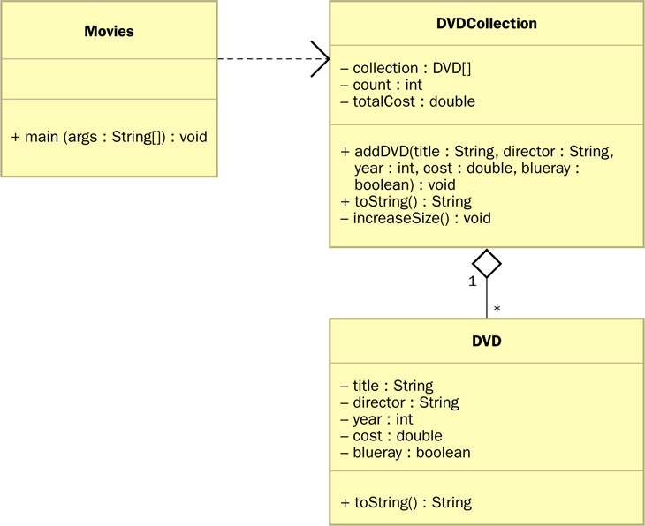
Arrays of Objects
A UML diagram for the Movies program:

Slide 56
Command-Line Arguments
The signature of the main method indicates that it takes an array of String objects as a parameter
These values come from command-line arguments that are provided when the interpreter is invoked
For example, the following invocation of the interpreter passes three String objects into the main method of the StateEval program:
java StateEval pennsylvania texas arizona
See NameTag.java

Slide 57
//********************************************************************
// NameTag.java Author: Lewis/Loftus
//
// Demonstrates the use of command line arguments.
//********************************************************************
public class NameTag
{
//-----------------------------------------------------------------
// Prints a simple name tag using a greeting and a name that is
// specified by the user.
//-----------------------------------------------------------------
public static void main(String[] args)
{
System.out.println();
System.out.println(" " + args[0]);
System.out.println("My name is " + args[1]);
}
}

Slide 58
Command-Line Execution
> java NameTag Howdy John
Howdy
My name is John
> java NameTag Hello Bill
Hello
My name is Bill
//********************************************************************
// NameTag.java Author: Lewis/Loftus
//
// Demonstrates the use of command line arguments.
//********************************************************************
public class NameTag
{
//-----------------------------------------------------------------
// Prints a simple name tag using a greeting and a name that is
// specified by the user.
//-----------------------------------------------------------------
public static void main(String[] args)
{
System.out.println();
System.out.println(" " + args[0]);
System.out.println("My name is " + args[1]);
}
}

Slide 59
Outline
Declaring and Using Arrays
Arrays of Objects
Variable Length Parameter Lists
Two-Dimensional Arrays
Polygons and Polylines
Array of Color Objects
Choice Boxes

Slide 60
Variable Length Parameter Lists
Suppose we wanted to create a method that processed a different amount of data from one invocation to the next
For example, let's define a method called average that returns the average of a set of integer parameters
// one call to average three values
mean1 = average(42, 69, 37);
// another call to average seven values
mean2 = average(35, 43, 93, 23, 40, 21, 75);

Slide 61
Variable Length Parameter Lists
We could define overloaded versions of the average method
Downside: we'd need a separate version of the method for each additional parameter
We could define the method to accept an array of integers
Downside: we'd have to create the array and store the integers prior to calling the method each time
Instead, Java provides a convenient way to create variable length parameter lists

Slide 62
Variable Length Parameter Lists
Using special syntax in the formal parameter list, we can define a method to accept any number of parameters of the same type
For each call, the parameters are automatically put into an array for easy processing in the method
Indicates a variable length parameter list
public double average(int ... list)
{
// whatever
}
element
type
array
name

Slide 63
Variable Length Parameter Lists
public double average(int ... list)
{
double result = 0.0;
if (list.length != 0)
{
int sum = 0;
for (int num : list)
sum += num;
result = (double)num / list.length;
}
return result;
}

Slide 64
Variable Length Parameter Lists
The type of the parameter can be any primitive or object type:
public void printGrades(Grade ... grades)
{
for (Grade letterGrade : grades)
System.out.println(letterGrade);
}

Slide 65
Quick Check
Write method called distance that accepts a variable number of integers (which each represent the distance of one leg of a trip) and returns the total distance of the trip.

Slide 66
Quick Check
Write method called distance that accepts a variable number of integers (which each represent the distance of one leg of a trip) and returns the total distance of the trip.
public int distance(int ... list)
{
int sum = 0;
for (int num : list)
sum = sum + num;
return sum;
}

Slide 67
Variable Length Parameter Lists
A method that accepts a variable number of parameters can also accept other parameters
The following method accepts an int, a String object, and a variable number of double values into an array called nums
public void test(int count, String name,
double ... nums)
{
// whatever
}

Slide 68
Variable Length Parameter Lists
The varying number of parameters must come last in the formal arguments
A method cannot accept two sets of varying parameters
Constructors can also be set up to accept a variable number of parameters
See VariableParameters.java
See Family.java

Slide 69
//********************************************************************
// VariableParameters.java Author: Lewis/Loftus
//
// Demonstrates the use of a variable length parameter list.
//********************************************************************
public class VariableParameters
{
//-----------------------------------------------------------------
// Creates two Family objects using a constructor that accepts
// a variable number of String objects as parameters.
//-----------------------------------------------------------------
public static void main(String[] args)
{
Family lewis = new Family("John", "Sharon", "Justin", "Kayla",
"Nathan", "Samantha");
Family camden = new Family("Stephen", "Annie", "Matt", "Mary",
"Simon", "Lucy", "Ruthie", "Sam", "David");
System.out.println(lewis);
System.out.println();
System.out.println(camden);
}
}

Slide 70
Output
John
Sharon
Justin
Kayla
Nathan
Samantha
Stephen
Annie
Matt
Mary
Simon
Lucy
Ruthie
Sam
David
//********************************************************************
// VariableParameters.java Author: Lewis/Loftus
//
// Demonstrates the use of a variable length parameter list.
//********************************************************************
public class VariableParameters
{
//-----------------------------------------------------------------
// Creates two Family objects using a constructor that accepts
// a variable number of String objects as parameters.
//-----------------------------------------------------------------
public static void main(String[] args)
{
Family lewis = new Family("John", "Sharon", "Justin", "Kayla",
"Nathan", "Samantha");
Family camden = new Family("Stephen", "Annie", "Matt", "Mary",
"Simon", "Lucy", "Ruthie", "Sam", "David");
System.out.println(lewis);
System.out.println();
System.out.println(camden);
}
}

Slide 71
//********************************************************************
// Family.java Author: Lewis/Loftus
//
// Demonstrates the use of variable length parameter lists.
//********************************************************************
public class Family
{
private String[] members;
//-----------------------------------------------------------------
// Constructor: Sets up this family by storing the (possibly
// multiple) names that are passed in as parameters.
//-----------------------------------------------------------------
public Family(String ... names)
{
members = names;
}
continue

Slide 72
continue
//-----------------------------------------------------------------
// Returns a string representation of this family.
//-----------------------------------------------------------------
public String toString()
{
String result = "";
for (String name : members)
result += name + "\n";
return result;
}
}

Slide 73
Outline
Declaring and Using Arrays
Arrays of Objects
Variable Length Parameter Lists
Two-Dimensional Arrays
Polygons and Polylines
Array of Color Objects
Choice Boxes

Slide 74
Two-Dimensional Arrays
A one-dimensional array stores a list of elements
A two-dimensional array can be thought of as a table of elements, with rows and columns
one
dimension
two
dimensions

Slide 75
Two-Dimensional Arrays
To be precise, in Java a two-dimensional array is an array of arrays
A two-dimensional array is declared by specifying the size of each dimension separately:
int[][] table = new int[12][50];
A array element is referenced using two index values:
value = table[3][6]
The array stored in one row can be specified using one index

Slide 76
Two-Dimensional Arrays
Expression | Type | Description
table | int[][] | 2D array of integers, or array of integer arrays
table[5] | int[] | array of integers
table[5][12] | int | integer
See TwoDArray.java
See SodaSurvey.java

Slide 77
//********************************************************************
// TwoDArray.java Author: Lewis/Loftus
//
// Demonstrates the use of a two-dimensional array.
//********************************************************************
public class TwoDArray
{
//-----------------------------------------------------------------
// Creates a 2D array of integers, fills it with increasing
// integer values, then prints them out.
//-----------------------------------------------------------------
public static void main(String[] args)
{
int[][] table = new int[5][10];
// Load the table with values
for (int row = 0; row < table.length; row++)
for (int col = 0; col < table[row].length; col++)
table[row][col] = row * 10 + col;
// Print the table
for (int row = 0; row < table.length; row++)
{
for (int col = 0; col < table[row].length; col++)
System.out.print(table[row][col] + "\t");
System.out.println();
}
}
}

Slide 78
//********************************************************************
// TwoDArray.java Author: Lewis/Loftus
//
// Demonstrates the use of a two-dimensional array.
//********************************************************************
public class TwoDArray
{
//-----------------------------------------------------------------
// Creates a 2D array of integers, fills it with increasing
// integer values, then prints them out.
//-----------------------------------------------------------------
public static void main(String[] args)
{
int[][] table = new int[5][10];
// Load the table with values
for (int row = 0; row < table.length; row++)
for (int col = 0; col < table[row].length; col++)
table[row][col] = row * 10 + col;
// Print the table
for (int row = 0; row < table.length; row++)
{
for (int col = 0; col < table[row].length; col++)
System.out.print(table[row][col] + "\t");
System.out.println();
}
}
}
Output
0 1 2 3 4 5 6 7 8 9
10 11 12 13 14 15 16 17 18 19
20 21 22 23 24 25 26 27 28 29
30 31 32 33 34 35 36 37 38 39
40 41 42 43 44 45 46 47 48 49

Slide 79
//********************************************************************
// SodaSurvey.java Author: Lewis/Loftus
//
// Demonstrates the use of a two-dimensional array.
//********************************************************************
import java.text.DecimalFormat;
public class SodaSurvey
{
//-----------------------------------------------------------------
// Determines and prints the average of each row (soda) and each
// column (respondent) of the survey scores.
//-----------------------------------------------------------------
public static void main(String[] args)
{
int[][] scores = { {3, 4, 5, 2, 1, 4, 3, 2, 4, 4},
{2, 4, 3, 4, 3, 3, 2, 1, 2, 2},
{3, 5, 4, 5, 5, 3, 2, 5, 5, 5},
{1, 1, 1, 3, 1, 2, 1, 3, 2, 4} };
final int SODAS = scores.length;
final int PEOPLE = scores[0].length;
int[] sodaSum = new int[SODAS];
int[] personSum = new int[PEOPLE];
continue

Slide 80
continue
for (int soda = 0; soda < SODAS; soda++)
for (int person = 0; person < PEOPLE; person++)
{
sodaSum[soda] += scores[soda][person];
personSum[person] += scores[soda][person];
}
DecimalFormat fmt = new DecimalFormat("0.#");
System.out.println("Averages:\n");
for (int soda = 0; soda < SODAS; soda++)
System.out.println("Soda #" + (soda+1) + ": " +
fmt.format((float)sodaSum[soda]/PEOPLE));
System.out.println ();
for (int person = 0; person < PEOPLE; person++)
System.out.println("Person #" + (person+1) + ": " +
fmt.format((float)personSum[person]/SODAS));
}
}

Slide 81
Output
Averages:
Soda #1: 3.2
Soda #2: 2.6
Soda #3: 4.2
Soda #4: 1.9
Person #1: 2.2
Person #2: 3.5
Person #3: 3.2
Person #4: 3.5
Person #5: 2.5
Person #6: 3
Person #7: 2
Person #8: 2.8
Person #9: 3.2
Person #10: 3.8
continue
for (int soda = 0; soda < SODAS; soda++)
for (int person = 0; person < PEOPLE; person++)
{
sodaSum[soda] += scores[soda][person];
personSum[person] += scores[soda][person];
}
DecimalFormat fmt = new DecimalFormat("0.#");
System.out.println("Averages:\n");
for (int soda = 0; soda < SODAS; soda++)
System.out.println("Soda #" + (soda+1) + ": " +
fmt.format((float)sodaSum[soda]/PEOPLE));
System.out.println ();
for (int person = 0; person < PEOPLE; person++)
System.out.println("Person #" + (person+1) + ": " +
fmt.format((float)personSum[person]/SODAS));
}
}

Slide 82
Multidimensional Arrays
An array can have many dimensions – if it has more than one dimension, it is called a multidimensional array
Each dimension subdivides the previous one into the specified number of elements
Each dimension has its own length constant
Because each dimension is an array of array references, the arrays within one dimension can be of different lengths
these are sometimes called ragged arrays

Slide 83
Outline
Declaring and Using Arrays
Arrays of Objects
Variable Length Parameter Lists
Two-Dimensional Arrays
Polygons and Polylines
Array of Color Objects
Choice Boxes

Slide 84
Polygons and Polylines
Arrays can be helpful in graphics processing
For example, they can be used to store a list of coordinates
A polygon is a multisided, closed shape
A polyline is similar to a polygon except that its endpoints do not meet, and it cannot be filled
See Rocket.java

Slide 85
import javafx.application.Application;
import javafx.scene.Group;
import javafx.scene.Scene;
import javafx.scene.paint.Color;
import javafx.scene.shape.Polygon;
import javafx.scene.shape.Polyline;
import javafx.stage.Stage;
//************************************************************************
// Rocket.java Author: Lewis/Loftus
//
// Demonstrates the use of polygons and polylines.
//************************************************************************
public class Rocket extends Application
{
//--------------------------------------------------------------------
// Displays a rocket lifting off. The rocket and hatch are polygons
// and the flame is a polyline.
//--------------------------------------------------------------------
public void start(Stage primaryStage)
{
double[] hullPoints = {200, 25, 240, 60, 240, 230, 270, 260,
270, 300, 140, 300, 140, 260, 160, 230, 160, 60};
Polygon rocket = new Polygon(hullPoints);
rocket.setFill(Color.BEIGE);
continue

Slide 86
continue
double[] hatchPoints = {185, 70, 215, 70, 220, 120, 180, 120};
Polygon hatch = new Polygon(hatchPoints);
hatch.setFill(Color.MAROON);
double[] flamePoints = {142, 310, 142, 330, 150, 325, 155, 380,
165, 340, 175, 360, 190, 350, 200, 375, 215, 330, 220, 360,
225, 355, 230, 370, 240, 340, 255, 370, 260, 335, 268, 340,
268, 310};
Polyline flame = new Polyline(flamePoints);
flame.setStroke(Color.RED);
flame.setStrokeWidth(3);
Group root = new Group(rocket, hatch, flame);
Scene scene = new Scene(root, 400, 400, Color.BLACK);
primaryStage.setTitle("Rocket");
primaryStage.setScene(scene);
primaryStage.show();
}
}

Slide 87
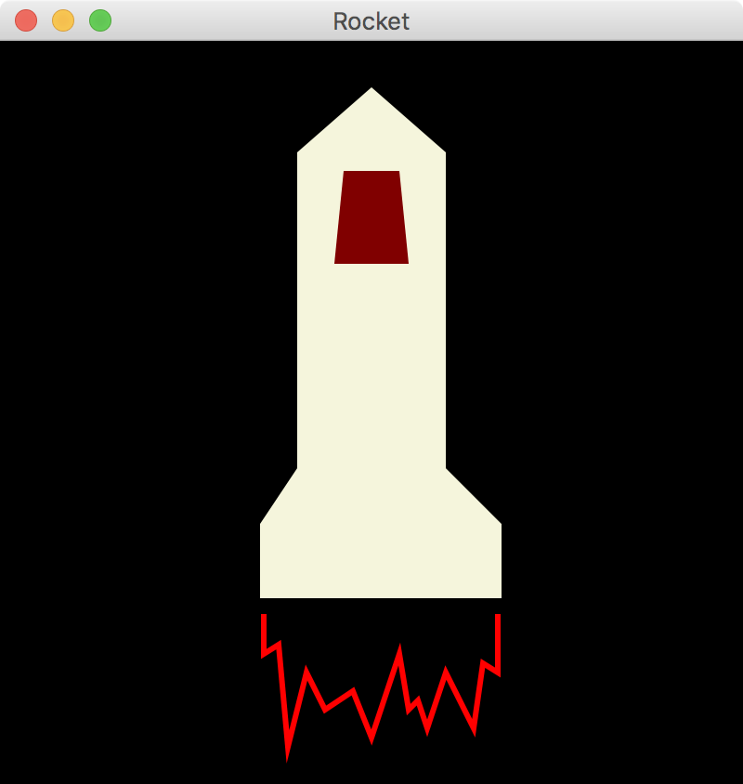
continue
double[] hatchPoints = {185, 70, 215, 70, 220, 120, 180, 120};
Polygon hatch = new Polygon(hatchPoints);
hatch.setFill(Color.MAROON);
double[] flamePoints = {142, 310, 142, 330, 150, 325, 155, 380,
165, 340, 175, 360, 190, 350, 200, 375, 215, 330, 220, 360,
225, 355, 230, 370, 240, 340, 255, 370, 260, 335, 268, 340,
268, 310};
Polyline flame = new Polyline(flamePoints);
flame.setStroke(Color.RED);
flame.setStrokeWidth(3);
Group root = new Group(rocket, hatch, flame);
Scene scene = new Scene(root, 400, 400, Color.BLACK);
primaryStage.setTitle("Rocket");
primaryStage.setScene(scene);
primaryStage.show();
}
}

Slide 88
Outline
Declaring and Using Arrays
Arrays of Objects
Variable Length Parameter Lists
Two-Dimensional Arrays
Polygons and Polylines
Array of Color Objects
Choice Boxes

Slide 89
Arrays of Color Objects
Let's look at an example that uses an array of Color objects
When the mouse button is clicked, a colored dot is displayed
A double-click clears the window
See Dots.java

Slide 90
import javafx.application.Application;
import javafx.scene.Group;
import javafx.scene.Scene;
import javafx.scene.input.MouseEvent;
import javafx.scene.paint.Color;
import javafx.scene.shape.Circle;
import javafx.scene.text.Font;
import javafx.scene.text.Text;
import javafx.stage.Stage;
//************************************************************************
// Dots.java Author: Lewis/Loftus
//
// Demonstrates the use of an array of Color objects and the capture of
// a double mouse click.
//************************************************************************
public class Dots extends Application
{
private Color[] colorList = {Color.RED, Color.CYAN, Color.MAGENTA,
Color.YELLOW, Color.LIME, Color.WHITE};
private int colorIndex = 0;
private int count = 0;
private Text countText;
private Group root;
continue

Slide 91
continue
//--------------------------------------------------------------------
// Displays a scene on which the user can add colored dots with
// mouse clicks.
//--------------------------------------------------------------------
public void start(Stage primaryStage)
{
countText = new Text(20, 30, "Count: 0");
countText.setFont(new Font(18));
countText.setFill(Color.WHITE);
root = new Group(countText);
Scene scene = new Scene(root, 400, 300, Color.BLACK);
scene.setOnMouseClicked(this::processMouseClick);
primaryStage.setTitle("Dots");
primaryStage.setScene(scene);
primaryStage.show();
}
continue

Slide 92
continue
//--------------------------------------------------------------------
// Process a mouse click by adding a circle to that location. Circle
// colors rotate through a set list of colors. A double click clears
// the dots and resets the counter.
//--------------------------------------------------------------------
public void processMouseClick(MouseEvent event)
{
if (event.getClickCount() == 2) // double click
{
count = 0;
colorIndex = 0;
root.getChildren().clear();
countText.setText("Count: 0");
root.getChildren().add(countText);
}
else
{
Circle circle = new Circle(event.getX(), event.getY(), 10);
circle.setFill(colorList[colorIndex]);
root.getChildren().add(circle);
colorIndex = (colorIndex + 1) % colorList.length;
count++;
countText.setText("Count: " + count);
}
}
}

Slide 93
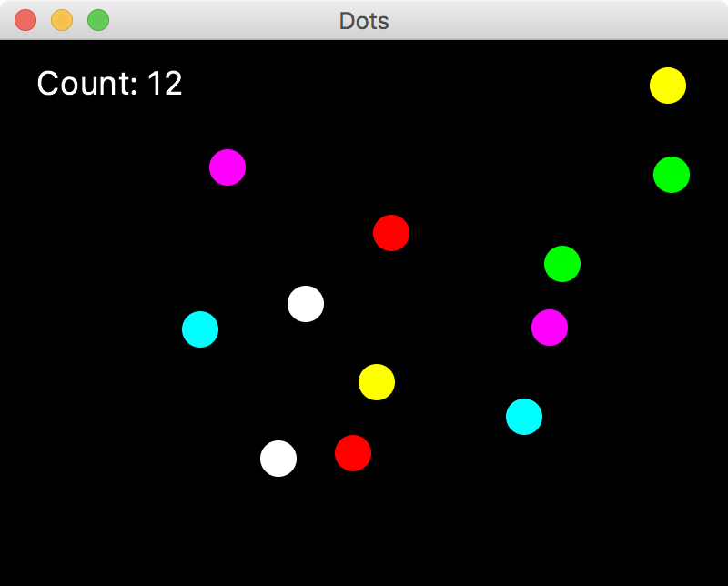
continue
//--------------------------------------------------------------------
// Process a mouse click by adding a circle to that location. Circle
// colors rotate through a set list of colors. A double click clears
// the dots and resets the counter.
//--------------------------------------------------------------------
public void processMouseClick(MouseEvent event)
{
if (event.getClickCount() == 2) // double click
{
count = 0;
colorIndex = 0;
root.getChildren().clear();
countText.setText("Count: 0");
root.getChildren().add(countText);
}
else
{
Circle circle = new Circle(event.getX(), event.getY(), 10);
circle.setFill(colorList[colorIndex]);
root.getChildren().add(circle);
colorIndex = (colorIndex + 1) % colorList.length;
count++;
countText.setText("Count: " + count);
}
}
}

Slide 94
Outline
Declaring and Using Arrays
Arrays of Objects
Variable Length Parameter Lists
Two-Dimensional Arrays
Polygons and Polylines
Array of Color Objects
Choice Boxes

Slide 95
Choice Boxes
A choice box lets the user select one of several options from a drop down menu
The JukeBox example allows the user to select a song from a choice box
Play and Stop buttons control the song playback
See JukeBox.java

Slide 96
import java.io.File;
import javafx.application.Application;
import javafx.event.ActionEvent;
import javafx.geometry.Insets;
import javafx.geometry.Pos;
import javafx.scene.Scene;
import javafx.scene.control.Button;
import javafx.scene.control.ChoiceBox;
import javafx.scene.control.Label;
import javafx.scene.layout.HBox;
import javafx.scene.layout.VBox;
import javafx.scene.media.AudioClip;
import javafx.stage.Stage;
//************************************************************************
// JukeBox.java Author: Lewis/Loftus
//
// Demonstrates the use of a combo box and audio clips.
//************************************************************************
public class JukeBox extends Application
{
private ChoiceBox<String> choice;
private AudioClip[] tunes;
private AudioClip current;
private Button playButton, stopButton;
continue

Slide 97
continue
//--------------------------------------------------------------------
// Presents an interface that allows the user to select and play
// a tune from a drop down box.
//--------------------------------------------------------------------
public void start(Stage primaryStage)
{
String[] names = {"Western Beat", "Classical Melody",
"Jeopardy Theme", "Eighties Jam", "New Age Rythm",
"Lullaby", "Alfred Hitchcock's Theme"};
File[] audioFiles = {new File("westernBeat.wav"),
new File("classical.wav"), new File("jeopardy.mp3"),
new File("eightiesJam.wav"), new File("newAgeRythm.wav"),
new File("lullaby.mp3"), new File("hitchcock.wav")};
tunes = new AudioClip[audioFiles.length];
for (int i = 0; i < audioFiles.length; i++)
tunes[i] = new AudioClip(audioFiles[i].toURI().toString());
current = tunes[0];
Label label = new Label("Select a tune:");
continue

Slide 98
continue
choice = new ChoiceBox<String>();
choice.getItems().addAll(names);
choice.getSelectionModel().selectFirst();
choice.setOnAction(this::processChoice);
playButton = new Button("Play");
stopButton = new Button("Stop");
HBox buttons = new HBox(playButton, stopButton);
buttons.setSpacing(10);
buttons.setPadding(new Insets(15, 0, 0, 0));
buttons.setAlignment(Pos.CENTER);
playButton.setOnAction(this::processButtonPush);
stopButton.setOnAction(this::processButtonPush);
VBox root = new VBox(label, choice, buttons);
root.setPadding(new Insets(15, 15, 15, 25));
root.setSpacing(10);
root.setStyle("-fx-background-color: skyblue");
Scene scene = new Scene(root, 300, 150);
primaryStage.setTitle("Java Juke Box");
primaryStage.setScene(scene);
primaryStage.show();
}
continue

Slide 99
continue
//--------------------------------------------------------------------
// When a choice box selection is made, stops the current clip (if
// one was playing) and sets the current tune.
//--------------------------------------------------------------------
public void processChoice(ActionEvent event)
{
current.stop();
current = tunes[choice.getSelectionModel().getSelectedIndex()];
}
//--------------------------------------------------------------------
// Handles the play and stop buttons. Stops the current clip in
// either case. If the play button was pressed, (re)starts the
// current clip.
//--------------------------------------------------------------------
public void processButtonPush(ActionEvent event)
{
current.stop();
if (event.getSource() == playButton)
current.play();
}
}

Slide 100
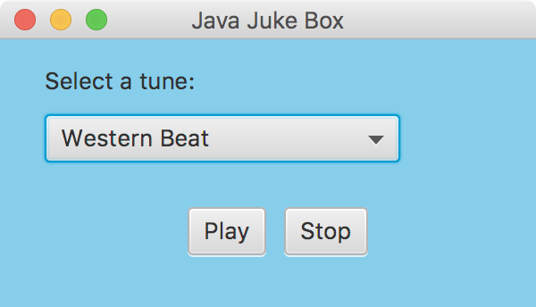
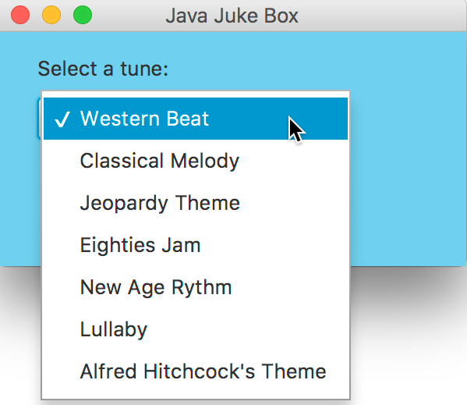
continue
//--------------------------------------------------------------------
// When a choice box selection is made, stops the current clip (if
// one was playing) and sets the current tune.
//--------------------------------------------------------------------
public void processChoice(ActionEvent event)
{
current.stop();
current = tunes[choice.getSelectionModel().getSelectedIndex()];
}
//--------------------------------------------------------------------
// Handles the play and stop buttons. Stops the current clip in
// either case. If the play button was pressed, (re)starts the
// current clip.
//--------------------------------------------------------------------
public void processButtonPush(ActionEvent event)
{
current.stop();
if (event.getSource() == playButton)
current.play();
}
}

Slide 101
Summary
Chapter 8 has focused on:
array declaration and use
bounds checking and capacity
arrays that store object references
variable length parameter lists
multidimensional arrays
polygons and polylines
choice boxes

