Slide 1
The benchmark is the bottleneck.
You do not need evals to move fast. You need evals to keep moving fast.
Notes:
Cold open with the statement.

Slide 2
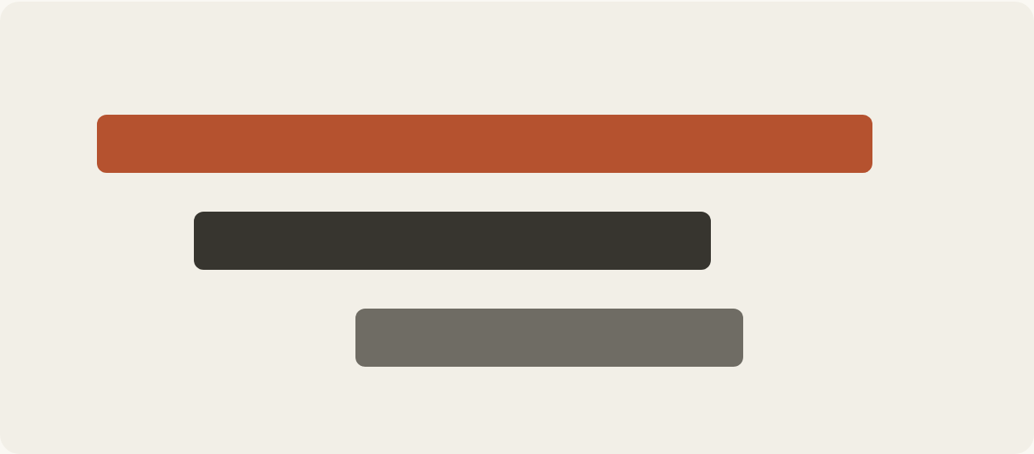
01 · AI STUDIO
Every run, laid out in time
Traces show where latency spikes and where calls fail in production.
interactions.py
client.interactions.create(model="gemini-2.5-pro")
Notes:
Walk through the streamed turn and the trace visual.

Slide 3
02 · MODELS
Three models, one API
2.5 Pro
2.5 Flash
2.5 Flash-Lite
Deep reasoning and complex coding.
Workhorse model with controllable thinking.
High-volume, low-latency classification.
Notes:
Compare the three model tiers.

