Slide 1
USMC BattleBots Training
By Ivan Ling

Slide 2
http://bit.ly/usmcrobot

Slide 3
Objectives
Learn basic Android programming
Learn basic Arduino programming
Linking Android and Arduino through Bluetooth
Crash course on Servo control

Slide 4
Android Programming
Install MIT App Inventor on your phone
Go to ai2.appinventor.mit.edu
Start new project

Slide 5
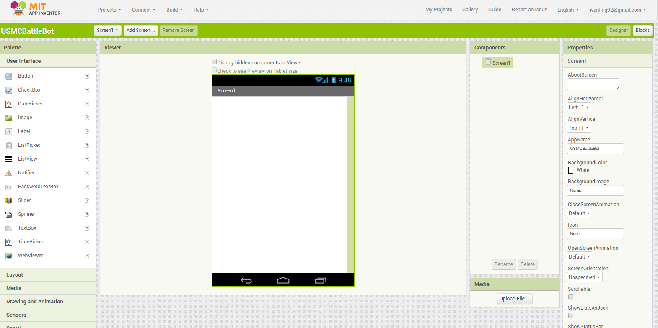
Android Programming

Slide 6
Design layout

Slide 7
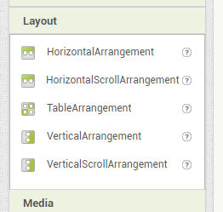
Design layout

Slide 8
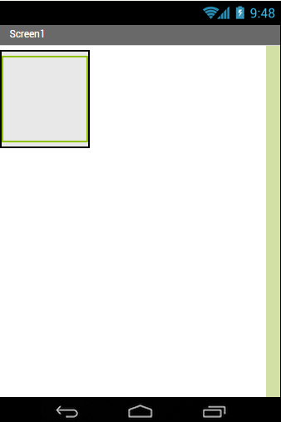
Design layout

Slide 9
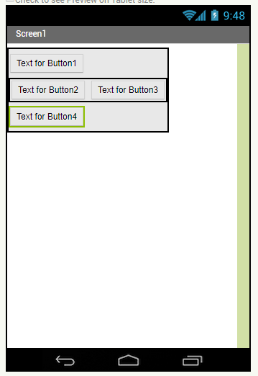
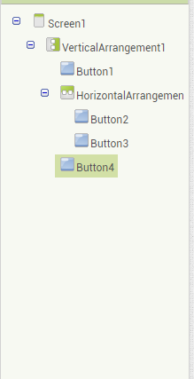
Design layout

Slide 10
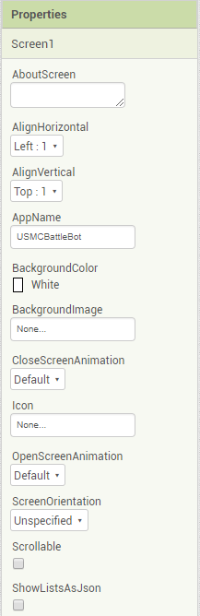
Design layout

Slide 11
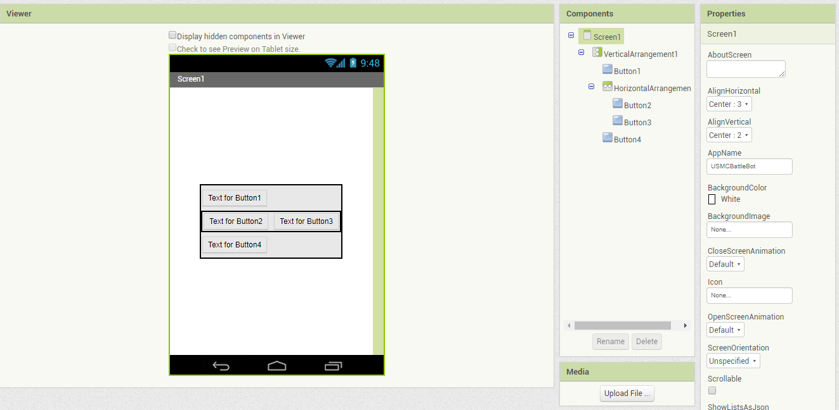
Design layout
Repeat step for verticalArrangement1 &
HorizontalArrangement1

Slide 12
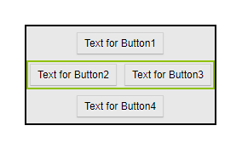
Design layout
End product should look like this

Slide 13
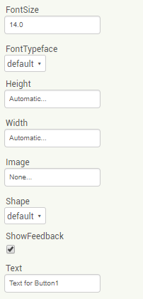
Design layout

Slide 14
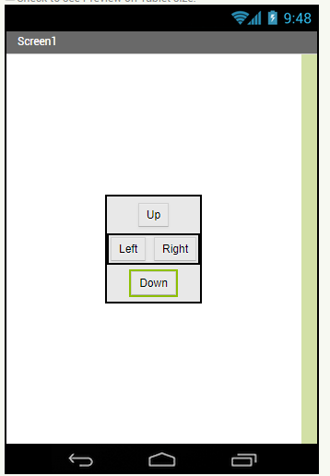
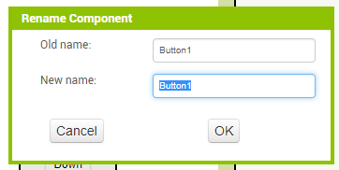
Design layout

Slide 15
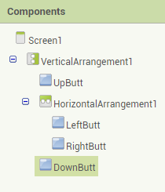
Design layout

Slide 16
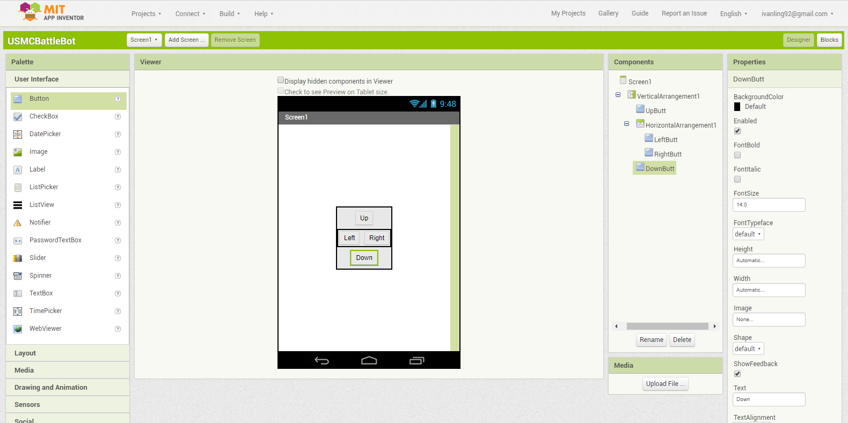
Design layout
Build, With QR

Slide 17
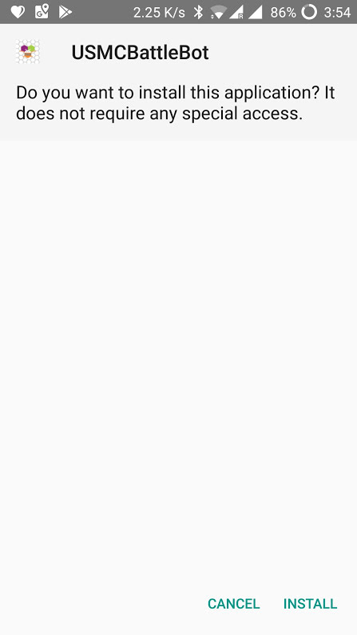
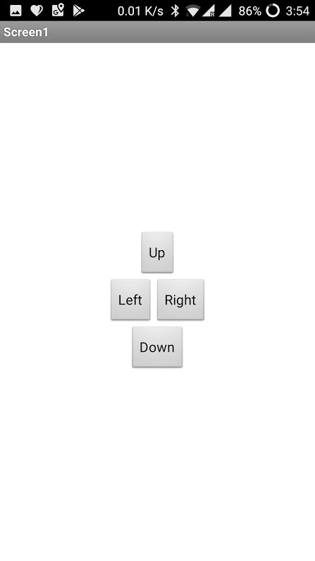
Test your app

Slide 18
Arduino
http://bit.ly/usmcrobot

Slide 19
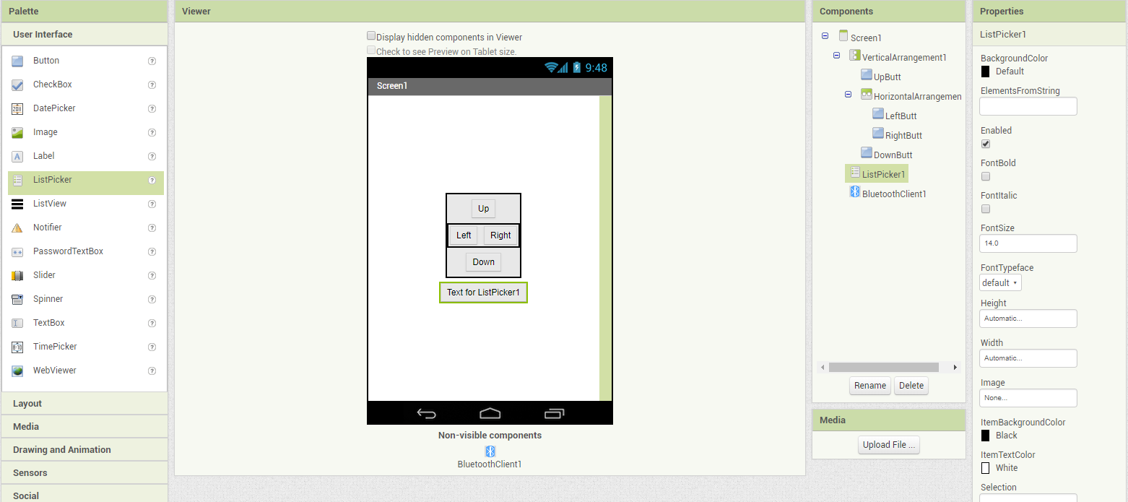
Bluetooth Connectivity

Slide 20
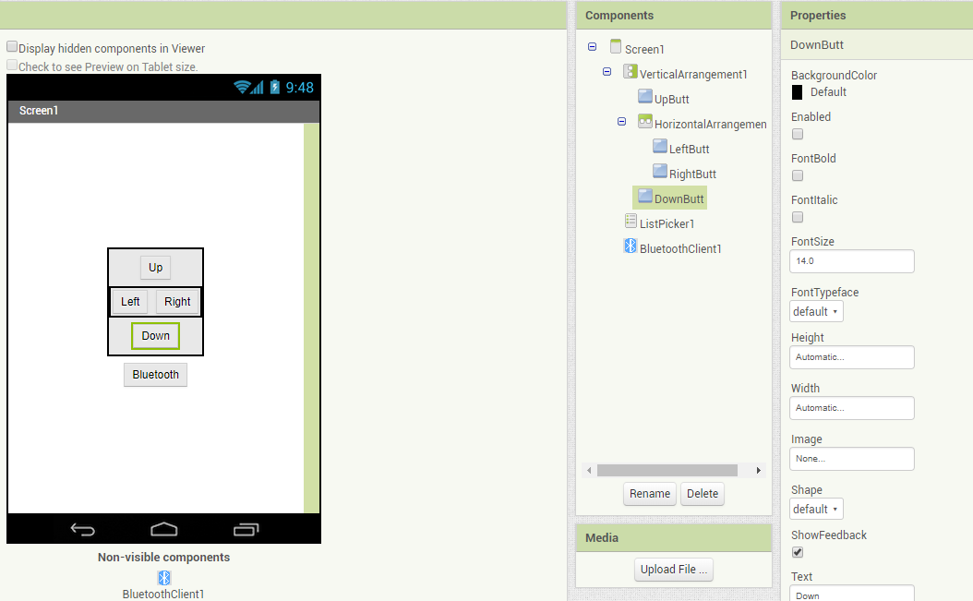
Bluetooth Connectivity

Slide 21
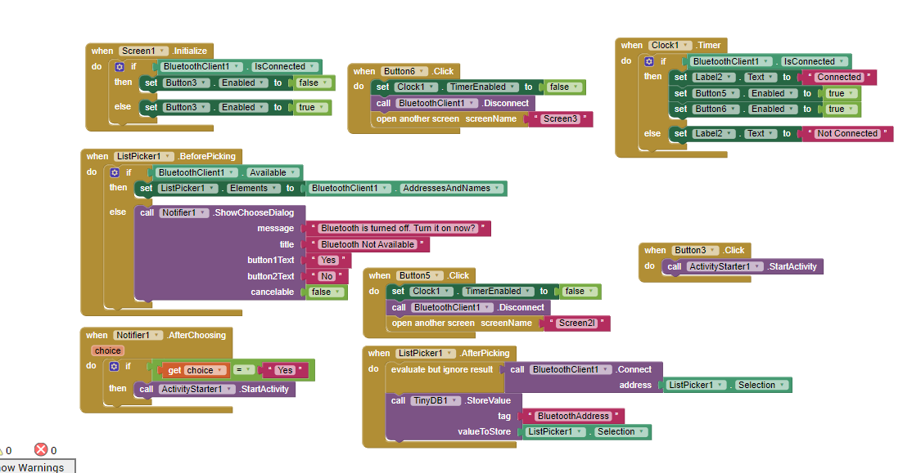
Bluetooth Connectivity

