Slide 1



Tangential and Centripetal Acceleration
Chapter 7 section 2

Slide 2
Linear and Angular Relationships
It is easier to describe the motion of an object that is in a circular path through angular quantities, but sometimes its useful to understand how the angular quantities affect the linear quantities of an object in a circular path.
  Example:
    Velocity of a bat as it hits a ball

Slide 3
What is a tangent?
Tangent – A line that just touches the edge of a point in a circular path and forms a 90º angle to the radius of the circle.
Tangent
r

Slide 4

Tangential Speed
Tangential Speed – The instantaneous linear speed of an object directed along the tangent to the object’s circular path.

Slide 5
Tangential Speed vs. Angular Speed
Imagine two points on a circle.
  One point is 1 meter away from the axis and another is 2 meters away.
  The points start to rotate.
Both points have the same angular speed because the angle between the initial and final positions are exactly the same.
Both points have different tangential speeds. The further away from the axis, the faster the point must travel.

Slide 6
Tangential Speed Explained
In order for both points to maintain the same angular displacement, the point further away from the axis has a longer radius and must travel through a larger arc length in the same amount of time.
The ratio between the arc length and radius must remain constant within a circle to keep the angle the same.

Slide 7
Tangential Speed Equation
vt = rω
vt = Tangential Speed
  Units: length per time (m/s)
r = Radius
ω = Angular speed
  Units for angular speed must be in (rad/s)

Slide 8
Example Problem
A golfer has an angular speed of 6.3 rad/s for his swing. He can chose between two drivers, one placing the club head 1.9 m from his axis of rotation and the other placing it 1.7 m from the axis.
  Find the tangential speed of each driver.
  Which will hit the ball further?

Slide 9
Example Problem Answer
1.9 m driver tangential speed = 12m/s
1.7 m driver tangential speed = 11m/s
The longer driver will hit the ball further given the knowledge learned from projectile motion.

Slide 10
Tangential Acceleration
Tangential Acceleration – The instantaneous linear acceleration of an object directed along the tangent to the object’s circular path.

Slide 11
Tangential Acceleration Explained
Going back to the golfer example problem.
  When he is getting ready to swing, the angular speed is zero and as he swings the driver down towards the ball, the angular speed increases
    Hence there is an angular acceleration
  Same holds true for tangential acceleration
  They are angular and tangential acceleration are both related to one another.

Slide 12
Tangential Acceleration Equation
at = rα
at = Tangential acceleration
  Units: length per second per second
    (m/s²)
r = radius
α = Angular acceleration
  Units must be in (rad/s²)

Slide 13

Example Problem
A centrifuge starts from rest and accelerates to 10.4 rad/s in 2.4 seconds. What is the tangential acceleration of a vial that is 4.7 cm from the center?

Slide 14

Example Problem Answer
at = 0.21m/s²

Slide 15
Velocity Is a Vector
Velocity is a vector quantity
  Has magnitude and direction
Using a car as an example if you travel at 30m/hr in a circle, is your velocity changing?
  Of course! Changing direction is changing velocity.
Changing velocity means there is acceleration.

Slide 16
Centripetal Acceleration
Centripetal Acceleration – The acceleration of an object directed towards the center of its circular path.

Slide 17
Graphical Look at Changing Velocity
vi
See how Δv points towards the center of the circle. That means the acceleration points towards the center of the circle.
Δs
vf
r
r
θ
vi
Δv
vf

Slide 18
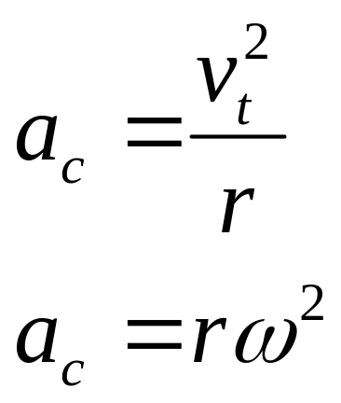
Centripetal Acceleration Equations
αc = Centripetal acceleration
vt = Tangential Velocity
r = Radius
ω = Angular speed

Slide 19
Centripetal Acceleration vs. Centrifugal Acceleration
Centripetal means, “Center-Seeking”
Centrifugal means, “Center-Fleeing”
  Centrifugal acceleration is an imaginary acceleration and force.
  It is actually inertia in action
  Example:
    Coat hanger and quarter trick

Slide 20
Example Problem
A cylindrical space station with a 115, radius rotates around its longitudinal axis at and angular speed of 0.292 rad/s. Calculate the centripetal acceleration on a person at the following locations.
  At the center of the space station
  Halfway to the rim of the space station
  At the rim of the space station

Slide 21

Example Problem Answers
0m/s²
4.90m/s²
9.81m/s²

Slide 22
Tangential and Centripetal Acceleration
Tangential and centripetal accelerations are always perpendicular.
Both can happen at the same time.
  Increasing a car’s speed while making a turn into a corner of a racetrack.
Tangential component is due to changing speed.
Centripetal component is due to changing direction.

Slide 23
Total Acceleration
If both accelerations are happening at the same time, then the Pythagorean Theorem must be used to find the total acceleration.
The direction of the total acceleration can be found using the tangent function.
  The acceleration still points towards the center of the circle

