Slide 1


$team
Data Analysis
Meng Xiao
Songsong Guan
Tianxiang Liu
Vader Thiru

Slide 2
Dataset Statistics
Total Bets: 3,461,173 transactions
Total Event: 44 (1 cancellation)
Total Accounts: 21,02 in 69 different countries
Total Matched bets: 2,812,898 – 81.2% of all trans
In-play Bets : 2,534,654 – 73.2% of all trans
Total user Profits(generate commission) :
$706,808,897
Total user Loss (approximately equal to total profits): $706,823,612

Slide 3
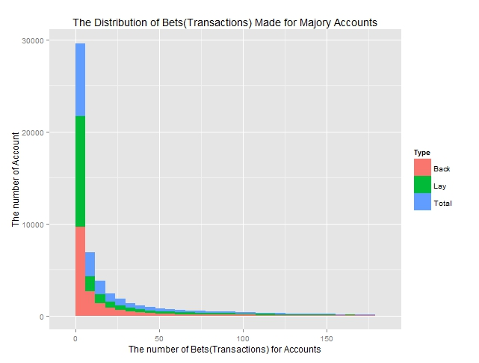
Exploration: Bets by Account

Slide 4
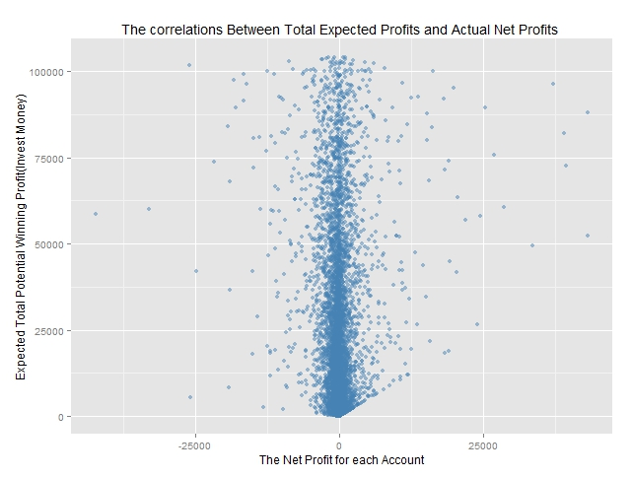
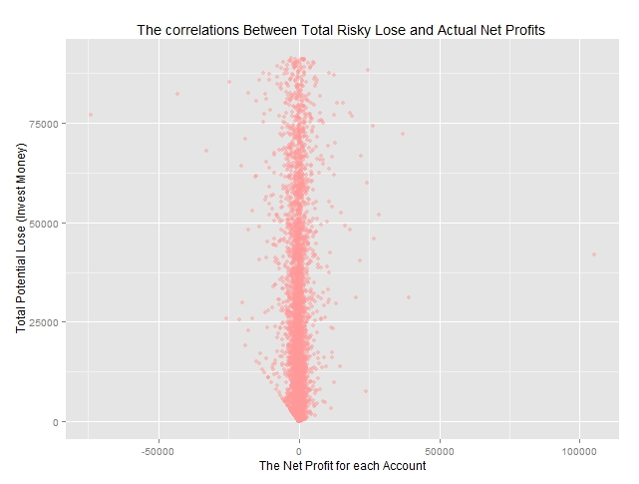
Exploration: Expectation vs. Actual

Slide 5
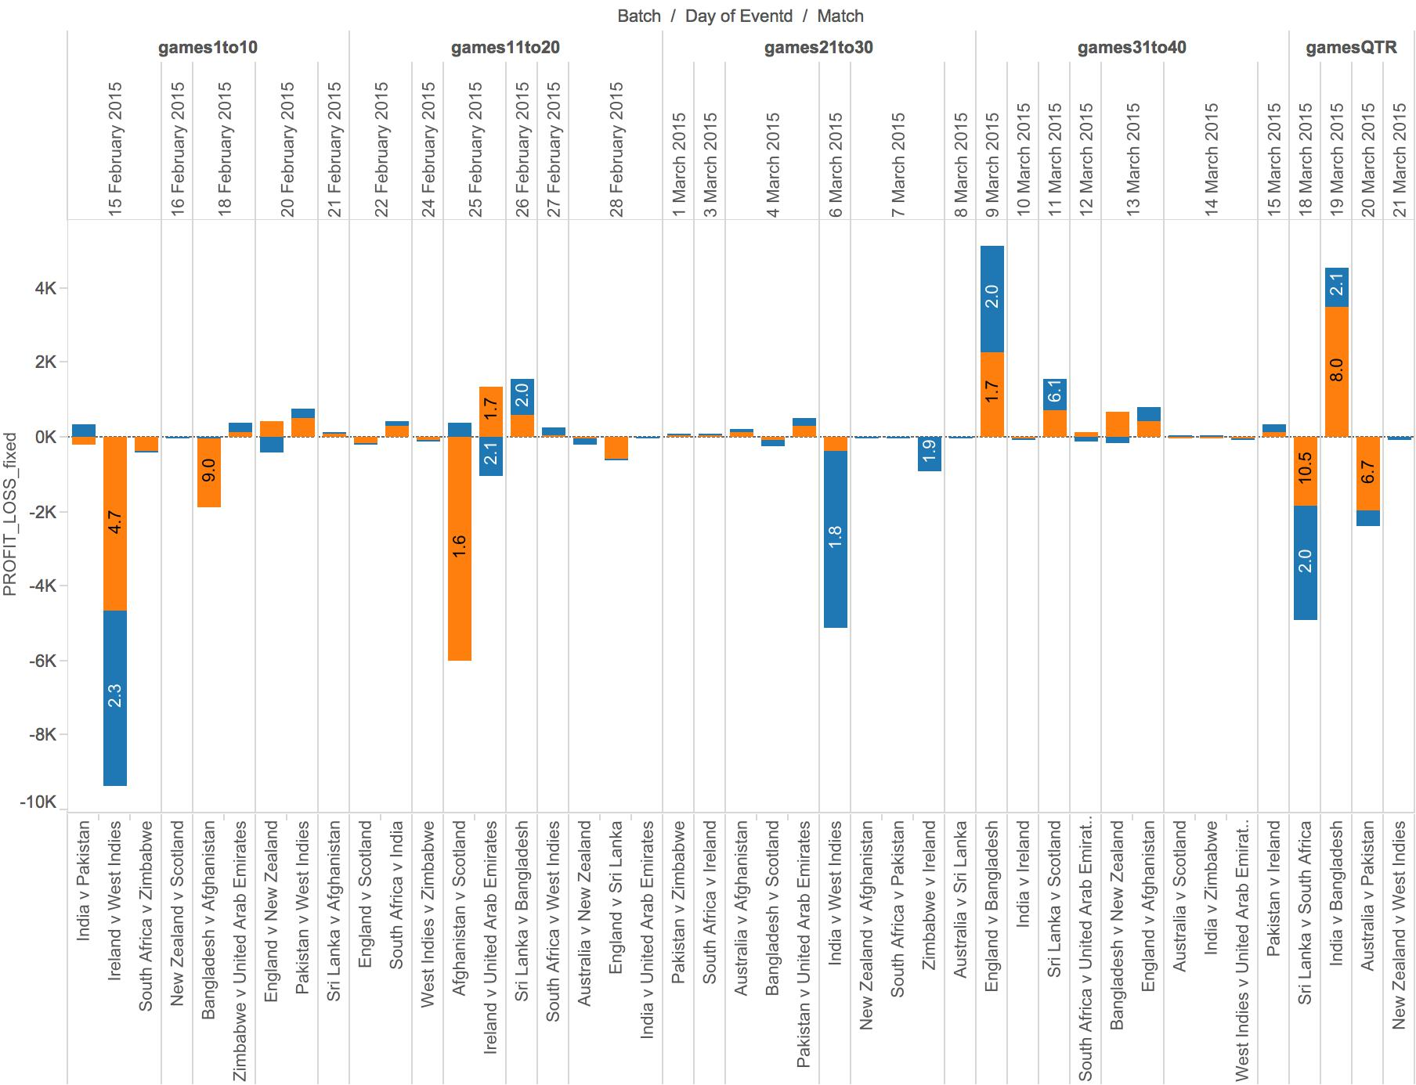
Exploration: Total Profit/Loss
Bangladesh
won
People seem to bet on games where there is a clear
Winner but lose
Ireland won!
Afghanistan won!

Slide 6
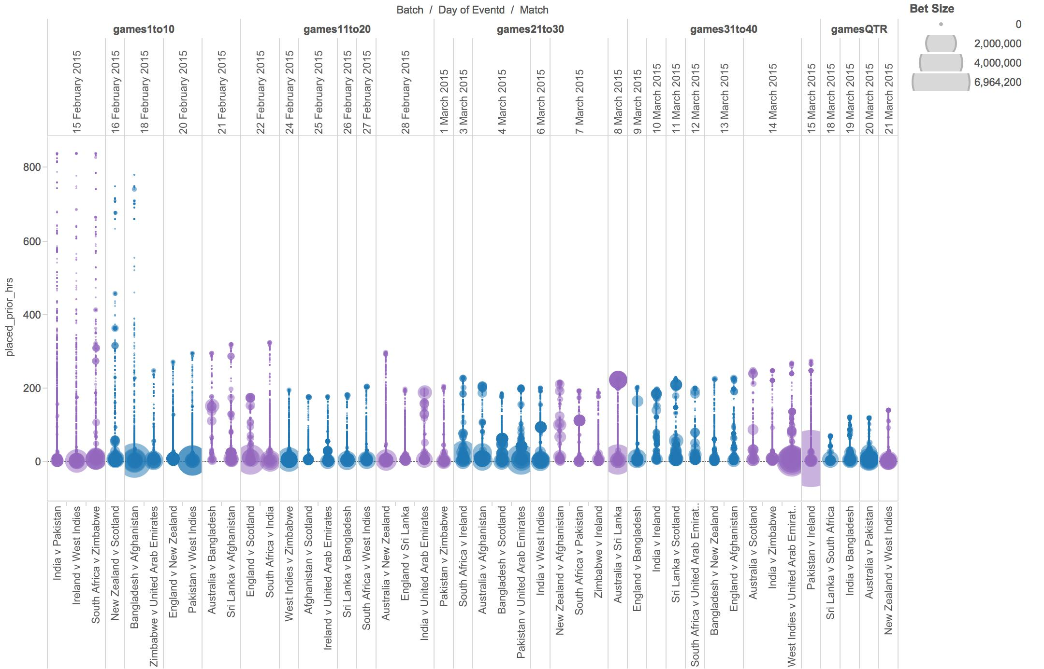
Exploration: Placed Time

Slide 7
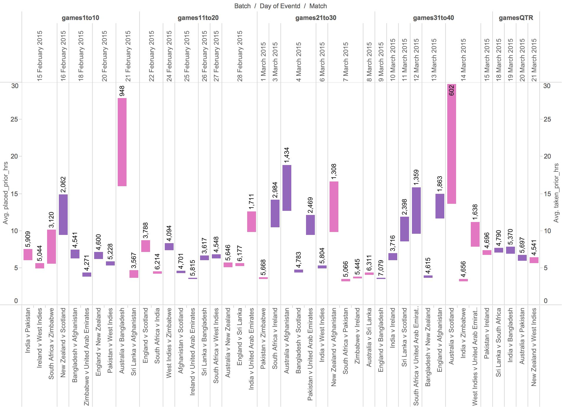
Exploration: Placed vs. Taken time

Slide 8
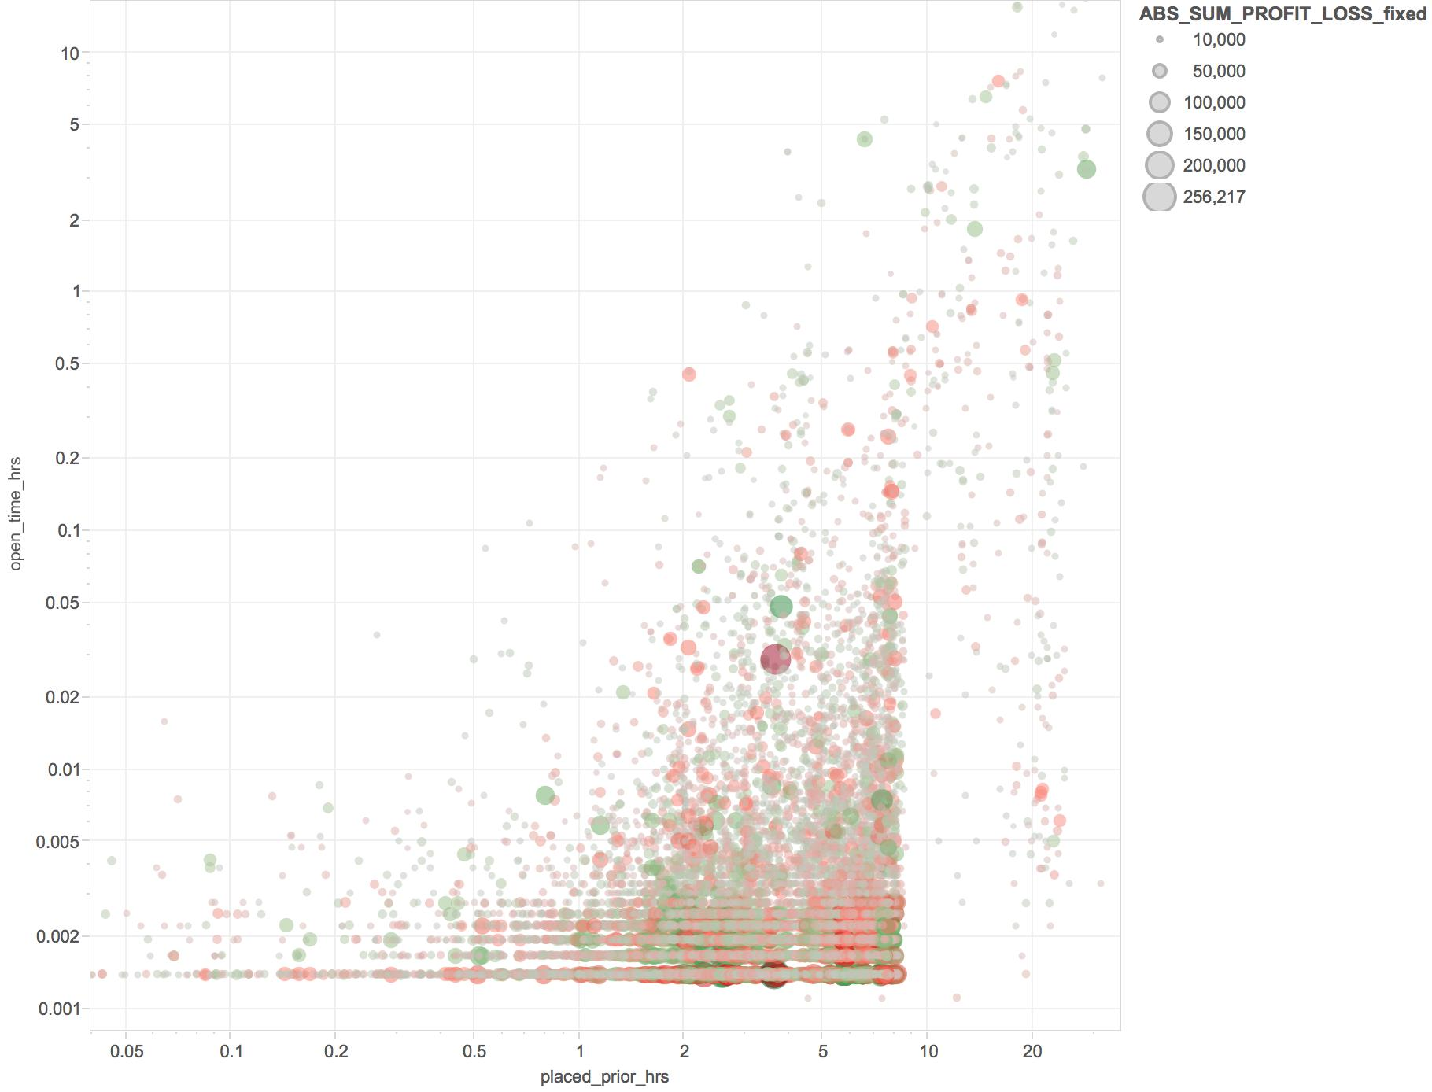
Exploration: Placed vs. Open time

Slide 9
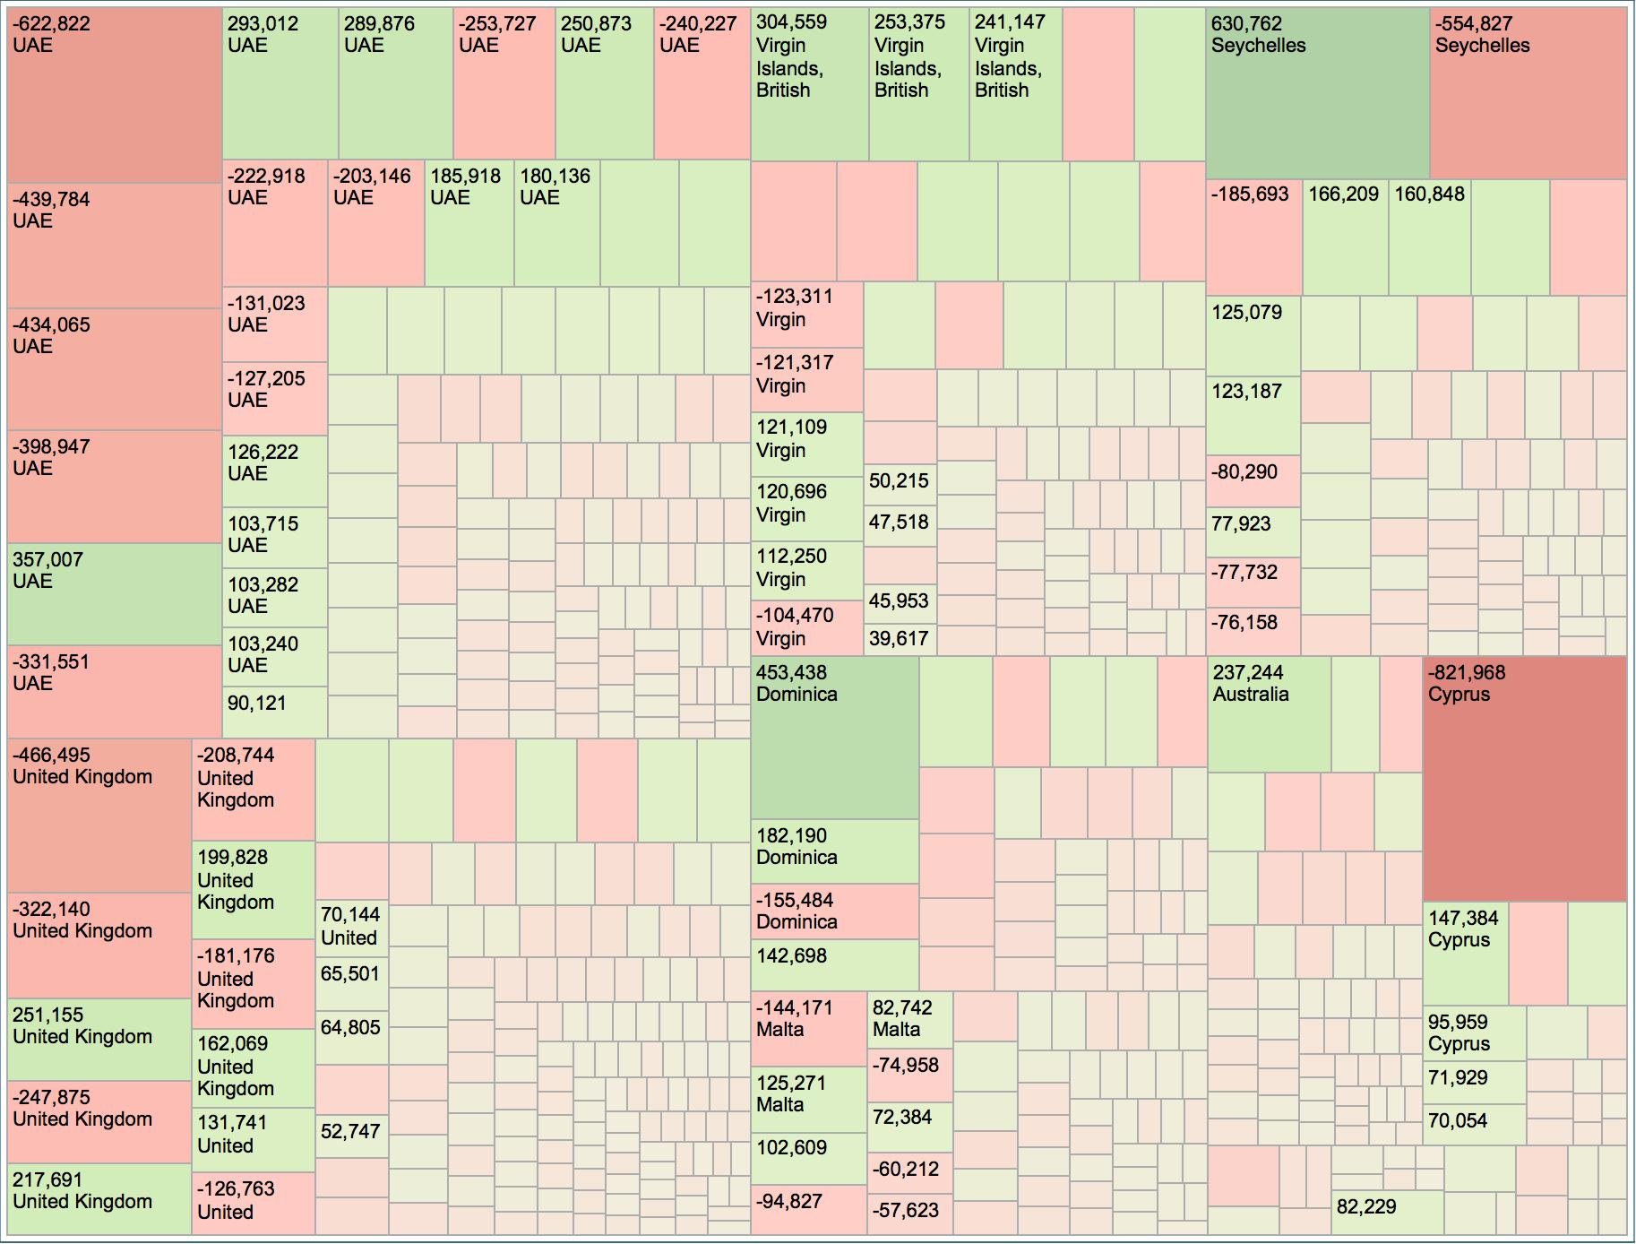
Exploration: Biggest Winners/Losers

Slide 10
Segmenting by Key Statistics
Key account segments customers (segment 1 & 2) generate well over half of transactions and over 90% of total transaction values.
Middle and lower value customers (> 70% of customers) generate around 5% of transactions and less than 1% of total transaction values.

Slide 11
Segmenting: RFM Model
Key Account |  | High Value |  | Mid Value |  | Low Value
Recency
The BetFair RFM model has been built over 3 months period.
 | Average Spend Bands
Bets Bands | <=$20 | $21 to $45 | $46 to $100 | $101 to $290 | $291 to $1000 | >$1000
<= 2 bets | 9. Experimenter |  |  | 8. Event-focused player
3 to 9 bets | 7. Casual entertainment player |  |  | 6. Frequent gambler
10 to 50 bets
51 to 100 bets | 5. Opportunist |  | 4. Strategy-driven gambler |  | 3. Professional gambler
101 to 500 bets
> 500 bets | 2. Small syndicate |  |  | 1. Large syndicate / business
Frequency
Number of bets over 3 months (grouped into 6 bands based on distribution of data).
Monetary
Average Transaction Value (ATV) over the 3 months (grouped into 6 bands based on distribution of data.)

Slide 12
Segmenting: Uplift Strategies
How can we lift customers from lower/middle value segments to a higher value segment via campaigns and promotions?
More bets
Bet More
 | Average Spend Bands
Bets Bands | <=$20 | $21 to $45 | $46 to $100 | $101 to $290 | $291 to $1000 | >$1000
<= 2 bets | 9. Experimenter |  |  | 8. Event-focused player
3 to 9 bets | 7. Casual entertainment player |  |  | 6. Frequent gambler
10 to 50 bets
51 to 100 bets | 5. Opportunist |  | 4. Strategy-driven gambler |  | 3. Professional gambler
101 to 500 bets
> 500 bets | 2. Small syndicate |  |  | 1. Large syndicate / business
Next, we'll develop a clustering model to identify exactly those customers who fall into each category:
  Aggressive (make bigger bets) or
  Defensive customers (bet more often)

Slide 13
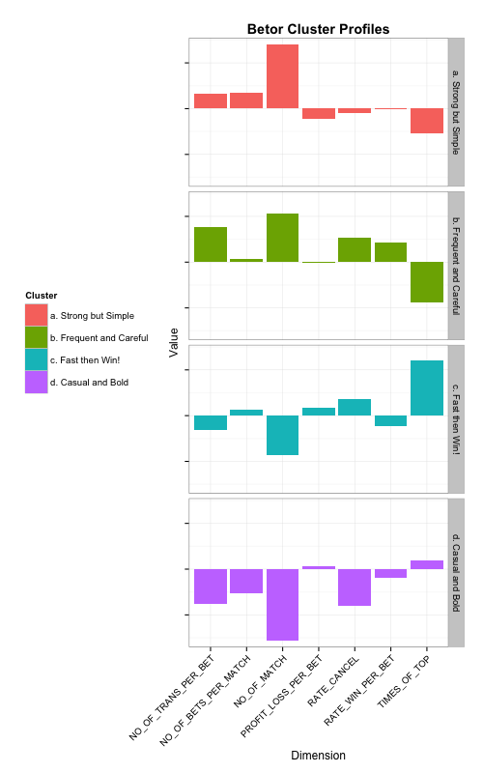
Clustering 1
A. Strong but Simple: Bet more and diversely, but does not have a good outcome
B. Frequent and Care: Bet frequently, but cancel a lot
C. Fast then Win!: Bet less and early, but wins a lot
D. Casual and Bold: No strategy, just casually play
Gut Findings from the Clusters Profiles
Those who placed the bet early and focus on smaller number of bets seem to gain more profit than others
Those who put more transactions into a single bet and carefully considering cancelling offers, turns out to have a higher win rate than others
More bets do not mean more win/profit

Slide 14
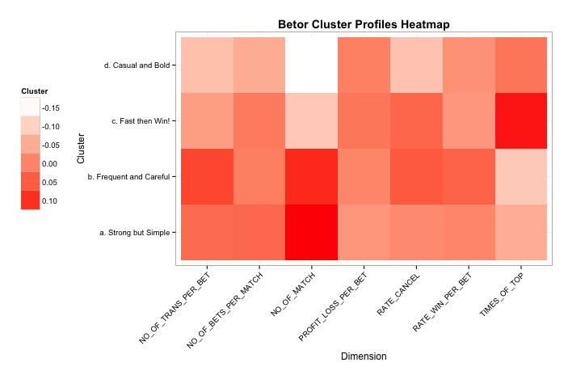
Clustering 2

Slide 15
Clustering 3
Send right customers the right offer to increase ROI and minimize campaign / offer costs
 | Average Spend Bands
Bets Bands | <=$20 | $21 to $45 | $46 to $100 | $101 to $290 | $291 to $1000 | >$1000
<= 2 bets | 9. Experimenter |  |  | 8. Event-focused player
3 to 9 bets | 7. Casual entertainment player |  |  | 6. Frequent gambler
10 to 50 bets
51 to 100 bets | 5. Opportunist |  | 4. Strategy-driven gambler |  | 3. Professional gambler
101 to 500 bets
> 500 bets | 2. Small syndicate |  |  | 1. Large syndicate / business
More bets
(towards RFM segment 7)
Bet more
(towards RFM segment 8)

Slide 16
That's all folks! -$team
Meng Xiao meng.noah.xiao@gmail.com
Songsong Guan songs.guan@gmail.com
Tianxiang Liu ivan.liu@servian.com.au
Vader Thiru vader.thiru@servian.com.au

