Slide 1
Heuristic Optimization Methods Project
Capacitated Vehicle Routing Problem with Time Windows (CVRPTW)
Ivan Navratil, Luka Mesarić
github.com/ivannavratil/hmo-project-cvrptw

Slide 2
High-level overview
Solution representation
Route = list of nodes
Solution = list of routes
Cache departure times, unvisited customers, capacity, distance
Fitness
Relative via pairs (vehicles, distance)
Two solution construction phases
Ant colony system (ACS)
Local search (LS)

Slide 3
Ant colony system
Initialize pheromones with a fixed or estimated value
Let ants traverse one after another
Construct a full solution
Update local pheromones
Select best ant
Run a quick local search
Update pheromones
Update incumbent solution

Slide 4
ACS parameters
α – regulates the relative importance of pheromones
β – regulates the relative importance of visibility
θ – regulates the relative importance of wait time
q₀ – the probability of choosing the best neighbor
τ₀ – initial pheromone value
ρ – pheromone evaporation factor
ants per iteration – number of ants to be used in each ACS iteration

Slide 5
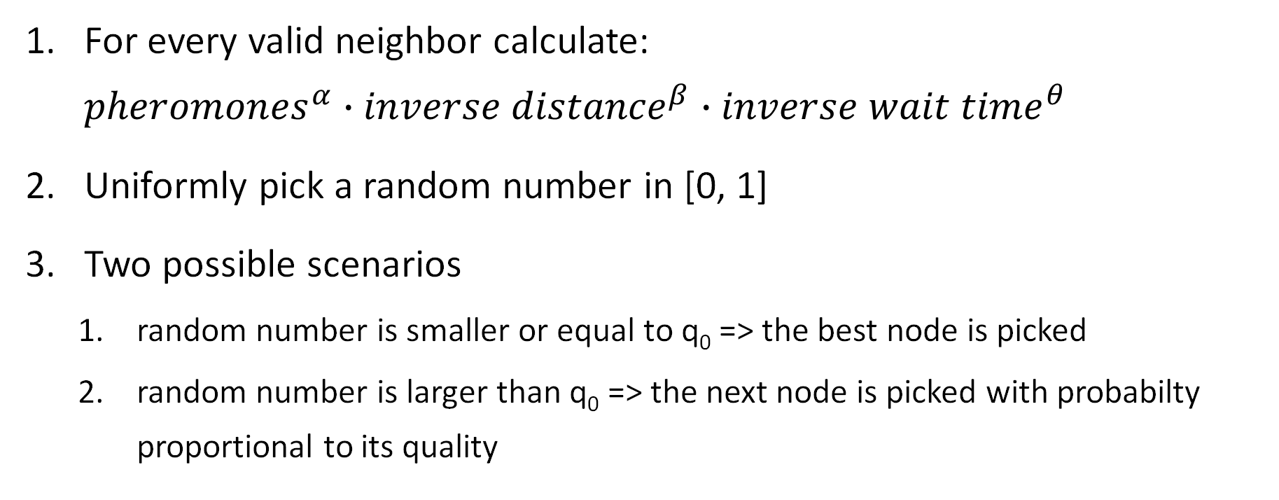
Choosing the next node
For every valid neighbor calculate: ${pheromones}^{α}∙{inverse distance}^{β}{∙inverse wait time}^{θ}$
Uniformly pick a random number in [0, 1]
Two possible scenarios
random number is smaller or equal to q₀ => the best node is picked
random number is larger than q₀ => the next node is picked with probabilty proportional to its quality

Slide 6
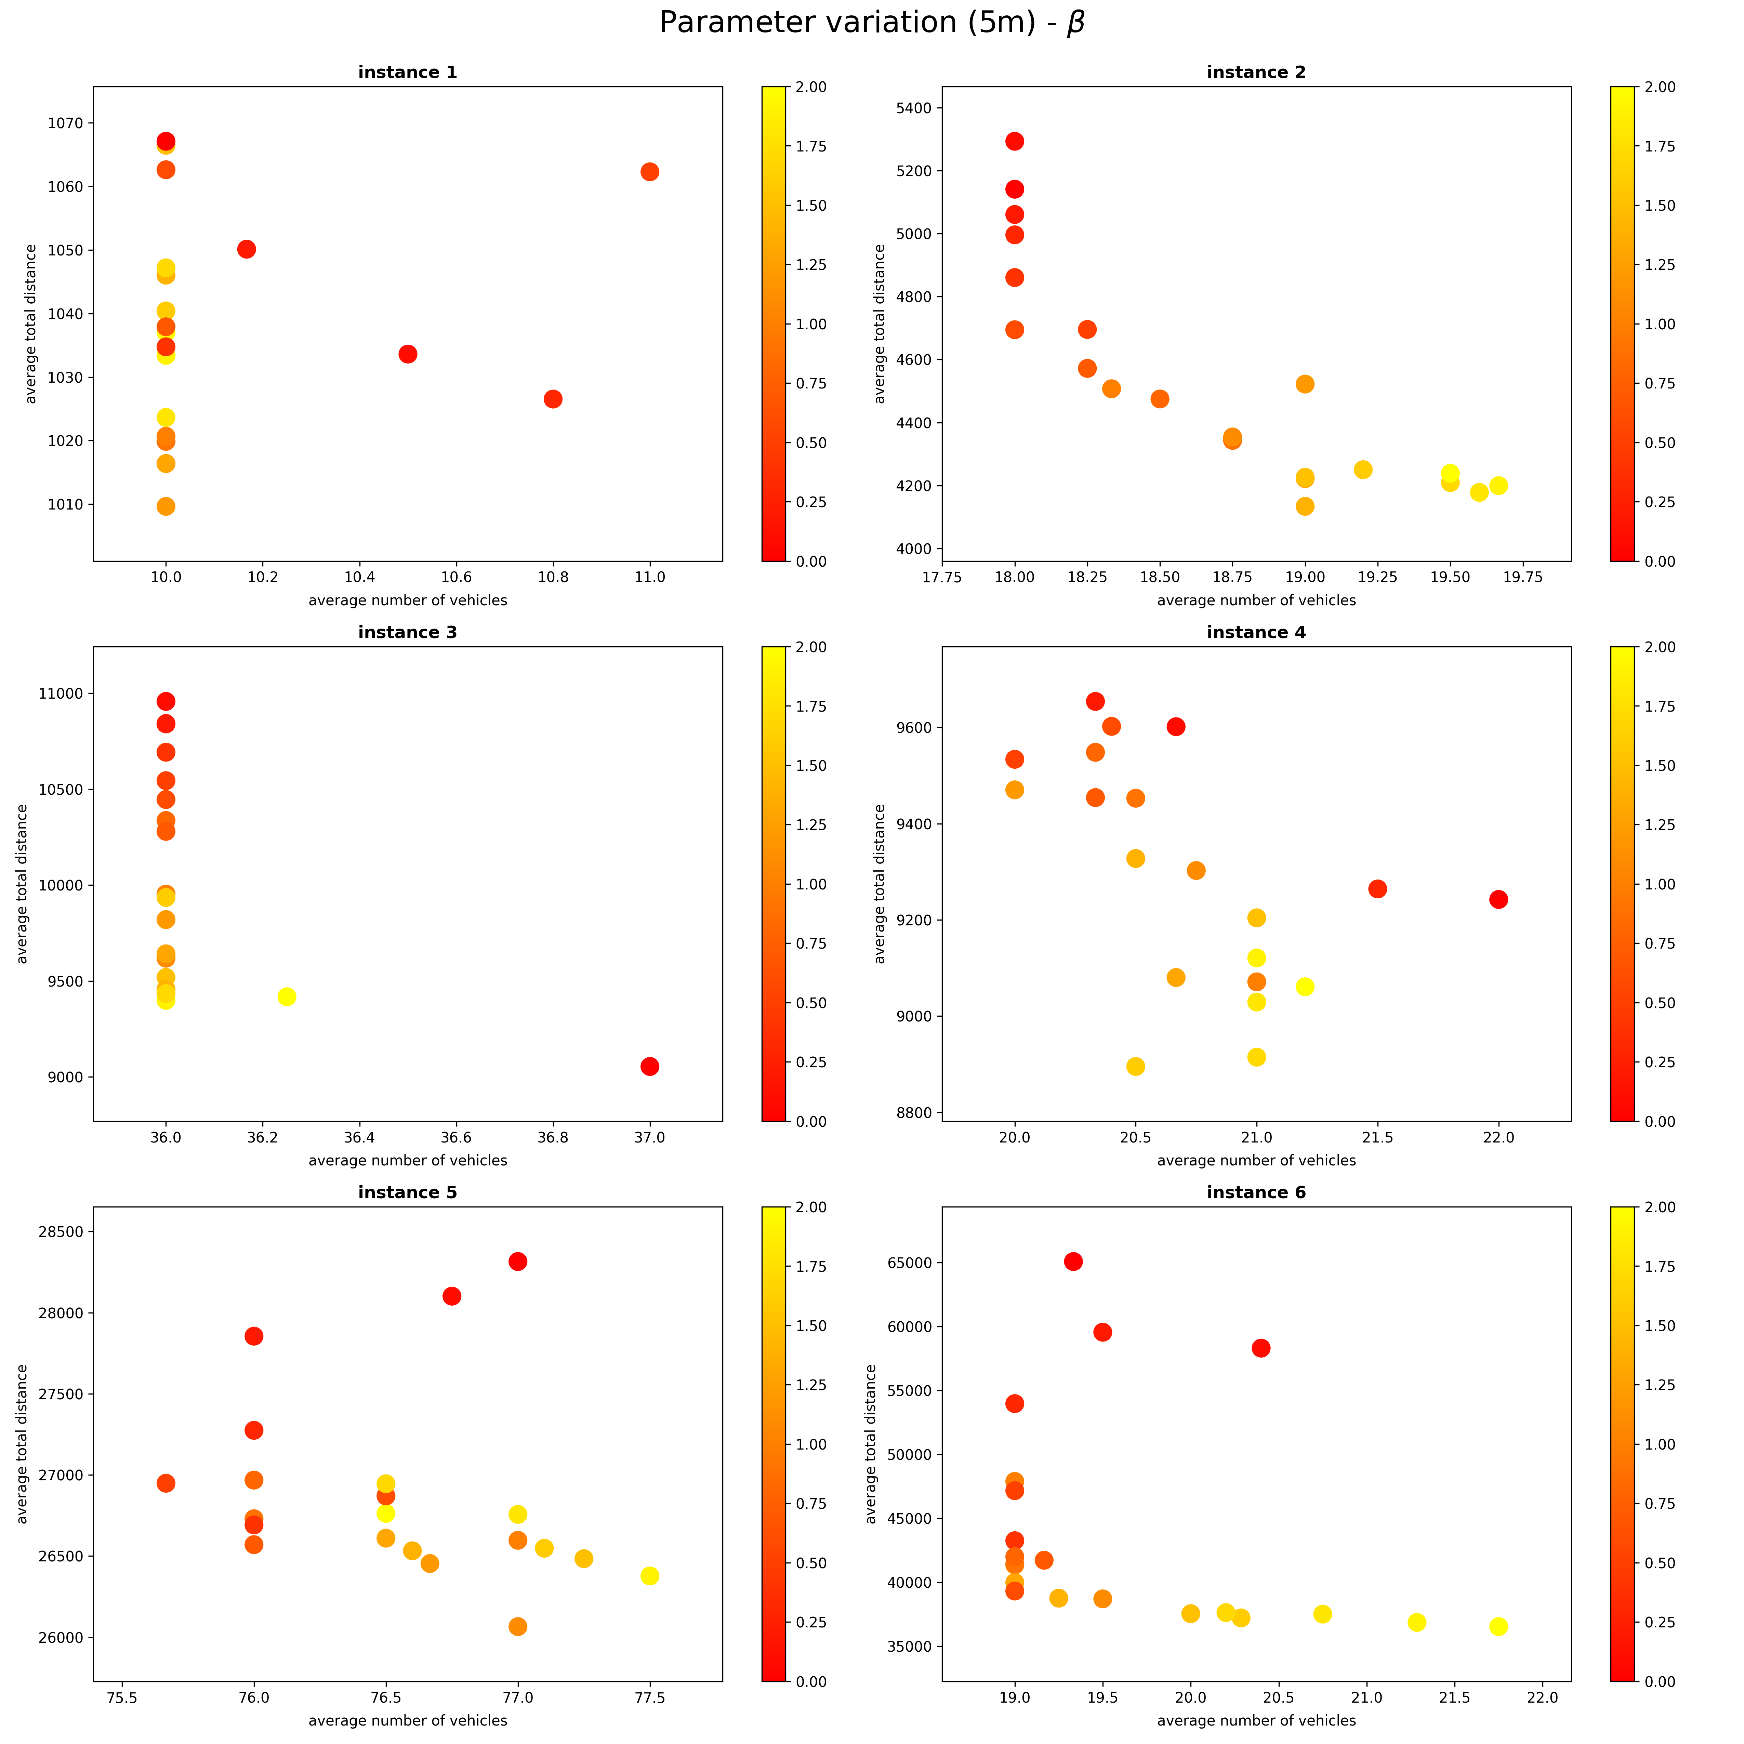
Parameter analysis
Changing a single parameter at a time
400+ five-minute runs per parameter
Not particularly useful

Slide 7
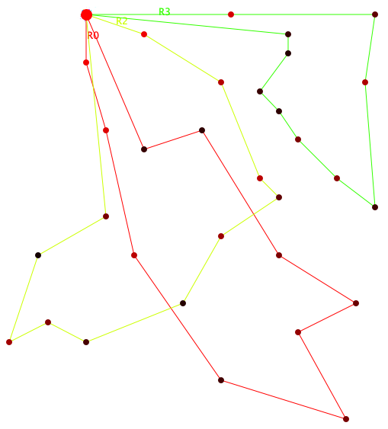
Local search – moves
2-opt*
Remove two arcs and exchange parts
Internal-2
Reorder two neighboring customers
Internal-3
Reorder three neighboring customers
Transfer
Move a customer between routes

Slide 8
Local search – comparing moves
Always prefer route removal
Transfer
2-opt*
Compare by
Relative difference of route lengths
Total distance savings
Consider only moves which reduce distance

Slide 9
Local search – neighborhoods
Deterministic
Best move from all move types
Best move with preference for types
Stochastic
Best move from random type
Random move from all types
Random move from RCL of all types (20%)
Up to 1,000,000 possible moves
Approx. 0.1% are valid

Slide 10
Local search – quick vs full
Quick local search
One deterministic neighborhood
Estimation of τ₀ = 1/L*
Improving best ant – 8 iterations or 100ms
Full local search
All deterministic neighborhoods
All stochastic neighborhoods, repeatedly until time limit
Final search after ACS

Slide 11
Other information
Termination criterion
Elapsed real time
Number of iterations
Optimizations
Reduced solution copying
Custom flat matrix implementation
Algorithm convergence
5 to 15 minutes
ACS
500 to 2000 iterations
1ms to 50ms per ant
Local search
100 to 700 iterations
1ms to 20ms per iteration
Total of 10,000 runs
36 CPU days

Slide 12
Possible improvements
Simulated annealing
Allow negative distance savings
ΔS = ?
Tabu search
Savings heuristic
More LS moves
Mutual Transfer
Internal-N
Parallelization of full LS

Slide 13
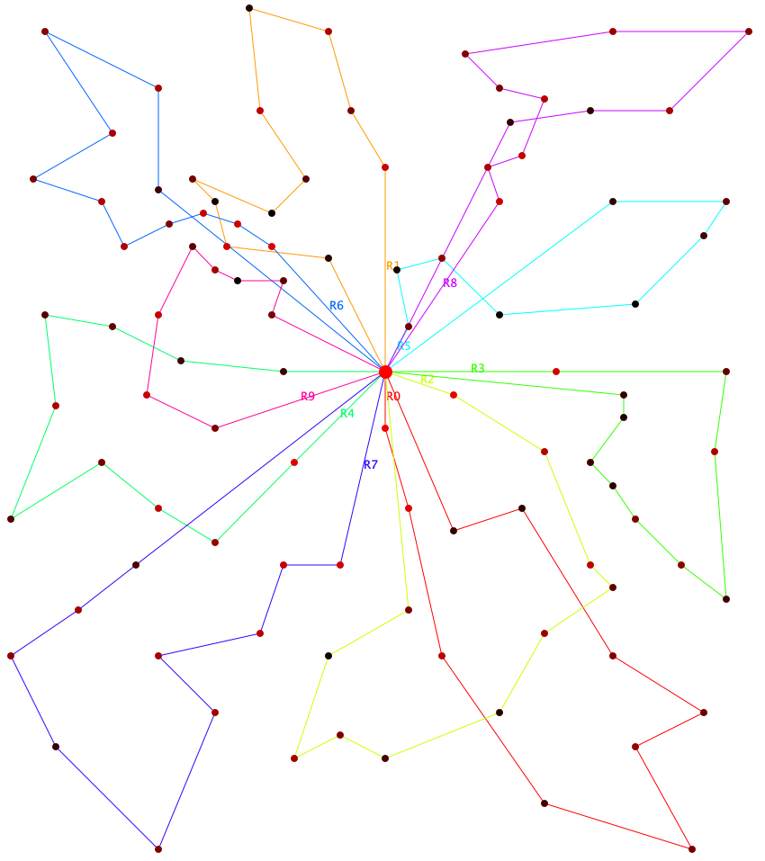
1st instance plot
Best found solution:
10 vehicles 980.17 units of distance

Slide 14
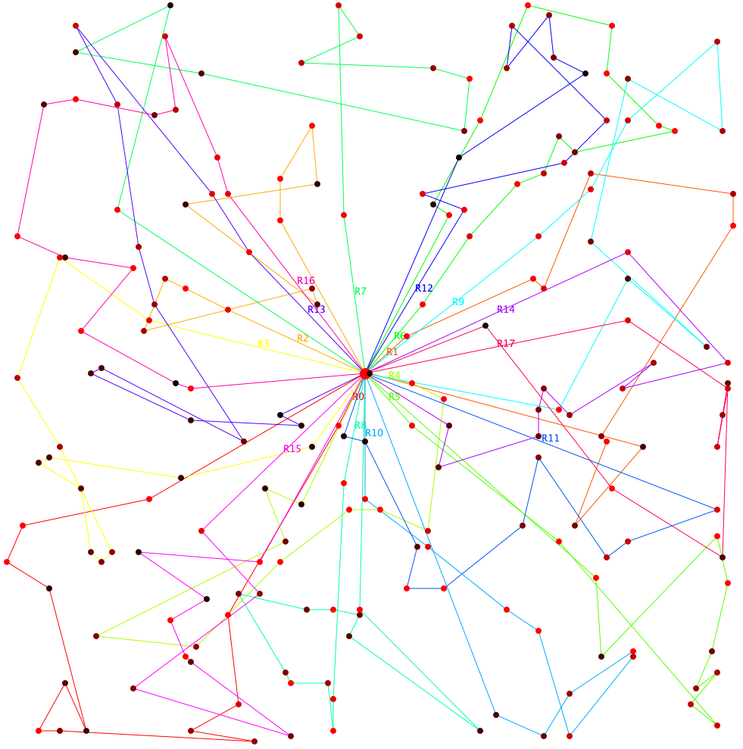
2nd instance plot
Best found solution:
18 vehicles 4233.05 units of distance

Slide 15
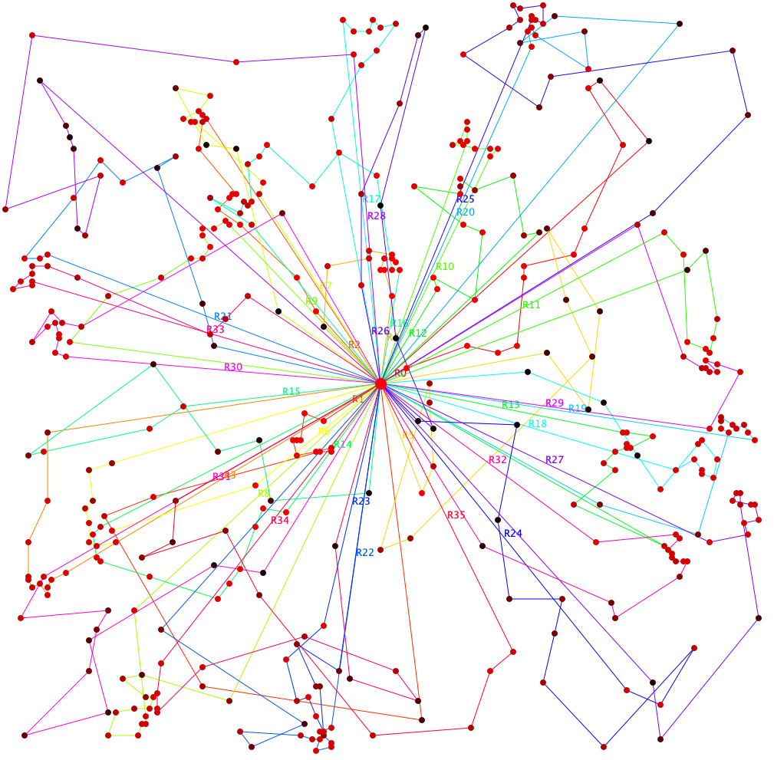
3rd instance plot
Best found solution:
36 vehicles 8997.76 units of distance

Slide 16
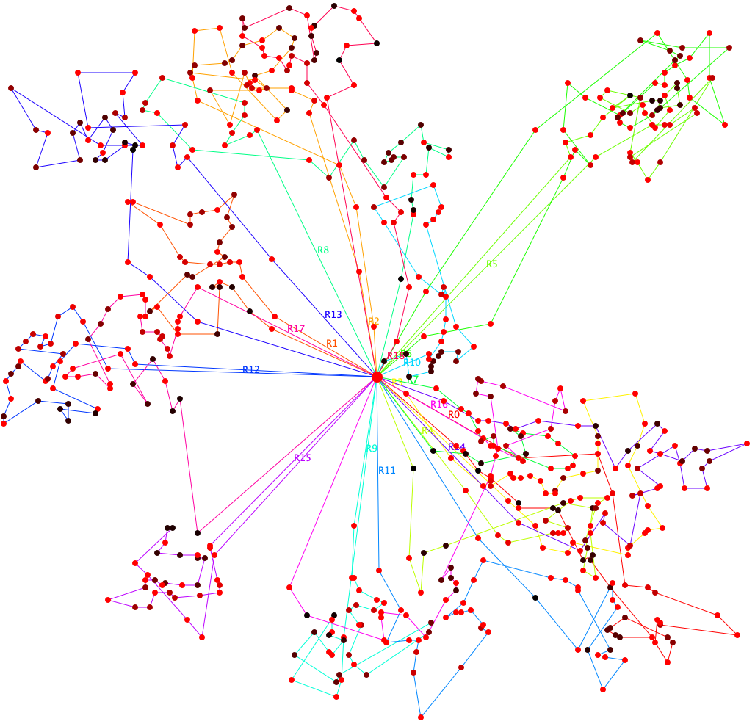
4th instance plot
Best found solution:
19 vehicles 8878.73 units of distance

Slide 17
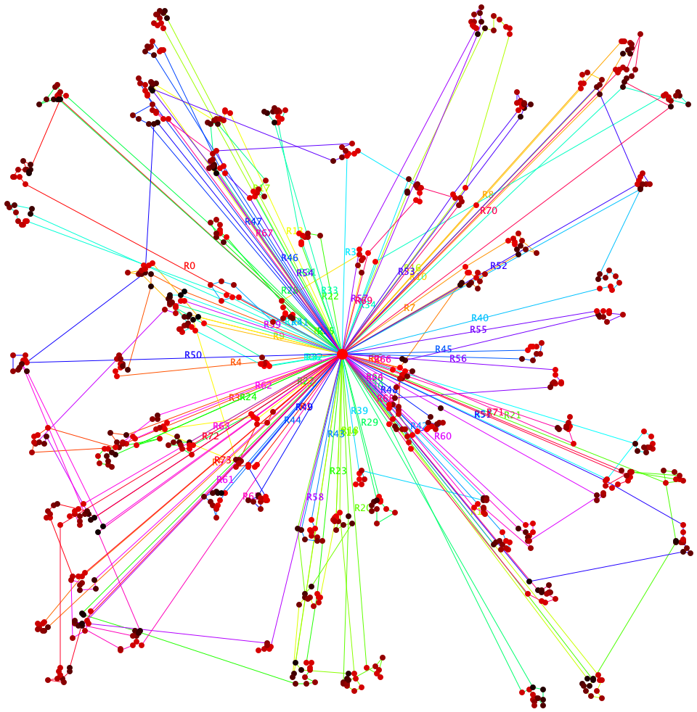
5th instance plot
Best found solution:
74 vehicles 26850.31 units of distance

Slide 18
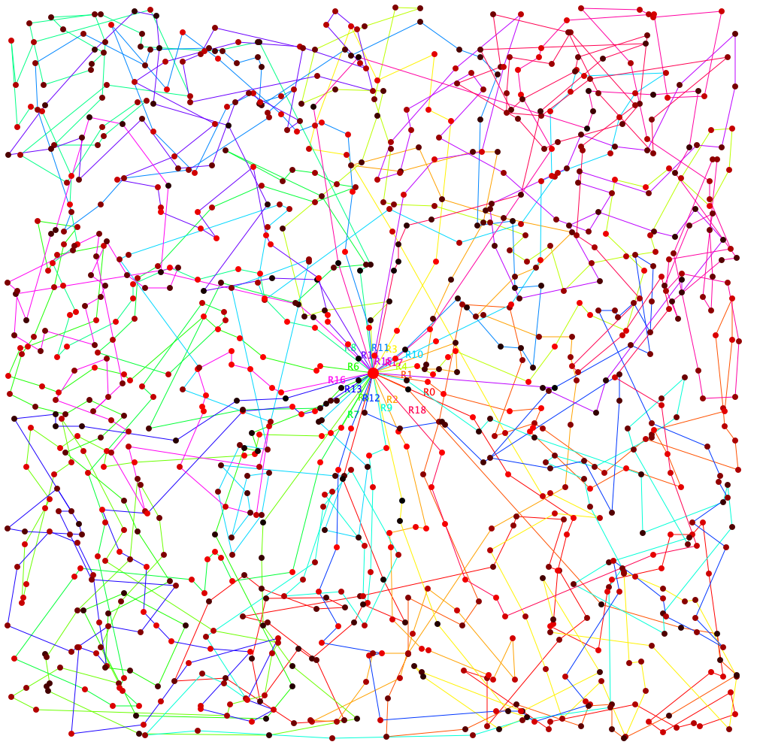
6th instance plot
Best found solution:
19 vehicles 35656.83 units of distance

