Slide 1
Intro to FPGAs and HDLs

Slide 2
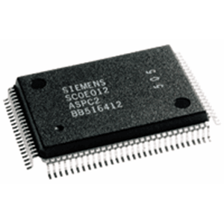

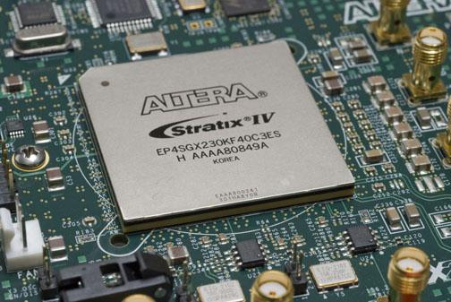
Digital systems
Microprocessors
General purpose
Software programmable
Inexpensive ($0.25 ~ $10)
Relatively Slow
*Not considering high end CPUs
ASIC
Application Specific Integrated Circuit
Non-programmable
Very expensive in low quantities unless CAOTS (manufacturing is expensive!)
Fastest
FPGA
Field Programmable Gate Array
General purpose (if you want)
HDL/Software programmable
Relatively cheap in low quantities ($100-$1000)
Medium-Fast speed

Slide 3
What is an FPGA?
Field Programmable Gate Array
Need to understand a Look-up Table (LUT) first.
4-cell memory
Truth Table (read enabled)
Data
Addr[1] | Addr[0] | Output
0 | 0 | 0
0 | 1 | 1
1 | 0 | 1
1 | 1 | 1
0
0
1
1
1
2
1
Addr
Output
2
3
Write
read
We we can use the memory cells as the outputs of a function and the address line as the inputs. This 4-cell memory can represent any 2 input gate if we write the appropriate values!

Slide 4
What is an FPGA?
An array of Gates? No, an Array of LUTs!
Main idea: Use many LUTs (Logic Elements) in a programmable routing matrix to represent any logical function.
Consists of 100k to several million LEs (LUTs)
Integrate special function units
Multipliers
PLLs
On-board memory
A high end FPGA
5.5M logic elements
2,880x DSPs (Multipliers)
Often uses off-chip memory and an integrated microprocessor
LUT
LUT
LUT
LUT
LUT
LUT
LUT
LUT
LUT
LUT
LUT
LUT
LUT
LUT
LUT
LUT

Slide 5
Why use an FPGA?
Much cheaper than a custom IC in low numbers
Reconfigurable
Easy to test before real world deployment
Can update and add features as needed
Can use as a testbench
Test your design on an FPGA before you spend millions to fabricate!
Good trade-off for speed.
Much faster than a microcontroller but not quite as fast as an ASIC

Slide 6
How do we use an FPGA?
Use a Hardware Description Language
VHDL ( actually its VHSIC-HDL but who wants to say that?), Verilog, System Verilog, System C
HDL
(Verilog, VHDL)
Synthesis
(Xilinx ISE)
FPGA
10001011101010100101010101010 …
Hardware info (which FPGA, # LEs, how they’re connected)
Describe the circuit using HDL
Synthesize w/ knowledge of FPGA hardware
Generates a bit stream
Download bit stream to FPGA (populate all the LUTs and configure the routing switches)

Slide 7
How SHOULD we use an FPGA?
Need to also write a testbench, simulate, and make sure our design is OK.
Simulation bad? Redesign
HDL
Description of digital system
HDL Simulator
Synthesis
HDL
Description of test bench
10001011101010100101010101010 …
Hardware info (which FPGA, # LEs, how they’re connected)
FPGA

Slide 8
Which HDL to use?
VHDL and Verilog most common
VHDL very popular in government / education / Aerospace and European companies
Verilog mostly used in the semiconductor industry (HDL also used to design ICs!)
System Verilog
Primarily used for verification, writing testbenches.
Technically, Verilog is a legacy standard. System Verilog standard has replaced Verilog.
System C
Actually just a C library for HDL.
Mostly useful for verification and emulating large digital systems
Verilog is probably the most widely known and used. If you can write Verilog, you can do any HDL task, e.g., hardware design, simulate, verification, emulation, etc.

Slide 9
Verilog intro
Remember, we are describing hardware, not writing a program.
In Verilog, we write “modules” which can instantiate other modules
Signals, or registers, are used internally. They don’t connect to things outside of the module
module
Input PORTS
OutputPORTS
AND
XOR
signals
Ports enter or leave the module, they don’t connect things internally (typically a VHDL restriction, Verilog will let you get away with it.. )
OR
Some modules, like logic gates (AND, OR, etc.) are special and are called “primitives”. They are built-in modules
How can we implement this in Verilog?

Slide 10
Basic Verilog Syntax
Datatypes
Drivers: anything that stores or transports electrons
E.g.
wire gate_out // a wire carries a signal, can be used to connect things
Wire [7:0] bus // 8-bit wide bus, it has 8 addressable wires, e.g., bus[0], bus[1], …,bus[7]
reg q // A register stores and outputs a value.
reg [4:0] my_bus // 5-bit wide register.
Operators
There are many! Just a few…
* Multiply
/ divide
+ add
- subtract
! Not
& and
| or
Many more..
The standard is quite diverse so you may see different operators used, e.g., && for AND and || for OR

Slide 11
Basic Verilog Syntax
Module and port declarations – first part of a Verilog module.
module modulename( [input/output] [dtype] [size] [name], … ,…);
Example:
module example_module( input wire A, input wire B, output wire [3:0] C);
Variable declarations
[dtype] [size] [name];
Example
reg myregister;
wire my_wire;
wire [3:0] my_bus;
localparameter IDLE;

Slide 12
Basic Verilog Syntax
Control statements
If, else, repeat, while, for, case : all are available and all work how you would expect.
Need to be careful though, some control statements may not translate well to hardware.
If-else example
If ([condition]) begin
[statements];
end else [if ([condition])] begin
[statements];
end

Slide 13
Basic Verilog Syntax
Always blocks: A key part of verilog
An always block is typically used to model sequential logic, can also model combinational logic.
An always block has a sensitivity list, the always block will execute anytime a variable changes in the sensitivity list.
An always block executes concurrently, or simultaneously with other always blocks!
Always @ ( posedge clk or reset) begin
if (reset) begin
outv <= 0;
end else begin
outv <= inv;
end
end

Slide 14
Basic Verilog Syntax
Assigning values in Verilog
Three different ways, very important to know the difference!
Continuous assignment statement: used to model combinational logic outside of an always block. Is continuously executed, concurrently.
assign outv = A & B;
Non-blocking assignment statement: Used to assign values concurrently within an always block.
outv <= A & B;
Blocking assignment statement: Used to assign values sequentially within an always block
outv = A +1
Example, assume A is initialized to 0, then inv changes to the value 5;
What is the value of outv after the always block executes?
Always @(inv) begin
A = inv;
outv = A + 1;
end
Always @(inv) begin
A <= inv;
outv <= A +1;
end

Slide 15
Basic Verilog Syntax
Numeric representation
Very important. Remember, Verilog describes real hardware.
General form
[# of bits]’[numeric base][value in the specified base]
Allows for custom and explicit numeric datatypes
A 1 bit number with a binary value of 0.
A = 1’b0;
A 2 bit number with a binary value of 2.
A = 2’b10;
An 8 bit number with a hexidecimal value of 11.
A = 8’hb;
Always make sure you are mindful of the datatypes being used!
It can be easy to think you are using a binary 1 or 0 but you may accidently infer something much larger, e.g., a 32bit integer!

Slide 16
Verilog example design
Recall our circuit from before, how do model this in verilog?
There are actually many ways to do it. Three primary modeling methodologies
Structural
Behavioral
Dataflow
module
A
Z
AND
XOR
B
C
OR

Slide 17
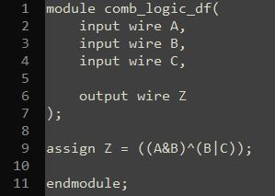
Simple Verilog for our circuit (Dataflow model)
Module declaration and name “comb_logic_df”
For modeling combinational logic. Just describe the circuit functionally and always execute.
Port declarations. What enters and exits the module?
Continuous Assignment statement
End our module

Slide 18
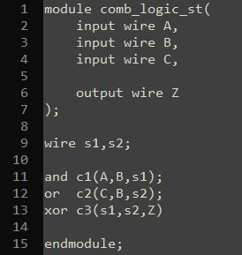
Simple Verilog for our circuit (Structural model)
Most circuit like method. Textual way to draw a circuit. Best for synthesizing
Give arbitrary names to instantiated primitive and modules
Declare intermediate wires
Instantiate gate primitives
Connect ports and wires to the gates (input, input, output)

Slide 19
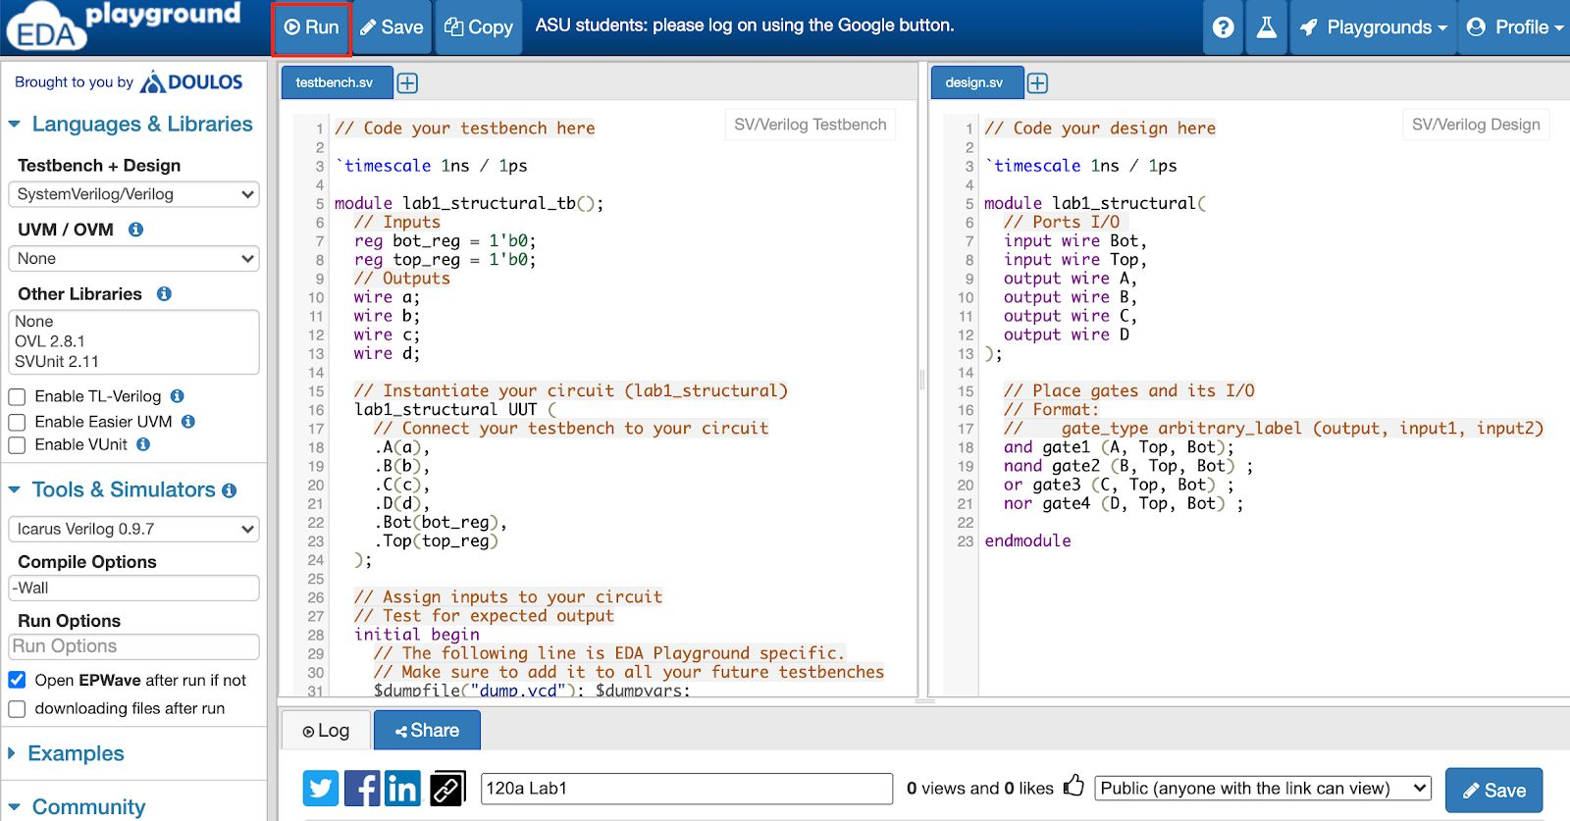
Simple Verilog for our circuit (Structural model)
In EDA Playground, the order of input/output is different!

Slide 20
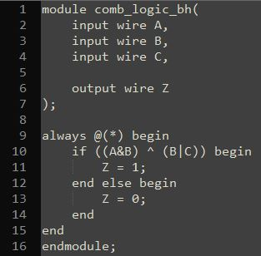
Simple Verilog for our circuit (Behavioral model)
Similar to traditional programming. Used mainly for sequential logic. Best for complex sequential circuits. EASY to make mistakes.
Always block: execute this when an input changes. Executes concurrently with other Always blocks. Similar to “While(1)”
“Begin” and “End” define the scope, Like curly brackets in C, indents in Python.
Good practice to always end with “ELSE” not “ELSE IF”.
Simple If-else statement
Need to be very careful. Easy to infer a latch, Need to cover ALL cases.

Slide 21
Test benches
Our Verilog module is just a circuit, it has no stimulus. We can’t just “run” it without stimulus.
Imagine a C program with nothing but function declarations but no functional calls or code in main().
The circuit we are testing, “Design Under Test”
Stimulus
Circuit
Test bench
DUT
Inputs
Executes like a normal programming language, i.e., Sequentially.
outputs

Slide 22
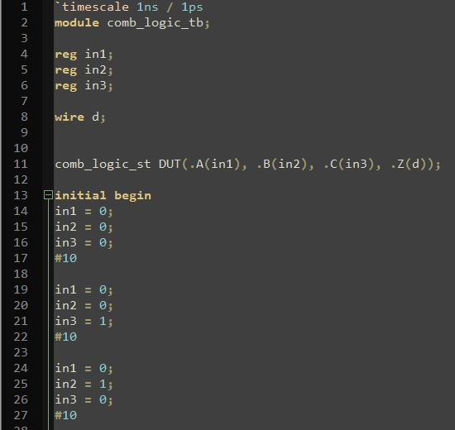
To simulate, need a testbench
Give it some arbitrary name. DUT (Device Under Test)
No port declarations this time. Just directly declare registers which act as variables
Instantiate the module we want to test
What values should our inputs be at the start?
“connect” our variables with the ports in the module we are testing.
Now what should our inputs be?
Wait 10 time steps ( 10*1ns )
Initial block execute only once
Didn’t finish, but should end with “end” and an “endmodule”

Slide 23
More info…
Great tutorial site. Has many examples. I still use this almost every time I need to write Verilog
http://www.asic-world.com/

