Slide 1
TIC-TAC-TOE GAME
Python Midterm Project
黃偉智 – B11107035

Slide 2
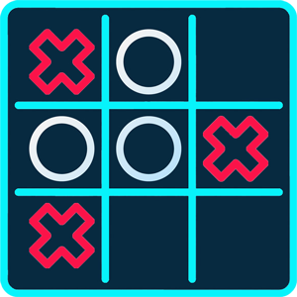
動機 Motivation
從小我就對玩遊戲很感興趣，所以我也很好奇遊戲是如何製作的。 我決定將井字遊戲作為我的中期項目，以便更多地了解製作該遊戲所涉及的算法和編程。
I've been interested in playing games since I was a kid. Because I like playing games, I was also curious about how games were made. Then, I decided to make Tic-Tac-Toe game as my midterm project so I can learn about the algorithms and programming involved in making this game.

Slide 3
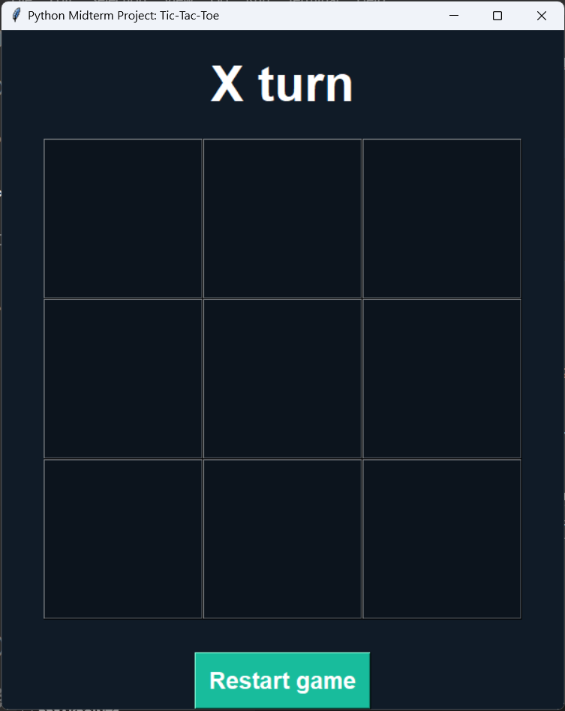
功能 Functions
當程序運行時，會彈出另一個窗口，井字遊戲將在該窗口內。
When the program runs, another window will pop up and the Tic-Tac-Toe game will be inside that window.
這是一款 2 人遊戲。 遊戲在 3 乘 3 格的網格上進行。 玩家輪流將他們的標記（X 和 O）放在空白方塊中。 第一個連續獲得 3 個標記的玩家（向上、向下、交叉或對角線）是獲勝者。
This is a 2-player game. The game is played on a grid that's 3 squares by 3 squares. Players take turns putting their marks (X and O) in empty squares. The first player to get 3 of their marks in a row (up, down, across, or diagonally) is the winner.

Slide 4
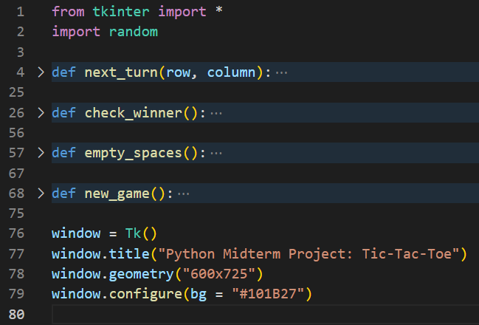
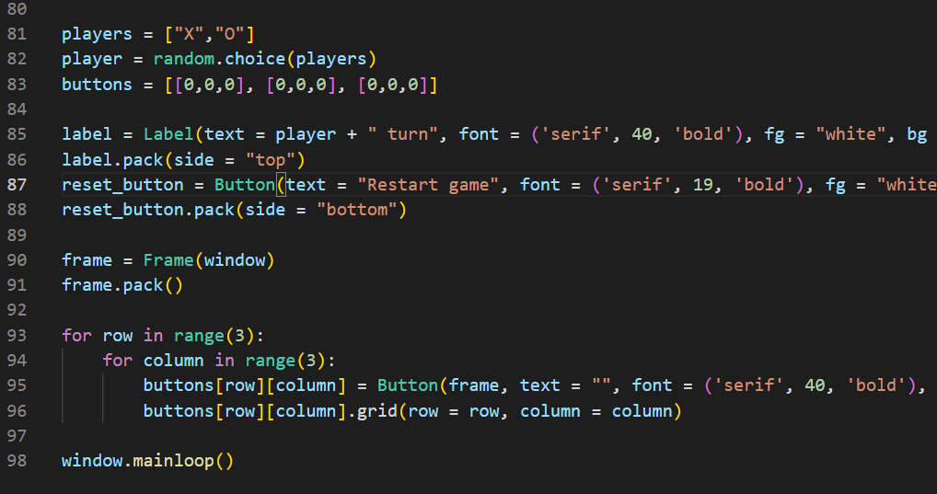
程式說明 Program Description
程式中做了4個函數：
1. empty_spaces()：計算剩下多少個空方塊。
2. check_winner()：檢查遊戲是否已經有贏家。
3. next_turn()：給出遊戲中玩家的下一個回合。
4. restart()：開始新一輪的遊戲。
There are 4 functions made in the program:
1. empty_spaces(): count how many empty squares are left.
2. check_winner(): check whether the game has a winner.
3. next_turn(): give the next turn of a player.
4. restart(): start a new round of the game.
該程式首先使用 Tkinter 庫創建遊戲窗口。 然後，它利用隨機函數隨機化哪個玩家（X 或 O）先走。在輪到每個玩家之前，程序通過檢查每個方塊中的標誌併計算剩餘空方塊的數量來檢查遊戲是否已經有贏家。
The program starts by creating a window of the game using Tkinter library. Then, it utilizes the random function to randomize which player (X or O) goes first. Before giving each player their turn, the program checks whether the game already has a winner yet by checking the sign in each square and counting the amount of empty squares left.

Slide 5
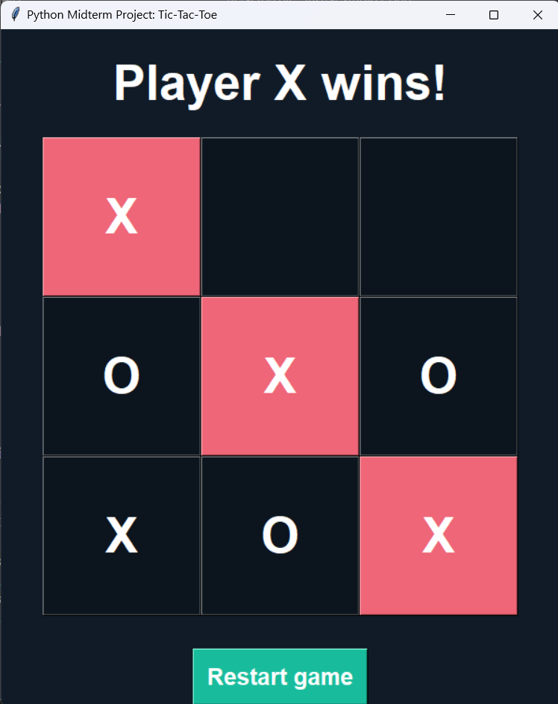
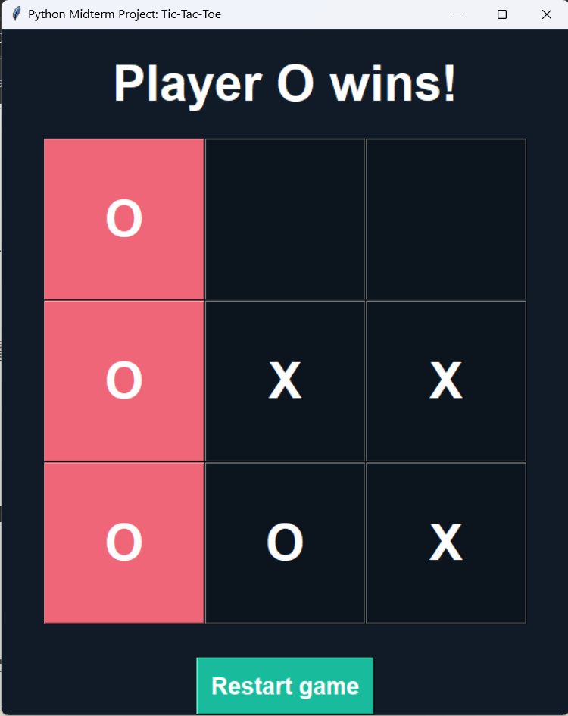
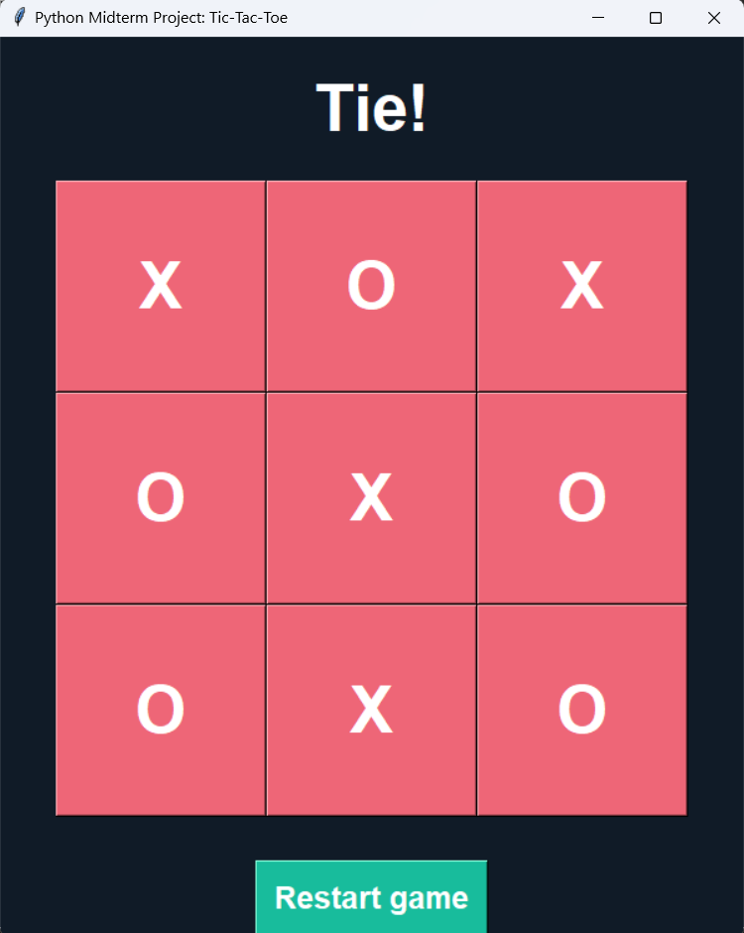
結果 Results
遊戲有 3 種可能的結果：玩家 O 獲勝、玩家 X 獲勝或平局。
The game has 3 possible results: Either player O wins, player X wins, or tie.
還有一個重新開始按鈕，可以在玩家完成一輪後開始新一輪。
There is also a restart button to start a new round after the players have finished a round.

