Slide 1
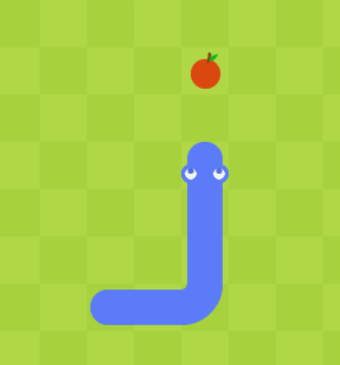
SNAKE GAME
Python程式設計 – 期末程式專案
黃偉智 – B11107035

Slide 2
動機 Motivation
對於期中項目，我製作了井字遊戲。 因為我真的很喜歡玩遊戲，所以我決定再次為這個期末項目做一個遊戲。 我想做一款更高級、更精彩的遊戲，所以我決定製作貪吃蛇遊戲。
For the midterm project, I made the Tic-Tac-Toe game. Because I really like playing games, I decided to once more make a game for this final project. I want to make a more advanced and exciting game, so I decided to make the Snake Game.

Slide 3
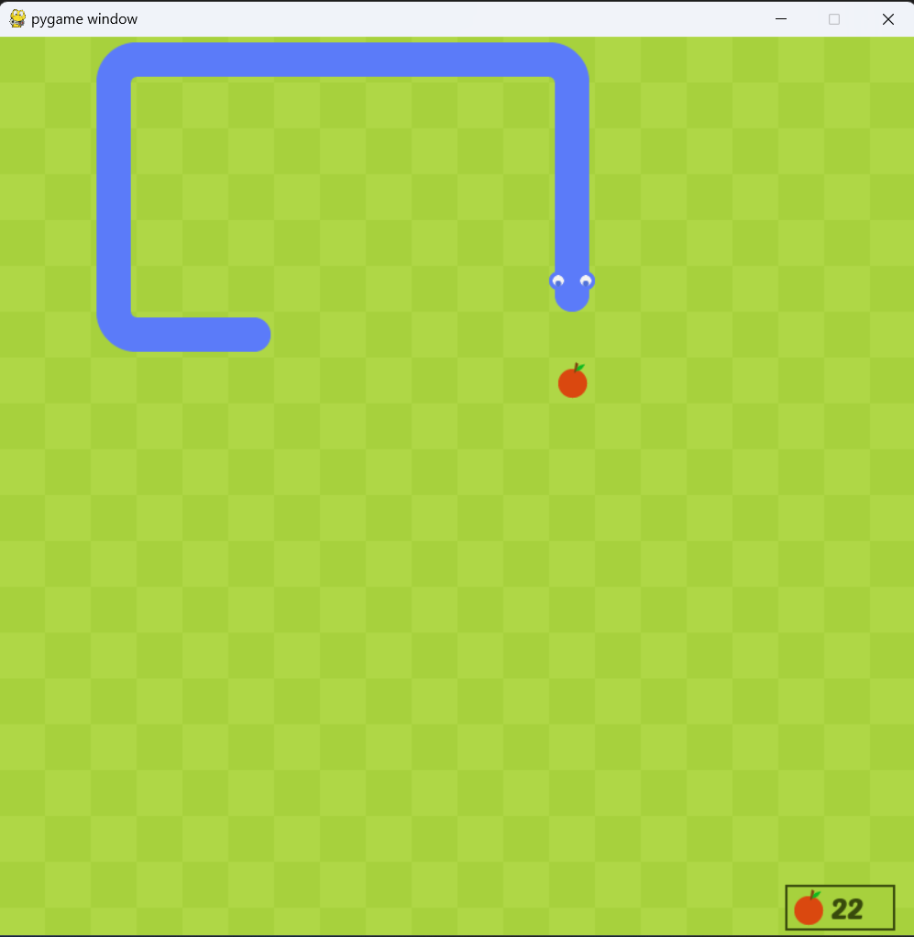
功能 Functions
使用箭頭鍵（上、右、下、左）移動蛇。
當蛇的頭碰到水果時，蛇會變長，我們得到一個分數。
每次被吃掉時，水果都會隨機生成。
Use the arrow keys (up, right, down, left) to move the snake.
When the head of the snake touches the fruit, the snake will become longer and we get a score.
The fruit will spawn randomly each time it gets eaten.

Slide 4
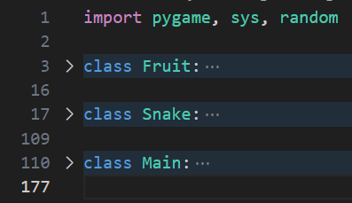
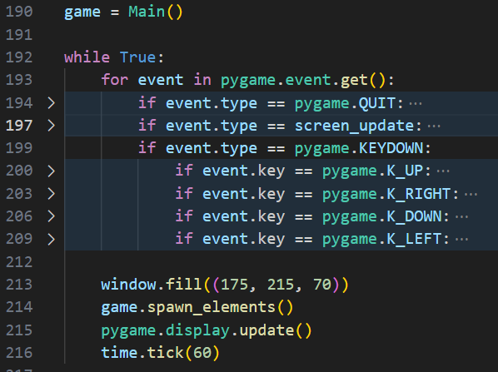
程式說明 Program Description
這個程序使用 Pygame 模塊。
Fruit class：產生水果並隨機化水果的位置。
Snake class：控制蛇的運動和圖形。
Main class：控制整個遊戲的程序。
為了讓遊戲更好玩，創建 ‘game’ 對象並在 while 循環中運行它以獲取用戶輸入並根據輸入更新 ‘game’ 對象。
This program uses Pygame module.
Fruit class: spawn and randomize position of fruit.
Snake class: control snake movement and graphics.
Main class: programs that control the overall game.
To make the game playable, first create the 'game' object and run it on a while loop to get user input and update the 'game' object based on the input.

Slide 5
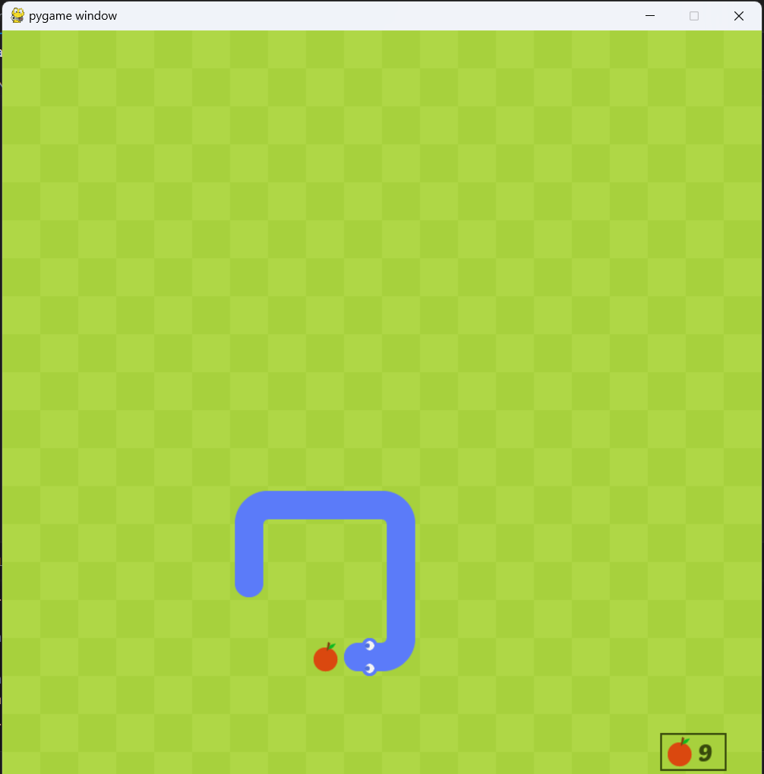
結果 Results
程式啟動時會彈出另一個窗口，就是遊戲本身。
我們可以朝任何方向走。
這個遊戲的目標是通過吃盡可能多的水果來獲得最高分。
當蛇撞到自己或撞到牆上時，遊戲就結束了。
When the program starts, another window will pop-up, which is the game itself.
We can go around in whichever direction we want.
The goal of this game is to get the highest score by eating as much fruit as possible.
The game ends when the snake hits itself or hits a wall.

Slide 6
THANK YOU!

