Slide 1
Web Secure Programming
Lecture 1
Tamara Rezk

Slide 2
Who is the teacher?
Tamara Rezk
security researcher at INRIA
Phd on security of mobile code
current security topics: web security, information flow security, formalization and verification of security properties, cryptography
http://www-sop.inria.fr/members/Tamara.Rezk
tamara.rezk@inria.fr

Slide 3
Objectives of this course
Get the basis to understand web attacks and defenses
Get acquainted with the top-ten web vulnerabilities today (Owasp top ten)
Primer on research activities regarding security

Slide 4
Plan
Lectures from 23/9 to 4/11
Topics discussed in 4 lectures of 2 hours+ 7 hours TP
introduction to web programming (today)
cross site scripting aka XSS
cookies and associated security problems
same origin policy
Research topic:
- owasp top-ten report: 21/10, presentations 40’
Exam: 18/11, includes all TPs + CMs + owasp top-10

Slide 5
Agenda
23/9 CM/TP
30/9 CM/TP
7/10 CM/TP
14/10 CM/TP
21/10 Research project presentations (3 x 40’)
28/10 Research project presentations (3 x 40’)
04/11 TPs
18/11: Exam

Slide 6
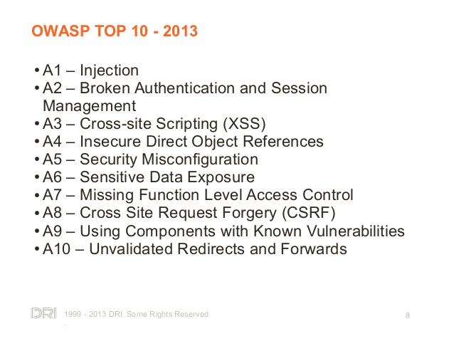
Owasp top ten

Slide 7
Project Topics
1 A1+A3
2 A2
3 A4
4 A5+A6
5 A7+A9
6 A10

Slide 8

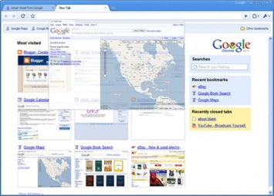
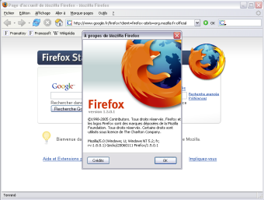
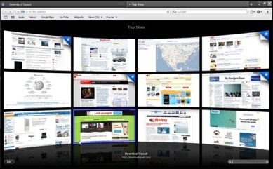
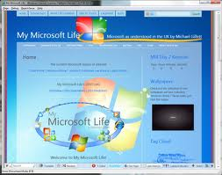
Web Applications
Network
Servers
Web Browsers
Distributed applications that run in a browser and
distant servers

Slide 9





Web Applications = Multi-tiers applications
WEB SERVER
Client code
Server code
BROWSER
Database
DB MANAGEMENT SYSTEM

Slide 10
Web Evolution
1990 Static web
2000 Web 2.0
1995 Dynamic web
see evolutionoftheweb.com

Slide 11
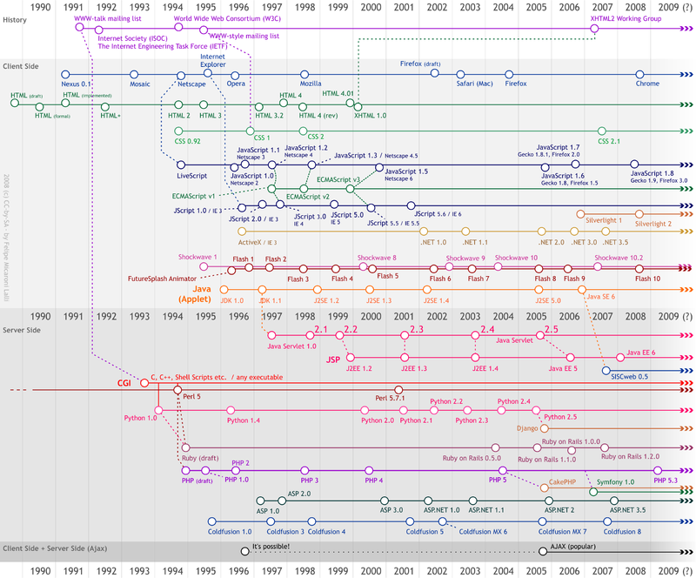

Slide 12





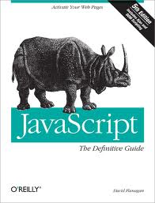
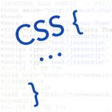






Complexity in Web 2.0 Apps
Generate
Generate
XHR API
Data query code
Server code
Client code
DOM API
How would my application behave?
Different programming languages;
Multi-tier nature;
Dynamic code generation
Thanks Zhengqin Luo for this slide

Slide 13
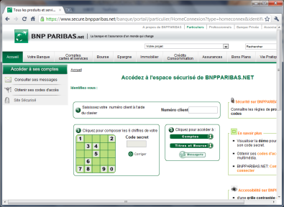
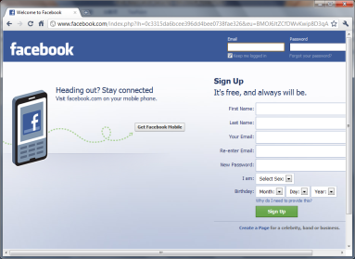
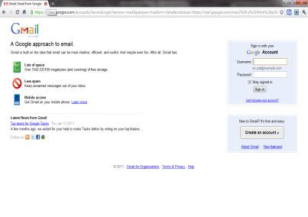
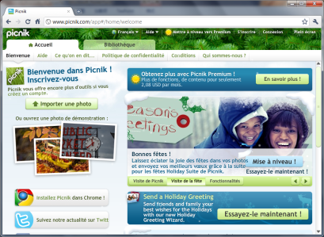
Importance of Protecting Web Apps
Web applications everywhere in your life!!!
Important Information
Identity
Financial situation
Social life
Security Requirements
Confidentiality
Integrity
Availability
Bank
Social Network
E-mail Service
Photo Editing

Slide 14
Security problems
Availability violation
Confidentiality violation
Integrity violation

Slide 15
Availability security problems
A service or resource is made unvailable

Slide 16
Integrity security problems
Unauthorized modification of data (authenticity of data), and unauthorized execution of programs

Slide 17
Confidentiality problems
Unauthorized disclosure of data

Slide 18
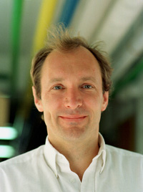
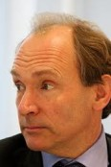

Slide 19
Tim Berners Lee

Slide 20
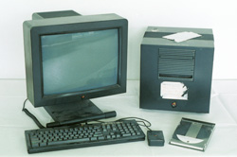
Web 1.0 Applications
1990: The static Web, Web 1.0
Info.cern.ch
First Browser called WorldWideWeb
First Server called httpd running at Info.cern.ch

Slide 21

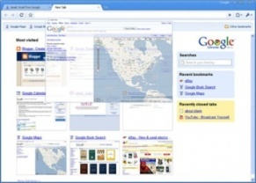

Web 1.0 Applications
1990: The static Web, Web 1.0
Apache HTTP Server

Slide 22
Web 1.0 Applications
1990: The static Web, Web 1.0
http://www.a.com
Apache HTTP Server

Slide 23
Web 1.0 Applications
1990: The static Web, Web 1.0
http://www.a.com
Apache HTTP Server

Slide 24

Web 1.0 Applications
1990: The static Web, Web 1.0
http://www.a.com
Apache HTTP Server

Slide 25
Web 1.0 Applications
1990: The static Web, Web 1.0
http://www.a.com
Apache HTTP Server
Technologies:
Web Server (first: CERN httpd)
Web Browser (first: WorldWideWeb browser)
Protocol : HTTP
Language:

Slide 26
Uniform Resource Locators (URLs)
Scheme
Port Number
Query
http://www.company.com:81/a/b/c.html?user=Alice&year=2008#p2
Host Name
Hierarchical portion
Fragment

Slide 27
HTTP: HyperText Transfer Protocol
HTTP important characteristic: no State request/response - each request is independent
HTTP header: header section of requests and responses, parameters of the HTTP transaction

Slide 28
HTTP Request
Method
URL
Protocol Version
GET /index.html HTTP/1.1
Host: www.example.com
User-Agent: Mozilla/5.0
Accept: text/html, */*
Accept-Language: en-us
Accept-Charset: ISO-8859-1,utf-8
Connection: keep-alive
blank line
Headers
Body (optional)

Slide 29
HTTP Response
Version
Status
Status Message
HTTP/1.1 200 OK
Date: Thu, 24 Jul 2008 17:36:27 GMT
Server: Apache-Coyote/1.1
Content-Type: text/html;charset=UTF-8
Content-Length: 1846
blank line
<html>
...
</html>
Headers
Body

Slide 30
Phishing attacks
www.paypal.com
www.payoak.szm.sk
Be aware of URLs that are shown in the browser
or links that are clicked!

Slide 31
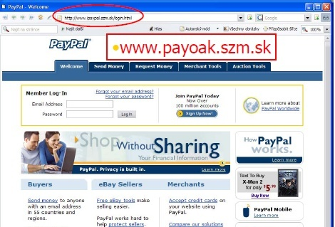
Phishing attacks

Slide 32
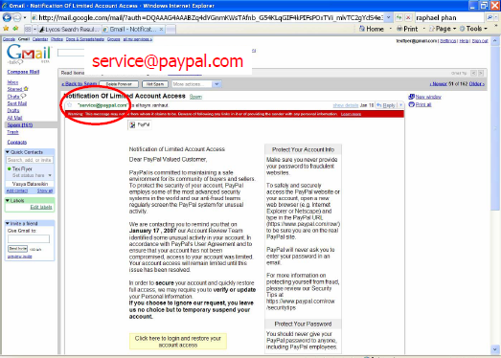
Phishing attacks: also emails with false senders

Slide 33
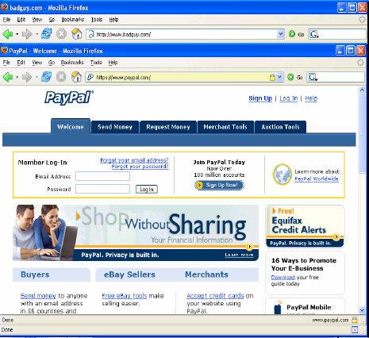
And even this!

Slide 34
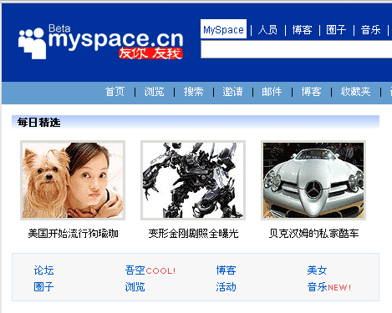
A phishing attack to MySpace
In 2006, a worm altered links to direct MySpace users to evil websites

Slide 35
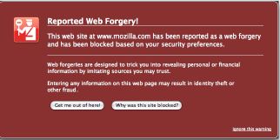
Phishing Solutions
Use https (created in 1994 by Netscape)
Verify carefully the URL
Browsers may have “black”lists

Slide 37
Web 1.0 Applications
1993: The Web becomes less static
http://www.a.com | a.cgi
http://www.b.com | b.cgi
http://www.c.com | c.cgi
http://www.a.com/foo?var=v

Slide 38



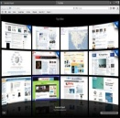
Web 1.0 Applications
1993: The Web becomes less static
http://www.a.com | a.cgi
http://www.b.com | b.cgi
http://www.c.com | c.cgi
http://www.a.com/foo?var=v
parameters
Example hello2.php

Slide 39
Web 1.0 Applications
1993: The Web becomes less static
http://www.a.com | a.cgi
http://www.b.com | b.cgi
http://www.c.com | c.cgi
http://www.a.com/foo?var=v
Technologies:
Web Browser, Web Server,
HTTP , HTML
CGI: Common Gateway Interface
1994: World Wide Web Consortium (W3C)
http://validator.w3.org/

Slide 40
How keep state information on sessions?
HTTP is stateless

Slide 41
HTTP: Session in URL Example
http://www.buy.com
see catalog
http://www.buy.com/shopping.cfm?pID=269
select item
http://www.buy.com/shopping.cfm?pID=269&item=40002
buy item
http://www.buy.com/checkout.cfm?pID=269&item=40002
Since HTTP is stateless all session information is saved in the URL
Thanks Ricardo Corin for this slide

Slide 42
HTTP: Session in hidden field Example
Why not to store sensitive information on the client side?
Integrity violation: Dansie Shopping Cart (2006)
<FORM METHOD=POST
ACTION="http://www.dansie.net/cgi-bin/scripts/cart.pl">
Black Leather purse with leather straps<BR>Price: $20.00<BR>
<INPUT TYPE=HIDDEN NAME=name VALUE="Black leather purse">
<INPUT TYPE=HIDDEN NAME=price VALUE="20.00">
<INPUT TYPE=HIDDEN NAME=sh VALUE="1">
<INPUT TYPE=HIDDEN NAME=img VALUE="purse.jpg">
<INPUT TYPE=HIDDEN NAME=custom1 VALUE="Black leather purse
with leather straps">
<INPUT TYPE=SUBMIT NAME="add" VALUE="Put in Shopping Cart">
</FORM>
Let’s see the form in action
Example formAttack.html

Slide 43
HTTP : Sessions as COOKIES
A cookie is set by the server but resides in the client disk and is created by the web browser

Slide 44
HTTP : COOKIES
A cookie resides in the disk and is created by the web browser
POST login.cgi (usr+pwd)
HTTP Header:
Set-cookie: NAME=VALUE ;
domain = (who can read the cookie) ;
expires = (when) ;
…
GET securepage.html
Cookie: NAME=VALUE

Slide 45
HTTP : COOKIES
HTTP does not have state, cookies add state
Cookies are useful for:
Authenticacion
to know if a user has authenticatde in the past
Personalization
recognize the user since last visit
Tracking
analyze the behaviour of the user

Slide 46
HTTP : COOKIES
Only the site that creates the cookie can read it

Slide 47
HTTP : COOKIES
set-cookie(“amount”,$amount);
Content-type:text/html
Cookie: Amount = 20$
To make it secure it is necessary to add a “MAC” (message-authenticatedcode) to the amount:
Cookie: Amount = 20$; HMAC(ServerKey, 20)
Example cookie.php/2

Slide 49
Web 1.0 Applications
1995: Php and Javascript are born
http://www.a.com | a.php
http://www.b.com | b.cgi
http://www.c.com | c.cgi
http://www.a.com/foo?var=v
Contains Javascript programs
Technologies:
Web Browser, Web Server,
HTTP , HTML
CGI: Common Gateway Interface
Javascript

Slide 50
Javascript
Execute code on the client side
Intepreted language, dymamically typed
ECMAScript standard

Slide 51
Embedding Javascript
External Javascript File
<body>
...
<script type="text/javascript" src=“myCode.js" />
<script type="text/javascript">
//<![CDATA[
alert("Page is loading");
//]]>
</script>
<p onclick="alert('I told you not to click on me!');">
Please do not click on this text.</p>
...
</body>
Inline Code
Event Handler
All scripts will share the memory (see
memory.html)

Slide 52
Javascript
An important object: the GLOBAL object
An important property: window
A Prototype chain (the root is Global)
A Scope chain (the root is Global)

Slide 53
Object Literals
var empty_object ={};
var user={
“first-name”: “Tamara”,
“last-name”: “Rezk”
};
property names are strings
Book: Javascript the Good Parts (Douglas Crockford)

Slide 54
Retrieval
user[“prenom”]
user.prenom
user[“PRENOM”] //(undefined)

Slide 55
Update
user[‘prenom’] = “John”;
If the object does not already have the property “prenom”, the object is augmented.

Slide 56
definition with var
document.write(x);
var x=3;
global
“window”:#g

Slide 57
definition with var
document.write(x);
var x=3;
global
“window”:#g
“x”: undefined

Slide 58
definition with var
document.write(x); //print undefined
var x=3;
global
“window”:#g
“x”: undefined

Slide 59
definition with var
document.write(x);
var x=3;
global
“window”:#g
“x”: 3

Slide 60
Functions
function foo(x) { s} ;
a function is also a property of an object (global in this example)
when a function is defined, it is NOT called(or executed).
there are two properties for prototypes that should not be confused
notice that a function definition IS an object
global
“window”:#g
“foo”:
@body: function(x){s}
@prototype: #funprot
prototype: l1

Slide 61
Function
var count=0;
var increment=
function(inc) {
var count=5;
if (inc == undefined)
{inc = 1;}
count += inc;
return count;
}

Slide 62
Invocation
increment();
var x =increment(2);

Slide 63
New
function foo(x) ={ s} ;
var x = new foo(3);
when a new function instance is created, it IS called (as constructor)
IMPORTANT DETAIL: but “this” is now associated to the new object
it is executed in the same scope where the object was defined.
Important: new is the only way to set the internal @prototype
@body: function(x){s}
@prototype: #funprot
prototype: l1
global
“window”:#g
“foo”: #f
“x”:
@prototype: l1

Slide 64
Prototype Chain
@prototype:null
x: value
y.x
@prototype:
If the property is not in the current object, it is searched in the prototype chained.
@prototype:
Example prototype.js
y
@prototype:

Slide 65
Scope Chain
var x=3;
var y = function(){console.log(x)};
global
“window”:#g
“foo”: #f
“x”: 3
@scope:
y
@scope:

Slide 66
Scope
function Foo() {
var x;
y = x;
x =3 ;
}
function Bar() {
y = x;
x = x +1;
}
var y ;
var x = 0;
Foo();
Bar();
What’s the value of global x after Foo ()?
and after Bar()?
Let’s try them in the console.

Slide 67
Document Tree Structure
document
document.
documentElement
document.body

Slide 68
<p> Sample <b>bold</b> display</p>
firstChild
lastChild
P
parentNode
parentNode
parentNode
nextSibling
nextSibling
#text
B
#text
prevSibling
prevSibling
Sample
display
firstChild, lastChild
parentNode
#text
bold

Slide 69
Web 2.0 Applications
2004: AJAX (Asynchronous Javascript and XML) becomes popular,
social sites emerge
XMLHttpRequest object for asynchronous communication
request a service
partial reloading of the webpage (iframe)
Technologies:
Web Browser, Web Server,
HTTP , HTML
CGI: Common Gateway Interface
AJAX : Javascript, CSS, XML, DOM, XMLHttpRequest

Slide 70
Web 2.0 Applications
2004: AJAX (Asynchronous Javascript and XML) becomes popular,
social sites emerge
XMLHttpRequest object for asynchronous communication
request a service
partial reloading of the webpage (iframe)
Technologies:
Web Browser, Web Server,
HTTP , HTML
CGI: Common Gateway Interface
AJAX : Javascript, CSS, XML, DOM, XMLHttpRequest

Slide 71
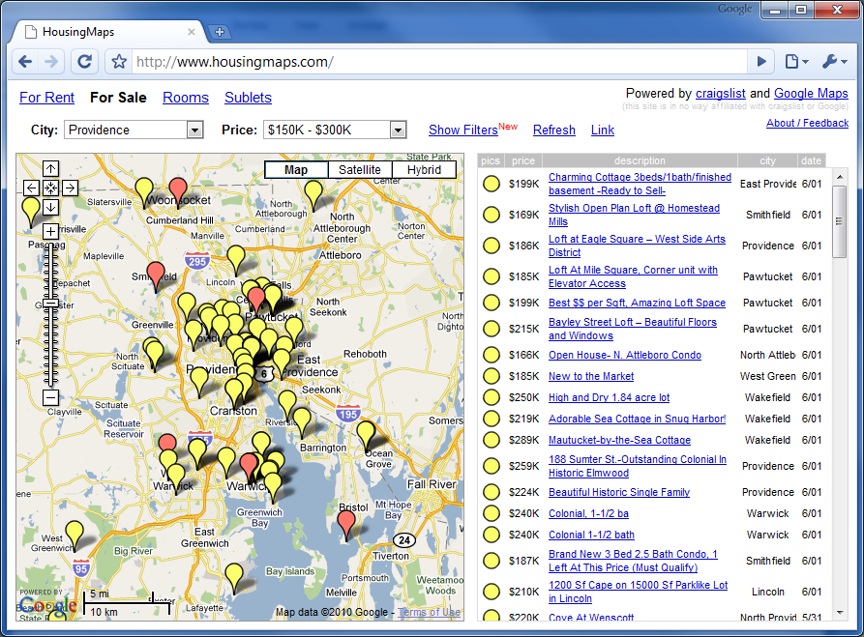
Mashups: HousingMaps, 2005

Slide 72
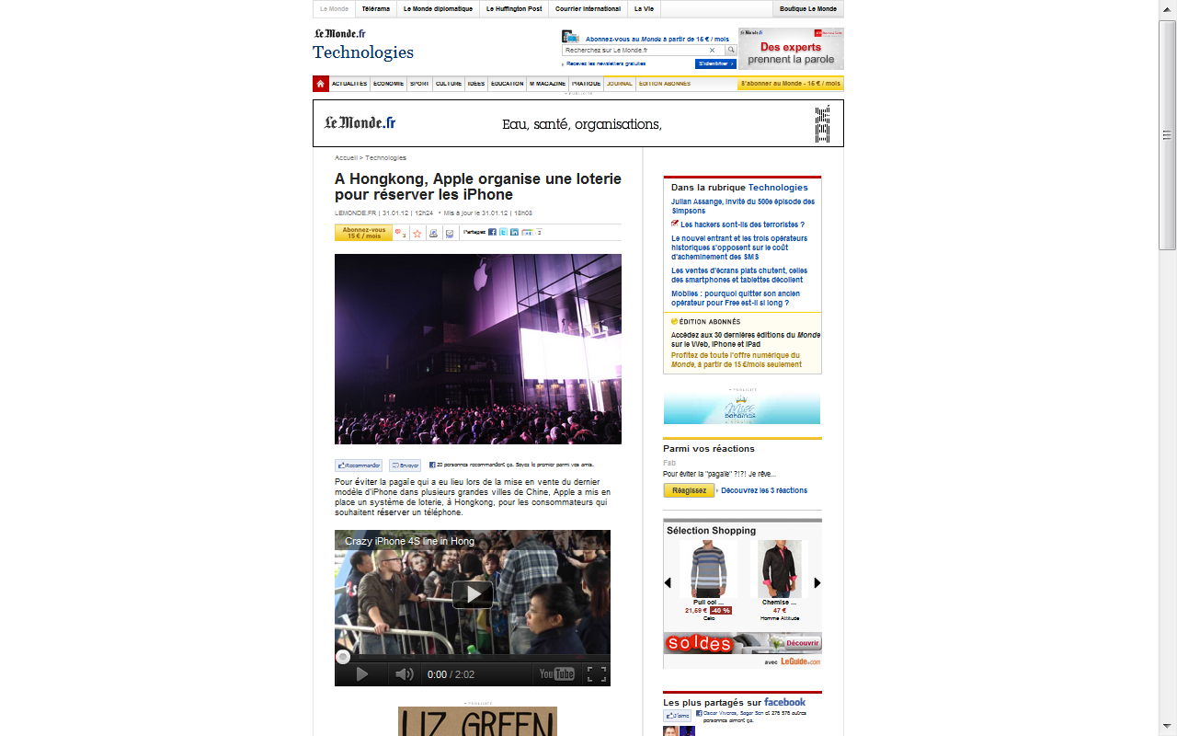
Le Monde is a mashup

Slide 73
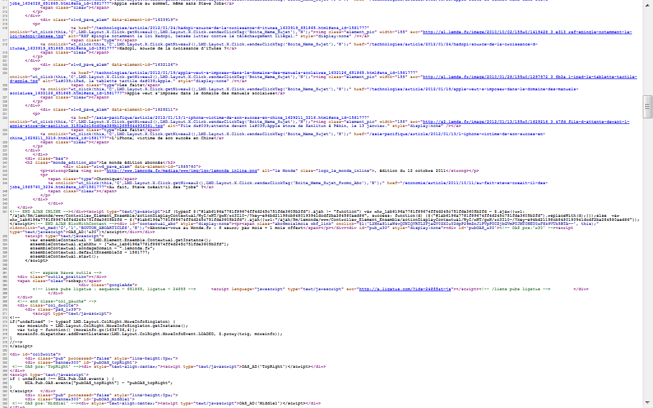
Code of Le Monde
<iframe src=
"http://www.youtube.com/embed/W8WP2SjsZw4?rel=0"
width="520" height="294"frameborder="0"></iframe>

Slide 74
Examples with google maps API
Exercise
simplemashup.html
Look at http://www.programmableweb.com/

