Slide 1
Web Secure Programming
Lecture 2
Tamara Rezk

Slide 2
Agenda
23/9 Introduction to Web Programming
30/9 Same Origin Policy and its Security Problems
7/10 CM/TP
14/10 CM/TP
21/10 Research project presentations (3 x 40’)
28/10 Research project presentations (3 x 40’)
04/11 TPs
18/11: Exam

Slide 3
Same Origin Policy (high level)
Implemented in the browsers :
Full access to same origin resources
Isolation from different origin resources

Slide 4

Same origin policy: “high level”
Same Origin Policy (SOP) for DOM:
Origin A can access origin B’s DOM if match on (scheme, domain, port)
Same Original Policy (SOP) for cookies:
Generally speaking, based on: ([scheme], domain, path)
optional
scheme://domain:port/path?params

Slide 5
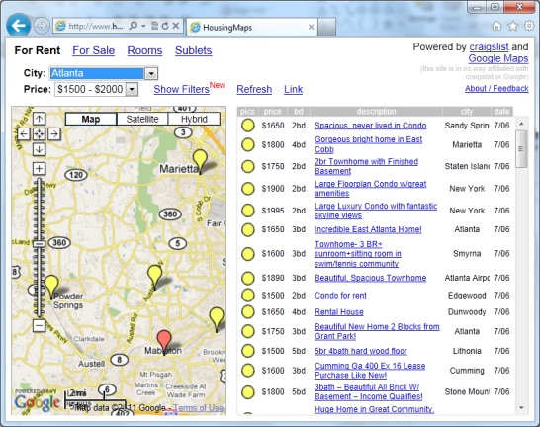
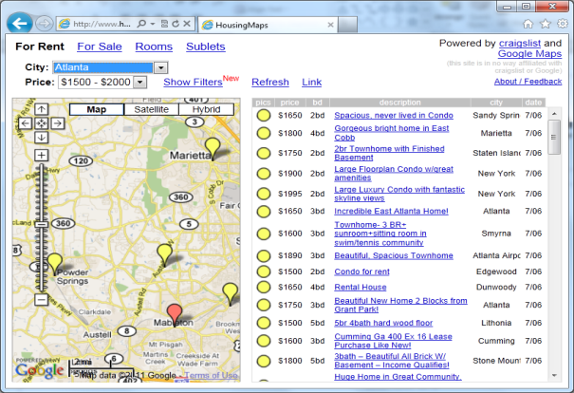
Same Origin Policy for DOM
Using <script> tag
Using <iframe> frame
X
Google Maps Gadget
Integrator’s
Housing Data
Google Maps Gadget
Integrator’s
Housing Data
Full sharing (JS Env.)
Running as integrator
Gadget trusted
Full isolation (by SOP)
Running as gadget
Limited sharing
Frame identifier
PostMessage

Slide 6
The same origin policy (SOP)
The <iframe> tag: Javascript memory
HEAP
integrator’s code
global object
global object
browser
<iframe src= http://b.com/gadget.html >
…
</iframe>

Slide 7
Frame isolation
Other frames cannot access resources from other origins
Example:
<!-- This is allowed -->
<iframe src="sameDomainPage.html"> </iframe>
alert(frames[0].contentDocument.body); //works fine
<!-- This is **NOT** allowed -->
<iframe src="http://google.com"> </iframe>
alert(frames[0].contentDocument.body); //throws error

Slide 8
The same origin policy (SOP)
The <iframe> tag: code treated as external code (different origin). The cross domain request is forbidden only before HTML5
integrator’s code
server
a.com
browser
<iframe src= http://b.com/gadget.html >
…
</iframe>
server
b.com

Slide 9
The same origin policy (SOP)
The <script> tag permits to treat code as code from the same origin. The cross domain request is forbidden only before HTML5
integrator’s code
server
a.com
browser
<script src=
http://b.com/gadget.js>
server
b.com

Slide 10
The same origin policy (SOP)
The <script> tag: what about Javascript behaviour?
HEAP
integrator’s code
global object
browser
<script src=
http://b.com/gadget.js
>

Slide 11
Security problems with SOP due to Frame Communication

Slide 12
Frame isolation
Other frames cannot access resources from other origins
Browsers implement a navigation policy that is allowed (changing .location attribute of frame)
permissive policy: Guninski attack on CitiBank
window policy: gadget hijacking attacks (igoogle+hotmail)

Slide 13
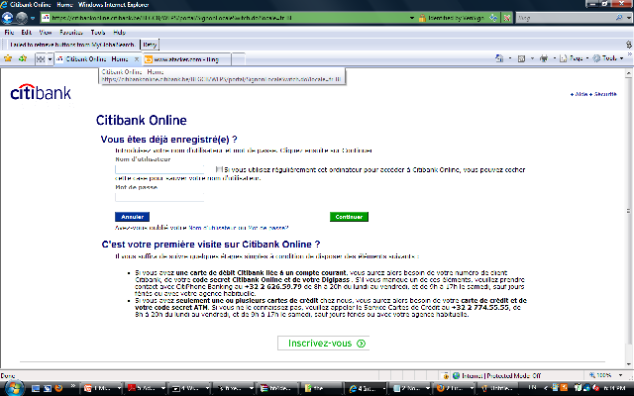
Guninski attack (permissive policy, 1999)
Other browser window/tab
location = attacker
citibankWindow.frames[0].
location = “https://attacker.com/login”
user:
pass:
SOP applies but attacker can navigate the login frame and replace it with its own code !

Slide 14
Frame isolation
Other frames cannot access resources from other origins
Browsers implement a navigation policy that is allowed (changing .location attribute of frame)
permissive policy: Guninski attack on CitiBank
window policy: gadget hijacking attacks (igoogle+hotmail)

Slide 15
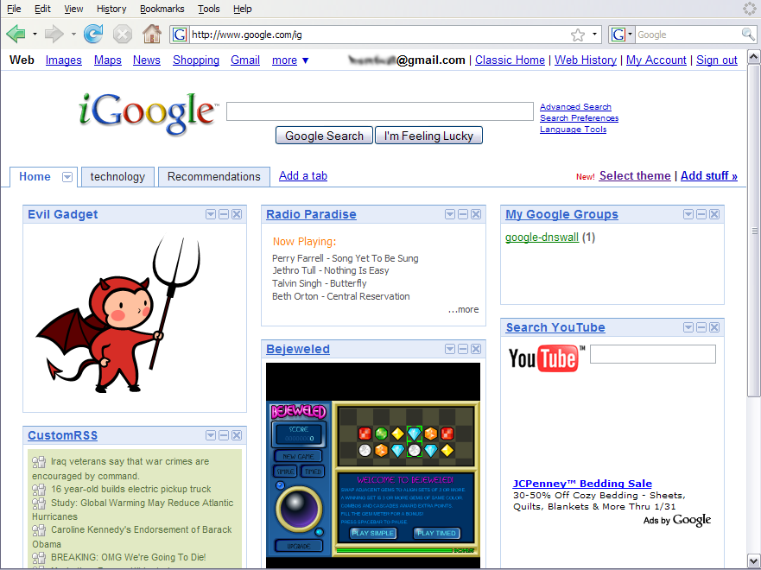
Gadget Hijacking
top.frames[1].location = "http:/www.attacker.com/...“;
top.frames[2].location = "http:/www.attacker.com/...“;
...

Slide 16
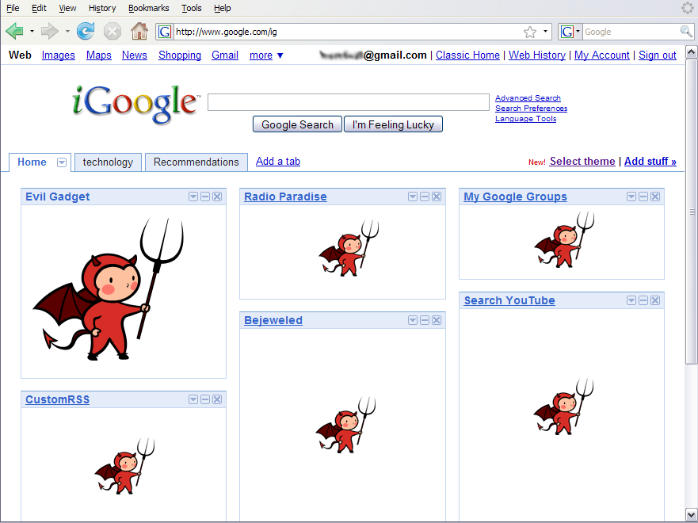
Gadget Hijacking

Slide 17
Frame isolation
Other frames cannot access resources from other origins
Browsers implement a navigation policy that is allowed (changing .location attribute of frame)
permissive policy: Guninski attack on CitiBank
window policy: gadget hijacking attacks (igoogle+hotmail)
descendant policy
child policy

Slide 18
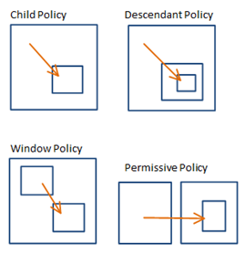
Navigation policies

Slide 19





Navigation policies
Browser | Policy
IE 6 (default) | Permissive
IE 6 (option) | Child
IE7 (no Flash) | Descendant
IE7 (with Flash) | Permissive
Firefox 2 | Window
Safari 2 | Permissive
IE7 | Descendant
Firefox 3 | Child
Safari 3 | Child
HTML 5 | Child

Slide 20
Fragment Identifier Messaging
Send information by navigating a frame
http://gadget.com/#hello
Navigating to fragment doesn’t reload frame
No network traffic, but frame can read its fragment
Not a secure channel
Confidentiality
Integrity
Authentication
✓
✓
✗

Slide 21
HTML 5
Cross-origin client side communications
Postmessage channel between frames
Child policy

Slide 22
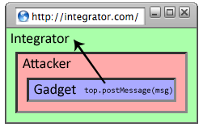
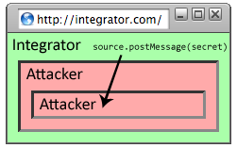
Reply Attack

Slide 23
Fix: Improve the API (Standford)
see Securing Frame Communication in Browsers
Let the sending specify the recipient
frame[0].postMessage(“Hello”, “http://gadget.com”)
Adoption
Firefox 3
Internet Explorer 8
Safari 3.1

Slide 24
Example of PostMessage
'http://destination.com
window.addEventListener('message',function(event){
if(event.origin !== 'http://originExpected.com') {return;} {console.log('received response: ',event.data);
event.source.postMessage(‘received’,event.origin});
frame at 'http://originExpected.com
var domain = 'http://destination.com';
var iframe = document.getElementById('myIFrame').contentWindow;
var message = 'Hello!’;
iframe.postMessage(message,domain);

Slide 25
Security considerations postmessage
Do not configure target origin (recipient) to “*”
Sensitive data can be leaked to unknown widgets
Always check for sender’s origin
Always validate data before use
Do not consume data directly with eval() or innerHTML

Slide 26
Same origin policy for cookies

Slide 27
Setting/deleting cookies by server
GET …
Server
Browser
HTTP Header:
Set-cookie: NAME=VALUE ;
domain = (when to send) ;
path = (when to send)
secure = (only send over SSL);
expires = (when expires) ;
HttpOnly (later)
scope
if expires=NULL:
this session only
Delete cookie by setting “expires” to date in past
Default scope is domain and path of setting URL

Slide 28
Scope setting rules (write SOP)
domain: any domain-suffix of URL-hostname, except TLD
example: host = “login.site.com”
⇒ login.site.com can set cookies for all of .site.com but not for another site or TLD
path: can be set to anything
allowed domains
login.site.com
.site.com
disallowed domains
user.site.com
othersite.com
.com

Slide 29
Cookies are identified by (name,domain,path)
cookie 1
name = userid
value = test
domain = login.site.com
path = /
secure
cookie 2
name = userid
value = test123
domain = .site.com
path = /
secure
distinct cookies
Both cookies stored in browser’s cookie jar;
both are in scope of login.site.com

Slide 30
Reading cookies on server (read SOP)
Server
Browser
GET //URL-domain/URL-path
Cookie: NAME = VALUE
Browser sends all cookies in URL scope:
cookie-domain is domain-suffix of URL-domain, and
cookie-path is prefix of URL-path, and
[protocol=HTTPS if cookie is “secure”]
Goal: server only sees cookies in its scope

Slide 31
Examples
both set by login.site.com
cookie 1
name = userid
value = u1
domain = login.site.com
path = /
secure
cookie 2
name = userid
value = u2
domain = .site.com
path = /
non-secure
http://checkout.site.com/
http://login.site.com/
https://login.site.com/
cookie: userid=u2
cookie: userid=u2
cookie: userid=u1; userid=u2
(arbitrary order)
Notes:
FF3: most specific cookie sent first

Slide 32
Client side read/write: document.cookie
Setting a cookie in Javascript:
document.cookie = “name=value; expires=…; ”
Reading a cookie: alert(document.cookie)
prints string containing all cookies available for document (based on [protocol], domain, path)
Deleting a cookie:
document.cookie = “name=; expires= Thu, 01-Jan-70”
document.cookie often used to customize page in Javascript
Notes:
SOP: same as server-side read/write

Slide 33
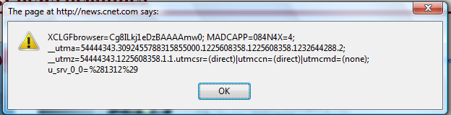
Javascript URL
javascript: alert(document.cookie)
Displays all cookies for current document

Slide 34
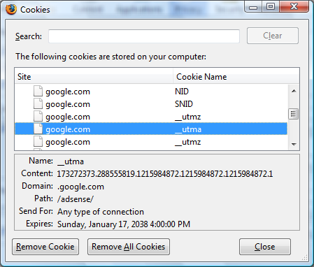
Viewing/deleting cookies in Browser UI

Slide 35
Cookie protocol problems
Server is blind:
Does not see cookie attributes (e.g. secure)
Does not see which domain set the cookie
Server only sees: Cookie: NAME=VALUE
Notes:
RFC 2109 (cookie RFC) has an option for including domain, path in Cookie header, but not supported by browsers.

Slide 36
Example 1: login server problems
Alice logs in at login.site.com
login.site.com sets session-id cookie for .site.com
Alice visits evil.site.com
overwrites .site.com session-id cookie with session-id of user “badguy”
Alice visits cs142hw.site.com to submit homework.
cs142hw.site.com thinks it is talking to “badguy”
Problem: cs142hw expects session-id from login.site.com;
cannot tell that session-id cookie was overwritten

Slide 37
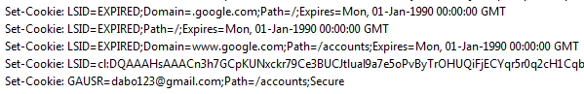
Example 2: “secure” cookies are not secure
Alice logs in at https://www.google.com/accounts
Alice visits http://www.google.com
Network attacker can inject into response
Set-Cookie: LSID=badguy; secure
and overwrite secure cookie
Problem: network attacker can re-write HTTPS cookies !
⇒ HTTPS cookie value cannot be trusted

Slide 38
Interaction with the DOM SOP
Cookie SOP: path separation
x.com/A does not see cookies of x.com/B
Not a security measure:
DOM SOP: x.com/A has access to DOM of x.com/B
<iframe src=“x.com/B"></iframe>
alert(frames[0].document.cookie);
Path separation is done for efficiency not security:
x.com/A is only sent the cookies it needs

