Slide 1
Mutual Analysis of Interaction Network and Quantitative Trait Loci for Yeast
Yuri Pritykin
Notes:
What I’m going to present today is an example of useful integration of different types of large-scale biological data, more precisely, interaction networks and quantitative trait loci.

Slide 2
Quantitative Traits
Different traits:
hair texture
skin color
eye color
height
Most traits are quantitative (not discrete) and complex (controlled by many genes)
Difference in genome of about 0.05%-0.1% only
How to explain traits via genome?
Notes:
Let’s look at it more closely. We have a diverse population, for example, here are some representatives of human population. We all have different traits: different skin color, different height, hair texture, eye color, and so on. Note that most traits are quantitative, that is, they are measured on a continuous scale. Also, it is known that most traits of interest are complex, that is, controlled by two or often many more genes, at different proportions. At the same time, in this example, the difference of our genomes is only about 0.1%. This raises the question: can we capture the dependence of trait variation with genome variation and explain how it works?

Slide 3
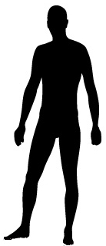
Quantitative Trait Loci
Associate variation in trait with variation in genotype
Toy example:
Notes:
For this, we can apply quantitative trait analysis. Let’s look at the following toy example. Suppose we have a group of people with different height.

Slide 4
Quantitative Trait Loci
Associate variation in trait with variation in genotype
Toy example:
trait variation
...AGCGCTACTGTAGC...
...AGCGCTGCTGTAGC...
genotype variation
Notes:
Suppose we somehow managed to find that variation in height is strongly associated with variation in one letter of their DNA sequence [sequences appear]: those with A in this locus, that’s how you call regions of the genome, tend to be shorter, and those with G tend to be taller. Then you say you found quantitative trait locus for height. [variation comments appear] Note that you may find it through full sequencing, but also with easier and much cheaper procedure of genotyping, where you read only certain portions of the genome.

Slide 5
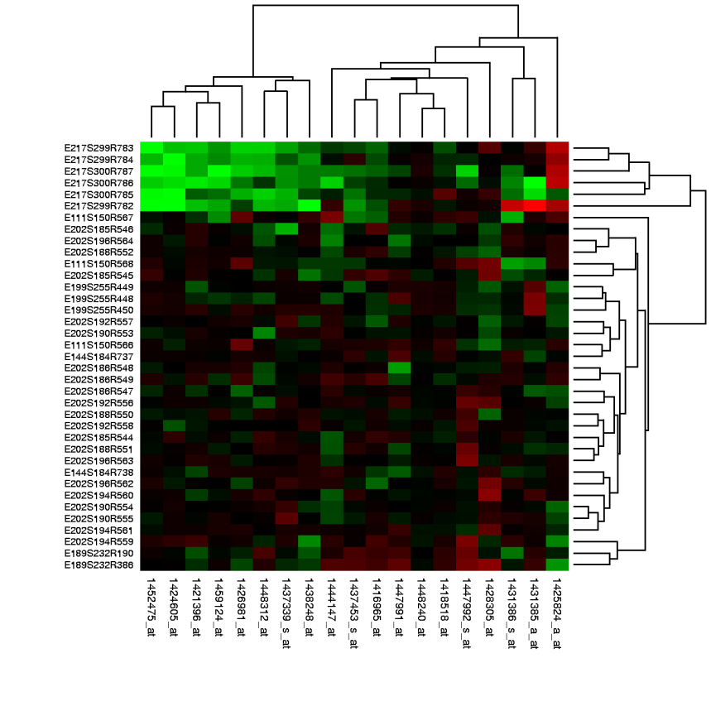

Quantitative Trait Loci
Idea: use genome-wide gene activity itself as quantitative trait
Transcript expression levels as quantitative traits: expression QTLs (eQTLs)
gene
(DNA)
transcript
(mRNA)
protein
Notes:
A very prominent idea along these lines was proposed not so long time ago: let’s consider genome-wide gene activity itself as quantitative trait. This is very reasonable to find association with gene activity, because the development of any phenotype, that is, any collection of traits, starts from gene activation. As you know, when activated, gene is transcribed to mRNA, which in turn is translated to protein. [show on picture] Currently the most common technique for measuring gene activity is transcript expression using microarrays. It measures gene expression of all genes simultaneously. The analysis of expression quantitative trait loci tries for a population of organisms to map statistically genotypic variation to variation in transcript expression. [show on picture]
Of course, in order to get a better idea about QTLs, we would like to do the same analysis for gene activity in terms of protein abundance as well. Until recently is was not possible, but with some new technologies and methods for analysis of data they produce, we now can start doing it. Using proteome data, we can compute protein quantitative trait loci.
My talk is essentially devoted to QTL analysis, so you’ll see more details about that later.

Slide 6
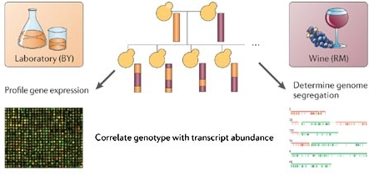
eQTLs and pQTLs
Test for linkage between all loci and all gene levels
Transcript expression levels as quantitative traits: expression QTLs (eQTLs)
Now possible with protein levels as well: protein QTLs (pQTLs)
M. V. Rockman and L. Kruglyak. Nature Reviews Genetics 7: 862-872 (2006)
Notes:
A very prominent idea along these lines was proposed not so long time ago: let’s consider genome-wide gene activity itself as quantitative trait. This is very reasonable to find association with gene activity, because the development of any phenotype, that is, any collection of traits, starts from gene activation. As you know, when activated, gene is transcribed to mRNA, which in turn is translated to protein. [show on picture] Currently the most common technique for measuring gene activity is transcript expression using microarrays. It measures gene expression of all genes simultaneously. The analysis of expression quantitative trait loci tries for a population of organisms to map statistically genotypic variation to variation in transcript expression. [show on picture]
Of course, in order to get a better idea about QTLs, we would like to do the same analysis for gene activity in terms of protein abundance as well. Until recently is was not possible, but with some new technologies and methods for analysis of data they produce, we now can start doing it. Using proteome data, we can compute protein quantitative trait loci.
My talk is essentially devoted to QTL analysis, so you’ll see more details about that later.

Slide 7
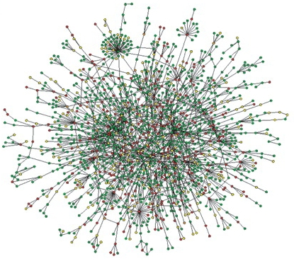
eQTLs/pQTLs and Interaction Networks
Integrate eQTLs and pQTLs with interaction networks
Analyze interactions with respect to QTLs
Improve pQTL analysis using eQTLs and interactions
+
Notes:
What I’m going to show you today is how we can integrate one kind of data I mentioned, interaction networks, with eQTL and pQTL analysis. I’ll show you some interesting properties of the integrated data. Then I’ll explain how using expression QTLs and interaction networks, we can improve protein QTLs analysis, let’s say get a better resolution with which we consider linkages. This could potentially lead to better understanding of quantitative traits via genome, their behavior and control.
“Could lead to better and more detailed explanation of quantitative trait behavior and regulation”
[6 min]

Slide 8
Quantitative Trait Loci
Genome-wide transcript levels as quantitative traits
Baker’s yeast (Saccharomyces cerevisiae)
Two strains BY and RM, genomes differ in 0.6%
Genotype and gene expression of each individual and each parent across whole genome
Notes:
Let me now explain more details of QTL analysis. As I already explained you briefly, the goal of eQTL analysis is to associate genome-wide genotypic variation with variation in gene expression. So let me describe the experiment in a little more detail. I will be using baker’s yeast, as one of the most common model organisms. We create an artificial population by crossing two very similar, but still clearly different organisms. These two strains of yeast, laboratory and wild, differ in only about 0.6% of their genome. We grow a number of children from this cross. They inherit genotype from two parents in about equal proportions. We genotype both parents and each individual extensively. We have many markers across whole genome, and in the end we can say about each individual how it inherited its genotype from parents. For each marker, or locus, we can say which parent it corresponds to. Also we measure gene expression for each individual in each gene.
Is it clear what data we collect? Two parents, many individuals, genotype them across whole genome, attribute each marker to one of the parents, measure gene expression genome-wide for each individual.

Slide 9
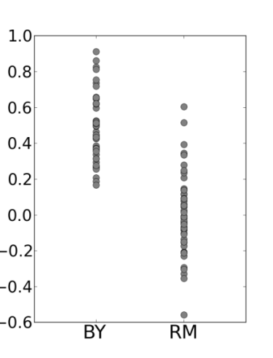
eQTLs
G
p-value
divide expression values of individuals based on genotype
apply WMW statistical test
genes
markers
M
Data from: R. B. Brem and L. Kruglyak. PNAS USA 102 (5): 1572-7 (2005)
Notes:
After the data is collected, we do the analysis. For each marker M and for each gene G, we do the following. We divide all individuals to two groups, based on the genotype they inherit in marker M. It’s either RM or BY genotype, from one of the parents. For these two groups, we take expression values of gene G for these groups, and apply a statistical test to see how different the distributions are. We use Wilcoxon-Mann-Whitney test here. The test returns you p-value that you associate with the pair of M and G. The smaller p-value, the more likely variation in marker M affects variation in expression of gene G.

Slide 10
eQTLs
Do multiple testing correction
For a certain FDR get a graph of linkages between markers and genes
G
p-value
divide expression values of individuals based on genotype
apply WMW statistical test
genes
markers
M
genes
linkages
markers
Data from: R. B. Brem and L. Kruglyak. PNAS USA 102 (5): 1572-7 (2005)
Notes:
And in this manner we do the analysis for each pair, fill the whole table with p-values. [data details appear] For example, in the data I have, there are 112 individuals with gene expression measured in more than 5000 genes, this is basically all yeast genes, and genotyped in almost 3000 markers distributed across the whole genome. Thus we do about 16 million statistical tests. [example appears] And for example, at the level 1e-4, we have about 84 thousand pairs that linked.
With this many tests, we need to correct for multiple testing. Or in other words, we need to decide how significant each p-value level is.

Slide 11

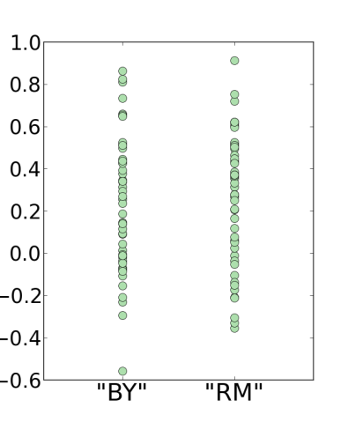
eQTLs
real data
G
p-value
7e-15
genes
shuffled data
markers
M
p-value
0.32
Notes:
For this, we repeat all the analysis for randomized data. We randomly shuffle the expression values for each individual and repeat the whole procedure. For example, for some pair of M and G, in real data you could get this very small p-value, and for shuffled data you could get this much higher p-value that doesn’t actually correspond to anything real.

Slide 12
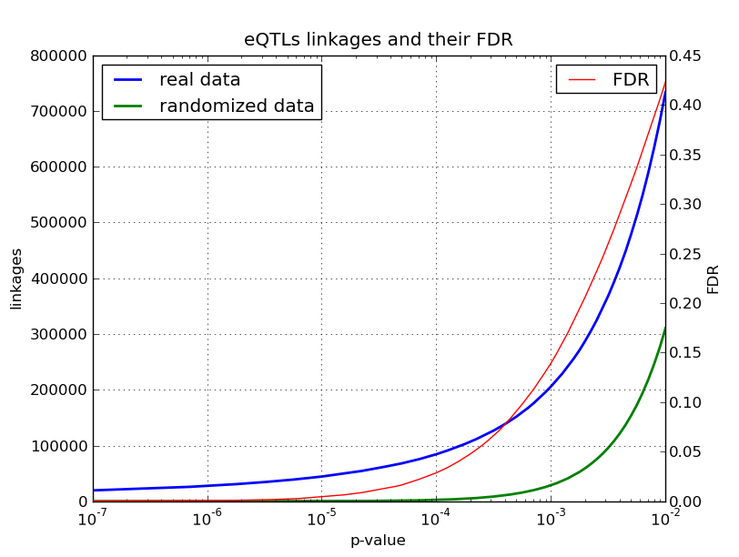
eQTLs: False Discovery Rate
Example: at level 1e-4:
84,299 real linkages
2,419 false “linkages”
FDR_{1e-4} = 2.9%
Real data:
L_{p} real linkages
at threshold p
genes
markers
FDR_{p} = F_{p} / L_{p}
Shuffled data:
F_{p} false linkages
at threshold p
genes
markers
Notes:
However, still for so many tests you’ll get some “false” linkages even on low p-value thresholds. Suppose we got L_p real linkages for threshold p. Suppose we got F_p “false” linkages for the same threshold, from randomized. Then you can say that you expect F_p “false” linkages when having L_p real linkages, or in other words, your false discovery rate is the ratio of F_p over L_p.
[example appears] For example, at p-value level of 1e-4, we get about 84 thousand real linkages and 2400 linkages on randomized data. This means that at this level our false discovery rate is 2.9%.
[plot appears] Here is the plot of the number of real and false linkages. Blue curve is real linkages and green curve is linkages from randomized data. You read the number of linkages on left. Red curve is the ratio of these two, it represents false discovery rate, you read it on right. And the point 1e-4 from the example is here.
Is it clear how the experiment and analysis works? It’s important for the rest, so please ask me to repeat if it’s not clear. [repeat if necessary]
[12 min]

Slide 13
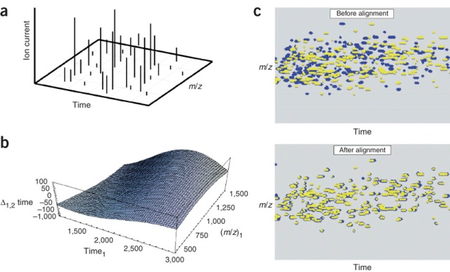
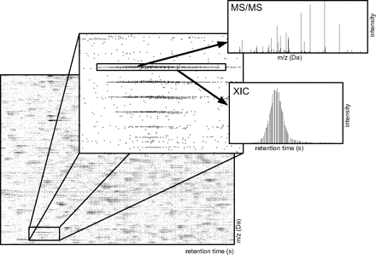
pQTLs
Protein abundance data from LC-MS/MS scan
E. J. Foss et al. Genetic basis of proteome variation in yeast. Nature genetics 39 (11): 1369-75 (2007)
Z. Khan et al. Protein quantification across hundreds of experimental conditions. PNAS USA 106 (37): 15544-8 (2009)
1,073 protein abundance levels
Detect pQTLs in the same manner as eQTLs
Notes:
Microarrays for measuring transcript expression are widely used. But with some new technology and a new bioinformatics method for analysis of the experiment using this technology, proteome data can be obtained. However, the analysis is more difficult, and the data is available for only about 1000 proteins. For this data, we can do exactly the same analysis and obtain protein QTLs.

Slide 14
eQTLs and pQTLs
112 individuals
5,610 transcript levels
2,820 markers
2,820 ∙ 5,610 = 15,820,200 tests
107 individuals
1,073 protein levels
2,820 markers
2,820 ∙ 1,073 = 3,025,860 tests
p-value | FDR | # linkages
2.0e-6 | 0.1% | 31,311
2.6e-5 | 1% | 57,056
2.1e-4 | 5% | 109,200
p-value | FDR | # linkages
1.1e-6 | 0.1% | 4,637
2.5e-5 | 1% | 9,513
1.6e-4 | 5% | 16,133
3,587
21,375, if only for genes with known protein abundance
Notes:
Let’s summarize. With the data I described, we obtain this many linkages for eQTLs and pQTLs, for differrent false discovery rates. For instance, at false discovery rate of 5% we get about 100000 linkages with transcript traits and about 16000 with protein levels. It’s remarkable that the intersection is only about 3500 linkages, very little. It’s little even if we consider only those transcripts for which we have corresponding protein abundance level, remember this is about 1000 genes. [middle part appears] We have about 21000 such eQTL linkages and about 16000 linkages, with intersection of about 3500. This little intersection can be caused by many reasons. First, transcript and protein levels can indeed behave differently. Second, there may be noise in the data: in genotypes, in expression, and of course in protein levels. And finally, there should be noise in the analysis. However, it seems that the main reason is extreme underestimation of the number of linkages we obtain in this analysis, mostly due to moderate number of individuals in the study. Actually, what I’ll show you later is how to improve the analysis and to find more linkages.
Anyway, for any fixed FDR, we can represent the results of eQTL or pQTL analysis as a network with edges between markers and genes. [last part appears]

Slide 15
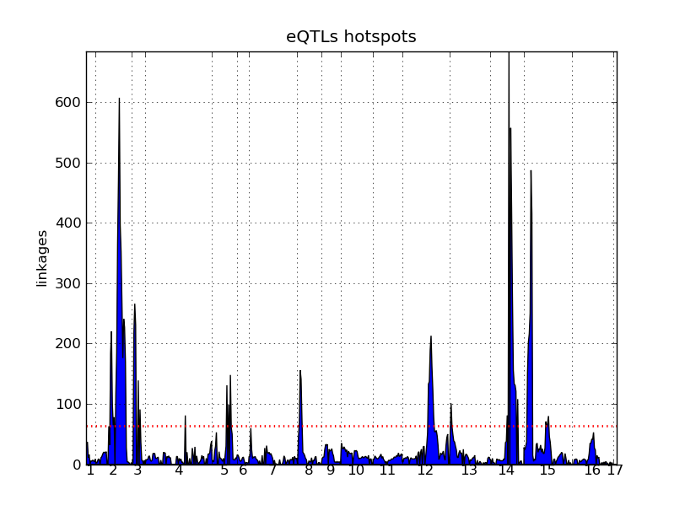
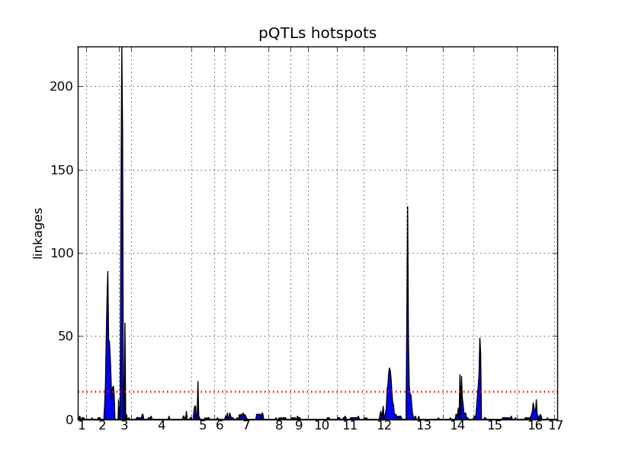
Genetics of Global Gene Expression
Hotspots: genomic loci enriched with linkages
Hard to find causal gene, hard to explain:
no enrichment with TFs or a particular function
hotspots
Notes:
After this kind of analysis was first published in 2002, it generated a lot of research, a whole new field of genetics of global gene expression, here gene expression meaning activation of genes in general. The experiment is very natural and let’s even say straightforward. It’s very natural to consider gene expression traits, as any phenotype, that is, any collection of traits of any organisms, is developing through gene expression. However, the analysis of the results of such experiment is not easy.
Still something interesting was observed. From the very beginning it was observed that linkages have so-called hotspots, regions that have many more linkages than you would expect by chance if throwing them to genome uniformly at random. Here are the pictures of hotspots for eQTLs and pQTLs. Here is the genome, all chromosomes of yeast. We divide it into bins and plot the number of linkages in each bin, actually for this pictures also corrected with the number of markers in the bin, because they are not uniformly distributed. These are hotspots. [hotspots with arrows appear] These I plotted after I repeated the analysis from the initial papers, though you can compare it with analogous plots from the papers and see they are about the same. A natural explanation for hotspots is responsibility for regulation of large groups of genes, often called “master regulator”. This was mostly confirmed, though other possibilities were reported, for example, an extreme case: mutation in an essential gene would reduce expression of every gene to zero, thus causing a hotspot.
For QTLs in general, there are even more possibilities. We can classify QTLs roughly as local and distant. Here you see several examples of possible explanations for both classes. Of course, it would be very useful to associate with each linkage a particular gene causing this linkage, you may think this should be the first thing to do. However, this turns out to be also difficult, as no transcription factors are reported to be overrepresented near QTLs, and QTLs are not enriched for any particular class of molecular function.
You can see a clear difference here between eQTL and pQTL hotspots. This is of course mostly due to the fact that we have protein levels for only 1000 proteins out of 6000. That’s why it’s more important that we do the analysis for the existing ones better, and this what I’m going to show you later.
Generally, currently, for understanding QTLs better, you need to do more biological experiments and do them more targeted. However, computationally, we could improve the analysis itself, and that’s what I’ll show later. I’ll be using interaction networks for that. So let’s talk about networks a little.
[18 min]

Slide 16
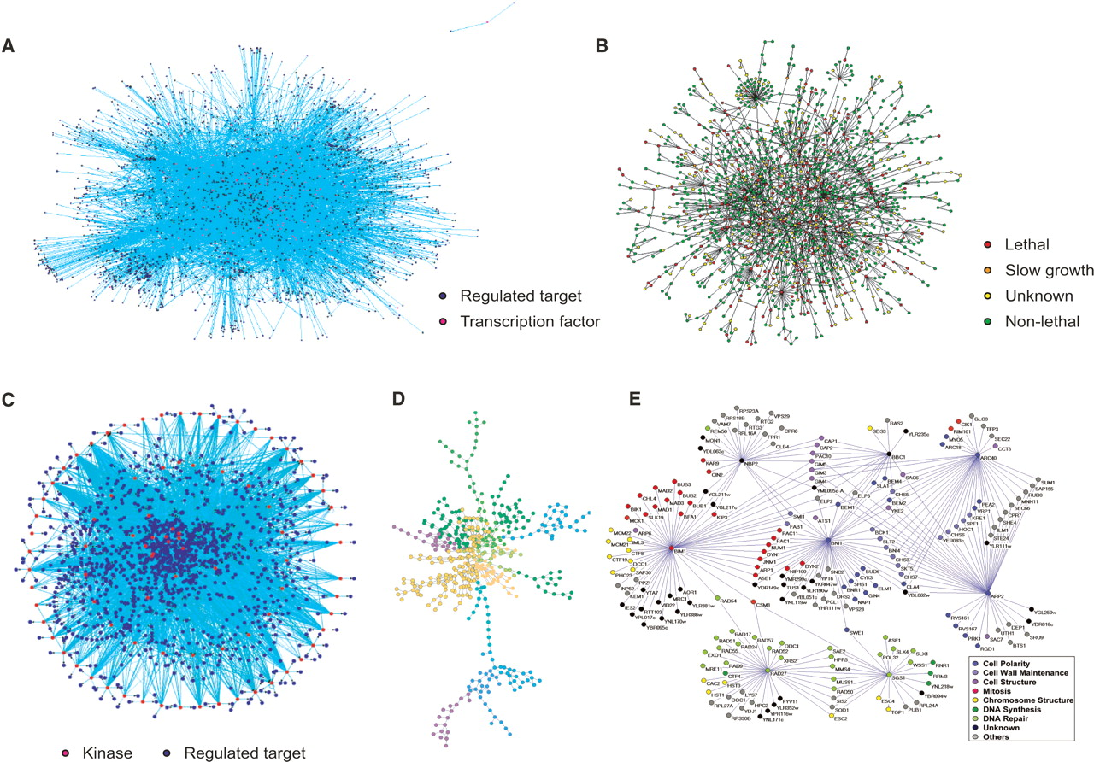
Cell Interactome
Interactors: genes/transcripts/proteins
Interactions:
physical
genetic
transcriptional
phosphorylation
metabolic
By association:
co-regulation
co-expression
X. Zhu et al. Genes Development. 21: 1010-1024 (2007)
Notes:
Two major achievements of the last decade have made possible construction of large biological networks of different types, with several examples on this picture. One achievement is the development of new technologies, in particular, high-throughput screening methods. Another one is the development of large databases that made possible aggregation of data from hundreds and thousands of papers with both high-throughput and small-scale experiments. Usually for simplicity in such networks genes and corresponding transcripts and proteins are represented in a unified node, that’s also what we’ll be doing. Interactions of many types are being considered: physical, genetic, transcriptional, phosphorylation, metabolic interactions. These are more or less from direct experiments. We can also consider interactions by association, for example, co-expression and co-regulation interactions.

Slide 17
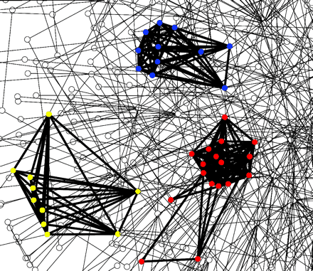
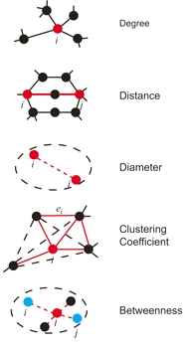

Cell Interactome
Extensively studied:
topology
modularity
motifs
network integration
data integration: gene expression, sequence data
Perspectives:
revealing signaling, regulatory, metabolic pathways
functional association and prediction
protein complexes and functional modules
network dynamics
X. Zhu et al. Genes Development. 21: 1010-1024 (2007)
V. Spirin and L. Mirny. PNAS USA 100 (21): 12123-8 (2003)
Notes:
Interaction networks have been extensively studied. Their different topological properties were studied, such as degree distribution, clustering coefficient, betweenness, average path length, diameter, and others. They were shown to be modular, so that you can find interesting clusters and community-like structures in them. These networks are enriched with some small subnetworks called network motifs when compared with randomized networks. You can do the analysis for networks separately, but also for several networks together. You can also integrate networks with other kinds of data, like gene expression, sequence data. Using networks, you can answer interesting biological question: reveal pathways of different kinds, consider functional annotation and do functional prediction, extract protein complexes and functional modules. Usually by integrating with other data, you can argue about network dynamics and evolution.

Slide 18
Cell Interactome for Yeast
type | # vertices | # edges
physical | 5,624 | 56,154
genetic | 5,314 | 108,699
regulatory | 5,974 208 sources 5,973 targets | 46,359
co-regulation | 5,397 | 49,992
Notes:
Here are the details about the networks that are available for yeast that I’m using. I take networks for physical and genetic interactions from the biogrid database that aggregates yeast interactions from more than 11000 publications. For regulatory network, I take the Yeastract database that aggregates more than 1000 publications, and I also add interactions from two publications. Also, I find it useful to build the co-regulation network. [co-regulation appears] I say that two genes are co-regulated if they have similar sets of regulators, with Jaccard coefficient of similarity of these sets at least 30%. Note that all these networks cover more or less the whole set of genes and proteins: yeast genome is reported to consist of about 6000 genes.
[22 min]

Slide 19
Interacting Genes Share Linkages
Linkage similarity: Jaccard coefficient of sets of markers linking to the genes
J(A, B) = #(A Å B) / #(A [ B)
Compute for interacting genes and for random pairs of genes
genes
linkages
markers
Notes:
Now let me start talking about observations I made. Consider the following experiment. For every pair of genes, we can compute how similar the sets of loci linking to these genes are. Here by similarity I mean Jaccard coefficient. Suppose we have two genes, black on this picture. Look at all markers linking to them, blue on the picture. They share some markers. Similarity is the ratio of the number of shared markers to the number of all markers here. For example, here it is 2 over 8, that is, 0.25.
We could compute this measure for any pair of genes. Let’s do it for all interacting genes and for the same number of randomly chosen pairs. Randomly chosen genes are usually non-interacting, since interaction graphs are sparse. For different linkage thresholds we’ll be obtaining different results.

Slide 20
Interacting Genes Share Linkages
eQTLs:
Physically interacting genes share linkages
Take linkages at FDR 5%
Compute for all 55,306 edges and for equal number of random pairs of genes
with reported p-value = 0 (WMW test)
Interactions with positive similarity 16,582 (30%)
 | edges | random pairs
average | 0.032 | 0.014
Notes:
On this left plot, blue curve is the average of linkage similarity for physically interacting genes, for different linkage p-value thresholds. Green curve is average linkage similarity for randomly chosen pairs of genes in the same network. We choose the same amount of random pairs as we have interactions. You can read similarity values on left. Red dashed curve is p-value for the difference of similarity value distributions on edges and on random pairs, you can read it on right. Is it clear what is pictured on these plots?
What you can observe from this plot is that physically interacting genes tend to share linkages. On the right picture, the same results are plotted for the network of genetic interactions. Genetically interacting genes don’t show much difference with random pairs, though the distributions of similarity values show difference on high threshold values.
Below you can see how many edges had non-zero similarity for each network. Most edges have zero similarity, though there are many with positive value.

Slide 21
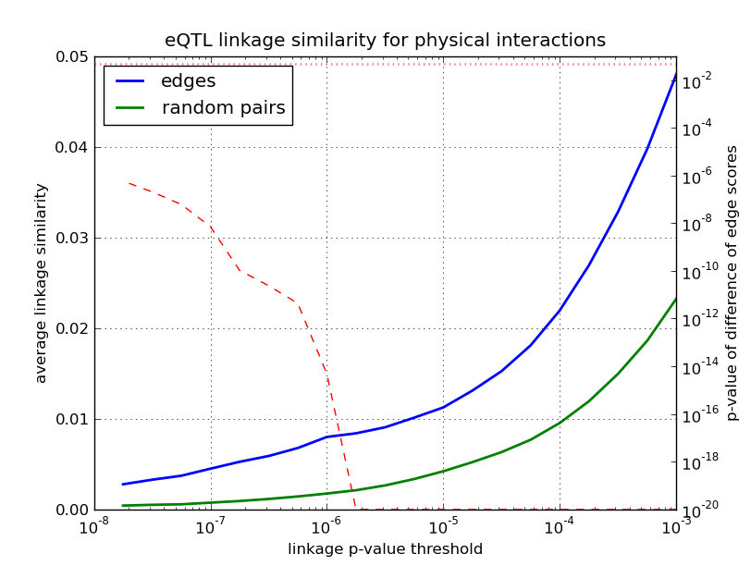
Interacting Genes Share Linkages
eQTLs: Physically interacting genes share linkages
Notes:
On this left plot, blue curve is the average of linkage similarity for physically interacting genes, for different linkage p-value thresholds. Green curve is average linkage similarity for randomly chosen pairs of genes in the same network. We choose the same amount of random pairs as we have interactions. You can read similarity values on left. Red dashed curve is p-value for the difference of similarity value distributions on edges and on random pairs, you can read it on right. Is it clear what is pictured on these plots?
What you can observe from this plot is that physically interacting genes tend to share linkages. On the right picture, the same results are plotted for the network of genetic interactions. Genetically interacting genes don’t show much difference with random pairs, though the distributions of similarity values show difference on high threshold values.
Below you can see how many edges had non-zero similarity for each network. Most edges have zero similarity, though there are many with positive value.

Slide 22
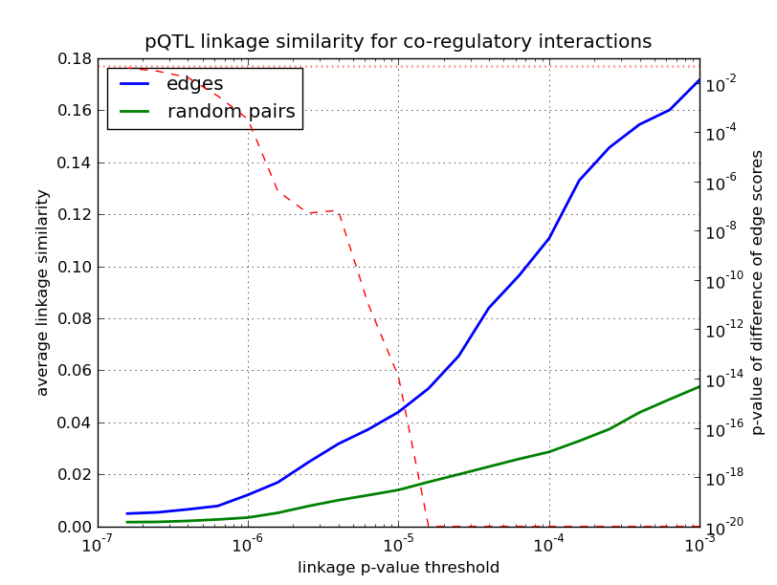
Interacting Genes Share Linkages
pQTLs: Co-regulatory interactions share linkages
Interactions with positive similarity at FDR 5%: 5,654 (84%)
Notes:
On this left plot, blue curve is the average of linkage similarity for physically interacting genes, for different linkage p-value thresholds. Green curve is average linkage similarity for randomly chosen pairs of genes in the same network. We choose the same amount of random pairs as we have interactions. You can read similarity values on left. Red dashed curve is p-value for the difference of similarity value distributions on edges and on random pairs, you can read it on right. Is it clear what is pictured on these plots?
What you can observe from this plot is that physically interacting genes tend to share linkages. On the right picture, the same results are plotted for the network of genetic interactions. Genetically interacting genes don’t show much difference with random pairs, though the distributions of similarity values show difference on high threshold values.
Below you can see how many edges had non-zero similarity for each network. Most edges have zero similarity, though there are many with positive value.

Slide 23
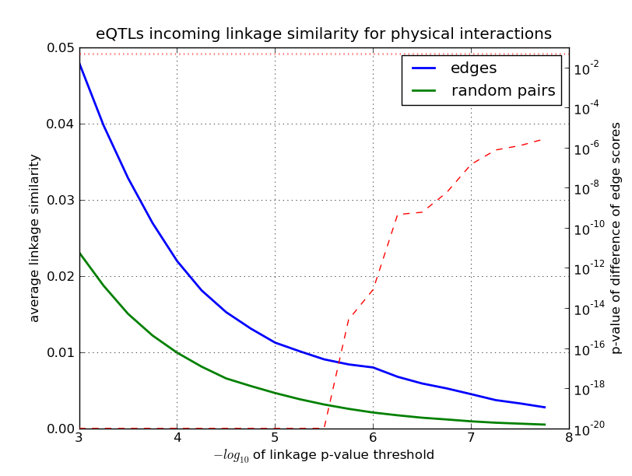
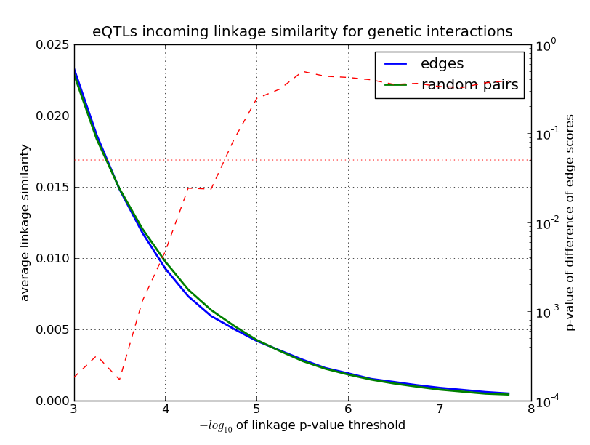
Interacting Genes Share Linkages
eQTLs:
Physically interacting genes share linkages
Genetically interacting genes less do so
Interactions with positive similarity at FDR 5%:
16,582 (30%)
19,789 (18%)
Notes:
On this left plot, blue curve is the average of linkage similarity for physically interacting genes, for different linkage p-value thresholds. Green curve is average linkage similarity for randomly chosen pairs of genes in the same network. We choose the same amount of random pairs as we have interactions. You can read similarity values on left. Red dashed curve is p-value for the difference of similarity value distributions on edges and on random pairs, you can read it on right. Is it clear what is pictured on these plots?
What you can observe from this plot is that physically interacting genes tend to share linkages. On the right picture, the same results are plotted for the network of genetic interactions. Genetically interacting genes don’t show much difference with random pairs, though the distributions of similarity values show difference on high threshold values.
Below you can see how many edges had non-zero similarity for each network. Most edges have zero similarity, though there are many with positive value.

Slide 24
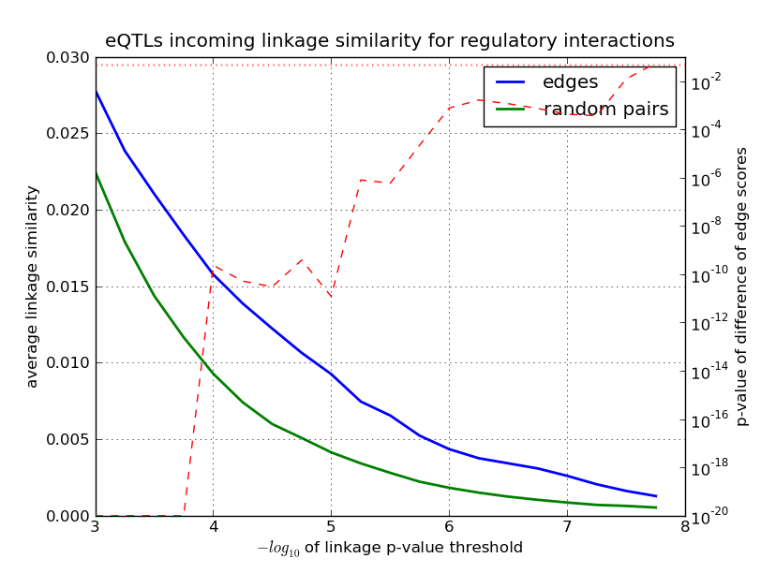
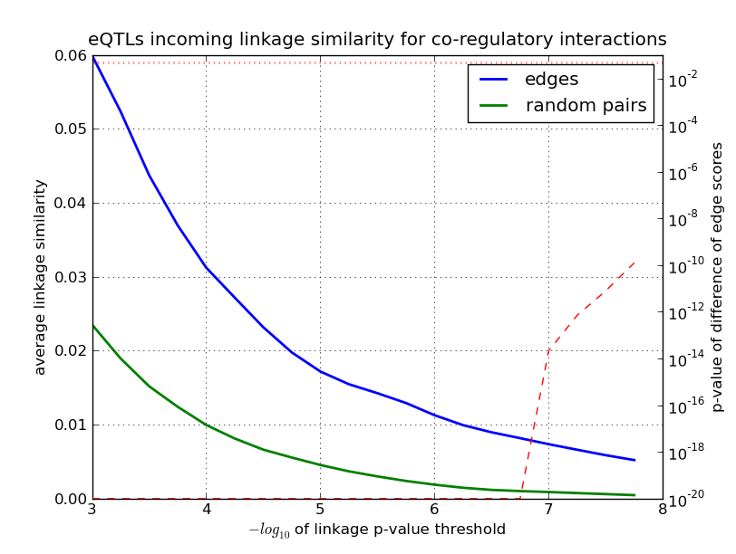
Interacting Genes Share Linkages
eQTLs:
Regulatory interactions share linkages
Co-regulatory interactions share linkages
Interactions with positive similarity at FDR 5%:
9,623 (22%)
15,842 (35%)
Notes:
Here are the same plots for regulatory interactions and for co-regulatory interactions. As you see, they both show that interacting genes tend to share linkages more than random pairs.
Also, quite many edges have positive similarity values in both cases. Note that in absolute values, co-regulatory network actually is the best. It has the largest fraction of edges with positive similarity, and also on average the similarity is larger than in the second best, physical interaction network.

Slide 25
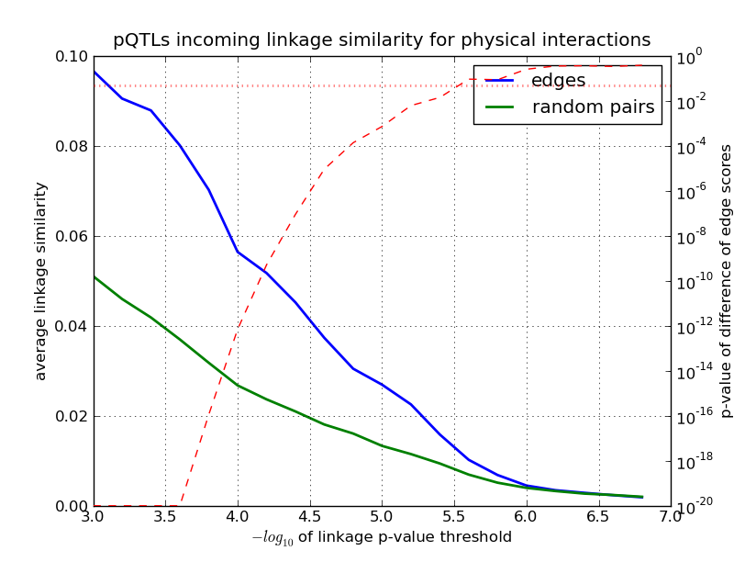
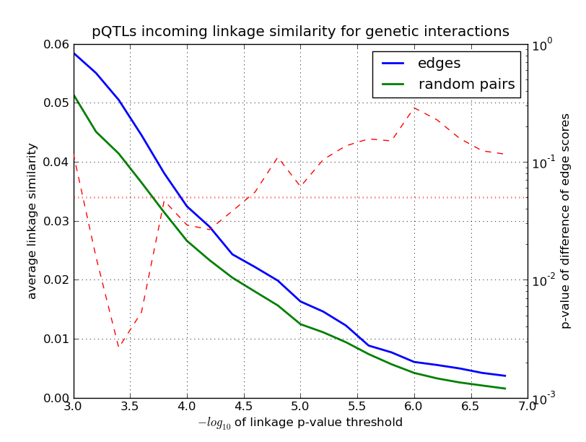
Interacting Genes Share Linkages
Similar results for pQTLs (for proteins with known levels):
Physical interactions share linkages
Genetic interactions less do so
Interactions with positive similarity at FDR 5%:
4,846 (79%)
3,606 (71%)
Notes:
And here are the same plots for pQTL linkage similarity. Here I restrict the networks to only those genes where corresponding proteins have known protein levels. This results in a smaller network, but the values for them seem to be better. Larger fraction of the networks have edges with positive similarity, and the difference when compared with random pairs of genes is higher. Now we can even see that genetic interactions in this case also have weak tendency for sharing linkages compared with random pairs.

Slide 26
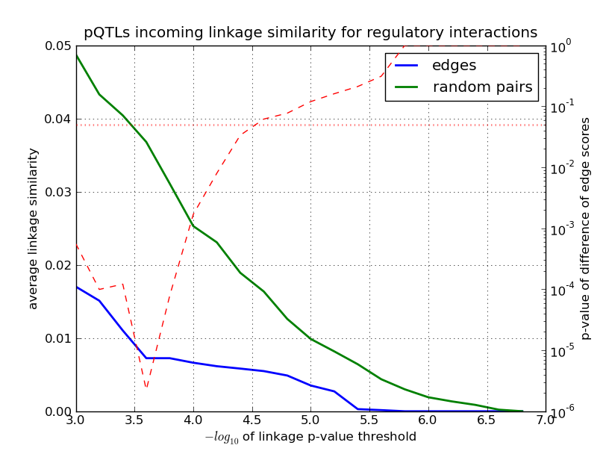
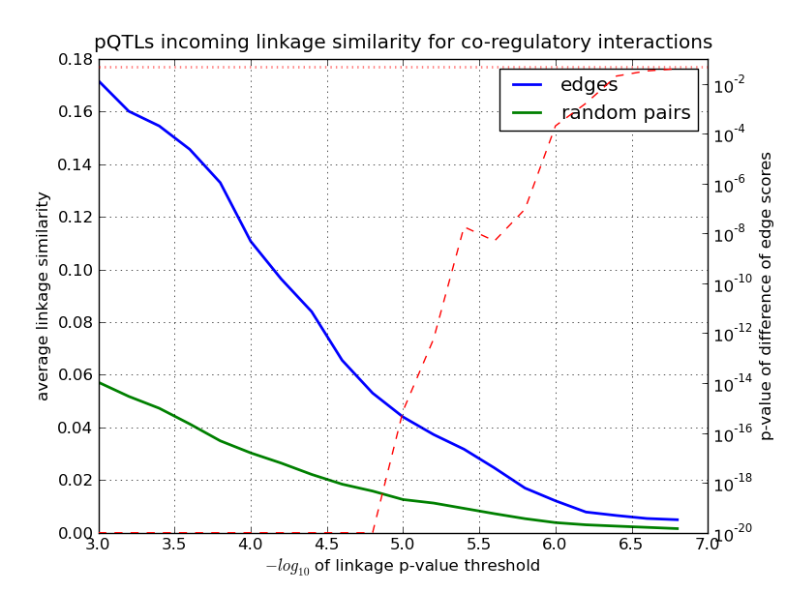
Interacting Genes Share Linkages
pQTLs (for proteins with known levels):
Regulatory interactions do not seem to share linkages, though data is not representative
Co-regulatory interactions share linkages
only 8 TFs have protein levels
Interactions with positive similarity at FDR 5%:
419 (60%)
5,654 (84%)
Notes:
And here are the plots for regulatory and co-regulatory interactions. Co-regulatory interactions are still good and even the best among all. However, here is an interesting thing with regulatory interactions: random pairs have higher values. But note that here we have only 400 edges, and the whole network has only 600 edges. Only 8 transcription factors, that is, source nodes in regulatory network, have known protein levels. So in this particular case, the data is probably not representative, which you can also see from absolute values of linkage similarity.
[29 min]

Slide 27
Subnetworks of Interaction Networks
<based on similarity of linkages>

Slide 28
Dense QTL Target Subnetworks
QTL target subnetwork
Density z-score of subnetwork with n nodes and m edges:
z = (m – e_{n}) / s_{n}
e_{n} = average number of edges on n nodes
s_{n} = standard deviation
target genes
marker
Notes:
Another way of looking at the same thing is the following: for each marker, we can consider its targets in linkages, and look at the properties of the network induced by these targets. One of the key properties is the density which you can estimate with the z-score. Let me remind you that in order to compute z-score of the subnetwork, you compute the average number of edges of the subnetwork with n nodes in this graph e_n and compute standard deviation s_n. Then z-score is this ratio.

Slide 29
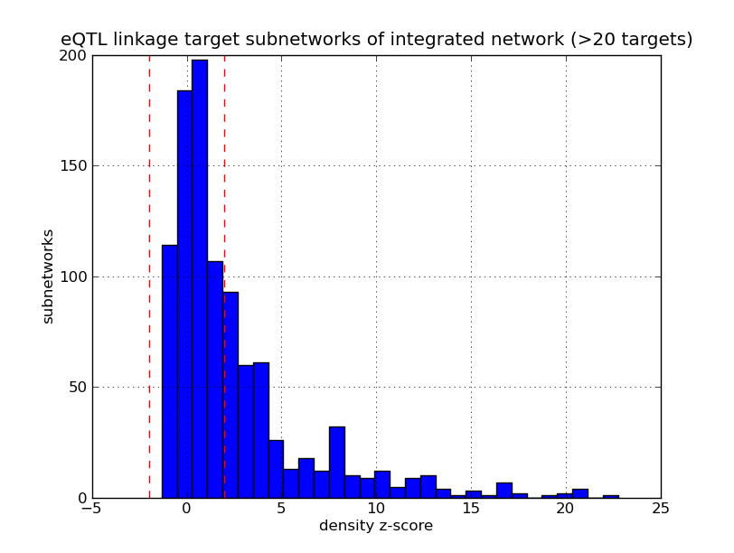
Dense QTL Target Subnetworks
eQTLs (FDR 5%): 38 targets on average
Notes:
Now for example for eQTLs at a certain false discovery rate, and for an interaction network, for each marker we can look at the subnetwork of its targets in this network and compute its z-score. Here we take integrated network of all interactions, and plot the distribution across all markers of density z-scores. eQTLs are on left, and pQTLs are on right. Here it’s for all markers with at least 20 linking genes, and here for at least 50 target genes, with average accross all eQTLs for this false discovery rate being 38. And for pQTLs, average is 11 targets per QTL, here plot for those with at least 5 targets, and here for those with at least 15 targets. What you can see from all of these plots that genes that share linkages, tend to interact between each other more than on average in the network. These heavy tails on right are responsible for that.
[32 min]

Slide 30
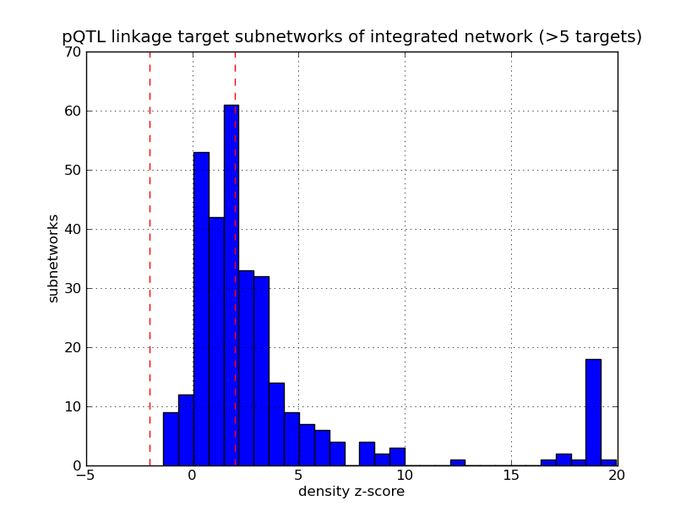
Dense QTL Target Subnetworks
pQTLs (FDR 5%): 11 targets on average
Notes:
Now for example for eQTLs at a certain false discovery rate, and for an interaction network, for each marker we can look at the subnetwork of its targets in this network and compute its z-score. Here we take integrated network of all interactions, and plot the distribution across all markers of density z-scores. eQTLs are on left, and pQTLs are on right. Here it’s for all markers with at least 20 linking genes, and here for at least 50 target genes, with average accross all eQTLs for this false discovery rate being 38. And for pQTLs, average is 11 targets per QTL, here plot for those with at least 5 targets, and here for those with at least 15 targets. What you can see from all of these plots that genes that share linkages, tend to interact between each other more than on average in the network. These heavy tails on right are responsible for that.
[32 min]

Slide 31
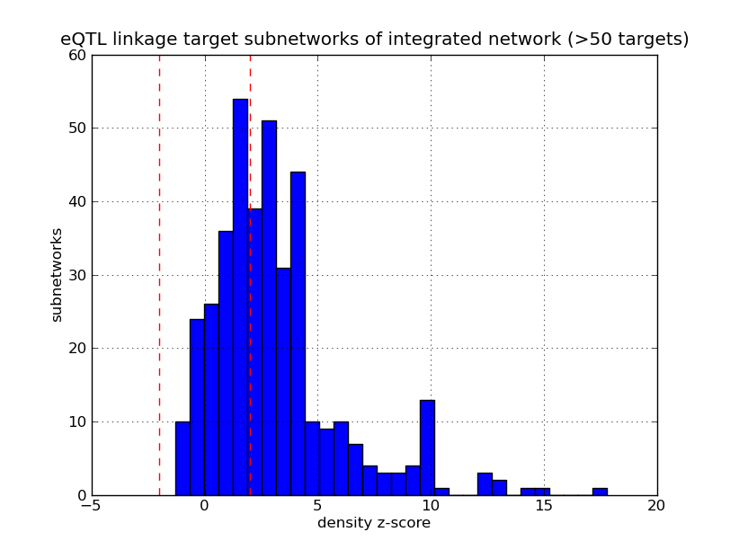
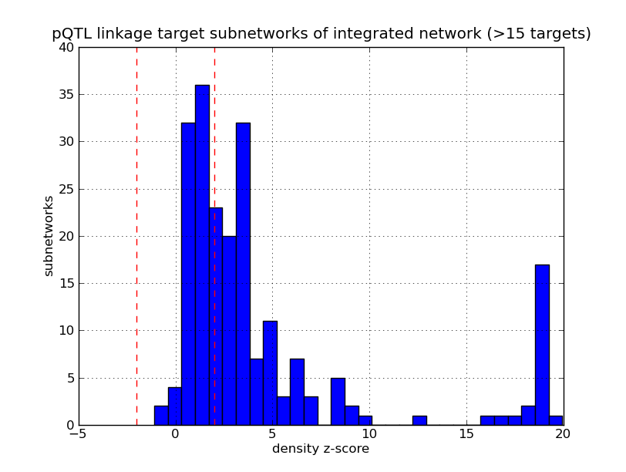
Dense QTL Target Subnetworks
eQTLs (FDR 5%)
38 targets on average
pQTLs (FDR 5%)
11 targets on average
Notes:
Now for example for eQTLs at a certain false discovery rate, and for an interaction network, for each marker we can look at the subnetwork of its targets in this network and compute its z-score. Here we take integrated network of all interactions, and plot the distribution across all markers of density z-scores. eQTLs are on left, and pQTLs are on right. Here it’s for all markers with at least 20 linking genes, and here for at least 50 target genes, with average accross all eQTLs for this false discovery rate being 38. And for pQTLs, average is 11 targets per QTL, here plot for those with at least 5 targets, and here for those with at least 15 targets. What you can see from all of these plots that genes that share linkages, tend to interact between each other more than on average in the network. These heavy tails on right are responsible for that.
[32 min]

Slide 32
QTLs and Interactions
Interacting genes tend to share linkages
Find more linkages: extend known linkages with interactions
Notes:
On this left plot, blue curve is the average of linkage similarity for physically interacting genes, for different linkage p-value thresholds. Green curve is average linkage similarity for randomly chosen pairs of genes in the same network. We choose the same amount of random pairs as we have interactions. You can read similarity values on left. Red dashed curve is p-value for the difference of similarity value distributions on edges and on random pairs, you can read it on right. Is it clear what is pictured on these plots?
What you can observe from this plot is that physically interacting genes tend to share linkages. On the right picture, the same results are plotted for the network of genetic interactions. Genetically interacting genes don’t show much difference with random pairs, though the distributions of similarity values show difference on high threshold values.
Below you can see how many edges had non-zero similarity for each network. Most edges have zero similarity, though there are many with positive value.

Slide 33
Subnetworks of Interaction Networks
<based on high density>

Slide 34
pQTLs: False Discovery Rate
real data
G
p-value
7e-15
genes
markers
M
shuffled data
p-value
0.32
Notes:
For this, we repeat all the analysis for randomized data. We randomly shuffle the expression values for each individual and repeat the whole procedure. For example, for some pair of M and G, in real data you could get this very small p-value, and for shuffled data you could get this much higher p-value that doesn’t actually correspond to anything real.

Slide 35
pQTLs: False Discovery Rate
Example: at level 1.6e-4:
16,133 real linkages
812 false “linkages”
FDR = 5%
Real data:
L_{p} real linkages
at threshold p
genes
markers
FDR_{p} = F_{p} / L_{p}
Shuffled data:
F_{p} false linkages
at threshold p
genes
markers
Notes:
Now I can show how we can improve the results of pQTL analysis. Recall how the analysis works. For each pair of marker and gene, that is, for each cell in this table, we compute p-value of linkage. We also do the same using randomized data. Then with a certain p-value threshold, false discovery rate is the ratio of the number of found linkages for real and randomized data. For example, for pQTLs, for this threshold, we obtain about 16000 real linkages and 812 false linkages, so that false discovery rate is 5%.

Slide 36
pQTLs: False Discovery Rate
Example: at level 1.6e-4:
16,133 real linkages
812 false “linkages”
FDR = 5%
Real data:
L_{p} real linkages
at threshold p
Idea: do not test all pairs, filter for trusted only
genes
markers
FDR_{p} = F_{p} / L_{p}
Shuffled data:
F_{p} false linkages
at threshold p
genes
markers
Notes:
Pease note the following: from 3,000,000 pairs we test, only 16,000 link. Most pairs do not link. So that would be much better if we could avoid testing those pairs that we are sure will not link. The idea is the following: let’s filter out the table before any tests are applied, so that hopefully only pairs which we think could potentially link are left for testing.

Slide 37
pQTLs: False Discovery Rate
Example: at level 1.6e-4:
16,133 real linkages
812 false “linkages”
FDR = 5%
Real data:
L_{p} real linkages
at threshold p
Idea: do not test all pairs, filter for trusted only
Goals:
filter out pairs that will not link,
or at least filter out more false than real linkages
FDR_{p} = F_{p} / L_{p}
Shuffled data:
F_{p} false linkages
at threshold p
genes
markers
Notes:
So the goal of such filtering is to filter out pairs that will not link in the end. This is probably too optimistic, so we are ok if we could filter out more false linkages than real linkages.

Slide 38
pQTLs: More Linkages
Idea: do not test all pairs, filter for trusted only
Goals:
filter out pairs that will not link,
or at least filter out more false than real linkages
FDR decreases for the same p-value threshold
more linkages found for the same FDR
Result:
21,227 (+32%) pQTL linkages at FDR 5%
with 90% previously found linkages preserved
Use eQTLs and interaction networks
Notes:
Again, the idea is to restrict the analysis to some trusted set of pairs marker-gene instead of conservatively testing all of them. In an ideal case, for a certain threshold, we will filter out most false linkages while preserving real linkages. This means for the same p-value threshold, we can decrease the false discovery rate. Or in other words, for the same false discovery rate, we can find more linkages.
With the approach I’m now going to show, we can find 34% more linkages at false discovery rate of 5%, though preserving 90% linkages found at false discovery rate 5% by the standard conservative approach. [last line appears] And the idea for this is to use eQTLs and interaction networks together.

Slide 39
pQTLs: More Linkages
First idea: use eQTL linkages as candidates for pQTL linkages
Second idea: extend eQTL linkages with interactions and take these as candidates for pQTL linkages
interactions
eQTL linkage
candidates
Notes:
We need to form some set of candidate pairs marker-gene for further testing. The first idea could be to take all eQTL linkages. However, you remember that the intersection of them with pQTLs is small. Therefore we need to extend this set. This is very simple and works as follows: take a eQTL linkage between markers and genes, blue and black here, and add it to the set of candidates, [interactions appear] then consider all interactions in which this gene is involved, [candidate arrows appear] and add all those pairs as candidates too. After this is done for all eQTL linkages, do the usual pQTL detection procedure for all candidates, instead of for all possible pairs of marker and gene.
[36 min]

Slide 40
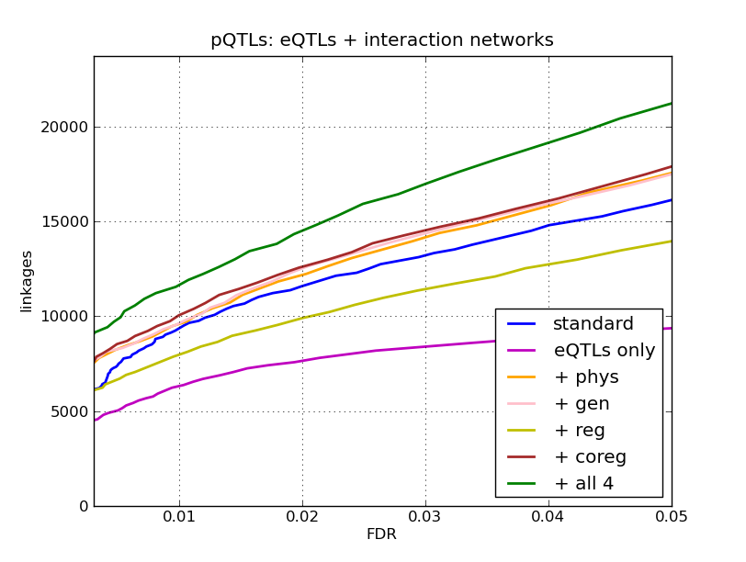
pQTLs: More Linkages
+32%
Notes:
This is more or less the main slide of the presentation. Here I plot the number of linkages found by different procedures depending on false discovery rate. [explain all curves; if necessary, go back and repeat what we do] The first thing you notice that, as expected, using only eQTL linkages performs poorly. Note also that three networks perform on about the same level here: physical, genetic, and co-regulatory. Regulatory network doesn’t perform well, which is consistent with previous observations. The best is the intergrated network of all four types of interactions. It gets 32% more linkages at false discovery rate of 5%.

Slide 41
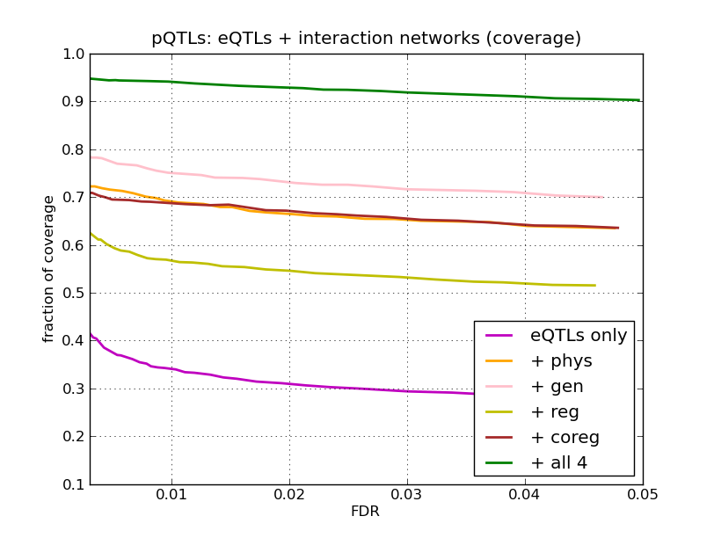
pQTLs: More Linkages
90%
Notes:
Now let’s look at how many linkages found in the standard, conservative analysis, are found with the new method. It’s plotted here. [explain curves] Again, you see that eQTL linkages alone have the worst coverage: as you remember, they have little intersection with pQTL linkages. Different networks work differently, and the best is again the intergrated network with all four kinds of interactions. It covers 90% of linkages at false discovery rate of 5% and even more than that at lower false discovery rate levels.
[39 min]

Slide 42
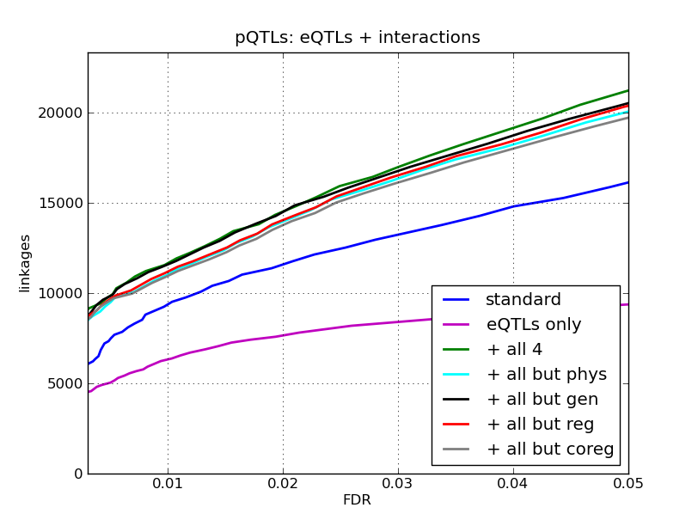
pQTLs: More Linkages
Notes:
[comparison with methods using three networks only]

Slide 43
pQTLs: More Linkages
Compare with randomized data
Can shuffle:
interaction network, preserving degree
eQTL linkages, preserving marker degree
Notes:
When applying randomization, as I said, it’s reasonable to preserve degree of the nodes in the network. For eQTL linkages, this means that hotspots, markers with many linkages, will have many fake linkages after randomization as well. Then, proportionally to that, these linkages are promoted further at higher rate when integrating even with randomized interaction network.
We can check that if we relax a little bit the randomization constraint and consider the randomization where only degree distribution should be preserved.

Slide 44
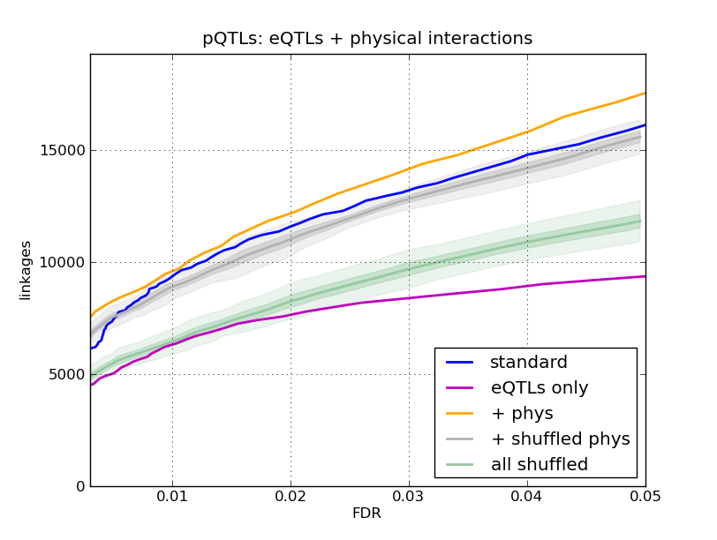
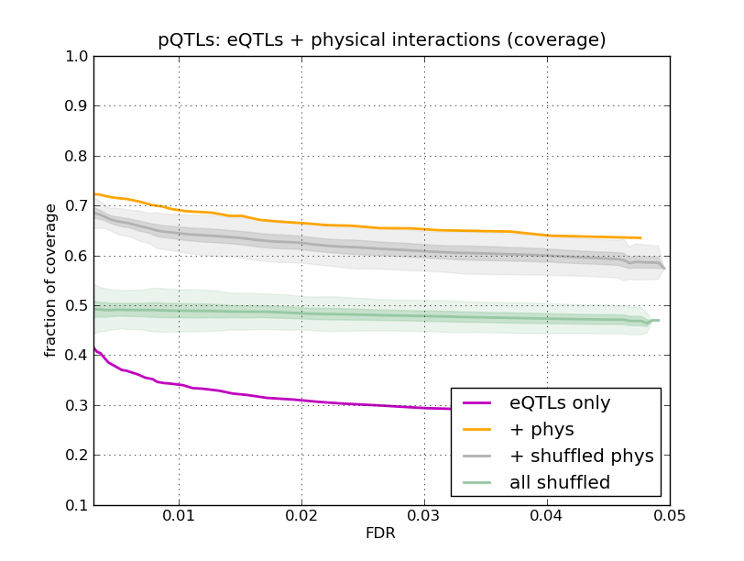
pQTLs: More Linkages
Randomization for physical interactions
Notes:
Here is the example for the network of physical interactions only. [explain curves; explain average and +-std and +-3*std curves for random runs] As you can see, both randomizations perform worse than the new approach and even worse than the standard approach. This is both in terms of the number of linkages found, and in terms of the number of linkages from standard approach covered.

Slide 45
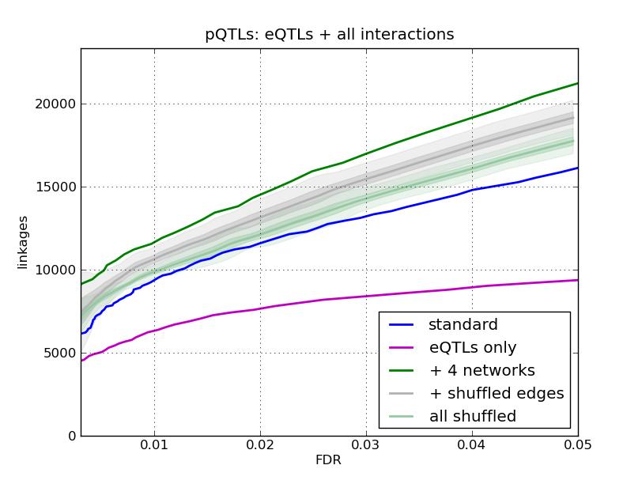
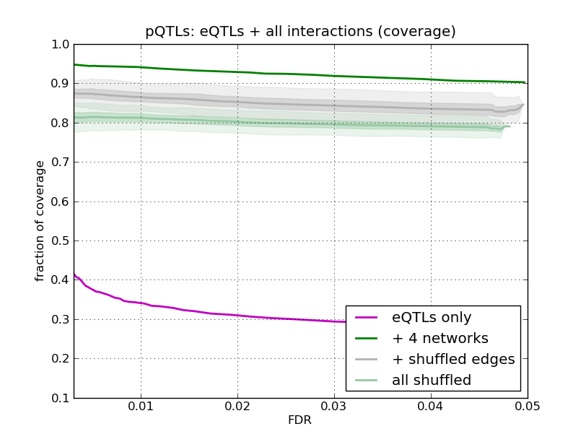
pQTLs: More Linkages
Randomization for combined network of all interactions
Why better than for eQTLs only?
Because of hotspots
Notes:
And here is the same thing for integrated network of 4 types of interactions. Again, the real data performs better than randomized. But a strange thing here is that still the performance is too good: it’s better than for eQTL linkages only and even better than the standard approach. Note that we seemingly use absolutely random linkages and random interactions. So why is that? It turns out that this is because of hotspots.

Slide 46
pQTLs: More Linkages
Compare with randomized data
Can shuffle:
interaction network, preserving degree
eQTL linkages, preserving marker degree
Why better than for eQTLs only? Because of hotspots
Then:
shuffle eQTL linkages, preserving marker degree distribution
Notes:
When applying randomization, as I said, it’s reasonable to preserve degree of the nodes in the network. For eQTL linkages, this means that hotspots, markers with many linkages, will have many fake linkages after randomization as well. Then, proportionally to that, these linkages are promoted further at higher rate when integrating even with randomized interaction network.
We can check that if we relax a little bit the randomization constraint and consider the randomization where only degree distribution should be preserved.

Slide 47
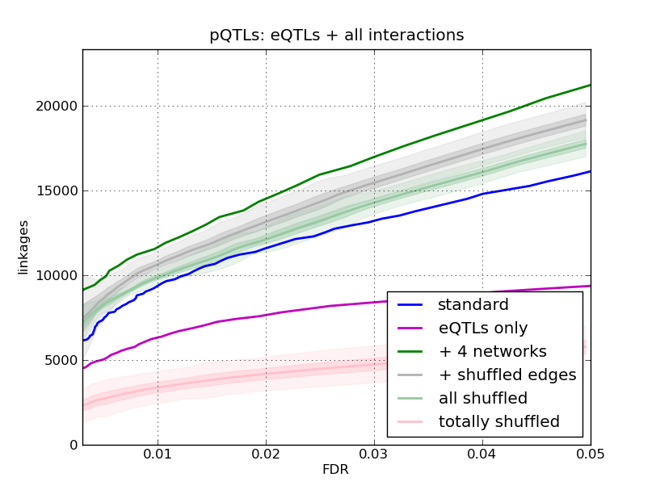
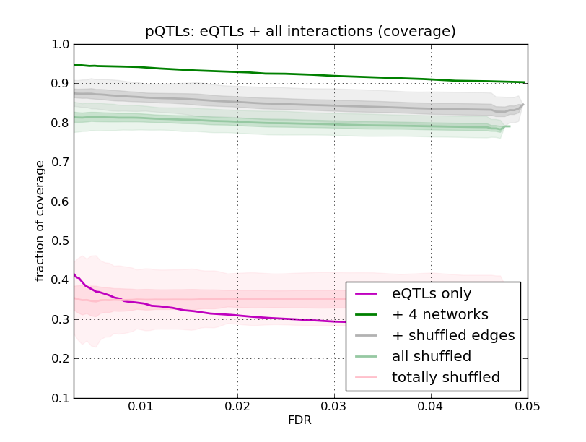
pQTLs: More Linkages
Randomization for combined network of all interactions
Notes:
If we add it to the previous picture, we’ll see what we expect. In terms of the number of linkages found, this randomization performs even worse than eQTLs only.
[43 min]

Slide 48
Conclusion
Analyzed interactions with respect to QTLs:
interacting genes share linkages
dense subnetworks with common linkages
Improve pQTL linkage detection using eQTLs and interactions:
32% more pQTL linkages at FDR 5%
with 90% previously found linkages preserved
At large: related pQTLs and eQTLs through interactions

Slide 49
Future
Improve filtering of potential linkage candidates using subnetwork of genes interacting with a linking locus
Move from considering locus-gene to gene-gene linkages by predicting actual causal genes for linkages
Relate eQTLs and pQTLs on a detailed level
Explain linkages with paths in interaction networks
Thank you!
Notes:
[45 min]

Slide 51
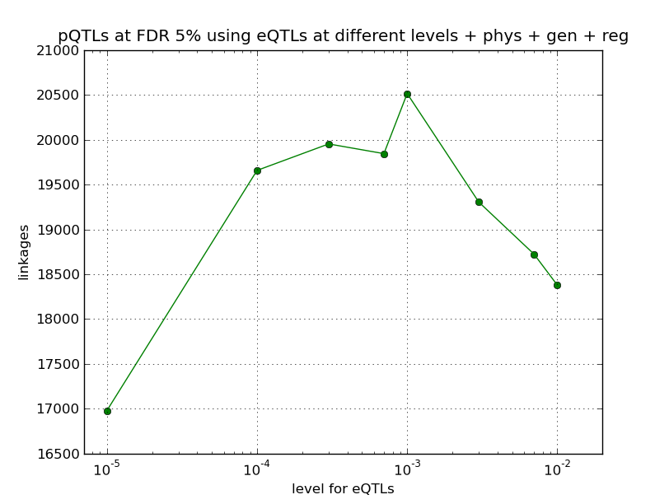
pQTLs: More Linkages
What level for eQTLs to choose?
1e-3 (FDR 14%)

Slide 52
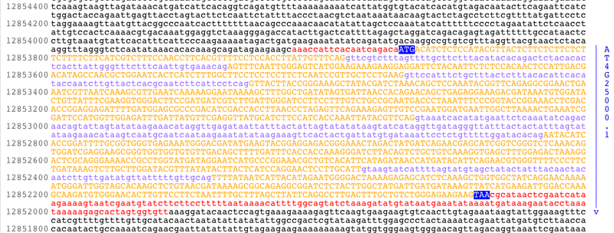

Notes:
In order to understand how genome functions, a lot of data is being collected: examples are DNA, RNA, and protein sequence data, microarray data measuring gene expression of the whole genome, protein and gene interaction data, and many others. Making use of all these kinds of data is not an easy task. For this, different scientific fields are uniting, and that’s what places like our Institute for Integrative Genomics are for. [institute appears]

Slide 53
Quantitative Trait Loci
Associate variation in trait with variation in genotype
Toy example:
trait variation
...AGCGCTACTGTAGC...
...AGCGCTGCTGTAGC...
genotype variation
Notes:
Suppose we somehow managed to find that variation in height is strongly associated with variation in one letter of their DNA sequence [sequences appear]: those with A in this locus, that’s how you call regions of the genome, tend to be shorter, and those with G tend to be taller. Then you say you found quantitative trait locus for height. [variation comments appear] Note that you may find it through full sequencing, but also with easier and much cheaper procedure of genotyping, where you read only certain portions of the genome.

Slide 54
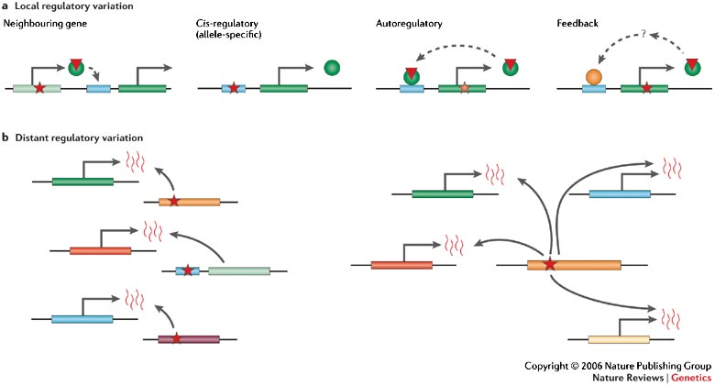
Genetics of Global Gene Expression
Hotspots: genomic loci enriched with linkages
Local and distant linkages
Hard to explain:
no enrichment with TFs or a particular function
hotspots
M. V. Rockman and L. Kruglyak. Nature Reviews Genetics 7: 862-872 (2006)
Notes:
After this kind of analysis was first published in 2002, it generated a lot of research, a whole new field of genetics of global gene expression, here gene expression meaning activation of genes in general. The experiment is very natural and let’s even say straightforward. It’s very natural to consider gene expression traits, as any phenotype, that is, any collection of traits of any organisms, is developing through gene expression. However, the analysis of the results of such experiment is not easy.
Still something interesting was observed. From the very beginning it was observed that linkages have so-called hotspots, regions that have many more linkages than you would expect by chance if throwing them to genome uniformly at random. Here are the pictures of hotspots for eQTLs and pQTLs. Here is the genome, all chromosomes of yeast. We divide it into bins and plot the number of linkages in each bin, actually for this pictures also corrected with the number of markers in the bin, because they are not uniformly distributed. These are hotspots. [hotspots with arrows appear] These I plotted after I repeated the analysis from the initial papers, though you can compare it with analogous plots from the papers and see they are about the same. A natural explanation for hotspots is responsibility for regulation of large groups of genes, often called “master regulator”. This was mostly confirmed, though other possibilities were reported, for example, an extreme case: mutation in an essential gene would reduce expression of every gene to zero, thus causing a hotspot.
For QTLs in general, there are even more possibilities. We can classify QTLs roughly as local and distant. Here you see several examples of possible explanations for both classes. Of course, it would be very useful to associate with each linkage a particular gene causing this linkage, you may think this should be the first thing to do. However, this turns out to be also difficult, as no transcription factors are reported to be overrepresented near QTLs, and QTLs are not enriched for any particular class of molecular function.
You can see a clear difference here between eQTL and pQTL hotspots. This is of course mostly due to the fact that we have protein levels for only 1000 proteins out of 6000. That’s why it’s more important that we do the analysis for the existing ones better, and this what I’m going to show you later.
Generally, currently, for understanding QTLs better, you need to do more biological experiments and do them more targeted. However, computationally, we could improve the analysis itself, and that’s what I’ll show later. I’ll be using interaction networks for that. So let’s talk about networks a little.
[18 min]

Slide 55
Results
Interacting genes share linkages
Extending eQTLs with interactions, can find more pQTLs than the standard approach

Slide 59
Title
<text>

